Slide 1

ChatGPT Social Unrest or Release
Yang Xin, CLS, BNU
2023/04/18

Slide 2
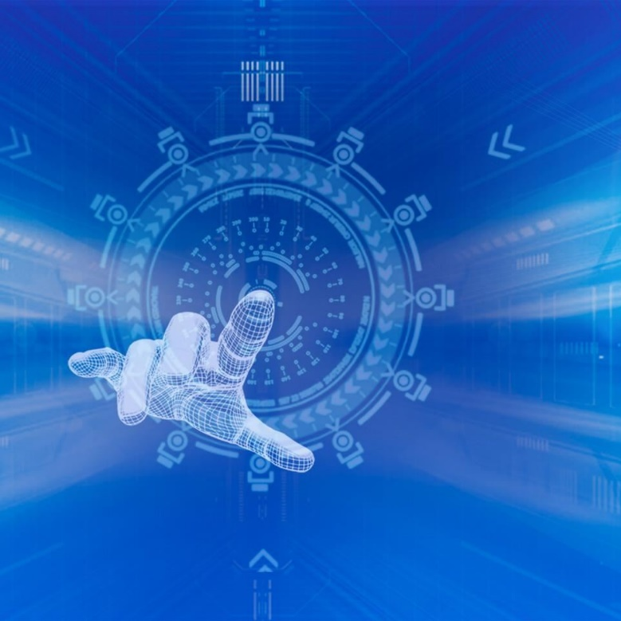
OUTLINE
1
Generative Pre-trained Transformer
2
Application of ChatGPT
3
Limits and Deficiency
4
Conclusion

Slide 3
Generative Pre-trained Transformer
01
What is ChatGPT?

Slide 4
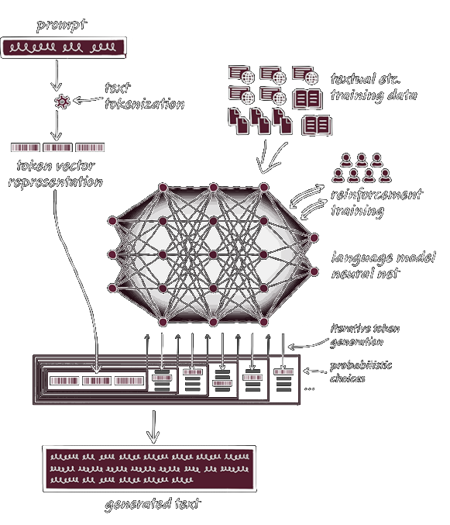
ChatGPT
AI
artificial intelligence chatbot
GPT
generative pre-trained transformer
LLM
large language models
SL & RL
supervised and reinforcement learning

Slide 5
Application of ChatGPT
02
What can ChatGPT do?

Slide 6
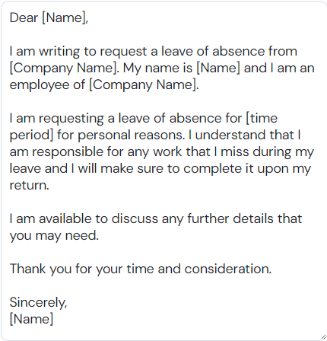
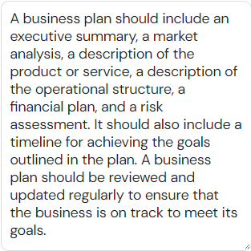
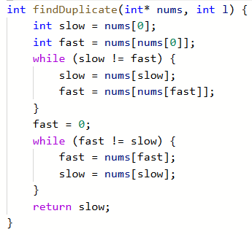
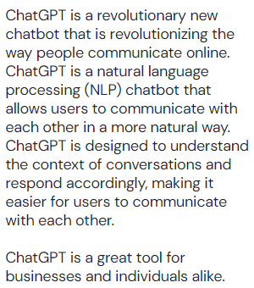
Application of ChatGPT
Email
Computer Codes
newspaper articles
academic essays
Business Plan
。。。

Slide 7
Limits and Deficiency
03
What can't ChatGPT do?

Slide 8
Limits and Deficiency
AGI
not artificial general intelligence can't process task
1
2
GPT
just process the language
3
Logic
lack of mathematical logic operation ability

Slide 9
Limits and Deficiency
The distance from Chicago, Illinois, USA to Tokyo, Japan is approximately 6,721 miles.
6313
Chicago
The distance from Chicago, Illinois, USA to Tokyo, Japan is approximately 6,636 miles.
Tokyo
The distance from Chicago, Illinois, USA to Tokyo, Japan is approximately 5,945 miles.

Slide 10
Conclusion
04
Elimination or liberation?

Slide 11
Conclusion
01
03
response need for human guidance
creation of new jobs and industries
02
04
some job losses or changes
Keep pace
Make use of AI

Slide 12
Thank you
YangXin
2023/04/18

