Slide 1
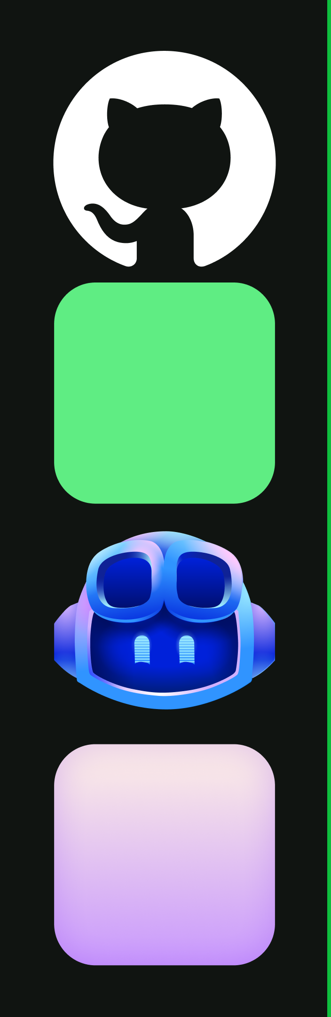
From one idea to
coordinated work
A 90-minute, hands-on GitHub Copilot app workshop using the Book App

Slide 2

What makes the app different?
•
Separate sessions: run focused tasks in parallel, each in its own worktree.
•
See the work: keep plans, diffs, terminal output, and browser preview in one session.
•
Specialize help: use a custom agent for a defined role and a skill for reusable task guidance.
•
Share state: use a canvas to keep decisions and validation evidence visible beside the work.
2

Slide 3
Wednesday participant preflight
Use slides 3–5 in the short setup call
3

Slide 4
Preflight call · 20 minutes
•
0–3 min · Explain the goal, public-repo access, and setup checklist.
•
3–8 min · Confirm app installation and sign-in.
•
8–13 min · Confirm repo access and add the course repo as a project.
•
13–18 min · Confirm Git and Node.js/npm; run sample checks.
•
18–20 min · Resolve blockers and confirm readiness.
4

Slide 5
Participant setup before class
GitHub account with Copilot access; organization policy allows the app
Copilot app installed and signed in
Clone the public course repo and add it as a Copilot app project
Git available; Node.js LTS and npm installed
Book App tests and build pass; preview opens
GitHub CLI is not required
5

Slide 6
90-minute hands-on workshop
The app is the control room; the Book App is the work
6

Slide 7
GitHub + Copilot: from code to collaboration
Part | Role in the work
GitHub | Shared repositories, issues, branches, pull requests, and reviews.
Copilot | Understand code, explore options, draft changes, and create tests.
Agents | Take defined tasks; people direct, review, and decide what ships.
Teams | Reduce repetitive work while staying accountable for quality.
7

Slide 8
What is the GitHub Copilot app?
•
A desktop workspace for working with Copilot agents across software tasks—not just
another chat window.
•
Each session keeps a task's conversation and work together; worktrees can isolate changes.
•
See and manage work in context: plans, file changes, terminal, browser preview, and
canvases.
•
Coordinate multiple tasks, then inspect the evidence and decide what is ready to share.
8

Slide 9
Skills and agents: guidance meets a focused role
•
A skill packages reusable instructions and resources for a task that comes up repeatedly.
•
Example: book-app-reviewer gives Copilot a consistent checklist for filters, stats, and
accessibility.
•
A custom agent is a named specialist with its own role instructions and selected tools.
•
Example: Book App Reviewer uses that role to create a read-only checklist; a person still
verifies the diff and evidence.
9

Slide 10
The GitHub work loop
Stage | What happens
Describe | State the need and what success looks like.
Plan | Review the approach before implementation.
Build | Make a focused change in an isolated worktree.
Prove | Review the diff, checks, and behavior.
10

Slide 11
90 minutes · the learning path
•
0–10 · Orient in the app, connect GitHub/Copilot concepts, and tour the Book App.
•
10–20 · Frame Clear filters and its acceptance criteria.
•
20–32 · Plan Session A; create a read-only review checklist in Session B.
•
32–42 · Mini-teach: sessions, worktrees, modes, agents, and skills.
•
42–62 · Implement in one session; finish the checklist in the other.
•
62–78 · Use a canvas, inspect changes, run checks, and validate in Browser.
•
78–90 · Compare evidence, debrief, and close.
11

Slide 12
Start with the Book App
Feature | Show learners
Search | Find books by title or author.
Filters | Narrow by genre and reading status.
Reading stats | See totals for books currently shown.
Empty state | Search/filter combination with no results.
12

Slide 13
The challenge · Clear filters
Show the control only when search, genre, or reading status is active
Selecting it resets all three filters to their defaults
The full book list and its reading stats return
Keep the change small; preserve existing behavior and dependencies
13

Slide 14
Show the app, not just chat
•
New and project sessions start the right kind of work.
•
Plan mode lets you review an approach before implementation.
•
Changes, Terminal, and Browser keep code and evidence in context.
•
Customize and Canvas manage reusable help and visible work state.
14

Slide 15
Describe → plan → build → prove
Stage | What the learner does
Describe | State the user need and observable acceptance criteria.
Plan | Inspect the approach before allowing implementation.
Build | Implement in an isolated worktree; use a second session for review criteria.
Prove | Check the diff, tests, build, browser behavior, and canvas evidence.
15

Slide 16
Hands-on 1 · Build session
Create Session A from the default branch in a new worktree; name it Clear
filters build
Use Plan mode and request a small implementation and validation plan
Check the plan against the criteria; approve only when it fits
Switch to Interactive and ask the agent to implement the approved plan
Do not merge or push during the workshop
16

Slide 17
Hands-on 2 · Reviewer session
•
Start Session B in a separate new worktree from the default branch; select Book App
Reviewer.
•
Use the book-app-reviewer skill to produce a read-only acceptance checklist.
•
Ask it to inspect the existing code and state what must be verified—not to edit or run
commands.
•
Session B is independent; it does not automatically see Session A's uncommitted diff.
•
Later compare its checklist with Session A's actual change and browser behavior.
17

Slide 18
Mini-teach · Keep the work in context
Part of the workflow | Why it matters in the app
Prompt | Describe this task and the outcome you need now.
Repository context | Ground work in the project files and existing patterns.
Session + worktree | Keep task history visible and changes isolated.
Canvas + checks | Track status, then verify with the diff, tests, and browser.
18

Slide 19
Mini-teach · Canvas as the shared board
•
Create or open a compact work board in the session side panel.
•
Track the feature proposal, Session A implementation, Session B review checklist, and
verification evidence.
•
The canvas makes status visible; it does not replace reviewing the diff or running checks.
•
Use the board to tell what needs attention without searching a long chat.
19

Slide 20
Hands-on 3 · Record and verify
Put acceptance criteria on the canvas; update both session lanes from what
actually happened
Inspect Session A's Changes diff; compare it with Session B's checklist
Run npm test -- --run and npm run build in samples/book-app-web
In Browser, test no filters, each active filter, and reset behavior
Record only checks you personally observed; mark blocked checks as not run
20

Slide 21
Validate Clear filters
State | Expected result
No active filters | Control hidden; full list and stats show.
Search, genre, or status active | Control is visible.
Select Clear filters | All filters reset; full list and stats return.
Automated checks | Tests and build pass; inspect actual output.
21

Slide 22
Compare the evidence
•
Session A · What files changed? Does the diff match the plan? Did tests and build pass?
•
Session B · What criteria did the reviewer identify? Which are confirmed in code?
•
Browser · What behavior did you personally observe?
•
Canvas · Does the board reflect actual status, including anything not run?
22

Slide 23
Takeaways
•
The app is a place to coordinate work, not only ask for code.
•
Separate sessions make concurrent tasks visible and isolated.
•
Skills and custom agents shape how help is delivered; they are not proof of correctness.
•
A canvas keeps status visible; people still inspect diffs and evidence.
23

Slide 24

Describe. Coordinate.
Verify.

