Slide 1
Clustering
Part 2
Mohammed Brahimi & Sami Belkacem

Slide 2
Outline
Overview of Clustering
Major Clustering Approaches
K-means Clustering
Hierarchical Clustering
DBSCAN Clustering
Cluster Evaluation

Slide 3
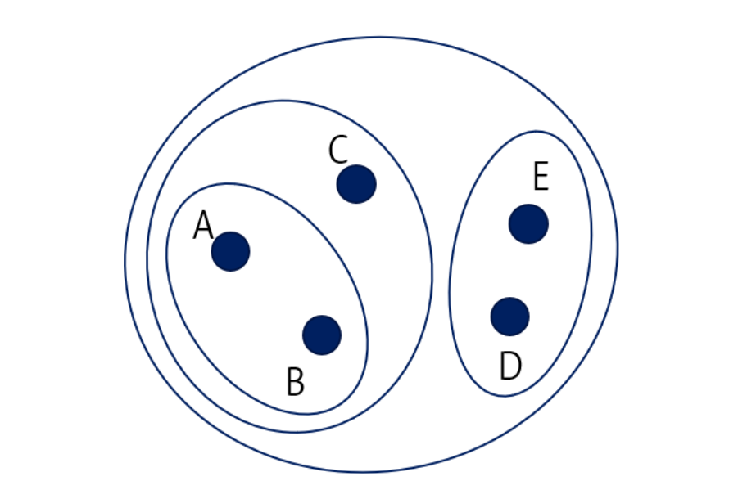
Hierarchical Clustering
Hierarchical Clustering produce a set of nested-clusters.
It does not have to assume any particular number of clusters.
It may correspond to meaningful taxonomies (e.g., biological taxonomy, animal kingdom, phylogeny reconstruction, …).
Nested clusters
of 5 data points

Slide 4
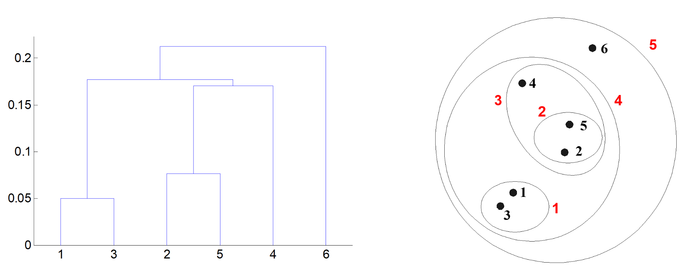
Hierarchical Clustering
The set of nested clusters can be organized as a hierarchical tree.
The hierarchical tree of clusters is called a dendrogram, which records the sequences of merges or splits
Different clustering of the data can be obtained by cutting the dendrogram at the desired level, then each connected component forms a cluster
distance
Dendrogram
5 nested clusters of 6 data points

Slide 5
Types of Hierarchical Clustering
Agglomerative:
Start with the points as individual clusters
At each step, merge the closest pair of clusters
Until only one cluster (or k clusters) left
Popular algorithm: AGNES (Agglomerative Nesting)
Divisive:
Start with one, all-inclusive cluster
At each step, split the least cohesive clusters
Until each cluster contains one point (or there are k clusters)
Popular algorithm: DIANA (Divisive Analysis)
Hierarchical algorithms use a proximity matrix (similarity or distance)
Merge or split one cluster at a time
Notes:
<number>

Slide 6
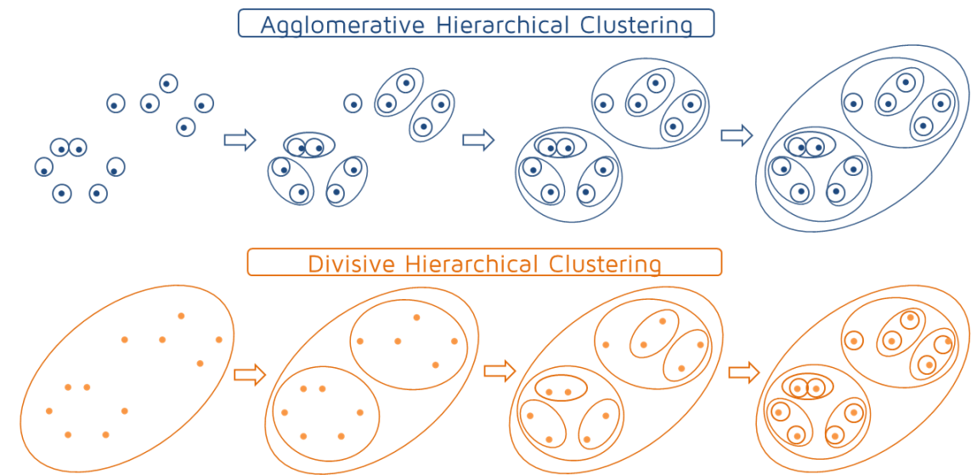
Agglomerative vs Divisive
2
Notes:
<number>

Slide 7
Agglomerative Clustering Algorithm
Key Idea: Successively merge the closest clusters
Basic algorithm:
Compute the proximity matrix for all data points
Let each data point be a cluster
Repeat
Merge the two closest clusters
Update the proximity matrix
Until only a single cluster remains (or k clusters left)
Key operation is the computation of the proximity of two clusters:
Different approaches to defining the distance between clusters distinguish the different algorithms (Min, Max, etc.)

Slide 8
How to measure the distance between two clusters?

Slide 9
How to Define Inter-Cluster Distance
p1
p2
p3
p4
p5
. . .
p1
Distance?
p2
p3
p4
p5
MIN
MAX
Group Average
Distance Between Centroids
.
.
.
Proximity Matrix

Slide 10
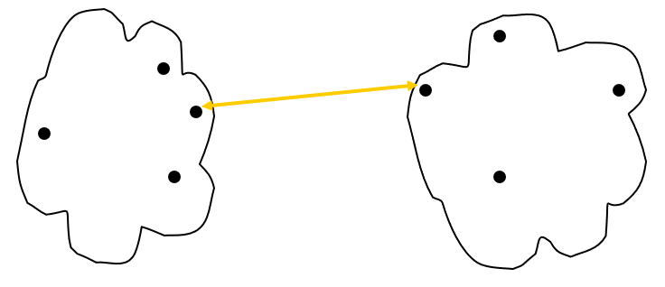
How to Define Inter-Cluster Distance
p1
p2
p3
p4
p5
. . .
p1
p2
p3
p4
p5
MIN
MAX
Group Average
Distance Between Centroids
.
.
.
Proximity Matrix

Slide 11
How to Define Inter-Cluster Distance
p1
p2
p3
p4
p5
. . .
p1
p2
p3
p4
p5
MIN
MAX
Group Average
Distance Between Centroids
.
.
.
Proximity Matrix

Slide 12
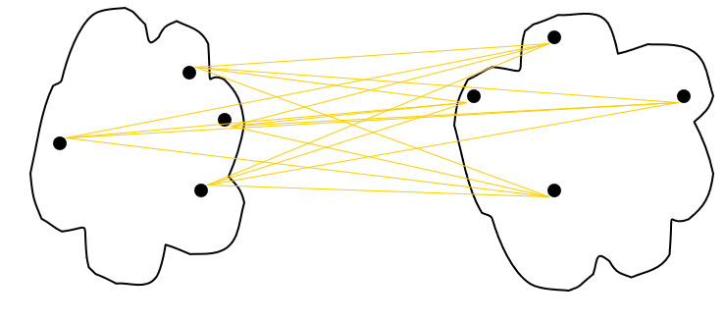
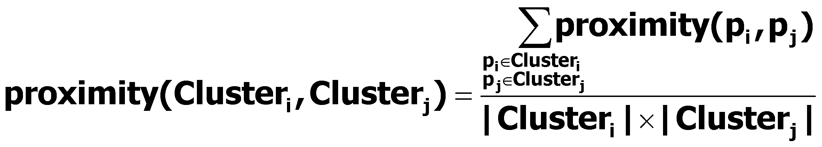
How to Define Inter-Cluster Distance
p1
p2
p3
p4
p5
. . .
p1
p2
p3
p4
p5
MIN
MAX
Group Average
Distance Between Centroids
.
.
.
Proximity Matrix

Slide 13
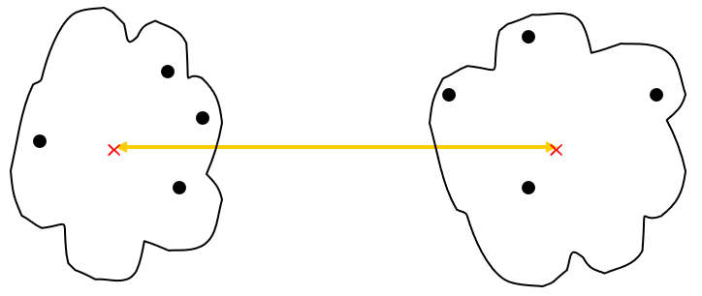
How to Define Inter-Cluster Distance
p1
p2
p3
p4
p5
. . .
p1
p2
p3
p4
p5
MIN
MAX
Group Average
Distance Between Centroids
.
.
.
Proximity Matrix

Slide 14
Inter-Cluster Distance
X
X
Min (Single link): smallest distance between an element in one cluster and an element in the other, dist(K_{i}, K_{j}) = min(t_{ip}, t_{jq})
Max (Complete link): largest distance between an element in one cluster and an element in the other, dist(K_{i}, K_{j}) = max(t_{ip}, t_{jq})
Group Average: avg distance between an element in one cluster and an element in the other, dist(K_{i}, K_{j}) = avg(t_{ip}, t_{jq})
Centroid: distance between the centroids of two clusters, dist(K_{i}, K_{j}) = dist(C_{i}, C_{j})
<number>
Notes:
<number>

Slide 15
Now that we've understood how to measure the distance between two clusters, let's go back to the steps of the Agglomerative Clustering algorithm.

Slide 16
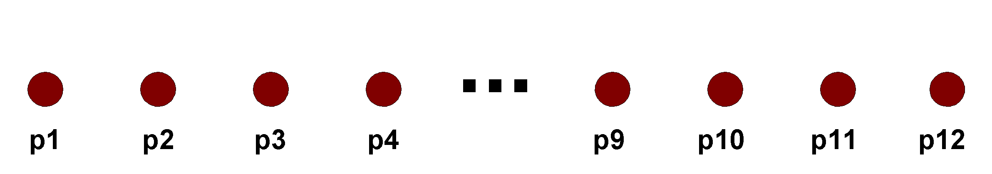
Agglomerative clustering: Steps 1 and 2
Start with clusters of individual points and a proximity matrix
p1
p2
p3
p4
p5
. . .
p1
p2
p3
p4
p5
.
.
.
Proximity Matrix

Slide 17
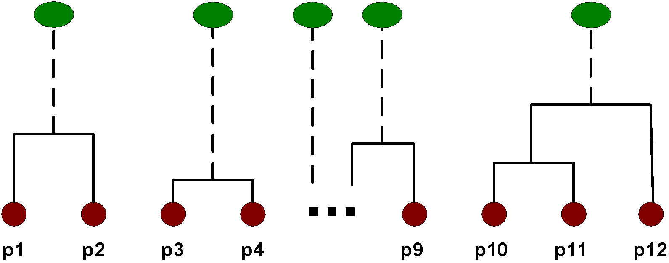
Intermediate Situation
After some merging steps, we have some clusters
C1
C2
C3
C4
C5
C1
C2
C3
C3
C4
C4
C5
C1
Proximity Matrix
C2
C5

Slide 18
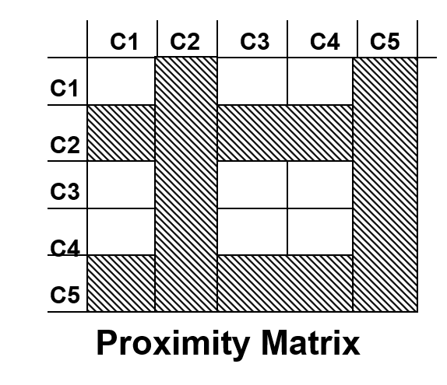
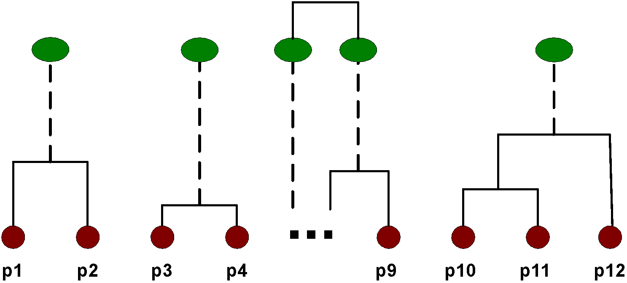
Step 4
Merge the two closest clusters (C2 and C5) and update the matrix
C3
C4
C1
C5
C2
C5
C2

Slide 19
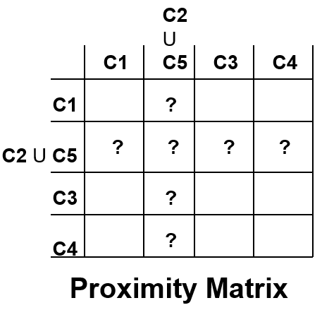
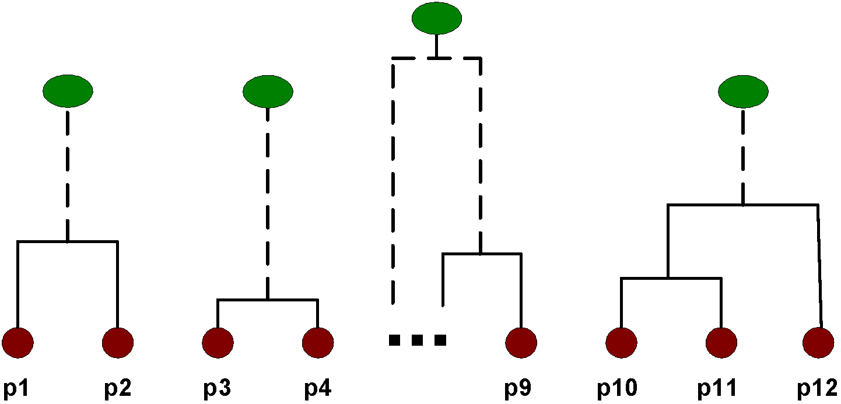
Step 5
Now, the question is “how do we update the proximity matrix?”
C3
C4
C1
C2 U C5

Slide 20
Answer: we update the proximity matrix
using the different approaches to defining the distance between clusters (Min, Max, etc.)
Note: to compute the distance between an individual data point and a cluster, we consider that data point itself as a cluster

Slide 21
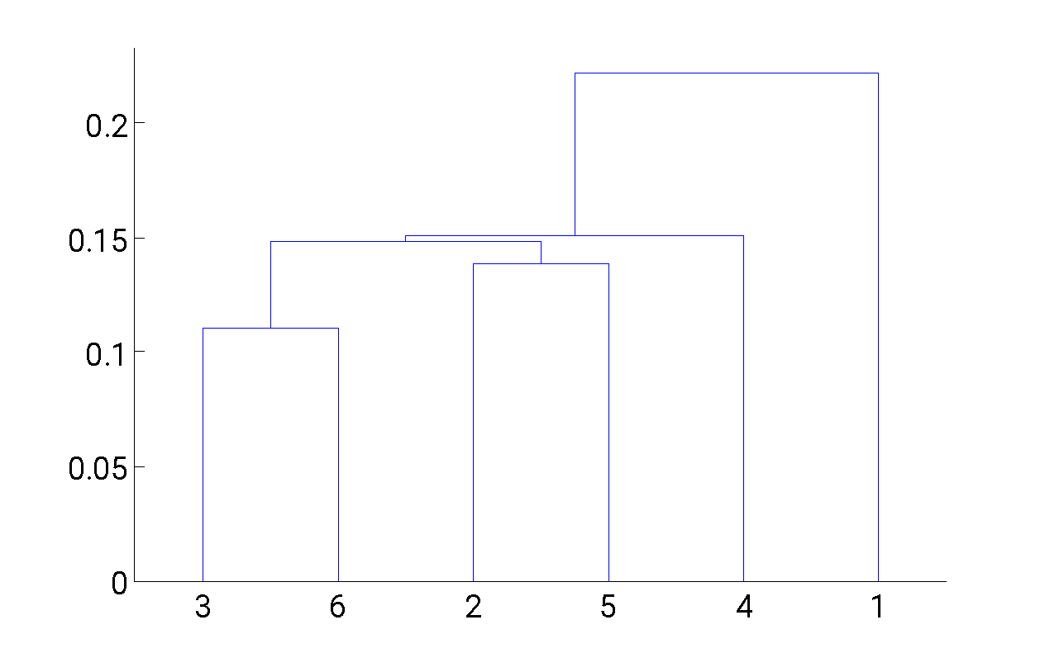
Hierarchical Clustering: MIN
5
1
3
5
2
1
2
3
6
4
4
Nested Clusters
Dendrogram

Slide 22

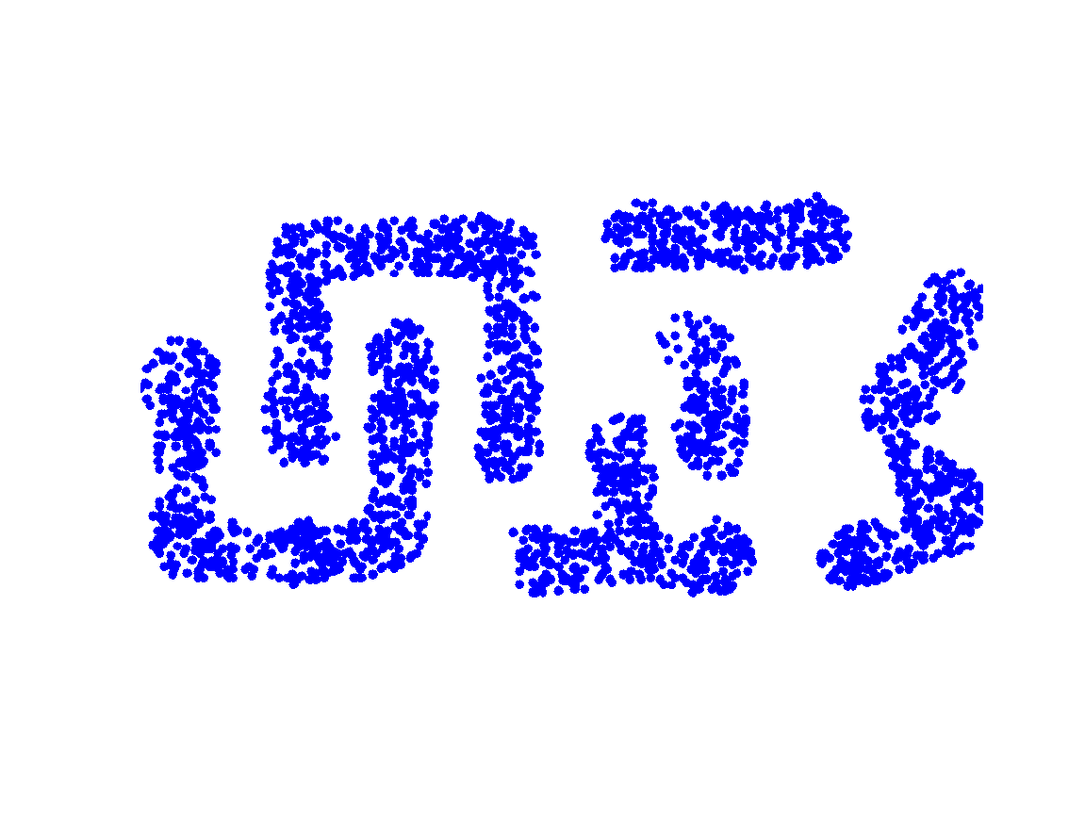
Strength of MIN
Original Points
Six Clusters
It detects clusters of any shape by focusing only on the nearest points between clusters, ignoring overall shape.
Captures irregularly shaped clusters effectively without assuming specific geometrical forms like elliptical shapes.

Slide 23
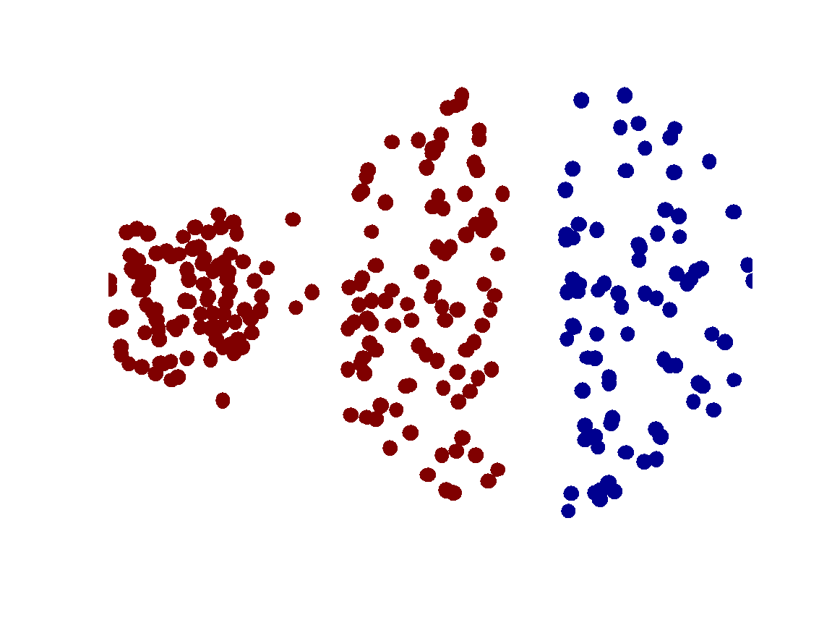
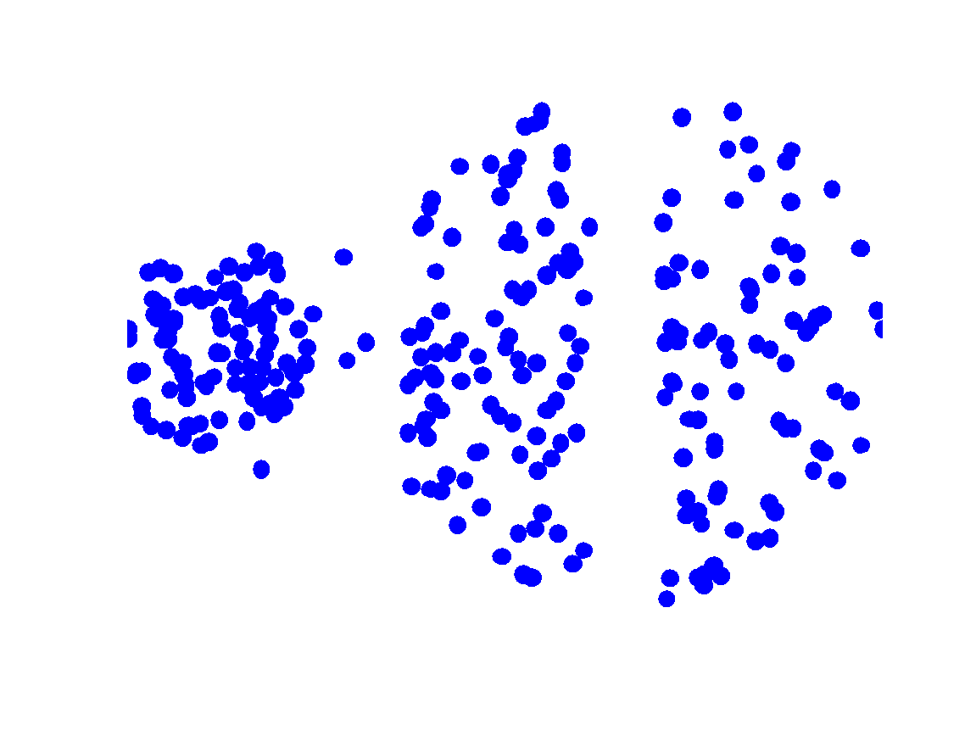
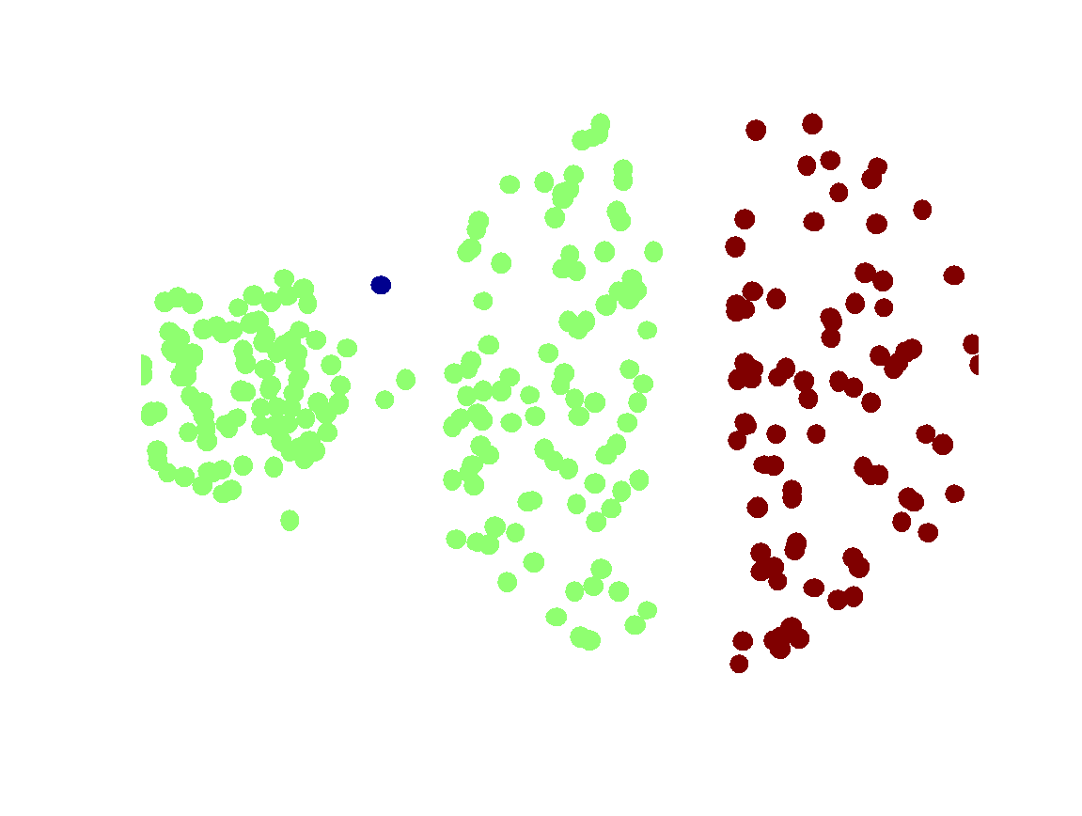
Limitations of MIN
Two Clusters
Original Points
Chaining effect: Merges two clusters due to closely paired points, leading to a chain of combined clusters.
Noise sensitivity: A single point can alter the cluster's shape.
Three Clusters

Slide 24
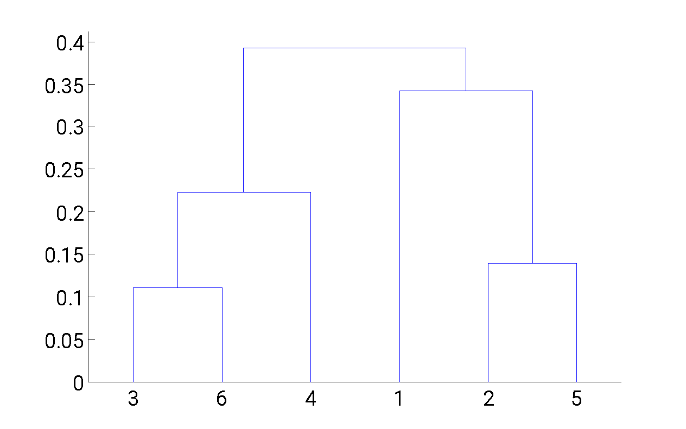
Hierarchical Clustering: MAX
4
1
2
5
5
2
3
6
3
1
4
Nested Clusters
Dendrogram

Slide 25
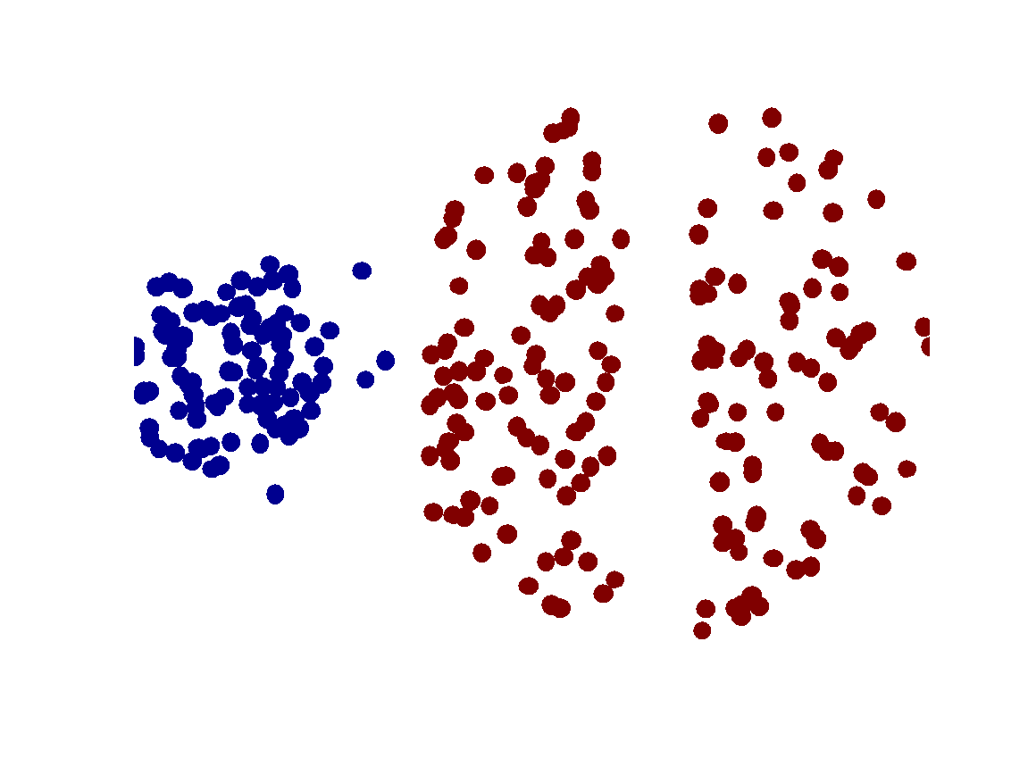
Strength of MAX
Original Points
Two Clusters
Robustness to Noise: Less affected by noise because it looks at the farthest points between clusters, forming compact groups less likely to be influenced by outliers.

Slide 26
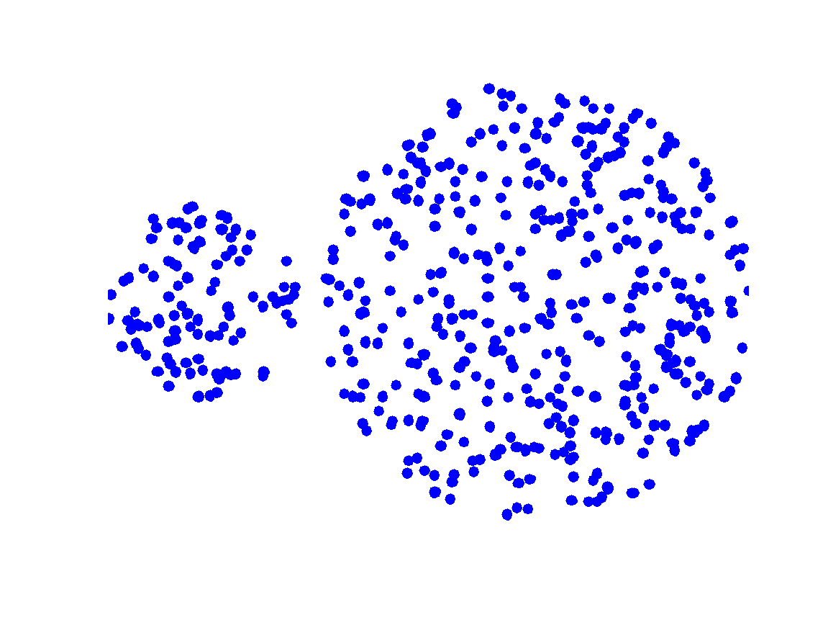
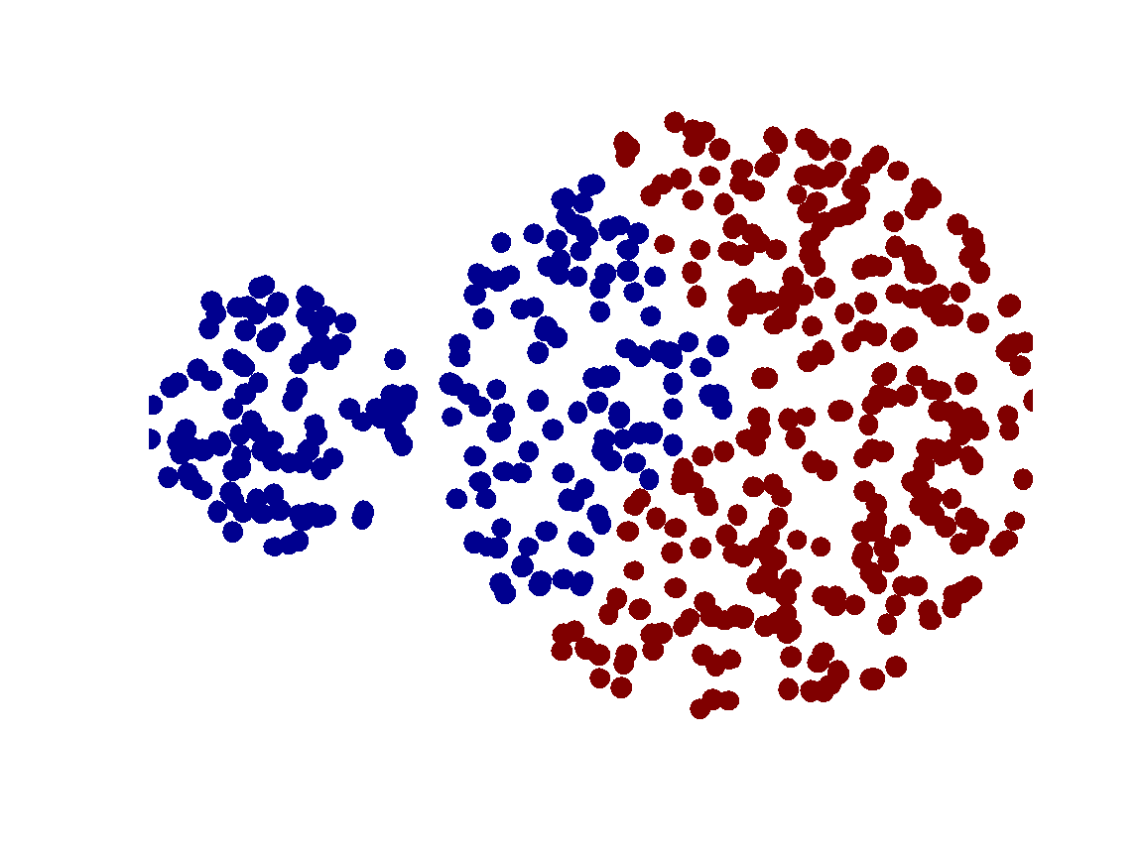
Limitations of MAX
Original Points
Two Clusters
Tends to break large clusters into smaller, more distinct ones.
Biased towards globular clusters

Slide 27
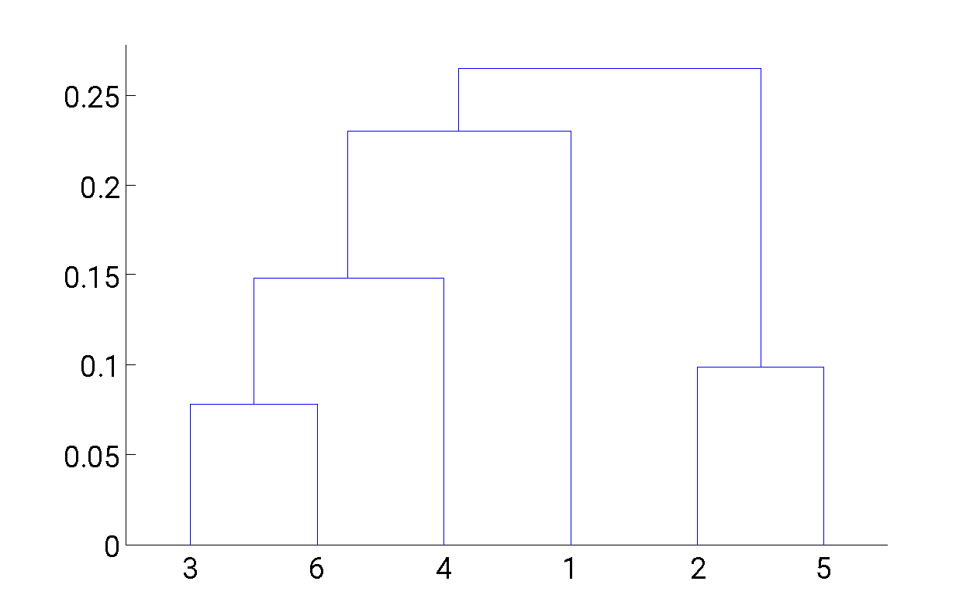
Hierarchical Clustering: Group Average
5
4
1
2
5
2
3
6
1
4
3
Nested Clusters
Dendrogram

Slide 28
Hierarchical Clustering: Group Average
Compromise between Single and Complete Link
Strengths
Averaging reduces the influence of noisy data points
Limitations
Biased towards globular clusters because the average distance favors clusters with compact, closely located points

Slide 29
Hierarchical Clustering: Space and Time Complexity
N is the number of data points or objects.
Space: O(N²)
O(N²) because the proximity matrix has N² entries for distances between N points.
Time: O(N³)
Find the min distance of the matrix O(N²) * N iterations ⇒ O(N³)
Complexity can be reduced to O(N² log(N))
Accelerate finding the minimum using a heap ….

Slide 30
Strength of Hierarchical Clustering
Do not have to assume any particular number of clusters.
Any desired number of clusters can be obtained by ‘cutting’ the dendrogram at the proper level.
Hierarchical clusters may correspond to meaningful taxonomies:
Example in biological sciences (e.g., animal kingdom, phylogeny reconstruction, …)

Slide 31
Weakness of Hierarchical Clustering
Once a decision is made to combine two clusters, it cannot be undone
Do not scale well: time complexity of O(n³), n is the number of objects
No global objective function is directly minimized
Different schemes have problems with one or more of the following:
Sensitivity to noise
Difficulty handling clusters of different sizes and non-globular shapes
Breaking large clusters
Improvements: Integration of hierarchical and distance-based clustering
Example of Algorithms: BIRCH, CHAMELEON

