Slide 1
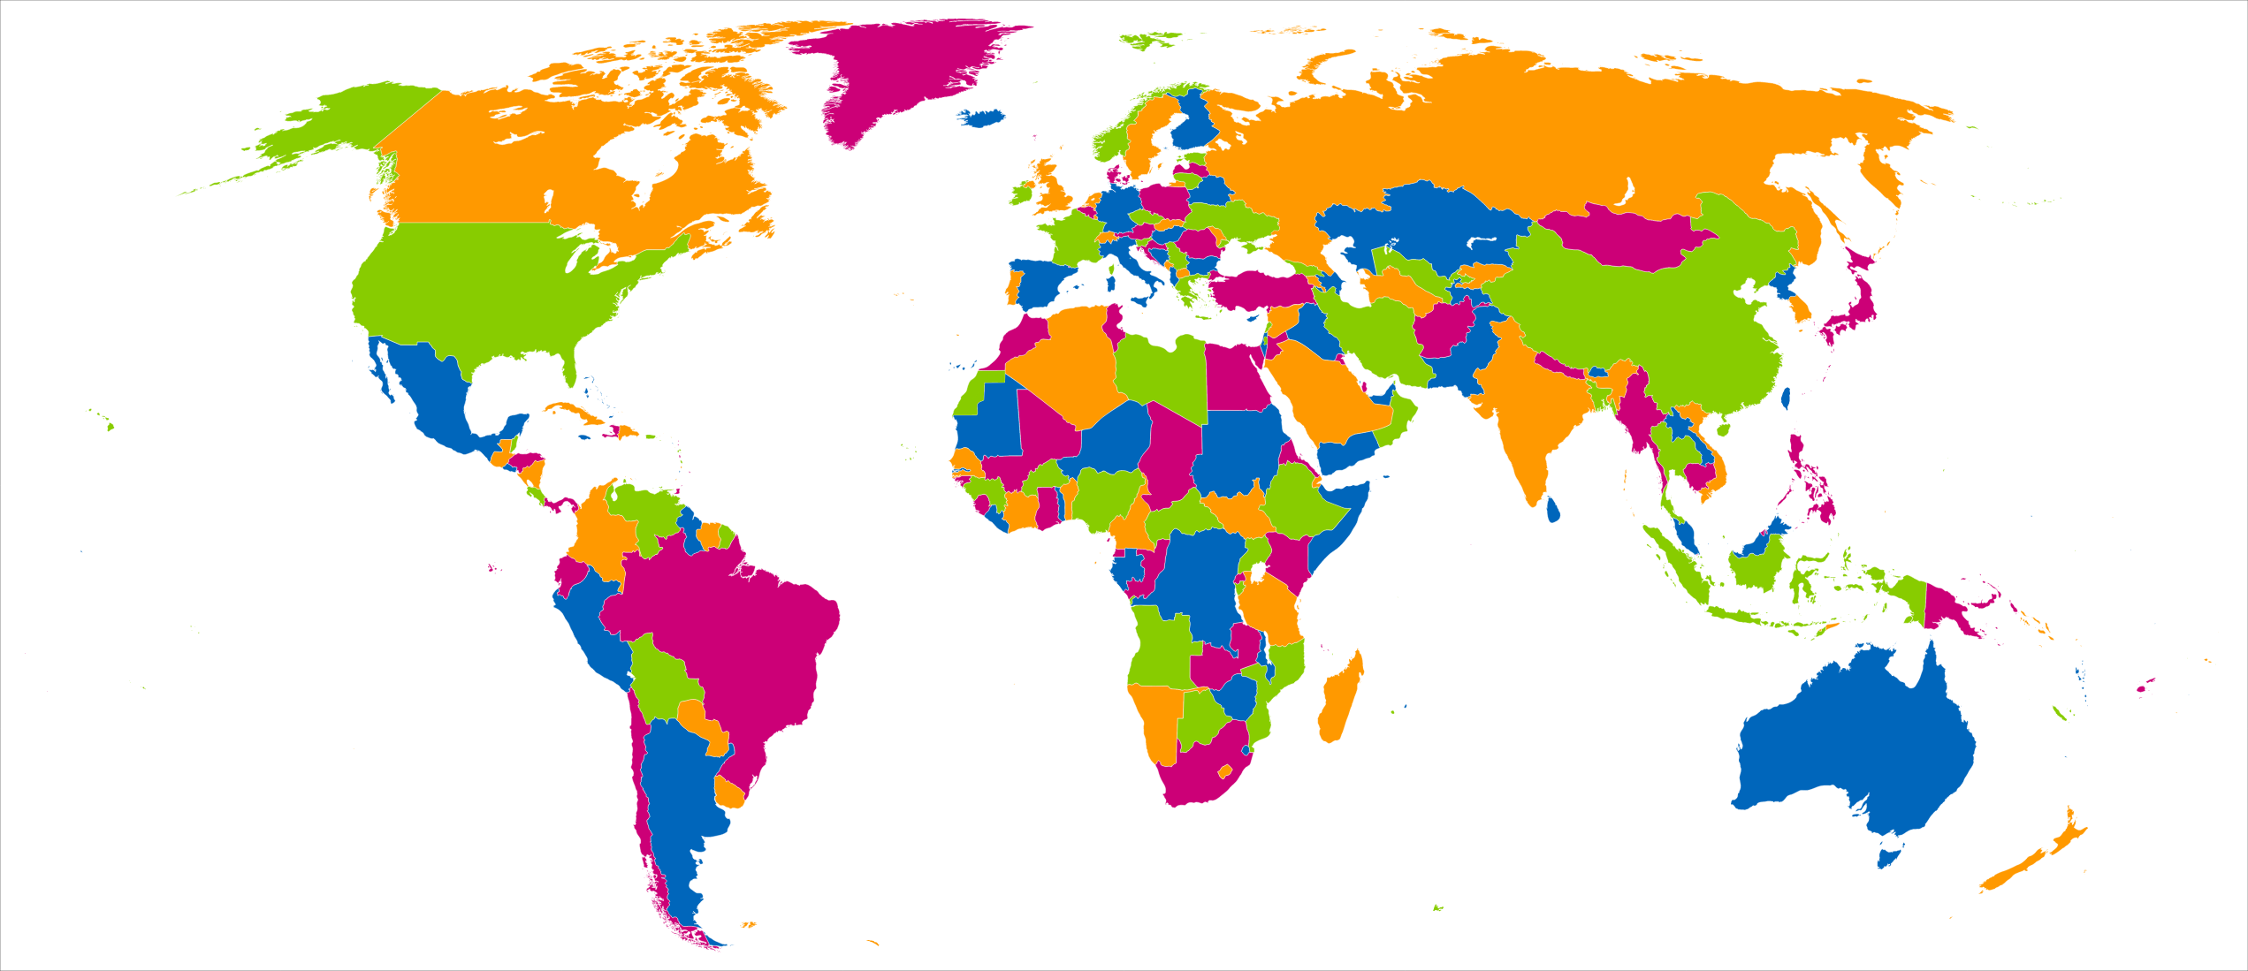
Graph coloring
Mohammed Brahimi

Slide 2

Module distribution concerns raised by students
Issues
Multiple difficult modules scheduled in the same term
Unbalanced distribution of workload between terms
Goal
Achieving a balanced load distribution between terms
Approach:
Represent modules as vertices
High-load modules are linked by edges
Assign colors to terms
Ensure that difficult and high-load modules are not scheduled in the same term.
Find optimal module-term assignment to minimize load imbalance and avoid clustering high-load modules.

Slide 3
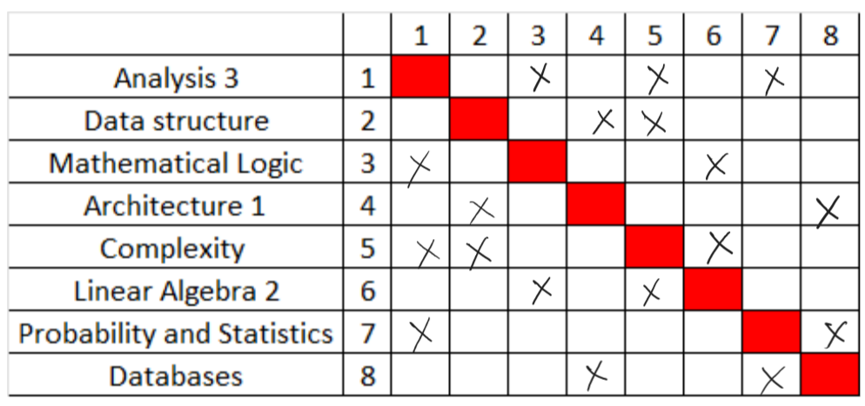
How to avoid challenging modules in the same term?

Slide 4
How to avoid challenging modules in the same term?
7
1
8
3
5
4
6
2

Slide 5
How to avoid challenging modules in the same term?
7
1
8
3
5
4
6
2

Slide 6
How to avoid challenging modules in the same term?
Term 1
1
6
8
2
3
7
5
4
Term 2

Slide 7
How to avoid challenging modules in the same term?
Term 1
Data structure
Linear Algebra 2
Databases
Analysis 3
Term 2
Architecture 1
Mathematical Logic
Complexity
Probability and Statistics
Term 1
1
6
8
2
3
7
5
4
Term 2

Slide 8
Problem extension
What if a teacher teach two modules together:
Assign a unique color to each teacher.
Modules taught by the same teacher are adjacent vertices in the graph.
Find a suitable coloring for the graph representing the modules and teachers.
What about other time table constraints:
Sessions represented as vertices.
Make two vertices adjacent based on any constraints.
Ensure that conflicting sessions, are not scheduled in parallel.
Create a well-structured time table that considers teacher availability, room constraints, and avoids conflicts between modules.

Slide 9
What is graph coloring ?
In the context of a simple graph G, a k-coloring refers to the assignment of at most k colors to its vertices.
k-coloring should color the adjacent vertices in G by different colors.
If G has a valid k-coloring, we say G is k-colorable.
The chromatic number of G, denoted by 𝜒(𝐺), is the smallest number k for which G is k-colorable.
Reason for restricting coloring to simple graphs:
Vertex with loop cannot be assigned a different color from itself.
The presence of one or multiple edges between two vertices has a similar effect, requiring them to be colored differently.

Slide 10
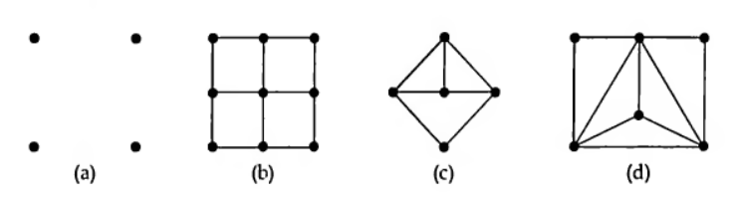
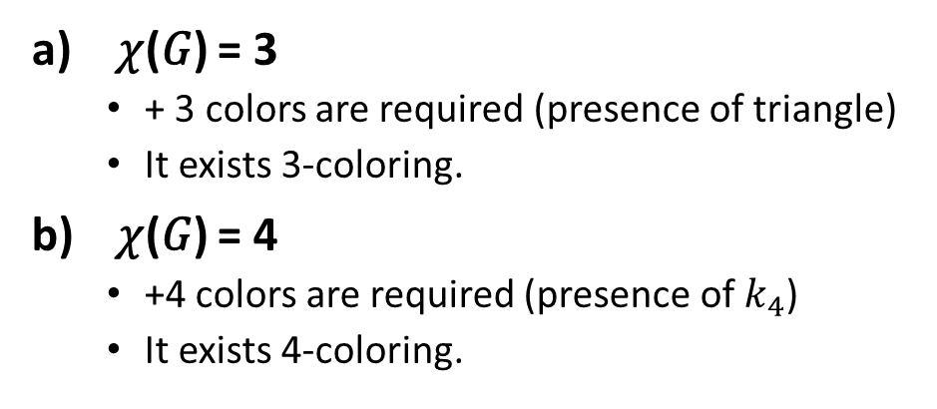
What is the chromatic number 𝜒(𝐺) ?
𝜒(𝐺) = 1
One color is sufficient
Absence of edges
𝜒(𝐺) = 2
+1 color is required (presence of edges)
It exists 2-coloring.
𝜒(𝐺) = 3
+ 3 colors are required (presence of triangle)
It exists 3-coloring.
𝜒(𝐺) = 4
+4 colors are required (presence of $k_{4}$)
It exists 4-coloring.

Slide 11
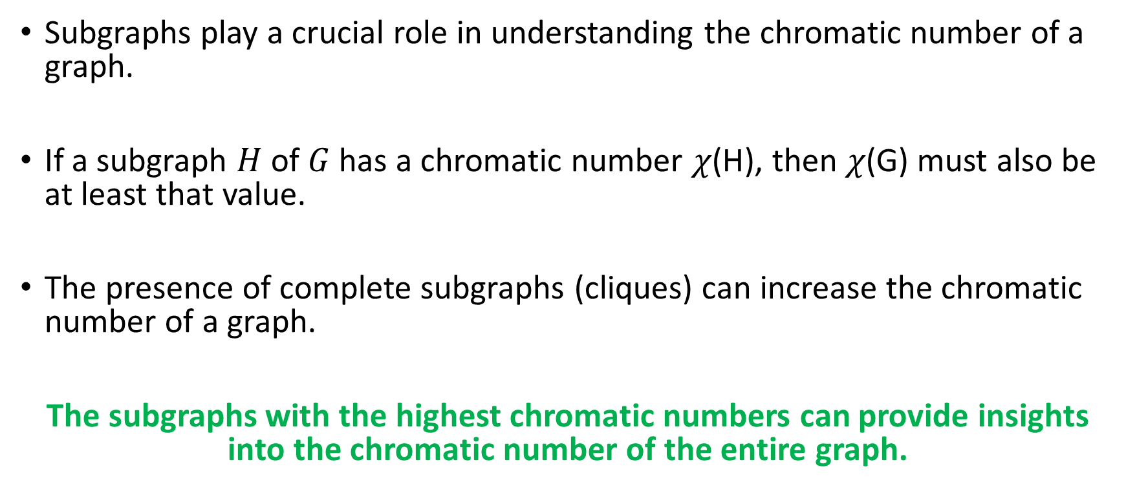
Subgraphs and the Chromatic Number
Subgraphs play a crucial role in understanding the chromatic number of a graph.
If a subgraph $H$ of $G$has a chromatic number 𝜒(H), then 𝜒(G) must also be at least that value.
The presence of complete subgraphs (cliques) can increase the chromatic number of a graph.
The subgraphs with the highest chromatic numbers can provide insights into the chromatic number of the entire graph.

Slide 12
THEORME 1 (coloring bipartite graph)
A graph is bipartite if and only if it is 𝜒(𝐺)=2
Direction 1: Bipartite graph ⟹ Chromatic number is 2.
In a bipartite graph, vertices can be split into two sets, A and B, where all edges connect vertices from different sets.
Assign color 1 to set A
Assign color 2 to set B.
This yields a valid 2-coloring.
Thus, the chromatic number of a bipartite graph is 2.
Direction 2: Chromatic number is 2 ⟹ Graph is bipartite.
If a graph can be colored with only two colors:
Put all the vertices of color 1 to the set A
Put all the vertices of color 2 to the set B
Two vertices from A (or B) are not adjacent because they have the same color.
This results in a partition of the graph into sets A and B where the vertices of each set are not adjacent.

Slide 13
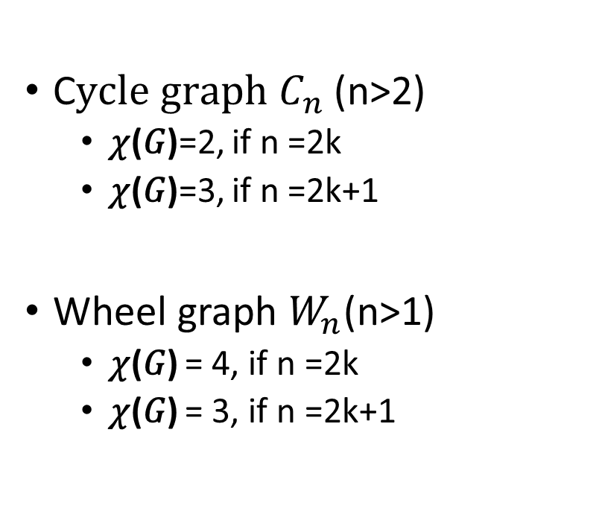
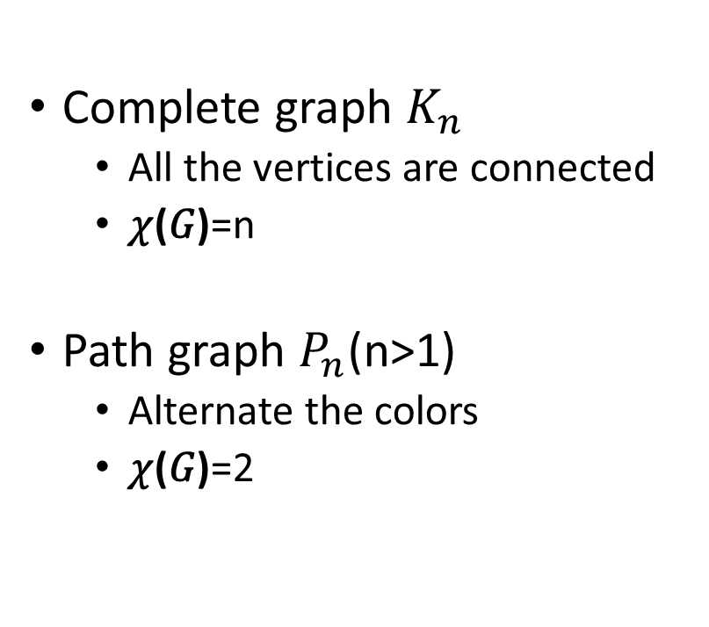
What is the chromatic number ?
Complete graph $K_{n}$
All the vertices are connected
𝜒(𝐺)=n
Path graph $P_{n}$(n>1)
Alternate the colors
𝜒(𝐺)=2
C$ycle graph C_{n}$(n>2)
𝜒(𝐺)=2, if n =2k
𝜒(𝐺)=3, if n =2k+1
Wheel graph $W_{n}$(n>1)
𝜒(𝐺) = 4, if n =2k
𝜒(𝐺) = 3, if n =2k+1

Slide 14
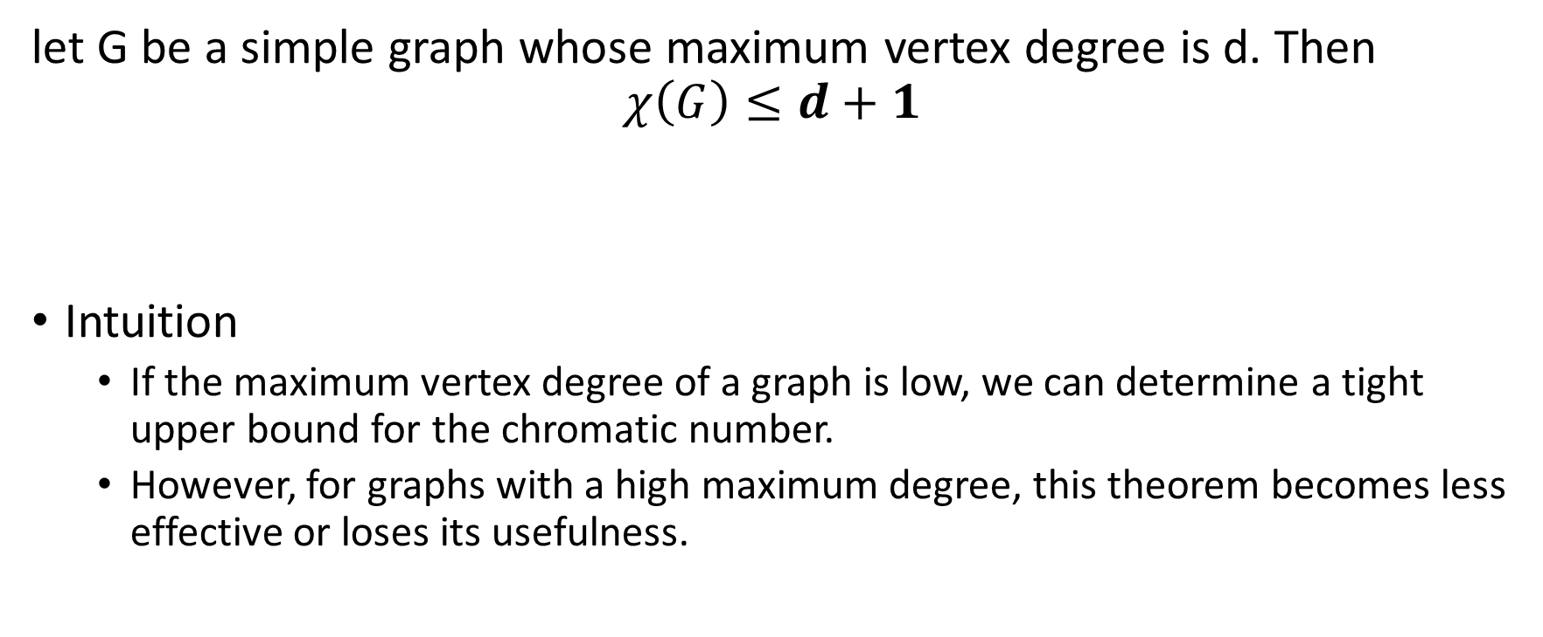
THEORME 2
let G be a simple graph whose maximum vertex degree is d. Then
$$χ\left(G\right)≤d+1$$
Intuition
If the maximum vertex degree of a graph is low, we can determine a tight upper bound for the chromatic number.
However, for graphs with a high maximum degree, this theorem becomes less effective or loses its usefulness.

Slide 15
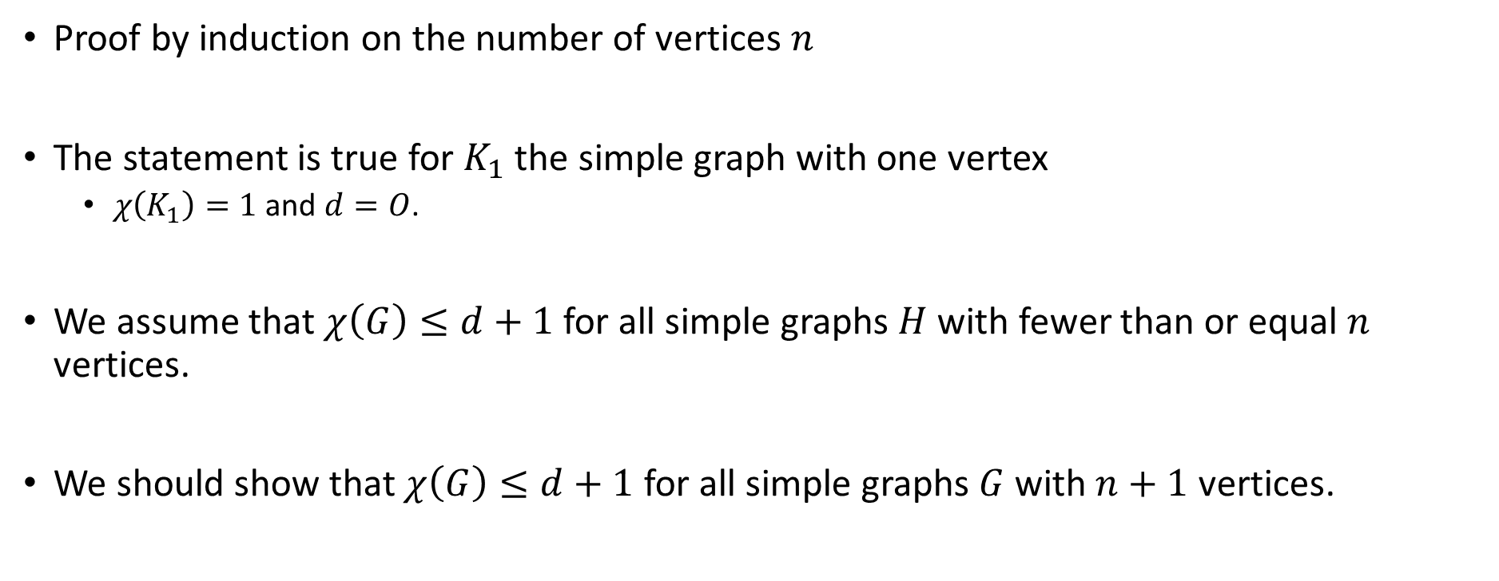
Proof
Proof by induction on the number of vertices $n$
The statement is true for $K_{1}$ the simple graph with one vertex
$χ\left(K_{1}\right)=1$ and $d=O$.
We assume that $χ\left(G\right)≤d+1$ for all simple graphs $H$ with fewer than or equal $n$ vertices.
We should show that $χ\left(G\right)≤d+1$ for all simple graphs $G$ with $n+1$ vertices.

Slide 16

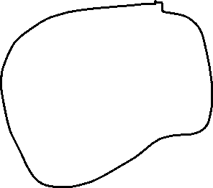
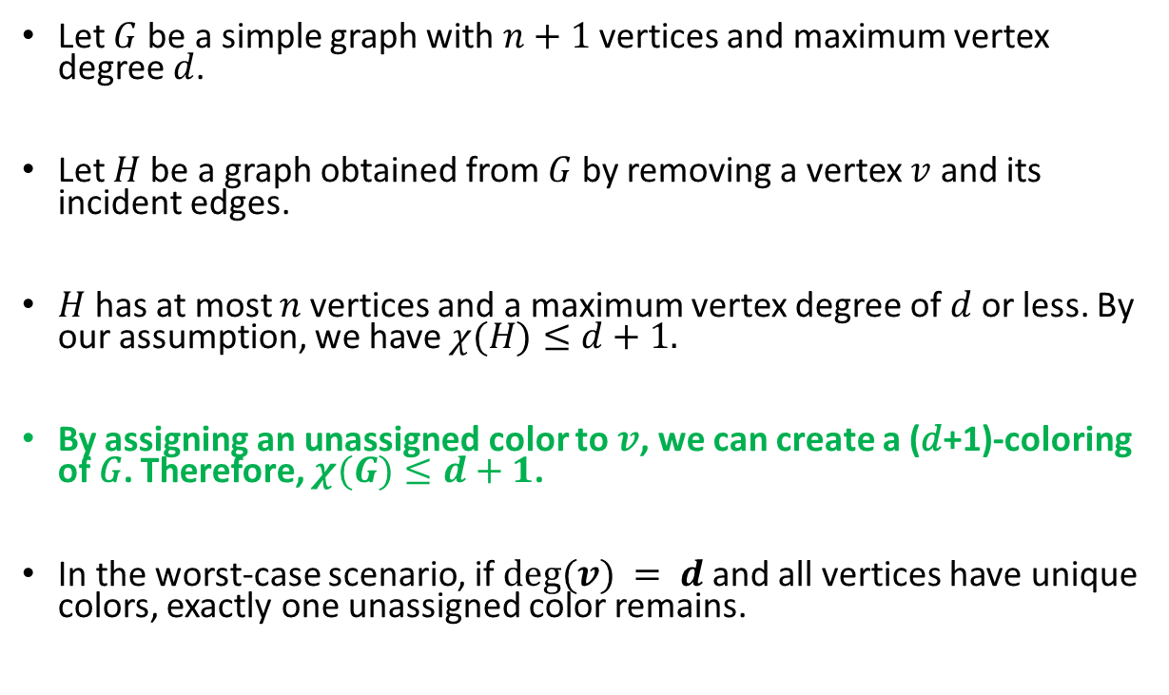

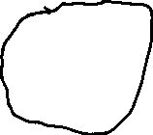
Proof
Let $G$ be a simple graph with $n+1$vertices and maximum vertex degree $d$.
Let $H$ be a graph obtained from $G$ by removing a vertex $v$ and its incident edges.
$H$ has at most $n$ vertices and a maximum vertex degree of $d$ or less. By our assumption, we have $χ(H)≤d+1.$
By assigning an unassigned color to $v$, we can create a (𝑑+1)-coloring of 𝐺. Therefore, $χ(G)≤d+1$.
In the worst-case scenario, if $deg⁡(v) = d$and all vertices have unique colors, exactly one unassigned color remains.

Slide 17
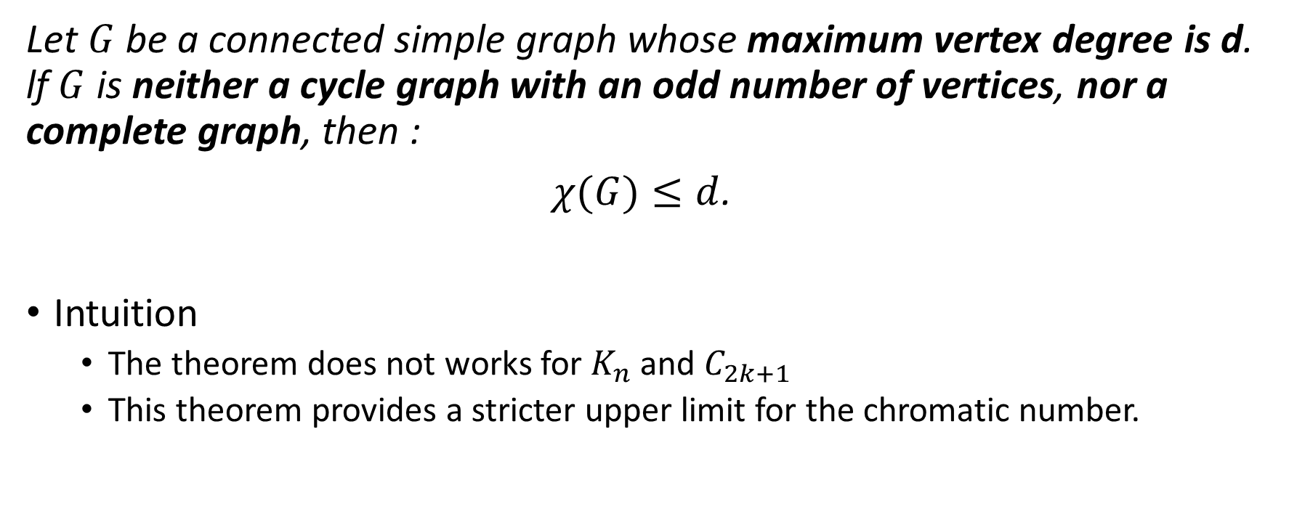
THEOREM 3 (Brooks 1941)
Let $G$ be a connected simple graph whose maximum vertex degree is d. lf $G$ is neither a cycle graph with an odd number of vertices, nor a complete graph, then :
$χ(G)≤d$.
Intuition
The theorem does not works for $K_{n}$ and $C_{2k+1}$
This theorem provides a stricter upper limit for the chromatic number.

Slide 18
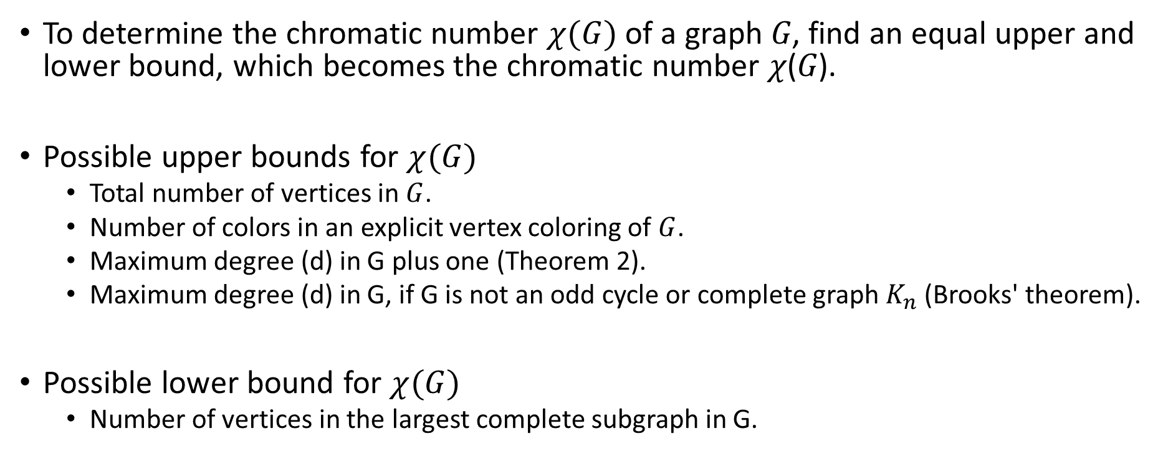
Chromatic Number 𝜒(𝐺) and Bounds
To determine the chromatic number $χ(G)$ of a graph 𝐺, find an equal upper and lower bound, which becomes the chromatic number 𝜒(𝐺).
Possible upper bounds for $χ(G)$
Total number of vertices in $G$.
Number of colors in an explicit vertex coloring of $G$.
Maximum degree (d) in G plus one (Theorem 2).
Maximum degree (d) in G, if G is not an odd cycle or complete graph $K_{n}$ (Brooks' theorem).
Possible lower bound for $χ(G)$
Number of vertices in the largest complete subgraph in G.

Slide 19
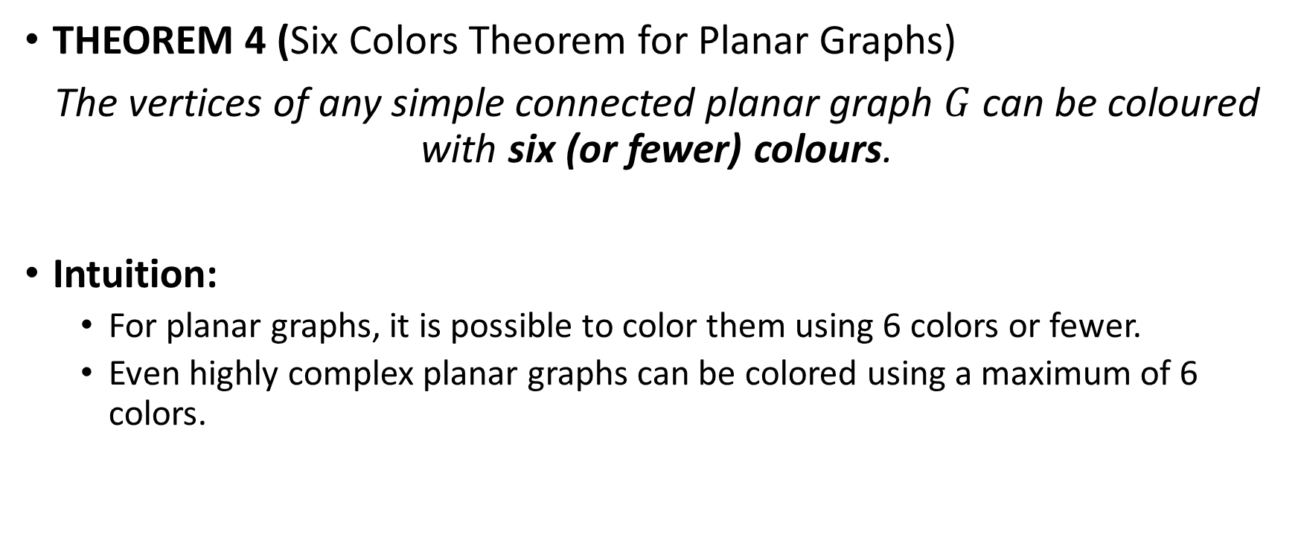
Coloring Planar Graphs
THEOREM 4 (Six Colors Theorem for Planar Graphs)
The vertices of any simple connected planar graph $G$ can be coloured with six (or fewer) colours.
Intuition:
For planar graphs, it is possible to color them using 6 colors or fewer.
Even highly complex planar graphs can be colored using a maximum of 6 colors.

Slide 20
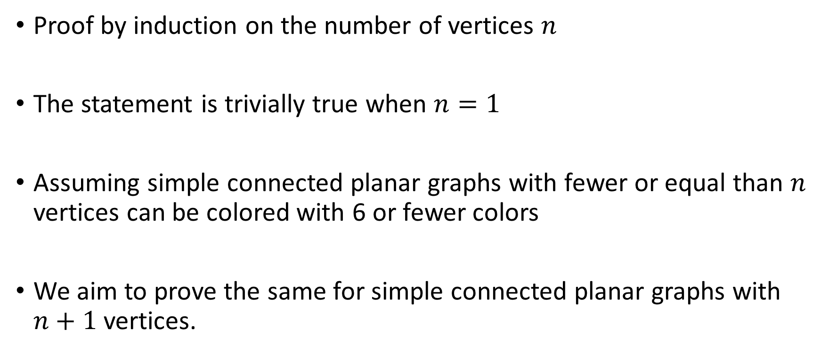
Proof
Proof by induction on the number of vertices $n$
The statement is trivially true when $n=1$
Assuming simple connected planar graphs with fewer or equal than $n$ vertices can be colored with 6 or fewer colors
We aim to prove the same for simple connected planar graphs with $n+1$ vertices.

Slide 21
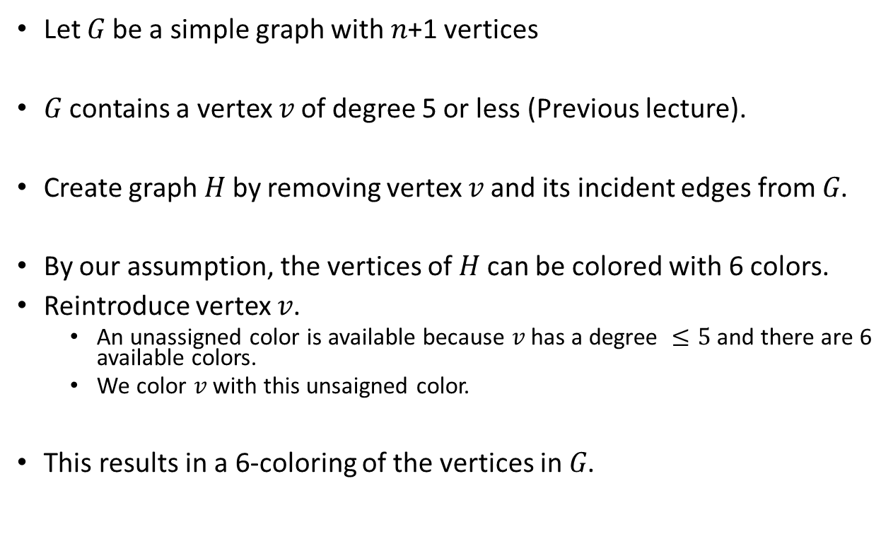

Proof
Let 𝐺 be a simple graph with 𝑛+1 vertices
𝐺 contains a vertex 𝑣 of degree 5 or less (Previous lecture).
Create graph 𝐻 by removing vertex 𝑣 and its incident edges from 𝐺.
By our assumption, the vertices of 𝐻 can be colored with 6 colors.
Reintroduce vertex 𝑣.
An unassigned color is available because 𝑣 has a degree $≤5$ and there are 6 available colors.
We color 𝑣 with this unsaigned color.
This results in a 6-coloring of the vertices in 𝐺.

Slide 22
THEORME 5 (Five Colors Theorem for Planar Graphs)
The vertices of any simple connected planar graph G can be colored with five (or fewer) colors.
Intuition:
For planar graphs, it is possible to color them using only 5 colors or fewer.
Even highly complex planar graphs can be colored using a maximum of 5 colors.

Slide 23
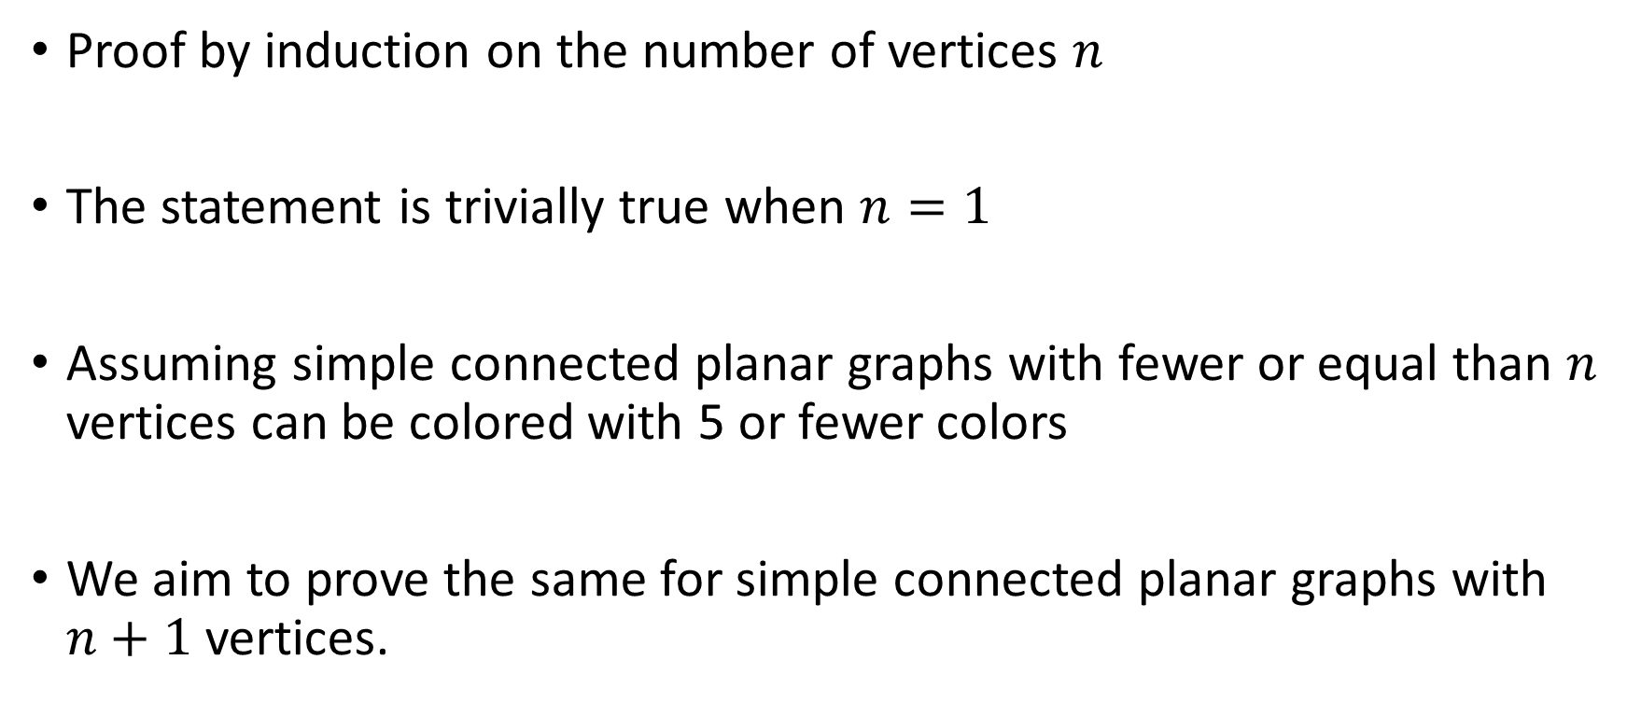
Proof
Proof by induction on the number of vertices $n$
The statement is trivially true when $n=1$
Assuming simple connected planar graphs with fewer or equal than $n$ vertices can be colored with 5 or fewer colors
We aim to prove the same for simple connected planar graphs with $n+1$ vertices.

Slide 24
Proof
Let 𝐺 be a simple graph with 𝑛+1 vertices
𝐺 contains a vertex 𝑣 of degree 5 or less (Previous lecture).
Create graph 𝐻 by removing vertex 𝑣 and its incident edges from 𝐺.
By our assumption, the vertices of 𝐻 can be colored with 5 colors.
If we reintroduce vertex 𝑣, three cases appear
Case 1: If there is an unassigned color, we are done
Case 2: two colors are not linked path
Case 3: two colors are connected with a path

Slide 25













Case 2: two colors are not linked path
By switching one color to be the same as another color, we created an unassigned color.

Slide 26



























Case 3: two colors are connected with a path
We simply switch two colors without creating an unassigned color.

Slide 27









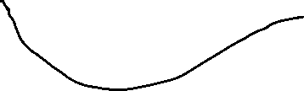






Case 3: two colors are connected with a path
The planarity prevents the colors from forming a path due to existing path

Slide 28


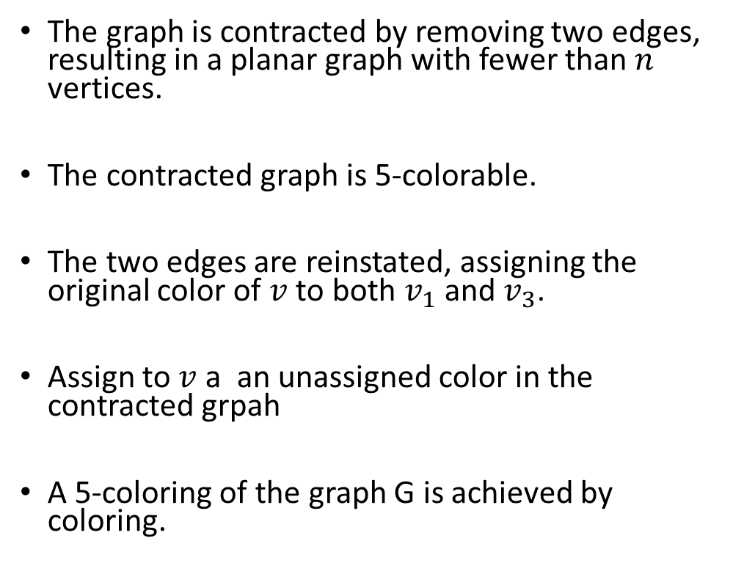
Another proof of case 3
The graph is contracted by removing two edges, resulting in a planar graph with fewer than $n$ vertices.
The contracted graph is 5-colorable.
The two edges are reinstated, assigning the original color of $v$ to both $v_{1}$ and $v_{3}$.
Assign to $v$ a an unassigned color in the contracted grpah
A 5-coloring of the graph G is achieved by coloring.

Slide 29
THEORME 6 (Four Colour Theorem for Planar Graphs )
The vertices of any simple connected planar graph can be colored with four (or fewer) colours.
Intuition
It states that only 4 colors are needed to color the regions oof any map.
Conjectured in the 19th century.
Proven in 1976 with computer assistance.
It demonstrates the inherent simplicity within complex spatial configurations.

Slide 30
Greedy Algorithm for Vertex Colouring
Start with graph G and a list of colors 1, 2, 3, ...
Step 1:
Label the vertices as a, b, c, ... in any manner.
Step 2:
Identify the uncolored vertex labeled with the earliest letter in the alphabet.
Color this vertex with the first color from the list that is not used by any adjacent colored vertex.
Repeat Step 2 until all vertices are colored.
Stop. A vertex coloring of G has been obtained.
The number of colors used depends on the labeling chosen for the vertices in Step 1.

Slide 31
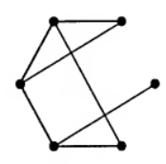
Example
Find a vertex colouring of the following graph G.
Step 1:
Label the vertices as a, b, c, ... in any manner.
Step 2:
Identify the uncolored vertex labeled with the earliest letter in the alphabet.
Color this vertex with the first color from the list that is not used by any adjacent colored vertex.

Slide 32



Example
Find a vertex colouring of the following graph G.
Step 1:
Label the vertices as a, b, c, ... in any manner.
Step 2:
Identify the uncolored vertex labeled with the earliest letter in the alphabet.
Color this vertex with the first color from the list that is not used by any adjacent colored vertex.

Slide 33
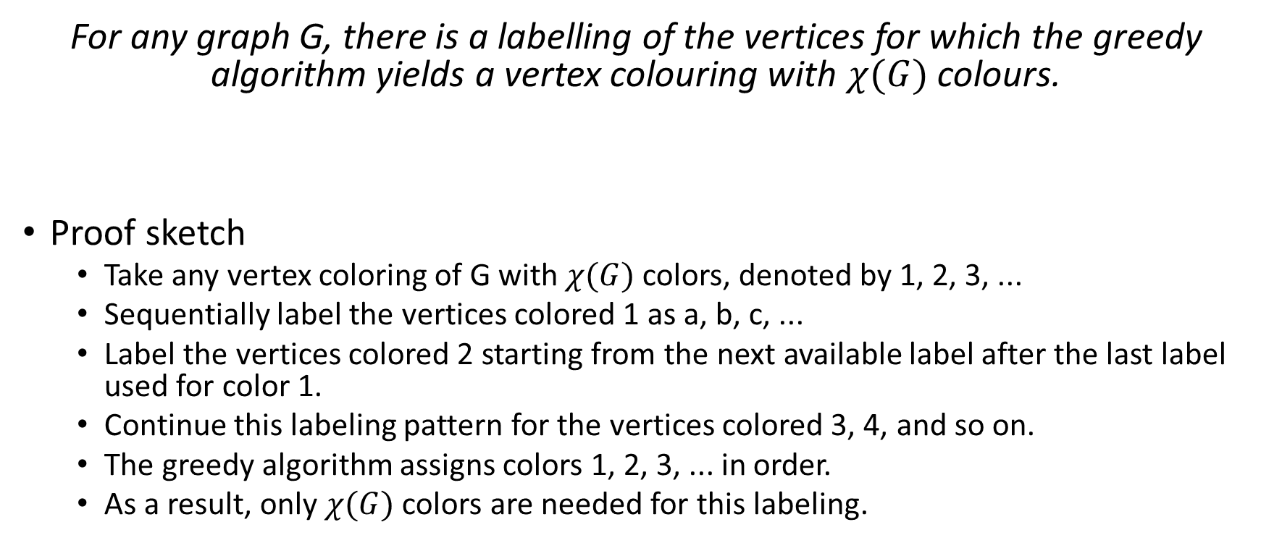
THEORME 6
For any graph G, there is a labelling of the vertices for which the greedy algorithm yields a vertex colouring with $χ(G)$ colours.
Proof sketch
Take any vertex coloring of G with $χ(G)$ colors, denoted by 1, 2, 3, ...
Sequentially label the vertices colored 1 as a, b, c, ...
Label the vertices colored 2 starting from the next available label after the last label used for color 1.
Continue this labeling pattern for the vertices colored 3, 4, and so on.
The greedy algorithm assigns colors 1, 2, 3, ... in order.
As a result, only $χ(G)$ colors are needed for this labeling.

Slide 34
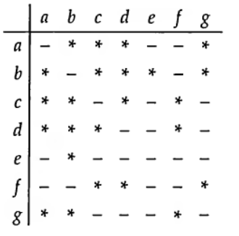
Coloring Problems: Storing Chemicals
Certain chemicals react violently when they are in contact.
The manufacturer plans to divide the warehouse into regions to separate dangerous chemical pairs.
The dangerous pairs of chemicals are marked with an asterisk in a table.
The objective is to find the minimum number of areas required to safely store the chemicals.

Slide 35
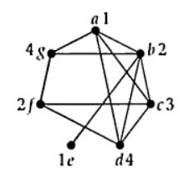
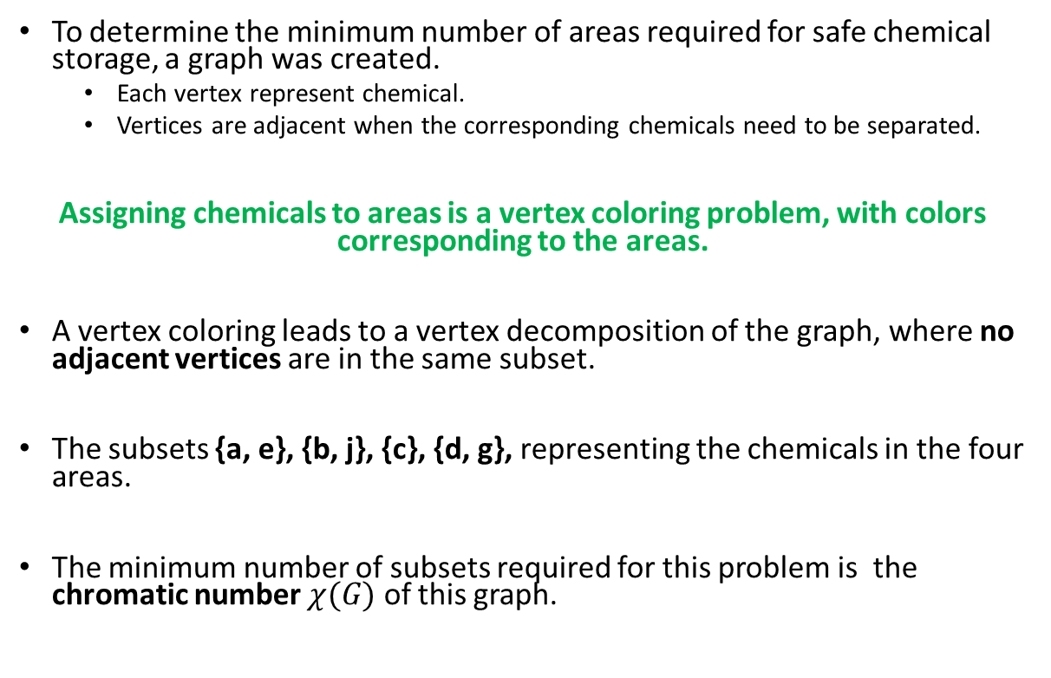
Coloring Problems
To determine the minimum number of areas required for safe chemical storage, a graph was created.
Each vertex represent chemical.
Vertices are adjacent when the corresponding chemicals need to be separated.
Assigning chemicals to areas is a vertex coloring problem, with colors corresponding to the areas.
A vertex coloring leads to a vertex decomposition of the graph, where no adjacent vertices are in the same subset.
The subsets {a, e}, {b, j}, {c}, {d, g}, representing the chemicals in the four areas.
The minimum number of subsets required for this problem is the chromatic number $χ(G)$ of this graph.

Slide 36
Coloring Problems: Map Colouring
In 1852, Francis Guthrie proposed the four-color problem:
Can all maps be colored with four colors so that neighboring countries have different colors?
Mathematicians, including De Morgan, Cayley, and Kempe, studied the problem.
In 1976, Appel and Haken provided a proof using nearly 2000 country configurations and extensive computer analysis.
Even today, no "simple" proof has been discovered for the four-color problem.

Slide 37
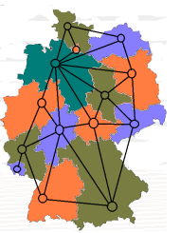
Coloring Problems: Map Colouring
Objective:
Assign colors to countries on a map, ensuring adjacent countries have different colors.
Representation:
Use the geometrical dual to represent countries as vertices in a graph, with edges connecting adjacent countries.
Determine the minimum number of colors needed to avoid adjacent countries sharing the same color.

Slide 38
Coloring Problems: Map Colouring
A map is planar graph
Theorem 4: Any map can be colored with 6 colors .
Theorem 5: Any map can be colored with 5 colors .
Theorem 6: Any map can be colored with 4 colors .

Slide 39
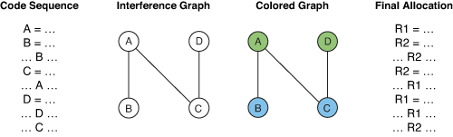
Coloring Problems: Register allocation
Register allocation can be seen as a graph coloring problem.
Nodes in the graph represent the live ranges of variables.
Edges indicate connections between two live ranges.
The objective is to assign colors to nodes such that adjacent nodes have different colors.
The chromatic number represents the minimum number of registers required.

Slide 40
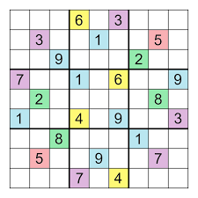
Let's play Sudoku
Objective:
Complete a 9x9 matrix.
Criteria:
In each row, column, and marked 3x3 square, the numbers 1 to 9 should occur exactly once.
Can we model this as coloring problem ?!

Slide 41
Conclusion
Graph coloring is a fundamental concept in graph theory with diverse applications.
It enables the assignment of colors to vertices by representing entities as vertices and their relationships as edges.
The goal is to ensure adjacent vertices have different colors, minimizing conflicts.
Efficient graph coloring algorithms are crucial for optimizing resource allocation and improving system performance.
Understanding graph coloring techniques helps solve complex optimization problems in various domains.
Graph coloring has applications beyond computer science, contributing to advancements in diverse fields.

Slide 42
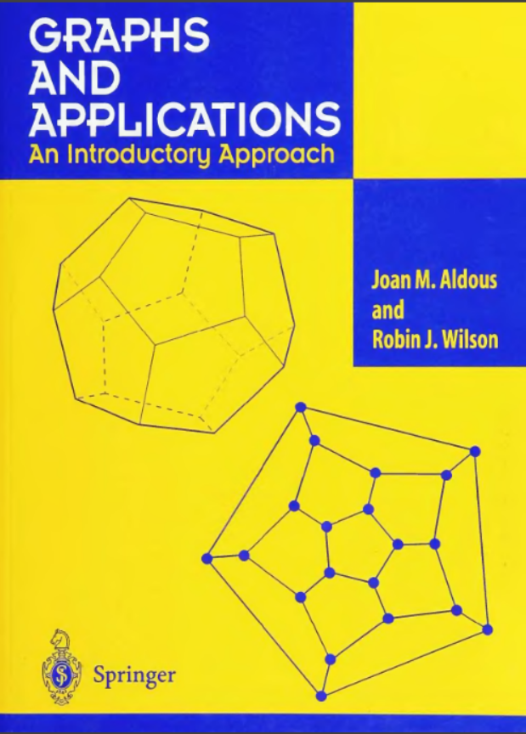
Reference

