Slide 1
Software Engineering :
4 : Requirements Engineering
Professor Imed Bouchrika National School of Artificial Intelligence imed.bouchrika@ensia.edu.dz

Slide 2
Outline :
Requirements Engineering
Definitions
Categorization of Requirements
Requirements Engineering Process
Requirements Gathering : Tools, Techniques..
Requirements Analysis
Requirements Documentation
Validation and Verification
Recommended Principles of RE
SRS Assignment

Slide 3
Requirements Engineering
What’s a requirement:
Something required, wanted, needed.
A functionality, a feature, a condition or a capability needed by a user to solve a problem or achieve an objective.
A condition or capability that must be met or possessed by a system or system component to satisfy a contract, standard, specification, or other formally imposed document.

Slide 4
Requirements Engineering
Requirements Engineering : Definition
It is a systematic process of developing the requirements through an iterative way of discovering, documenting and managing a set of requirements for a software system in addition to the constraints under which it operates.

Slide 5
Requirements Engineering
Requirements Engineering : Definition
Software requirements engineering is the process of determining what is to be produced in a software system.
It is the process of discovering, documenting and managing a set of requirements for a computer-based system in addition to the constraints under which it operates.
Requirements Engineering is complete sub-field in Software Engineering.
It is taught as a separate module at many universities

Slide 6
Requirements Engineering
Objectives of Requirements Engineering
To decide precisely what to build and document the results.
To produce a set of system/software requirements that, as far as possible, is complete, consistent, relevant and reflects what the customer actually want

Slide 7
Requirements Engineering
Objectives of Requirements Engineering
To decide precisely what to build and document the results.
To produce a set of system/software requirements that, as far as possible, is complete, consistent, relevant and reflects what the customer actually want
Can we develop a Software Product without conducting the requirements engineering ?

Slide 8
Requirements Engineering
Why RE is extremely important :
Comprehension: People do not know what they want
Communication: Software requirements are difficult to communicate effectively in an informal way.
Protection for your company : There are always changes, but there are riskier changes that can lead the project to go over budget.
Experience ?

Slide 9
Requirements Engineering
Why RE is extremely important :
From Experience :
Requirements are the biggest software engineering problem for software developers of large and complex systems.
The failure to develop and document good requirements specifications is the major cause of software development failures. (40 - 60 % of all defects)

Slide 10
Requirements Engineering
Types of the Requirements:
Functional Requirements
What the software product shall do
“The system shall do ….”
A system/software requirement that specifies a function that a system/software system or software components must be capable of performing.
Defines the behavior of the system/software.

Slide 11
Requirements Engineering
Types of the Requirements:
Functional Requirements
Functionalities to be implemented
Case Study : Personal Expenses Tracker
Add, Edit and remove expenses
Manage Categories
See daily and monthly reports

Slide 12
Requirements Engineering
Types of the Requirements:
Functional Requirements
Domain requirements : are also functional requirements derived from the domain where the software operates.
Example : Point of Sale for the Pharmaceutical Domain
Pricing is regulated by the government
The price of a product ( Medicine ) can differ based on its batch number.

Slide 13
Requirements Engineering
Types of the Requirements:
Non-Functional requirements
Qualities the product needs to have.
“The system needs to be ….”
A software requirement that describes not what the software will do, but how the software will do it.
Qualities and Constraints on how functional requirements are implemented

Slide 14
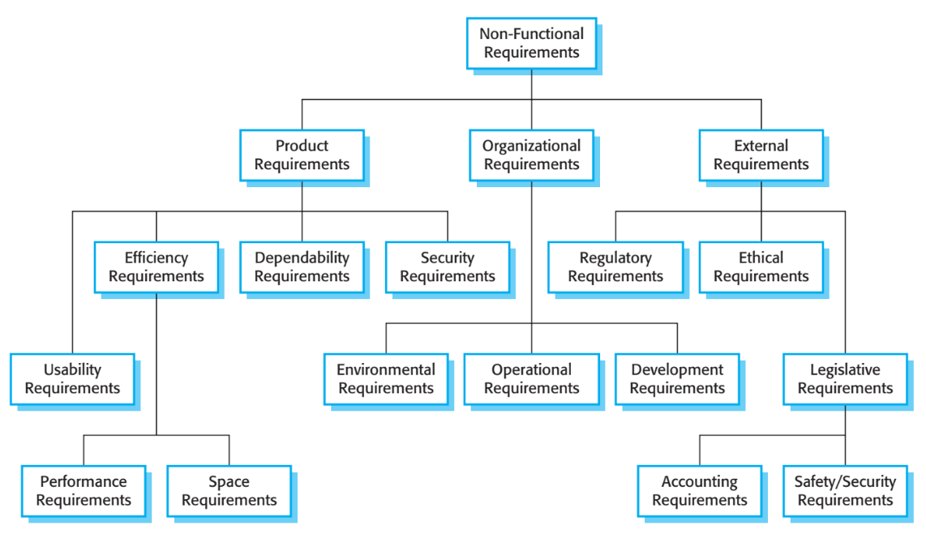
Requirements Engineering
Types of the Requirements:
Non-Functional requirements
Conditions, constraints or quality requirements
Constraints on how these functional requirements are implemented

Slide 15
Requirements Engineering
Types of the Requirements:
Non-Functional requirements
Case Study : Personal Expense Tracker
Easy to use
Fast to produce reports
Initial screen loads quick
It respects the localization setting of different users ( Decimal point : point or comma ? )

Slide 16
Requirements Engineering
Types of the Requirements:
Non-Functional requirements
Constraints :
Define the Non-Functional aspects of a system or component, such as restrictions on technology, resources or techniques to be used
Example :
Software needs to run on Windows, Linux and iOS

Slide 17
Requirements Engineering
Types of the Requirements:
Non-Functional requirements
Non-functional requirements are very difficult :
To Quantify and To state precisely
→ Imprecise requirements are difficult to verify.
Software must be easy to use : how to verify that this requirement is met ?

Slide 18
Requirements Engineering
Types of the Requirements:
Non-Functional requirements
Instead of expressing a non-functional requirement as a Goal
Example, ease of use
which is a general intention of the user
It is better to write them as a Verifiable non-functional requirement
A statement using some measure that can be objectively tested.

Slide 19
Requirements Engineering
Types of the Requirements:
Non-Functional requirements
Goal : The system should be easy to use by medical staff and should be organized in such a way that user errors are minimized.
Verifiable/Testable Statement : Medical staff shall be able to use all the system functions after four hours of training. After this training, the average number of errors made by experienced users shall not exceed two per hour of system use.

Slide 20
Requirements Engineering
Types of the Requirements:
Non-Functional requirements
Reliability
Mean time to failure
Rate of failure occurrence
Availability
Size
Megabytes
Scaling
Speed when increasing data
Speed when 1000.. users access at the same time
Robustness
Time to restart after failure
Probability of data corruption
Accessibility
Speed
Processed Transactions/Second
Response Time
Screen refresh time
Ease of use
Training Time
Duration to perform a task
Steps/Clicks/Mouse Distance ..
Portability
Number of target systems
Percentage of target dependent statements
Migrate system to another platform/framework…

Slide 21
Requirements Engineering
Types of the Requirements :
System requirements vs Software Requirements vs Hardware Requirements
Software requirements = for the software components.
System requirements = for the system as a whole. It includes
Software Requirements
Hardware Requirements

Slide 22
Requirements Engineering
Types of the Requirements :
System requirements vs Software Requirements vs Hardware Requirements
Information systems
Requirements engineering is primarily software requirements engineering.
Embedded systems
Requirements engineering involves both hardware and software requirements engineering.

Slide 23
Requirements Engineering
Types of the Requirements :
Abstract Requirements vs Detailed Requirements
If a company wants to hire another software development company to build their large software project, it must define its needs in a sufficiently abstract way that a solution is not predefined.
The requirements must be written so that several contractors can bid for the contract, offering, perhaps, different ways of meeting the client organization’s needs.
Once a contract is awarded, the contractor must write a system definition for the client in more detail so that the client understands and can validate what the software will do.

Slide 24
Requirements Engineering Process
Requirements Engineering Process :
A set of activities and tasks that needs to be performed in a structured way.
When engineering the the process, the following questions need to be addressed:
The structuring or schedule of these activities.
Who is responsible for each activity.
The inputs and outputs to/from the activity.
The tools used to support the process.
The output of the process ( RE)

Slide 25
Requirements Engineering Process
Requirements Engineering Process :
Requirements Elicitation
Requirements Analysis
Requirements Documentation
Validation

Slide 26
Requirements Engineering Process
Activity 1 : Requirements Elicitation
It is the process of discovering, gathering and understanding the requirements from the stakeholders and other relevant sources.
Stakeholders needs
Requirements Elicitation
Informal/Raw requirements
Application domain information
Standards
Regulations…

Slide 27
Requirements Engineering Process
Activity 1 : Requirements Elicitation
Defining who are the stakeholders ?
Stakeholder : is any entity that has a vested interest in the system to be built.
Type of Stakeholders :
Internal : Project Manager, Team members ( developers, testers….)
External : Customer, end-user, supplier, government,...

Slide 28
Requirements Engineering Process
Activity 1 : Requirements Elicitation
Where the requirements come from:
Goals : why the need for a new software ? what’s the problem to be solved ?
Domain Knowledge
System stakeholders
Organization Environment : Business Processes, Validation Procedures …
Operational Environment : Outdoor end-users….

Slide 29
Requirements Engineering Process
Activity 1 : Requirements Elicitation
How to elicit requirements
It is not :
Going to the end-user/customer and just ask questions in an improvised way
It would be a waste of time (Customer’s time)
The customer would feel that you are totally unprofessional and lack expertise.
How ?

Slide 30
Requirements Engineering Process
Activity 1 : Requirements Elicitation
How ?
A fully planned and organized process that requires :
Have knowledge about:
Application domain
Organizational and Business process
Problem
Choose an elicitation technique and prepare ( Construct your questions…)
Get as much information from the end-users as possible about their needs, constraints

Slide 31
Requirements Engineering Process
Activity 1 : Requirements Elicitation
Techniques for Requirements Elicitation
Interviews ( Closed or Open Interviews..)
Scenarios ( Use-bases)
Prototyping
Participant Observation ( Ethnography )
JAD (Joint Application Development)
…

Slide 32
Requirements Engineering Process
Activity 1 : Requirements Elicitation
Problems with the Elicitation of Requirements :
Stakeholders don’t know what they want
Stakeholders express requirements in their own terms (vs. language of coders)
Stakeholders are unconvinced of the need for a new system
Different stakeholders may have conflicting requirements
Stakeholders may give unnecessary information
Organisational and political factors may influence the system requirements.
The requirements change during the analysis process.
New stakeholders may emerge and the business environment may change.

Slide 33
Requirements Engineering Process
Activity 1 : Requirements Elicitation
Problems with the Elicitation of Requirements :
Stakeholders don’t know what they want
Stakeholders express requirements in their own terms
Stakeholders are unconvinced of the need for a new system
Different stakeholders may have conflicting requirements
Stakeholders may give unnecessary information
Organisational and political factors may influence the system requirements.
The requirements change during the analysis process.
New stakeholders may emerge and the business environment may change.
Bigger Problem : Implicitness and Assumptions

Slide 34
Requirements Engineering Process
Activity 1 : Requirements Elicitation
Problems with the Elicitation of Requirements :
Implicitness and Assumptions
Stakeholders do not talk about certain requirements because they assume they are common sense to everyone ( including the developers)
Developers make assumptions about how end-users think and about their needs.

Slide 35
Requirements Engineering Process
Activity 1 : Requirements Elicitation
Questions to Ask
Why do you need to build a new software ?
Can you just use an Excel file ?
Can you just use that existing software ?
What problem are you expecting the software to solve ?
Who will be using the software ? who are the actual users of the software ?
Where the software will be used ?
Given that the user X want to perform a task Y. Can we describe the scenario for him in doing that task ?
How would you assess that the software product is a success ? What would you like to see at the end ?
… ( including more why, when, where, what and how)

Slide 36
Requirements Engineering Process
Activity 2 : Requirements Analysis
The process of reviewing and analyzing the raw requirements in order to discover:
Missing Requirements
Overlapping Requirements
Ambiguous Requirements
Unrealistic Requirements
Conflictual Requirements
Inconsistent Requirements
And negotiating with the stakeholders to resolve any conflict, inconsistency and improving the interpretation of raw requirements

Slide 37
Requirements Engineering Process
Activity 2 : Requirements Analysis
The process of reviewing and analyzing the raw requirements in order to discover:
Missing Requirements
Overlapping Requirements
Ambiguous Requirements
Unrealistic Requirements
Conflictual Requirements
Inconsistent Requirements
And negotiating with the stakeholders to resolve any conflict, inconsistency and improving the interpretation of raw requirements
Personal Expense Tracker ?

Slide 38
Requirements Engineering Process
Activity 2 : Requirements Analysis
The process of reviewing and analyzing the raw requirements in order to discover:
Missing Requirements
Overlapping Requirements
Ambiguous Requirements
Unrealistic Requirements
Conflictual Requirements
Inconsistent Requirements
Search by keyword

Slide 39
Requirements Engineering Process
Activity 2 : Requirements Analysis
The process of reviewing and analyzing the raw requirements in order to discover:
Missing Requirements
Overlapping Requirements
Ambiguous Requirements
Unrealistic Requirements
Conflictual Requirements
Inconsistent Requirements
Show the total quantity bought today ? (Impossible to sum quantities of different products)

Slide 40
Requirements Engineering Process
Activity 2 : Requirements Analysis
The process of reviewing and analyzing the raw requirements in order to discover:
Missing Requirements
Overlapping Requirements
Ambiguous Requirements
Unrealistic Requirements
Conflictual Requirements
Inconsistent Requirements
Expense must have a category + Possibility to Delete a Category ?

Slide 41
Requirements Engineering Process
Activity 3 : Requirements Documentation
The process of developing a document that, clearly, precisely, formally and officially records each of the requirements of the software system.
This document is used to communicate the requirements to:
Customers
End-users
Software developers.
Project Managers
Quality Assurance Engineers/Testers
The resulting artifact from this process is mostly a DRAFT version of the Software Requirements Specification (SRS) document

Slide 42
Requirements Engineering Process
Activity 3 : Requirements Documentation
Software Requirements Specification (SRS):
Identifies the customer requirements by detailing the results of the elicitation , problem analysis and even modelling.
Serves as foundation for the design, implementation and testing of the software.
Provides guidance for future system maintenance
It must be : Correct, Complete, Unambiguous, Consistent, Verifiable, Understandable, Modifiable, Traceable…

Slide 43
Requirements Engineering Process
Activity 3 : Requirements Documentation
Software Requirements Specification (SRS):
There is no best way to write requirements but there are recommendations to follow :
IEEE Std 830-1998, Recommended Practice for Software Requirements Specifications
IEEE Std 1362-1998, Guide for Information Technology -System Design -Concept of Operations Document
IEEE Std 1233-1998, Guide for Developing System Requirements Specification
Most requirements are written as natural language sentences supplemented with diagrams, tables of detailed information, formal or semi-formal descriptions.

Slide 44
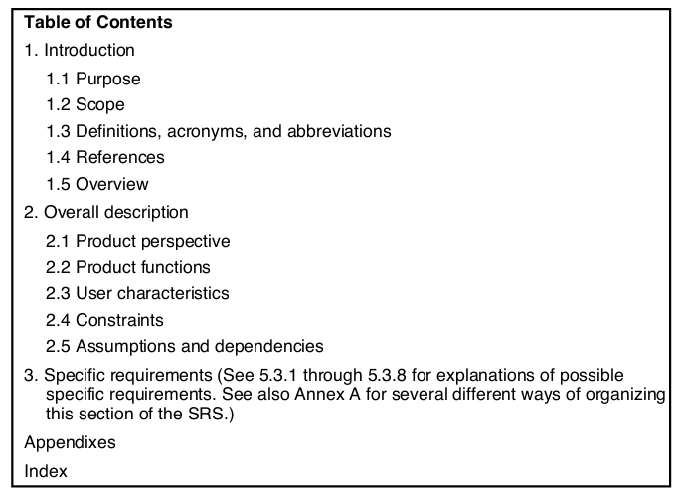
Requirements Engineering Process
Activity 3 : Requirements Documentation
Structure of the Software Requirements Specification (SRS) document:
IEEE Std 830-1998, Recommended Practice for Software Requirements Specifications
See provided examples

Slide 45
Requirements Engineering Process
Activity 4 : Requirements Validation
Certifies that the requirements document is an acceptable description of the system to be implemented.
We finalize the SRS document at this stage with the stakeholders checking for :
Completeness and consistency
Requirements conflicts
Ambiguous requirements
Conformance to standards
Technical errors

Slide 46
Recommended Principles of RE
Value-orientation
Requirements are a means to an end, not an end in itself!
Requirements engineering places a strong focus on the value creation of a development.
If requirement is add expense : this is not the end, it is the means :
The end /value is to have a clean daily history of your spending
01

Slide 47
Recommended Principles of RE
Stakeholder
RE is about satisfying the stakeholders’ desires and needs!
In order to understand the wishes and needs of stakeholders, stakeholder management is a core task in requirements engineering.
Different roles, different age, different education levels….your system must satisfy their needs
02

Slide 48
Recommended Principles of RE
Shared understanding
Successful systems development is impossible without a common basis!
For the successful development of systems, a common understanding between the parties involved – stakeholders, requirements engineers and developers – is essential.
03

Slide 49
Recommended Principles of RE
Context
Systems cannot be understood in isolation!
Systems are embedded in a context. The system context describes the interaction of a system with its environment.
04

Slide 50
Recommended Principles of RE
Problem – Requirement – Solution
Solutions can always bring problems , which bring new requirements
05
Validation
Non-validated requirements are useless !
06
Evolution
Changing requirements are no accident, but the normal case!
07
Innovation
More of the same is not enough!
08

Slide 51
Recommended Principles of RE
Systematic and disciplined work
We can’t do without in RE!
There is no one process or procedure in requirements engineering that works well in every situation. To ensure the quality of a system, the processes, practices and work products that best suit the situation must be chosen. Systematic and disciplined work means adapting the approach to the particular problem, context and working environment.
09

Slide 52
Personal Expense Tracker
More functional Requirements
Problem : I am spending too much ?
Solution : Add Badges to motivate the user to spend less and gamify their spending habits by using psychological theories:
Spending less than an amount of X for some consecutive days, give them a badge..
Requirement : Adding gamified elements to the software : Stars, Badges….

Slide 53
Personal Expense Tracker
More functional Requirements
Problem : I like to consolidate all expenses for all family members
Solution : Invite users to add their expenses
Requirement : Add sub-users creation and management
Problem Created : I don’t like my kid, to see what I am buying, nor i like the other kid to see his brother/sister what they buy.
….

