Slide 1
Software Engineering :
11 : From Architecture to Implementation
Professor Imed Bouchrika National School of Artificial Intelligence imed.bouchrika@ensia.edu.dz

Slide 2
Outline :
Case Study 1 : Ticket Queue Management Sys.
Specifications
Software Architecture:
Functional Requirements
Non-Functional Requirements
Components and Modules: Modularization & Cohesion
Technological Stack
Designing the Architecture :
Coupling and Communication
Low-Level Entities
Implementation
Ticket Server
Kiosk Client
Display Server
Display Client
AdminGui
Case Study 2 : Mobile-App-Based Monitoring System

Slide 3
Software Engineering : Too Many Concepts ?
Behavioral Diagram
Software Process
Agile Methods
Custom Software
Layered
MVC
Collaboration
Class Diagram
Kanban
Stamp Coupling
Structural Diagram
Adapter Pattern
S.O.L.I.D
Clean Code
Factory Pattern
DRY
Scrum
Software Entropy
XP
Software Crisis
SRS
TDD
Extensibility
Interface
Abstraction
Cohesion
GIT/CVS
UML
Req Elicitation
Concretion
Liskov Substitution
Modularization

Slide 4
Software Engineering: 11 weeks of lectures….
A lot of concepts
A lot of methods
A lot of techniques
A lot of terminologies
A lot of Blahware…
Not to over-complicate the development of software development
But to :
Simplify the Development and Implementation
Make sure that the system can be extensible and maintainable

Slide 5
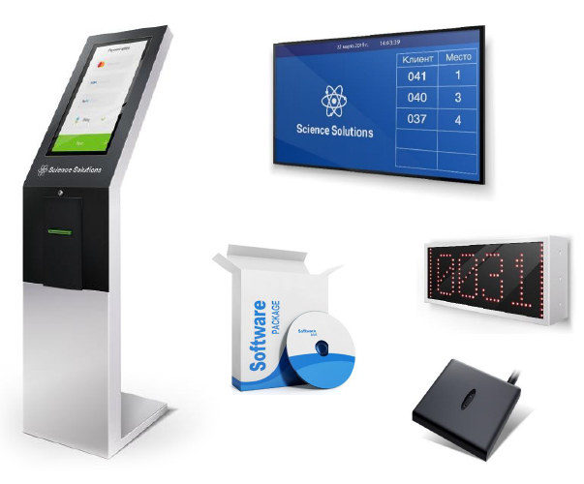
Ticket Queueing System: Specification
Raw Specification:
A company (Algerie Poste) wanted to develop a new software for managing the queue of their waiting clients inside the waiting room where a new client is given a ticket with a number. There are many agents dealing with clients. When an agent becomes free, he/she will call the next client where the number is shown in a central display screen.

Slide 6
Ticket Queueing System: Functional Requirements
List of requirements :
Issue Ticket
Call Next Customer
Skip To Next Customer
Display Waiting Info
Manage and reset the counter

Slide 7
Ticket Queueing System: Functional Requirements
List of requirements :
Implicit requirements
Customize the printed ticket :
Add/Edit company logo
Add/Edit company name/address
Add/Edit Greeting messages…
Special priority queues
For people with special needs
?

Slide 8
Ticket Queueing System: Functional Requirements
List of requirements :
Implicit requirements
Customize the printed ticket :
Add/Edit company logo
Add/Edit company name/address
Add/Edit Greeting messages…
Special priority queues
For people with special needs
?
What’s the objective for a company to deploy such system ? What the company would like to see when they deploy the system ?

Slide 9
Ticket Queueing System: Functional Requirements
List of requirements :
Implicit requirements
Customize the printed ticket :
Add/Edit company logo
Add/Edit company name/address
Add/Edit Greeting messages…
Special priority queues
For people with special needs
?
- Statistics about the daily wait time + number of customers being served. - Times/hours when the agency is busy vs when the agency has no customers. - Analyse the performance of employees.

Slide 10
Ticket Queueing System: Functional Requirements
List of requirements :
Implicit requirements
Customize the printed ticket :
Add/Edit company logo
Add/Edit company name/address
Add/Edit Greeting messages…
Special priority queues
For people with special needs
?
- Statistics about the daily wait time + number of customers being served. - Times/hours when the agency is busy vs when the agency has no customers. - Analyse the performance of employees.
These objectives can greatly impact the architecture and implementation : Employee Performance : Authentication may be needed for employee + track all activities for an employee

Slide 11
Ticket Queueing System: Functional Requirements
List of requirements :
Implicit requirements
Customize the printed ticket :
Add/Edit company logo
Add/Edit company name/address
Add/Edit Greeting messages…
Special priority queues
For people with special needs
?
- Statistics about the daily wait time + number of customers being served. - Times/hours when the agency is busy vs when the agency has no customers. - Analyse the performance of employees.
These objectives can greatly impact the architecture and implementation : Employee Performance : Authentication may be needed for employee + track all activities for an employee
What if the objective : Reduce fraudulent and abusive activities of people getting multiple tickets for the sake to sell them for a profit ?

Slide 12
Ticket Queueing System: Functional Requirements
List of requirements :
Implicit requirements
Customize the printed ticket :
Add/Edit company logo
Add/Edit company name/address
Add/Edit Greeting messages…
Special priority queues
For people with special needs
?
- Statistics about the daily wait time + number of customers being served. - Times/hours when the agency is busy vs when the agency has no customers. - Analyse the performance of employees.
These objectives can greatly impact the architecture and implementation : Employee Performance : Authentication may be needed for employee + track all activities for an employee
This will even impact the hardware architecture, legal aspect, software architecture As a potential solution : biometric solution can be used to record the fingerprint of people …
What if the objective : Reduce fraudulent and abusive activities of people getting multiple tickets for the sake to sell them for a profit ?

Slide 13
Ticket Queueing System: Functional Requirements
To remember about the requirements
The customer does not know what they want,
Ask always for their objectives
Try to see existing products, analyse their functionalities
Gather and understand as much knowledge about the application domain and the company business processes.
Ask who will be using the system, where the system will run, possibly the materials available, infrastructure…

Slide 14
Ticket Queueing System: Technical Capacities
Extensibility ?
Scalability ?
Portability ?
Manageability ?
Fault tolerance ?
Performance ?
Usability ?
…

Slide 15
Ticket Queueing System: Components and Roles
Modularization of the System :
How to find the components :
Start with user stories for each role
List the responsibility or functionality,
Assign cohesive functionalities it to a module
Ask always :
whether it will be deployed separately or within a single system.
Distributed
Monolithic System
How many instances of it to be deployed.
Any constraints.

Slide 16
Ticket Queueing System: Components and Roles
Modularization of the System :
How to find the components :
Try to decompose the module into other modules based on :
Finding other responsibilities or technical functionalities that can be delegated.
If a business logic/functionalities can be reused by other modules.
If distributed , you may check based on hardware ? communication paradigm ? or even the architecture style ? ..

Slide 17
Ticket Queueing System: Components and Roles
Modularization of the System :
Finding Components :
User Story : As a visitor, I would like to get queue ticket printed so that I would be served.
Module : Kiosk
Responsability : Printing Ticket
Kiosk

Slide 18
Ticket Queueing System: Components and Roles
Modularization of the System :
Finding Components :
User Story : As a visitor, I would like to get queue ticket printed so that i would be served.
Module : Kiosk
Responsability : Printing Ticket
Kiosk
Will this module Keep track of the current queue number ?

Slide 19
Ticket Queueing System: Components and Roles
Modularization of the System :
Finding Components :
Module : Ticket Server
Responsability :
Tracking the current queue number
Giving this number to kiosks
TicketServer

Slide 20
Ticket Queueing System: Components and Roles
Modularization of the System :
Finding Components :
Other user story : As a staff, I would like to call automatically for the next customer in the queue so that I can serve.

Slide 21
Ticket Queueing System: Components and Roles
Modularization of the System :
Finding Components :
Other user story : As a staff, I would like to call automatically for the next customer in the queue so that I can serve.
Module : AgentGUI
Responsability :
Get the next number in the queue to serve.
Skip to the next customer (in case a customer does not show up) ( I will ignore this feature in this case study)
AgentGui

Slide 22
Ticket Queueing System: Components and Roles
Modularization of the System :
Finding Components :
Other user story : As visitor, i would like to see on the display screen current queue number being served so that i can estimate how much longer to wait.

Slide 23
Ticket Queueing System: Components and Roles
Modularization of the System :
Finding Components :
Other user story : As visitor, i would like to see on the display screen current queue number being served so that i can estimate how much longer to wait.
Module : Display ?
Responsibility :
Get or Receive Data from TicketServer
Format Data
Display Data according to some hardware specs

Slide 24
Ticket Queueing System: Components and Roles
Modularization of the System :
Finding Components :
Module : DisplayServer
Responsibility :
Get or Receive Data from TicketServer
Format Data
Module : DisplayClient
Responsibility:
Display Data

Slide 25
Ticket Queueing System: Components and Roles
Modularization of the System :
User story : As a system administrator or IT person, would like to manage the system by resetting counters, edit configuration, see statistics..…
Module : AdminGUI
Responsibility :
Reset Counters

Slide 26
Ticket Queueing System: Components and Roles
Can we rely on ChatGPT ? or AI ?

Slide 27
Ticket Queueing System: Architecture Overview
Monolithic Application :
Create it as a Web App (WAMP/LAMP) with many different web pages/interfaces:
One for the Kiosk Printing System.
One interface for the agent
One interface for the display
One interface for admin
Advantage :
Easy and cheap to develop .
Easy to maintain
Any problems ?

Slide 28
Ticket Queueing System: Architecture Overview
Monolithic Application :
Create it as a Web App (WAMP/LAMP) with many different web pages/interfaces:
One for the Kiosk Printing System.
One interface for the agent
One interface for the display
One interface for admin
Advantage :
Easy and cheap to develop and cheap.
Easy to maintain
Problems : Complexity with custom hardware + Need for a browser + Need for a PC for the Agent + Live-events with Web App can be a problem + Display Issues/Refresh?When?Often ?

Slide 29
Ticket Queueing System: Architecture Overview
Distributed Application :
Create a different module as a separate system to run on the relevant platform
Advantage :
Scalable and integrated on any hardware/settings
Drawbacks:
Difficult and costly.
Hard to maintain ( Depending on the architecture itself).

Slide 30
Ticket Queueing System: Technological Stack
Ticket Server ( Can be a background Process)
Background process : Java, Python or NodeJS
Kiosk:
GUI usually to run on
Touch display screen with a printer linked
It can be android or windows operating system
Windows : Java, Python
Mobile : Flutter…

Slide 31
Ticket Queueing System: Technological Stack
DisplayServer :
Background process : Java, Python or NodeJS
DisplayClient :
GUI with rich multimedia support for playing videos, viewing images and text
It will be connected to large display screen.
Java, Python or even Web-Based Technologies.

Slide 32
Ticket Queueing System: Design and Architecture
Kiosk
TicketServer
Who calls who ? where to put the direction of the arrow ?

Slide 33
Ticket Queueing System: Design and Architecture
Kiosk
TicketServer
Kiosk calls with the TicketServer to get the number ?

Slide 34
Ticket Queueing System: Design and Architecture
Kiosk
TicketServer
Kiosk calls the TicketServer to get the number ?

Slide 35
Ticket Queueing System: Design and Architecture
Coupling and Connecting Modules : Communication
Use the analogy of : Teacher to give an exam mark to a student
Student asks for their mark from the Teacher : [ex: teacher.askMark(ali) ]
Problems : The mark is not ready, students need to come again and again
Teacher gives for the mark to the Teacher : [ex: ali.giveMark(19) ]
Problems : What if the student is absent ? the teacher went away ?
Student
Teacher
Teacher
Student

Slide 36
Ticket Queueing System: Design and Architecture
Coupling and Connecting Modules : Communication
Use the analogy of : Teacher to give an exam mark to a student
Students subscribe a to Module List at the secretary desk.
Teacher gives the mark to a secretary [secretary.putMarks(module, marks) ]
Secretary notifies students : module.subscribed.notify(mark)
(Or it can be even on demand, students would come to the secretary to get their mark)
Teacher
Secretary
Student

Slide 37
Ticket Queueing System: Design and Architecture
Coupling and Connecting Modules : Communication
Use the analogy of : Teacher to give an exam mark to a student
Students subscribe a to Module List at the secretary desk.
Teacher gives the mark to a secretary [secretary.putMarks(module, marks) ]
Secretary notifies students : module.subscribed.notify(mark)
(Or it can be even on demand, students would come to the secretary to get their mark)
What if there are over 10000 students accessing the secretary office at the same time ?
Teacher
Secretary
Student

Slide 38
Ticket Queueing System: Design and Architecture
Kiosk
TicketServer
AgentGui

Slide 39
Ticket Queueing System: Design and Architecture
Kiosk
TicketServer
AgentGui
DisplayServer

Slide 40
Ticket Queueing System: Design and Architecture
Kiosk
TicketServer
AgentGui
DisplayServer
DisplayClient
DisplayClient

Slide 41
Ticket Queueing System: Design and Architecture
DAL
Kiosk
TicketServer
AgentGui
DisplayServer
DisplayClient
DisplayClient

Slide 42
Ticket Queueing System: Design. : Ticket Server
Class Diagram:

Slide 43
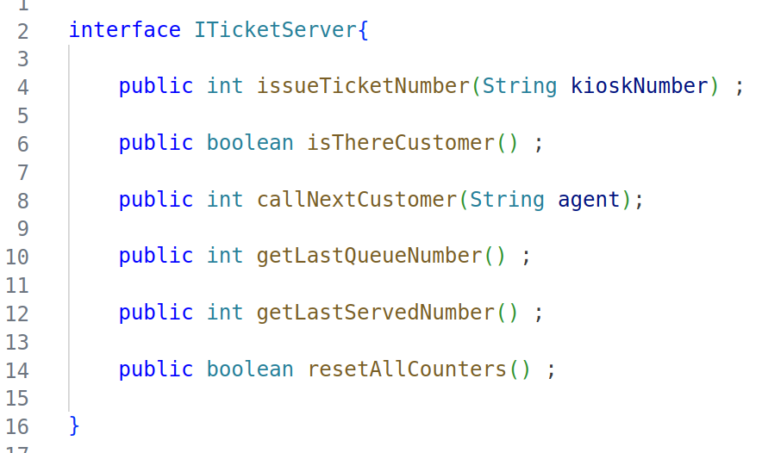
Ticket Queueing System: Dev. : Ticket Server
Using Java
Start Always with the interface

Slide 44
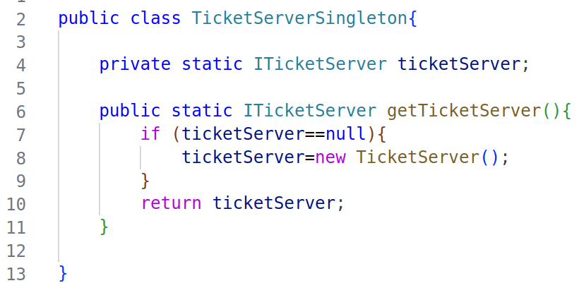
Ticket Queueing System: Dev. : Ticket Server
Using Java
Implement the interface with whatever business logic you want.
Create Singleton Pattern to create an instance of the TicketServer

Slide 45
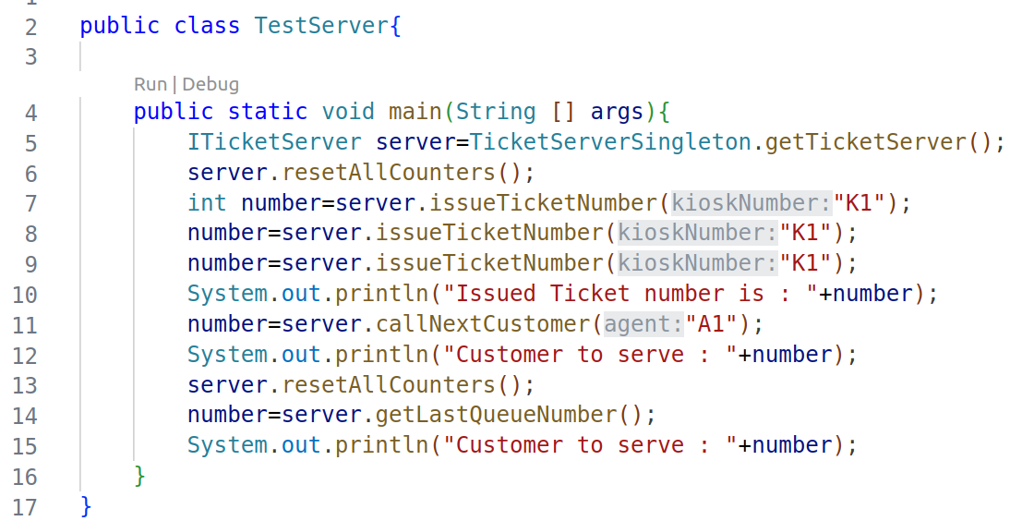
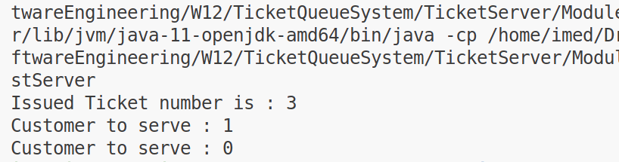
Ticket Queueing System: Dev. : Ticket Server
Using Java
Testing the TicketServer

Slide 46
Ticket Queueing System: Dev. : Ticket Server
Using Java
Testing the TicketServer
But : other modules will run on separate machines ? How will they call such functions ?

Slide 47
Ticket Queueing System: Dev. : Ticket Server
Using Java
Testing the TicketServer
We create another technical module to wrap around the ticketServer and gives an interface/plugin/socket to communicate based on whichever technology we like

Slide 48
Ticket Queueing System: Dev. : Ticket Server
Compiling and Packaging:
Maven / Ant / CMake / Grade …:
Are Build Automation tools with various features to facilitate compiling, building, packaging, testing and even installing software systems and components
TicketServer will be packaged as a separate module ( without the main method).

Slide 49
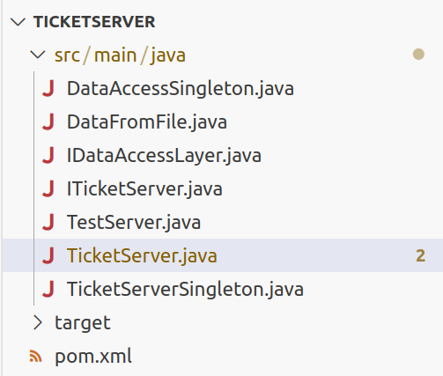
Ticket Queueing System: Dev. : Ticket Server
Compiling and Packaging : maven
Install maven on your windows or Ubuntu machine
Structure your project in the following structure :
Under : src/main/java place your java files
The pom.xml contains the maven config for compiling and building

Slide 50
Ticket Queueing System: Dev. : Ticket Server
Compiling and Packaging : pom.xml file
<?xml version="1.0" encoding="UTF-8"?>
<project xmlns="http://maven.apache.org/POM/4.0.0" xmlns:xsi="http://www.w3.org/2001/XMLSchema-instance"
xsi:schemaLocation="http://maven.apache.org/POM/4.0.0 https://maven.apache.org/xsd/maven-4.0.0.xsd">
<modelVersion>4.0.0</modelVersion>
<groupId>dev.startsoftware</groupId>
<artifactId>ticket-server-java</artifactId>
<packaging>jar</packaging>
<version>0.1.0</version>
<properties>
<maven.compiler.source>1.8</maven.compiler.source>
<maven.compiler.target>1.8</maven.compiler.target>
</properties>
</project>

Slide 51
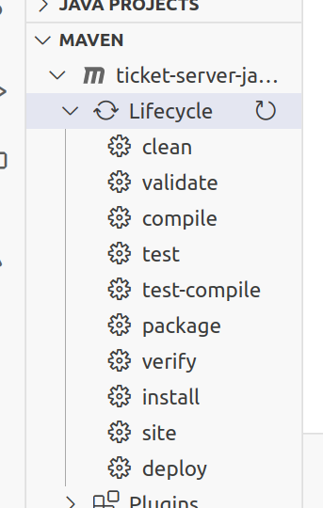
Ticket Queueing System: Dev. : Ticket Server
Compiling using maven
Using your terminal inside the main folder:
mvn clean
mvn compile
mvn package

Slide 52
Ticket Queueing System: Dev. : Ticket Server
Installing the module as part of the Maven Repository (Locally)
Using your terminal inside the main folder:
mvn install:install-file -Dfile="target/ticket-server-java-0.1.0.jar" -DgroupId=dev.startsoftware -DartifactId=ticket-server-java -Dversion=0.1.0 -Dpackaging=jar
Those values are inside the pom.xml file

Slide 53
Ticket Queueing System: Dev. : Ticket Server
How can we access the TicketServer from another machine ?
RMI : Remote Invocation :
We couple other components to Java only.
Problem with firewalls + complexity
Rest API :
Run over HTTP + Loose coupling by simple data passage.
Socket
Corba
Or Even a hybrid or all of them…

Slide 54
Ticket Queueing System: Dev. : Ticket Server
RestAPI Module
Using the Maven structuring, create a new project for a new module
We will be using the Spark Library which is micro-framework for Java to create web applications including API-endpoints.
For the POM :
Need to include the dependencies of : JavaSpark + TicketServer
Need to tell MAVEN that this module has a main class to start executing

Slide 55
Ticket Queueing System: Dev. : Ticket Server
import static spark.Spark.*;
public class StartRestEndpoint{
public static void main(String [] args){
ITicketServer server=TicketServerSingleton.getTicketServer();
System.out.println("Rest API EndPoint is Running ");
get("/issueTicket/:kiosk",
(req, res) -> ""+server.issueTicketNumber(req.params(":kiosk")));
get("/callNextCustomer/:agent",
(req, res) -> ""+server.issueTicketNumber(req.params(":agent")));
get("/isThereCustomer", (req, res) -> ""+server.isThereCustomer());
get("/resetCounters", (req, res) -> ""+server.resetAllCounters());
}
}
RestAPI Module

Slide 56
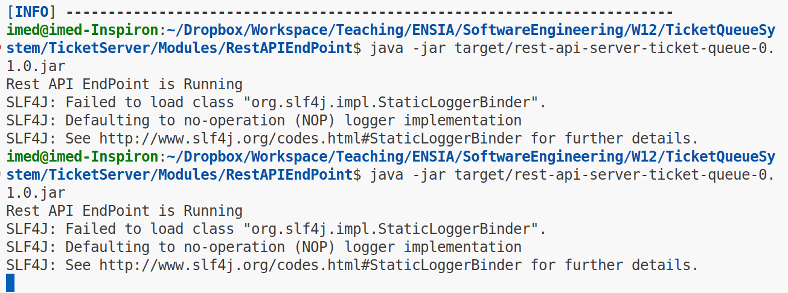
Ticket Queueing System: Dev. : Ticket Server
Running the RestAPI Module

Slide 57
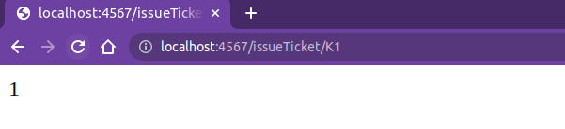
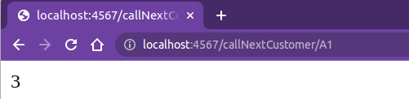
Ticket Queueing System: Dev. : Ticket Server
Testing and Verifying the RestAPI vs. TicketServer
Open a Browser and visit the URL :
http://localhost:4567/issueTicket/K1 (Feel free to keep refreshing..)
http://localhost:4567/callNextCustomer/A1

Slide 58
Ticket Queueing System: Dev. : Ticket Server
GUIs (Java Only)
GUIs ( Python, Java..)
RMI
RestAPI
Architectural Style
Layered Approach
TicketServer
DAL
Files
MySQL

Slide 59
Ticket Queueing System: Dev. : Kiosk + AgentGui
Kiosk
Using Java Swing
Or Python Tkinter
AgentGui
Using Java Swing
Or Python
Or even other programming languages suited for embedded systems.

Slide 60
Ticket Queueing System: Design and Architecture
Kiosk
TicketServer
AgentGui
DisplayServer

Slide 61
Ticket Queueing System: DisplayServer
Which module to modify when we develop this new module ?
Only the ServerTicket.
Other modules will not be impacted and not tested.
When there is an event ? action ? the DisplayServer needs to be notified.
What’s the best strategy to implement this on the TicketServer first

Slide 62
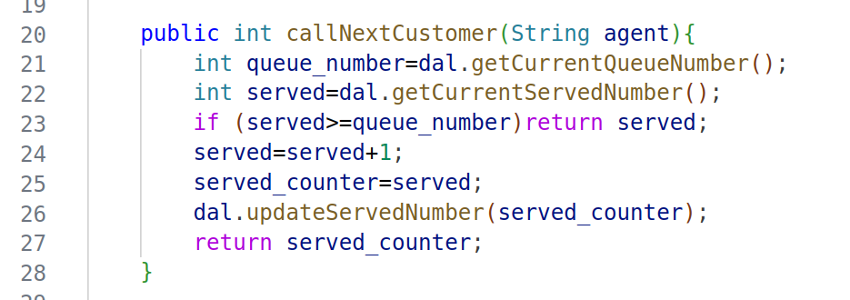
Ticket Queueing System: DisplayServer
Where to call the DisplayServer ? + How ?
Which module to modify when we develop this new module ?
Only the ServerTicket.
Other modules will not be impacted and not tested.
When there is an event ? action ? the DisplayServer needs to be notified.
What’s the best strategy to implement this on the TicketServer first

Slide 63
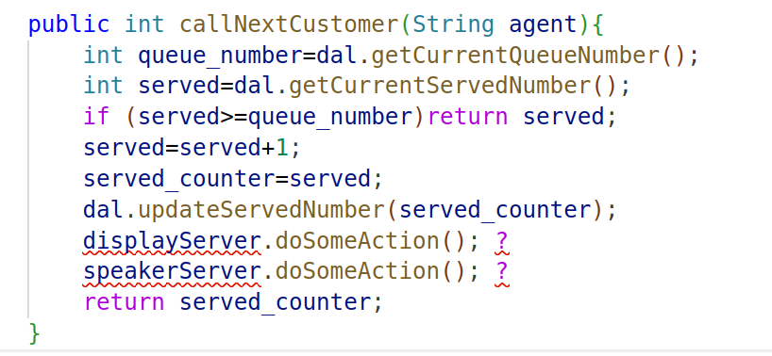
Ticket Queueing System: DisplayServer
This is the worst content coupling ever in terms of code and execution, if the DisplayServer dies, or connection is SLOW, everything will break
Which module to modify when we develop this new module ?
Only the ServerTicket.
Other modules will not be impacted and not tested.
When there is an event ? action ? the DisplayServer needs to be notified.
What’s the best strategy to implement this on the TicketServer first

Slide 64
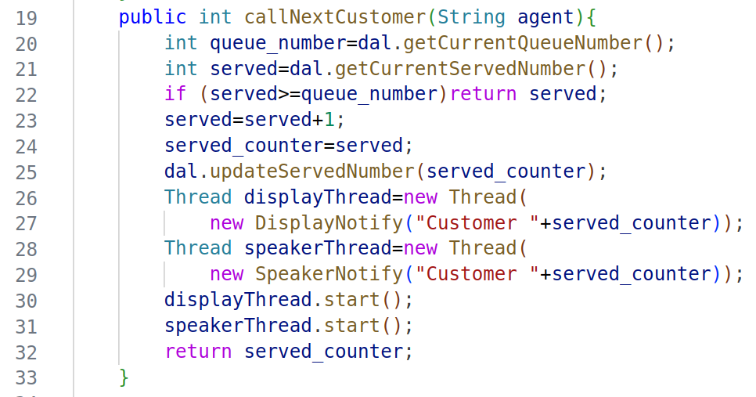
Ticket Queueing System: DisplayServer
Same way as Command Pattern , threads are used to execute commands in a different/parallel flow without the risk to break the main flow

Slide 65
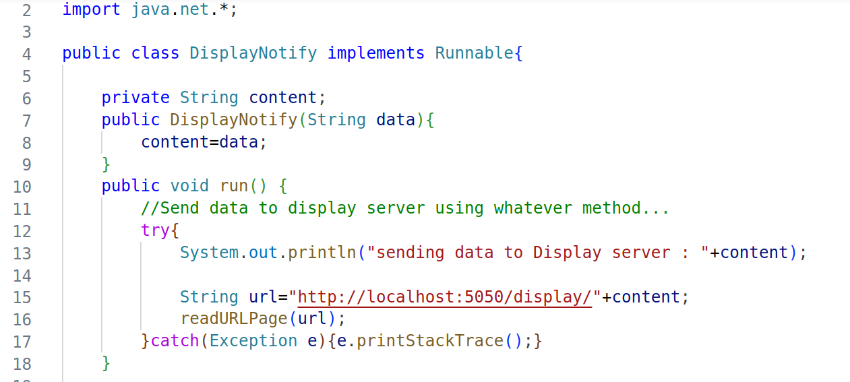
Ticket Queueing System: DisplayServer
NEXT : how to execute those commands in a different/parallel flow without the risk to break the main flow
Of course, hardcode a URL into the code is not a good practice ! better to pass it via arguments or use config files

