Slide 1
Software Engineering :
12 : Implementation and Development
Professor Imed Bouchrika National School of Artificial Intelligence imed.bouchrika@ensia.edu.dz

Slide 2
Outline :
Revision : Use Case + Activity
Introduction : Implementation and Dev.
Programming Best Practices : Clean Code
Refactoring
Technological Tools
Programming Languages
Development Environment
Frameworks

Slide 3
Revision : UML Use Case Diagram
ATM
Questions :
Who are the users of my systems ( Primary Actors )
Will the system use any other external systems ( Secondary Actors )
What every actor can do on the system

Slide 4
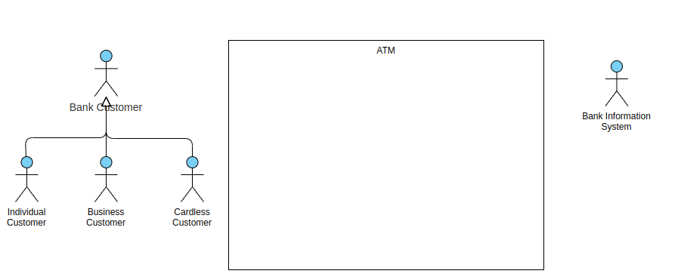
Revision : UML Use Case Diagram
ATM

Slide 5
Revision : UML Use Case Diagram
ATM
For simplicity, we are not adding the bank staff to :
See Machine Status
Fill in money
Set machine in Maintenance mode

Slide 6
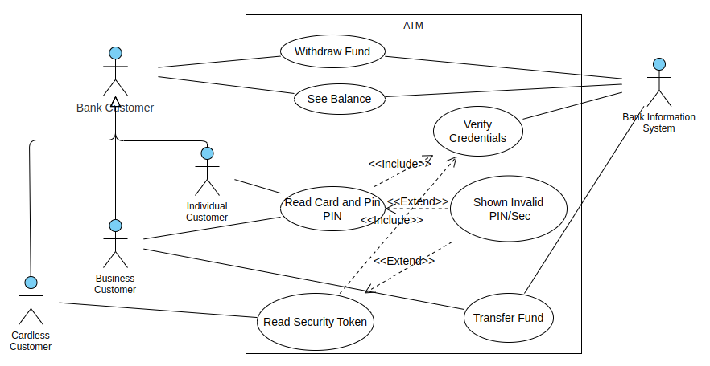
Revision : UML Use Case Diagram
ATM

Slide 7
Revision : UML Activity Diagram
Cash Withdrawal for an ATM
Better way to draw, describe verbally the sequence of instructions in their logical order, step by step.
If needed, you may write them in textual format

Slide 8
Revision : UML Activity Diagram
Cash Withdrawal for an ATM
The user would enter their card
The machine would verify the validity of the card
The machine would ask for the pin to be inserted by the user
The machine would verify that the PIN is Ok
If ok, the machine would show the menu for withdrawal
The user would set the amount to be withdrawn
The machine would verify :
The format of the amount ( Multiple of bank notes that machine can actually give )
The machine has enough money
The user has enough money in their account.
The user limit or even the machine limit.
If all are OK..
In Parallel :
Give money to the user + update the balance of the user
Return card to the user.

Slide 9
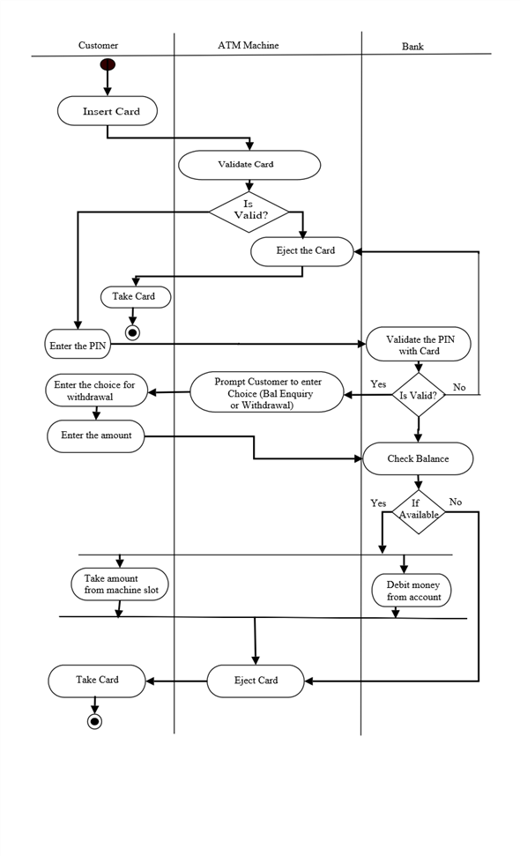
Revision : UML Activity Diagram
Cash Withdrawal for an ATM
The user would enter their card
The machine would verify the validity of the card
The machine would ask for the pin to be inserted by the user
The machine would verify that the PIN is Ok
If ok, the machine would show the menu for withdrawal
The user would set the amount to be withdrawn
The machine would verify :
The format of the amount ( Multiple of bank notes that machine can actually give )
The machine has enough money
The user has enough money in their account.
The user limit or even the machine limit….
If all are OK..
In Parallel :
Give money to the user + update the balance of the user
Return card to the user.

Slide 10
Introduction: Implementation & Development
Is the development stage just a Programming task where the code is written ?
Is the Programming Task just an execution of what the software architects designed and envisioned ?
Why can’t just the software developers or architects write the code themselves directly based on how they designed the system ?

Slide 11
Introduction: Implementation & Development
Is the development stage just a Programming task where the code is written ?
The major task of the development state is coding, though, it includes other activities including :
Development environment setup and administration
Data Schema or Database Design and Implementation
Communication/API/Network Schema Design
Content creation
UI and Graphics design

Slide 12
Introduction: Implementation & Development
Is the Programming Task an execution of what the software architects designed and envisioned ?
Programming is a creative process to write code in order to implement the designs for a given software system. It will involves solving problems and taking design decision at the low-level

Slide 13
Introduction: Implementation & Development
Why can’t just the software developers or architects write the code themselves directly based on how they designed the system ?
Because ?

Slide 14
Introduction: Implementation & Development
Programming activities includes :
Thinking Code
Writing Code
Reading Code
Reviewing Code
Testing Code
Fixing Bugs in Code
Compiling Code

Slide 15
Introduction: Implementation & Development
Programming activities includes :
Thinking Code
Writing Code
Reading Code
Reviewing Code
Testing Code
Fixing Bugs in Code
Compiling Code
Which task is more difficult and take more time

Slide 16
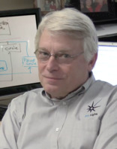
Introduction: Implementation & Development
Reading Code:
“ Indeed, the ratio of time spent reading versus writing is well over 10 to 1. We are constantly reading old code as part of the effort to write new code. ...[Therefore,] making it easy to read makes it easier to write. ” Robert C. Martin ( Uncle Bob) “Clean Code: A Handbook of Agile Software Craftsmanship”

Slide 17
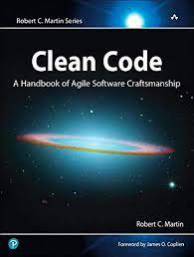
Introduction: Implementation & Development
Robert C. Martin ( Uncle Bob) “Clean Code: A Handbook of Agile Software Craftsmanship”

Slide 18
Introduction: Implementation & Development
The problem in development :
Programmers can spend :
Only few minutes per day coding
Hours of paid time reading old code per day ( can reach 5hours/day)
This is because ?

Slide 19
Introduction: Implementation & Development
The problem in development :
Programmers can spend :
Only few minutes per day coding
Hours of paid time reading old code per day ( can reach 5 hours/day)
Aim : Write readable and clean code to reduce time wasted on understanding previous code

Slide 20
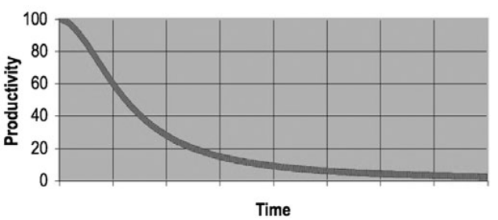
Programming Principles: Clean Code
The impact of writing Spaghetti or bad Code :
Less productivity
Cost money and resources
Professional survival
Even if you add more staff to the team, there will no be difference
Risk going into a cyclic loop “Do the grand redesign → bad code again → redesign → .Failure of the project
Not maintainable

Slide 21
Programming Principles: Clean Code
Why programmers make a messy code :

Slide 22
Programming Principles: Clean Code
Why programmers make a messy code :
Important and tight deadline ?
Making messy code, would just slow more the delivery of your software product

Slide 23
Programming Principles: Clean Code
Why programmers make a messy code :
Lack of experience in Software Development
Young programmers should be trained on the principles and best practices of clean code.
Accompanied by Senior Programmers
Pair Programming shall be used.
Code Review and Inspection must be always observed with constructive feedback.
Company should explicitly produce their internal documents on their recommended principles of clean coding

Slide 24
Programming Principles: Clean Code
Why programmers make a messy code :
Being Lazy and careless
Companies should fire careless coders
Programmers should learn about ethics and risks encountered for a software badly written.
Not professional
Think that coding is getting a functional software.

Slide 25
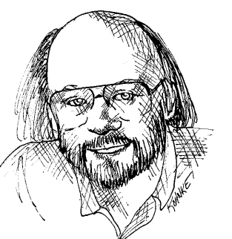
Programming Principles: Clean Code
What’s Clean Code
Defined by Bjarne Stroustrup ( Inventor of C++) as
“I like my code to be elegant and efﬁcient. The logic should be straightforward to make it hard for bugs to hide, the dependencies minimal to ease maintenance, error handling complete according to an articulated strategy, and performance close to optimal so as not to tempt people to make the code messy with unprincipled optimizations. Clean code does one thing well.”

Slide 26
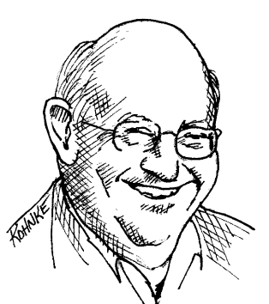
Programming Principles: Clean Code
What’s Clean Code
Defined by “Big” Dave Thomas ( Founder of OTI ) as
“Clean code can be read, and enhanced by a developer other than its original author. It has unit and acceptance tests. It has meaningful names. It provides one way rather than many ways for doing one thing. It has minimal dependencies, which are explicitly deﬁned, and provides a clear and minimal API. Code should be literate since depending on the language, not all necessary information can be expressed clearly in code alone.

Slide 27
Programming Principles: Clean Code
Clean Code aspects to be discussed today :
Meaningful names
Functions
Comments
Formatting and Structuring the code
Handling of Exception and Errors

Slide 28
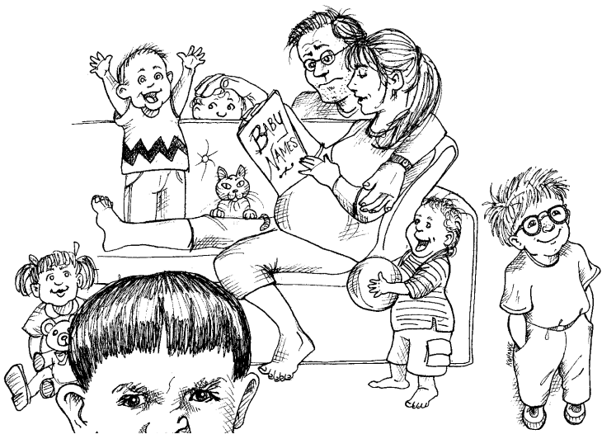
Programming Principles: Clean Code
Meaningful names
“You should name a variable using the same care with which you name a first-born child.”
Names are everywhere in software : variables, functions, arguments, classes, packages, components, services, data types…

Slide 29
Programming Principles: Clean Code
Meaningful names
“You should name a variable using the same care with which you name a first-born child.”
Names are everywhere in software : variables, functions, arguments, classes, packages, components, services, data types…
Choosing good names takes time but saves more than it takes when reading and maintaining your code

Slide 30
Programming Principles: Clean Code
Meaningful names
Use Intention-Revealing Names
Avoid Disinformation
Use Pronounceable Names
Use Searchable Names
Avoid Encodings
Don’t Be Cute
Conventions for Classes and Methods

Slide 31

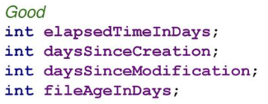
Programming Principles: Clean Code
Meaningful names
Use Intention-Revealing Names :
If a name requires a comment, then the name does not reveal its intent.
The name of a variable, function, or class, should answer all the big questions. It should tell you :
Why it exists
What it does,
How it is used.

Slide 32
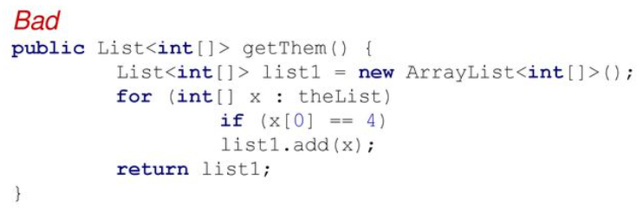
Programming Principles: Clean Code
Meaningful names
Use Intention-Revealing Names :
Names that reveal intent can make it much easier to understand and change code.
What is the purpose of this code?

Slide 33
Programming Principles: Clean Code
Meaningful names
Use Intention-Revealing Names :
Names that reveal intent can make it much easier to understand and change code.
Spacing ?
Indentation ?
Complexity ?

Slide 34
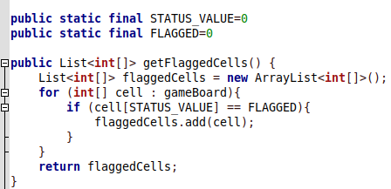
Programming Principles: Clean Code
Meaningful names
Use Intention-Revealing Names :
Names that reveal intent can make it much easier to understand and change code.
Spacing ?
Indentation ?
Complexity ?

Slide 35
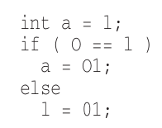
Programming Principles: Clean Code
Meaningful names
Avoid Disinformation
Programmers must avoid leaving false clues that obscure the meaning of code
Example : group of bank accounts → accountList
The word List may have a meaning to programmers as a data structure, better use the name : accounts, or groupOfAccounts

Slide 36
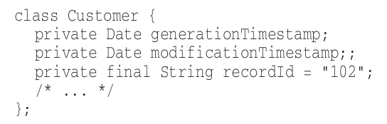
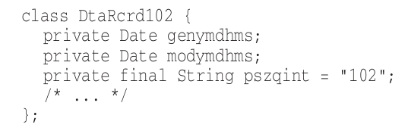
Programming Principles: Clean Code
Meaningful names
Use Pronounceable Names
It would speed up the reading of your code.
Help the brain to memorize variable names

Slide 37
Programming Principles: Clean Code
Meaningful names
Use Searchable Names
Single-letter names and numeric constants have a particular problem in that they are not easy to locate across millions of lines..
Single-letter names can ONLY be used as local variables inside small functions or methods ( or loops)
Example for a variable name that can located easily : WORK_DAYS_PER_WEEK

Slide 38
Programming Principles: Clean Code
Meaningful names
Avoid Encodings
Encoding the variable type or scope would :
just clutter to your code
New employees need to learn about the new encoding
Increase the maintenance complexity and risk of your software
Examples :
Phone

Slide 39
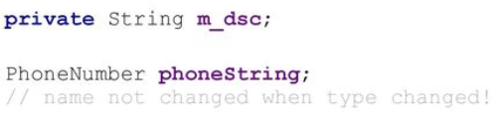

Programming Principles: Clean Code
Meaningful names
Avoid Encodings
m_desc : to indicate the m_desc is a member variable
phoneString : encoding the type or format into the name

Slide 40
Programming Principles: Clean Code
Meaningful names
Don’t be cute
Using metaphor is good to remind but never go with names that are only memorable to people who share the author’s sense of humor
Examples :
HolyHandGrenade( ) ( for the delete function or unlink )

Slide 41
Programming Principles: Clean Code
Meaningful names
Conventions for Classes and Methods
Classes :
Should be a noun
Capitalized, with every word, starts with capital letter.
Methods:
Should start with a verb
Starts with a lower letter, but capitalized for consecutive words

Slide 42
Programming Principles: Clean Code
Functions
Keep it Small
Do one thing
Function Arguments
Have no side effects
Command Query Separation
DRY : Don’t Repeat Yourself
Switch Statements
Exceptions vs. Return Error Codes
Code Structuring

Slide 43
Programming Principles: Clean Code
Functions
Keep it Small
You can write functions with
10 lines of code
1000 lines of code
Small functions are easier to read, extend, maintain
Large functions especially with many deep levels of inner indent ( blocks ) , it would be impossible to navigate the scope of an if or for ..
How small it should be ?

Slide 44
Programming Principles: Clean Code
Functions
Keep it Small
You can write functions with
10 lines of code
1000 lines of code
Small functions are easier to read, extend, maintain
Large functions especially with many deep levels of inner indent ( blocks ) , it would be impossible to navigate the scope of an if or for ..
How small it should be ?
Never bigger than the screen : No more than 100 lines and 120 columns

Slide 45
Programming Principles: Clean Code
Functions
Do one thing
Functions should be doing it only one task, one action or serve one objective/purpose.
A function implemented to perform many tasks:
Instructions to Compute data
Instructions to Export data to PDF
Instructions to Export data to CSV
We want to add another column to the data ? without changing the original code.

Slide 46
Programming Principles: Clean Code
Functions
Do one thing
Functions should be doing it only one task, one action or serve one objective/purpose.
A function implemented to perform many tasks:
Instructions to Compute data
Instructions to Export data to PDF
Instructions to Export data to CSV
We want to add another column to the data ? without changing the original code.
To be done by creating another sub-class with an overriding function But : you will paste the same code almostly redundantly for a simple addition of a single line.

Slide 47
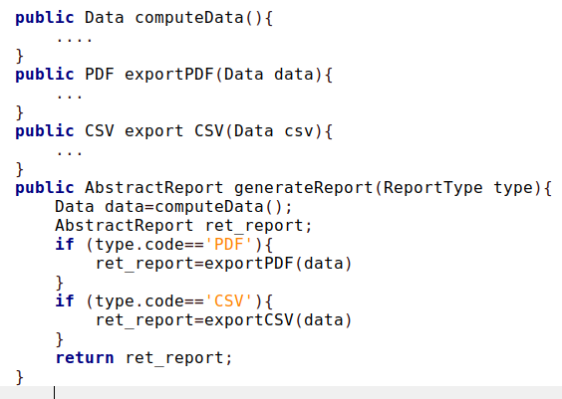
Programming Principles: Clean Code
Functions
Do one thing
Functions should be doing it only one task, one action or serve one objective/purpose.
A function implemented to perform many tasks:
Instructions to Compute data
Instructions to Export data to PDF
Instructions to Export data to CSV
We want to add another column to the data ? without changing the original code.

Slide 48

Programming Principles: Clean Code
Functions
Function Arguments
Idea number of arguments for a function is zero
Three arguments, you need to justify
More than three arguments is not recommended,
It makes the testing more difficult to consider all possible values for many arguments.
Use argument objects when possible to reduce the number of args.

Slide 49
Programming Principles: Clean Code
Functions
Have no side effects
Function are intended to do one thing, but it also does other hidden things. Sometimes it will make unexpected changes to :
The variables of its own class.
Parameters passed into the function or
System globals.

Slide 50
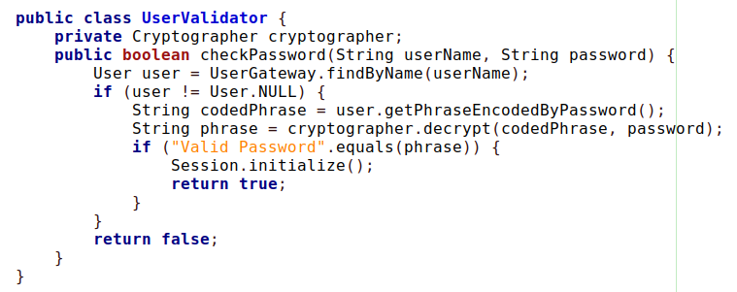
Programming Principles: Clean Code
Functions
Have no side effects
The variables of its own class.
Parameters passed into the function or
System globals.

Slide 51
Programming Principles: Clean Code
What if we want to call the function when the user tried to change their password, we ask them again to put their old password to check only ?
Do we need to initialize the session for a logged user ?just to change their password ?
Functions
Have no side effects
The variables of its own class.
Parameters passed into the function or
System globals.

Slide 52
Programming Principles: Clean Code
Functions
Have no side effects
Function are intended to do one thing, but it also does other hidden things. Sometimes it will make unexpected changes to :
The variables of its own class.
Parameters passed into the function or
System globals.

Slide 53
Programming Principles: Clean Code
Functions
Command Query Separation
Functions should either
do something (update the state, variable value…) or
answer something ( return the variable value, state…)
But not both.
It can do both ? the aim is to produce readable code with no confusion.

Slide 54
Programming Principles: Clean Code
Functions
DRY : Don’t Repeat Yourself
Avoid duplication
Lines of code doing the same business logic, encapsulate them into a function

Slide 55
Programming Principles: Clean Code
Functions
Switch Statements
Avoid them in case there is a risk that the number of cases would grow, use the Polymorphism when necessary.

Slide 56
Programming Principles: Clean Code
Functions
Exception vs. Return Error Codes
Returning error codes from command functions is a subtle violation of command query separation.

Slide 57
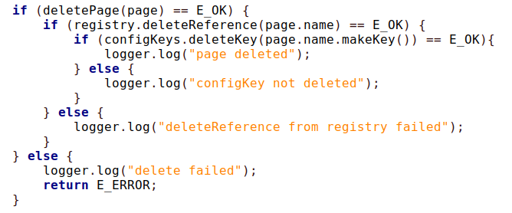
Programming Principles: Clean Code
Functions
Exception vs. Return Error Codes

Slide 58
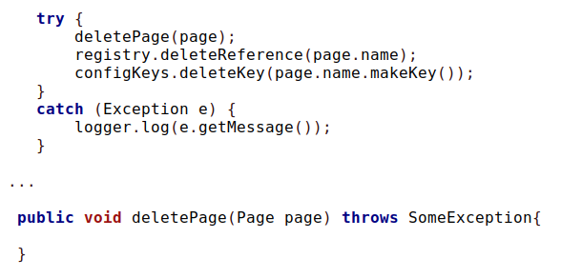
Programming Principles: Clean Code
Functions
Exception vs. Return Error Codes

Slide 59
Programming Principles: Clean Code
Comments
Comments are meant to explain complex code but clean and nicely written code.
For bad code, “Don’t comment bad code—rewrite it.”
The proper use of comments is to compensate for our failure to express ourselves in code
A number of software developers considered comments as “necessary evil”
Bad Comments vs. Good Comments

Slide 60
Programming Principles: Clean Code
Comments
Comments are meant to explain complex code but clean and nicely written code.
For bad code, “Don’t comment bad code—rewrite it.”
The proper use of comments is to compensate for our failure to express ourselves in code
A number of software developers considered comments as “necessary evil”
Always Explain yourself in code

Slide 61
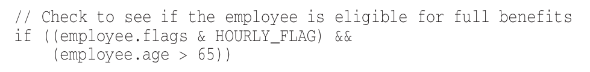
Programming Principles: Clean Code
Comments
Always Explain yourself in code

Slide 62
Programming Principles: Clean Code
Comments
Good Comments
Legal Comments
Showing the author, company, copyright, license information

Slide 63
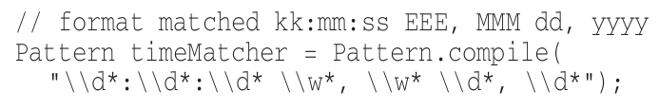
Programming Principles: Clean Code
Comments
Good Comments
Informative Comments
Showing further/extra information to assist the code reader better understand complex lines of code

Slide 64
Programming Principles: Clean Code
Comments
Good Comments
Explanation of Intent
To explain why a programming decision is made

Slide 65
Programming Principles: Clean Code
Comments
Bad Comments
Redundant and non-informative comments
Misleading comments
Mandated Comments which just add clutter to the code
Commented-Out Code
…

Slide 66
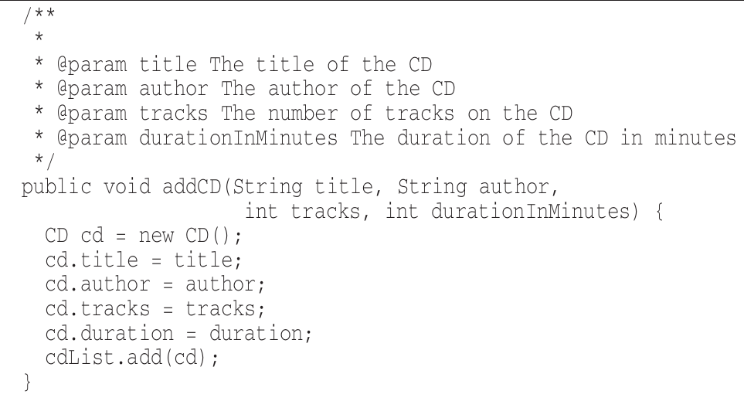
Programming Principles: Clean Code
Comments
Bad Comments
Redundant and non-informative comments
Misleading comments
Mandated Comments which just add clutter to the code
Commented-Out Code
…

Slide 67
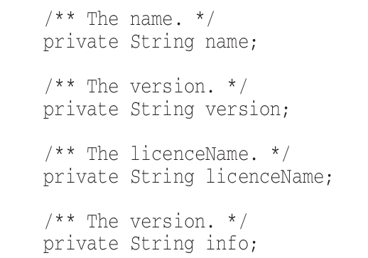
Programming Principles: Clean Code
Comments
Bad Comments
Redundant and non-informative comments
Misleading comments
Mandated Comments which just add clutter to the code
Commented-Out Code
…

Slide 68
Programming Principles: Clean Code
Formatting and Structuring the code
The functionality that you create today has a good chance of changing in the next release, but the readability of your code will have a profound effect on all the changes that will ever be made
Your style of formatting reflect your professionality level.

Slide 69
Programming Principles: Clean Code
Formatting and Structuring the code
Vertical Formatting
Reduce the vertical distance
Declare variables close where they are used. ( Exception to the debatable issue for instance variables that they should be placed at the top)
Dependent Functions : If one function calls another, they should be vertically close, and the caller should be above the callee,

Slide 70
Programming Principles: Clean Code
Formatting and Structuring the code
Horizontal Formatting
Number of columns ( no more than 120 characters)
Use Horizontal Alignment
Strict use of Indentation

Slide 71
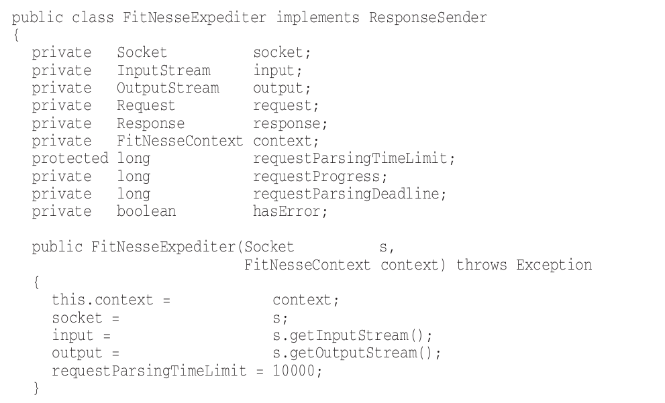
Programming Principles: Clean Code
Formatting and Structuring the code
Horizontal Formatting
Number of columns ( no more than 120 characters)
Use Horizontal Alignment
Strict use of Indentation

Slide 72
Programming Principles: Clean Code
Handling of Exceptions and Errors
Employ defensive programming approach where to anticipate for possible errors, invalid data or illegal cases to treat them.
Use Exception and handle all those errors whilst ensuring
The that your software continue to flow normally
The data is always in a consistent state after handling an exception
Never EVER trust the End-User, Expect all evil stuff from them.

Slide 73
Clean Code : Programming Principles
How to detect that code is bad ( Code smells ) ?

Slide 74
Clean Code : Programming Principles
For Clean Code, it should be :
Code are written for people not machines..
it’s Focused
Readable, simple and direct with no clutter
Compact and literate
Contains only what is necessary
Makes it easy for other developers to enhance it
Looks like it’s author cares
Contains no duplicates

Slide 75
Refactoring of Software Code
Definition :
Refactoring is the process of altering source code whilst keeping its existing functionality unchanged.
Why Refactoring :
To improve readability and maintainability
To account for new enhancements as design evolves for new requirements.

Slide 76
Refactoring of Software Code
What types of changes are involved in the refactoring process.
Renaming ( variables, classes, methods …)
Promoting attribute to class
Composing methods
Moving features ( variables or methods ) between classes/objects
Organizing and Simplifying code
Big Refactoring
Note that most IDEs offer wizards and tools to assist with the refactoring.

Slide 77
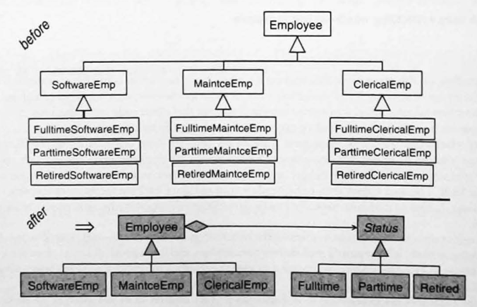
Refactoring of Software Code
What types of changes are involved in the refactoring process.
Renaming ( variables, classes, methods …)
Promoting attribute to class
Composing methods
Moving features ( variables or methods ) between classes/objects
Organizing and Simplifying code
Big Refactoring

Slide 78
Technological Tools: Programming Languages
Factors for choosing a programming language:
Experience
Portability
Community Support
Richness of available libraries and components
Context of use.
Or even use shell programming when necessary..

Slide 79
Technological Tools: Development Environment
Choosing the right IDE can have an enormous impact on the productivity
Can easily see the structure of the code including direct access to :
Instance Variables
Methods/Functions
Classes
Use GIT to track changes + Make Branches containing one small functionality.
If needed, use virtual environment or virtual container for development to avoid messing your personal computer.

Slide 80
Technological Tools: Frameworks
Frameworks are a set of libraries for a specific programming language with the aim to speed up the development.
On top of the programming language, You may be forced to learn how they are structured and used. But, it may save you time later during the development process.

