Slide 1
Software Engineering :
13 : Software Testing
Professor Imed Bouchrika National School of Artificial Intelligence imed.bouchrika@ensia.edu.dz

Slide 2
Outline :
Introduction Testing
Examples
Testing and Software Quality
Terminologies: Bugs/Defects, errors and failures…
Testing Approaches and Techniques
Static vs. Dynamic
Active vs. Passive
Positive vs. Negative
White-Box vs. Black Box
Functional vs. Non-Functional Testing
Regression Testing
Automated vs. Manual
Test Driven Development
Testing Levels
Unit
Component
Integration
System testing
Acceptance
Tools for Writing Unit Tests
Mindset of Testers and QA staff
Best Practices for Testing

Slide 3
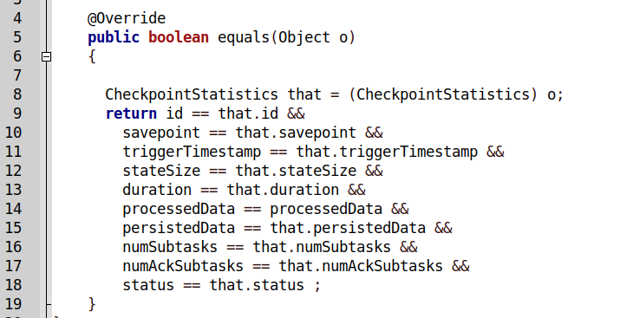
Introduction to Software Testing
Given the following code : Find the defect/bug

Slide 4
Introduction to Software Testing
Given the following code : Find the defect/bug

Slide 5
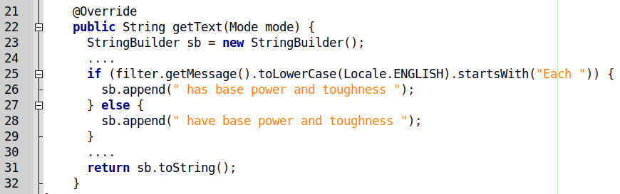
Introduction to Software Testing
Given the following code : Find the defect/bug

Slide 6
Introduction to Software Testing
Given the following code : Find the defect/bug
Comparing lower case against E ?

Slide 7
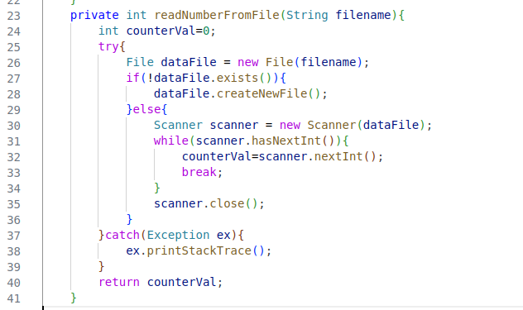
Introduction to Software Testing
Given the following code : Find the defect/bug Queue Ticket System…

Slide 8
Introduction to Software Testing
Given the following code : Find the defect/bug Queue Ticket System…
For you to find ?

Slide 9
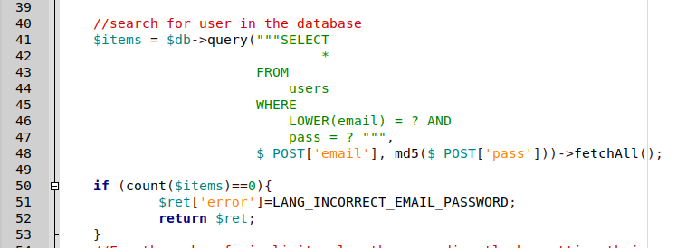
Introduction to Software Testing
Given the following code, find the potential error :

Slide 10
Introduction to Software Testing
The code is perfectly fine, no bug, no error !
But if the user copies their email address with trailing space or new line ? will it work ? The user would report an error and call you that he cannot log in ? will you keep teaching users to make sure that they don’t have an invisible character at the end of their email ?
I consider it a bug. Trim/strip variables when necessary.
Given the following code, find the potential error :

Slide 11
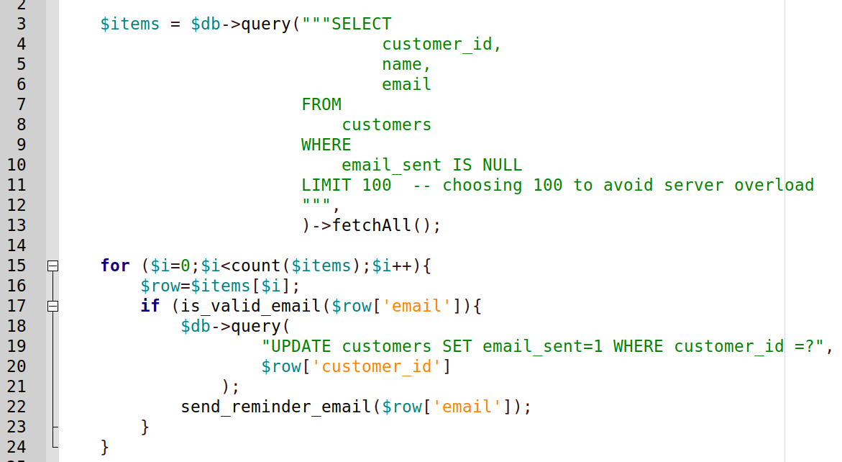
Introduction to Software Testing
Given the following code : Find the logical error ( not syntax )

Slide 12
Introduction to Software Testing
Given the following code : Find the logical error ( not syntax )
What happens if you happen to have the first 100 customers with invalid email addresses ?
What to do to fix it ?

Slide 13
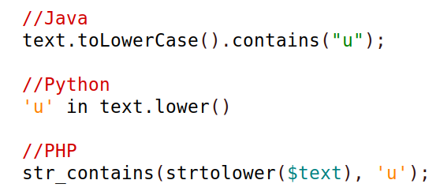
Introduction to Software Testing
Given the following code : Search for names contains u ( case - insensitive)

Slide 14
Introduction to Software Testing
Given the following code : Search for names contains u ( case - insensitive)
What about those names containing : ù,ú,û,ü ?
It is not u, but an accented u that should be also considered as u when searching.

Slide 15
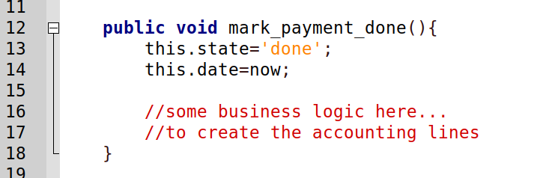
Introduction to Software Testing
Given the following code : Syntax is good, logic is good. Where is the error ?

Slide 16
Introduction to Software Testing
Assume two agents on two different computers seeing this draft payment at the same time.
One of them, clicks the the button “Process” and then the other one would also click the button “Process”
How to fix it ?
Given the following code : Syntax is good, logic is good. Where is the error ?

Slide 17
Introduction to Software Testing
Definition of Software Testing :
It is the process of :
Examining that the software does what it is supposed to do
Uncovering errors and defects during the previous stages of the software development life cycle including requirements, design and implementation.
The software testing can be defined as the process of validating, verifying the software requirements to establish a confidence that the software of defect-free

Slide 18
Introduction to Software Testing
Definition of Software Testing :
Validation :
Are we implementing the right functionalities
Demonstrate to the developer and the customer that the software meets its requirements.
Check to see if the software satisfies customer’s requirements.
We are implementing the login procedure using Google Oauth ?

Slide 19
Introduction to Software Testing
Definition of Software Testing :
Verification :
Are we implementing the functionalities right ( and correctly)
The software should conform to its given requirements specification
Is the implemented Google Integration for login right ? functional ?
This includes Discovering Defects by :
Finding inputs or input sequences where the behavior of the software is incorrect, undesirable, or does not conform to its specification.

Slide 20
Introduction to Software Testing
Definition of Software Testing :
The software testing process involves also Software Inspections and Reviews of :
System requirements
Design models
The program source code
System tests/scripts/scenarios

Slide 21
Introduction to Software Testing
Objectives of Software Testing :
Uncover all software bugs / defects
Improve the performance, usability and other quality attributes.
Establish a confidence that the software is fit for use.

Slide 22
Introduction to Software Testing
Objectives of Software Testing :
Uncover all software bugs / defects
Improve the performance, usability and other quality attributes.
Establish a confidence that the software is fit for use.
The aim of software testing is never to demonstrate that the software has no bugs or defects . As it is impossible.

Slide 23
Introduction to Software Testing
Objectives of Software Testing :
Uncover all software bugs / defects
Improve the performance, usability and other quality attributes.
Establish a confidence that the software is fit for use.
“Testing can only show the presence of errors, not their absence ”
Dijkstra, E. W. 1972. “The Humble Programmer.”

Slide 24
Introduction to Software Testing
Why Software Testing is extremely important :
Apart from the common reasons:
Improve the quality attributes of software : Performance, usability, acceptance...
Remove defects and bugs…

Slide 25
Introduction to Software Testing
Why Software Testing is extremely important :
“A study conducted by NIST in 2002 reports that software bugs cost the U.S. economy $59.5 billion annually. More than a third of this cost could be avoided, if better software testing was performed” https://www.nist.gov/director/planning/upload/report02-3.pdf

Slide 26
Introduction to Software Testing
Why Software Testing is extremely important :
Reduce Costs in both : Development and Maintenance
Customer Satisfaction and Confidence in using your software
Reputation for your brand
Avoid Disasters, Stressful nights,…etc.

Slide 27
Introduction to Software Testing
When we do Software Testing :
From the requirements till the company drops the maintenance of the developed software.

Slide 28
Introduction to Software Testing
Who does Software Testing :
Software Developers
Testing Team :
Testers : to do the actual testing and examine certain case scenarios.
Quality Assurance Staff : Oversee the testing process and defines the quality standards and metrics.
Test Automation/QA Engineers/programmers : ( for writing test cases/scripts.)
End-Users
UX Experts
System Administrators
…even random people

Slide 29
Introduction to Software Testing
Terminology :
Bug
Defect
Fault
Severity
Debug
Error
Failure

Slide 30
Introduction to Software Testing
Terminology :
Thomas Muller stated “A person can make an error (mistake), which produces a defect (fault, bug) in the code, in software or a system, or a document. If the execution of the defect in code happens, the system will fail to do what it should do (or something it shouldn’t), which causes a failure”.

Slide 31
Introduction to Software Testing
Terminology :
Error : is a human mistake. An Error appears not only due to the logical mistake in the code made by the developer. Anyone in the team can make mistakes during the different phases of software development. For instance,
BA (business analyst) may misinterpret or misunderstand requirements.
The customer may provide insufficient or incorrect information.
The architect may cause a flaw in software design.
People on the team can also make mistakes due to unclear or insufficient requirements, time pressure, lethargy, or other reasons.

Slide 32
Introduction to Software Testing
Terminology :
Types of Errors :
User Interface Error : Appear during user interaction with the system. Such as missing or incorrect functionality of the system.
Error handling error : Any error that occurs while the user is interacting with the software needs precise and meaningful handling.
Syntactic error : Misspelled words or grammatically incorrect sentences are Syntactic errors and are very evident when testing the software GUI.
Calculation errors : These errors occur due to bad logic, incorrect formulas, mismatched data type, etc.

Slide 33
Introduction to Software Testing
Terminology :
Types of Errors :
Flow control error: Errors concerning passing the control of the program in an incorrect direction where the software program behaves unexpectedly are flow control errors. Such as the presence of an infinite loop, reporting syntax error during run-time, etc.
Testing errors : It implies the errors that occurred when implementing and executing the test process. For example, bug scanning failure, inefficiency in reporting an error or defect.
Hardware errors : Such errors are related to the hardware device. Such as no availability and no compatibility with the device.
In addition to : Integration errors, security errors, usability errors…

Slide 34
Introduction to Software Testing
Terminology :
What the main causes of errors in software systems
Inadequate requirements: The success of any software application depends on the gathering and compiling of the correct specification in addition to the understanding of development teams on client requirements. Unclear requirements and misunderstanding of the requirements are two main factors that cause software defects.
Human Fallibility and Programming errors: Programmers, like any other person, can make programming mistakes. Inexperienced programmers or programmers without proper domain knowledge can introduce simple errors during coding. The lack of simple coding practices, unit tests, debugging are some of the common reasons why most problems appear at the stage of development. This applies even to designers, database developers…

Slide 35
Introduction to Software Testing
Terminology :
What the main causes of errors in software systems
Communication gap : Defects are introduced in the development stage if the exact requirements are not communicated correctly to the development teams. Sometimes miscommunication between the developers and testers may also lead to defects in software.
Time Pressures : Scheduling of software projects is not an easy job. When the deadline approaches and the crisis arrives, mistakes happen. If there is not enough time for proper design, coding, and testing, it is quite evident that defects will be introduced and missed in testing
Inappropriate environment : Inappropriate environment such as hardware or software incompatibility leads to defects in the software. Often test data present in one environment is different from another environment. Therefore, some of the defects go undetected.

Slide 36
Introduction to Software Testing
Terminology :
Defect ( Fault or bug ) :
Just an error which is found by the tester.
A Defect in a software product reflects its inability or inefficiency to comply with the specified requirements and criteria and, subsequently, prevent the software application from performing the desired and expected behaviour.
Severity of Defects :
Defines the degree of impact and potential risk associated with this fault and failure (How badly it would impact operations, data, users…).

Slide 37
Introduction to Software Testing
Terminology :
Severity Levels of Defects ( Fault or bug ) :
Critical : requires immediate attention and treatment. A critical defect directly affects the essential functionalities which can otherwise affect a software product or its large-scale functionality. For instance, users cannot login.
Major : affects the main functions of a software product. Although, these defects do not result in the complete failure of a system but may bring several primary functions of the software down. Example : Changing password not working.
Minor : produces less impact and have no significant influence on a software product. The results of these defects are visible in the operation of the product. However, it does not prevent users from executing the task. Example : Email Notification of due tasks not working.
Trivial : These types of defects have no impact on the operation of a product. Hence, sometimes, we ignore and omit them. For example, spelling or grammatical errors.

Slide 38
Introduction to Software Testing
Terminology :
Software Debugging vs Software Testing
Software Testing :
Find the errors in the software
Done by all people including a random person
Software Debugging :
Is the process to locate a defect and resolve it.
Done only by Software Developers.
Very Difficult and Very Costly

Slide 39
Approaches and Techniques for Software Testing
Static vs. Dynamic Testing
Static Testing :
This is conducted by reviewing and inspecting the actual source code or design models without executing or running the code
Is it really efficient ?
Depending on the experience of the inspector and their dedication to find errors.
Very tedious process. ( Because ? )

Slide 40
Approaches and Techniques for Software Testing
Static vs. Dynamic Testing
Static Testing :
This is conducted by reviewing and inspecting the actual source code or design models without executing or running the code
Is it really efficient ?
Depending on the experience of the inspector and their dedication to find errors.
Very tedious process.(Because Reading Code takes more time )

Slide 41
Approaches and Techniques for Software Testing
Static vs. Dynamic Testing
Static Testing :
This is conducted by reviewing and inspecting the actual source code or design models without executing or running the code
Is it really efficient ?
Depending on the experience of the inspector and their dedication to find errors.
Fagan (1976) reported that more than 60% of the errors in a program can be detected using informal program inspections.
In the Cleanroom process (Prowell et al. 1999), it is claimed that more than 90% of defects can be discovered in program inspections.
The cleanroom software engineering process is a software development process intended to produce software with a certifiable level of reliability

Slide 42
Approaches and Techniques for Software Testing
Static vs. Dynamic Testing
Static Testing :
This is conducted by reviewing and inspecting the actual source code or design models without executing or running the code
Is it really efficient ?
Depending on the experience of the inspector and their dedication to find errors.
A lot of AI-based tools are showing up recently to detect code smells and bugs via automated verification of source code.

Slide 43
Approaches and Techniques for Software Testing
Static vs. Dynamic Testing
Dynamic Testing :
Inversely to static testing, this is done during the execution of the software ( whether in a local development environment, or staging or even a production environment).
Testers would interact with the system and its components to find errors during the execution of the software.

Slide 44
Approaches and Techniques for Software Testing
Passive vs. Active Testing
Passive Testing :
The software is verified indirectly without any interaction with the actual software.
This is done via analysing the software logs and traces
Extremely useful when software is actually deployed and you need to know what’s going on. ( A user cannot log in ? why )
Active Testing :
Testers interact with the software product directly to examine its functionality and quality attributes.

Slide 45
Approaches and Techniques for Software Testing
Positive vs. Negative Testing
Positive Testing :
The software system is validated against the valid input data
The main intention of this testing is to check whether a software application does what it is supposed to do based on valid paths/user scenarios
Negative Testing :
Commonly referred to as error path testing or failure testing
Its aim is to ensure the stability of the application.
Done by applying as much creativity as possible and validating the application against invalid data as input : Example, Age from birth, input : 02/29/2021

Slide 46
Approaches and Techniques for Software Testing
Black Box vs. White Box Testing
Black Box Testing :
The tester would treat the software as a black box where the functionalities of the system are tested without any knowledge of how they are implemented.
Testers need to know the test case in addition to the input and expected output or behaviour. No need to have any programming experience.
Occasionally called as functional testing as it is mostly used for the functional requirements ( but can be also for non-functional reqs)

Slide 48
Approaches and Techniques for Software Testing
Black Box vs. White Box Testing
White Box Testing :
Conducted by a software developer where they can see and test internal structure of the code.
The tester needs to have a good understanding of the code so that they can examine different code paths and scenarios using tests.
White box tests are mainly used to detect logical errors in the program code.
Called also : Clear-box testing, structural testing, code-based testing or Glass box testing

Slide 49
Approaches and Techniques for Software Testing
Functional vs. Non-Functional Testing
Functional Testing :
The tester would focus on testing the primary use cases of the software product or user stories of a specific function of the code
Functional tests would answer the questions :
Can the user do this ?
Does this particular feature work ?
For instance: Registration ? Login ? Posting , editing and completing a to-do item ? Resetting a forgotten password ? Changing the email address ?

Slide 50
Approaches and Techniques for Software Testing
Functional vs. Non-Functional Testing
Non-Functional Testing :
It is related to the quality attributes, how well does the software perform its functionalities in terms of : performance ? reliability ? availability ? fault tolerance ? usability ? Security ? ….

Slide 51
Approaches and Techniques for Software Testing
Functional vs. Non-Functional Testing
Non-Functional Testing :
Usability Testing : Is it easy to use : SUS can be used.
Security Testing : Authorization ? Authentication ? Confidentiality?
Stress Testing : Testing how much strain the system can take before it fails. Considered to be a type of non-functional testing.
Destructive Testing
Performance Testing
Acceptance Testing
Accessibility Testing
Localization Testing
Concurrent Testing
…

Slide 52
Approaches and Techniques for Software Testing
Regression Testing
Is to re-run all test cases including functional and non-functional to ensure that the software ( which was previously tested) still performs as expected after a change. The change includes:
Fixing a bug
Adding new functionality
Configuration change
Substitution of hardware

Slide 53
Approaches and Techniques for Software Testing
Manual vs. Automated Testing
Manual Testing :
A human tester would go manually to test or inspect the software.
The main drawback of manual testing is the need to retest and redo all tedious tasks again in case of a new functionality or new release

Slide 54
Approaches and Techniques for Software Testing
Manual vs. Automated Testing
Automated Testing :
Testing code/scripts are written using/for Testing automation Tools or frameworks to ensure that the software at different levels behaves correctly.
Test Data needs to be prepared to run on the test scripts which simulate the execution of the software product
It can help to automate some or most repetitive tasks in a formalized test process.
For larger projects, it is becoming a must

Slide 55
Approaches and Techniques for Software Testing
Manual vs. Automated Testing
Automated Testing :
It is vital for Continuous delivery and Integration systems where there is a frequent release of the software product.
Fast and Efficient
Improved Test Coverage
Re-usability of the testing automation scripts.
Cost and Time savings.

Slide 56
Approaches and Techniques for Software Testing
Automated Testing
Test-Driven Development :
Test scripts are written before they implement new code or even change existing code.
Forces the Developers or Test Engineers to achieve a better understanding of software requirements
Developers write code for testability.
It limits the scope of development.
Every feature or function written is tested.

Slide 57
Software Testing by Level
Different Types of Testing based on the level or phase
Unit
Component/Service
Integration
Release/Deployment
Post-Release
Acceptance Test

Slide 58
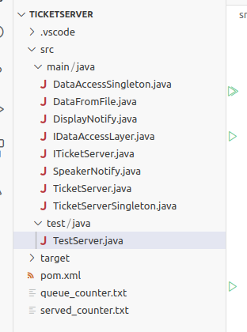
Example : Writing Unit Tests
As an Example, Unit tests can be written in Java for Maven using the Jupiter Library
Create a folder : test/java under src
Create your TestServer class inside The created folder.

Slide 59
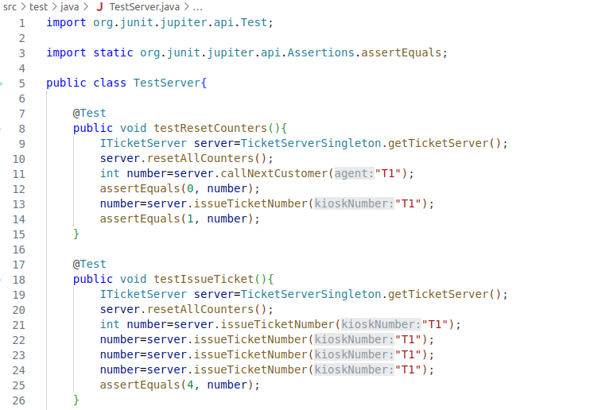
Example : Writing Unit Tests
Use the annotation @Test
The following methods can be employed:
AssertEquals(v1,v2)
AssertTrue( bool )

Slide 60
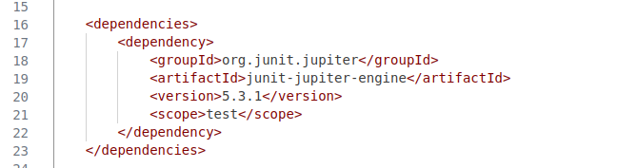
Example : Writing Unit Tests
Maven POM.XML File

Slide 61
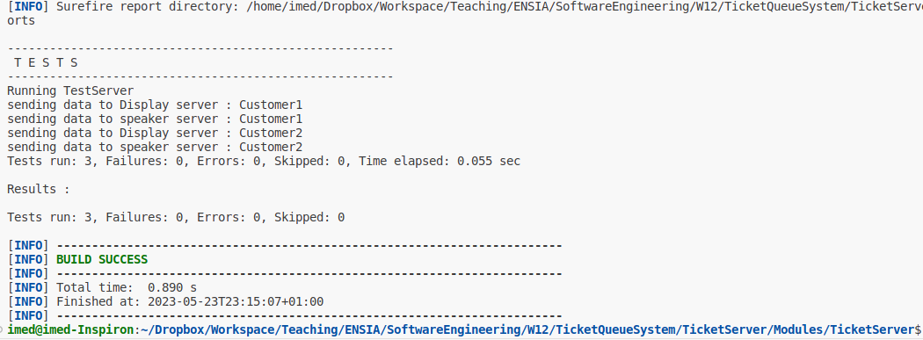
Example : Writing Unit Tests
Run : mvn test
Run the maven for test

Slide 62
Example : Writing Unit Tests
There is a number of tools and Frameworks for automated testing including :
Selenium
WebDriverIO
Robot Framework
Serenity
Spock
Pytest
TestCafe
Cypress
….

Slide 63
Mindset of Testers and Quality Assurance Staff
Developer will ask:
What do I need to build ?
how should I do it?
The tester will ask:
What can go wrong?
What can I do to break the application or find the weaknesses?"

Slide 64
Mindset of Testers and Quality Assurance Staff
Tester or QA Staff needs to have the following skills:
Interpersonal skills: effective communication between testers & developers about defects, failures, test results, the progress of tests and risks, etc.
Sharp observation : must have an "eye for detail". The testers can quickly identify or detect many critical errors if they observe sharply. Moreover, they should examine the software for the parameters such as 'look & feel' of GUI, incorrect data representation, ease of use, etc.
Destructive creativity : needs to develop destructive skills as well. In other words, the tester should not "hesitate to do negative testing".
Customer-oriented perspective: The software testers should adopt a customer-oriented perspective while testing the software product. They should be able to place themselves in customer shoes and test the product as a mere end-user.
Organized, flexible, and patient at work: Testers realize that they can also make mistakes. Therefore, they should be excellent organizers -they must-have checklists, facts, and figures to support their findings.
Objective and neutral attitude : No one likes to hear and believe the bad news. Well, testers resemble messengers of bad news in a software project team. No matter how brilliant the testers are at their job; nobody wants to share the bad news. But, the tester always communicates the wrong part of the software, which the developers do not like.

Slide 65
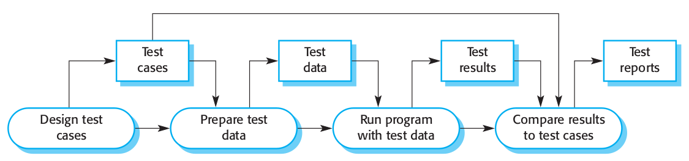
Best Practices for Testing Your Software
Software Testing Process

Slide 66
Best Practices for Testing Your Software
Setup a Plan for Testing Process
01
Define clearly what functionalities or non-functional attributes to be tested.
Write the test cases/scenarios with their goals and objectives which should be SMART( specific, measurable, achievable, relevant, and time-bound).
Describe even the testing procedure/metrics and so on

Slide 67
Best Practices for Testing Your Software
Collaboration, Communication and Management System
02
Ensure to have Collaboration, Communication and Management System with a repository shared among all members of the project including developers, testers and support staff.
The repository can be used to store and share test reports, software specification documents…

Slide 68
Best Practices for Testing Your Software
Setup/Install Bug Tracking Platform
03
It is a must to have a system to track of bugs found by the system whilst ensure that the developers are informed about them, and be notified when fixed in case of further testing is needed.
An Excel file can used though, a complete software suite like Jira or other project management can be used.

Slide 69
Best Practices for Testing Your Software
Setup your Testing Platform/Environment
Use Automation : Integrate automated testing during the development stage by writing test scripts.
Setup Staging or Testing Environment : To invite other testers examine your software as opposed to test it on the production environment.
Use Virtualization/Containers when necessary to simulate different configurations instantly
04

Slide 70
Best Practices for Testing Your Software
Never communicate bugs VERBALLY, write first, then you may verbally..
05
Write a professional bug report/document consisting of the following details:
Date/time + Functionality being tested
Steps to generate the error,
provide users details, data being used…
Describe the environment being used ( Chrome ? Linux ? Laptop ? Screen Resolution ?...)

Slide 71
Best Practices for Testing Your Software
Don’t test your own software and start testing EARLY.
06
Get some other colleagues to review your code
Have your software tested away from you, away from your development environment.
Start testing early your software even on minimal version

Slide 72
Best Practices for Testing Your Software
Finding errors is cheap,
Fixing bugs during development is expensive
Fixing bugs in prod/maintenance is prohibitively expensive ( and sometimes IMPOSSIBLE)

