Slide 1
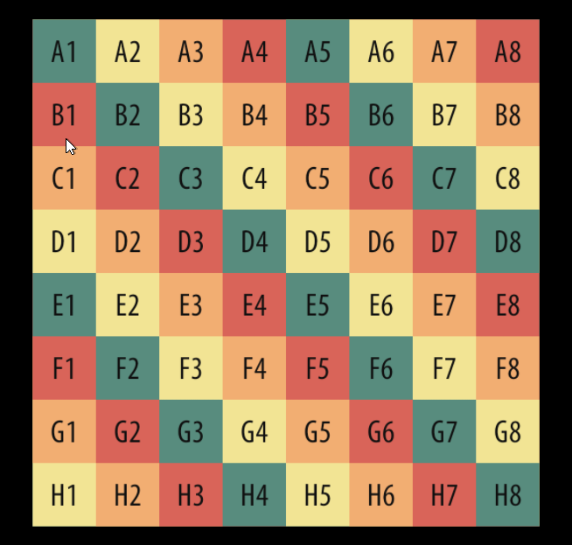
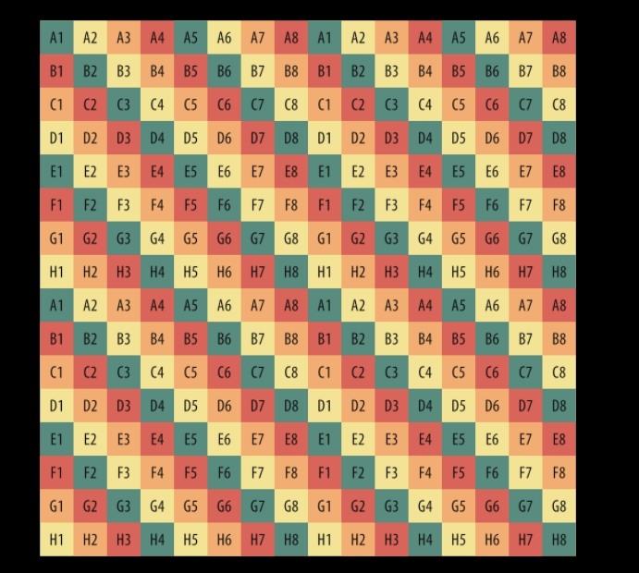
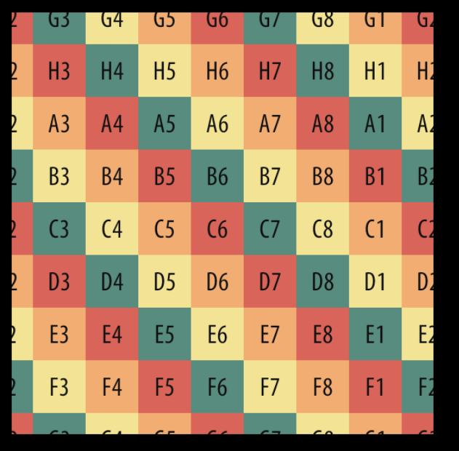
Tiling=1, offset = 0
Tiling=2, offset = 0
Tiling=1, offset = 0.2

