Slide 1
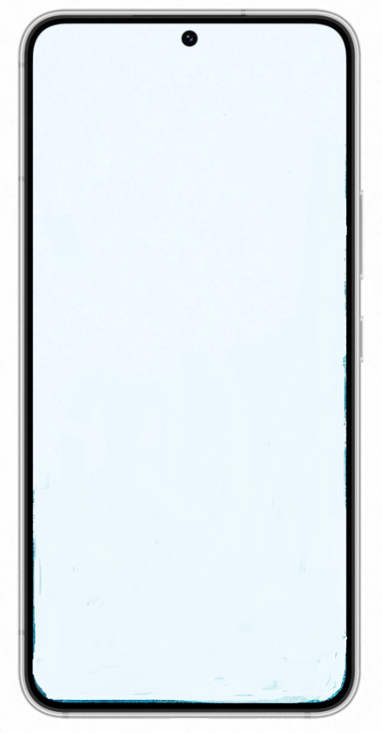


That That (prod. ＆ feat. SUGA of BTS)
01:15
03:20

