Slide 1
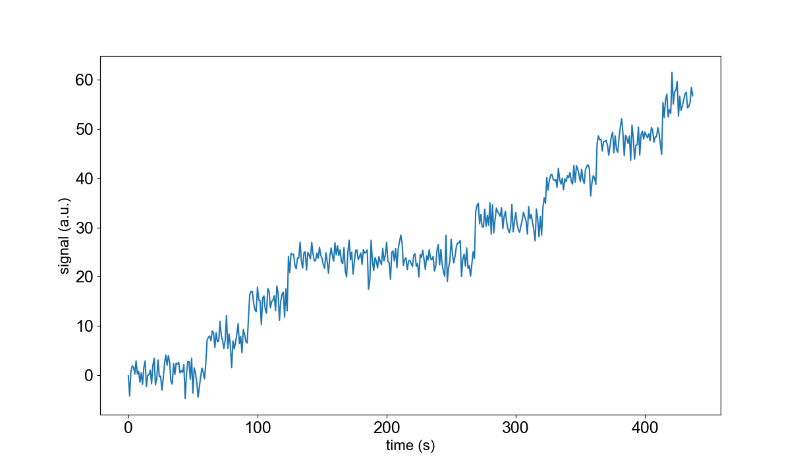
Dwell time
Step size

