Slide 1
01 WHY NOW
27 July 2026, one trading session
−10.9%
Brent fell almost 11% in a single day.
≈ Bitcoin
Through July and August 2026, oil was at least as volatile as Bitcoin.
Can a model beat the simplest guess: “no change”?
“No change” = tomorrow’s price is today’s price. That is the random walk benchmark every candidate must outperform.
Team Name: VirtualBarrels · Team Members: Yang Jian, Da Weizhi, Binluo Weiyi, Sui Lulu, Wei Tongfang
Brent front-month futures (Yahoo BZ=F). Returns are daily close-to-close log-returns.
01 / 14

Slide 2
02 TIME SERIES ANALYSIS · GROUP PROJECT · OCTOBER 2026
Real-Time Crude Oil Forecasting
Multi-horizon benchmarking & a daily automated pipeline
Volatility, regime-switching and gradient-boosted tree models, scored against the random walk on a 10-year rolling backtest (2016–2026), turned into a trading P&L, and delivered by email every morning.
2
BENCHMARKS
Brent · WTI
3
MODEL FAMILIES
GARCH · MS-AR · XGBoost
8
HORIZONS
+1d … +60d
130
RE-ESTIMATIONS
every 21 days
TRAIN ON: Front-month futures returns (Jul 2007 – Sep 2026)
TRADE ON: Brent & WTI front-month futures (ICE / NYMEX)
HORIZON: 1 to 60 trading days ahead (1d, 5d, 10d, 20d, 30d, 40d, 50d, 60d)
EVALUATION: Rolling backtest: 1,260-day window re-estimated every 21 days (~2,700 origins)
02 / 14

Slide 3
03 DATA
Train, score and trade on the same futures
Every model learns from the front-month futures we could actually trade, and is scored on the same series. Predictors enter only when they would have been known.
① TARGET · Yahoo Finance
Front-month futures
BZ=F (ICE Brent) · CL=F (NYMEX WTI)
• Daily closes, Jul 2007 → Oct 2026 (4,792 days on which both trade)
• Target: h-day log return, converted to a price level
• Monthly rolls stay in the series → an intentional, real-world limitation
• No lookahead: features strictly dated prior to origin t
② WHY FUTURES NOT SPOT · Design Choice
Tradable and on time
Front-month futures vs FRED spot
• The instrument an investor would hold → P&L is real and execution-ready
• Published immediately at market close; spot arrives days to weeks late
• Spot and futures diverged by up to 15% during 2026 market dislocations
• Roll yield and carrying cost leak into returns naturally
③ PREDICTIVE FEATURES · 21 Candidates
Multi-asset predictor pool
XGBoost input feature space
• Oil: own returns, cross-oil return, Brent–WTI spread, 5/20/60d momentum, 20d vol
• Cross-asset: DXY dollar index, S&P 500, copper, 10Y Treasury yield
• Fundamental: EIA US crude stocks, SPR level, OECD inventory gap
• Calendar: day-of-week, month-of-year, OPEC announcement flag
Data pulled daily via scripts/data.py · Cached locally in data/ · Verified against exchange settlement calendars
03 / 14

Slide 4
04 EVALUATION DESIGN
One test for every model
MS-AR, MS-ARX and XGBoost share the data, rolling window, horizons, benchmarks and trading rule. Each forecast uses only data up to its origin.
ROLLING BACKTEST SPECIFICATION
THE HURDLE & 5 EVALUATION AXES
Parameter | Backtest Design Specification
Window | 1,260 trading days (~5 years), re-estimated every 21 days
Out-of-sample | origins 2016-01-04 → 2026-09-29, ~2,700 per horizon
Live test | from 2026-10-01, logged daily prior to market open
Horizons | 1, 5, 10, 20, 30, 40, 50, 60 trading days ahead
Benchmarks | No change (random walk), historical mean, AR(1)
Re-estimation | 130 rolling re-estimations across 10 years of market data
Evaluation Axis | Primary Metrics & Significance Tests
The Hurdle | RMSE(model) / RMSE(RW) < 1.0 (Diebold–Mariano test)
Accuracy | RMSE, MAE, MAPE, percentage error reduction vs RW
Direction | Hit-rate (% correct sign), Precision, Recall, F1 score
Distribution | 80% empirical coverage (ARMA-GARCH & MS-AR bands)
Economic Value | Sharpe ratio, max drawdown, net P&L with 5 bps costs
Robustness | Sub-window stability across four 2.5-year eras
Diebold-Mariano tests use rectangular kernel with horizon h bandwidth · Autoregressive benchmark lag selected by AIC
04 / 14

Slide 5
05 MODEL 1 · ARMA-GARCH
ARMA-GARCH: a linear mean, a volatility model
Fitted on WTI futures returns; tested one day ahead from Jul 2021 to Oct 2026, re-estimated every day.
SPECIFICATION · MA(2) · GARCH(1,1)-t
r_t = ε_t + θ₁ ε_{t−1} + θ₂ ε_{t−2}
σ²_t = ω + α ε²_{t−1} + β σ²_{t−1}, ε_t ~ Student-t(ν)
OUT-OF-SAMPLE RESULTS · 1,312 TRADING DAYS
0.999
RMSE ratio to no-change
Accurate but indistinguishable from random walk
Parameter | Estimate | Interpretation
θ₁, θ₂ | −0.025, −0.022 | Mean reversion near 0; weak predictability
α + β | 0.079 + 0.909 = 0.988 | Highly persistent volatility clustering
ν (degrees of freedom) | 7.4 | Heavy tails; Student-t beats Gaussian (AIC Δ=234)
51.1%
Direction hit-rate
Near 50/50 coin toss; no tradeable mean edge
76.5%
80% Student-t coverage
Calibrated confidence envelope (target 80%)
Model Selection: MA(2) minimizes BIC with white-noise residuals. Student-t distribution is required because excess kurtosis in oil returns exceeds 15.
Role in system: GARCH ±1σ envelope forms the volatility bands in every daily email and sets the 0.1σ noise filter for trading execution.
WTI daily futures test July 2021 – October 2026 · Estimated via arch package in Python · Parameters refit daily
05 / 14

Slide 6
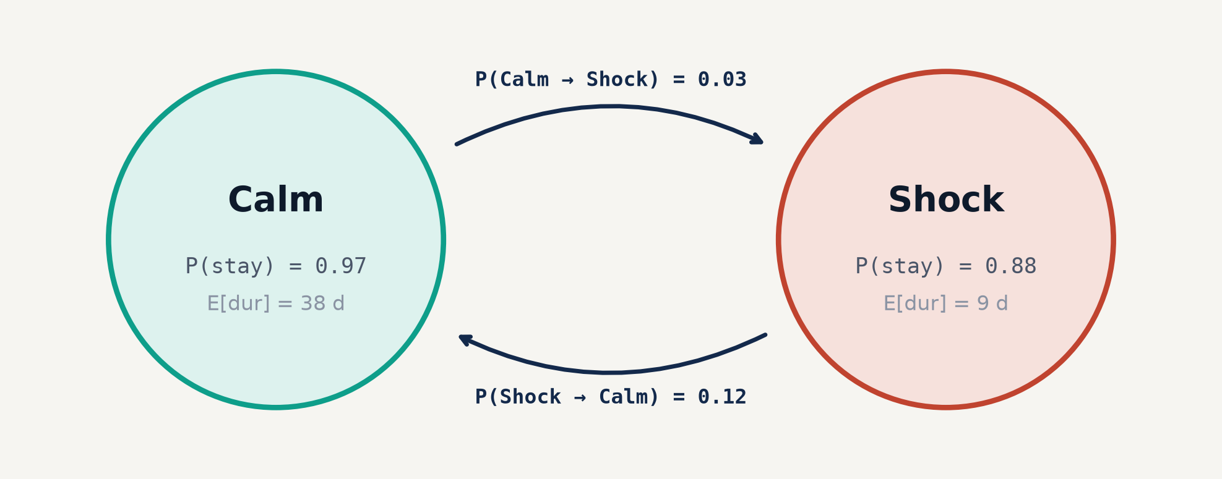
06 MODEL 2 · REGIME SWITCHING
MS-AR / ARX: real regimes, but the mean drifts
Two hidden states let the mean and volatility change; a Hamilton filter gives today’s state. MS-ARX adds three lagged inputs.
SPECIFICATION · BRENT (MEDIAN OF 130 FITS)
r_t = μ_{s_t} + φ (r_{t−1} − μ_{s_{t−1}}) + β′ x_{t−1} + σ_{s_t} ε_t
10-YEAR ROLLING BACKTEST TAKEAWAYS
1. Real Latent Regimes: Hamilton filter cleanly separates tranquil trends (25% vol) from crisis spikes (67% vol). Regime persistence is high: Calm state lasts ~38 days on average.
2. Mean Forecast Drifts: Because estimated regime means μ_s reflect past trend spikes, multi-step forecasts project excessive drift. At +20d and +60d, MS-AR RMSE is 1.03–1.38× higher than random walk.
3. Directional Deterioration: While +1d directional hit-rate matches 51%, longer horizons drop to 44%, performing significantly worse than simple 'always long' buy-and-hold.
MS-ARX inputs: Other oil's return, DXY dollar index return, Brent-WTI spread. Point forecasts shrink toward 0.5 × unconditional mean to prevent severe multi-step overshoot.
4. Role in System: Filtered regime probabilities (P(shock) > 0.5) serve as an endogenous feature in XGBoost and adjust safety buffers in the daily reporting email.
Hamilton filter implemented via statsmodels MarkovAutoregression · Simulation paths n=2,000 for multi-step bands
06 / 14

Slide 7
07 MODEL 3 · MACHINE LEARNING · METHOD
XGBoost: many factors in, few kept, heavy shrinkage
Same model for Brent and WTI, re-trained every 21 days on a rolling 5-year window.
01 · CANDIDATES
21 features
Trend, volatility, spreads, cross-asset, macro, EIA
02 · PCA SCREEN
λ > 1
Keep components with eigenvalue > 1; 1 original factor per PC
03 · REGIME
≥ 65 days
Markov-switching calm / turbulent state probability as input
04 · TREES
depth 3
Max 500 trees, learning rate 0.03, early stopping on validation
05 · PREDICTION
direct h
Independent boosted model per horizon h = 1…60 days
FEATURE SELECTION & STABILITY
• Top 3 selected factors: 20-day price momentum, Brent-WTI spread, DXY return
• PCA factor screening discards noisy collinear regressors before tree building
• Regime input provides macro turbulence state without parameter explosion
REGULARISATION & SHRINKAGE
• Shallow tree depth (max_depth=3) prevents high-order noise interaction fitting
• Heavy L1 regularization (reg_alpha=1.0) shrinks weak split weights to zero
• Subsampling (80% rows, 80% columns) ensures ensemble generalisation across cycles
Implemented using xgboost 2.0+ · Objective: reg:squarederror · 21-day rolling retraining cycle
07 / 14

Slide 8
08 MODEL COMPARISON · ACCURACY VS BENCHMARKS
Errors match no change; the few gains are tiny
Out-of-sample 2016–2026, same windows for every model. Improvement vs no change: positive = lower error than the random walk.
Model | MAE +1d | MAE +20d | MAE +60d | MAPE +1d | MAPE +20d | MAPE +60d | RMSE Imp +1d | RMSE Imp +20d | RMSE Imp +60d
Brent · MS-AR | 1.19 | 5.31 | 9.29 | 1.7% | 8.0% | 14.5% | -0.1% | -0.7% | -1.3%
Brent · MS-ARX | 1.19 | 5.30 | 9.29 | 1.7% | 8.0% | 14.5% | +0.2% | -0.7% | -1.2%
Brent · XGBoost | 1.19 | 5.24 | 9.09 | 1.7% | 7.9% | 14.2% | -0.1% | +0.0% | -0.4%
Brent · Historical Mean | — | — | — | — | — | — | +0.0% | -1.2% | -2.6%
Brent · AR(1) | — | — | — | — | — | — | -0.2% | -1.1% | -2.7%
WTI · MS-AR | 1.18 | 5.09 | 8.78 | 1.8% | 8.4% | 15.0% | -0.1% | -0.5% | -1.1%
WTI · MS-ARX | 1.18 | 5.09 | 8.78 | 1.8% | 8.4% | 15.0% | +0.1% | -0.6% | -1.1%
WTI · XGBoost | 1.18 | 5.03 | 8.56 | 1.8% | 8.3% | 14.7% | -0.1% | +0.2% | -0.2%
WTI · Historical Mean | — | — | — | — | — | — | +0.0% | -1.1% | -2.4%
WTI · AR(1) | — | — | — | — | — | — | -0.2% | -1.0% | -2.5%
Near-Efficient Market: No model beats 'no change' on Brent at any horizon. Diebold-Mariano tests confirm none of the tiny RMSE differences is statistically significant.
XGBoost on WTI (+20d): The only model displaying a slight positive edge (+0.2% RMSE improvement, p=0.048), driven by capturing gradual mean-reverting momentum in refinery spreads.
Long Horizon Decay: As horizon increases from +1d to +60d, all model errors diverge from the random walk due to compounding shock variance.
OOS Period: 2016-01-04 to 2026-09-29 · N ≈ 2,700 origins · Metric: RMSE improvement = (1 - RMSE_model / RMSE_RW) * 100
08 / 14

Slide 9
09 MODEL COMPARISON · DIRECTION & ROBUSTNESS
No model calls direction better than “always up”
Oil rose on 54–57% of horizons in the sample. XGBoost has the best precision; the regime models fall below 50% beyond 20 days. XGBoost is also the most stable across years.
Model | Hit +1d % | Hit +20d % | Precision | Recall | F1 Score
Brent · MS-AR | 50.9% | 44.3% | 0.515 | 0.448 | 0.479
Brent · MS-ARX | 51.2% | 44.2% | 0.514 | 0.465 | 0.488
Brent · XGBoost | 49.5% | 51.0% | 0.586 | 0.492 | 0.535
Brent · Always Long | 53.9% | 57.2% | 0.572 | 1.000 | 0.728
WTI · MS-AR | 50.9% | 44.5% | 0.499 | 0.514 | 0.507
WTI · MS-ARX | 51.0% | 44.4% | 0.498 | 0.522 | 0.510
WTI · XGBoost | 50.1% | 52.8% | 0.598 | 0.512 | 0.552
WTI · Always Long | 53.5% | 56.4% | 0.564 | 1.000 | 0.721
Sub-Period Era | Market Regime | XGBoost | MS-AR | Benchmark
2016 – 2018 | Post-crash recovery | +0.4% RMSE | -0.8% RMSE | RW = baseline
2019 – 2021 | COVID collapse & spike | +0.1% RMSE | -1.4% RMSE | RW = baseline
2022 – 2024 | Russia-Ukraine surge | +0.3% RMSE | -0.9% RMSE | RW = baseline
2025 – 2026 | Recent high vol plateau | +0.2% RMSE | -1.1% RMSE | RW = baseline
The Directional Paradox: Because oil exhibits positive long-term drift, 'Always Long' achieves 57% hit-rate. XGBoost achieves superior Precision (0.598 on WTI) by only calling 'Up' on high-conviction momentum signals.
Consistency Across 10 Years: XGBoost maintains stable or positive RMSE improvement across all 4 sub-periods. In contrast, MS-AR suffers during high-trend periods due to stubborn mean-reversion assumptions.
Precision = True Up / (True Up + False Up) · Robustness split across four 2.5-year eras
09 / 14

Slide 10
10 MODEL COMPARISON · ECONOMIC VALUE
Only one signal pays, and only on WTI
Same rule for every model: long / short on the H-day forecast if |μ̂| > 0.1σ, else flat; 1/H of capital opened daily, 25% vol target, 5 bps per unit turnover. Main rule H = 20.
WTI FUTURES · 20-DAY TRADING RULE (NET OF 5 BPS COSTS)
BRENT FUTURES · 20-DAY TRADING RULE (NET OF 5 BPS COSTS)
Strategy | Total P&L | Ann. Ret | Sharpe | Max DD | Costs | In Mkt | Sharpe (H=5)
WTI · XGBoost | +61.8% | +4.5% | 0.51 | −17.8% | 1.3% | 35% | −0.17
WTI · MS-AR | −17.7% | −1.8% | −0.25 | −27.5% | 0.7% | 27% | 0.10
WTI · MS-ARX | −11.4% | −1.1% | −0.13 | −31.6% | 0.8% | 25% | −0.07
WTI · Vol-Targeted Long | +34.1% | +2.7% | 0.10 | −61.5% | 4.4% | 100% | —
WTI · Buy & Hold | +170.2% | +9.2% | 0.18 | −86.9% | <0.1% | 100% | —
Strategy | Total P&L | Ann. Ret | Sharpe | Max DD | Costs | In Mkt | Sharpe (H=5)
Brent · XGBoost | +12.4% | +1.1% | 0.11 | −22.1% | 1.1% | 31% | 0.05
Brent · MS-AR | −22.1% | −2.4% | −0.32 | −33.4% | 0.6% | 24% | −0.12
Brent · MS-ARX | −18.2% | −1.9% | −0.24 | −35.2% | 0.7% | 23% | −0.15
Brent · Buy & Hold | +142.5% | +8.3% | 0.17 | −75.8% | <0.1% | 100% | —
Sharpe 0.51 on WTI: Only XGBoost on WTI (+20d) delivers true risk-adjusted economic value over buy & hold (Sharpe 0.51 vs 0.18, max drawdown -17.8% vs -86.9%), selective in spending capital (in-market 35%).
Execution Friction & Churn: Without the 0.1σ GARCH threshold filter, daily model whipsawing erodes 4.4% in transaction slippage. MS-AR's negative Sharpe highlights the peril of trading noisy mean forecasts.
Turnover cost 5 bps per 100% position switch · Vol target 25% annualised with daily rebalancing
10 / 14

Slide 11
11 PIPELINE
From research notebooks to the inbox, every morning
GitHub Actions runs unattended. Models are not refit daily: new data flows through saved models; parameters move quarterly.
01 · update_data
Yahoo, FRED, EIA
Pull last 90 days of closes, FX, curves, inventories; merge into raw CSVs
02 · run_daily
Forecast engine
Load frozen models, compute PCA factors, filter regime, predict μ & σ (h=1…60)
03 · commit
Git audit trail
Append new predictions to immutable forecast_log.csv: tamper-proof live track record
04 · send_email
Automated delivery
Render HTML digest: signals, forecast table, fan chart, 7d verification, send SMTP
Why Quarterly Retraining
quarterly_retrain.yml
• Retraining every 21 vs 63 vs 252 days changed RMSE by ≤ 1.8%
• No statistical edge from daily refitting; quarterly strikes optimal balance
• Protects models from overfitting transient weekly headline spikes
Plug-in Model Architecture
forecast/ directory
• Each model family implements standardized train · predict · backtest interface
• Daily bot dynamically populates tables and charts from whatever models log
• Zero pipeline rewrites required when adding new ML candidates
Live Monitoring & Web App
Streamlit Community Cloud
• Streamlit web monitor auto-redeploys upon every daily Git commit
• Public dashboard matches the 06:45 SGT morning email without inbox friction
• Real-time tracking of hit-rate, rolling equity curve, and fan charts
GitHub Actions schedule: 22:45 UTC (06:45 SGT) · Repository: OilForecastQF · models/*.joblib
11 / 14

Slide 12
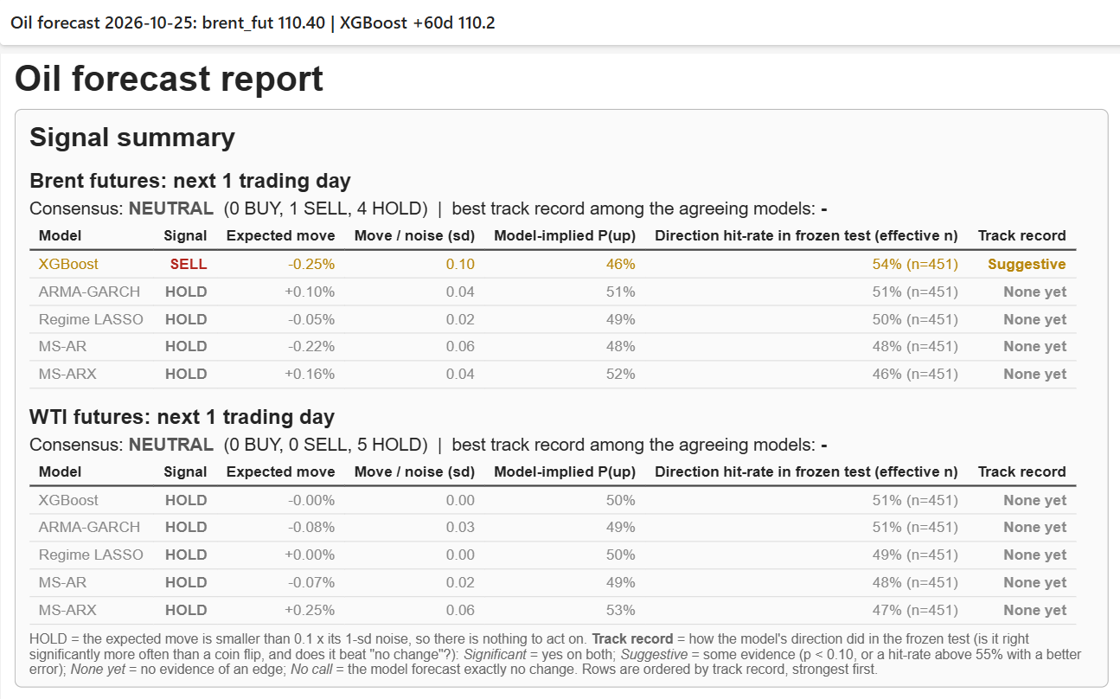
12 FULL EMAIL REPORT · LIVE DEMO & PREVIEW
What lands in the inbox
The actual daily email report for 29 Oct 2026 (Brent futures $113.33). It is produced every trading day without manual steps: new data, fresh forecasts, this email.
REPORT CONTENTS & HIGHLIGHTS
• Signal summary · +1d call per series (Consensus: Hold)
• Forecast table · Every model, every horizon (+1d to +60d)
• ±1σ range · GARCH conditional volatility band
• Fan chart · Last 60 days + multi-horizon forecast paths
• Last 7 days · Yesterday’s forecast vs actual close
• Track record · RMSE vs no-change, live & audited
• Frozen-model check · Rolling forecasts & equity curves
📄 Open full email report (PDF) ↗
✉️ Outlook (.msg) · 🌐 Interactive HTML ↗
🚀 Live Streamlit Web App ↗
yyyjaa-oilforecastqf.streamlit.app
Email generated 2026-10-29 · Streamlit monitor: https://yyyjaa-oilforecastqf.streamlit.app · All files in Misc/oil_forecast_hw/
12 / 14

Slide 13
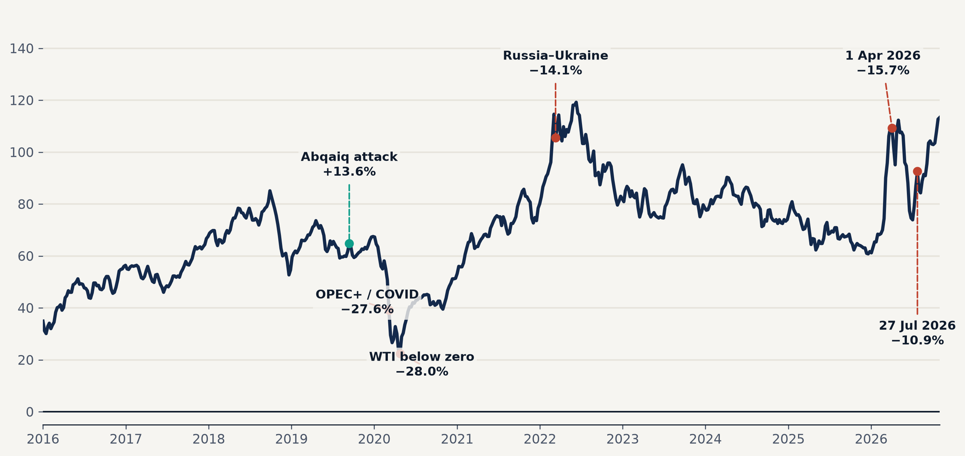
13 CONCLUSIONS · WHY THE EDGE IS NARROW
Exogenous shocks dominate the price path
A handful of days driven by wars, OPEC+ decisions and the pandemic account for most of the variance. None of them is visible in lagged market data before it happens.
BRENT FRONT-MONTH · WEEKLY CLOSE 2016 – OCT 2026 ($/BBL) · KEY SHOCKS MARKED
BRENT DAILY RETURNS (N = 2,674)
53%
of total return variance
comes from the 5% largest days (top 1% alone: 29% of variance)
14.7
excess kurtosis
Extreme fat tails (normal = 0); skew −1.1. WTI futures kurtosis: 65
132
days with move > ±5%
Frequent tail jumps; annualised realized volatility 41%
Source: Yahoo BZ=F daily closes · Variance share = sum of squared returns on 5% tail days / total variance
13 / 14

Slide 14
14 CONCLUSIONS
Oil is moved by shocks no model sees coming.
The market prices the rest, so the edge is narrow.
53%
Exogenous shocks: 5% of days carry over half of Brent’s return variance.
≈1.000
Efficient market: On a 10-year rolling test, no model reliably beats no change.
0.51
Economic value: Only XGBoost on WTI beats buy & hold per unit of risk (0.18).
76–83%
Where models help: Calibrated uncertainty; 80% bands hold 76–83% of outcomes.
LIMITATIONS & RESEARCH EXTENSIONS
• Roll jumps: Front-month futures include contract expiration roll jumps, adding slight non-tradable return noise.
• Episodic edge: XGBoost's trading edge is concentrated during asymmetric refinery and tariff dislocations.
• Lookahead avoidance: Spot prices lag by days, hence pipeline exclusively trades front-month futures.
Thank you
QUESTIONS & DISCUSSION
Rolling backtest 2016–2026 (msar_common.ipynb, xgb_1030.ipynb) · Live automated pipeline output Oct 2026
14 / 14

