Slide 1
信息安全导论
Final Review
重庆大学软件学院

Slide 2
密码学原理及算法
1. 概述
2. 对称密码体系
3. 公钥密码体系
4. 密码散列函数
Final Review 胡海波
page<number>

Slide 3
1. 概述
安全攻击：
      Interruption 阻断
      Interception 窃听
      Modification 修改
      Fabrication 伪装
Active Attack
Passive Attack
Final Review 胡海波
page<number>

Slide 4
1. 概述
安全服务
    Confidentiality (保密性)
    Availability (可用性)
    Nonrepudiation (防抵赖)
    Authentication (真实性)
    Integrity (完整性)
    Access Control (可控性)
Final Review 胡海波
page<number>

Slide 5
1. 概述
Symmetric Cryptography
Asymmetric Cryptography
Cryptography
Cryptographic Hash Function
Final Review 胡海波
page<number>

Slide 6




1. 概述
Symmetric Cryptography
General idea of Symmetric-key cipher 对称密码
Encipherment（加密）
Asymmetric Cryptography
Alice
Bob
Plaintext
Plaintext
Cryptographic Hash Function
Encryption
Algorithm
Secure Key-exchange Channel
Decryption
Algorithm
Shared
Secret-Key
Shared
Secret-Key
Ciphertext
Ciphertext
Insecure Channel
Final Review 胡海波
page<number>

Slide 7

1. 概述
Symmetric Cryptography
General idea of Asymmetric-key cipher
1
Digital Signature数字签名
Asymmetric Cryptography
Alice
Bob
Plaintext
Plaintext
Cryptographic Hash Function
Encryption
Algorithm
Alice’s
Private-Key
Alice’s
Public Key
Decryption
Algorithm
Ciphertext
Ciphertext
Insecure Channel
Final Review 胡海波
page<number>

Slide 8
1. 概述
Asymmetric Cryptography
General idea of Asymmetric-key cipher
2
Encipherment
Symmetric Cryptography
Alice
Bob
Plaintext
Plaintext
Cryptographic Hash Function
Decryption
Algorithm
Encryption
Algorithm
Alice’s
Private-Key
Alice’s
Public Key
Ciphertext
Ciphertext
Insecure Channel
Final Review 胡海波
page<number>

Slide 9
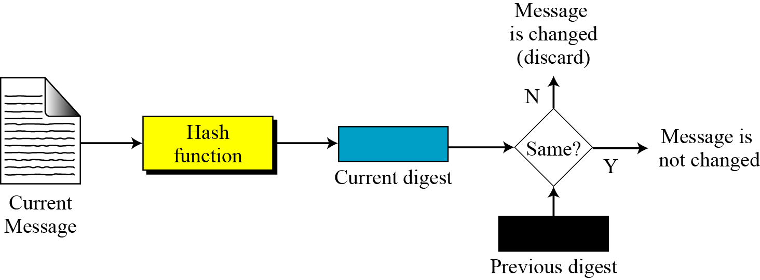

1. 概述
Symmetric Cryptography
General idea of Hash Function for Message Digest
Checking integrity 完整性检验
Asymmetric Cryptography
Cryptographic Hash Function
Original
Message
Final Review 胡海波
page<number>

Slide 10
密码学原理及算法
1. 概述
2. 对称密码体系
3. 公钥密码体系
4. 密码散列函数
Final Review 胡海波
page<number>

Slide 11
1. 概述
分组密码
流密码
对称密码
秘钥管理
Final Review 胡海波
page<number>

Slide 12
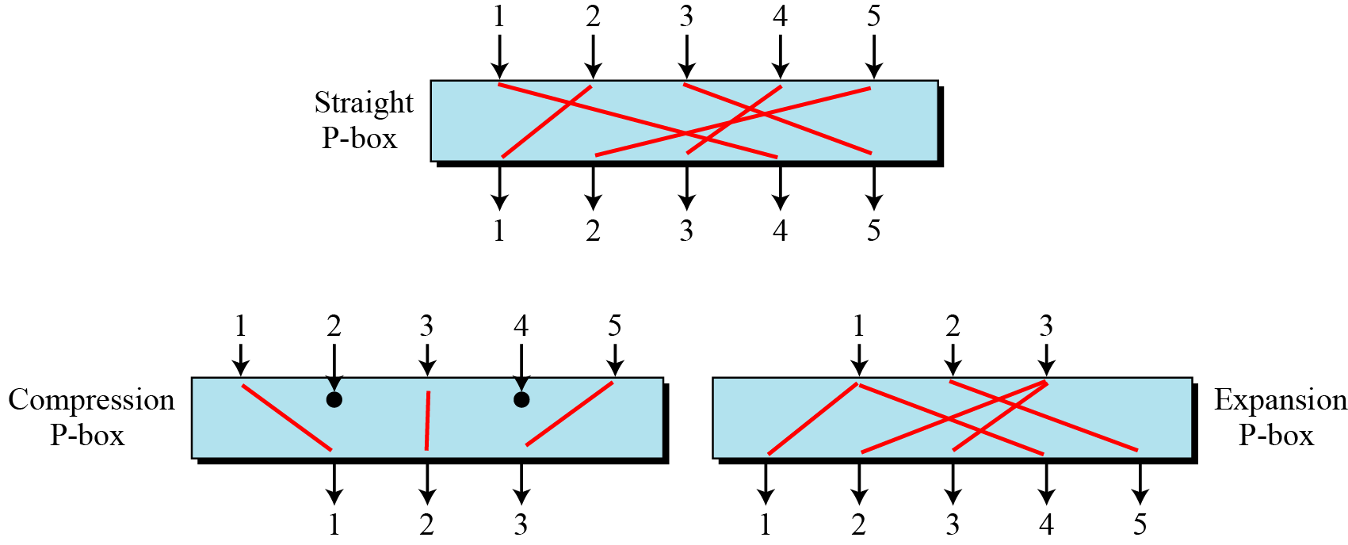
2. 对称密码
2.1 分组密码: 基本变换函数
P-Box
A P-box (置换盒) parallels the traditional transposition cipher for characters. It transposes (移动) bits.
A straight(直接的) P-box is invertible(可逆的), but compression and expansion P-boxes are not.
S-Box
XOR
e.g.
Circular Shift
Swap
Split / Combine
Final Review 胡海波
page<number>

Slide 13
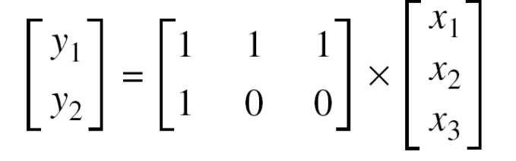
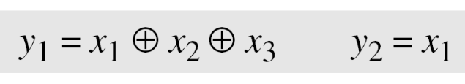
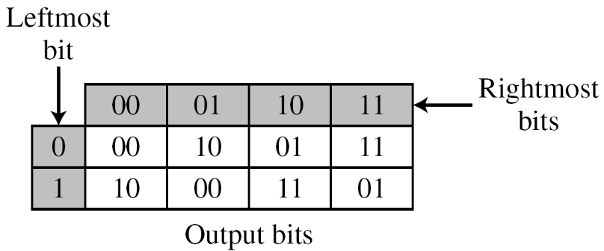
2. 对称密码
2.1 分组密码: 基本变换函数
P-Box
An S-box (替换盒) can be thought of as a miniature(微小的) substitution cipher.
An S-box is an m × n substitution unit, where m and n are not necessarily the same.
S-Box
XOR
e.g.1
Circular Shift
Swap
Split / Combine
e.g.2
110 → 11
010 → 01
Final Review 胡海波
page<number>

Slide 14
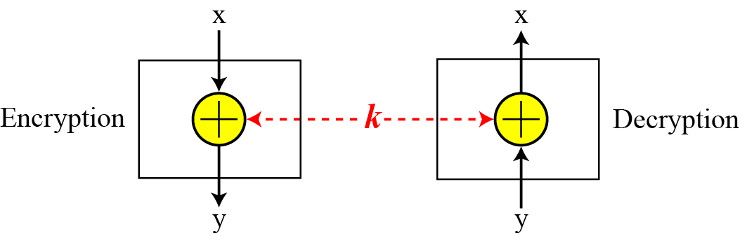
2. 对称密码
2.1 分组密码: 基本变换函数
P-Box
The exclusive-or operation is an important component in most block ciphers.
S-Box
XOR | 0 | 1
0 | 0 | 1
1 | 1 | 0
+
XOR
Circular Shift
Swap
Split / Combine
e.g.
Final Review 胡海波
page<number>

Slide 15
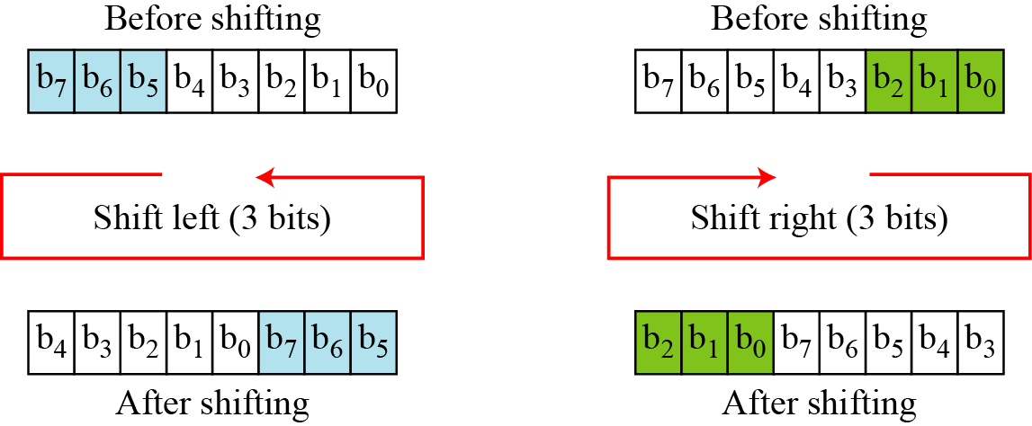
2. 对称密码
2.1 分组密码: 基本变换函数
P-Box
The circular shift operation is another component found in some modern block ciphers.
S-Box
e.g.
XOR
Circular Shift
Swap
Split / Combine
Final Review 胡海波
page<number>

Slide 16
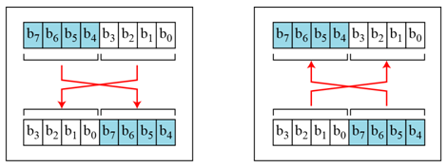
2. 对称密码
2.1 分组密码: 基本变换函数
P-Box
The swap operation is a special case of the circular shift operation where k = n/2.
S-Box
e.g.
XOR
Circular Shift
Swap
Split / Combine
Encryption
Decryption
Final Review 胡海波
page<number>

Slide 17
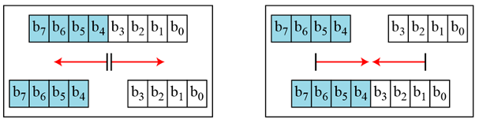
2. 对称密码
2.1 分组密码: 基本变换函数
P-Box
Two other operations found in some block ciphers are split and combine.
S-Box
e.g.
XOR
Circular Shift
Split
Combine
Swap
Encryption
Decryption
Split / Combine
Final Review 胡海波
page<number>

Slide 18
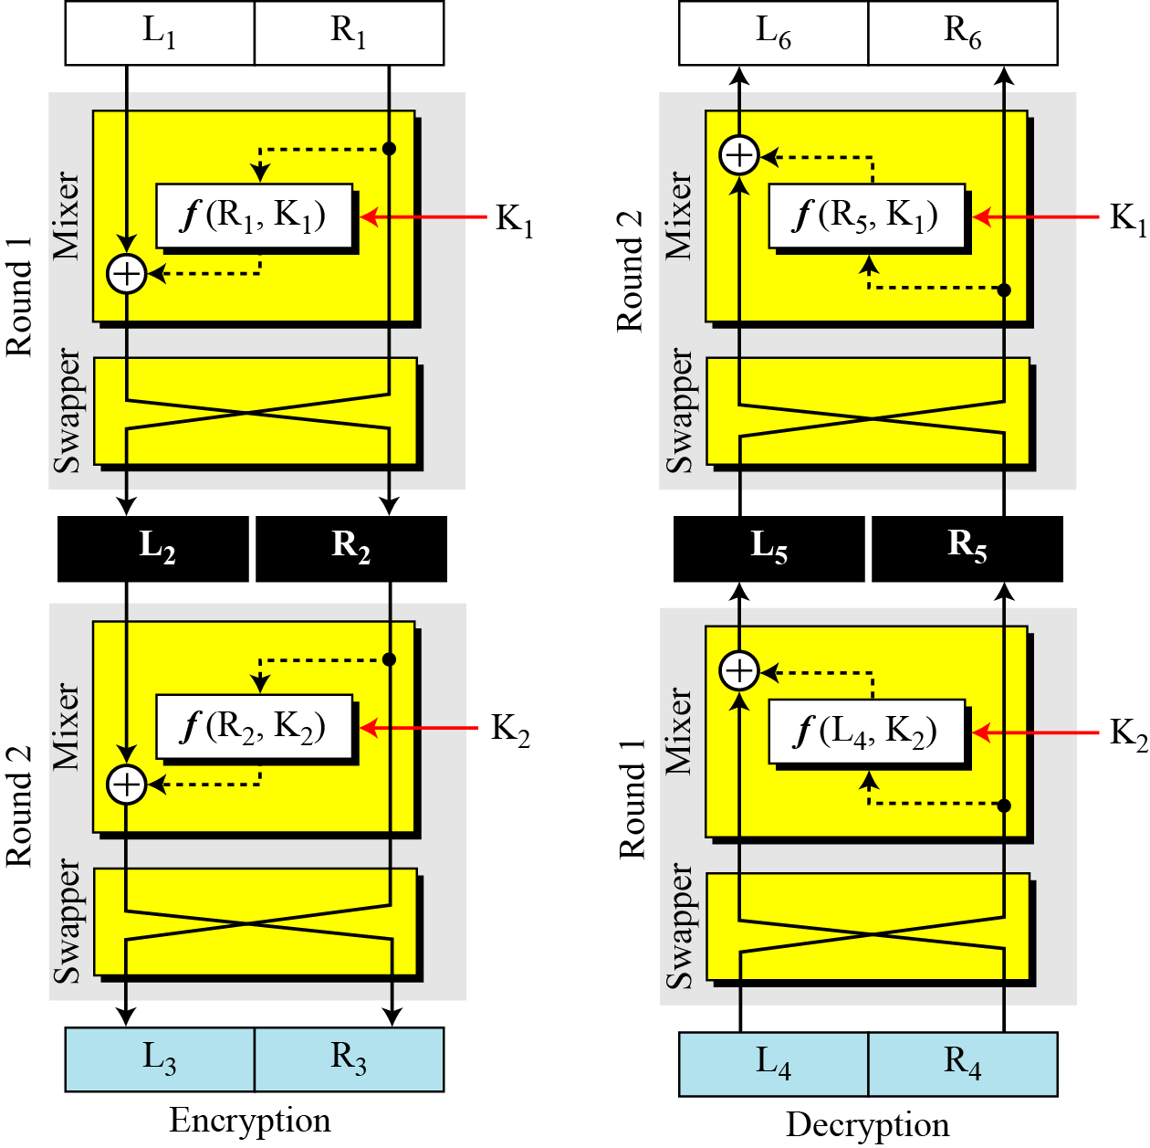
2. 对称密码
2.1 分组密码: Feistel 密码
  Block size
  Key size
  Number of rounds
  Subkey generation
  Round function
  Fast software E/D
  Ease of analysis
Final Review 胡海波
page<number>

Slide 19


2. 对称密码
2.1 分组密码: DES（数据加密标准）
Initial permutation
DES
64bit plaintext
K₁
56bit key
Round 1
K₂
Round 2
Round-key generator
.
.
.
.
.
.
K₁₆
Round 16
64bit ciphertext
Final permutation
Final Review 胡海波
page<number>

Slide 20
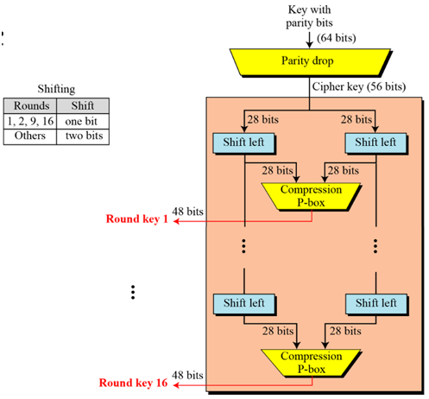
2. 对称密码
2.1 分组密码: DES（数据加密标准）
  秘钥扩展：生成16个轮秘钥
Final Review 胡海波
page<number>

Slide 21
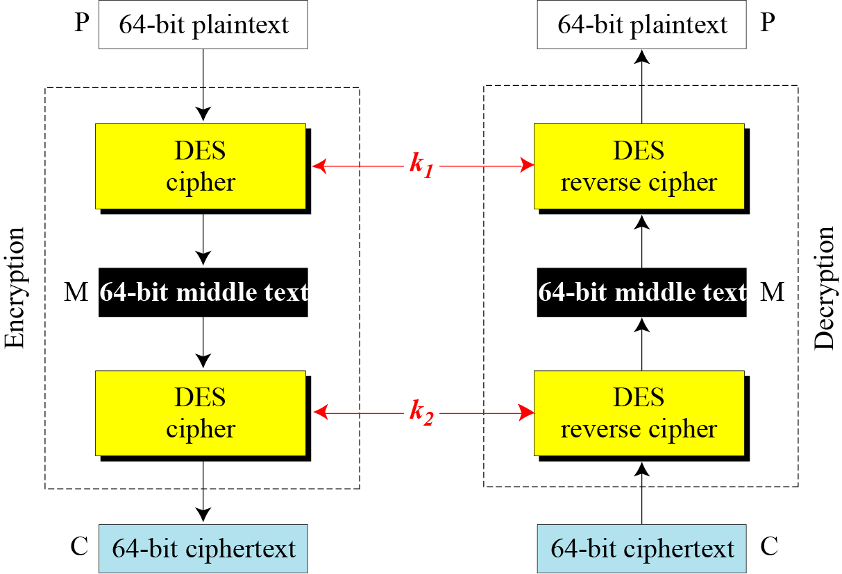
2. 对称密码
2.1 分组密码: DES（数据加密标准）
  多重加密(Multiple Encryption)
Double DES
  C = E_{K2}(E_{K1}(P))
  M = D_{K1}(D_{K2}(P))
  meet in the middle attack:
Triple DES
  Triple DES with 2 keys
    C=E_{k1}(D_{k2}(E_{k1}(P)))
    P=D_{k1}(E_{k2}(D_{k1}(P)))
    K1+K2: 112bits
  Triple DES with 3 keys
    C=E_{k3}(D_{k2}(E_{k1}(P)))
    P=D_{k1}(E_{k2}(D_{k3}(C)))
    More secure than DES, but with more cost
Final Review 胡海波
page<number>

Slide 22
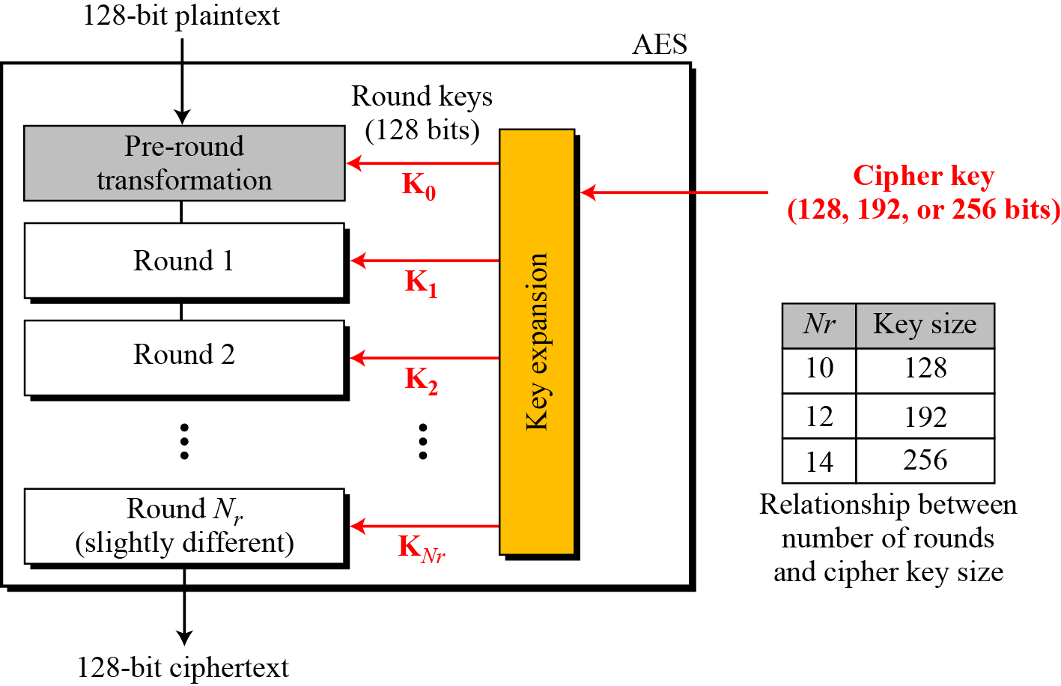
2. 对称密码
2.1 分组密码: AES（高级数据加密标准）
Final Review 胡海波
page<number>

Slide 23
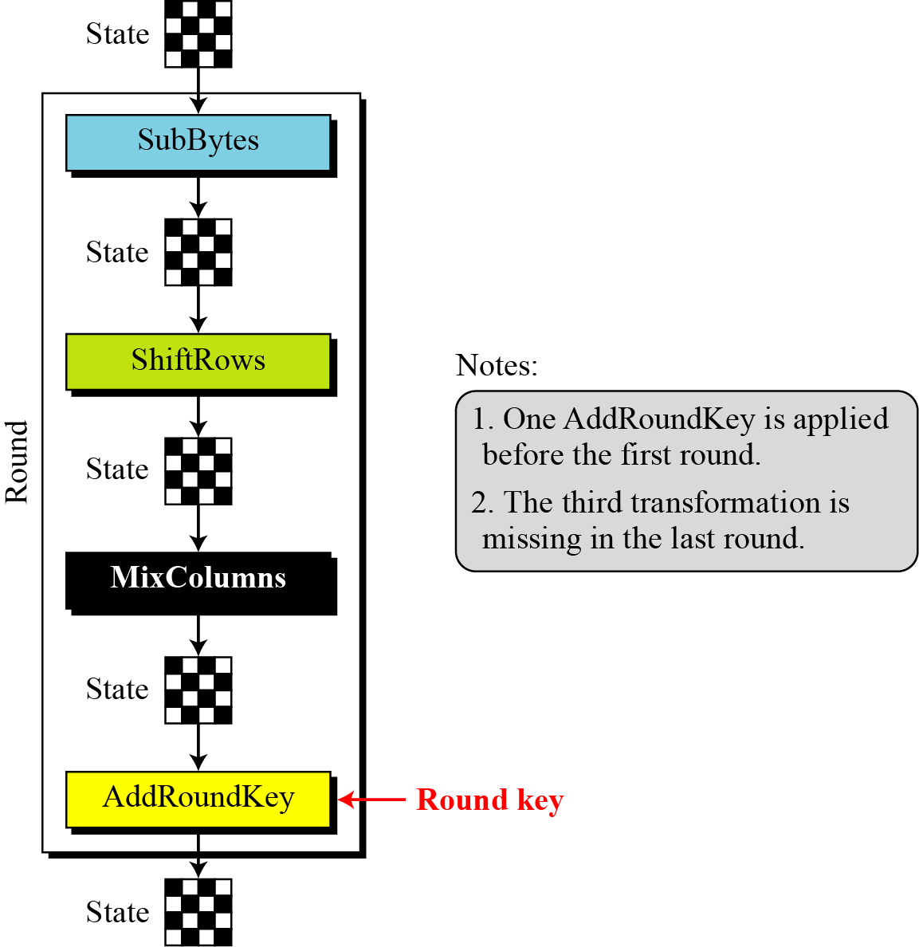
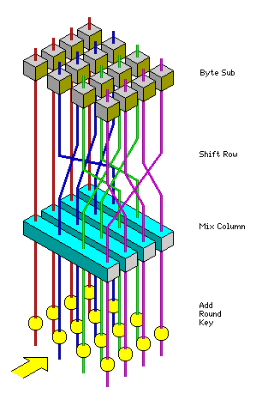
2. 对称密码
2.1 分组密码: AES（高级数据加密标准）
1) Byte Substitution
2) Shift Rows
3) Mix Columns
4) Add Round key
Final Review 胡海波
page<number>

Slide 24
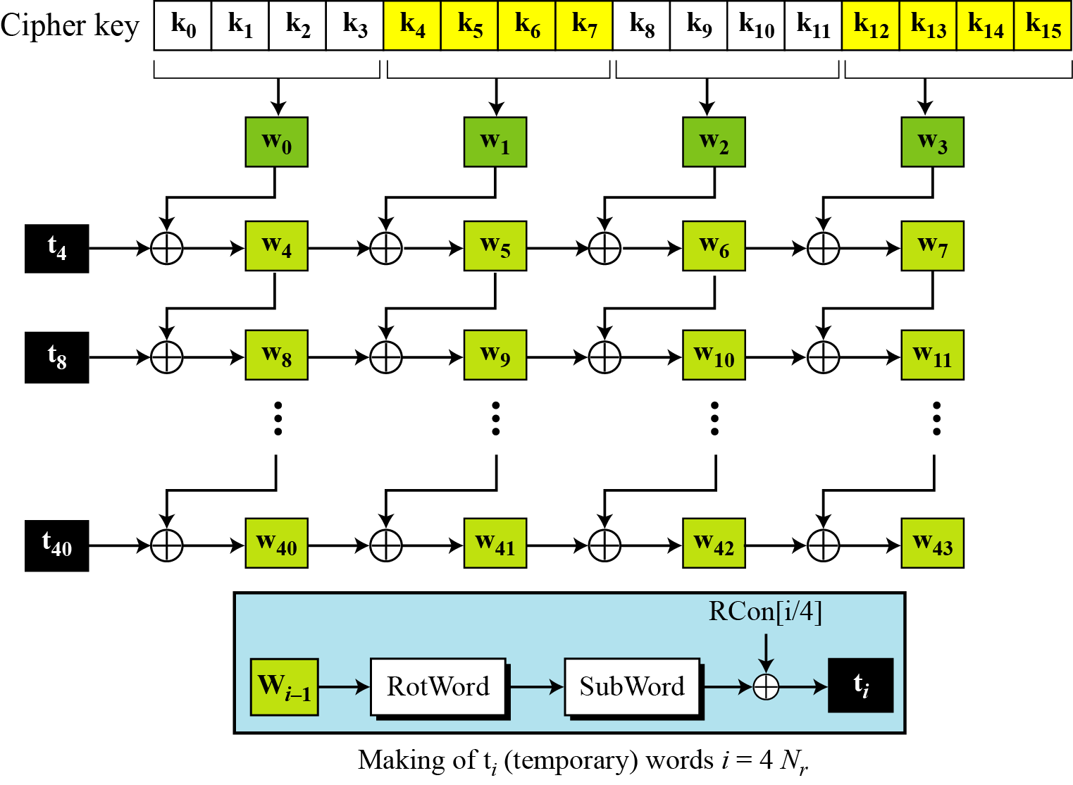
2. 对称密码
2.1 分组密码: AES（高级数据加密标准）
秘钥扩展
Final Review 胡海波
page<number>

Slide 25
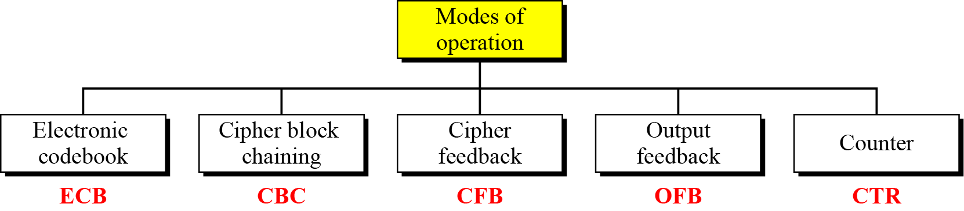
2. 对称密码
2.1 分组密码：加密模式
  对称密码算法的具体应用机制
  增加安全性，如完整性
  可以将分组加密算法用作流加密
Final Review 胡海波
page<number>

Slide 26
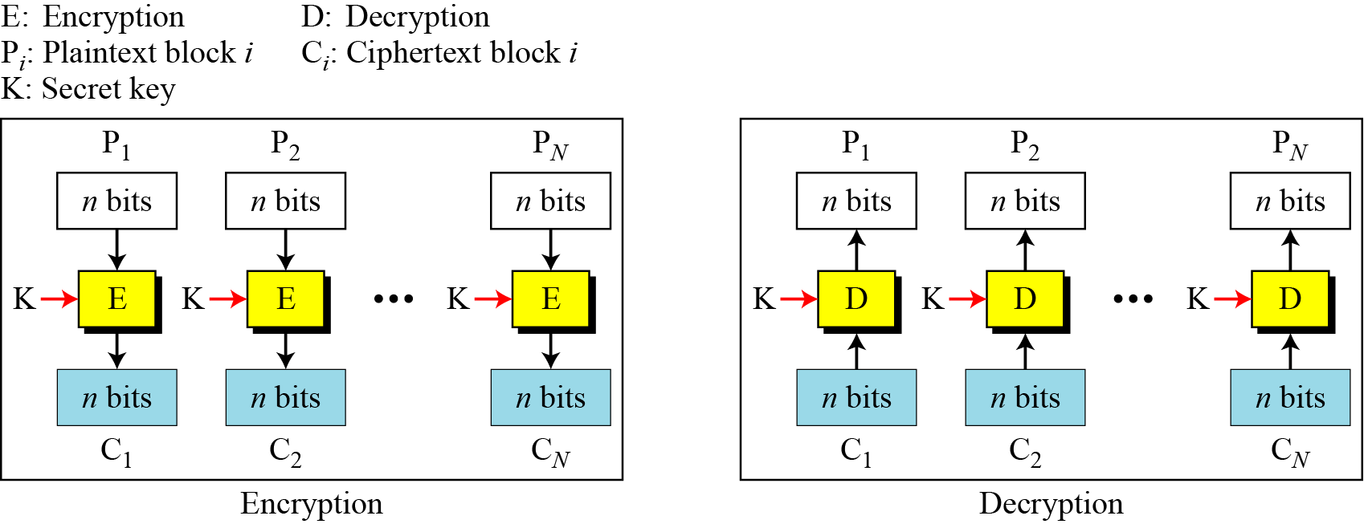
2. 对称密码
2.1 分组密码：加密模式
The electronic codebook (ECB) mode is the simplest mode of operation.
Each block of plaintext is encoded independently(独立地) using the same key.
ECB
CBC
CFB
OFB
CTR
Final Review 胡海波
page<number>

Slide 27
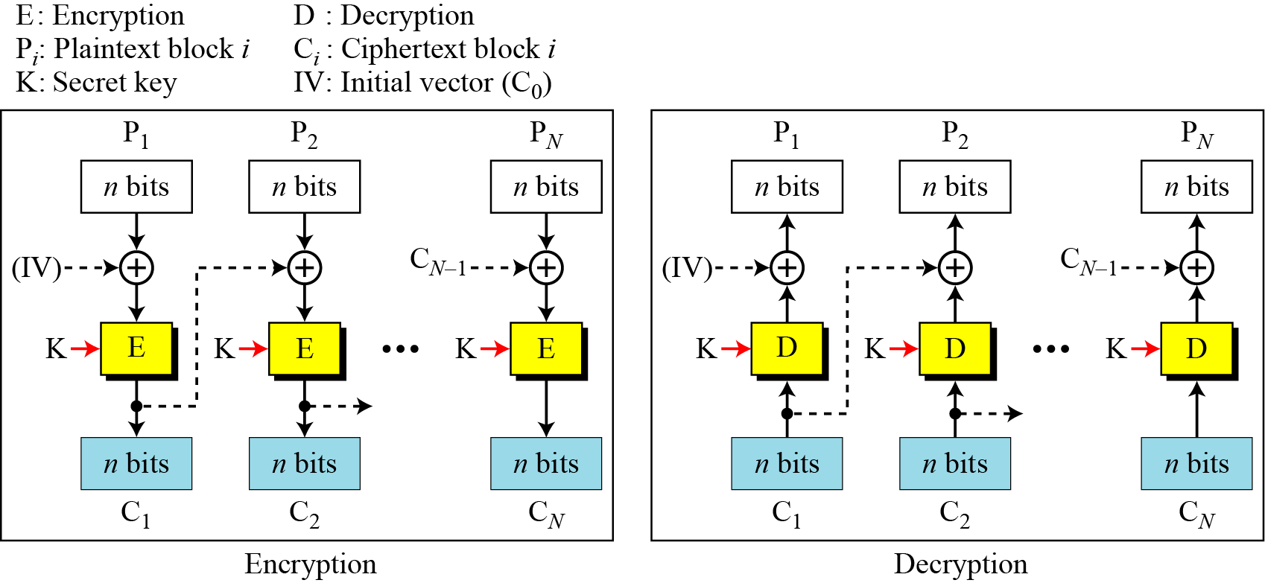
2. 对称密码
2.1 分组密码：加密模式
To transmit a lengthy message, we might employ the so called Cipher Block Chaining (CBC) mode；
In this scheme, the input to the encryption algorithm is the XOR of the current plaintext block and the preceding ciphertext block; the same key is used for each block.
ECB
CBC
To transmit a lengthy message, we might employ the so called Cipher Block Chaining (CBC) mode；
In this scheme, the input to the encryption algorithm is the XOR of the current plaintext block and the preceding ciphertext block; the same key is used for each block.
CFB
OFB
CTR
Final Review 胡海波
page<number>

Slide 28
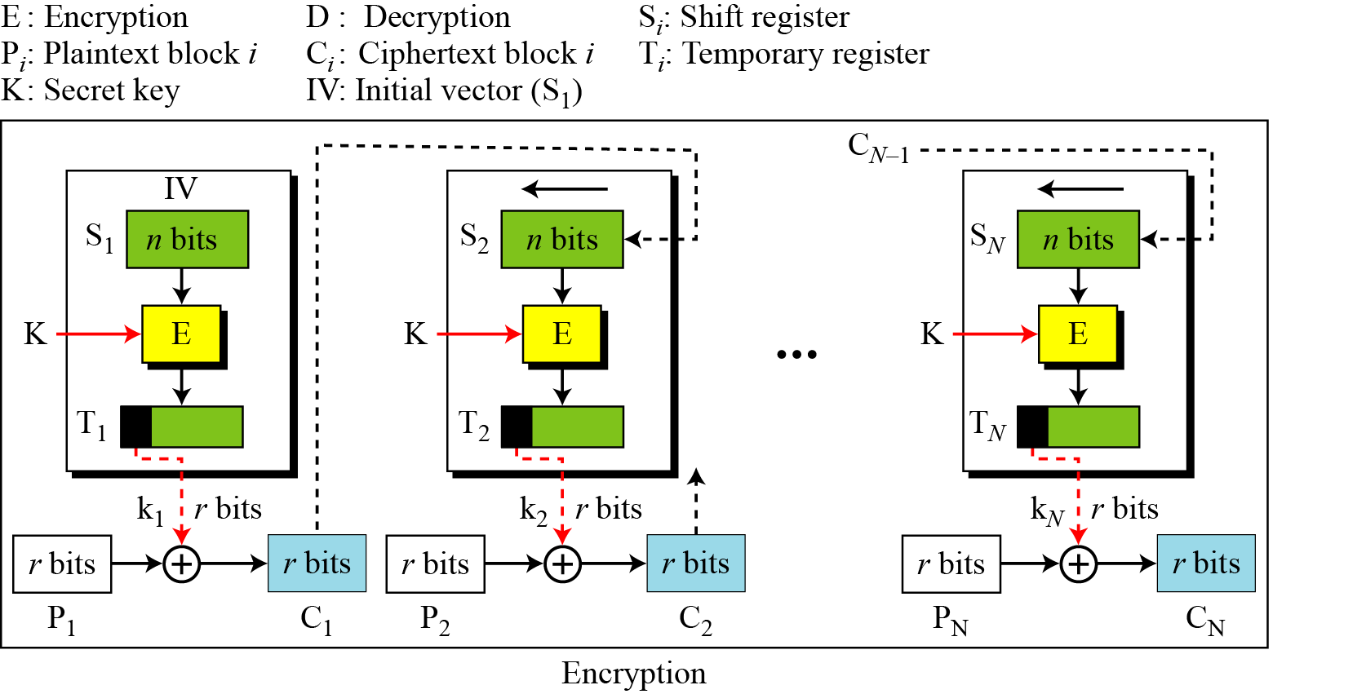
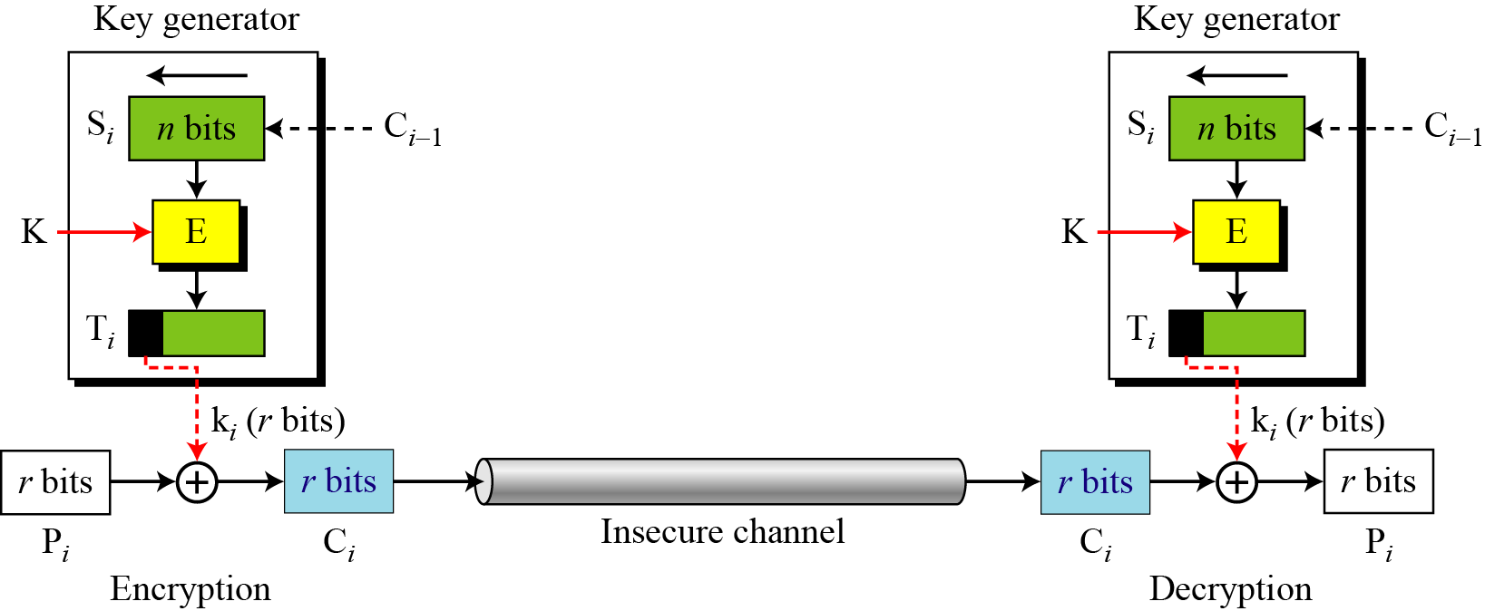
2. 对称密码
2.1 分组密码：加密模式
ECB
CBC
CFB
OFB
CTR
Final Review 胡海波
page<number>

Slide 29
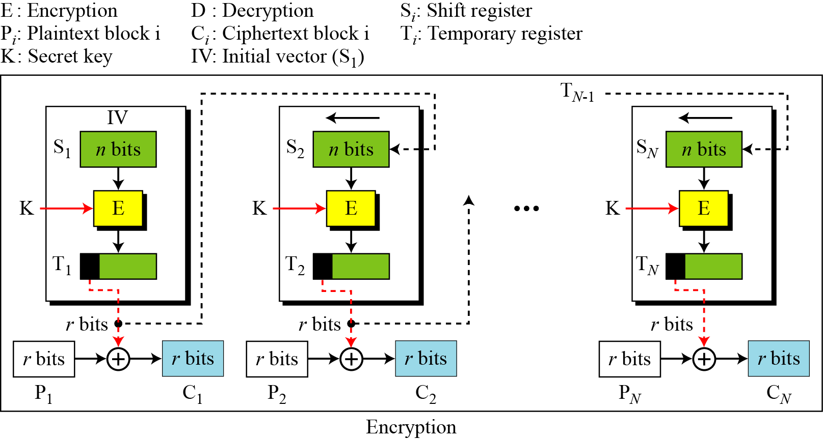
2. 对称密码
2.1 分组密码：加密模式
ECB
Output Feedback Mode is Similar to CFB.
Can you find the difference?
CBC
CFB
OFB
CTR
Final Review 胡海波
page<number>

Slide 30
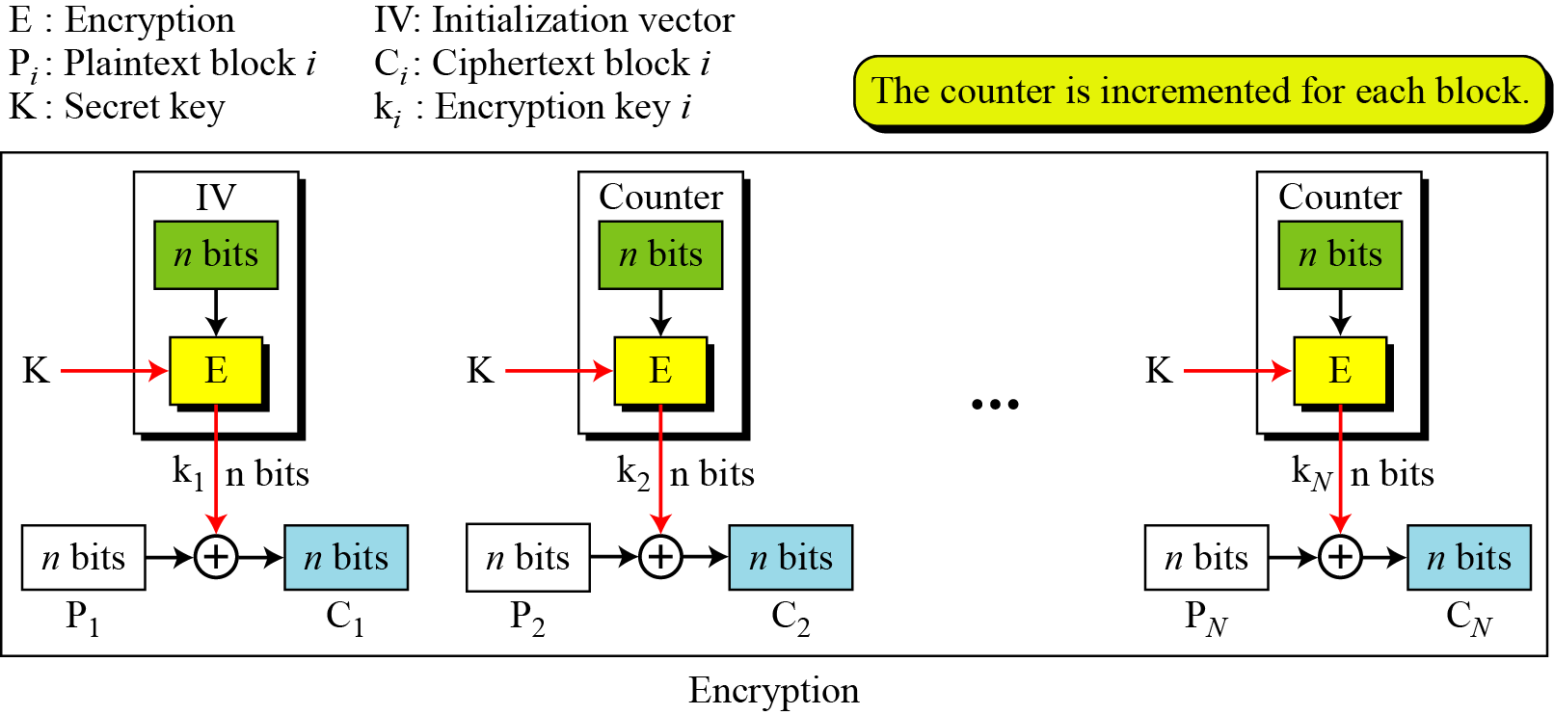
2. 对称密码
2.1 分组密码：加密模式
ECB
In the counter (CTR) mode, there is no feedback. The pseudo-randomness(伪随机) in the key stream is achieved using a counter.
CBC
CFB
OFB
CTR
Final Review 胡海波
page<number>

Slide 31

2. 对称密码
2.2 流密码
Structure
11001100
plaintext
+
01101100
key stream
10100000
ciphertext
Final Review 胡海波
page<number>

Slide 32
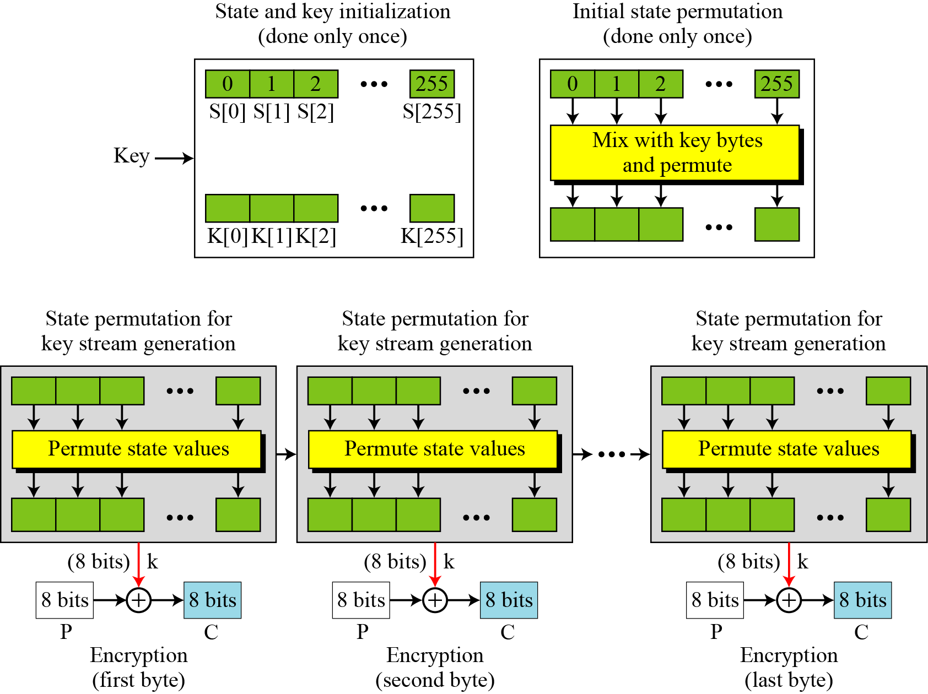
2. 对称密码
2.2 流密码：RC4算法
Final Review 胡海波
page<number>

Slide 33
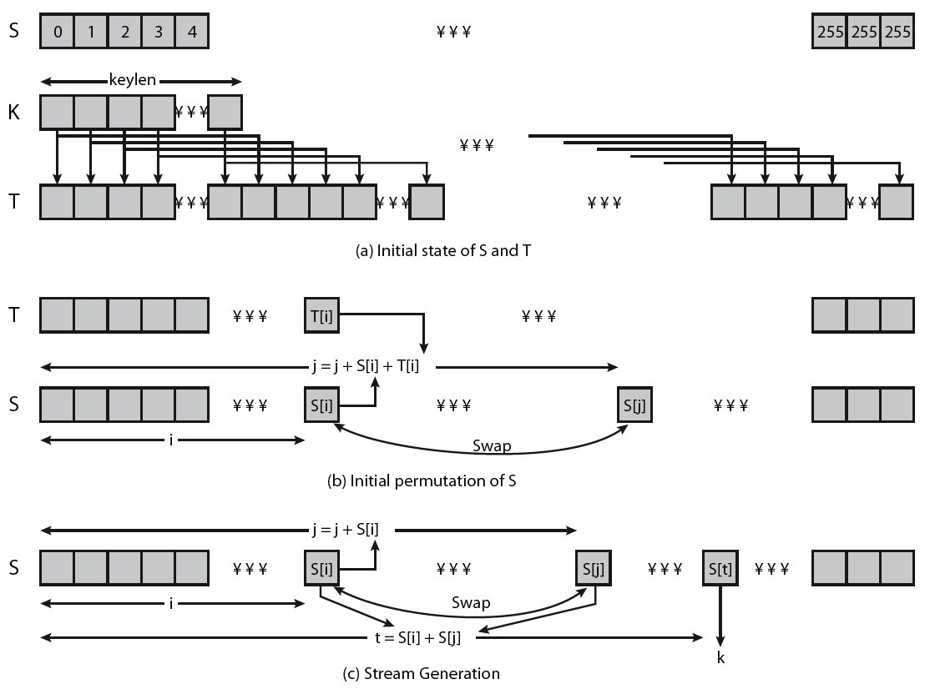
2. 对称密码
2.2 流密码：RC4算法
Final Review 胡海波
page<number>

Slide 34
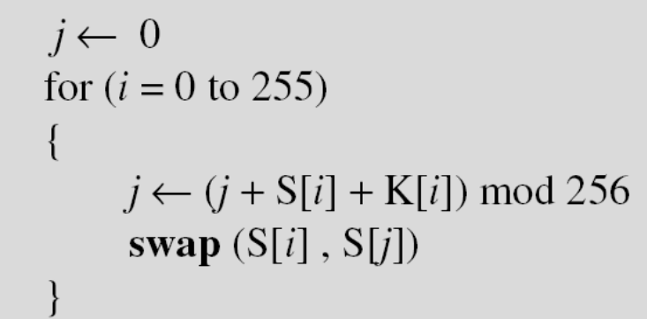
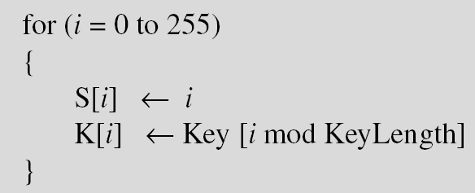
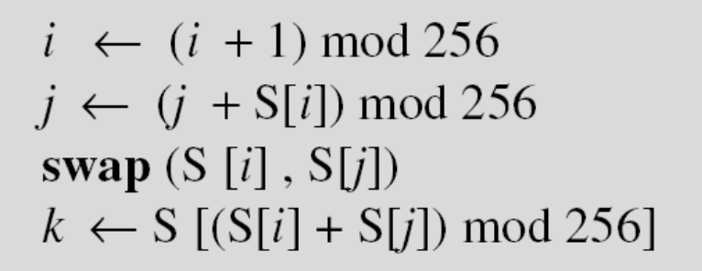
2. 对称密码
2.2 流密码：RC4算法
Initialization
Initialization is done in two steps:
Key Stream Generation
The keys in the key stream are generated, one by one.
Final Review 胡海波
page<number>

Slide 35

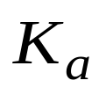
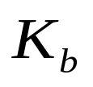
2. 对称密码
2.3 秘钥分配
Secret channel
Key Distribution Scenario: preconditions(前提)
Secret channel
KDC
A
B
A wishes to establish a logical connection with B
A requires a session key from KDC to protect the communication
A share a master key with KDC, B share with KDC
Final Review 胡海波
page<number>

Slide 36

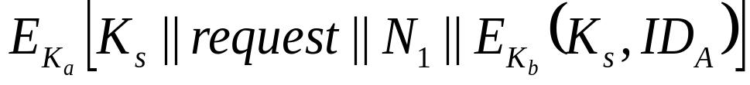
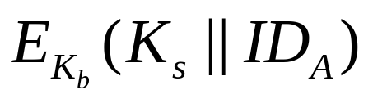

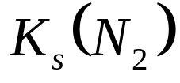
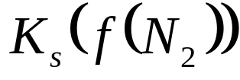
2. 对称密码
2.3 秘钥分配：KDC Scenario
KDC
1
2
A
B
A
4
5
6
Final Review 胡海波
page<number>

Slide 37
密码学原理及算法
1. 概述
2. 对称密码体系
3. 公钥密码体系
4. 密码散列函数
Final Review 胡海波
page<number>

Slide 38
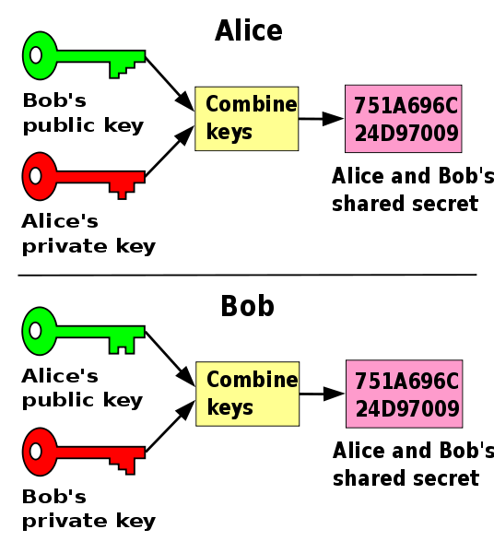
3. 公钥密码
3.1 Diffie-Hellman Key Exchange Scheme
Final Review 胡海波
page<number>

Slide 39
3. 公钥密码
3.1 Diffie-Hellman Key Exchange Scheme
Global Public Elements
Y：Y<P, Y是P的素数根
P：素数
For Alice
Selected private: A, ( A<P )
Calculate public α=Y^{A} mod P
For Bob
Selected private B, ( B<P )
Calculate public β=Y^{B} mod P
For Alice
Key= β^{A} mod P
For Bob
Key= α^{B} mod P
Final Review 胡海波
page<number>

Slide 40

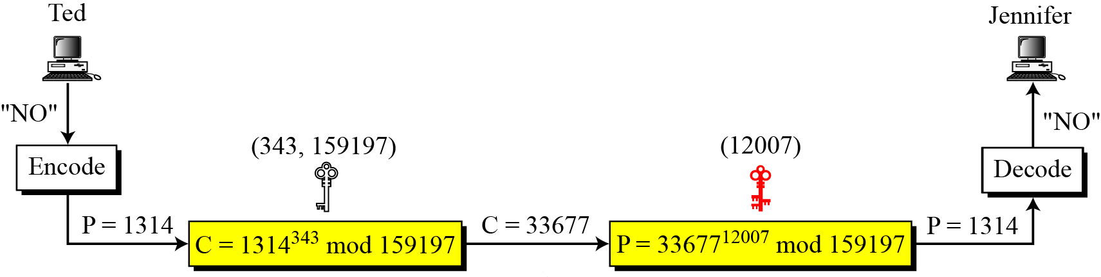
3. 公钥密码
3.2 RSA
Principles of RSA
For plaintext M and ciphertext C, assume that we can find integers e, d, and n such that:
Final Review 胡海波
page<number>

Slide 41



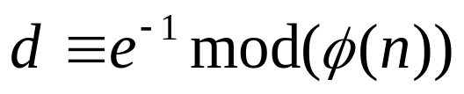
3. 公钥密码
3.2 RSA
Key Generation of RSA
1. Choose two (large) prime number p, q privately
2. Calculate
3. Choose e with
4. Calculate
5. Publicize {e,n} and keep d private
Final Review 胡海波
page<number>

Slide 42
密码学原理及算法
1. 概述
2. 对称密码体系
3. 公钥密码体系
4. 密码散列函数
Final Review 胡海波
page<number>

Slide 43
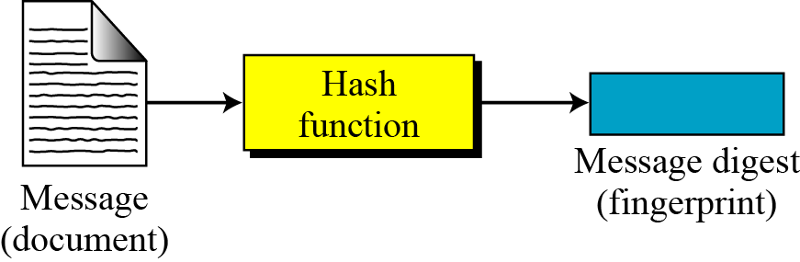
4.密码散列函数
Final Review 胡海波
page<number>

Slide 44

4.密码散列函数
消息鉴别
I
N
T
E
R
N
E
T
M
M
M
Hash
MD’
MD
MD
MD
Hash
Final Review 胡海波
page<number>

Slide 45




组合应用：PGP
N-bit
session
key
M
SHA-1
RSA
RSA
M
C
AES
Internet
RSA
C
N-bit
session
key
RSA
M
AES
SHA-1
Final Review 胡海波
page<number>

Slide 46
Q&A

