Slide 1
Lecture 14: Message Authentication Protocols
An Introduction to
Information Security
School of Software Engineering, CQU
Fall, 2014

Slide 2


Quickly Review
Lecture 11
Review of Security Services
Message Authentication(鉴别)
Message Authentication Code (MAC)
Cryptographic Hash Function
  Requirements of Hash Function
  MD5
  SHA
An Introduction to Information Security

Slide 3
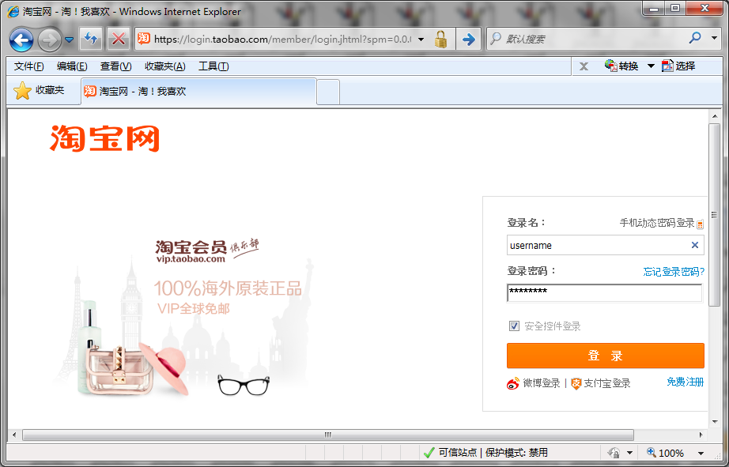


More Application of Hash Function
Password Protection
Server
User Table
Id1, user1, pass1
Id2, user2, pass2
Id3, user3, pass3
Id4, user4, pass4
…., ……., …...
An Introduction to Information Security

Slide 4
More Application of Hash Function
Password Protection
Server
张山
123456
Hash(password)
User Table
Id1, user1, #@&?
Id2, user2, *&|!%
Id3, user3, $^~}.
Id4, user4, %*!；
…., ……., …...
An Introduction to Information Security

Slide 5


Contents
1. Digital Signature
2. Authentication Protocols
3. Pretty Good Privacy
An Introduction to Information Security

Slide 6

Locations
Slides p7-15 are talking about digital signature issue which can be found in section 13.1 of the text book
An Introduction to Information Security

Slide 7
1.Digital Signature
A digital signature or digital signature scheme is a mathematical scheme for demonstrating the authenticity(真实性) of a digital message or document.
A valid digital signature gives a recipient reason to believe that the message was created by a known sender, and that it was not altered in transit.
Digital signatures are commonly used for software distribution, financial transactions, and in other cases where it is important to detect modification.
An Introduction to Information Security

Slide 8
1.Digital Signature
Requirements of Digital Signature Scheme
  Verify the author, date and time of the signature
  Authenticate the contents at the time of signature
  Be verifiable by third parties to resolve disputes
So as to:
  The signature must be a bit pattern that depends on the message being signed
  Use unique information of sender to prevent both forgery and denial
  Easy to be produced, recognized, and verified
  Infeasible to forge (伪造) a digital signature
  Practical for storage
An Introduction to Information Security

Slide 9
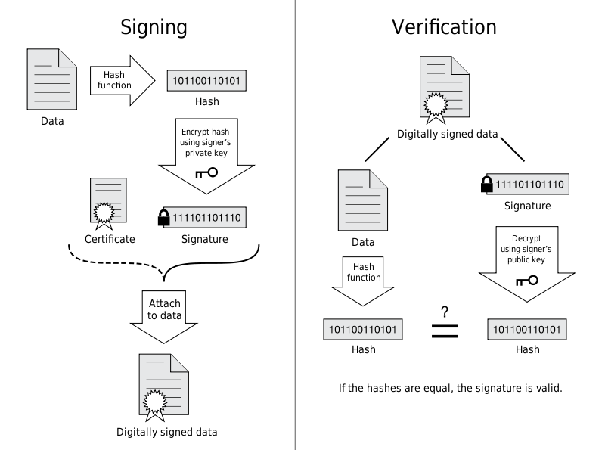
1.Digital Signature
An Introduction to Information Security

Slide 10
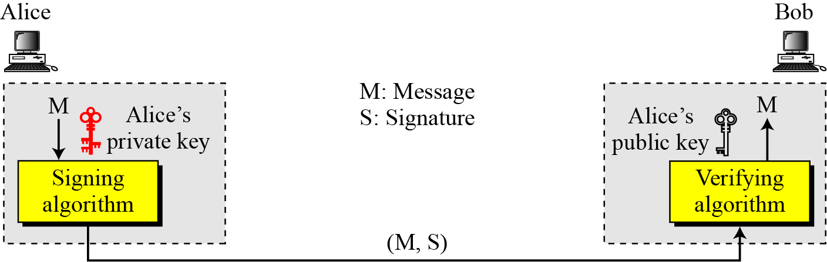

1.Digital Signature
Note
A digital signature needs a public-key system.
The signer signs with her private key; the verifier verifies with the signer’s public key.
An Introduction to Information Security

Slide 11
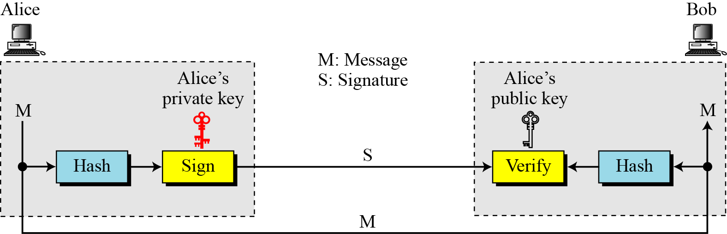
1.Digital Signature
Signing the digest
An Introduction to Information Security

Slide 12
1.Digital Signature
Digital Signature provide security services as:
    Message Authentication
    Message Integrity
    Non-repudiation
    Confidentiality
An Introduction to Information Security

Slide 13




1. Digital Signature
RSA Digital Signature Scheme
I
n
t
e
r
n
e
t
M
Hash
RSA
RSA
M
M
a
b
Hash
An Introduction to Information Security

Slide 14
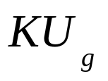
1. Digital Signature
DSS: Digital Signature Standards
I
n
t
e
r
n
e
t
r
Ver
M
H
Sig
r
s
r
s
M
M
r’
k
Random Number
H
An Introduction to Information Security

Slide 15
Contents
1. Digital Signature
2. Authentication Protocols
3. Pretty Good Privacy
An Introduction to Information Security

Slide 16
Locations
Slides p18-21 are talking about Authentication Protocols issue which can be found in section 14.1 of the text book
An Introduction to Information Security

Slide 17
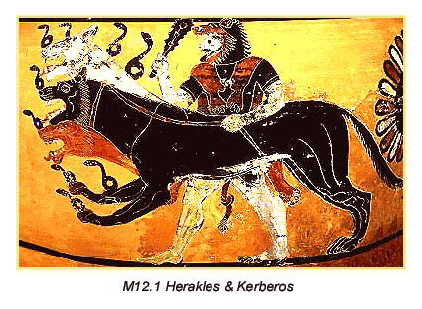
2. Authentication Protocols
Kerberos: Overview
  Kerberos (pronounced /kɛərbərəs/) is a computer network authentication protocol, which allows nodes communicating over a non-secure network to prove their identity to one another in a secure manner.
  It is also a suite of free software published by MIT that implements this protocol
  MIT developed Kerberos to protect network services provided by Project Athena
  Several versions of the protocol exist; versions 1-3 occurred only internally at MIT.
  version 4 was published in the late 1980s
  version 5 appeared as RFC 1510 in 1993
An Introduction to Information Security

Slide 18









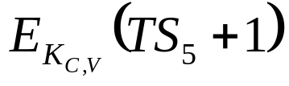
2. Authentication Protocols
Kerberos v4
AS: Authentication Server
E(K_{AS,C}, (K_{C,TGS} || ID_{TGS} || ID_{tgs}|| TS2 || Lifetime2 || Ticket_{TGS}
2
ID_{c} || ID_{tgs}|| TS1
1
3
4
TGS: Ticket Granting Server
5
C: Client
6
V: Application Server
An Introduction to Information Security

Slide 19
2. Authentication Protocols
Kerberos: Realms
A full-service Kerberos environment consisting of
a Kerberos server
a number of clients
a number of application servers
This Kerberos environment requires that
the Kerberos server must have the user’s ID & user’s password
the Kerberos server must share a secret key with each server.
Such an environment is referred
to as a realm
An Introduction to Information Security

Slide 20
2. Authentication Protocols
X.509
  X.509 is an ITU-T(国际电信联盟) standard for a public key infrastructure(公钥基础设施) (PKI) for single sign-on (SSO) and Privilege(权益) Management Infrastructure (PMI).
  X.509 specifies, amongst other things, standard formats for public key certificates(证书), certificate revocation(撤回) lists, attribute certificates, and a certification path validation(确认) algorithm.
  For details of X.509, please refer to Section 14.2 or wikipedia
An Introduction to Information Security

Slide 21
Contents
1. Digital Signature
2. Authentication Protocols
3. Pretty Good Privacy
An Introduction to Information Security

Slide 22
Locations
Slides p24-28 are talking about PGP issue which can be found in section 15.1 of the text book
An Introduction to Information Security

Slide 23
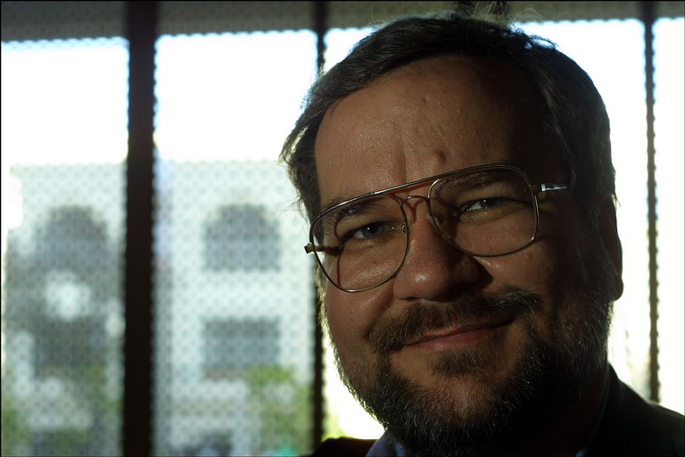
3. Pretty Good Privacy
Pretty Good Privacy (PGP) is a computer program that provides cryptographic privacy and authentication.
PGP is often used for signing, encrypting and decrypting e-mails to increase the security of e-mail communications.
It was created by Philip Zimmermann in 1991.
PGP and other similar products follow the OpenPGP standard (RFC 4880) for encrypting and decrypting data.
Philip Zimmerman
An Introduction to Information Security

Slide 24


3. Pretty Good Privacy
Authentication using PGP
I
n
t
e
r
n
e
t
M
SHA-1
RSA
RSA
M
M
SHA-1
An Introduction to Information Security

Slide 25

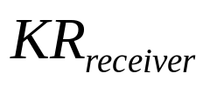
3. Pretty Good Privacy
Confidentiality using PGP
N-bit
session
key
I
n
t
e
r
n
e
t
RSA
RSA
M
M
C
C
N-bit
session
key
AES
AES
An Introduction to Information Security

Slide 26
3. Pretty Good Privacy
N-bit
session
key
M
SHA-1
RSA
RSA
M
C
AES
Internet
RSA
C
N-bit
session
key
RSA
M
AES
SHA-1
An Introduction to Information Security

Slide 27
3. Pretty Good Privacy
For more detail about PGP, please refer to Chapter 15 of wikipedia
An Introduction to Information Security

Slide 28
Lecture 10: Public Key Cryptography-RSA
Summary
Digital Signature
Authentication Protocol
    Kerberos
Pretty Good Privacy
An Introduction to Information Security

Slide 29

An Introduction to
Information Security
Thanks for your attention!
Q&A

