Slide 1
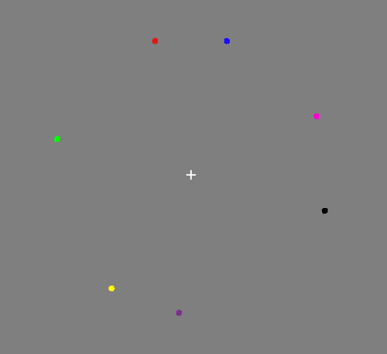
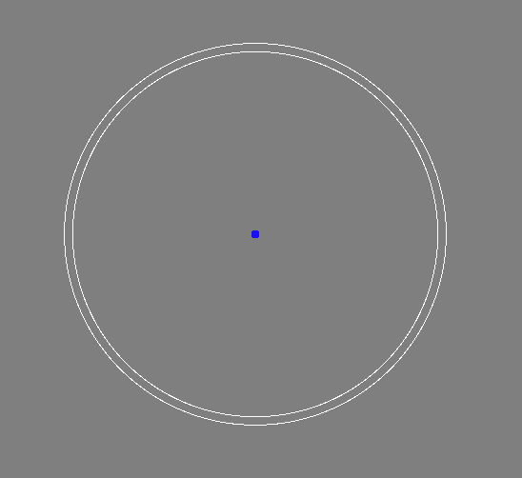
1/3/5/7 dots with different colors
ITI 0.5s
Sample 0.2s
Delay 3 / 4 / 5s
Until response
~ 7s / trial
Run 1
…
Run 5
~ 50min-60min / day
80 trials / run, 5 runs / day
Day 1
Day 2
Day 3
Day 4
Day 5
Pre-test
Post-test
Group 1: Anodal (offline) + training
Group 2: Sham (offline) + training

Slide 2
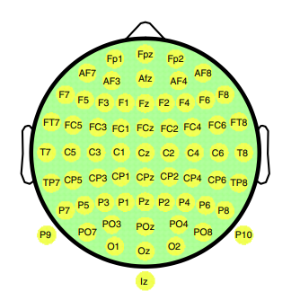
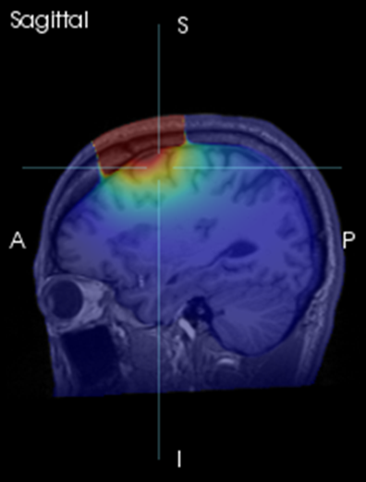
tDCS day
20min tDCS
Training
H1. Anodal (precision ss=1/3 ) ↓ ;
H2. Anodal (capacity ss=5/7 ) ↑;
H3. Anodal to enhance learning ability;

