Slide 1
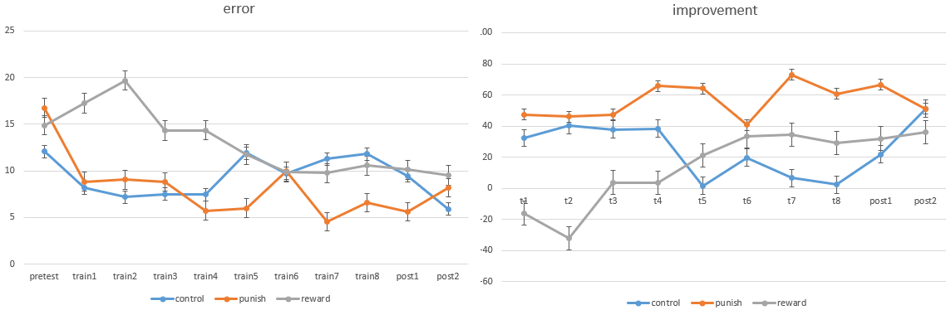
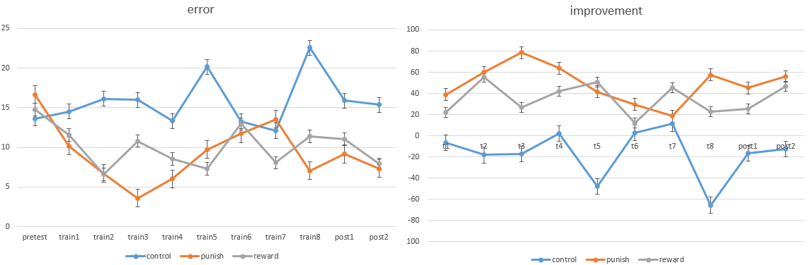
Error = 3 / 5 / 7 single subject
czd
dwx

Slide 2
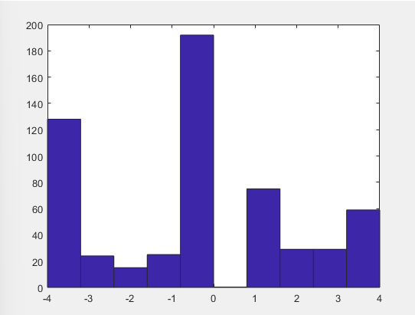
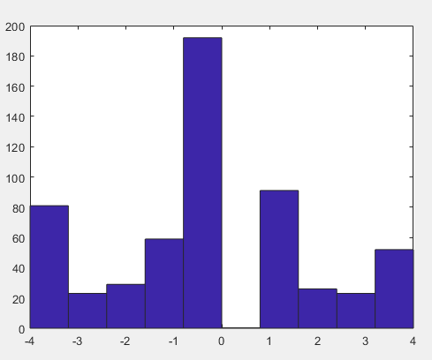
Error = 3 / 5 / 7 single subject
czd
dwx
Value Count Percent
-4 128 22.22%
-3 24 4.17%
-2 15 2.60%
-1 25 4.34%
1 75 13.02%
2 29 5.03%
3 29 5.03%
4 59 10.24%
Value Count Percent
-4 81 14.06%
-3 23 3.99%
-2 29 5.03%
-1 59 10.24%
1 91 15.80%
2 26 4.51%
3 23 3.99%
4 52 9.03%

Slide 3
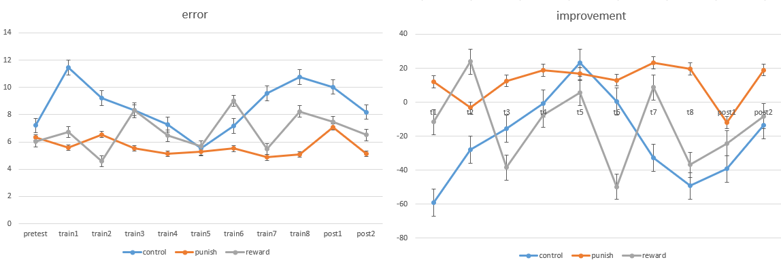
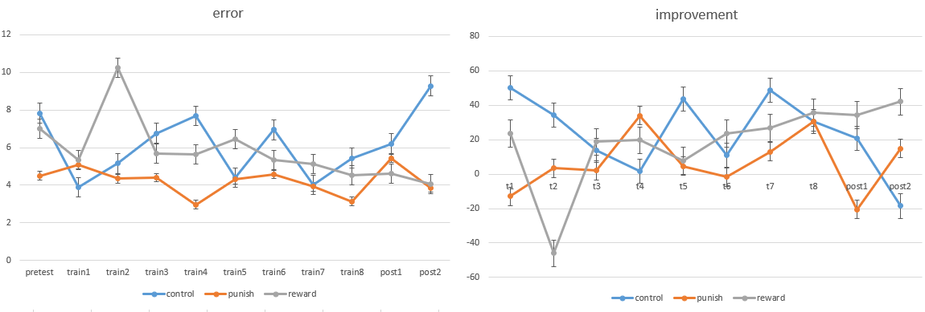
Error = 3 / 5 / 7 single subject
lt
qxy

Slide 4
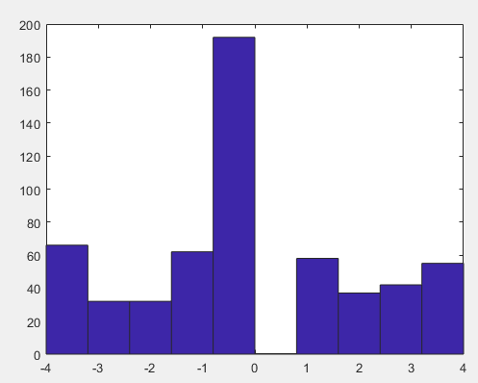
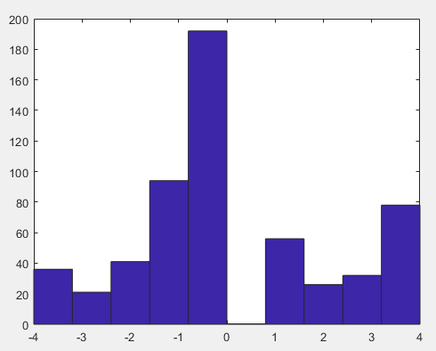
Error = 3 / 5 / 7 single subject
lt
qxy
Value Count Percent
-4 66 11.46%
-3 32 5.56%
-2 32 5.56%
-1 62 10.76%
1 58 10.07%
2 37 6.42%
3 42 7.29%
4 55 9.55%
Value Count Percent
-4 36 6.25%
-3 21 3.65%
-2 41 7.12%
-1 94 16.32%
1 56 9.72%
2 26 4.51%
3 32 5.56%
4 78 13.54%

Slide 5
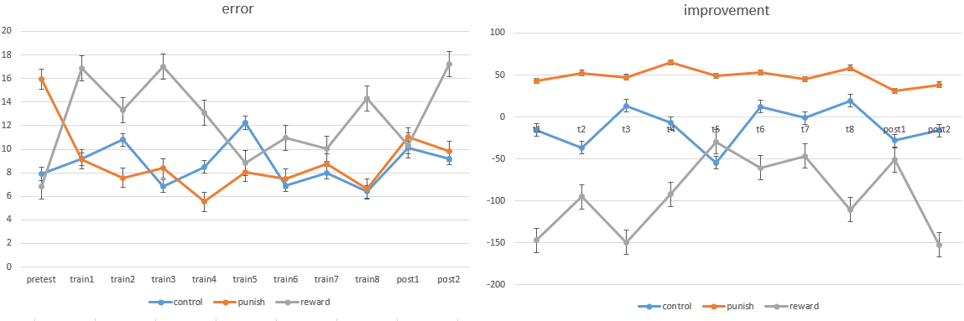
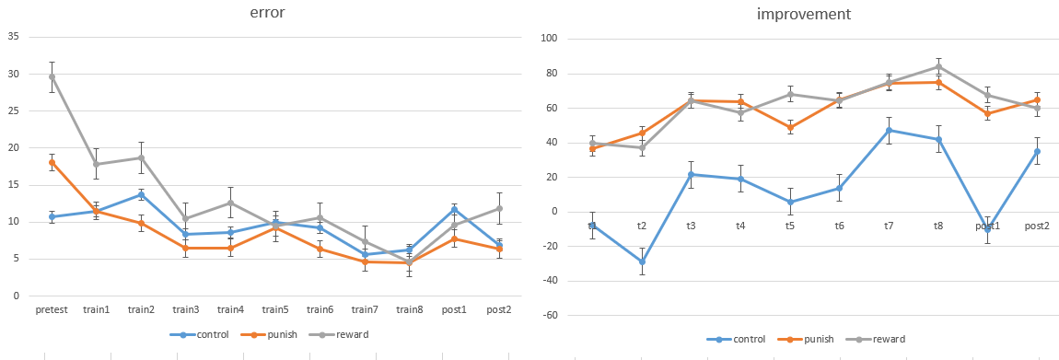
Error = 3 / 5 / 7 single subject
zrj
zzf

Slide 6
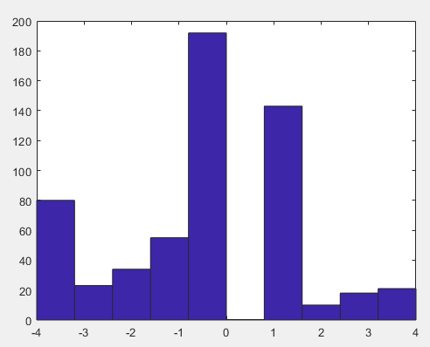
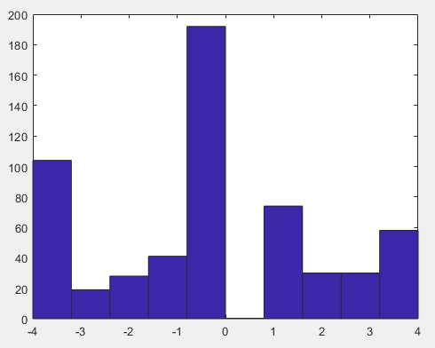
Error = 3 / 5 / 7 single subject
zrj
zzf
Value Count Percent
-4 36 6.25%
-3 21 3.65%
-2 41 7.12%
-1 94 16.32%
1 56 9.72%
2 26 4.51%
3 32 5.56%
4 78 13.54%
Value Count Percent
-4 104 18.06%
-3 19 3.30%
-2 28 4.86%
-1 41 7.12%
1 74 12.85%
2 30 5.21%
3 30 5.21%
4 58 10.07%

Slide 7
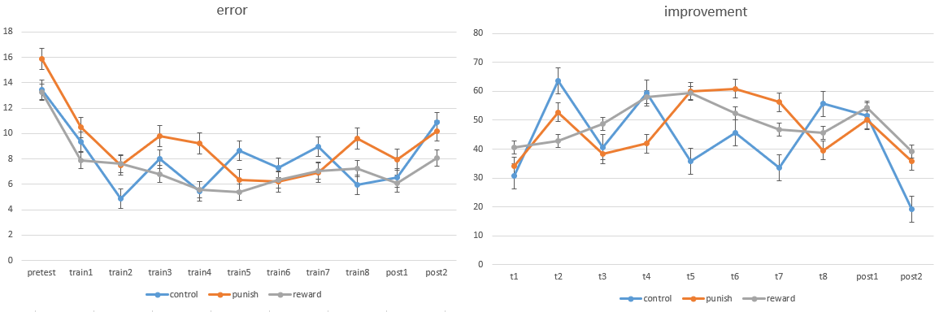
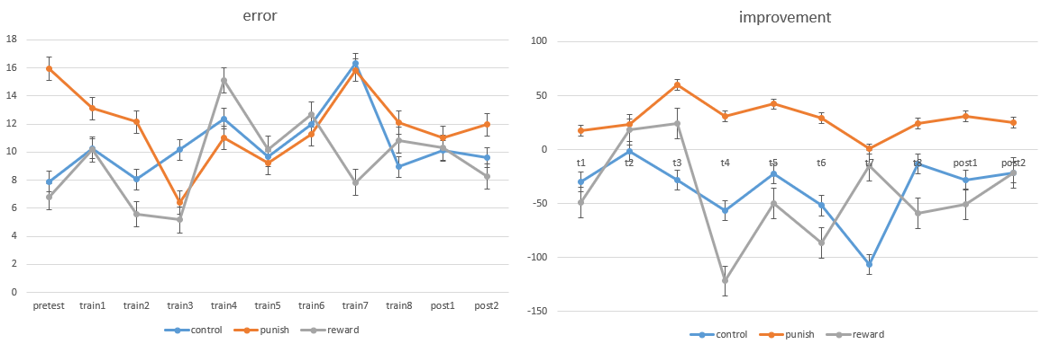
Error = 3 / 5 / 7 single subject
hwy
jyl

Slide 8
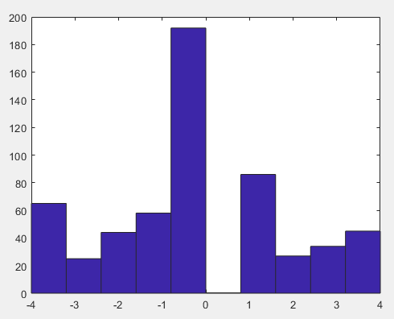
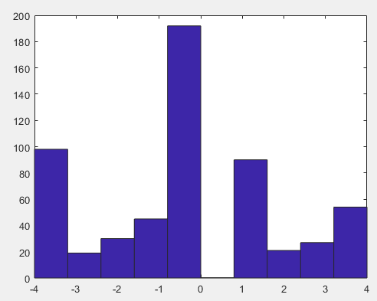
Error = 3 / 5 / 7 single subject
hwy
jyl
Value Count Percent
-4 65 11.28%
-3 25 4.34%
-2 44 7.64%
-1 58 10.07%
1 86 14.93%
2 27 4.69%
3 34 5.90%
4 45 7.81%
Value Count Percent
-4 98 17.01%
-3 19 3.30%
-2 30 5.21%
-1 45 7.81%
1 90 15.62%
2 21 3.65%
3 27 4.69%
4 54 9.38%

Slide 9
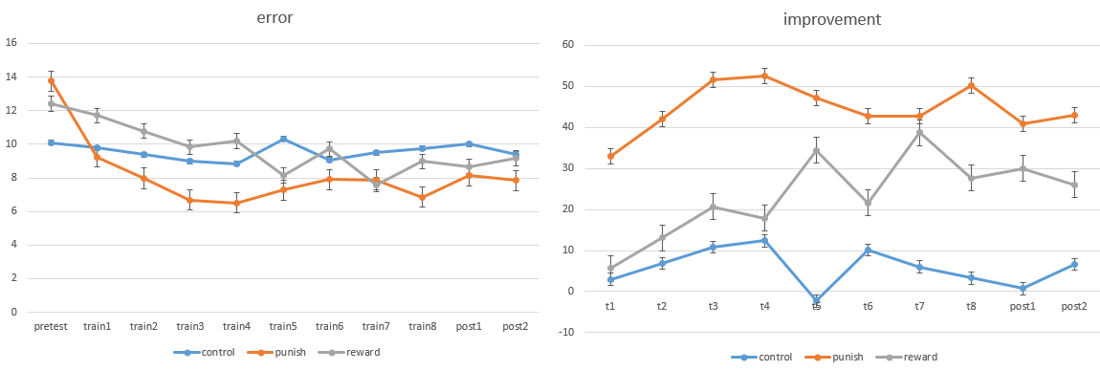
Error = 3 / 5 / 7

Slide 10
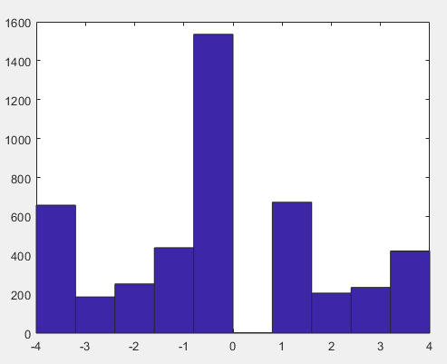
Error = 3 / 5 / 7
Value Count Percent
-4 658 14.28%
-3 186 4.04%
-2 253 5.49%
-1 439 9.53%
0 1536 33.33%
1 673 14.61%
2 206 4.47%
3 235 5.10%
4 422 9.16%

Slide 11
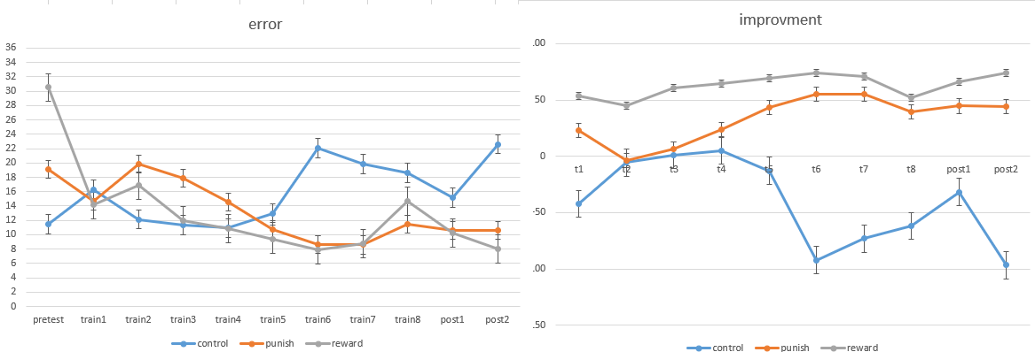
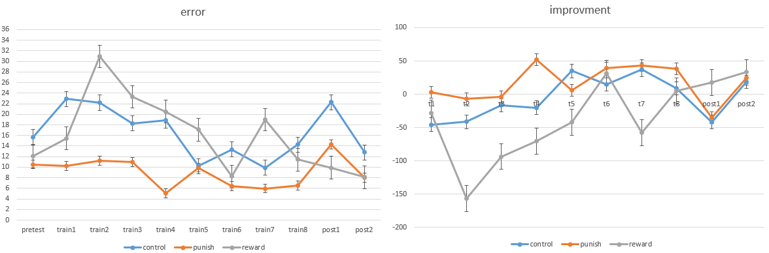
Error = 0.6mean / 0.8mean / mean single subject
czn
dzy

Slide 12
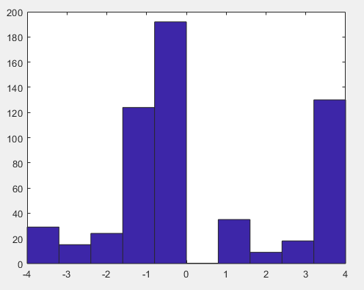
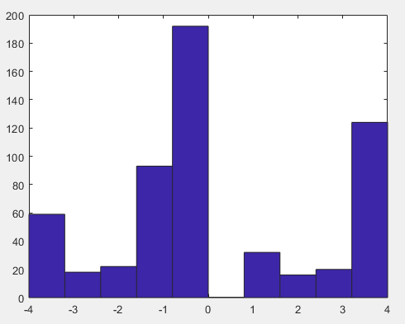
Error = 0.6mean / 0.8mean / mean single subject
czn
dzy
Value Count Percent
-4 29 5.03%
-3 15 2.60%
-2 24 4.17%
-1 124 21.53%
1 35 6.08%
2 9 1.56%
3 18 3.12%
4 130 22.57%
Value Count Percent
-4 59 10.24%
-3 18 3.12%
-2 22 3.82%
-1 93 16.15%
1 32 5.56%
2 16 2.78%
3 20 3.47%
4 124 21.53%

Slide 13
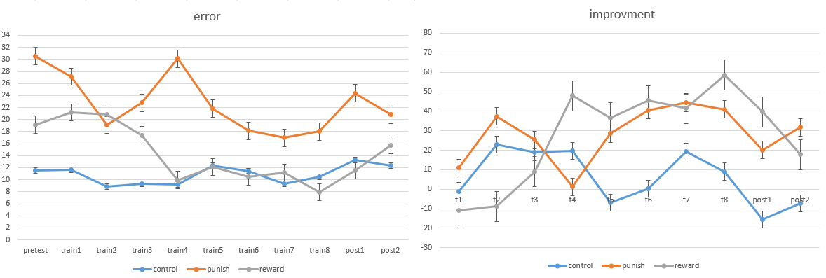
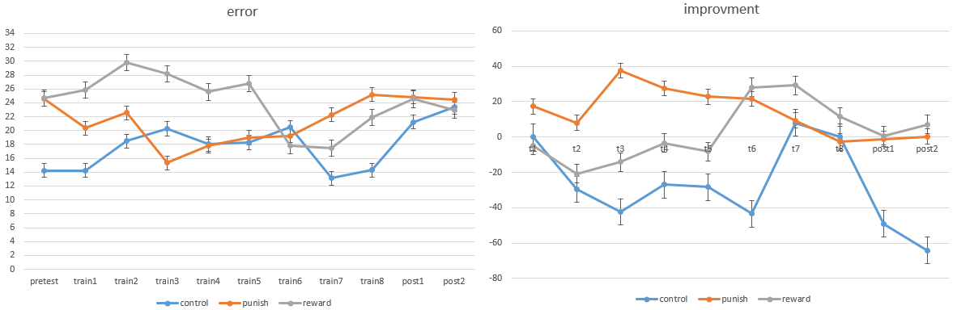
Error = 0.6mean / 0.8mean / mean single subject
hxj
ljy

Slide 14
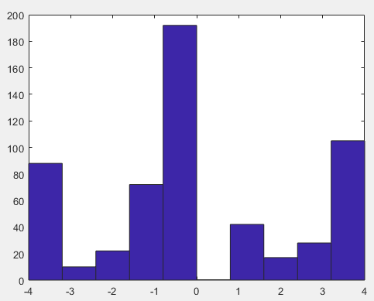
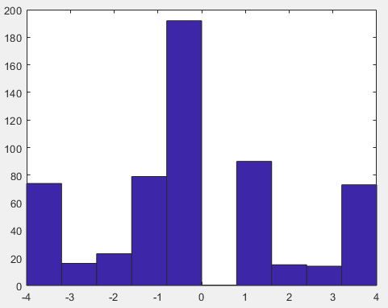
Error = 0.6mean / 0.8mean / mean single subject
hxj
ljy
Value Count Percent
-4 88 15.28%
-3 10 1.74%
-2 22 3.82%
-1 72 12.50%
1 42 7.29%
2 17 2.95%
3 28 4.86%
4 105 18.23%
Value Count Percent
-4 74 12.85%
-3 16 2.78%
-2 23 3.99%
-1 79 13.72%
1 90 15.62%
2 15 2.60%
3 14 2.43%
4 73 12.67%

Slide 15
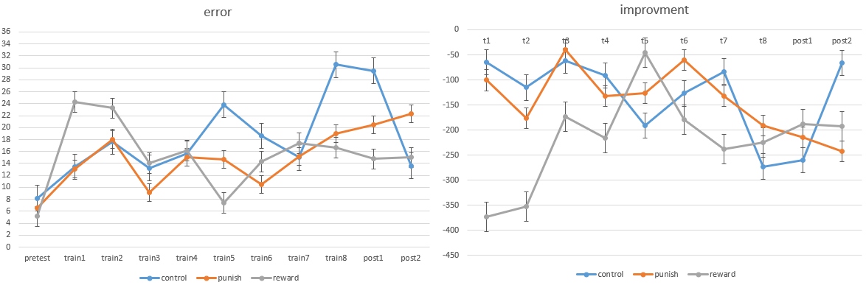
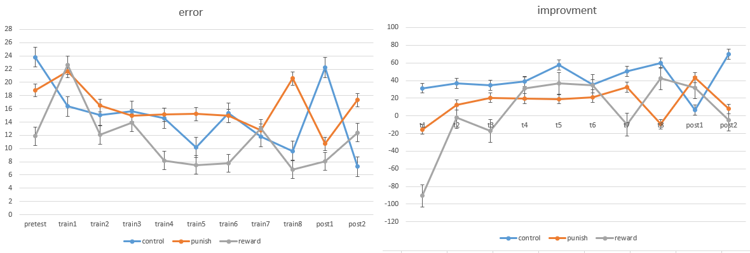
Error = 0.6mean / 0.8mean / mean single subject
ay
ljh

Slide 16
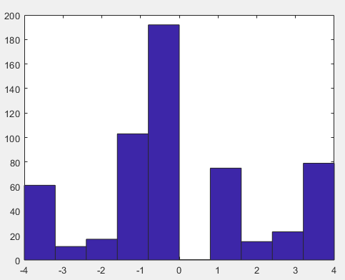
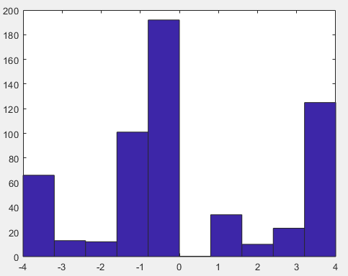
Error = 0.6mean / 0.8mean / mean single subject
ay
ljh
Value Count Percent
-4 74 12.85%
-3 16 2.78%
-2 23 3.99%
-1 79 13.72%
1 90 15.62%
2 15 2.60%
3 14 2.43%
4 73 12.67%
Value Count Percent
-4 66 11.46%
-3 13 2.26%
-2 12 2.08%
-1 101 17.53%
1 34 5.90%
2 10 1.74%
3 23 3.99%
4 125 21.70%

Slide 17
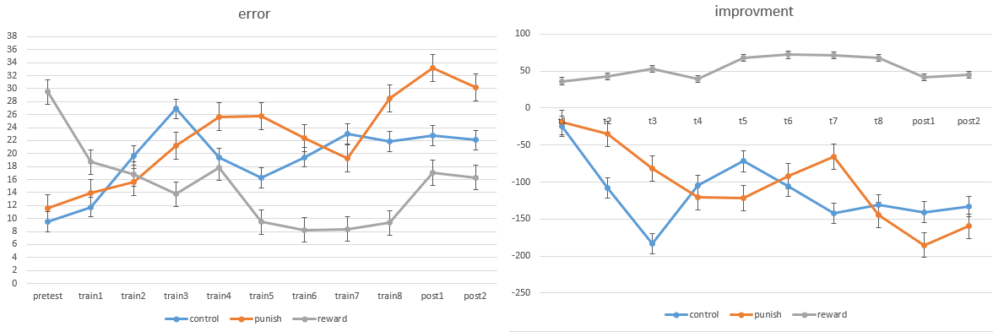
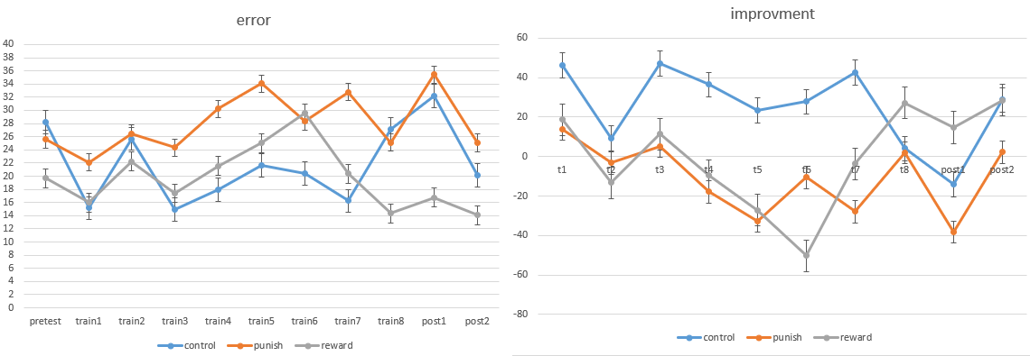
Error = 0.6mean / 0.8mean / mean single subject
whq
zyx

Slide 18
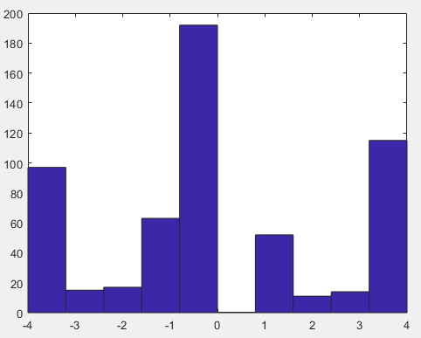
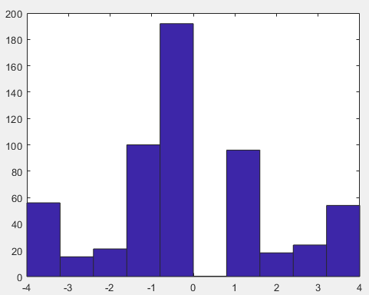
Error = 0.6mean / 0.8mean / mean single subject
whq
zyx
Value Count Percent
-4 97 16.84%
-3 15 2.60%
-2 17 2.95%
-1 63 10.94%
1 52 9.03%
2 11 1.91%
3 14 2.43%
4 115 19.97%
Value Count Percent
-4 56 9.72%
-3 15 2.60%
-2 21 3.65%
-1 100 17.36%
1 96 16.67%
2 18 3.12%
3 24 4.17%
4 54 9.38%

Slide 19
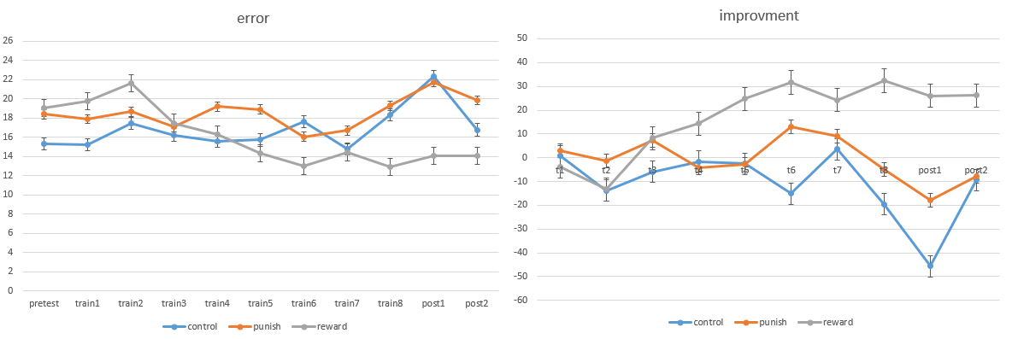
Error = 0.6mean / 0.8mean / mean

Slide 20
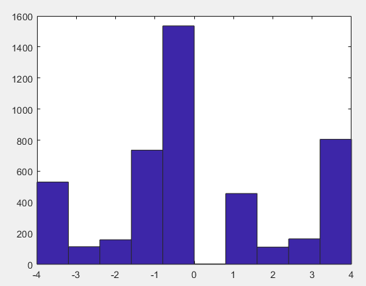
Error = 0.6mean / 0.8mean / mean
Value Count Percent
-4 530 11.50%
-3 113 2.45%
-2 158 3.43%
-1 735 15.95%
0 1536 33.33%
1 456 9.90%
2 111 2.41%
3 164 3.56%
4 805 17.47%

