Slide 1
Movie Rating Prediction Model
BIA660 Web Mining
Group 6
Yunfeng Liu
Linli Tang
Yanyan Jiang
Minghui Jin
Dec 3,2018

Slide 2
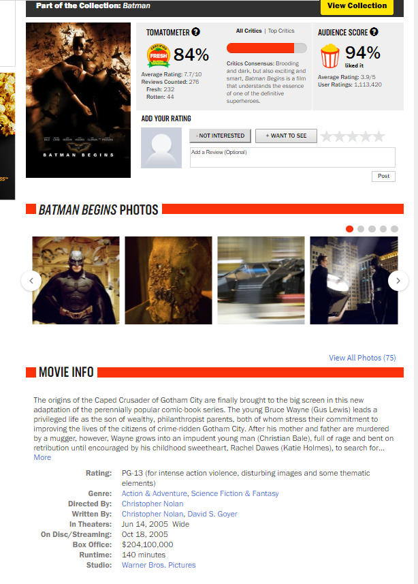
Project Objects
What to predict？
Whether a movie is more welcomed by critics or audiences
How to predict?
Movie information which is available when the movie releases

Slide 3
Data Scraping
Source of data: https://www.rottentomatoes.com
Scrape movie links according to category
Delete repeated movies
Output movie_link.txt
Scrape movie information by visiting each link
Scrape director, writer, actors information by visiting their links in movie information
Output movie_info.txt

Slide 4
Variable Selection
Variable | Description
Runtime | Movie runtime in minutes
Rating | Indicate restriction level: G PG PG13 NR R NC17
Genre | Indicate genre of the movie: action animation etc
Director | Median score of the movies shot by the director
Writer | Median score of the movie written by the writer
Actor | Weighted average of the median scores of the movies cast by 1 to 4 main actors
Studio | 1-3 tier of the studio representing the percentage among 1500 studios in terms of movies amounts
Theater | In theater information about when and how is the movie release in theater

Slide 5
Data Processing
Data Cleaning Process | Rows of data
Data scraping | 15193
Delete unavailable movies(link error or blank) | 15136
Critic or audience score is missing | 15050
Critic and audience score difference is not obvious(<5%） | 12236
Delete movies not in theatre(theatre information missing) | 11768

Slide 6
Missing Value Processing Data scale:11768
Variable | NA amounts | NA processing
Runtime | 100 | Replaced by median of runtime,99
Director | 110 | Replaced by median of director score,66
Writer | 992 | Replaced by median of writer score,63
Actor | 214 | Replaced by 0 meaning no actors
Studio | 5518 | Replaced by 0 treated as infamous studio

Slide 7
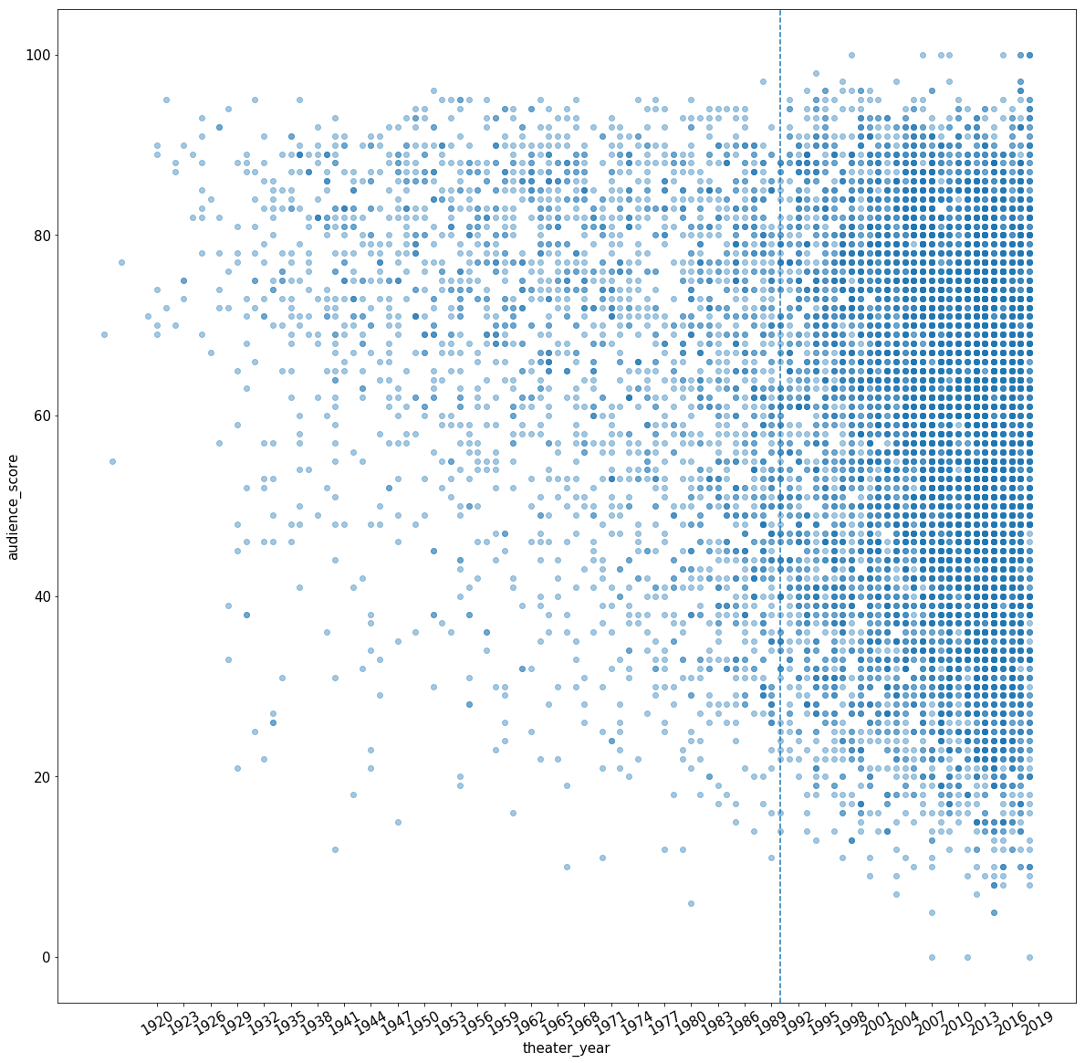
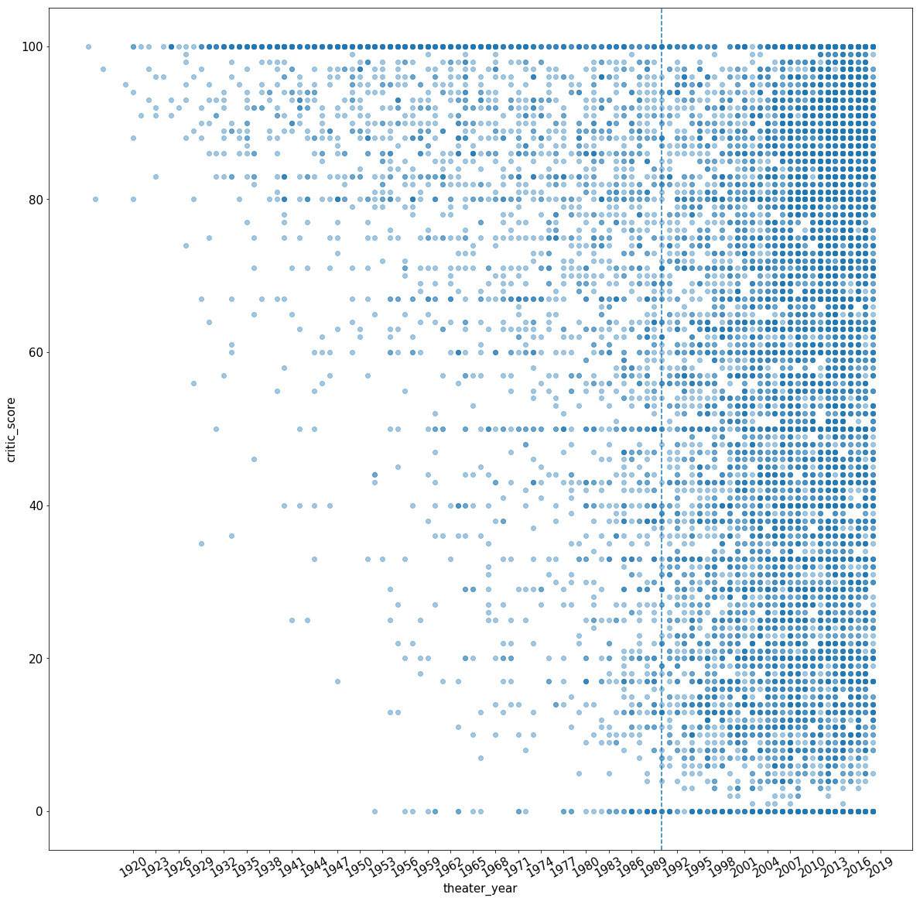
EDA - Theater year
Audience Score
Critic Score

Slide 8
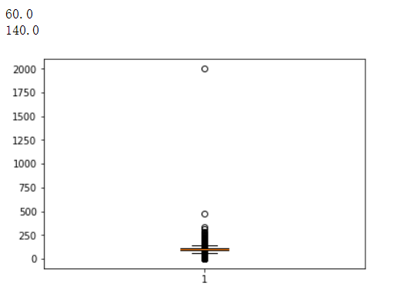
EDA - Runtime outliers
Notes:
boxplot

Slide 9
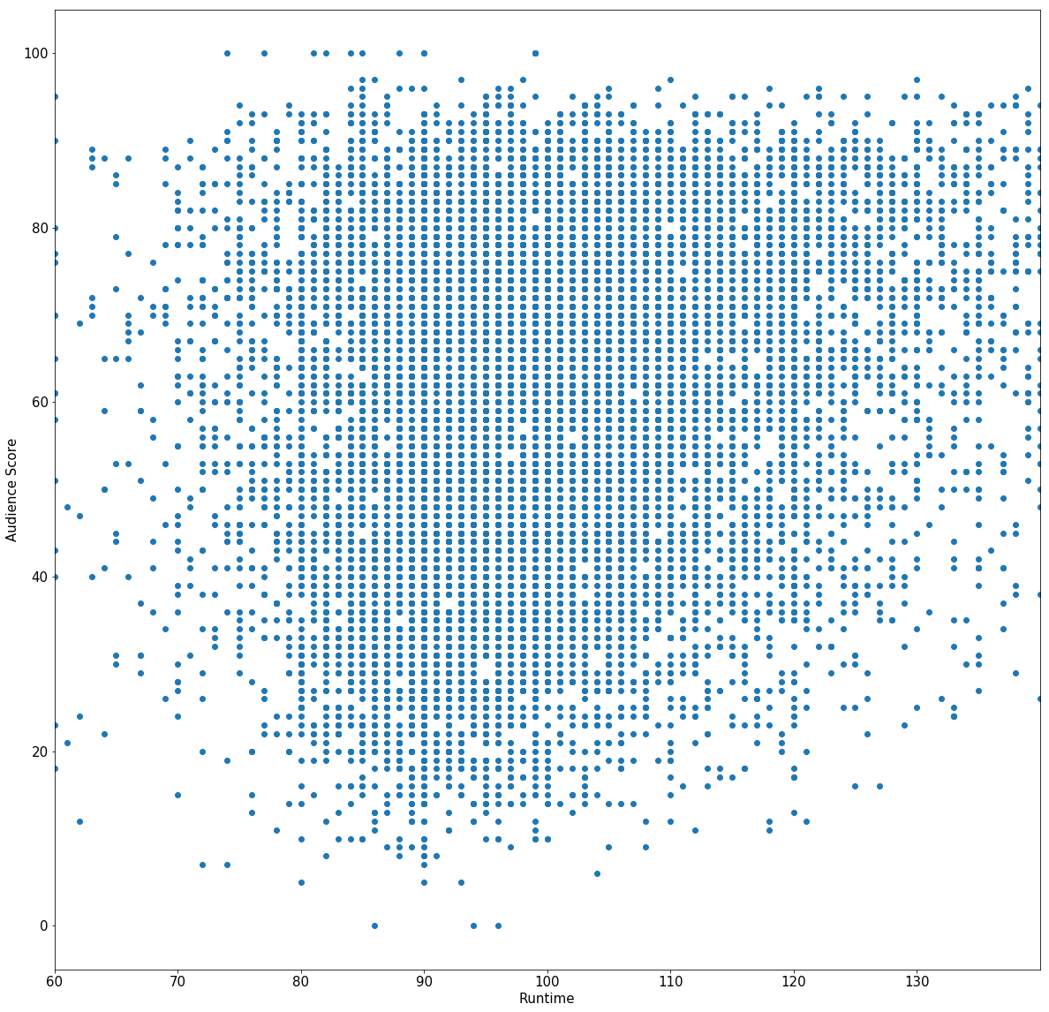
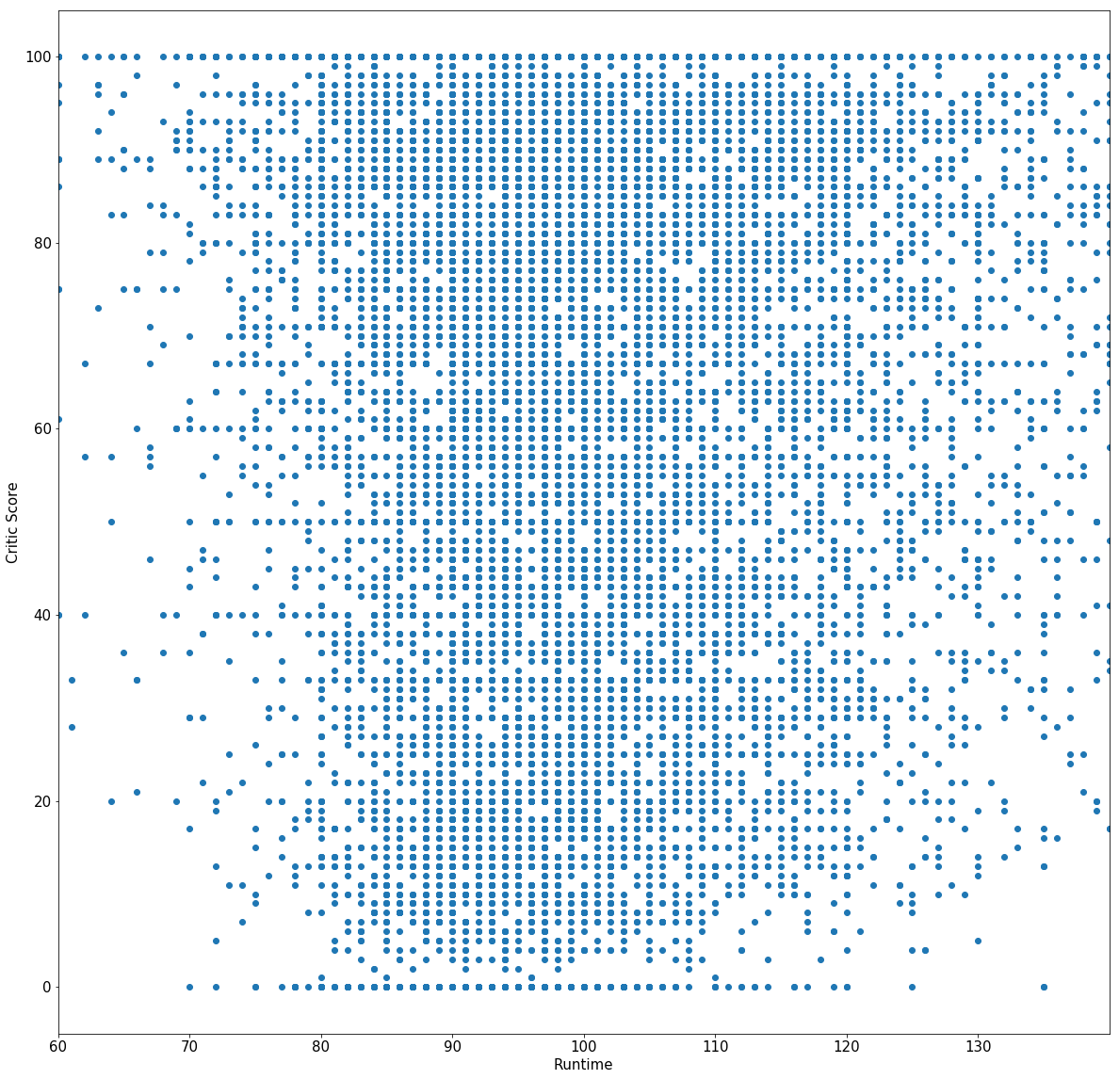
EDA - Runtime
Audience Score
Critic Score
Notes:
runtime

Slide 10
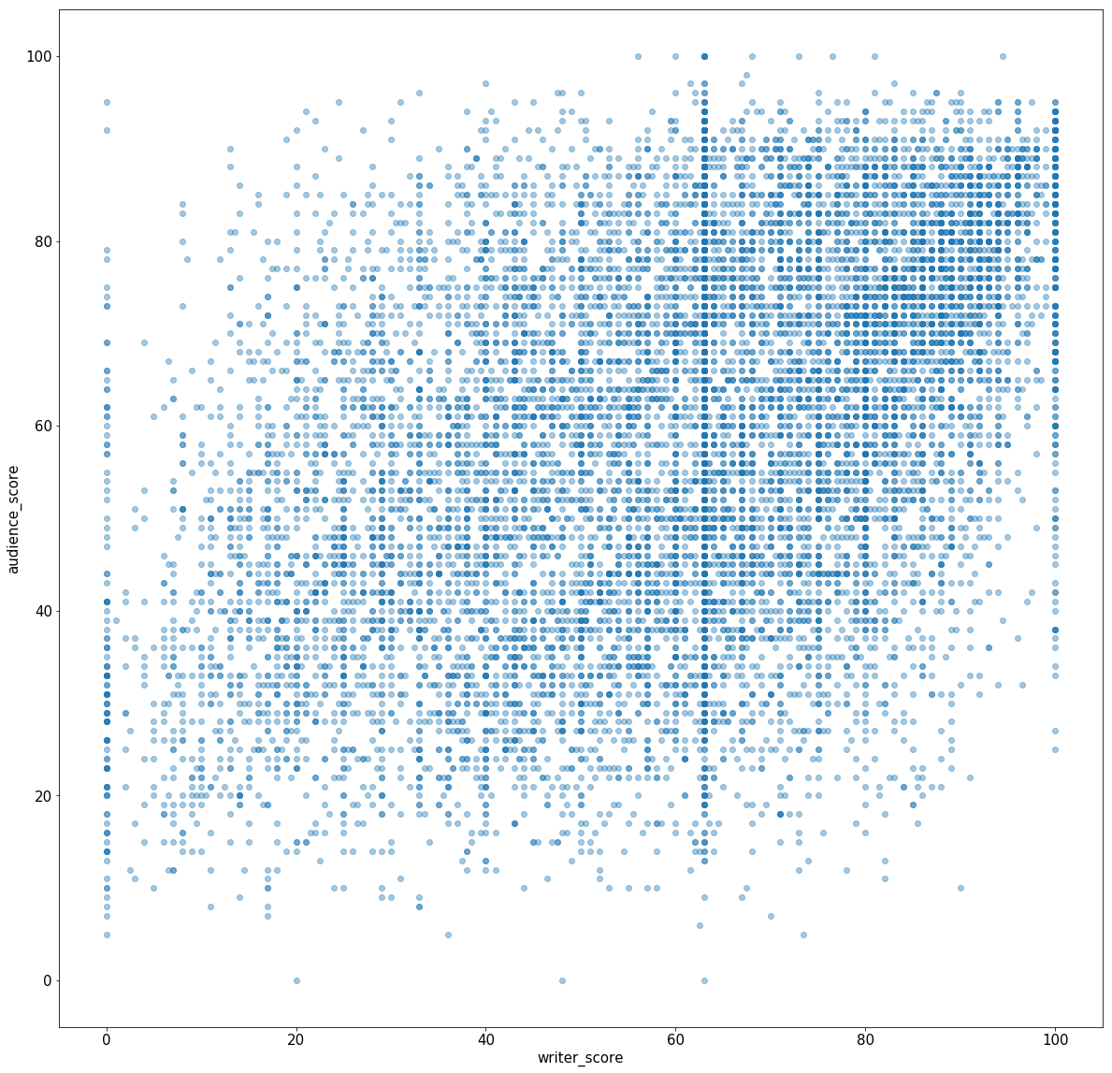
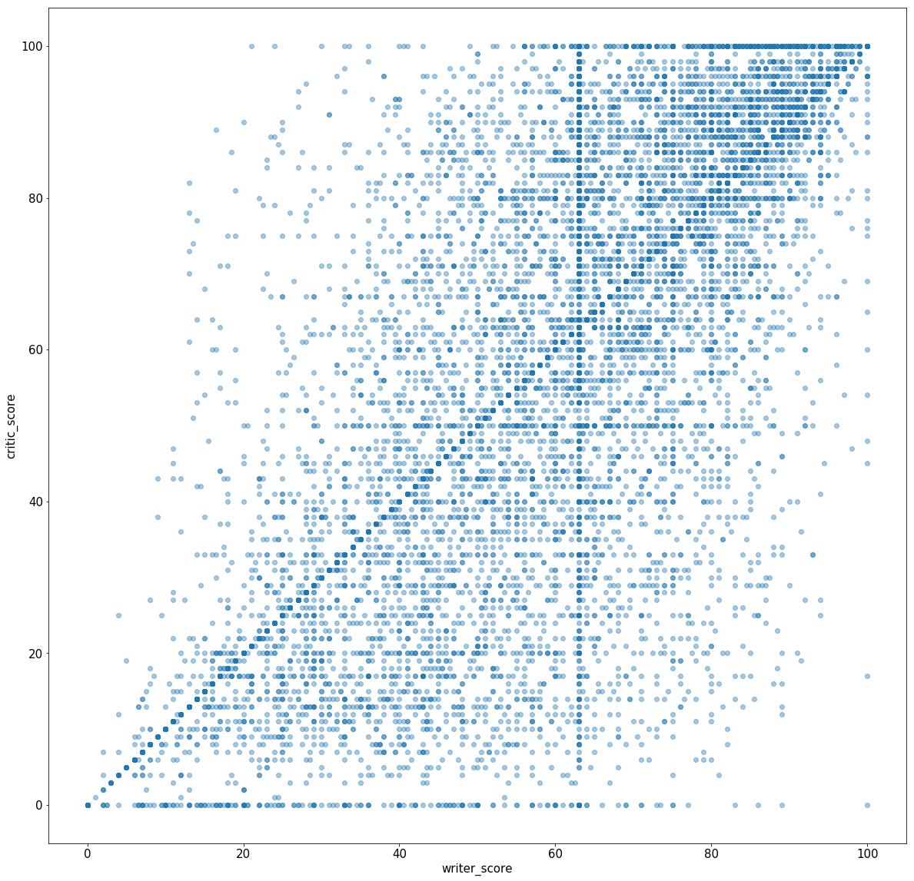
EDA - Writer score
Audience Score
Critic Score
Notes:
w score

Slide 11
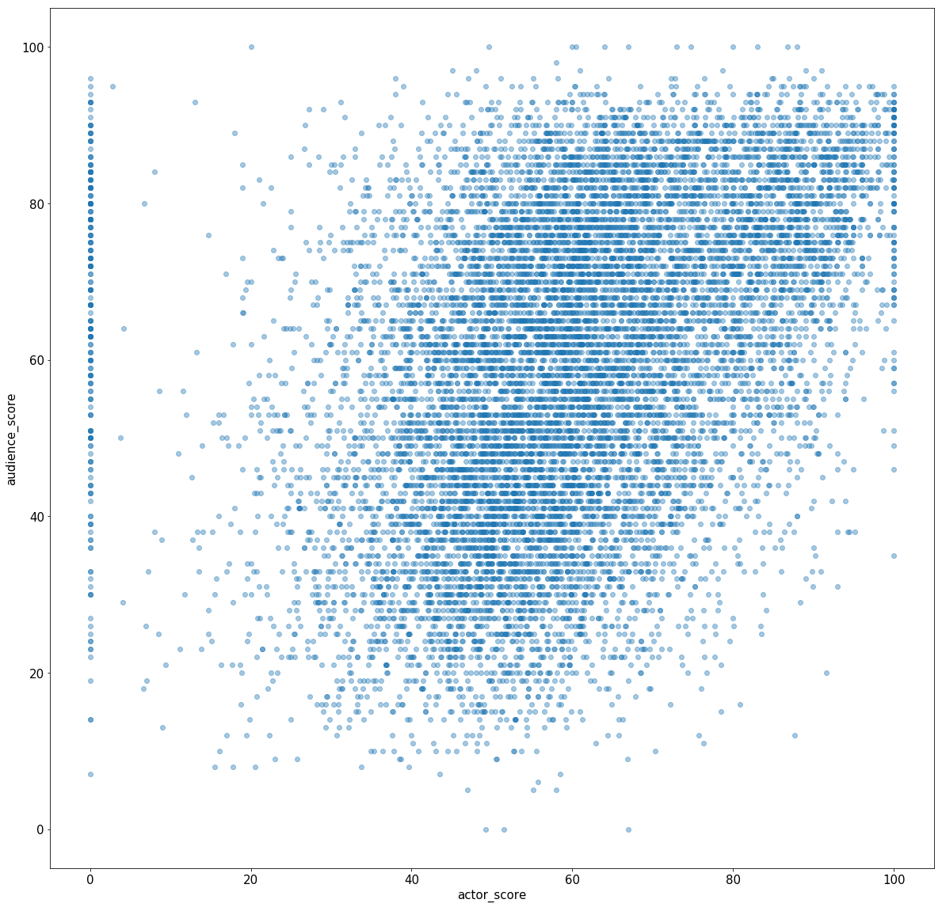
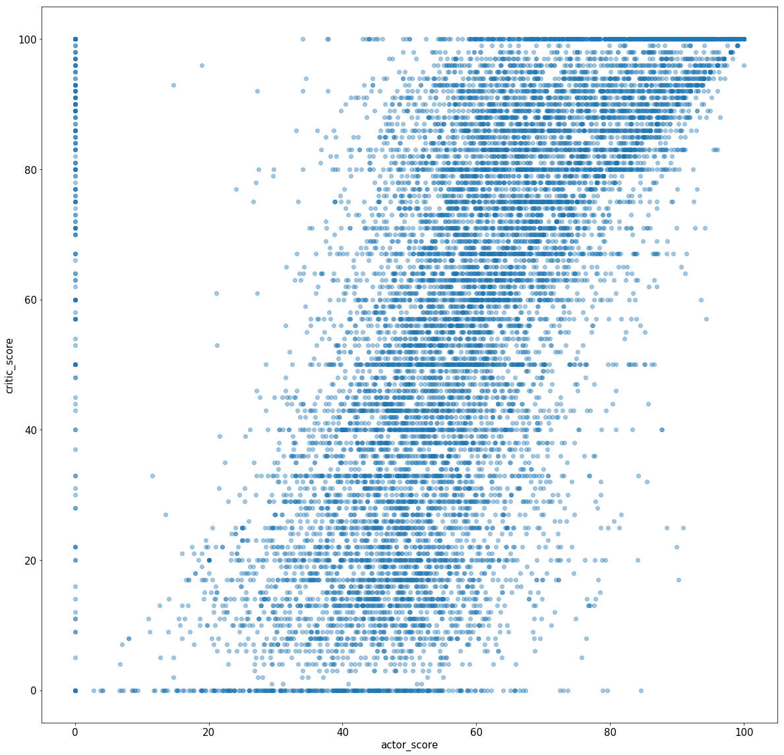
EDA - Actor score
Audience Score
Critic Score
Notes:
a score

Slide 12
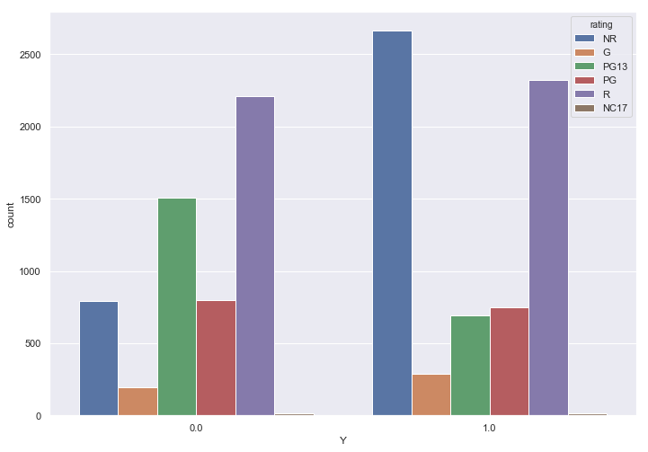
EDA - Rating

Slide 13
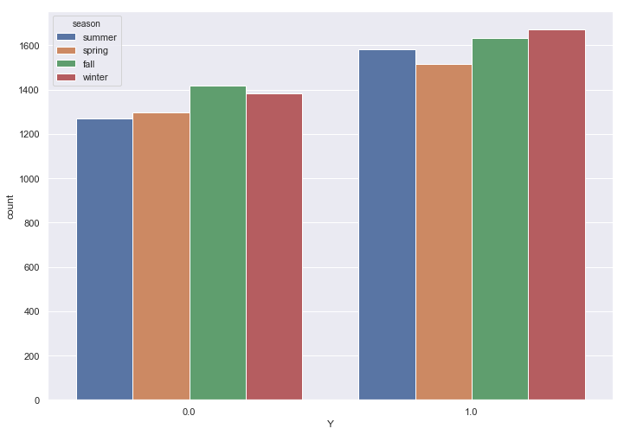
EDA - Season
Notes:
season
rating

Slide 14
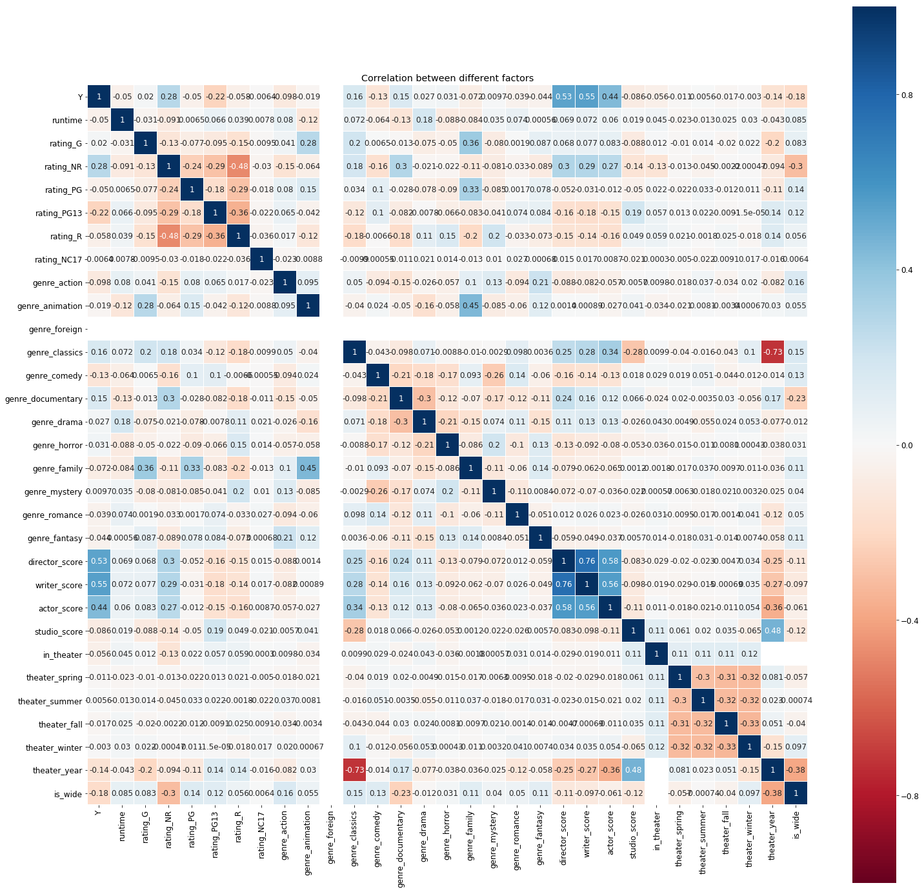
EDA - Correlation
Notes:
heatmap

Slide 15
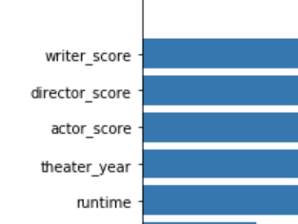
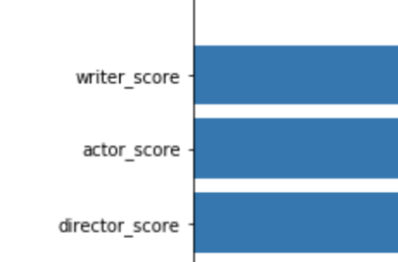
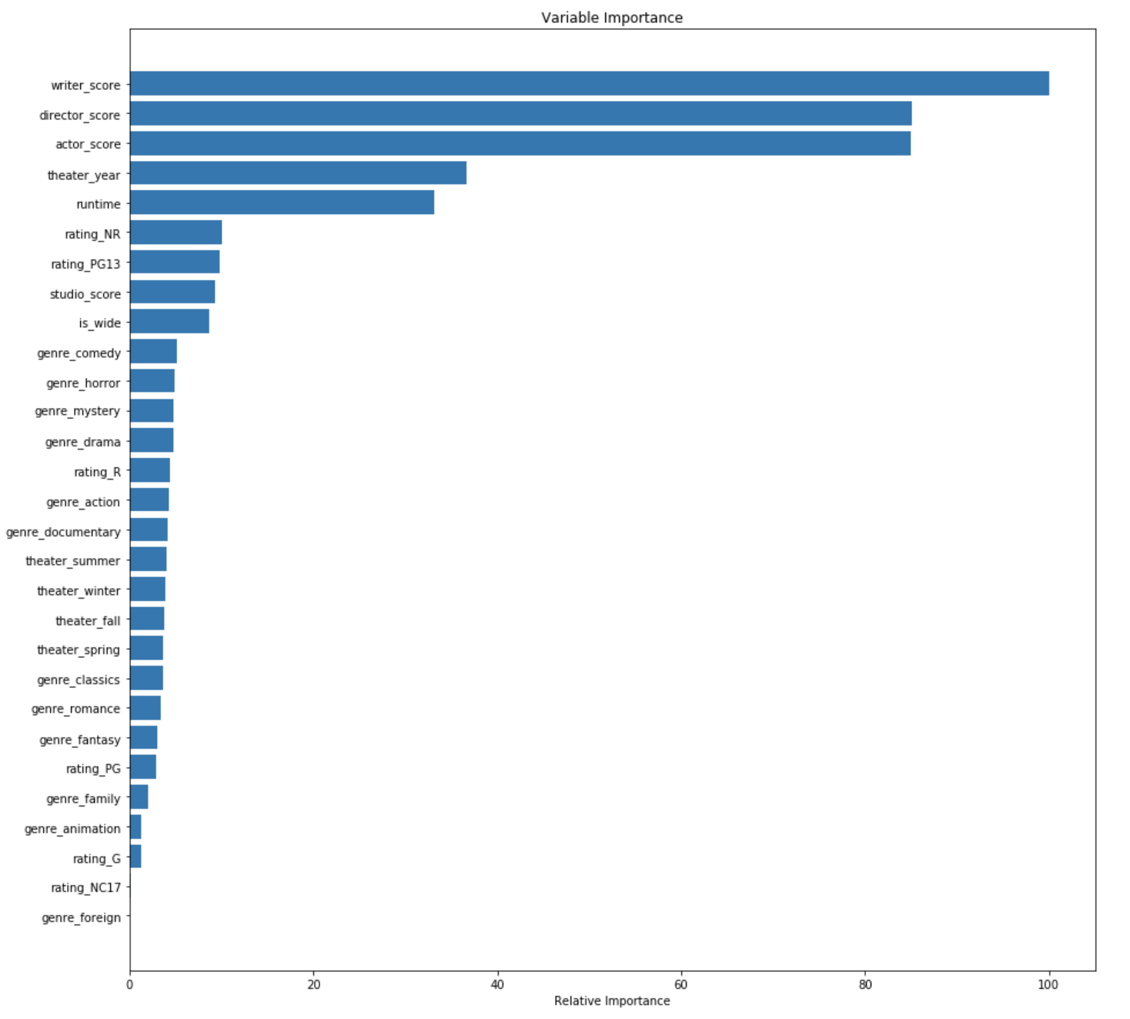
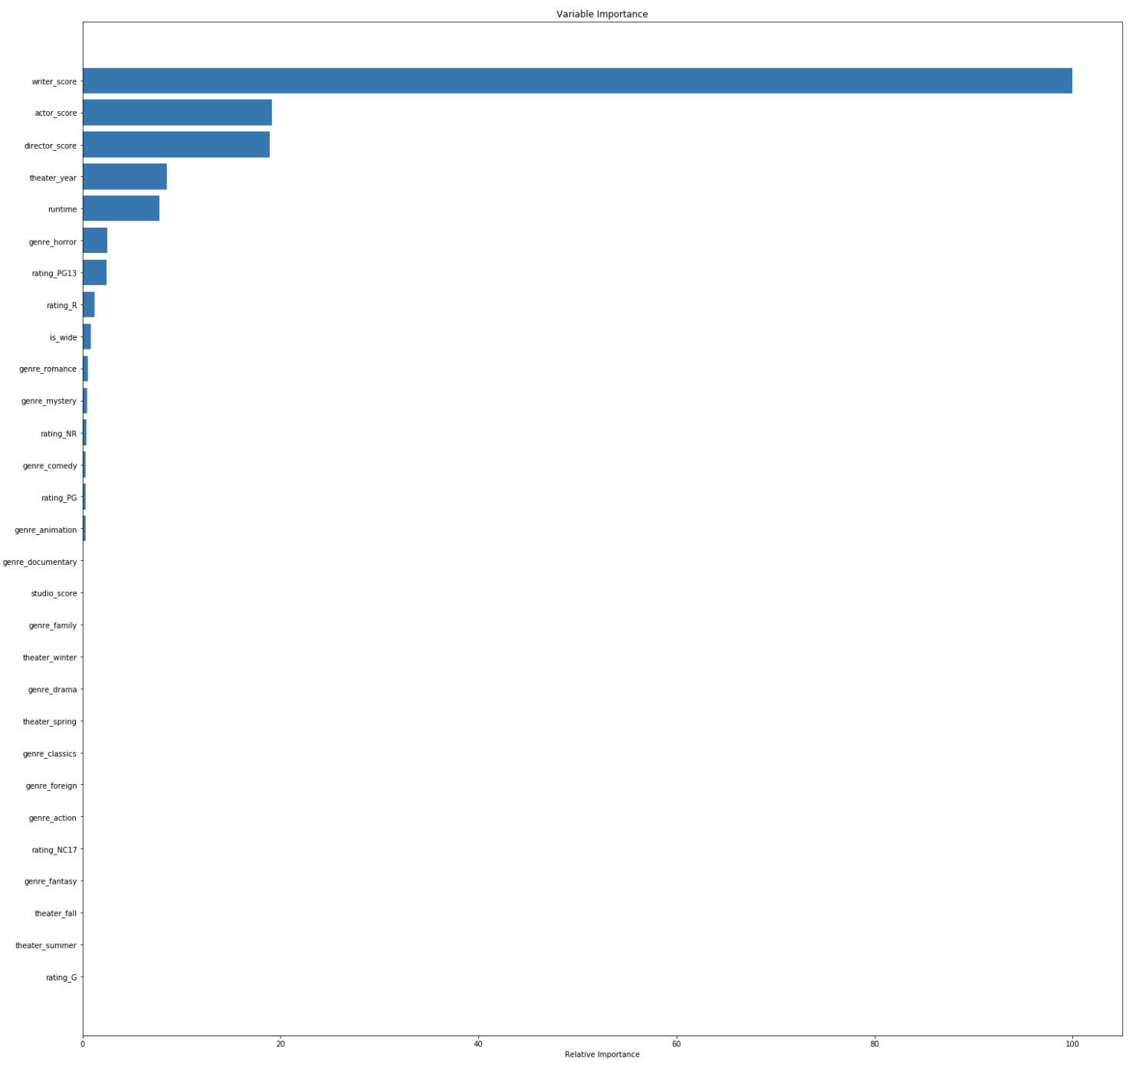
Random Forest
Decision Tree

Slide 16
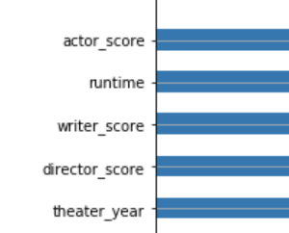
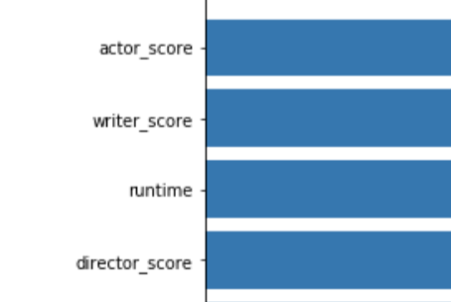
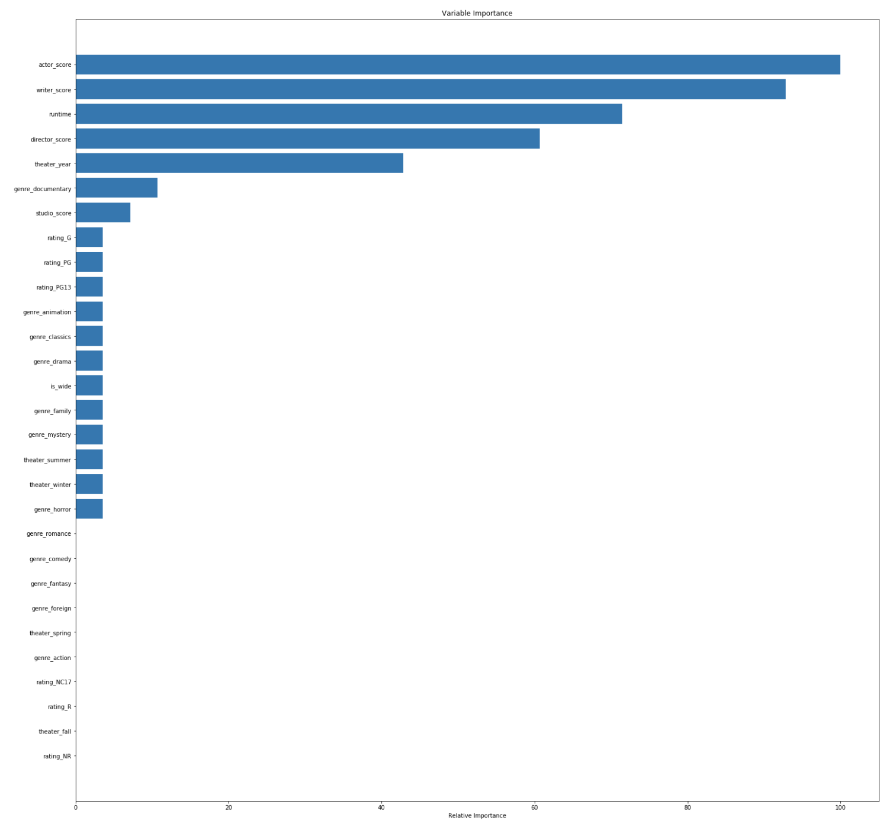
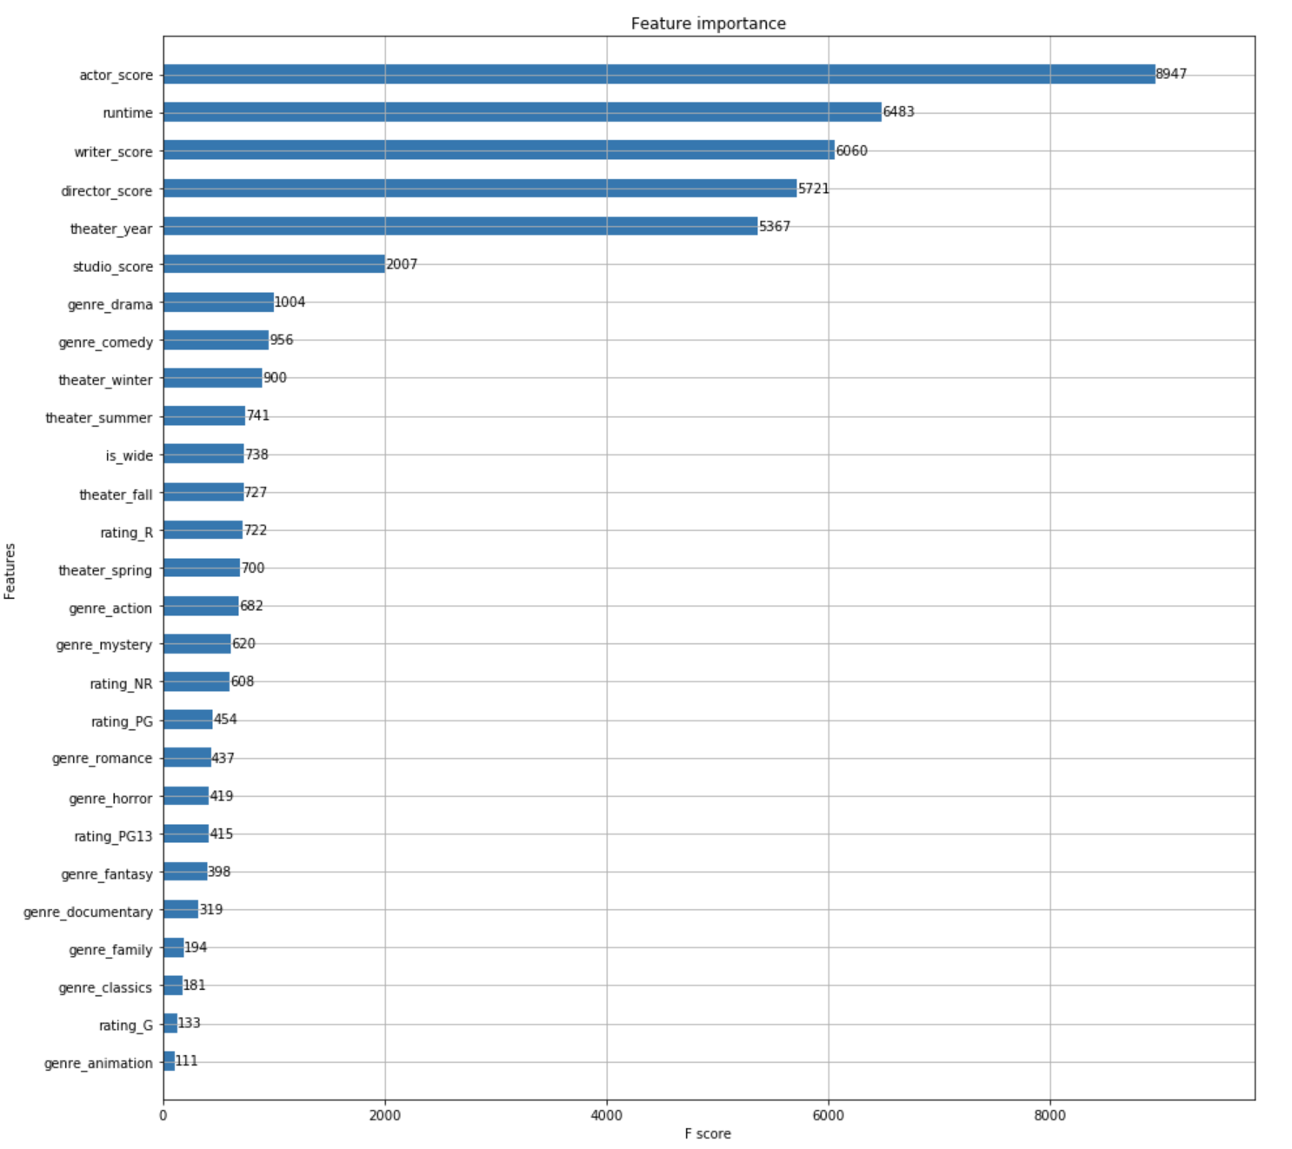
Xgboost
AdaBoost

Slide 17
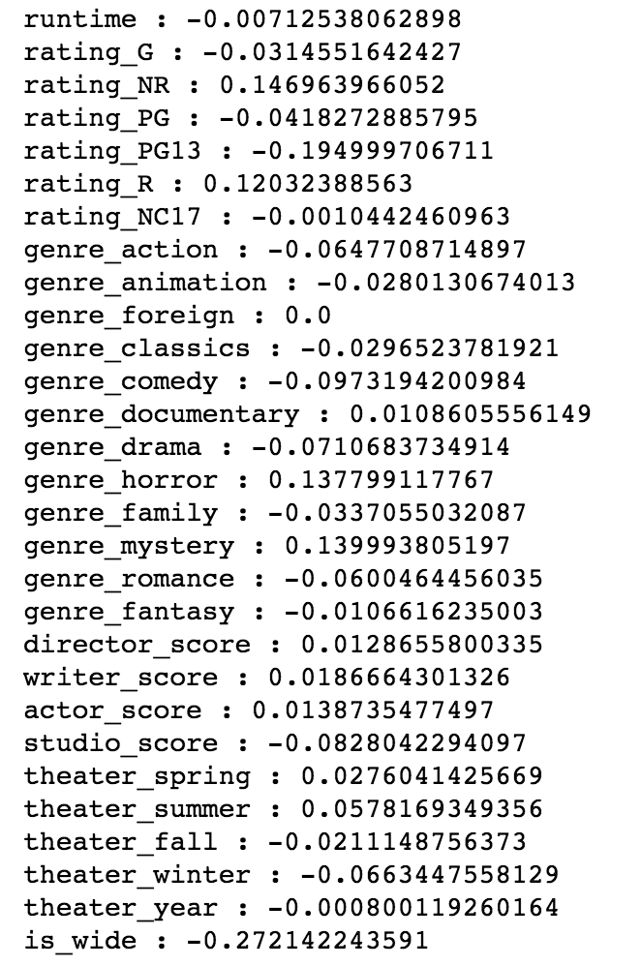
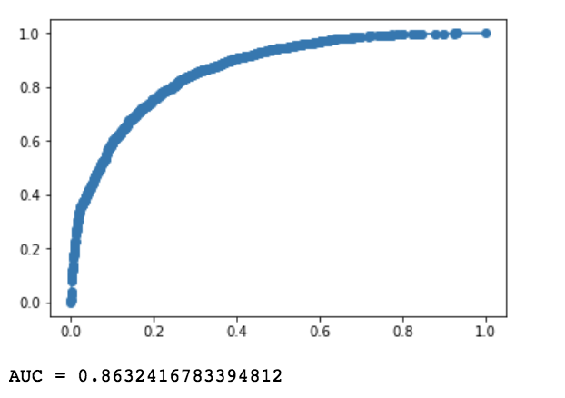
Logistic Regression
The correlation coefficient of features.

Slide 18
 | Random Forest | Decision Tree | XgBoost | AdaBoost
accuracy score | 79.49% | 79.49% | 80.03% | 79.15%
f1 score | 81.45% | 81.45% | 81.72% | 81.08%
 | Logistic Regression | One-Vs-Rest | K-Neighbors | SVC
accuracy score | 77.92% | 78.12% | 78.12% | 78.20%
f1 score | 79.81% | 80.20% | 80.20% | 80.26%

Slide 19
Conclusion
Based on observation and analysis, Xgboost model achieved the best results. It is known that the director, actor and writer scores have a greater impact on the positive correlation of the prediction, followed by the runtime and the amount of movies in theater have a negative correlation with the results.
This means that for critics, movies with good actors, directors and writers will generally be higher evaluated.

