Slide 1
CB2200 Tutorial
Week14
Tutor:
YANG Yihang

Slide 2
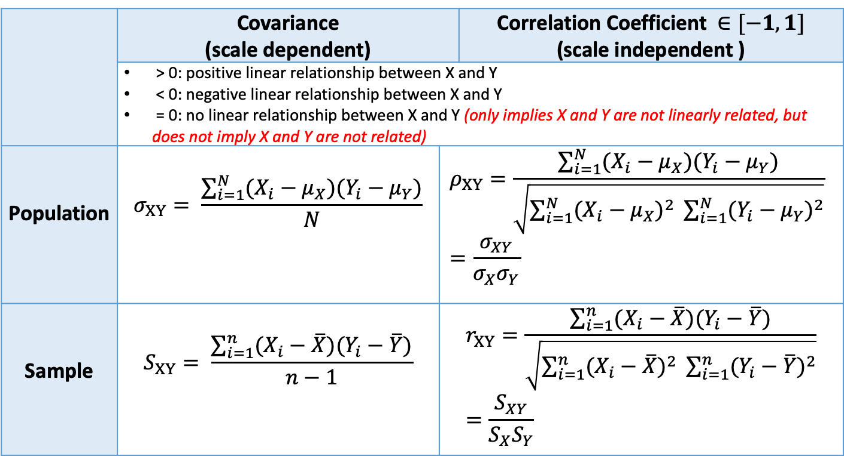
Summary---Topic 8: Simple Linear Regression
Covariance and Correlation Coefficient (indicating linear relationship)
 | Covariance (scale dependent) |  | Correlation Coefficient $∈[−1,1]$ (scale independent )
 | > 0: positive linear relationship between X and Y < 0: negative linear relationship between X and Y = 0: no linear relationship between X and Y (only implies X and Y are not linearly related, but does not imply X and Y are not related)
Population | $$σ_{XY}= \frac{\sum_{i=1}^{N}{(X_{i}−μ_{X})(Y_{i}−μ_{Y})}}{N}$$ | $$ρ_{XY}=\frac{\sum_{i=1}^{N}{(X_{i}−μ_{X})(Y_{i}−μ_{Y})}}{\sqrt{\sum_{i=1}^{N}{{(X_{i}−μ_{X})}^{2}} \sum_{i=1}^{N}{{(Y_{i}−μ_{Y})}^{2}}}} =\frac{σ_{XY}}{σ_{X}σ_{Y}}$$
Sample | $$S_{XY}= \frac{\sum_{i=1}^{n}{(X_{i}−\overline{X})(Y_{i}−\overline{Y})}}{n−1}$$ | $$r_{XY}=\frac{\sum_{i=1}^{n}{(X_{i}−\overline{X})(Y_{i}−\overline{Y})}}{\sqrt{\sum_{i=1}^{n}{{(X_{i}−\overline{X})}^{2}} \sum_{i=1}^{n}{{(Y_{i}−\overline{Y})}^{2}}}}=\frac{S_{XY}}{S_{X}S_{Y}}$$
The sign of $ρ_{XY}$ ($r_{XY}$) is the same as that of $σ_{XY}$ ($S_{XY}$)

Slide 3
Correlation Coefficient
Covariance does not have any upper boundary or lower boundary, while correlation coefficient must range between -1 and 1.
The magnitude of correlation coefficient can measure the strength of the linear relationship:
The closer the absolute value of correlation coefficient to 1 (i.e. correlation coefficient is close to 1 or -1), the stronger is the relationship between X and Y.
Interpretation of correlation coefficient:
There is (strong/weak) (positive/negative) linear relationship between X and Y
There is weak negative linear relationship between X and Y
There is weak positive linear relationship between X and Y
There is strong negative linear relationship between X and Y
There is strong positive linear relationship between X and Y
-1
0
1
There is no linear relationship between X and Y

Slide 4
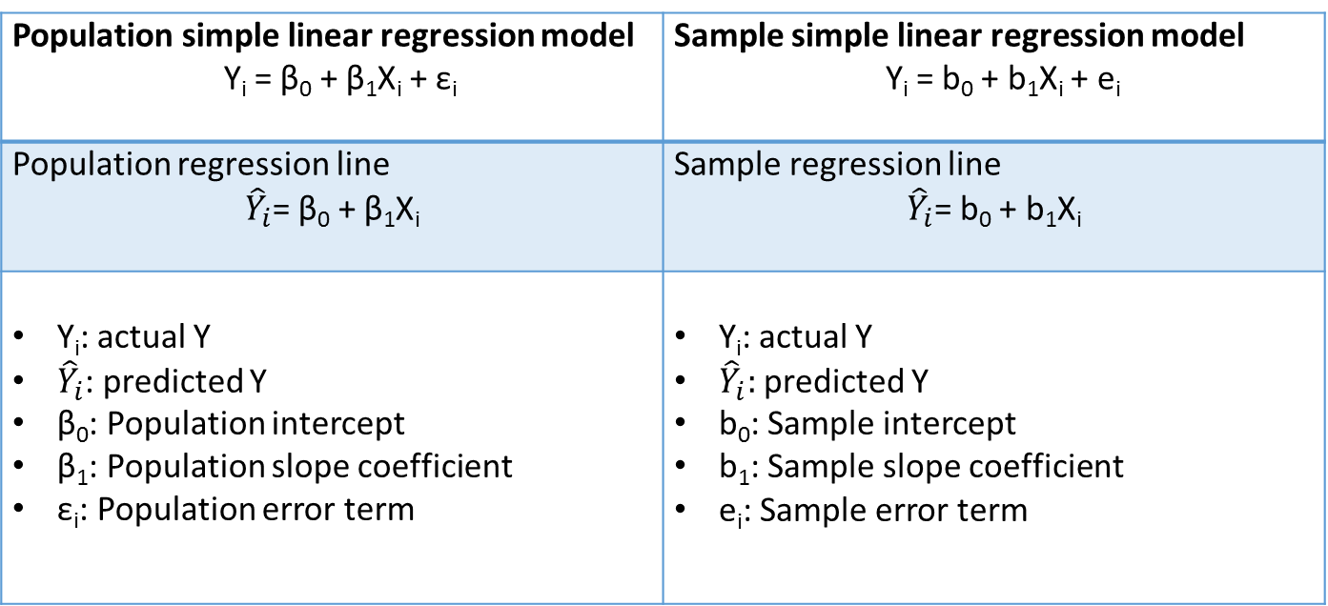
Simple Linear Regression
Relate the dependent variable with a single independent variable by a linear equation
Population simple linear regression model Y_{i} = β₀ + β₁X_{i} + ε_{i} | Sample simple linear regression model Y_{i} = b₀ + b₁X_{i} + e_{i}
Population regression line ${\hat{Y}}_{i}$= β₀ + β₁X_{i} | Sample regression line ${\hat{Y}}_{i}$= b₀ + b₁X_{i}
Y_{i}: actual Y ${\hat{Y}}_{i}$: predicted Y β₀: Population intercept β₁: Population slope coefficient ε_{i}: Population error term | Y_{i}: actual Y ${\hat{Y}}_{i}:$predicted Y b₀: Sample intercept b₁: Sample slope coefficient e_{i}: Sample error term

Slide 5
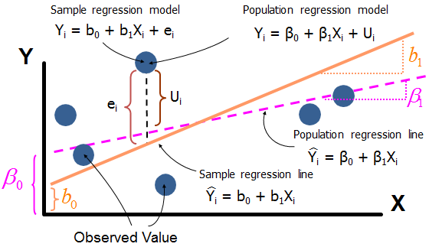
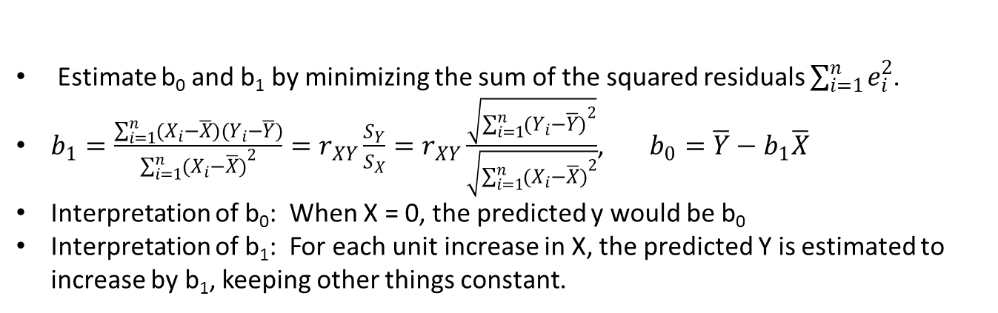
Simple Linear Regression(con’t)
Estimate b₀ and b₁ by minimizing the sum of the squared residuals $\sum_{i=1}^{n}{e_{i}^{2}}$.
$b_{1}=\frac{\sum_{i=1}^{n}{(X_{i}−\overline{X})(Y_{i}−\overline{Y})}}{\sum_{i=1}^{n}{{(X_{i}−\overline{X})}^{2}}}=r_{XY}\frac{S_{Y}}{S_{X}}=r_{XY}\frac{\sqrt{\sum_{i=1}^{n}{{(Y_{i}−\overline{Y})}^{2}}}}{\sqrt{\sum_{i=1}^{n}{{(X_{i}−\overline{X})}^{2}}}}$, $b_{0}=\overline{Y}−b_{1}\overline{X}$
Interpretation of b₀: When X = 0, the predicted y would be b₀
Interpretation of b₁: For each unit increase in X, the predicted Y is estimated to increase by b₁, keeping other things constant.

Slide 6
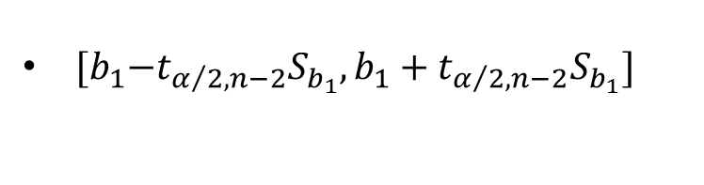
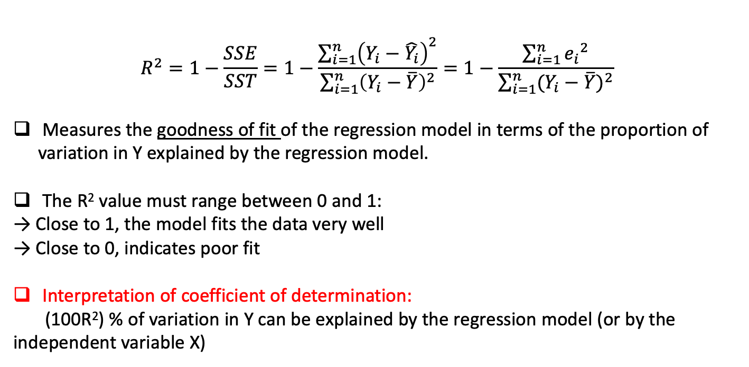
Coefficient of Determination (R-square: square of correlation coefficient)
$$R^{2}=1−\frac{SSE}{SST}=1−\frac{\sum_{i=1}^{n}{{\left(Y_{i}−\hat{Y_{i}}\right)}^{2}}}{\sum_{i=1}^{n}{{\left(Y_{i}−\overline{Y}\right)}^{2}}}=1−\frac{\sum_{i=1}^{n}{{e_{i}}^{2}}}{\sum_{i=1}^{n}{{(Y_{i}−\overline{Y})}^{2}}}$$
Measures the goodness of fit of the regression model in terms of the proportion of variation in Y explained by the regression model.
The R² value must range between 0 and 1:
→ Close to 1, the model fits the data very well
→ Close to 0, indicates poor fit
Interpretation of coefficient of determination:
(100R²) % of variation in Y can be explained by the regression model (or by the independent variable X)
Confidence Interval for β₁
${[b}_{1}−t_{α/2, n−2}S_{b_{1}},b_{1}+t_{α/2, n−2}S_{b_{1}}]$

Slide 7
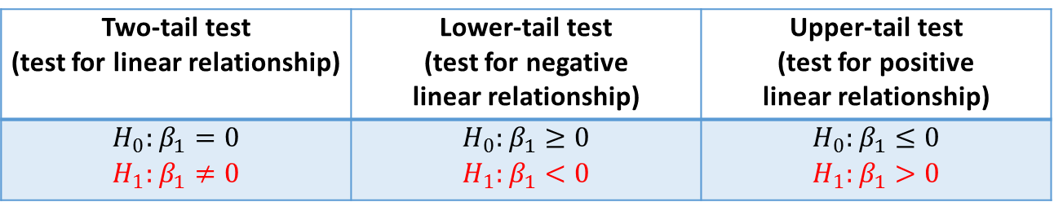

Hypothesis Test for Population Slope Coefficient
1. Critical Value Approach
Step 1: Define Hypotheses
Two-tail test (test for linear relationship) | Lower-tail test (test for negative linear relationship) | Upper-tail test (test for positive linear relationship)
$$H_{0}:β_{1}=0$$ $$H_{1}:β_{1}≠0$$ | $$H_{0}:β_{1}≥0$$ $$H_{1}:β_{1}<0$$ | $$H_{0}:β_{1}≤0$$ $$H_{1}:β_{1}>0$$
Step 2: Choose Test & Rejection Region (Degree of freedom = n - 2)
Reject $H_{0}$ if:
 | Two-tail test | Lower-tail test | Upper-tail test
t test | t < - t_{α/2, (n-2)} or t > t_{α/2, (n-2)} | t < - t_{α, (n-2)} | t > t_{α, (n-2)}
$t=\frac{b_{1}−{β_{1}}_{0}}{S_{b_{1}}}=\frac{b_{1}−0}{S_{b_{1}}}$
Step 3: Compute Test Statistic:
Step 4: Make Statistical Decision
If the t test statistic value falls in the rejection region ➔reject H₀ ➔There is insufficient evidence that the H₁ is true. (X and Y have significant linear relationship)
Otherwise, do not reject H₀ (Do not reject H₀ ≠ Accept H₀)➔ There is insufficient evidence that the H₁ is true.

Slide 8
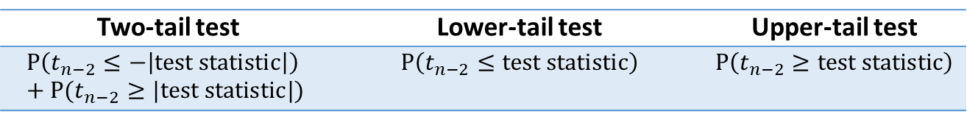
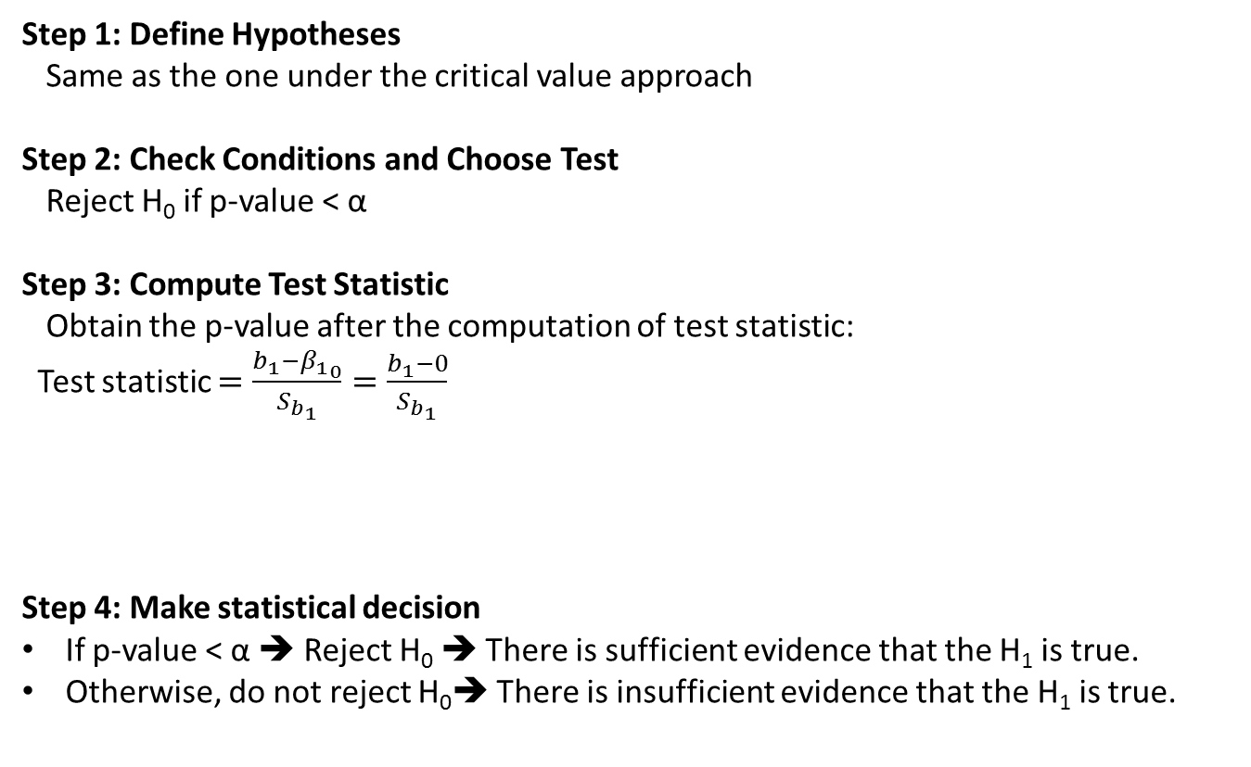
2. P-value Approach
Step 1: Define Hypotheses
Same as the one under the critical value approach
Step 2: Check Conditions and Choose Test
Reject H₀ if p-value < α
Step 3: Compute Test Statistic
Obtain the p-value after the computation of test statistic:
Test statistic $=\frac{b_{1}−{β_{1}}_{0}}{S_{b_{1}}}=\frac{b_{1}−0}{S_{b_{1}}}$
Step 4: Make statistical decision
If p-value < α ➔ Reject H₀ ➔ There is sufficient evidence that the H₁ is true.
Otherwise, do not reject H₀➔ There is insufficient evidence that the H₁ is true.
Two-tail test | Lower-tail test | Upper-tail test
$$P\left(t_{n−2}≤−\left|test statistic\right|\right)+P(t_{n−2}≥|test statistic|)$$ | $$P\left(t_{n−2}≤test statistic\right)$$ | $$P\left(t_{n−2}≥test statistic\right)$$

Slide 9
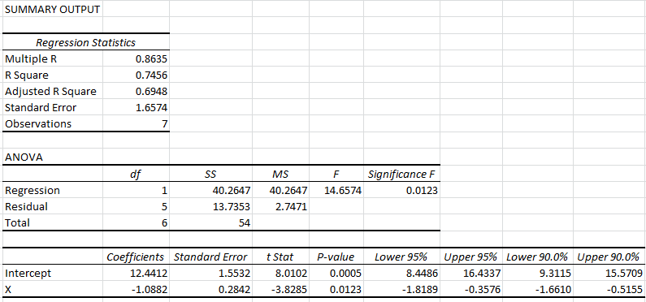
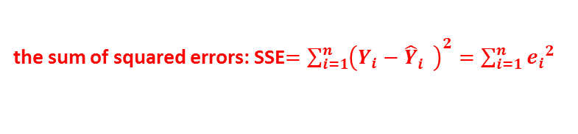



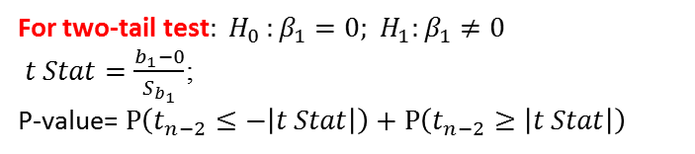


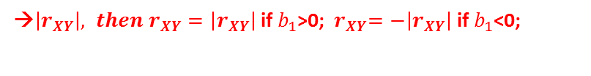


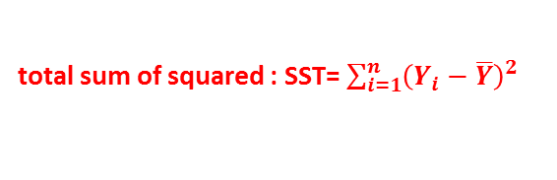
Excel Output
→$\left|r_{XY}\right|, then{ r}_{XY}=\left|r_{XY}\right|$ if $b_{1}$>0; ${ r}_{XY}=−\left|r_{XY}\right|$ if $b_{1}$<0;
→$R^{2}(={r_{XY}}^{2})=1−\frac{SSE}{SST}$
→$S_{e}$
→ $n$
the sum of squared errors: SSE$=\sum_{i=1}^{n}{{\left(Y_{i}−{\hat{Y}}_{i}^{}\right)}^{2}}=\sum_{i=1}^{n}{{e_{i}}^{2}}$
total sum of squared : SST= $\sum_{i=1}^{n}{{\left(Y_{i}−\overline{Y}\right)}^{2}}$
$b_{0}$
$$S_{b_{0}}$$
$b_{1}$
$$S_{b_{1}}$$
95%CI
For two-tail test${: H}_{0}:β_{1}=0; H_{1}:β_{1}≠0$
$t Stat=\frac{b_{1}−0}{S_{b_{1}}}$;
P-value= $P\left(t_{n−2}≤−\left|t Stat\right|\right)+P\left(t_{n−2}≥\left|t Stat\right|\right)$
90%CI
$$\hat{Y}=b_{0}+b_{1}X$$

Slide 10
Prediction in Regression Analysis
When the regression model is used for prediction, we should check whether the independent variable value of the new observation is within the relevant range of the data. The regression model can only predict well if the new observation has independent variable value which is within the relevant range.
→If the independent variable value of the new observation is out of the relevant range, we may still use the regression model to find out the predicted value, but the accuracy of the predicted value will be doubted.
When X is not within the range [X_{min},X_{max}] , it is inappropriate for predicting Y by the regression equation. (the accuracy of the predicted value will be doubted)

Slide 11
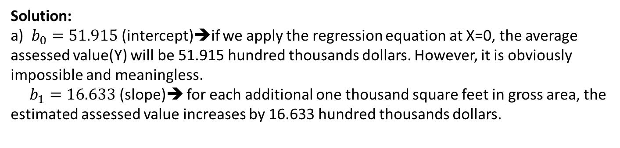
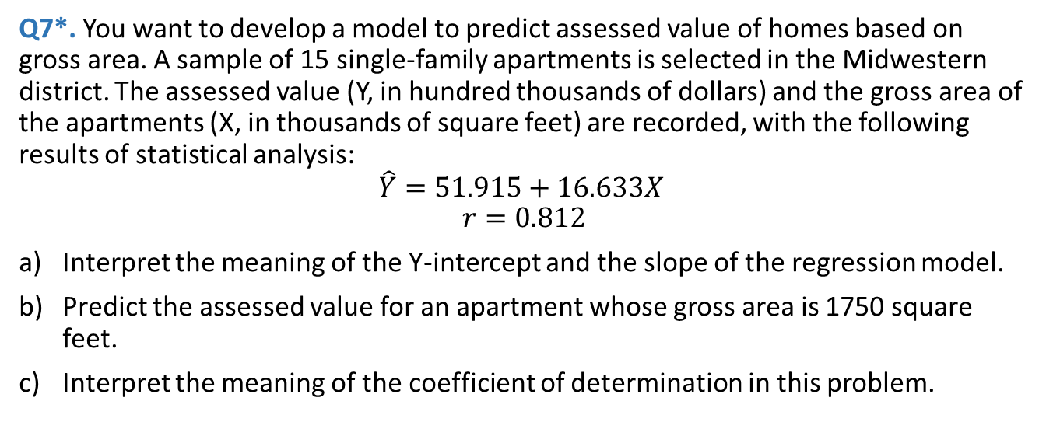
Exercises and Solutions (Topic 8)
Q7*. You want to develop a model to predict assessed value of homes based on gross area. A sample of 15 single-family apartments is selected in the Midwestern district. The assessed value (Y, in hundred thousands of dollars) and the gross area of the apartments (X, in thousands of square feet) are recorded, with the following results of statistical analysis:
$$\hat{Y}=51.915+16.633X$$
$$r=0.812$$
Interpret the meaning of the Y-intercept and the slope of the regression model.
Predict the assessed value for an apartment whose gross area is 1750 square feet.
Interpret the meaning of the coefficient of determination in this problem.
Solution:
a) $b_{0}=51.915$ (intercept)➔if we apply the regression equation at X=0, the average assessed value(Y) will be 51.915 hundred thousands dollars. However, it is obviously impossible and meaningless.
$b_{1}=16.633$ (slope)➔ for each additional one thousand square feet in gross area, the estimated assessed value increases by 16.633 hundred thousands dollars.

Slide 12
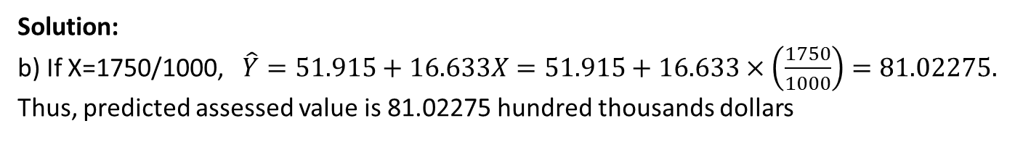
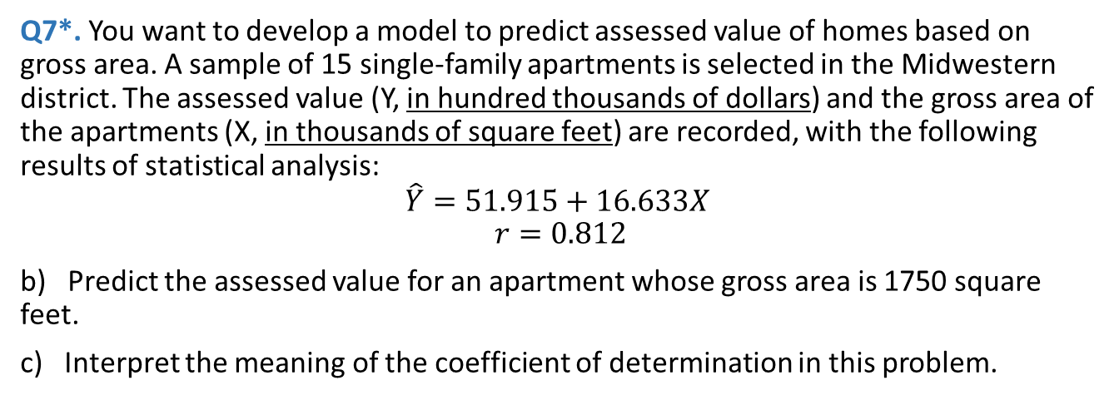
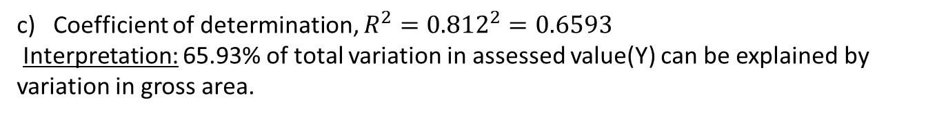
Q7*. You want to develop a model to predict assessed value of homes based on gross area. A sample of 15 single-family apartments is selected in the Midwestern district. The assessed value (Y, in hundred thousands of dollars) and the gross area of the apartments (X, in thousands of square feet) are recorded, with the following results of statistical analysis:
$$\hat{Y}=51.915+16.633X$$
$$r=0.812$$
b) Predict the assessed value for an apartment whose gross area is 1750 square feet.
c) Interpret the meaning of the coefficient of determination in this problem.
Solution:
b) If X=1750/1000, $\hat{Y}=51.915+16.633X=51.915+16.633×\left(\frac{1750}{1000}\right)=81.02275.$
Thus, predicted assessed value is 81.02275 hundred thousands dollars
c) Coefficient of determination, $R^{2}={0.812}^{2}=0.6593$
Interpretation: 65.93% of total variation in assessed value(Y) can be explained by variation in gross area.

Slide 13

Q8. Circulation is the lifeblood of the publishing business. The larger the sales of magazine, the more it can charge advertisers. Recently, a circulation gap has appeared between the publishers’ reports of magazines’ newsstand sales and subsequent audits by the Audit Bureau of Circulations. The data in the file Circulation represent the reported and audited newsstand yearly sales (in thousands) for the following 10 magazines (i.e. n = 10)
Source: Data extracted from M. Rose, “In Fight for Ads, Publishers Often Overstate Their Sales,” The Wall Street Journal, August 6, 2003, pp. A1, A10.
For these data, b₀ = 26.724, b₁ = 0.5719 and S_{b1} = 0.0668
Magazine | Reported (X) ←independent variable | Audited (Y) ←dependent variable
YM | 621.0 | 299.6
CosmoGirl | 359.7 | 207.7
Rosie | 530.0 | 325.0
Playboy | 492.1 | 336.3
Esquire | 70.5 | 48.6
TeenPeople | 567.0 | 400.3
More | 125.5 | 91.2
Spin | 50.6 | 39.1
Vogue | 353.3 | 268.6
Elle | 263.6 | 214.3
$$\hat{Y}=b_{0}+b_{1}X=26.724+0.5719X$$

Slide 14
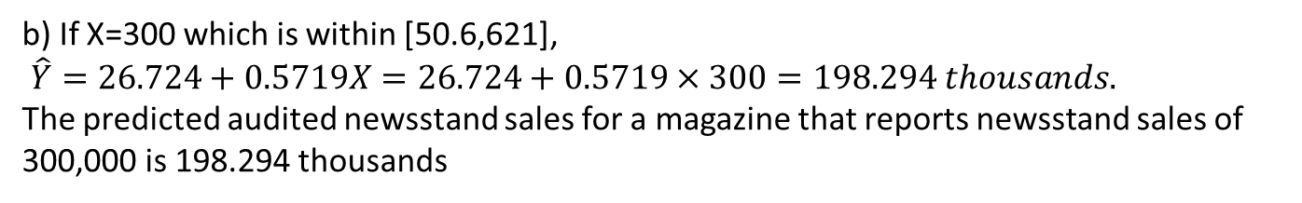
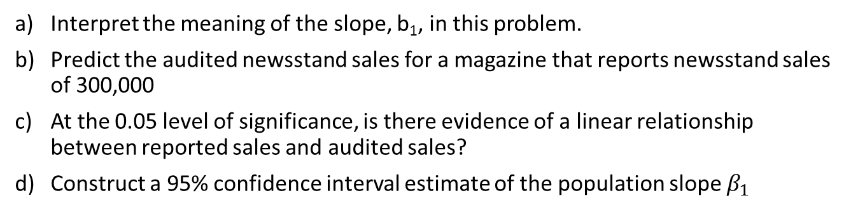
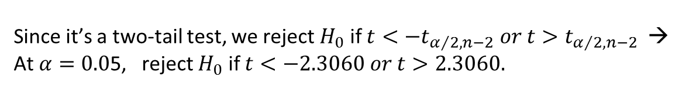
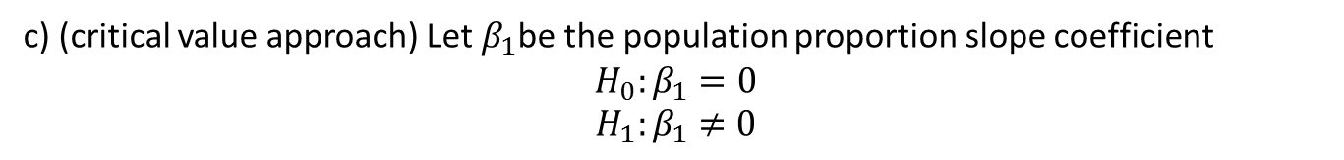
Interpret the meaning of the slope, b₁, in this problem.
Predict the audited newsstand sales for a magazine that reports newsstand sales of 300,000
At the 0.05 level of significance, is there evidence of a linear relationship between reported sales and audited sales?
Construct a 95% confidence interval estimate of the population slope $β_{1}$
Solution:
a) b₁ = 0.5719. For each additional thousand units increase in reported newsstand sales, the mean audited sales will increase by an estimated 0.5719 thousand units.
b) If X=300 which is within [50.6,621],
$\hat{Y}=26.724+0.5719X=26.724+0.5719×300=198.294 thousands.$
The predicted audited newsstand sales for a magazine that reports newsstand sales of 300,000 is 198.294 thousands
c) (critical value approach) Let $β_{1}$be the population proportion slope coefficient
$$H_{0}:β_{1}=0$$
$$H_{1}:β_{1}≠0$$
Since it’s a two-tail test, we reject $H_{0}$ if $t<{−t}_{α/2,n−2} or t>t_{α/2,n−2}$ →
At $α=0.0$5, reject $H_{0}$ if $t<−2.3060 or t>2.3060.$

Slide 15
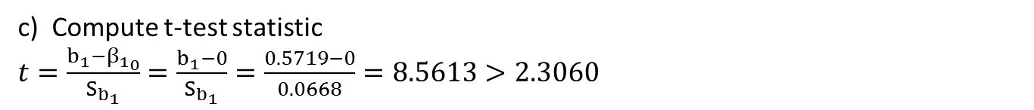
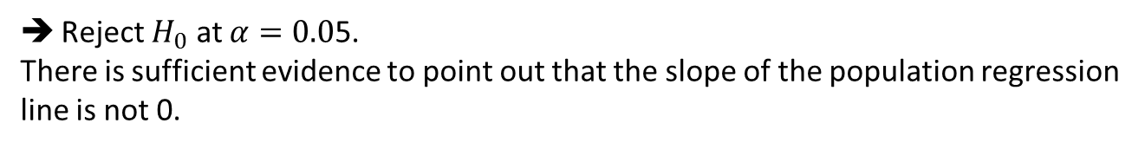
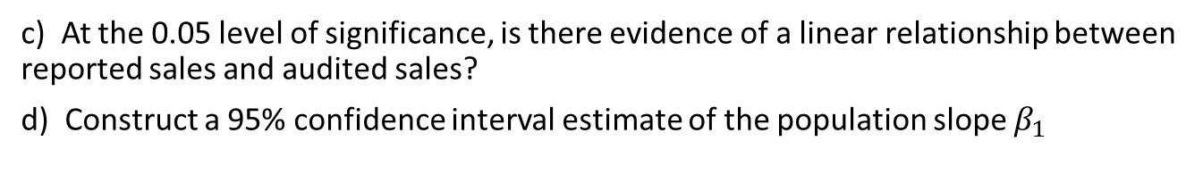
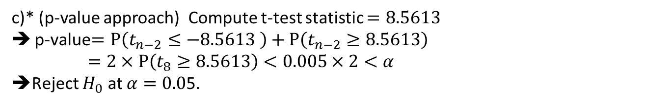
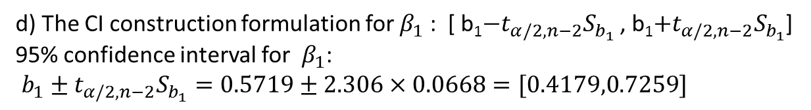
c) At the 0.05 level of significance, is there evidence of a linear relationship between reported sales and audited sales?
d) Construct a 95% confidence interval estimate of the population slope $β_{1}$
Solution:
c) Compute t-test statistic
$t=\frac{b_{1}−{β_{1}}_{0}}{S_{b_{1}}}$ $=\frac{b_{1}−0}{S_{b_{1}}}=\frac{0.5719−0}{0.0668}=8.5613>2.3060$
Reject $H_{0}$ at $α=0.0$5.
There is sufficient evidence to point out that the slope of the population regression line is not 0.
c)* (p-value approach) Compute t-test statistic $=8.5613$
p-value$=P\left(t_{n−2}≤−8.5613 \right)+P\left(t_{n−2}≥8.5613\right)$
$=2×P\left(t_{8}≥8.5613\right)<0.005×2<α$
➔Reject $H_{0}$ at $α=0.0$5.
d) The CI construction formulation for $β_{1}$ : [ b₁$−t_{α/2, n−2}S_{b_{1}}$ , b₁$+t_{α/2, n−2}S_{b_{1}}$]
95% confidence interval for $β_{1}$:
$b_{1}±t_{α/2, n−2}S_{b_{1}}=0.5719±2.306×0.0668=[0.4179,0.7259]$
We are 95% confidence that population slope $β_{1}$ is between 0.4179 and 0.7259.

Slide 16
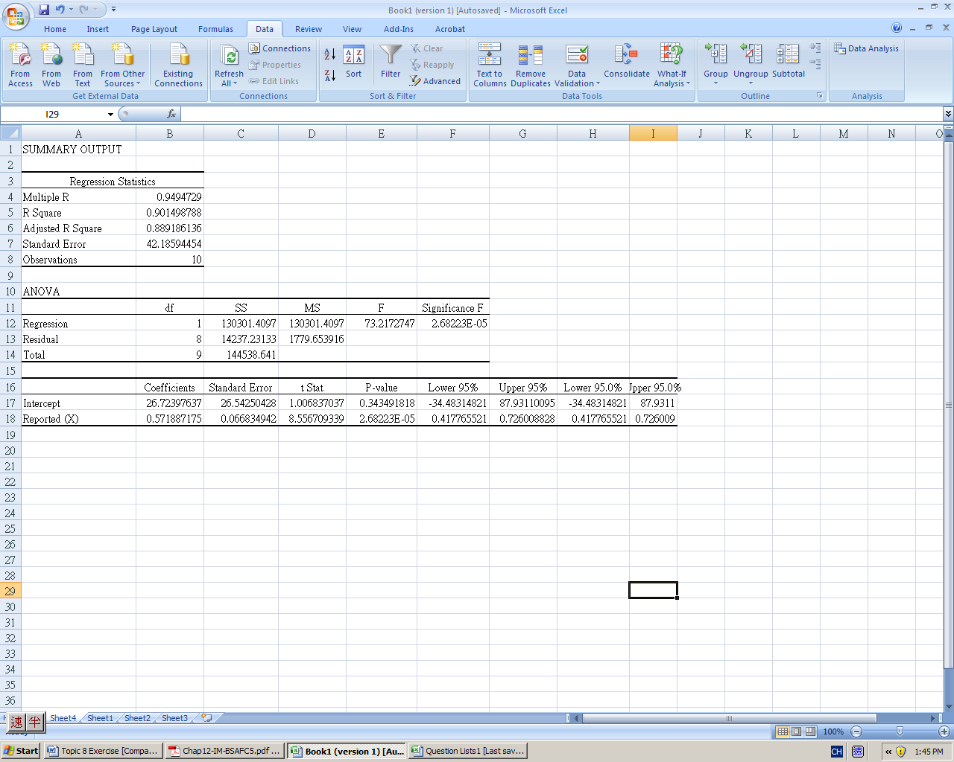
Magazine | Reported (X) ←independent variable | Audited (Y) ←dependent variable
YM | 621.0 | 299.6
CosmoGirl | 359.7 | 207.7
Rosie | 530.0 | 325.0
Playboy | 492.1 | 336.3
Esquire | 70.5 | 48.6
TeenPeople | 567.0 | 400.3
More | 125.5 | 91.2
Spin | 50.6 | 39.1
Vogue | 353.3 | 268.6
Elle | 263.6 | 214.3

Slide 17
Q9*. An agent for a residential real estate company in a large city would like to be able to predict the monthly rental cost for apartments, based on the size of the apartment, as defined by square footage. A sample of 25 apartments in a particular residential neighborhood was selected, and the information gathered revealed the following:
Rent(Y) | Size(X) | Rent | Size
950 | 850 | 1800 | 1369
1600 | 1450 | 1400 | 1175
1200 | 1085 | 1450 | 1225
1500 | 1232 | 1100 | 1245
950 | 718 | 1700 | 1259
1700 | 1485 | 1200 | 1150
1650 | 1136 | 1150 | 896
935 | 726 | 1600 | 1361
875 | 700 | 1650 | 1040
1150 | 956 | 1200 | 755
1400 | 1100 | 800 | 1000
1650 | 1285 | 1750 | 1200
2300 | 1985
a) Use the least-squares method to find the regression coefficients $b_{0}$ and $b_{1}$.
$b_{0}\text{=177.1208} \text{and} b_{1}=1.0651,$ ➔ $\hat{Y}=\text{177.1208}+1.0651X$

Slide 18
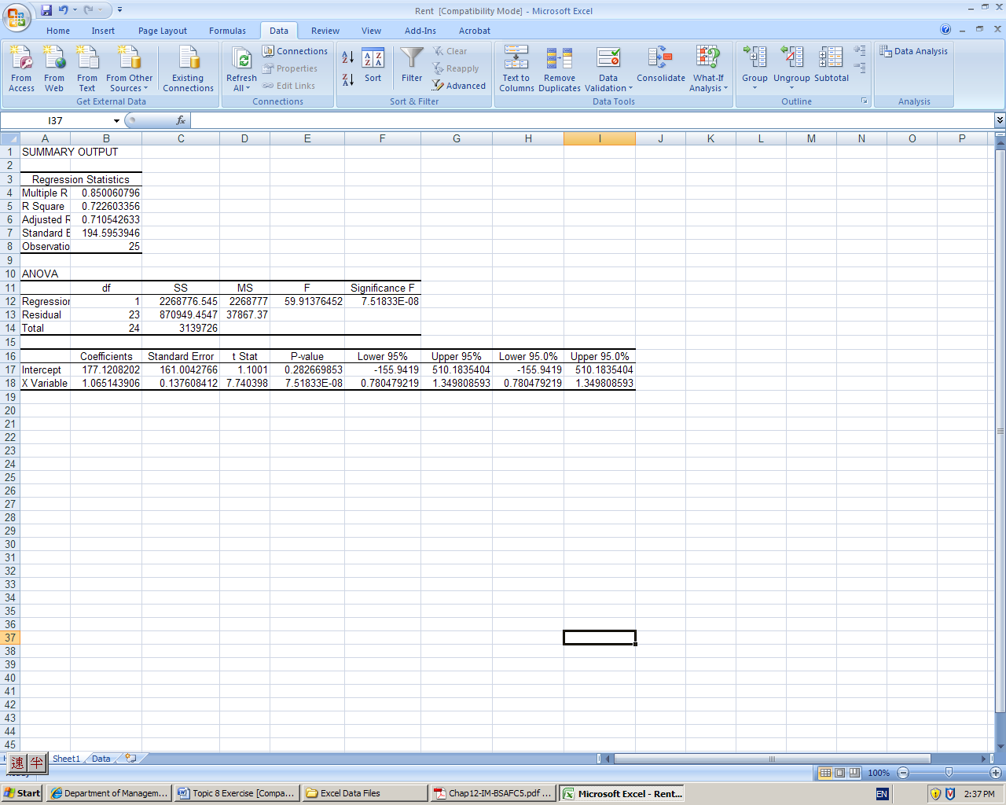

Slide 19
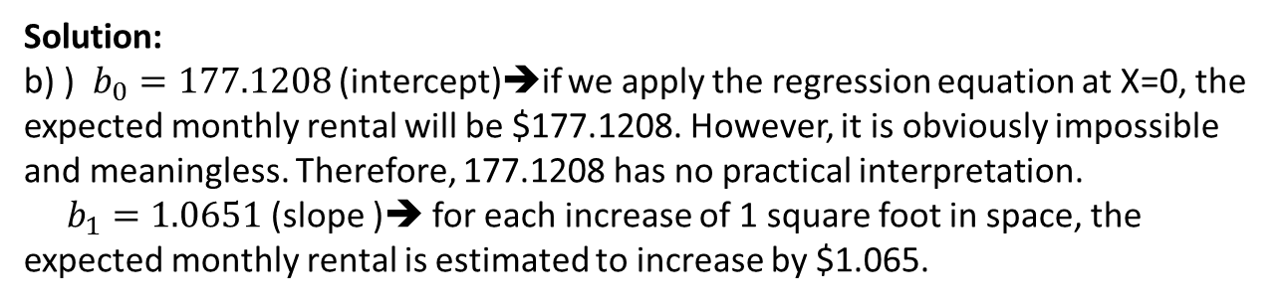
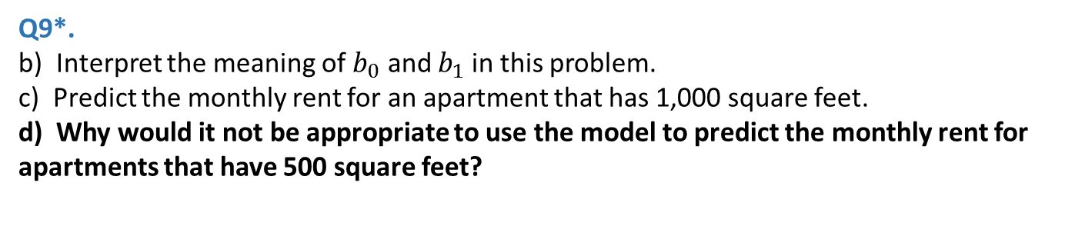
Q9*.
b) Interpret the meaning of $b_{0}$ and $b_{1}$in this problem.
c) Predict the monthly rent for an apartment that has 1,000 square feet.
d) Why would it not be appropriate to use the model to predict the monthly rent for apartments that have 500 square feet?
Solution:
b) ) $b_{0}=177.1208$ (intercept)➔if we apply the regression equation at X=0, the expected monthly rental will be $177.1208. However, it is obviously impossible and meaningless. Therefore, 177.1208 has no practical interpretation.
$b_{1}=1.0651$ (slope )➔ for each increase of 1 square foot in space, the expected monthly rental is estimated to increase by $1.065.
c) If X=1000, $\hat{Y}=177.1208+1.0651X=177.1208+1.0651×1000=1242.2208.$
d) X_{min}=700, X_{max}=1985. An apartment with 500 square feet is outside the relevant range [700,1985] for the independent variable. So, it is not appropriate to use the model to predict the monthly rent for apartments that have 500 square feet

Slide 20
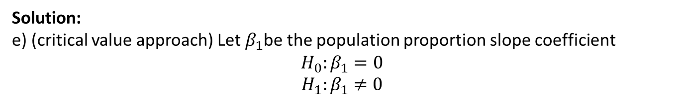
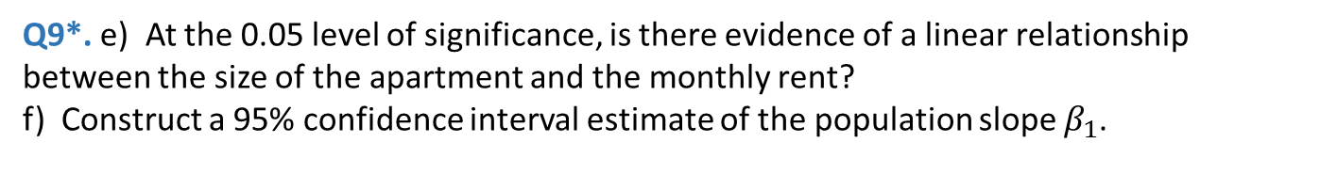
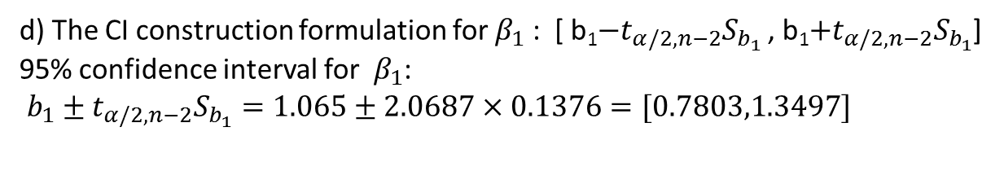
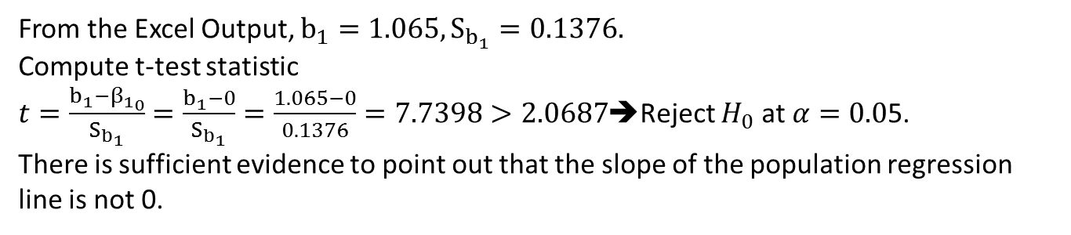
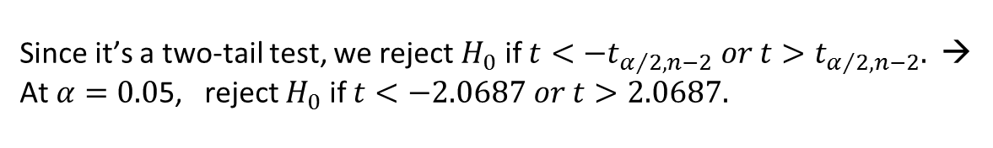
Q9*. e) At the 0.05 level of significance, is there evidence of a linear relationship between the size of the apartment and the monthly rent?
f) Construct a 95% confidence interval estimate of the population slope $β_{1}$.
Solution:
e) (critical value approach) Let $β_{1}$be the population proportion slope coefficient
$$H_{0}:β_{1}=0$$
$$H_{1}:β_{1}≠0$$
Since it’s a two-tail test, we reject $H_{0}$ if $t<{−t}_{α/2,n−2} or t>t_{α/2,n−2}.$ →
At $α=0.0$5, reject $H_{0}$ if $t<−2.0687 or t>2.0687.$
From the Excel Output, $b_{1}=1.065,S_{b_{1}}=0.1376.$
Compute t-test statistic
$t=\frac{b_{1}−{β_{1}}_{0}}{S_{b_{1}}}$ $=\frac{b_{1}−0}{S_{b_{1}}}=\frac{1.065−0}{0.1376}=7.7398>2.0687$➔Reject $H_{0}$ at $α=0.0$5.
There is sufficient evidence to point out that the slope of the population regression line is not 0.
d) The CI construction formulation for $β_{1}$ : [ b₁$−t_{α/2, n−2}S_{b_{1}}$ , b₁$+t_{α/2, n−2}S_{b_{1}}$]
95% confidence interval for $β_{1}$:
$b_{1}±t_{α/2, n−2}S_{b_{1}}=1.065±2.0687×0.1376=[0.7803,1.3497]$
We are 95% confidence that population slope $β_{1}$ is between 0.7803 and 1.3497.

Slide 21
Q10. A random sample of 12 companies was selected and the sales and earnings, in millions of dollars, are reported below:
SUMMARY OUTPUT
Regression Statistics |  |  | ANOVA
Multiple R | 0.887504192 |  |  | df | SS | MS | F | Significance F
R Square | 0.787663691 |  | Regression | 1 | 58.75117833 | 58.7511783 | 37.0951014 | 0.000117143
Adjusted R Square | 0.76643006 |  | Residual | 10 | 15.83798834 | 1.58379883
Standard Error | 1.258490697 |  | Total | 11 | 74.58916667
Observations | 12
 | Coefficients | Standard Error | t Stat | P-value | Lower 95% | Upper 95% | Lower 95.0% | Upper 95.0%
Intercept | 1.64574594 | 0.728503942 | 2.259076233 | 0.047442872 | 0.022538011 | 3.26895387 | 0.022538011 | 3.268953869
X Variable 1 | 0.103873619 | 0.017054814 | 6.090574801 | 0.000117143 | 0.065873126 | 0.14187411 | 0.065873126 | 0.141874111
Company | Sales | Earnings
C1 | 40.2 | 5.3
C2 | 10.4 | 3.7
C3 | 18.6 | 4.4
C4 | 71.7 | 8.0
C5 | 58.6 | 6.6
C6 | 46.8 | 5.1
C7 | 17.5 | 2.6
C8 | 11.9 | 1.7
C9 | 19.6 | 3.5
C10 | 51.2 | 8.2
C11 | 28.6 | 6.0
C12 | 69.2 | 10.8

Slide 22
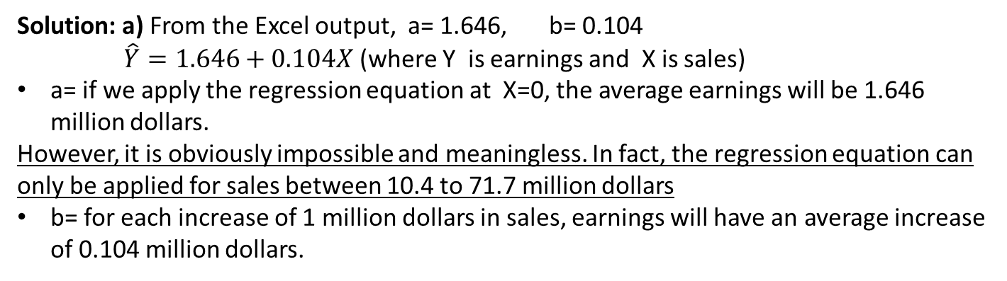
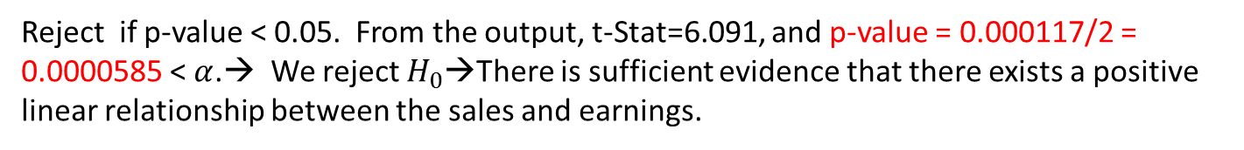
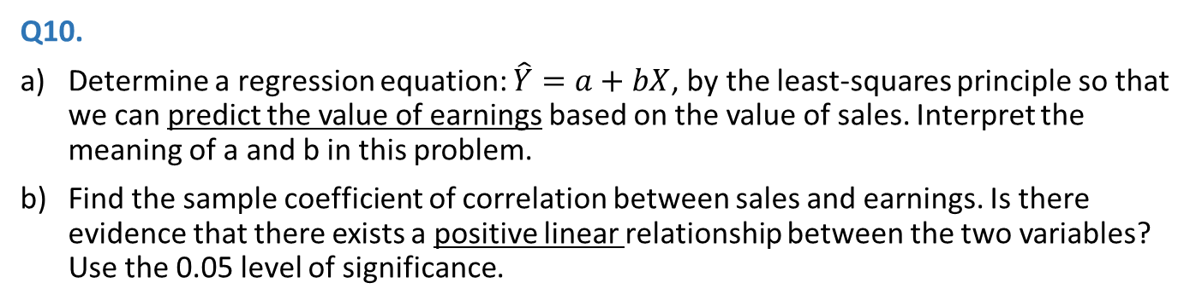
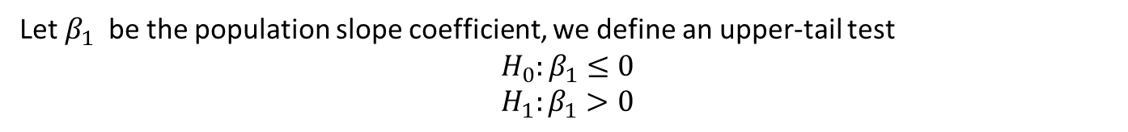
Q10.
Determine a regression equation: $\hat{Y}=a+bX$, by the least-squares principle so that we can predict the value of earnings based on the value of sales. Interpret the meaning of a and b in this problem.
Find the sample coefficient of correlation between sales and earnings. Is there evidence that there exists a positive linear relationship between the two variables? Use the 0.05 level of significance.
Solution: a) From the Excel output, a= 1.646, b= 0.104
$\hat{Y}=1.646+0.104X$(where Y is earnings and X is sales)
a= if we apply the regression equation at X=0, the average earnings will be 1.646 million dollars.
However, it is obviously impossible and meaningless. In fact, the regression equation can only be applied for sales between 10.4 to 71.7 million dollars
b= for each increase of 1 million dollars in sales, earnings will have an average increase of 0.104 million dollars.
b) From the Excel output, ${|r}_{XY}|=0.$888.
Furthermore, the slope$a=0.104>0$ → $r_{XY}>0$ → $r_{XY}=0.888$
Let $β_{1}$ be the population slope coefficient, we define an upper-tail test
$$H_{0}:β_{1}≤0$$
$$H_{1}:β_{1}>0$$
Reject if p-value < 0.05. From the output, t-Stat=6.091, and p-value = 0.000117/2 = 0.0000585 < $α$.→ We reject $H_{0}$→There is sufficient evidence that there exists a positive linear relationship between the sales and earnings.

Slide 23
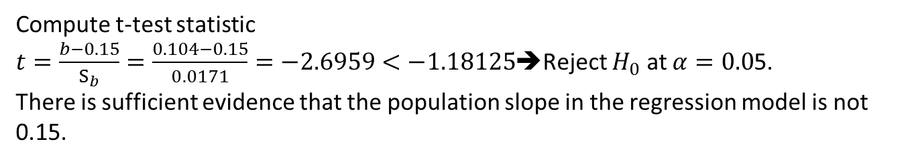
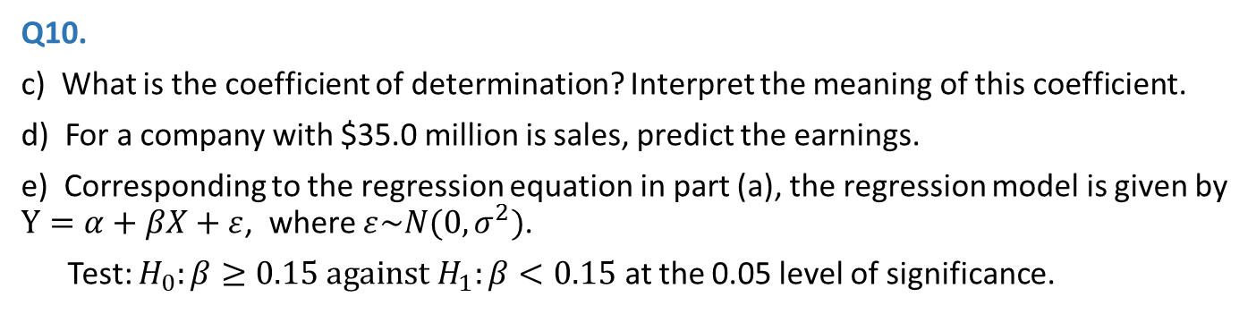

Q10.
c) What is the coefficient of determination? Interpret the meaning of this coefficient.
d) For a company with $35.0 million is sales, predict the earnings.
e) Corresponding to the regression equation in part (a), the regression model is given by $Y=α+βX+ε$, where $ε\sim N(0,σ^{2})$.
Test: $H_{0}:β≥0.15 against H_{1}:β<0.15$ at the 0.05 level of significance.
SUMMARY OUTPUT
Regression Statistics |  |  | ANOVA
Multiple R | 0.887504192 |  |  | df | SS | MS | F | Significance F
R Square | 0.787663691 |  | Regression | 1 | 58.75117833 | 58.7511783 | 37.0951014 | 0.000117143
Adjusted R Square | 0.76643006 |  | Residual | 10 | 15.83798834 | 1.58379883
Standard Error | 1.258490697 |  | Total | 11 | 74.58916667
Observations | 12
 | Coefficients | Standard Error | t Stat | P-value | Lower 95% | Upper 95% | Lower 95.0% | Upper 95.0%
Intercept | 1.64574594 | 0.728503942 | 2.259076233 | 0.047442872 | 0.022538011 | 3.26895387 | 0.022538011 | 3.268953869
X Variable 1 | 0.103873619 | 0.017054814 | 6.090574801 | 0.000117143 | 0.065873126 | 0.14187411 | 0.065873126 | 0.141874111
Solution: c) Coefficient of determination = $R^{2}$= 0.788
78.8% of total variation in earnings can be explained by variation in sales.
Solution: d) $\hat{Y}=1.646+0.104X=1.646+0.104×35=5.286 million dollars$
Solution: e) Define an lower-tail test
$$H_{0}:β≥0.15$$
$$H_{1}:β<0.15$$
Since it’s a lower-tail test, we reject $H_{0}$ if $t<{−t}_{α,n−2}=−1.18125$ at $α=0.0$5
Compute t-test statistic
$t=\frac{b−0.15}{S_{b}}=\frac{0.104−0.15}{0.0171}=−2.6959<−1.18125$➔Reject $H_{0}$ at $α=0.0$5.
There is sufficient evidence that the population slope in the regression model is not 0.15.

Slide 24
Q11*. The following table shows, for eight brands of tea, the average purchase quantity per buyer (Y) and the purchasing frequency (X) in a year.
Y (kg) | 3.6 | 3.3 | 2.8 | 2.6 | 2.7 | 2.9 | 2.0 | 2.6
X | 24 | 21 | 22 | 22 | 18 | 13 | 9 | 6
SUMMARY OUTPUT
Regression Statistics
Multiple R | 0.647613
R Square | 0.419402
Adjusted R Square | 0.322636
Standard Error | 0.396999
Observations | 8
ANOVA
 | df | SS | MS | F | Significance F
Regression | 1 | 0.683101 | 0.683101 | 4.334174 | 0.082521
Residual | 6 | 0.945649 | 0.157608
Total | 7 | 1.62875
 | Coefficients | Standard Error | t Stat | P-value | Lower 95% | Upper 95% | Lower 95.0% | Upper 95.0%
Intercept | 2.028994 | 0.40167 | 5.0514 | 0.00233 | 1.046144 | 3.011844 | 1.046144 | 3.011844
X Variable 1 | 0.04643 | 0.022302 | 2.081868 | 0.082521 | -0.008141 | 0.101001 | -0.00814 | 0.101001

Slide 25
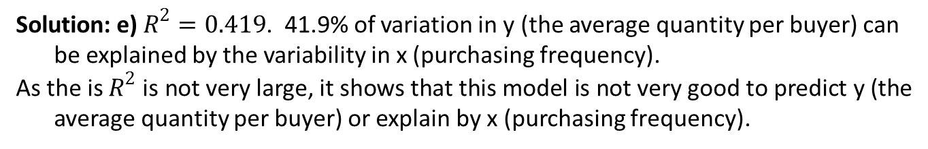
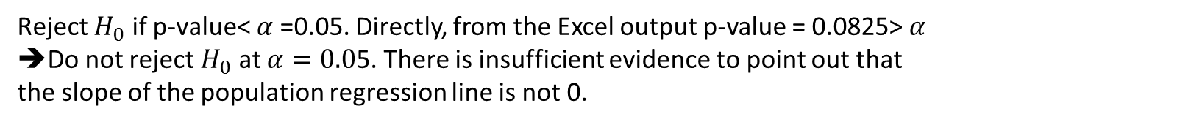

Estimate the regression of average purchase quantity per buyer on purchase frequency.
Interpret the slope of the estimated regression line.
Estimate the average purchase per buyer for the purchasing frequency 20.
Test the hypothesis that the slope of the population regression line is zero against that the slope is not zero. Use a 5% level of significance.
Find and interpret the coefficient of determination. Comment on the result.
Solution: a) $\hat{Y}=2.0289+0.04643X$
Solution: b) Slope=0.04643
For each increase of purchasing frequency, the average purchase quantity per buyer will have an average increase of 0.04643kg
Solution: c) $\hat{Y}=2.0289+0.04643X=2.0289+0.04643×20=2.9575$
Solution: d) Let $β_{1}$be the population proportion slope coefficient
$$H_{0}:β_{1}=0$$
$$H_{1}:β_{1}≠0$$
Reject $H_{0}$ if p-value< $α$=0.05. Directly, from the Excel output p-value = 0.0825> $α$
➔Do not reject $H_{0}$ at $α=0.0$5. There is insufficient evidence to point out that the slope of the population regression line is not 0.
Solution: e) $R^{2}=0.419$. 41.9% of variation in y (the average quantity per buyer) can be explained by the variability in x (purchasing frequency).
As the is $R^{2}$ is not very large, it shows that this model is not very good to predict y (the average quantity per buyer) or explain by x (purchasing frequency).

Slide 26
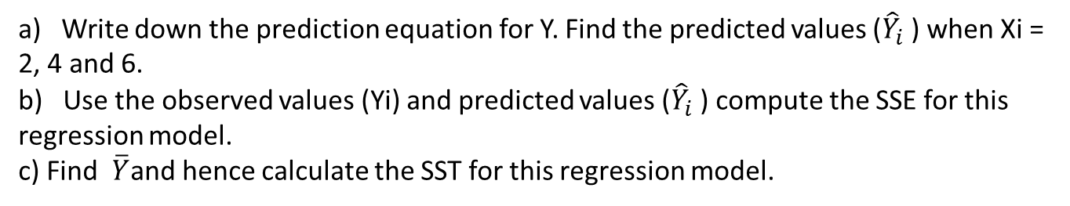
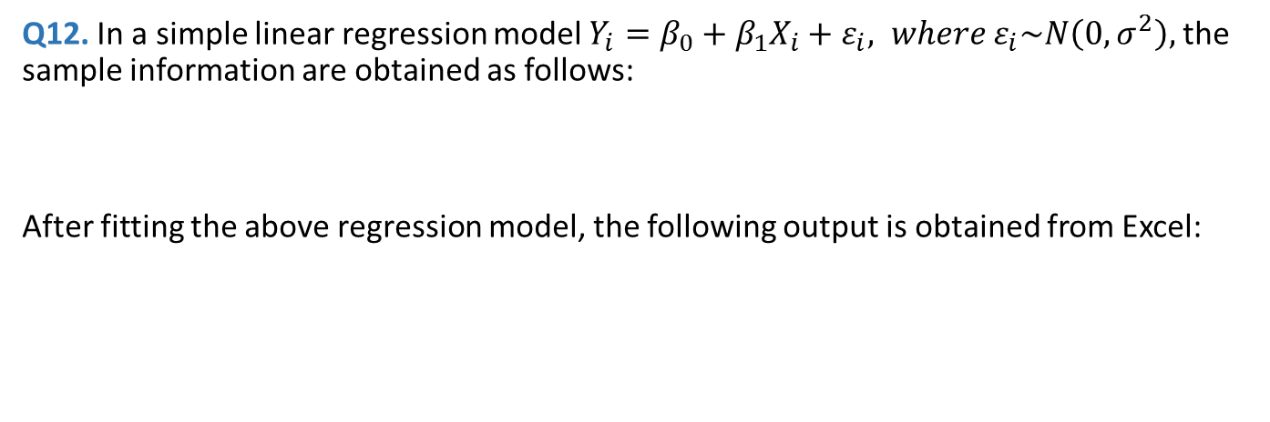
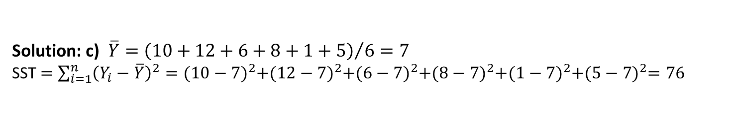
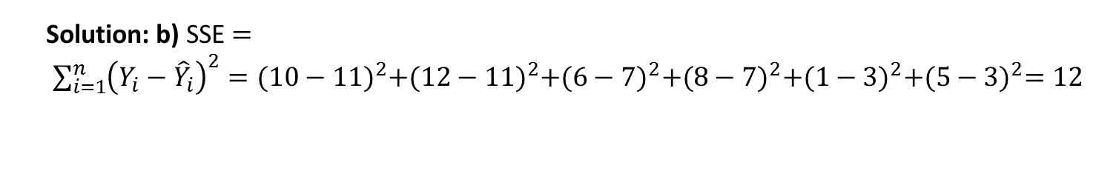
Q12. In a simple linear regression model $Y_{i}=β_{0}+β_{1}X_{i}+ε_{i}, where ε_{i}\sim N\left(0,σ^{2}\right),$ the sample information are obtained as follows:
After fitting the above regression model, the following output is obtained from Excel:
X_{i} | 2 | 2 | 4 | 4 | 6 | 6
Y_{i} | 10 | 12 | 6 | 8 | 1 | 5
 | Coefficients | Standard Error | t Stat | P-value
Intercept | 15 | 1.870828693 | 8.0178373 | 0.0013127
X Variable 1 | -2 | 0.433012702 | -4.618802 | 0.00989
a) Write down the prediction equation for Y. Find the predicted values (${\hat{Y}}_{i}$ ) when Xi = 2, 4 and 6.
b) Use the observed values (Yi) and predicted values (${\hat{Y}}_{i}$ ) compute the SSE for this regression model.
c) Find $\overline{Y}$and hence calculate the SST for this regression model.
Solution: a) $\hat{Y}=15−2X;$
$\hat{Y}$(X=2) = 15-2(2) = 11; $\hat{Y}$(X=4) = 15-2(4) = 7; $\hat{Y}$(X=6) = 15-2(6) = 3
Solution: b) SSE $=$
$\sum_{i=1}^{n}{{\left(Y_{i}−{\hat{Y}}_{i}\right)}^{2}={(10−11)}^{2}+{(12−11)}^{2}+{(6−7)}^{2}+{(8−7)}^{2}+{(1−3)}^{2}+{(5−3)}^{2}=12}$
Solution: c) $\overline{Y}={\left(10+12+6+8+1+5\right)}/6=7$
SST $=$ $\sum_{i=1}^{n}{{\left(Y_{i}−\overline{Y}\right)}^{2}={(10−7)}^{2}+{(12−7)}^{2}+{(6−7)}^{2}+{(8−7)}^{2}+{(1−7)}^{2}+{(5−7)}^{2}=76}$

Slide 27
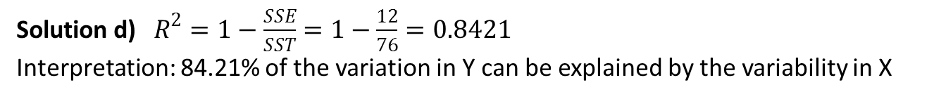



 | Coefficients | Standard Error | t Stat | P-value
Intercept | 15 | 1.870828693 | 8.0178373 | 0.0013127
X Variable 1 | -2 | 0.433012702 | -4.618802 | 0.00989
Q12.
d) Make use of the results obtained in parts (b) and (c), find and interpret the coefficient of determination ($R^{2}$).
e) Based on your result obtained in part (d), or otherwise, find the coefficient of correlation.
f) According to the p-value(s) from the Excel output, is there any evidence showing that variable X is an important factor affecting Y?
Solution d) $R^{2}=1−\frac{SSE}{SST}=1−\frac{12}{76}=0.8421$
Interpretation: 84.21% of the variation in Y can be explained by the variability in X
Solution e) ${|r}_{XY}|=R=\sqrt{0.8421 }=0.9177$.
Furthermore, the slope$b_{1}=−2$ → negative linear relationship→ $r_{XY}=−0.9177$
Solution: f) Let $β_{1}$be the population proportion slope coefficient
$$H_{0}:β_{1}=0$$
$$H_{1}:β_{1}≠0$$
L$et α$=0.05. (or $α$=0.01, $α$=0.1 )
Directly, from the Excel output p-value = 0.00989< $α$➔R$eject H_{0}$ at $α=0.0$5.
There is sufficient evidence that there is a linear relationship between X & Y. i.e. X is an important factor affecting Y.

Slide 28

Q13*. A retails company conducted a study on the cost of opening stores in 2004. the information about number of stores (NUMSTORE), total store area (in square feet) (STORESIZE), and corresponding total cost in (USD) to set up these stores (COST) is collected from 14 areas. The administrator of the company wants to develop an equation that is helpful in pricing the opening of new stores. With the data available, two regression models are constructed with COST as the dependent variable. The Excel regression results are given below. Use the outputs to answer the following questions (α = 0.05).

Slide 29



Q13*. a) What is the sample linear regression equation relating COST and NUMSTORE?
b) Suppose the population linear regression equation relating COST and STORESIZE is $COST=β_{0}+β_{1}STORESIZE+ε$, find the point estimate and 95% interval estimate for $β_{1}$ .
c) A claim is made that each new store adds at least 3000USD of cost. Can you find any evidence to support this claim?
d) Which variable, NUMSTOTE or STORESIZE, is more useful to explain the variations in store setup cost? Why?
e) Based on the regression results, describe the relationship between number of stores in an area and the corresponding setup cost.
f) Based on the regression results, predict the total setup cost for a business area that needs 1000 square feet of store area.
Solution: a) $\hat{Cost}=16593.65+2600.68Numstores$
Solution: b) Point estimator: $b_{1}$=21.76
The CI construction formulation for $β_{1}$ : [ b₁$−t_{α/2, n−2}S_{b_{1}}$ , b₁$+t_{α/2, n−2}S_{b_{1}}$]
95% confidence interval for $β_{1}$:
$b_{1}±t_{α/2, n−2}S_{b_{1}}=21.76±2.1788×7.37=[5.7022,37.8178]$
Solution: c) Let $β_{1}$be the population proportion slope coefficient
$$H_{0}:β_{1}≥3000$$
$$H_{1}:β_{1}<3000$$

Slide 30


Since it’s a lower-tail test, we reject $H_{0}$ if $t<{−t}_{α,n−2}=−1.7823$ at $α=0.0$5
Compute t-test statistic
$t=\frac{b_{1}−3000}{S_{b}}=\frac{2600.68−0.15}{267.66}=−1.49>−1.7823$➔Do not reject $H_{0}$ at $α=0.0$5.
There is insufficient evidence that each new store adds is less than 3000 USD of cost.
Solution: d) According to $R^{2}$ of the two regression models, NUMSTORE explained 88.72% of variations in COST, STORESIZE explained 42.09% of variations in COST. Therefore, NUMSTORE is more useful to explain the variations in store setup cost.
Solution: e) r = 0.9419, there is a strong positive relationship between number of stores in an area and store setup cost
OR $b_{1}$=2600.68, for each additional store added, the store setup cost is estimated to be increased by 2600.68USD on average.
Solution: f) $\hat{Cost}=$10961.14+21.76 STORESIZE=10961.14+21.76*1000=32721.14USD.
The average total setup cost for a business area that needs 1000 square feet of store area is estimated to be 32721.14 USD.

Slide 31
Q14*. In planning for an orientation gathering with new Management Science (MS) major students, the Head of the Department wants to emphasize the importance of doing well in the major courses in order to get better-paying jobs after graduation. To support this point, the Head plans to show that there is a strong positive correlation between starting salaries (SALARY) for recent MS graduates and their grade-point averages (GPA) in the major courses. Records for seven of last year’s MS graduates are selected at random and given in the table. The Excel regression results are given below.

Slide 32
Q14*.
a) What is the sample linear regression equation relating SALARY and GPA? Interpret the intercept and slope of the sample linear regression equation.
b) What is the estimated starting salary for MS graduates with GPA 4.0?
Solution: a) $\hat{Salary}=4.5538+2.6708GPA$
Intercept: If applying the regression equation at GPA=0, the average starting salary is $4553.8. However, the regression equation can only be applied for GPA within [2.23,3.85].
Slope: For each increase of one unit in GPA, the starting salary will have an average increase of $ 2670.8.
Solution: b) It is inappropriate for predicting the starting salary by this regression equation since GPA=4.0 is not within [2.23,3.85]

Slide 33



Q14*. c) Test whether there is a positive linear relationship between SALARY and GPA with level of significance 0.01.
Solution: c) Let $β_{1}$be the population proportion slope coefficient
$$H_{0}:β_{1}≤0$$
$$H_{1}:β_{1}>0$$
Directly, from the Excel output p-value = $P\left(t≥8.4753\right)=\frac{0.000375688}{2}≈0.0001878<0.01=$ $α$➔R$eject H_{0}$ at $α=0.0$1.
There is sufficient evidence that there is a positive linear relationship between SALARY and GPA.
d) The personal secretary of the Head of Department has conducted another study on the same group of graduated to investigate the relationship between SALARY and their IELTS results (IELTS) with the coefficient of correlation 0.92. Which variable, GPA or IELTS, is more useful to explain the variations in starting salary of MS graduates? Explain.
Solution: d)
From the relationship between SALARY and GPA, $R^{2}$= 0.9349
From the relationship between SALARY and IELTS, $R^{2}$=${(0.92)}^{2}$ =0.8464
GPA explained 93.49% of variations in SALARY while IELTS explained 84.64%
➔ GPA is more useful to explain the variations in starting salary.

Slide 34
Q15*. In a manufacturing process, the assembly line speed, Xi (feet per minute) was thought to affect the number of defective parts found, Yi during the inspection process. To test this theory, managers devised a situation in which the same batch of parts was inspected visually at a variety of line speeds. The following tables list the collected data and the Excel output.

Slide 35


Q15*. a) Develop the estimated regression equation that relates line speed to the number of defective parts found. Interpret the intercept and slope of the estimated regression equation?
b) What is the estimated number of defective parts found with line speed 55 feet per minute?
c) At a 0.05 level of significance, determine whether line speed and number of defective parts found are negatively related.
d) Find the predicted values, ${\hat{Y}}_{i}$ when $X_{i}$ = 20, 40 and 60. Compute the SSE for this regression model using the observed values, $Y_{i}$ and predicted values, ${\hat{Y}}_{i}$ . Find and hence calculate the SST for this regression model.
e) From the results in (d), find the coefficient of determination. Compute the percentage of the total variation unexplained by the estimated regression equation.
f) Determine and interpret the correlation coefficient.
Solution: a) $\hat{Y}=250−2X$
Intercept: If applying the regression equation at line speed, X=0, the average number of defective parts is 250. However, the regression equation can only be applied for X within [20,60]
Slope: For each increase of one foot in line speed, the number of defective parts will have any average decrease of 2

Slide 36




Q15*.
Solution: b) $when X=55,$ $\hat{Y}=250−2×55=140$
Solution: c) Let $β_{1}$be the population proportion slope coefficient
$$H_{0}:β_{1}≥0$$
$$H_{1}:β_{1}<0$$
Directly, from the Excel output :
p-value = $P\left(t<−5.7966\right)=\frac{0.0103}{2}=0.00515<0.05=$ $α$
➔R$eject H_{0}$ at $α=0.0$5.
There is sufficient evidence that line speed and number of defective parts found are negatively related.
Solution: d)
SSE $=$ $\sum_{i=1}^{n}{{\left(Y_{i}−{\hat{Y}}_{i}\right)}^{2}=100+100+100+0+100=400}$
$\overline{Y}={\left(220+200+160+130+180\right)}/5=178$
SST $=$ $\sum_{i=1}^{n}{{\left(Y_{i}−\overline{Y}\right)}^{2}=1764+484+324+2304+4=4880}$

Slide 37

Q15*.
e) $R^{2}=1−\frac{SSE}{SST}=1−\frac{400}{4880}=0.9180$
1 $−R^{2}$ = 1-0.9180 = 0.0820 = 8.2% of total variation is unexplained by the estimated regression equation
f) Since the slope is negative, the correlation coefficient is also negative.
r =$−\sqrt{R^{2}}=−\sqrt{0.9180}=−0.9581$
which indicates there is a strong negative linear relationship between Y and X.

Slide 38

Q16. Suppose a fire insurance company wants to relate the amount of fire damage in major residential fires to the distance between the burning house and the nearest fire station. The study is to be conducted in a large suburb of a major city; a sample of 15 recent fires in this suburb is selected. The amount of damage, y, and the distance between the fire and the nearest fire station, x, are recorded for each fire. The results are given as below (α = 0.05).
a) According to the scatter diagram, describe the relationship between X and Y.
b) Find the regression equation.
c) Interpret the slope of the regression equation.
d) Is there sufficient evidence to show that X and Y are linearly correlated? Test this hypothesis using p-value approach and use α = 0.05.
e) Find coefficient of determination and interpret the result.
f) Can we use the above regression equation to do prediction? Why?
g) Find correlation coefficient.
h) Find the 95% confidence interval of $β_{1}$.

Slide 39
Solution: a) There is a strong positive correlation between DAMAGE and DISTANCE.

Slide 40



Solution b) From Excel output, we can find that $b_{0}\text{=1}\text{0.2779 }$
$\text{and} b_{1}=12.5254×0.3927=4.9187$
➔ $\hat{Y}=\text{10.2779}+4.9187X$
c) Interpret the slope of the regression equation.
d) Is there sufficient evidence to show that X and Y are linearly correlated? Test this hypothesis using p-value approach and use α = 0.05.
Solution c) For each increase of one additional mile in DISTANCE, the estimated average amount of DAMAGE will increase by 4918.7 dollars.
Solution: d) Let $β_{1}$be the population proportion slope coefficient
$$H_{0}:β_{1}=0$$
$$H_{1}:β_{1}≠0$$
Directly, from the Excel output :
p-value = $P\left(t<−12.5254\right)+P\left(t>12.5254\right)=1.2478E−08<0.05=$ $α$
➔R$eject H_{0}$ at $α=0.0$5.
There is sufficient evidence that there is linear relationship between DISTANCE and DAMAGE.

Slide 41



Q16.
e) Find coefficient of determination and interpret the result.
f) Can we use the above regression equation to do prediction? Why?
g) Find correlation coefficient.
h) Find the 95% confidence interval of $β_{1}$.
Solution: e) Since
$R^{2}=1−\frac{SSE}{SST}=1−\frac{69.750975}{911.51733}=0.9235$
92.35% of the variation in amount of DAMAGE can be explained by the variability in the DISTANCE.
Solution: f) Yes. Since the coefficient of determination is very high. It indicates that the regression line fits the data set very well.
Or: DISTANCE is a good predictor for the amount of DAMAGE.
Solution: g) slope>0 →positive linear relationship→
Correlation coefficient r= $\sqrt{0.9235}=$0.9610
Solution: h) The 95% confidence interval of $β_{1}$ is [4.0708, 5.7678] from Excel output.

Slide 42

Teaching and Learning Questionnaire (TLQ)
Please access the TLQ system during the evaluation period in the following ways:
through a link in an invitation email (a sample is available on the TLQ website (“FAQ” >“Student FAQ” page));
b. through the course site on Canvas
c. by logging into the TLQ system directly → https://onlinesurvey.cityu.edu.hk/
d. by scanning the TLQ QR Code by smart phones or tablets.

