Slide 1
Impact Study of COVID-19 on the Private and Social Insurance Sectors
- Using Toronto/Ontario as an example
Presenter:
Yuhan Zhao

Slide 2
Background
COVID-19 has imposed significant challenges on the global economy, all countries are joining the journey together to fight against the pandemic during this unprecedented period. Effective actions including implementing social distance, shutting down non-essential businesses have been taken to help slow down the spread and protect vulnerable and innocent lives.
Amid the turbulence, insurance, as one of essential business with the special social responsibilities, is facing greater uncertainty across different line of businesses.

Slide 3
Purpose of Study
The purpose of this paper is to study the impact of COVID-19 across major insurance lines including commercial line, personal auto, residential property and social insurance for both private and social sectors using Toronto or Ontario as an example.
To help the industry -
understand the increasing insurance risks during the pandemic
navigate resources efficiently to the places where is mostly needed
take proactive actions to eliminate potential losses

Slide 4
Business Problem
Commercial line of business- Business Interruption
Commercial insurance is a complex and highly specialized product offered by experienced insurers. Individual study is required for each insurer to assess their exposures triggered by COVID-19.
Using Toronto as an example, The study used Cluster Analysis to help commercial specialists understand the similarity and difference among boroughs in Toronto, so that they could prioritize their tasks accordingly.
The study is based on publicly available information through Foursquare API, the findings is for an average insurance company, each individual insurer should consult this study through the lens of understanding on their own commercial business profiles.
The delivery service was not considered within this study, its impact could be material if more restaurants are trying to adapt to the ‘new norm’ over the long run.

Slide 5
Business Problem - cont.
Personal and Commercial Property – Residential Property
The shut-down of University dorms and outbreak in Senior Homes since March Break in Toronto triggered additional risks for residential property in Toronto.
in general, international students are facing disadvantages when it comes to renting given their short credit histories, COVID-19 might push them further to the less-maintained apartments. Combining with the fact that students are less experienced in cooking, it could trigger extra risks on residential properties due to the cookware malpractice during the lockdown from this angle.
In the meanwhile, the latest reports showed that COVID-19 continues to ravage in senior homes, given the panic outbreaks and short of stuffs in long-term care facilities, it could inject even higher risks for residential properties.
Within this study, both location data from Foursquare and Open Database of Healthcare Facilities from Statistics Canada were leveraged to identify related residential information and conducted cluster analysis on boroughs in Toronto, the feature of this section is to apply condo and nursing houses as two key dimensions when reviewing the residential property risk due to the pandemic.

Slide 6
Business Problem - cont.
Personal Auto – Toronto Killed and Seriously Injured Claims
Working from home during the lockdown leads to decrease on collision claim. At the same time, a number of Canadian insurers are reducing or rebating auto insurance premium to compensate customers for the change.
A trend analysis has been performed using Toronto Police Service Public Safety Data Portal to estimate the Q2 Killed and Seriously Injured (KSI) claims based on 2008-2018 data assuming there is no COVID-19.
The finding from this section serves as a great benchmark for the industry to understand the favorable impact on collision frequency due to COVID-19, and be able to assess the combined impact from both frequency decrease and premium rebate during this period.
Again, the finding applies to an average insurance company assuming it shares the personal auto insurance market fairly among all auto collision claims, each insurer will need to consult this study through a lens of understanding on their own personal auto business portfolios.

Slide 7
Business Problem - cont.
Social Insurance - Unemployment Insurance
More workers lost their jobs recently due to COVID-19, Given the surge of unemployment rate, more EI claims are expected to be submitted in the following months even weeks.
Ontario monthly unemployment by type of work was used as a leading indication to estimate the expected EI benefits claims during the lockdown given the strong correlation between the unemployment and EI claims.
One interesting finding has also been discussed under this section, I believe that the study will help the government to manage the work around upcoming EI claims efficiently, and shed some lights on the near-future claim trend.

Slide 8
Data Sources
Data has been leveraged from different sources to fit in the various analysis within this study
Foursquare: https://developer.foursquare.com/
List of postal codes of Canada: M: https://en.wikipedia.org/wiki/List_of_postal_codes_of_Canada:_M
Open Database of Healthcare Facilities https://www.statcan.gc.ca/eng/lode/databases/odhf
Toronto Police Service Public Safety Data Portal: http://data.torontopolice.on.ca/search?q=traffic
Employment insurance claims received by province and territory, monthly, seasonally adjusted https://www150.statcan.gc.ca/t1/tbl1/en/cv.action?pid=1410000501#timeframe
Unemployment by type of work sought and search method, monthly, unadjusted for seasonality (x 1,000) https://www150.statcan.gc.ca/t1/tbl1/en/tv.action?pid=1410005801

Slide 9
Data Preparation
Similar to the most common journey taken by all data analysis projects, tremendous amount of time has been spent on data preparation stage.
The data is extracted from different sources and merged for various types of analysis. In general, extra spaces and non-sense symbols have been removed from the working database during this stage using Python, also, necessary dimensions i.e. Geospatial data of Toronto are added into the major working database as it seems appropriate.

Slide 10
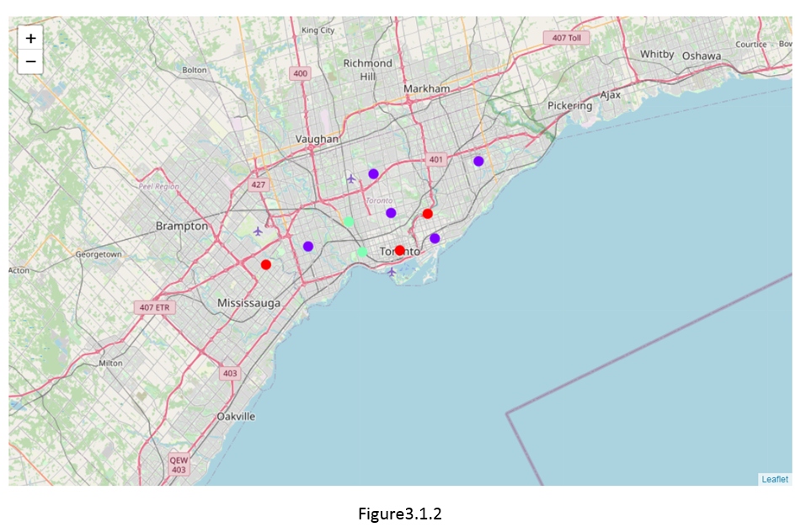
COVID-19 Impact Study – Business Interruption
The study clustered boroughs in Toronto into 3 clusters based on the mostly affected business types( Dining in, Checking in, and Working out). Figure3.1.2 visualizes the final clusters for boroughs in Toronto.

Slide 11
COVID-19 Impact Study – Business Interruption
Commercial line specialists could use this clustering to prioritize their tasks based on their own business profiles.
Similar information, thinking process and actions should apply to the similar clients within the same cluster in order to achieve fairness and improve the work efficiency.
Cluster | Toronto Borough
1 | Downtown Toronto, East York, Mississauga
2 | Central Toronto, East Toronto, Etobicoke, North York, Scarborough
3 | West Toronto, York

Slide 12
COVID-19 Impact Study – Residential Property
Figure3.2.1 visualizes the final clusters based on Residential Building( Apartment/Condo) and additional nursing and residential care facilities information.
The types of nursing and residential care facilities covered in the study are retirement home, long-term care, and long-term care home.
Extra attention should be given to boroughs within cluster 3. North York and Scarborough in cluster 3 are both relatively dominated by nursing and residential care facilities comparing with the rest of boroughs.
Cluster | Toronto Borough
1 | East York, East Toronto, Mississauga, York
2 | Central Toronto, Downtown Toronto, Etobicoke, West Toronto,
3 | North York, Scarborough

Slide 13
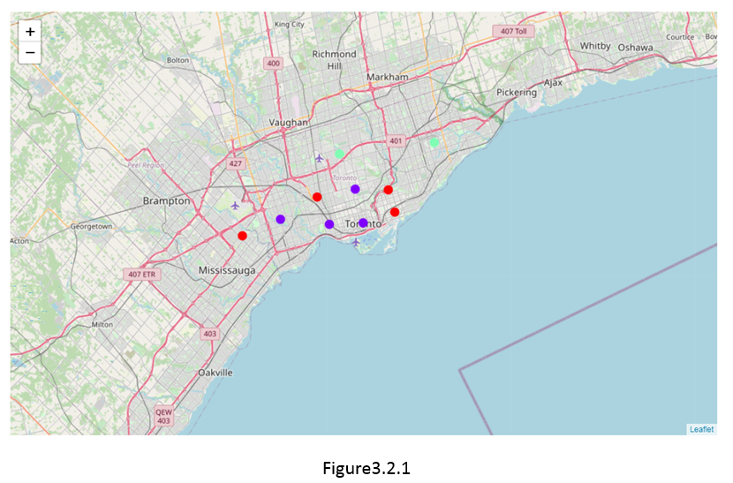
COVID-19 Impact Study – Residential Property

Slide 14
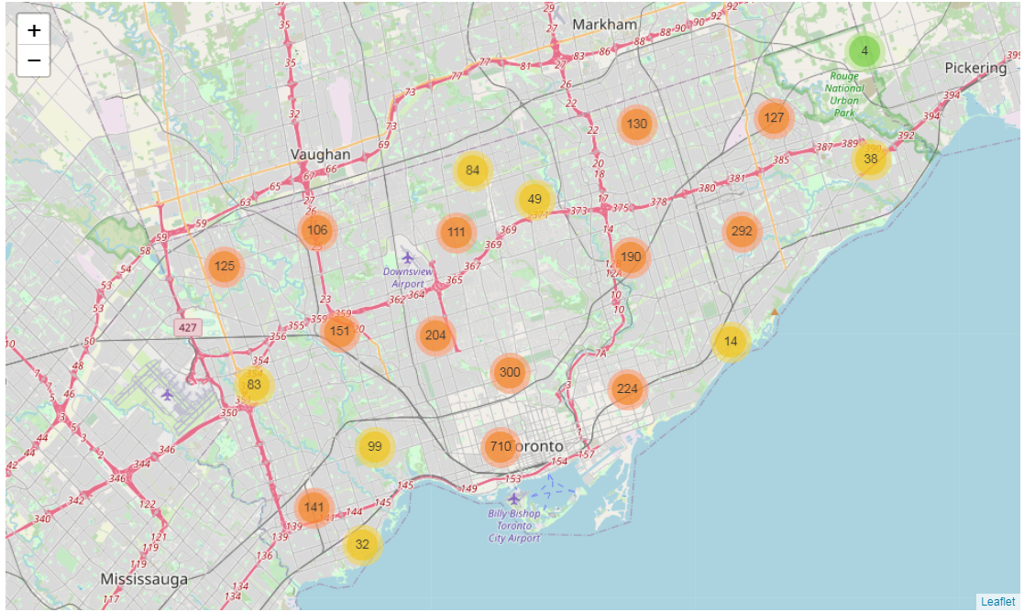
COVID-19 Impact Study – Personal Auto KSI Claims
Figure 3.3.2 grouped the markers into different clusters. Each cluster is represented by the number of Killed or Seriously Injured (KSI) claims in each neighborhood.

Slide 15
COVID-19 Impact Study – Personal Auto KSI Claims
Performed Trend analysis on 2008-2018Q2 KSI claim counts using polynomial curving fitting with the degree of 2. Predicted 2020Q2 KSI claims assuming no impact of COVID-19 is 253.
Due to the scarcity and disparity of data as it’s shown in the figure, the result is subjected to high error term. Insurance companies could use this figure as a benchmark to conduct high-level sense-check on the impact of COVID-19 while looking at their Q2 analysis results.
Again, since the study is based on public data with great volatility, the results need to be considered with great caution.
When considering premium reduction and rebates for policyholders, insurance companies need to understand that the favorable loss development, which is driven by the lockdown, could be mostly offset by the premium rebase, thus IBNR true-up and projections need to be carefully evaluated with the premium rebate action in mind.

Slide 16
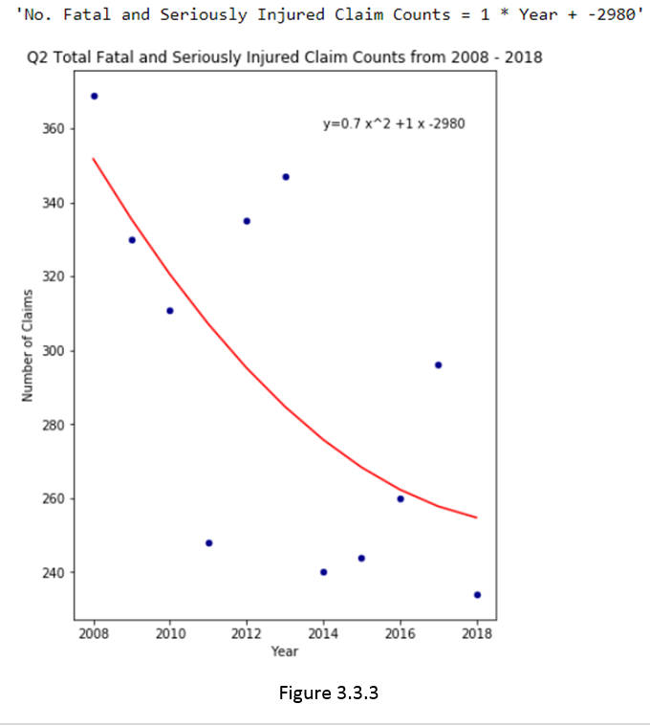
COVID-19 Impact Study – Personal Auto KSI Claims

Slide 17
COVID-19 Impact Study – EI Benefits
Figure3.4.1 shows the comparison of unemployment in Ontario by type between the simple historical average from 2010 to 2018 and Mar.2020.
Temporary layoff increased by 10 times compared with 10-year historical average, it indicates a spike on the unemployment right after the announcement of lockdown in Ontario at the end of March.
The unemployment increase is significant and could serve as a leading factor to predict the surge of EI claims.
Figure3.4.2 shows the plots of normalized unemployment and EI claim counts in Ontario from 2020Feb to 2020Mar. Although the unemployment shows more volatility comparing with EI claim counts during the same periods, the two show the similar pattern over time. When the unemployment changes, the EI claim counts are most likely to follow its path.

Slide 18
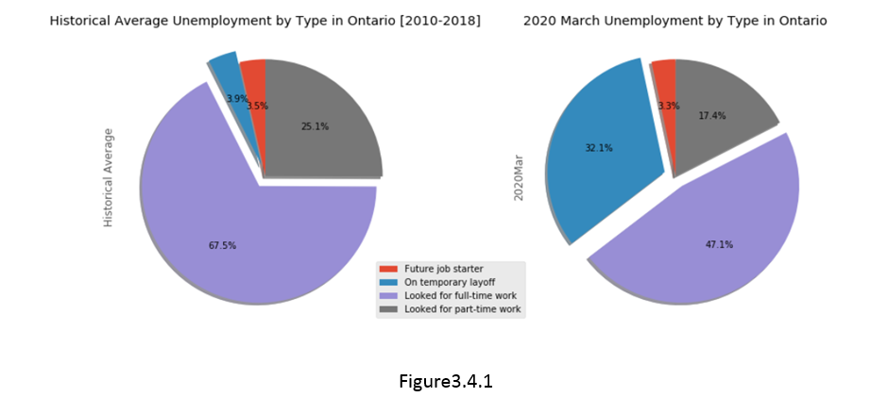
COVID-19 Impact Study – EI Benefits

Slide 19
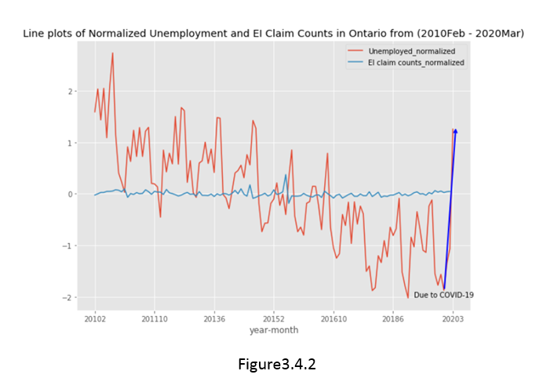
COVID-19 Impact Study – EI Benefits

Slide 20
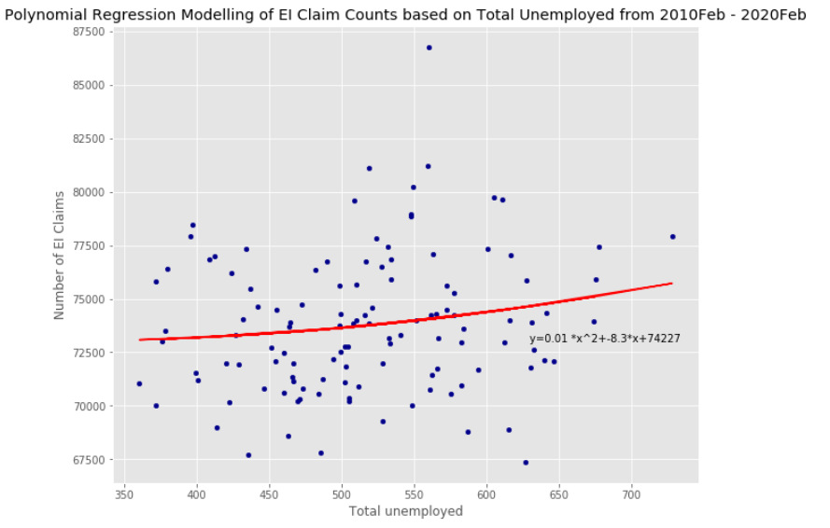
COVID-19 Impact Study – EI Benefits
Performed polynomial regression on EI claim counts based on total unemployment, the result is presented below.
Estimated EI claim counts for 2020March is 74,487, the estimate is lower than EI claim counts during Jan2020 and Feb2020, which seems counter-intuitive to some extent.

Slide 21
COVID-19 Impact Study – EI Benefits
Taking a second look at Figure3.4.2 line plots to check if the model needs to be revised.
Firstly, unemployed are at the different level before and after 2016, it makes more sense to only use more recent experience for modelling given the level of unemployed have been moved to a different mean level, thus data since 2017 was chosen to fit into the second round of modelling.
Secondly, a delay on EI employment claim counts has been observed in the data since it usually takes time to process EI claim payments especially when the unemployment spikes, that explained why the increase on EI claim count did not happen when the unemployment increased by 50% in March 2020. Having this mismatch in the dataset would distort the true correlation between unemployment and EI claim counts. Continuing modelling with the unadjusted database would lead to the wrong conclusion.
In order to remove the impact on the timing delay, the EI claim counts have been shifted 2 month ahead to pair with the true unemployment level during the second round of modelling. Graph3.3.4 shows the polynomial fit with matplotlib for EI claim counts – Total unemployed.
After adjusting the model within the second round, the model indicates that EI claim counts will spike at 82,667 in May 2020 as a reflection on the COVID-19 impact, the claim counts will remain relatively low at 73,222 and 72,974 in March and April as it is shown in Figure 3.4.4

Slide 22
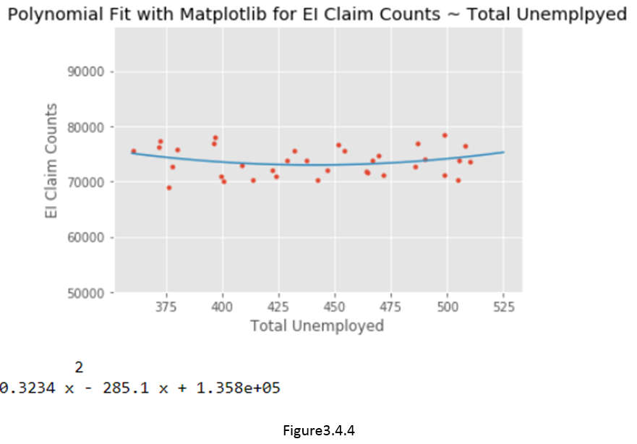
COVID-19 Impact Study – EI Benefits

Slide 23
Conclusion
Thank for taking time reviewing my report. I would like to take this chance to thank the course for encouraging us to apply what we have learnt during the course into the real-life problem. Various analysis technics including Cluster Analysis, Data Visualization, Polynomial Regression, Trend Analysis, and Model Validation play a critical role within this study.
The study gives a well-rounded review on the increasing insurance risks for both private and social insurance imposed by COVID-19, and provides suggestions on proactive actions the industry could consider based on the analysis results. The study can not be completed without the knowledge obtained during the course.

Slide 24
Conclusion – cont.
For business interruption coverage, specialists should prioritize their works based on cluster analysis results. Similar information, thinking process and actions should apply to the similar clients within the same cluster in order to achieve fairness and improve the work efficiency.
For residential property coverage, extra attention should be given to boroughs where most of nursing and residential care facilities are located.
For personal auto line of business, trend analysis on Killed or Seriously Injured claims indicates that when considering premium reduction and rebates for policyholders during the lockdown, insurance companies need to understand that the favorable loss development, which is driven by the lockdown, could be mostly offset by the premium rebase, thus IBNR true-up and projections need to be carefully evaluated with the premium rebate action in mind.
For unemployment benefit, the study shows that there is a delay on the EI claim counts following the spike of unemployment. The model was adjusted to correct the delay and reflect the true correlation between the two.

Slide 25
Reference
[1] http://www.ibc.ca/on/business/covid-19
[2] https://www.ctvnews.ca/health/coronavirus/students-at-several-colleges-and-universities-asked-to-vacate-dorms-over-covid-19-1.4858086
[3] https://www.theglobeandmail.com/canada/article-outbreaks-at-seniors-homes-linked-to-almost-half-of-covid-19-deaths/
[4] https://business.financialpost.com/news/fp-street/insurers-cutting-auto-premiums-amid-pandemic-as-less-driving-leads-to-fewer-claims
[5] https://business.financialpost.com/news/fp-street/insurers-cutting-auto-premiums-amid-pandemic-as-less-driving-leads-to-fewer-claims
[6] https://developer.foursquare.com/docs/

Slide 26
Thank you

