Slide 1

BANKOMAT

Slide 2
Table of contents
01
02
03
04
Topic
TEAM
MEMBERS
STAGES OF REALIZATION
USED TECHNOLOGY

Slide 3
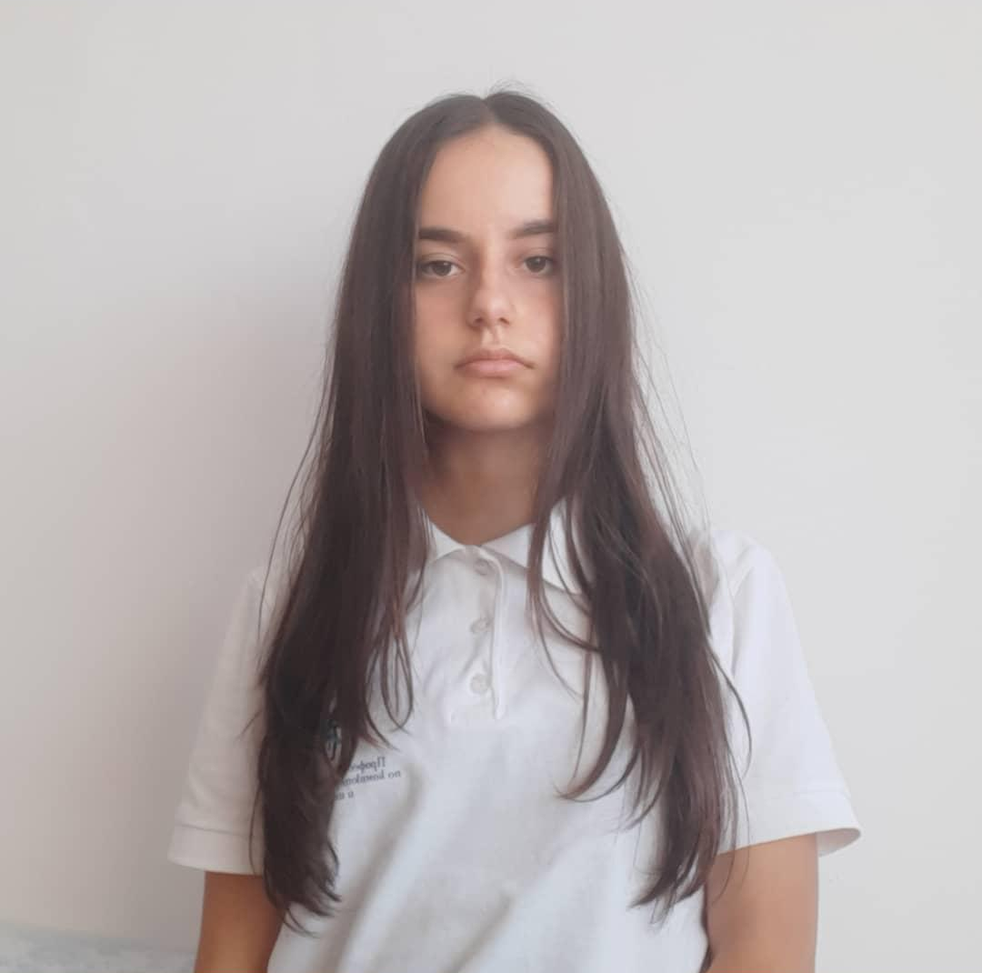
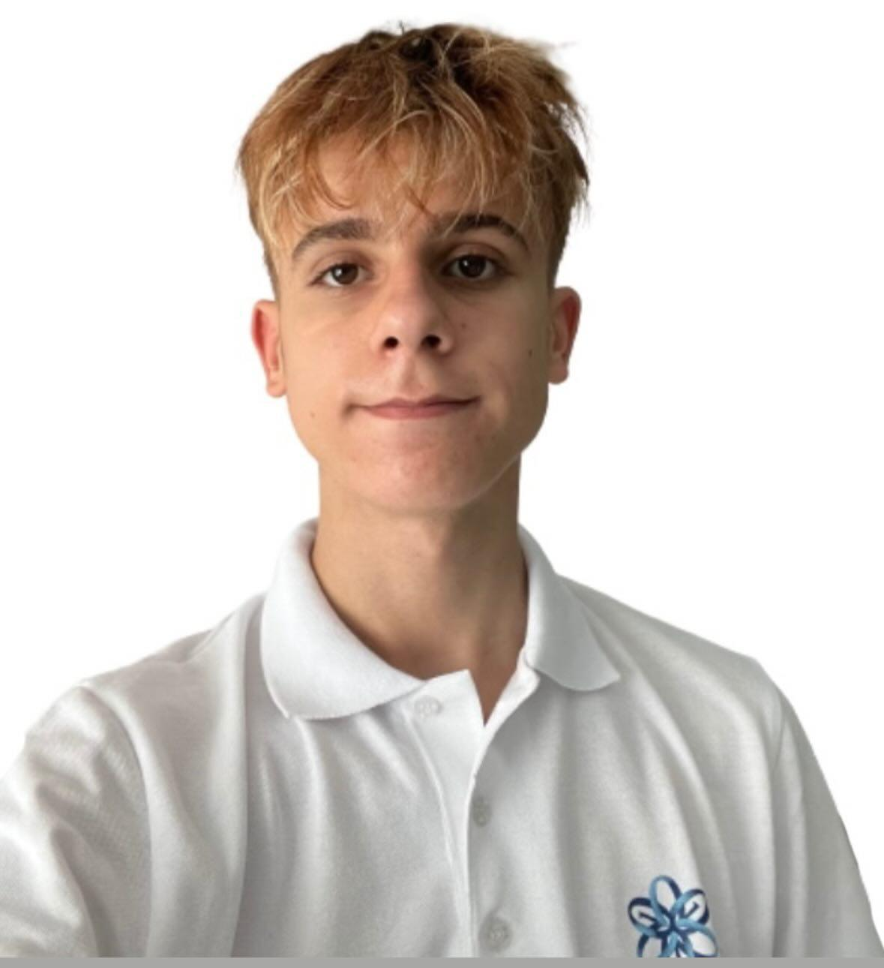
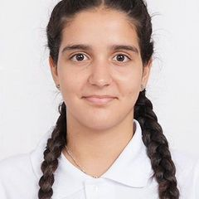
TEAM MEMBERS
Yana Ilcheva
Krisitan Gaydov
Demetra Karagyozova
Scrum Trainer
10v
Back-end developer
10b
Frond-end developer
10g

Slide 4
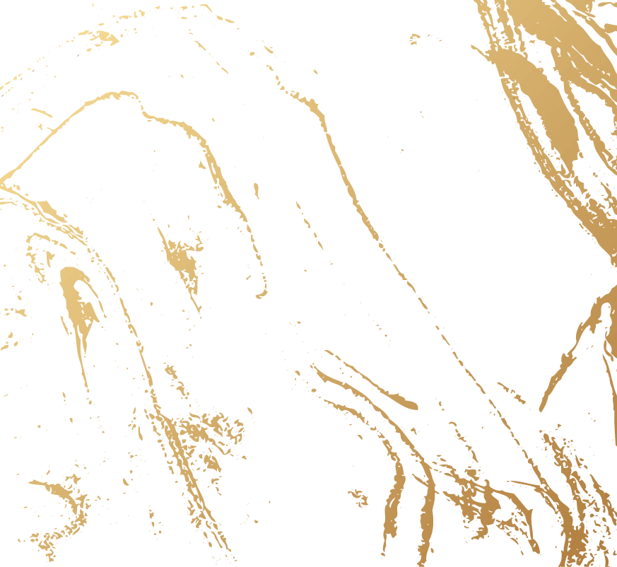
Topic
The topic of this project is to make a C++ application or website. Our project's purpose is to keep your finances save and show your purchase activity.

Slide 5
STAGES OF REALIZATION
1
2
3
4
Organizing and giving everyone a role
Thinking of an idea
Realization
Presenting the final result

Slide 6










USED TECHNOLOGY

Slide 7
LET’S MOVE ON TO OUR PROJECT

