Slide 1
DiffBind: Differential binding analysis of ChIPSeq peak data
Yanzijun
2019.01.02

Slide 2
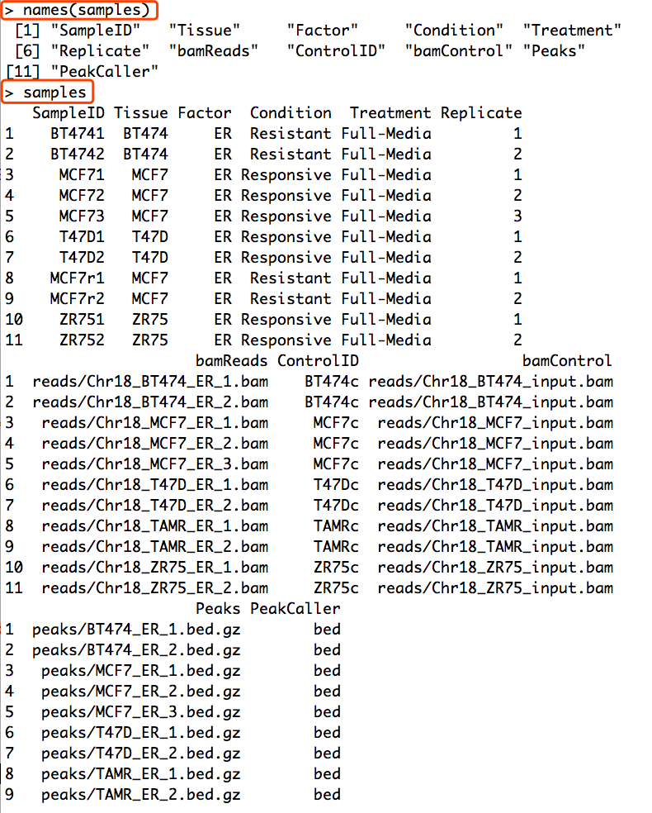
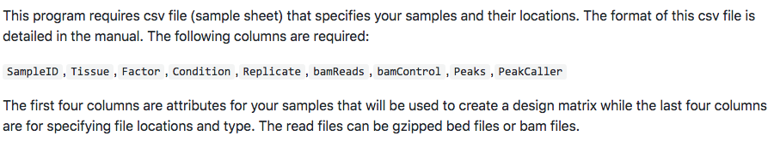
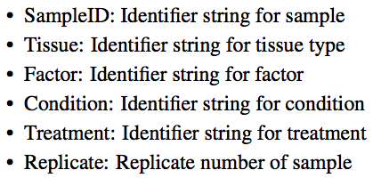
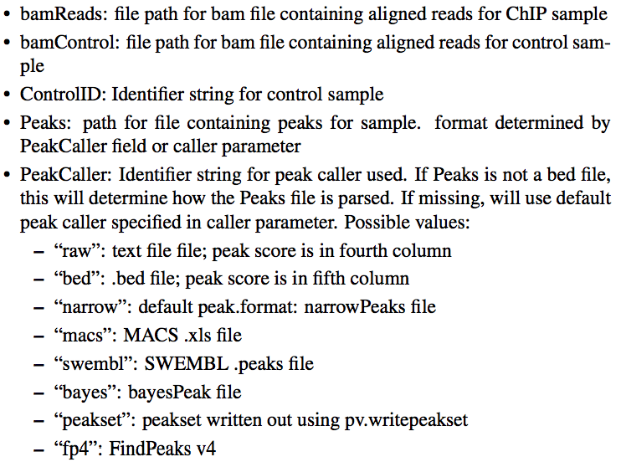
1. Reading in the peaksets

Slide 3
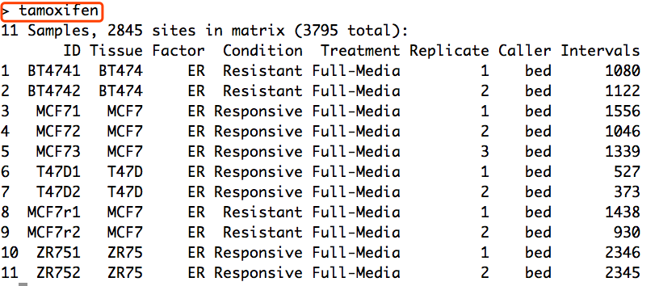
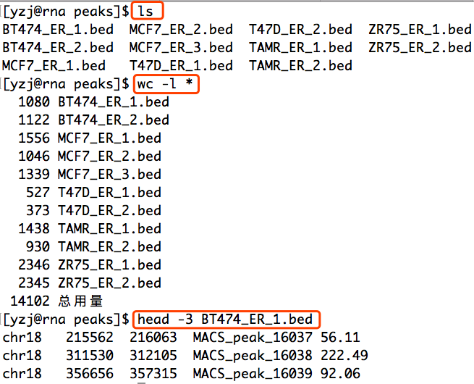
1. Reading in the peaksets
This shows how many peaks are in each peak set, as well as (in the first line) the total number of unique peaks after merging overlapping ones (3795), and the dimensions of dba.plotPCA(default binding matrix of 11 samples by the 2845 sites that overlap in at least two of the samples.

Slide 4
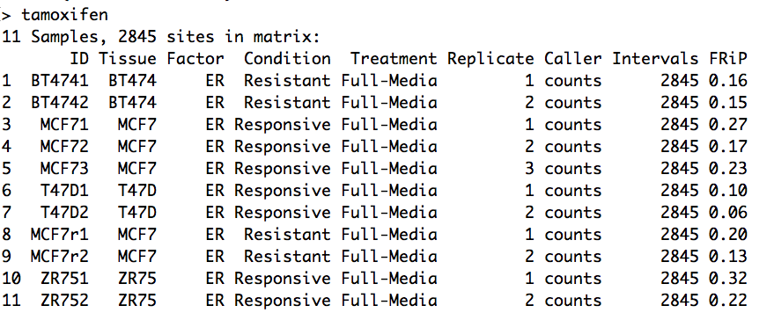
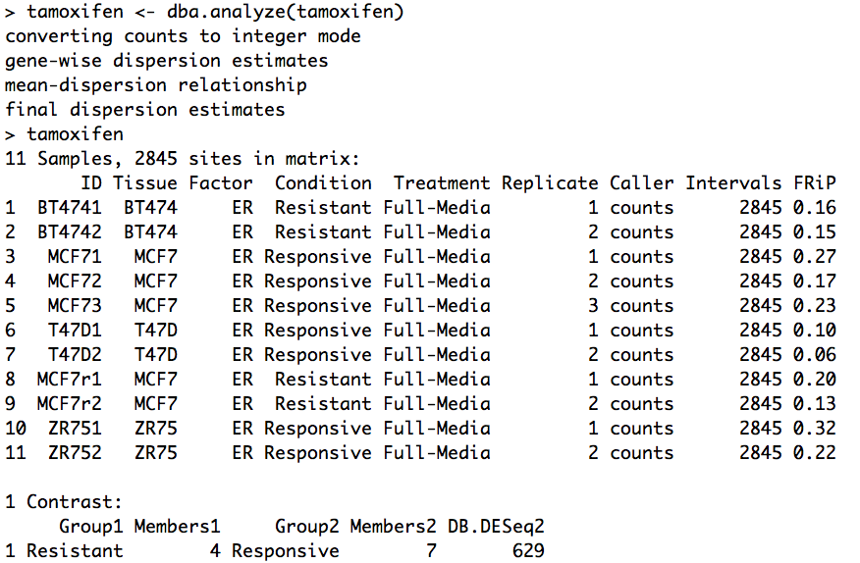
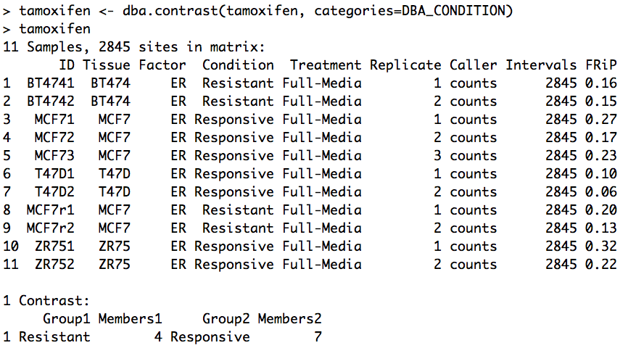
2. Counting reads
4. Performing the differential analysis
3. Making a contrast

Slide 5
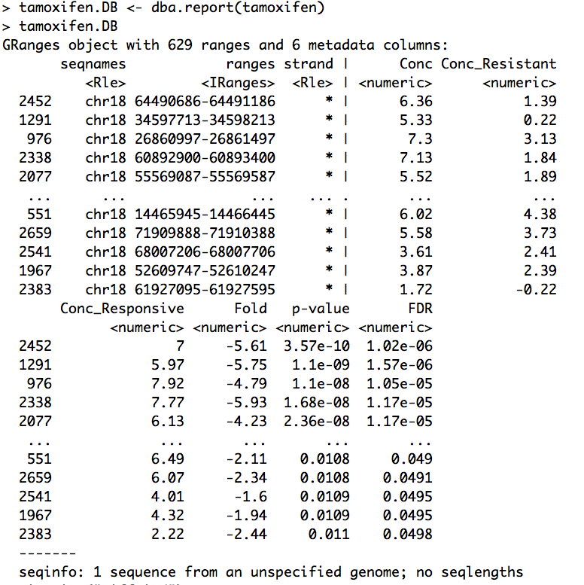
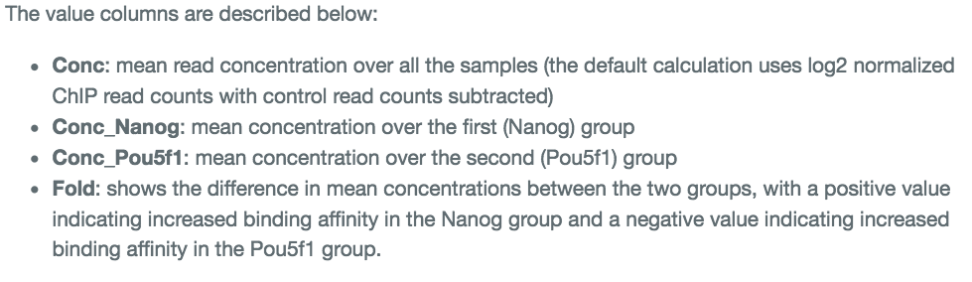
5. Retrieving the differentially bound sites

