Slide 1
Assigned Paper:
SCAN: a structural clustering algorithm for networks
Group 8: Pinchen Cui, Qian Wang, Wenyu Zhu, Yunfan Rao

Slide 2
Problem Definition
Network/Graph Clustering
Not only partition the data into clusters but also identify the hub and outliers
Hub: vertices that bridge multiple clusters
Outliers: vertices that are marginally connected to clusters.

Slide 3
Example
A Network with 2 Clusters, a Hub and an Outlier
7
6
Many methods such as modularity-based algorithm can partition this example into 2 clusters but cannot isolate vertex 6 and 13.
8
11
12
3
4
2
9
10
5
0
1
13
Notes:
Modularity was proposed as a quality measure of network clustering. For a clustering of graph with k clusters, the modularity is defined as:
Q = sigma(k,s=1) [Ls/L – (Ds/2L)^2]. By finding max Q - NP complete.

Slide 4
Concepts
Vertex Structure
Γ(𝑣) = {𝑤 ∈ 𝑉|(𝑣, 𝑤) ∈ 𝐸} ∪ {𝑣}
7
6
The SCAN algorithm use the neighborhood of the
vertices as clustering criteria instead of only their direct
connections.
Γ(0): {0,1,4,5,6}
Γ(5): {5,0,1,2,3,4}
8
11
12
3
4
2
9
10
5
0
1
13

Slide 5
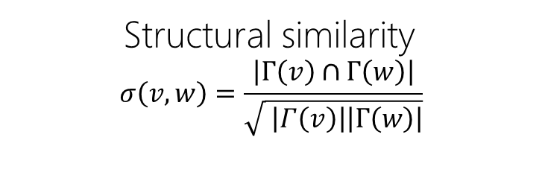
Concepts
Structural similarity
$$σ\left(v,w\right)=\frac{\left|Γ\left(v\right)∩Γ\left(w\right)\right|}{\sqrt{ \left|Γ\left(v\right)\right|\left|Γ\left(w\right)\right|}}$$
7
6
Vertex 6 ?
Normalize the number of common neighbors
by the geometric mean of the two neighborhoods’ size
𝜎(0,5) = 0.73
𝜎(0,4) = 0.8
8
11
12
3
4
2
9
10
5
0
1
13

Slide 6
Concepts
ε-neighborhood
N_{ε}(v)={w∈Γ(v)|σ(v,w)≥ε }
Core
CORE_{(ε,μ)} (v)⇔|N_ε (v)|≥μ
ε-neighborhood is a collection of vertex v: it contains all the neighbors of v that has similarity larger than threshold ε.
When the number of neighbors in N_{ε}(v) > μ, then we mark v as Core vertex.
If vertex w is a ε-neighbor of core vertex v, then w is directly reachable from v. And they should be in one Cluster.

Slide 7
Algorithm Overview
for each Vertex in Graph do:
if Vertex is Core: A new Cluster is generated
insert all ε-neighborhood of Vertex into queue Q
While Q!=0 do:
y = first vertex in Q
for each x in [direct reachable vertices of y] do:
if x is unclassified or non-member:
assign x to this Cluster
if x is unclassified:
insert x into Q
remove y from Q
if Vertex is not Core: marked as a non-member
for each non-member vertex v do:
if v’s neighbors locate in two or more clusters: marked as Hub
else: marked as Outlier

Slide 8
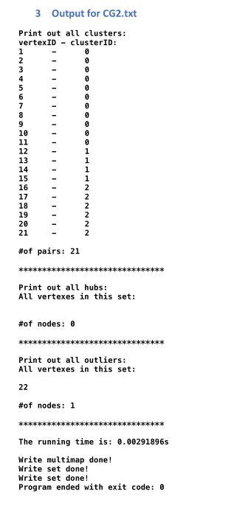
Implementation
Programing Language: C++
Dataset:
xsmall_dataset
CG1
CG2
CA-GrQc
Facebook_combined
com-dblp.ungraph

Slide 9
Evaluation
SCAN algorithm and FastModularity algorithm.
Dataset:
xsmall_dataset
CG1
CG2
CA-GrQc
Facebook_combined
com-dblp.ungraph
Efficiency, Effectiveness

Slide 10
Evaluation - Efficiency
Run time of all the datasets:
Datasets | # of nodes | # of edges | SCAN Running time | FastModularity Running time
Xsmall_dataset | 14 | 27 | 0.00068s | 0.00977s
CG1 | 16 | 39 | 0.00117s | 0.01431s
CG2 | 22 | 81 | 0.00293s | 0.01799s
CA-GrQc | 5242 | 28980 | 1.00958s | 1.3176s
Facebook_combined | 6039 | 90234 | 24.5235s | 2.42043s
Com-dblp.ungraph | 317080 | 1049866 | 63.6722s | 5763.2s

Slide 11
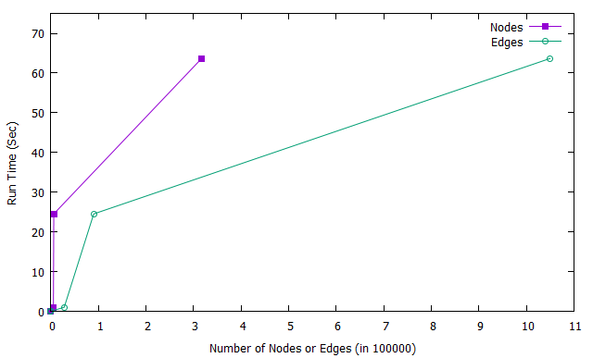
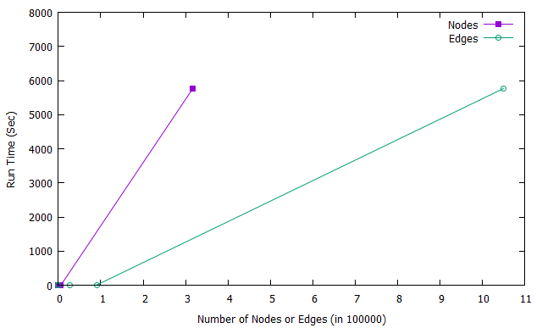
Evaluation - Efficiency
SCAN
FastModularity

Slide 12
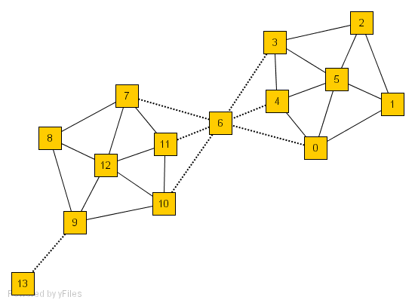
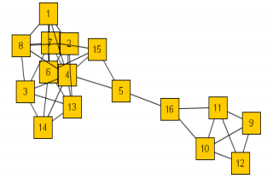
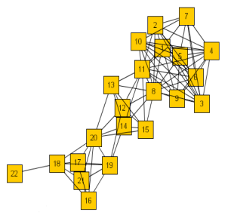
Evaluation - Effectiveness
Graph3
Graph1
Graph2

Slide 13
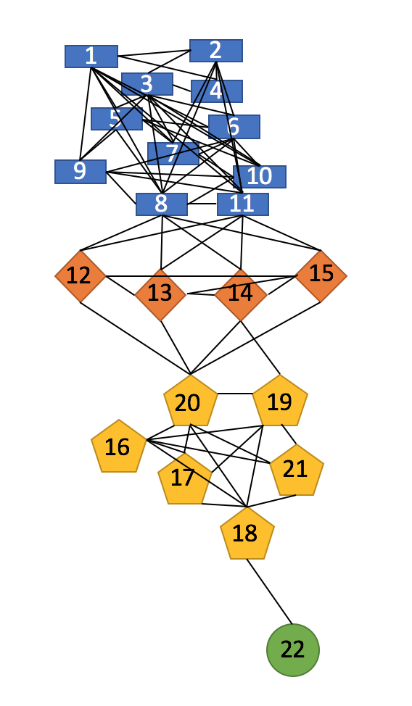
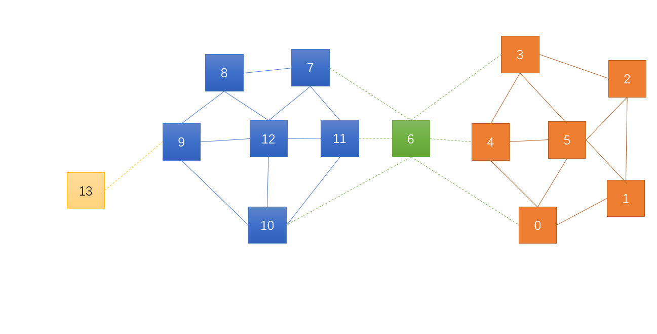
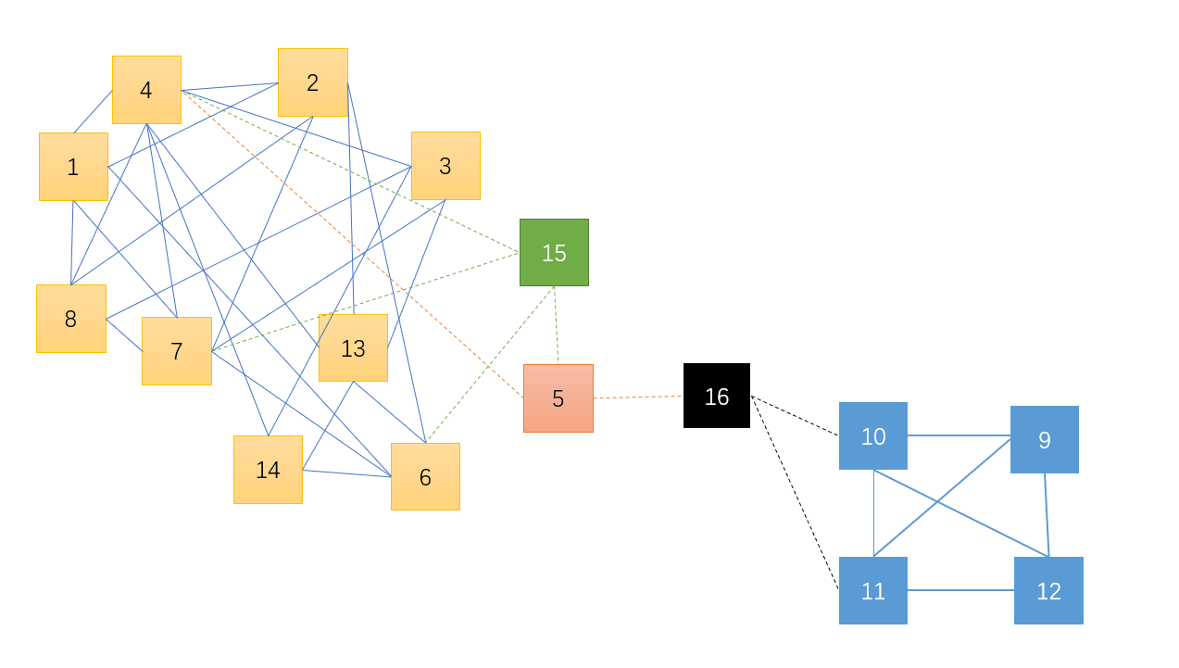
Evaluation - Effectiveness
Graph1
Graph2
Graph3

Slide 14
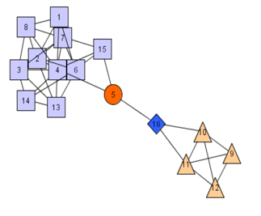
Evaluation - Effectiveness
Graph2
We have a different clustering result with the paper in Graph 2.
(Vertex 15)

Slide 15
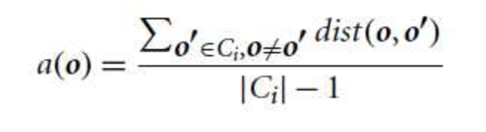

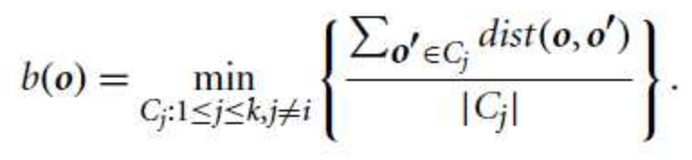
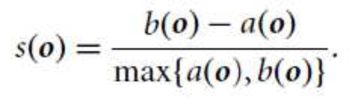
Evaluation - Effectiveness
Sihouette Coefficient
Adjusted Rand Index
Graph | ARI Value
G1 | 1
G2 | 0.84
G3 | 1
Graph | Point # | a(o) | b(o) | s(o)
G1 | 5 | 5 | 28 | 0.82
G2 | 4 | 9 | 18 | 0.5
G3 | 3 | 10 | 31 | 0.68

Slide 16
Extension and Improvements
For a given dataset, the parameter ε and μ need to be manually picked.
And the different parameters will change the clustering result.
An algorithm has been proposed to eliminate the parameter sensitivity of SCAN.
--A clustering algorithm based on natural nearest neighbor.

Slide 17
Extension and Improvements
On the other hand, another paper proposes a optimized version of SCAN, which aims to reduce the time complexity.
SCAN++: Efficient Algorithm for Finding Clusters, Hubs
and Outliers on Large-scale Graphs.

Slide 18
Question?

