Slide 1
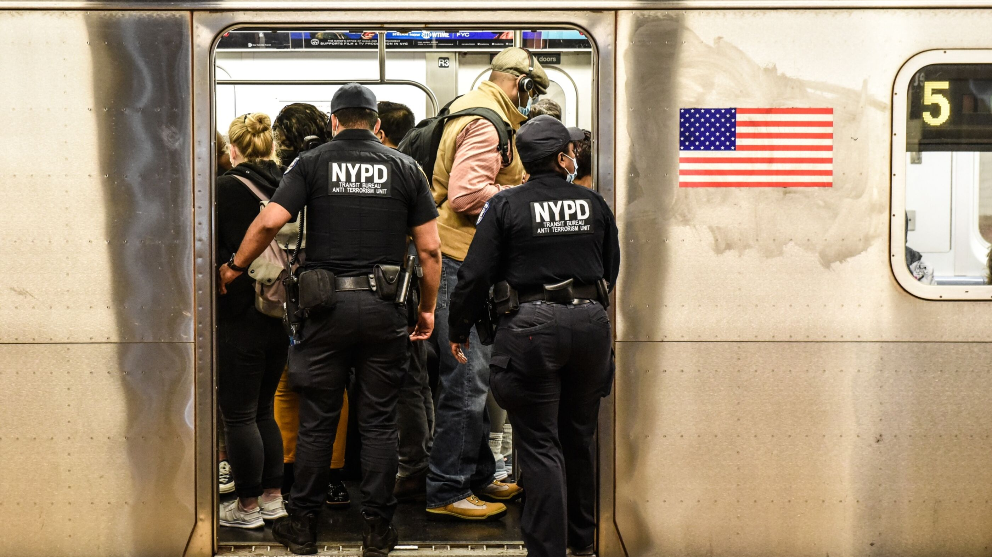
Lockdowns and Loaded Guns
The Impact of COVID on NYC's Shooting Dynamics
Chris Pei, Jeremy Zhang
Notes:
A close look at NYPD shooting instance data to see who is affected, where are potential hot spots, and how the pandemic may have unintentionally increased NYC shootings in recent years.

Slide 2


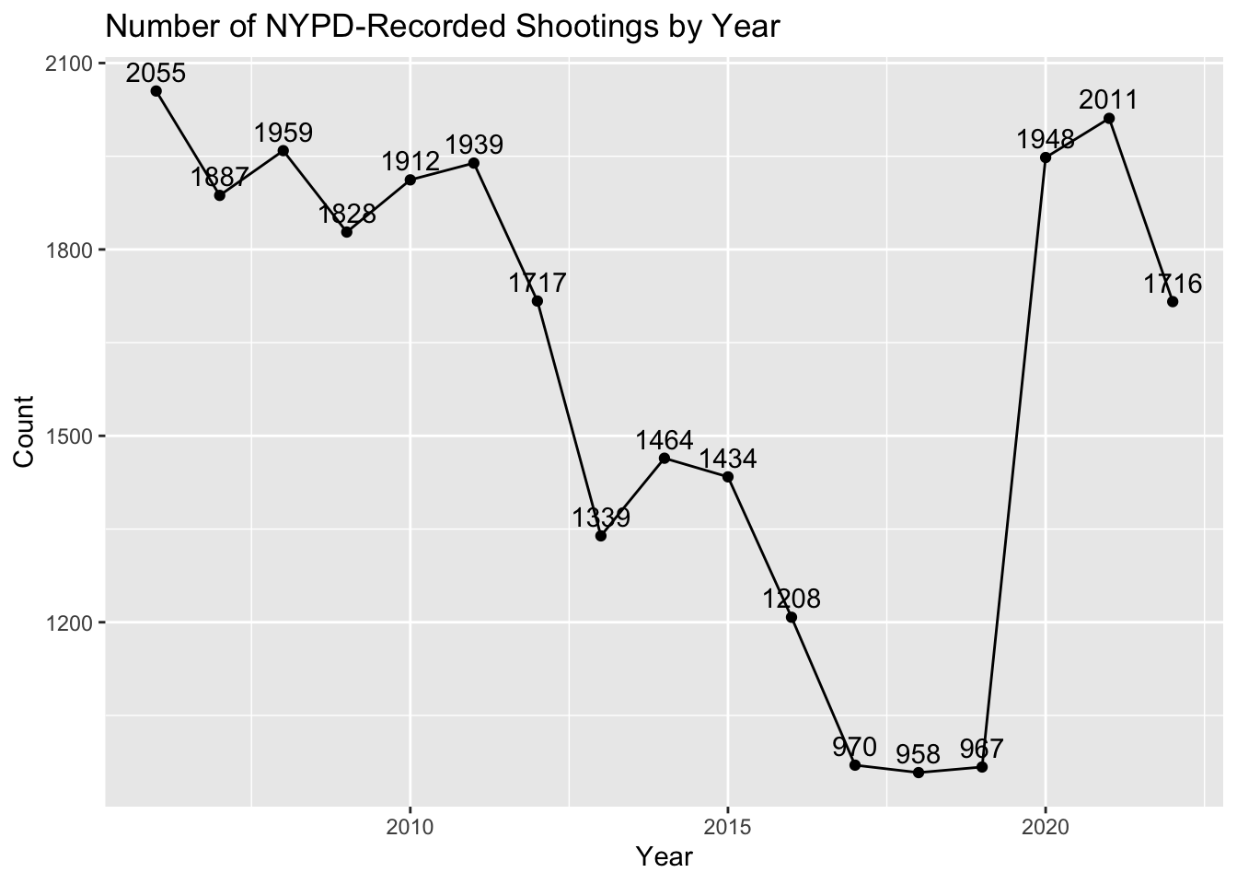
Introduction
From the late 1980s to the 2010s, New York City recorded a significant reduction in crime
Changes in policing strategies
Economic conditions
Urban development
Social programs
…
In 2020, the world was significantly upended by the COVID-19 pandemic
We will investigate if the lockdown, combined with other ensuing socioeconomic conditions, contributed to the uptick in shooting instances in NYC.

Slide 3
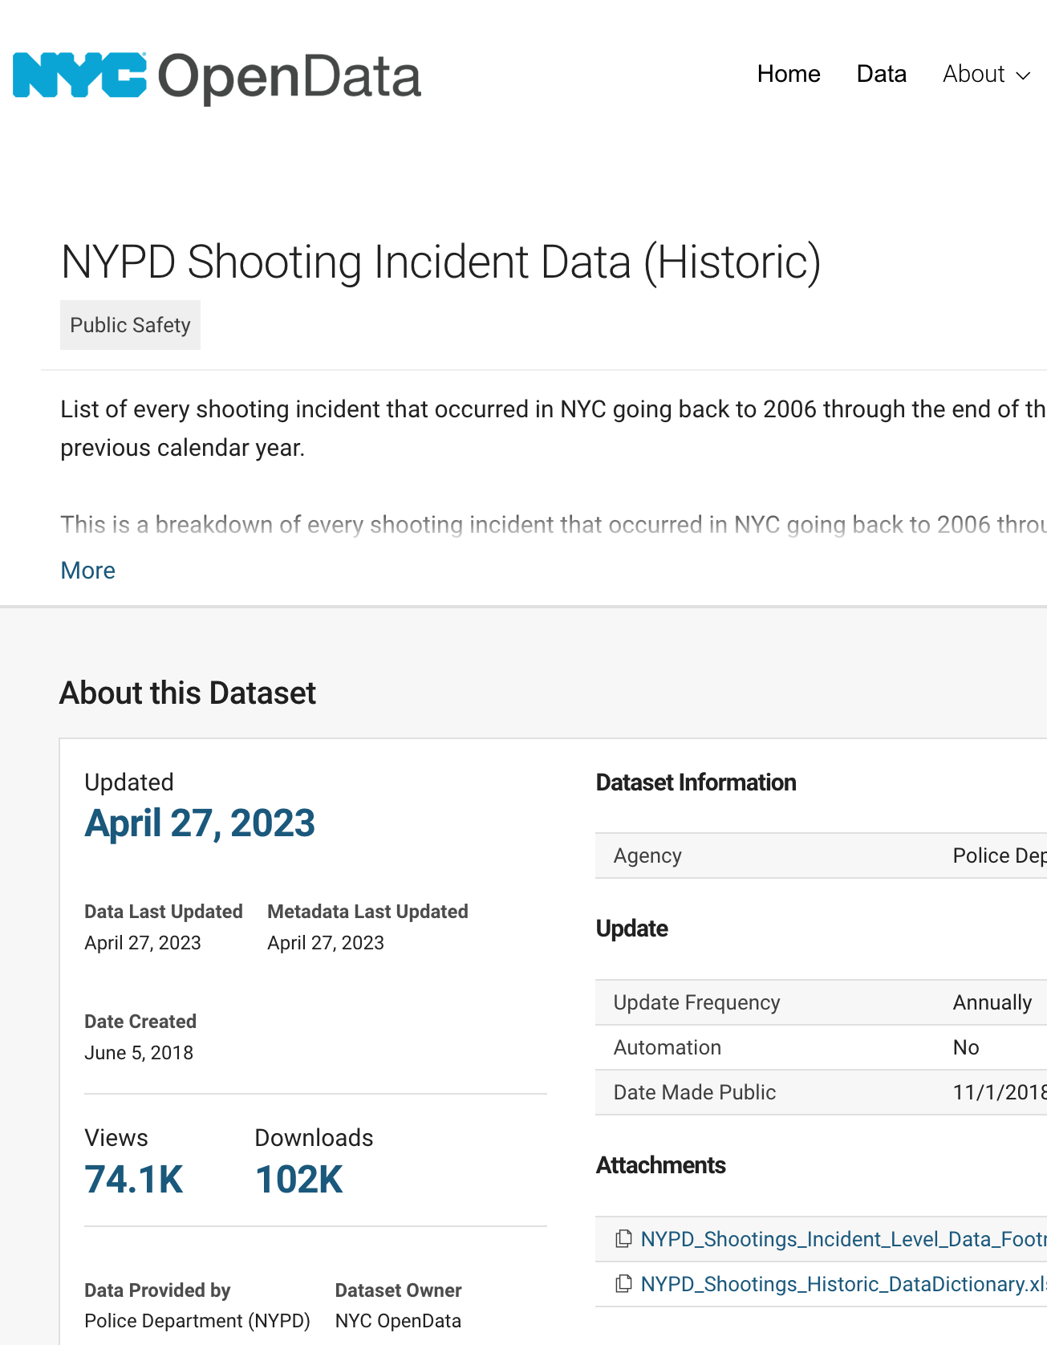
The Data
Authored by the New York Police Department (NYPD)
Specifically, by the Office of Management Analysis and Planning
Comprehensive record of recorded shooting incidents in New York City, spanning from 2006 to the end of 2022
Shooting incident: location, time
Demographic information: age, race, and sex of the individuals
Potential Biases
Historical policing policies
Social inequalities
Prejudices in documenting data
Misuse of certain fields: e.g., gender and race

Slide 4
Our Data Approach
Clean
Inspected for reliability
Formatted “NA” and unexpected values
Adjusted data types
…
Manipulate
Aggregated values by year or by month
Formatted categorical data
Ensured appropriate scope of study
Calculated percentage for easier comparison
…
Visualize
Mapping
Line Plot
Bar Graph
Faceting

Slide 5
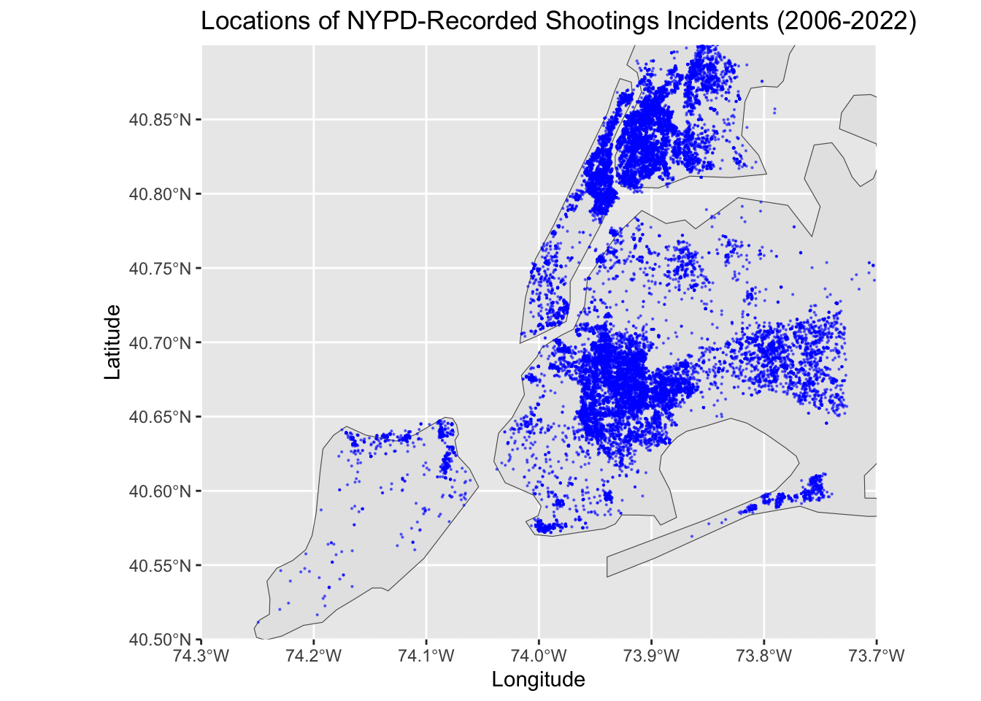
Mapping Shootings
Geographical patterns
Identify high volume locations
Explore community impact
Goes beyond crime mapping
economic disparities, urban development, or discriminatory policies
Notes:
Geographical Perspective: Emphasizing the importance of spatial distribution in understanding urban crime dynamics in New York City.
Longitude and Latitude Mapping: Utilization of longitude and latitude data to create a detailed map of shooting incidents, providing a clear visual representation of where these events are occurring in the city.
Identifying High Volume Locations: Analyzing the geographic spread to pinpoint areas with a high frequency of shooting incidents.
Exploring Community Impact: Investigating how certain communities, particularly those with higher instances of shootings, are affected. This includes examining socio-economic and demographic characteristics.
Beyond Crime Mapping: This approach goes further than just mapping crime - it initiates a deeper dive into the complex interplay of factors in NYC life, such as economic disparities, the effects of discriminatory policies, and patterns of urban development.
Insight into Violent Crime Trends: The geographical analysis helps in discerning patterns and trends in violent crime that might be obscured in traditional, non-spatial data analyses.

Slide 6
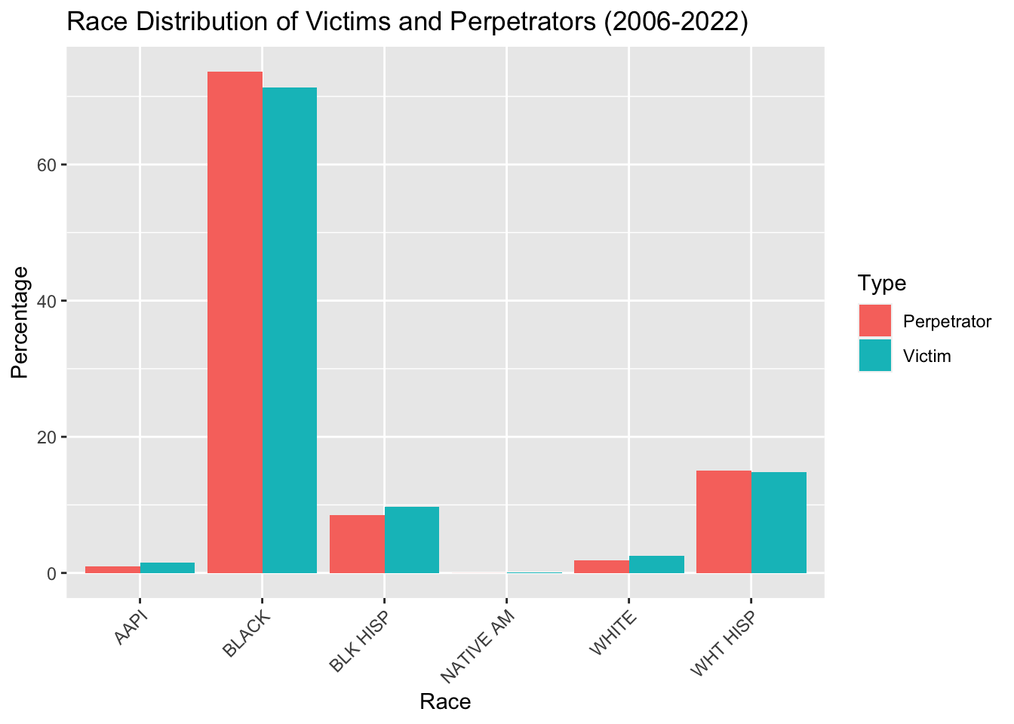
Racial Makeup
Racial Demographics of Victims and Perpetrators
Perpetrator > Victims
Black, White Hispanic
Perpetrator < Victims
AAPI, Black Hispanic, Native American, White
Insights?
Historical context
“Stock and frisk”
Biases
Racial dynamics
Interactions
Conflicts
Communities

Slide 7
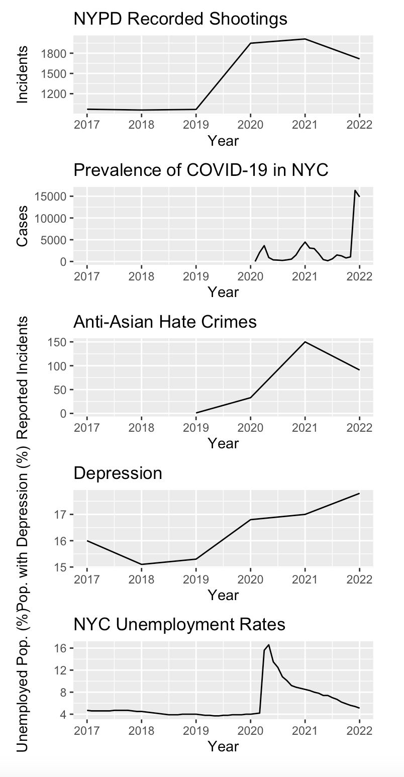
Potential Drivers Behind the “Loaded Guns”
COVID-19 Prevalence
Within weeks of shelter in place mandates, shooting instances increased 11.7%¹
Anti-Asian Hate Crime
Public opinion and social unrest led to increase of hate crimes²
Depression
"67% of the participants in states hit hardest by COVID-19 reported an increase in alcohol consumption […] 25% reporting a significant increase"³
Unemployment
Limited in-person work environments, coupled with poor economic conditions, led to massive layoffs and unemployment
Sutherland, M., McKenney, M. and Elkbuli, A. (2020), “Gun violence during COVID-19 pandemic: paradoxical trends in New York city, Chicago, Los Angeles and Baltimore”, The American Journal of Emergency Medicine, Vol. 39.
Gover, A.R., Harper, S.B. and Langton, L. (2020), “Anti-Asian hate crime during the COVID-19 pandemic: exploring the reproduction of inequality”, American Journal of Criminal Justice, Vol. 45 No. 4, pp. 647-667.
Koppel, S., Capellan, J. A., &amp; Sharp, J. (2022). Disentangling the impact of covid-19: An interrupted time series analysis of Crime in New York City. American Journal of Criminal Justice, 48(2), 368–394. https://doi.org/10.1007/s12103-021-09666-1

Slide 8

Summary
COVID-19 Impact
Shelter-in-place and its disruptive effect on crime patterns
Surge in shootings during the pandemic
Data Analysis and Findings
Temporal yearly trends of shooting incidents
Geographical distribution of shootings across NYC
Racial demographics of victims and perpetrators
Discovering potential drivers behind the post-pandemic surge
Societal and Economic Factors
Challenges in Analysis
Limitations due to data scope and accuracy
Historical context of policing and societal inequities
Implications and Future Research
Need for more in-depth studies on the causal relationship
Racial dynamics
Final Thoughts
Broader societal challenges
Underlying causes, including economic and racial disparities

