Slide 1
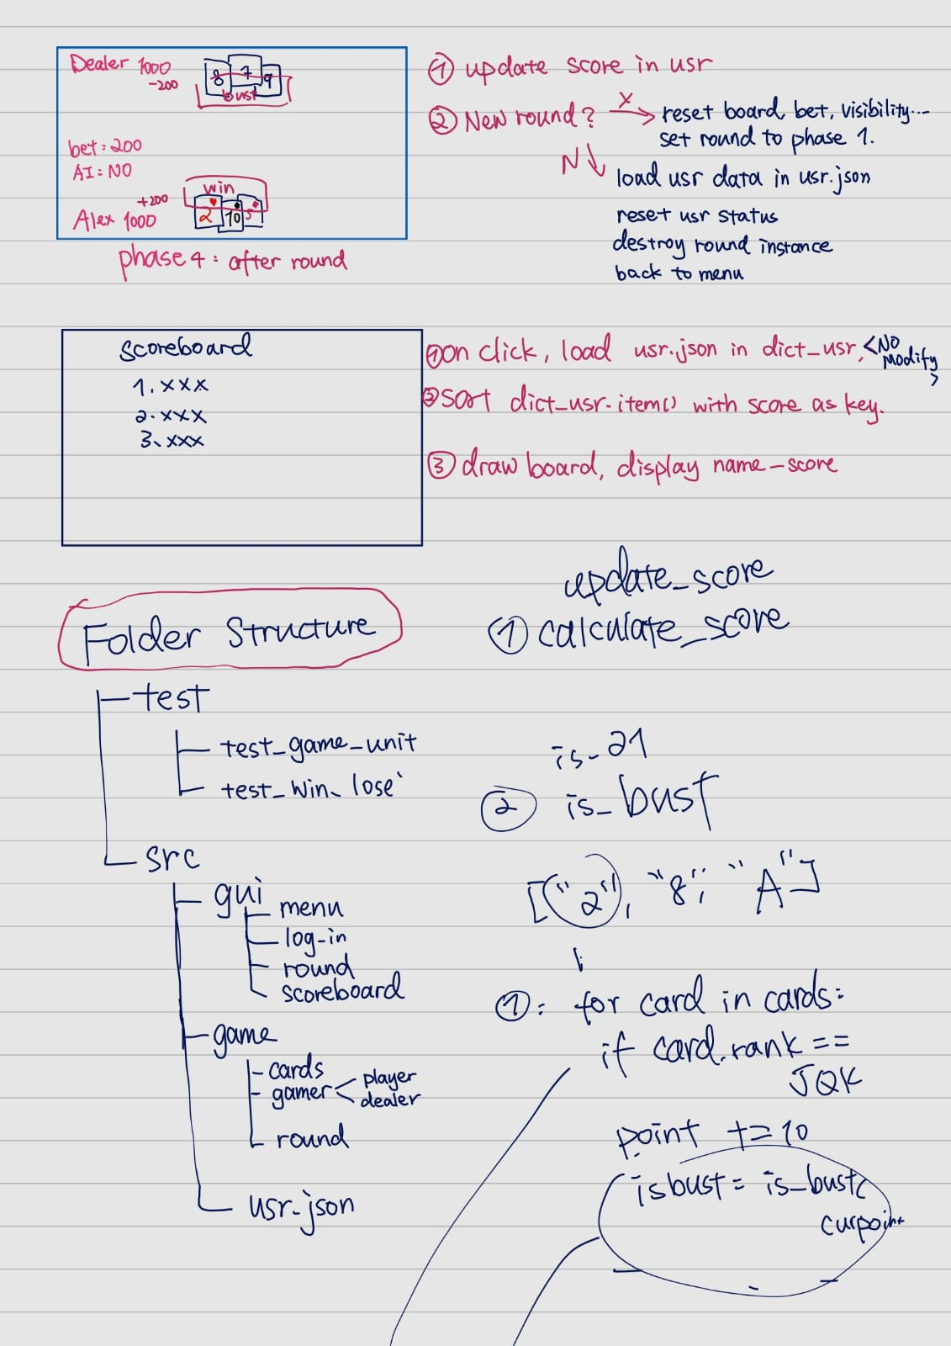
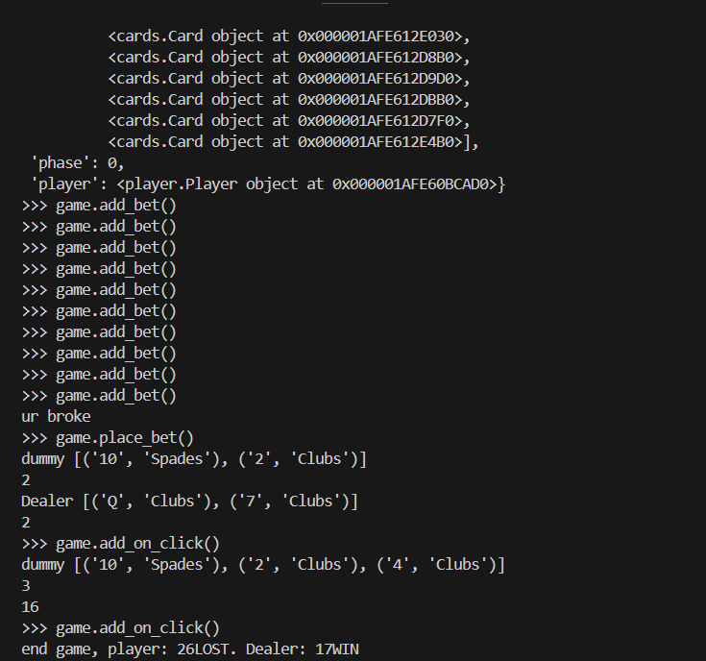
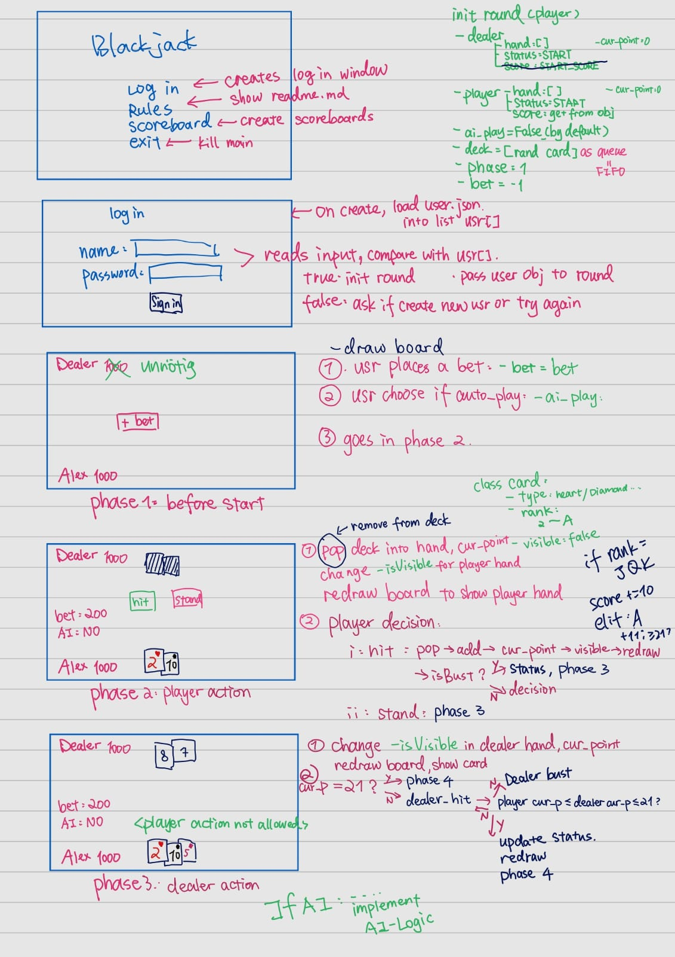

POV: You have a wonderful team.
How it started:
How it‘s going:
Introduction to Python Programming - Group 7
Bildquelle: https://cdn-icons-png.flaticon.com/512/10553/10553491.png

Slide 2
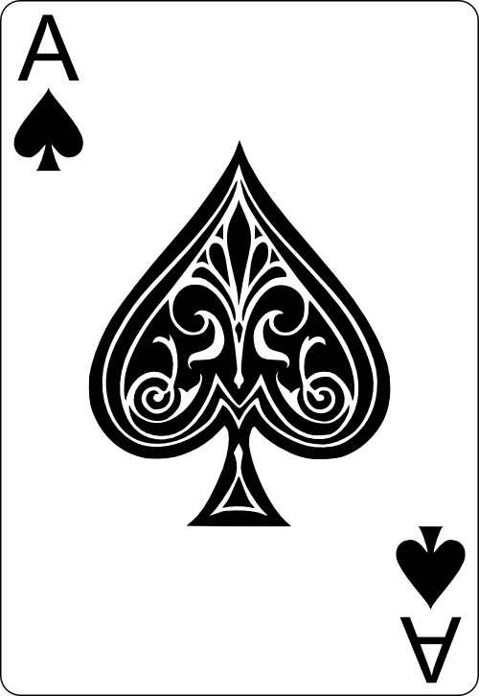

Frontend:
  -main menu
  -login page
  -game table
  -place bet
  -score board
Backend:
  -Game logic
  -Cards
  -Player & Dealer
  -User Management
  -User database
Let‘s play a round!
Introduction to Python Programming - Group 7
Bildquelle: GitHub - hayeah/playing-cards-assets: Playing Cards Image Assets (SVG+PNG)

Slide 3

TODO:
Beautiful frontend
Integration
Brutally test it until it broke…
Deliver Bug-free project
README.md
Introduction to Python Programming - Group 7
Bildquelle: https://cdn-icons-png.flaticon.com/512/2857/2857100.png

Slide 4
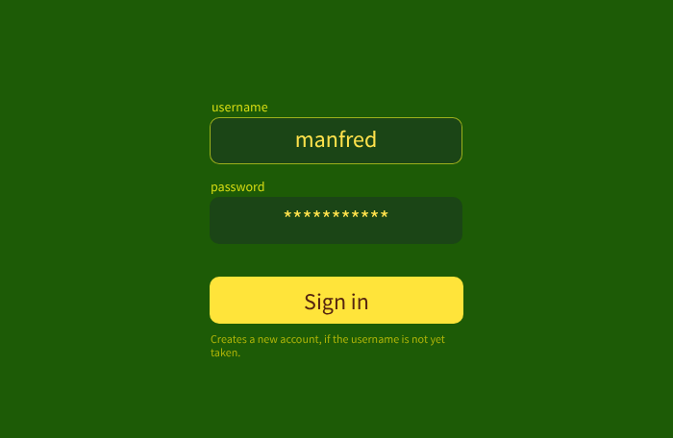
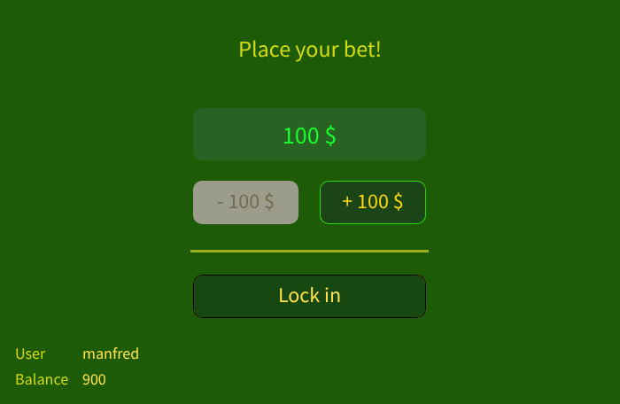
..and it will look like this(hopefully):
Presented by:
Abigail Major
Nils Maier
Yining Zhou
Introduction to Python Programming - Group 7

