Slide 1


Managing Risk

Slide 2
Chapter Concepts
Identifying risks and their potential impact
Assessing the likelihood of occurrence and degree of impact of risks
Risk response planning
Controlling risks

Slide 3
Learning Outcomes
Discuss what is involved in managing risks
Identify and categorise risks
Assess and prioritise risks
Prepare a risk response plan
Develop a risk assessment matrix
Control risks

Slide 4
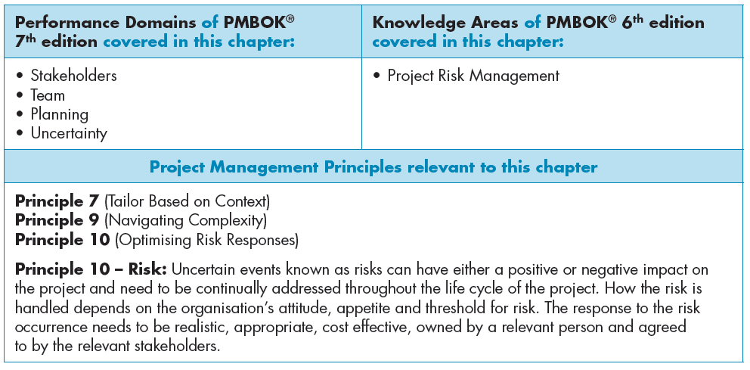

Slide 5
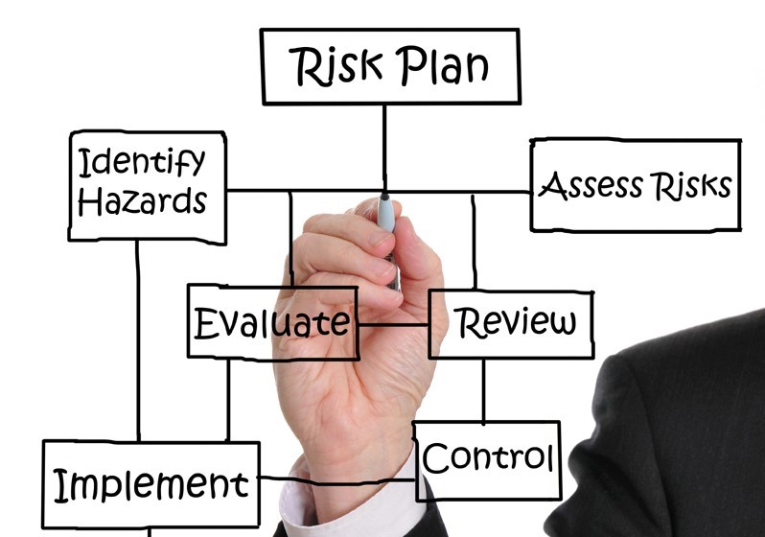
What is the purpose of risk management?
Why is it important to manage risks throughout the lifecycle of a project?
How could risks be identified, categorised and assessed?
How should a risk response plan be prepared?
How should a risk assessment matrix be developed?
How could the project risk control process be described?
  How should a risk response plan be implemented?
  What does risk monitoring involve?

Slide 6
Identify Risks
Can jeopardise achieving the project objective
Brainstorm sources of risks
Establish categories for risks and evaluate
Use historical information
Progressively elaborate and identify new risks as more information becomes available
Notes:
Identify risks
A risk is an uncertain event that, if it occurs, can jeopardise achieving the project objective.
Risk identification includes determining which risks may adversely affect the project objective and what the impact of each risk might be if it occurs.
Sometimes a sponsor identifies major risks in the project charter when the project is authorised.
A common approach to identifying the sources of risks is brainstorming.
Risks that are accounted for should be somewhat likely to occur and/or can have a significant negative impact on achieving the project objective.
Establishing risk categories may help to identify and evaluate risks.
Some possible categories are technical, schedule, cost, human resources, external, or sponsor/customer.
Historical information from past projects is another source that can be helpful in identifying possible risks.
The project team can progressively elaborate and identify new risks, as well as the estimated impacts of previously identified risks as more information becomes available.

Slide 7
Approaches to identifying risks
Brainstorming
A common approach to identifying the sources of risks
The project manager should involve key project team members in identifying potential sources of risk
Each member of the project team can bring his or her experience and insight to help develop a comprehensive list of risks
Common sense and reason must prevail when identifying risks
Risk Categories
Are groupings of potential sources of risk by topic and then identifying risks that might occur for each category
Examples of risk categories (pg 296 – 297):
Technical
Schedule
Cost
Human resources
External
Sponsor/customer

Slide 8
Approaches to identifying risks
Historical information
Historical information from past projects can be helpful in identifying possible risks
If post project evaluations are done on completed projects, they could be a good source for identifying possible risks
Additional examples of specific risks – page 297

Slide 9
Assess Risks
Determine the likelihood the risk event will occur
Evaluate degree of impact on the project objective
Prioritise
  Likelihood of occurrence and degree of impact
  Position relative to the critical path
Notes:
Assess risks
Risk assessment involves determining the likelihood that the risk event will occur and the degree of impact the event will have on the project objective.
Risks can then be prioritised based on the likelihood of occurrence and degree of impact
Risks on the critical path should be given higher priority because, if the risk occurs, it would have a greater impact on the schedule than if it was associated with activities on a path that has a large positive value of total slack.

Slide 10
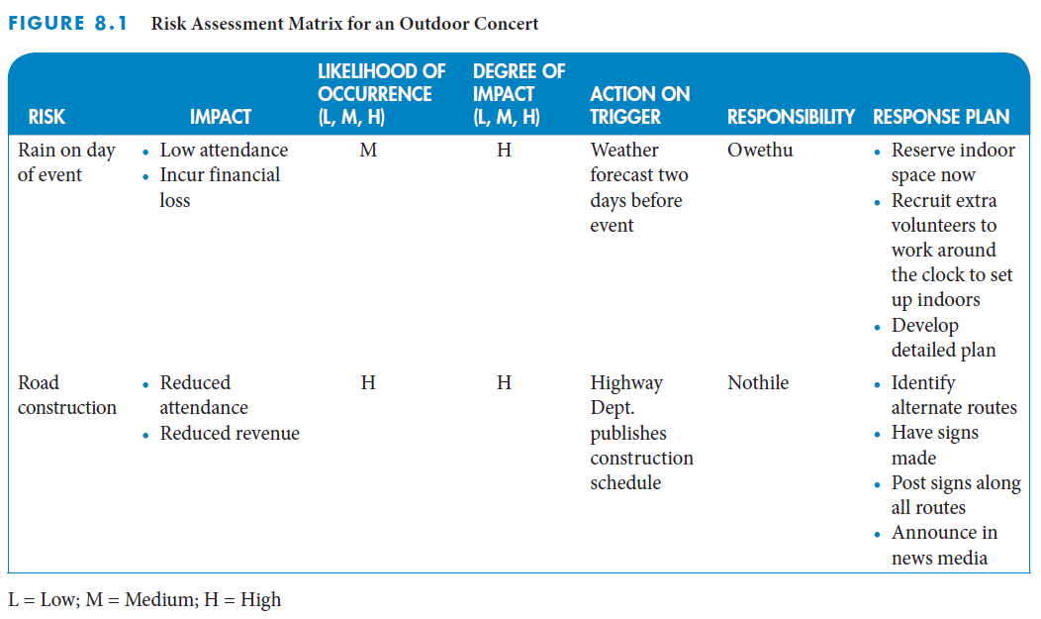
Risk assessment matrix
Notes:
Risk assessment matrix
This figure depicts a risk assessment matrix, a tool for assessing and managing risks.
It helps to:
List the impact of the risk
Evaluate the likelihood of occurrence
Determine the degree of impact
Identify the action trigger
Name a person responsible
Create a response plan to avoid, mitigate, or accept the risk

Slide 11
Plan Risk Responses
Set of actions
  Prevent or reduce the likelihood of occurrence or the impact of a risk
  Implement if the risk event occurs
Establishes a trigger point for implementing an action
Assigns responsibility for implementation
Avoid, mitigate, or accept the risk
Include a contingency fund to cover implementation cost
Notes:
Plan risk responses
A risk response plan is a defined set of actions that seek to prevent or reduce the likelihood of occurrence or the impact of a risk.
The risk response plan is implemented if the risk event occurs.
Risk response planning involves establishing a trigger point for when to implement the actions to address each risk
It assigns responsibility to specific individuals for implementing the response plan.
A risk response plan can be helpful in avoiding, mitigating, or accepting the risk.
Project prices and budgets should include a contingency or management reserve to pay for additional costs associated with implementing response plans.

Slide 12
Control Risks
Risk control includes implementing risk response plans and monitoring risks
Risk response plans should be implemented as appropriate when their trigger point is reached
Risk monitoring includes regularly reviewing the risk assessment matrix throughout the project
Regularly review and evaluate all risks to determine whether there are any changes to the likelihood or potential impact of any of the risks
Project meetings are a good forum for regularly reviewing, updating and addressing risks
Track and document which risks actually occurred and their impact

Slide 13
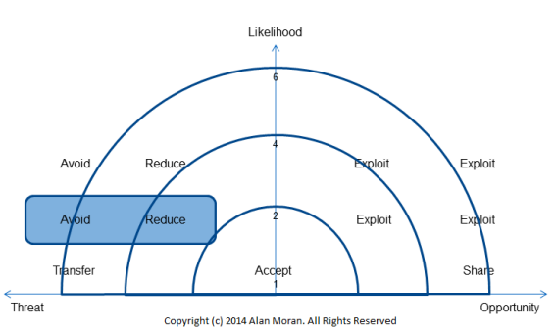
What are examples of IT project risks?
  How is project risk managed in these projects?
What principles and techniques are involved in managing risks in agile projects?
What are the risk responses in agile projects?
  How would you explain the risk response strategies that are used agile projects?
In what way can IT project teams in particular, benefit from agile risk management techniques?

Slide 14
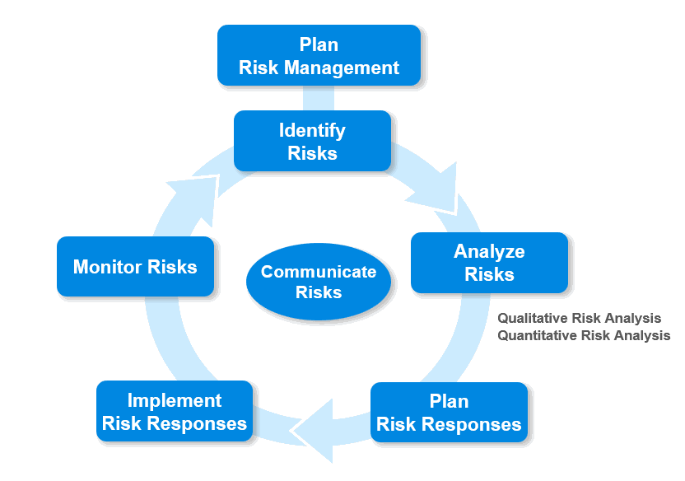

Slide 15
Managing Risks for Information Systems Development
Risks can be categorised into seven types
  Technological risk
  Human risk
  Usability risk
  Project team risk
  Project risk
  Organisational risk
  Strategic and political risk
Notes:
Managing risks for information systems development
Risks for information systems (IS) development are inherent in all aspects of an IS project. The risks can be categorised into seven types:
Technological risk
Human risk
Usability risk
Project team risk
Project risk
Organisational risk
Strategic and political risk
These categories help to explain the risks associated with developing systems that accept data inputs, process those inputs, and produce information for users.
Chapters 4, 5, 6, and 7 provided foundation information about the definition, scheduling, resources, and costs associated with IS development projects.

Slide 16
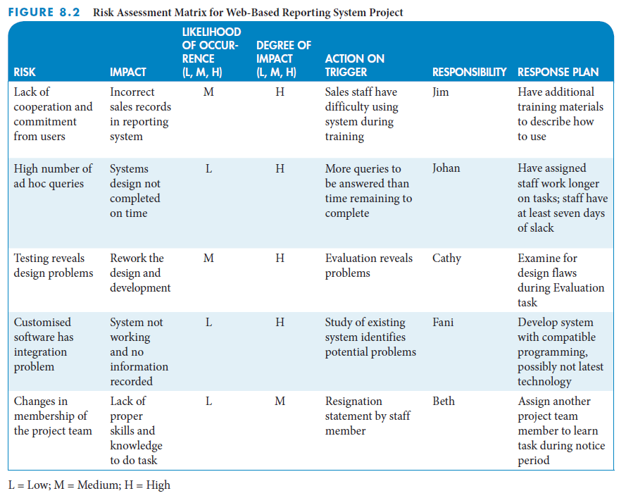
IS example: risk assessment matrix
Notes:
IS example: Internet applications development for Ukudala Office Designs
This is a continuation of the web-based reporting system project that we have used as an example in previous chapters.
Beth wants to prepare for potential project risks so that the team can address them early enough that they do not impact the delivery date for the system.
Beth planned for the team to determine the impact of the risk, the likelihood of occurrence, the degree of impact if it does occur, the action trigger that will serve as a warning flag for the risk, who is responsible for the risk, and the response plan to avoid, mitigate, or accept the risk.
Beth reviewed the lessons learned from other projects to make sure that the project team discussed the risks from the other projects.
This figure depicts the risk assessment matrix for web-based reporting system project.

Slide 17
Critical Success Factors
Identify risks and their potential impacts before the project starts.
Involve the project team or experts in assessing risks.
Assign high priority to managing risks that have a high likelihood of occurrence and a high potential impact on the project outcome.
Develop response plans for addressing high priority risks.

Slide 18
Summary
Risk is an uncertain event that, if it occurs, can jeopardise achieving the project objective.
Risk management includes identification, assessment, control, and response to project risks in order to minimise the likelihood of occurrence and/or the potential impact of adverse events on the achievement of the project objective.
Risk identification includes determining which risks may adversely affect the project objective and estimating what the potential impacts of each risk might be if it occurs.
Assessing each risk involves determining the likelihood that the risk event will occur and the degree of impact the event will have on the project objective, and then prioritising the risks.
A risk response plan is a defined set of actions to prevent or reduce the likelihood of occurrence or the impact of a risk, or to implement if the risk event occurs.
Regularly review and evaluate all risks to determine if there are any changes to the likelihood of occurrence or the potential impact of any of the risks, or if any new risks have been identified.

