Slide 1


Determining Costs, Budget and Earned Value

Slide 2

What do your daily transport expenses to and from the campus or workplace amount to?
  How do you know how much you spend weekly, monthly and annually?
  What is the possible impact if the daily transport expenses increases? What do you do about this?
  How do you calculate your monthly expenses?
How do project teams know how to spend money allocated to a project and what to spend it on?

Slide 3
Chapter Concepts
Estimating the costs of activities
Determining a time-phased baseline budget
Determining the earned value of the work performed
Analysing cost performance
Forecasting project cost at completion
Controlling project costs
Managing cash flow
Notes:
Chapter concepts
Based on the material in this chapter, learners will become familiar with:
Estimating the costs of activities
Determining a time-phased baseline budget
Determining the earned value of the work performed
Analysing cost performance
Forecasting project cost at completion
Controlling project costs
Managing cash flow

Slide 4
Learning Outcomes
Estimate the cost of activities
Aggregate the total budgeted cost
Develop a time-phased baseline budget
Describe how to accumulate actual costs
Determine the earned value of work performed
Calculate and analyse key project performance measures
Discuss and apply approaches to control the project budget
Explain the importance of managing cash flow
Notes:
Learning outcomes
After studying this chapter, learners should be able to:
Estimate the cost of activities
Aggregate the total budgeted cost
Develop a time-phased baseline budget
Describe how to accumulate actual costs
Determine the earned value of work performed
Calculate and analyse key project performance measures
Discuss and apply approaches to control the project budget
Explain the importance of managing cash flow

Slide 5
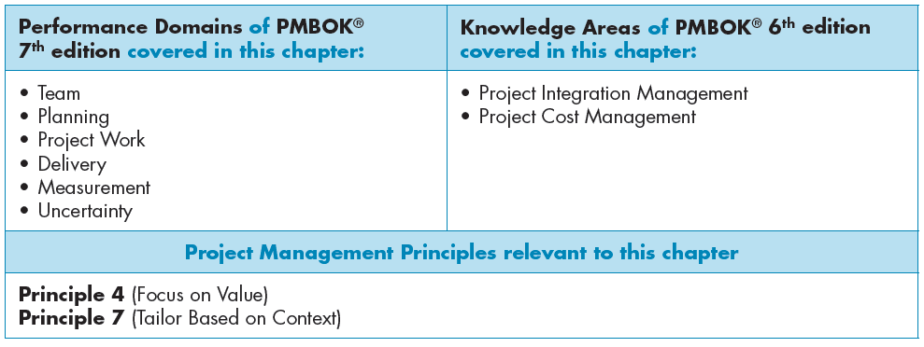

Slide 6
Estimate Activity Costs
Elements
Good practices
Labour
Materials
Equipment
Facilities
Subcontractors and consultants
Travel
Reserve
Have the person responsible estimate costs
Use historical data to inform current project
Be reasonable and realistic
Estimate near-term activities more accurately
Elaborate other costs as additional information known
Notes:
Estimate activity costs
The total project cost is often estimated during the initiating phase of the project, or when the project charter or a proposal is prepared.
During the planning phase of the project, specific activities are defined, and a network plan is created. Once specific activities are defined, estimates can be made of resources, durations and costs for each specific activity. 4
The estimated cost of an activity is based on an estimate of the types and quantities of resources required to perform the activity.
The estimated cost for each specific activity can include the following elements:
Labor: Estimated costs for the various classifications of people who are expected to work on the project
Are based on the estimated work time (not necessarily the same as the activity estimated duration) and the Rand labor rate for each person or classification
Materials: Are the estimated costs of materials that the project team or contractor needs to purchase for the project
Equipment: The equipment that must be purchased as part of the project
Facilities: Special facilities or additional space for the project team; for security reasons; to store materials; or to build, assemble, and test the project end item (deliverable)
Subcontractors and consultants: Are outsourced when project teams or contractors do not have the expertise or resources to conduct certain project tasks
Travel: Travel (other than local travel) may be required during the project
Reserve (also referred to as contingency): Funds set aside to cover unexpected situations that may come up during the project
Such as items that may have been overlooked when the initial project scope was defined, activities that may have to be redone because they may not work the first time (redesigns), or a high probability or high impact risk that may occur
There are a number of good practices that project managers should keep in mind when estimating costs
Have the person responsible for the task estimate costs
Use historical data to inform the current project because you can learn from past projects’ mistakes
Be reasonable and realistic
Estimate near-term activities as accurately as possible
Although, at the beginning of the project, it may not be possible to estimate the costs for all activities with a high degree of confidence regarding accuracy
This is especially true for longer-term projects
Elaborate other costs as additional information becomes available

Slide 7
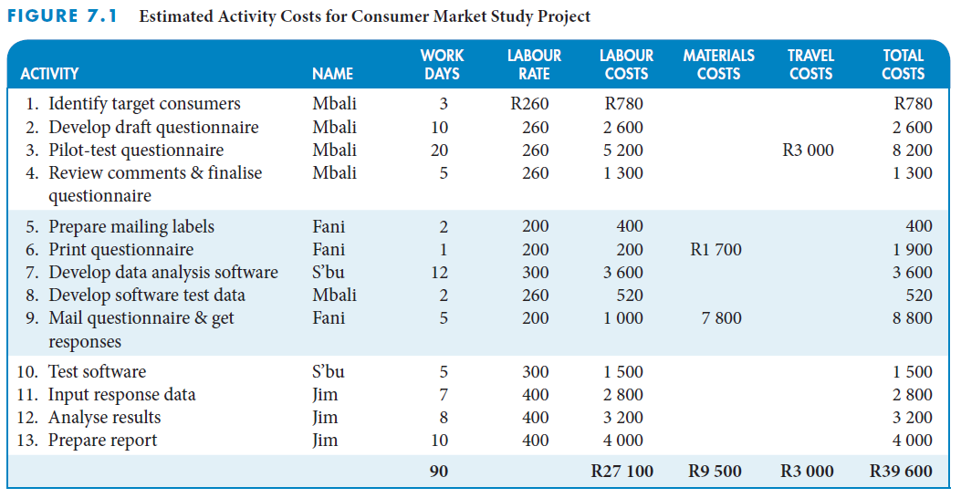
Consumer market study project estimated costs
Notes:
Consumer market study project estimated costs
The figure on this slide depicts the estimated costs for each activity in the consumer market study project.

Slide 8
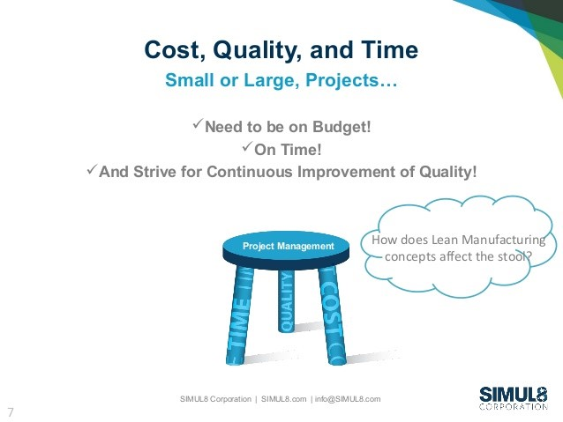
Determine Project Budget
The project budgeting process has two steps:
First, the project cost estimate is allocated to the various work packages in the project work breakdown structure
Second, the budget for each work package is distributed over the duration of the work package
Notes:
In the first step, we determine the total budgeted cost (TBC) – this is the aggregate amount of the estimated costs of all the specific activities to perform and complete a work package or the project.
In the second step – we develop a time-phased budget - we distribute the total budgeted cost for a work package or a project over its expected time span based on when specific activities are scheduled to be performed.

Slide 9
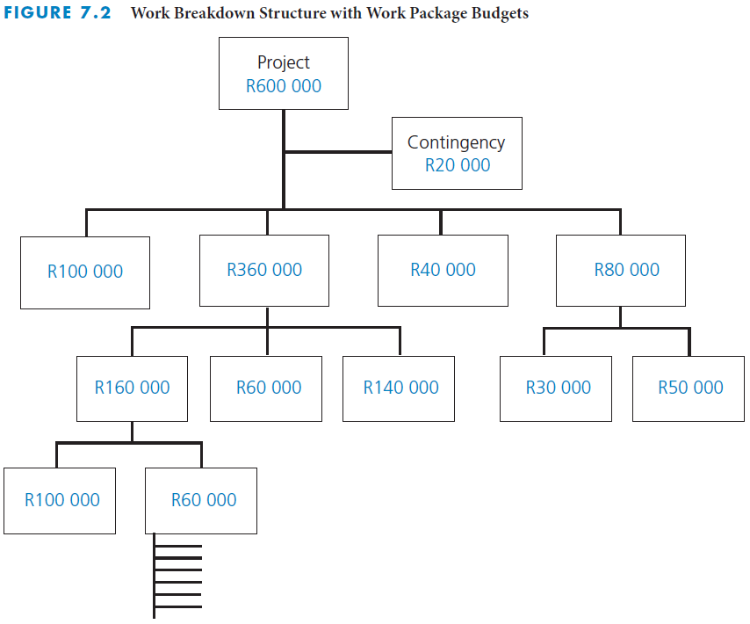
Aggregate total budgeted cost
Establish a TBC for each work package
Determine the process
  Top-down
  Bottom-up
If sum of initial estimates exceeds sponsor budget, then reduce costs and recalculate
Notes:
Aggregate total budgeted cost
Allocating total project costs to the appropriate work packages will establish a total budgeted cost (TBC) for each work package – TBC is also referred to as budget at completion (BAC)
There are two approaches to establishing the TBC for each work package: top-down and bottom-up.
When the budgets for all the work packages are summed up, they cannot exceed the total project budgeted cost – they cannot exceed the total amount of funds the sponsor or customer budgeted for the project.
Often, the sum of the initial estimated costs is greater than the sponsor’s budget sponsor.
Several iterations of working out the costs may be required to reduce the costs to within an acceptable level.
The figure on this slide illustrates the cost allocations for a R600 000 project.
The costs are assigned to each work package.

Slide 10
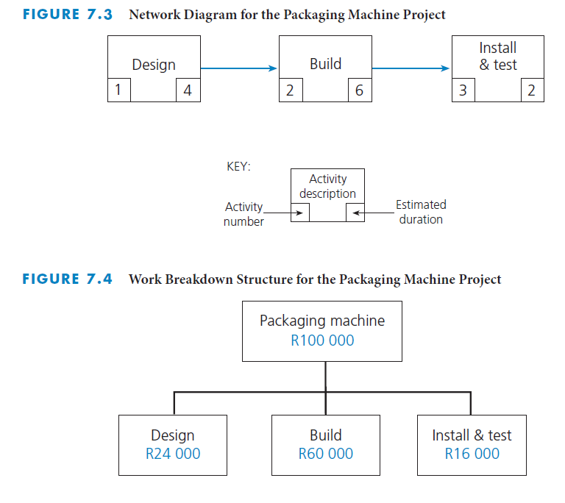
Packaging machine project aggregate total budgeted cost
Notes:
Packaging machine project aggregate total budgeted cost
The two figures on this slide depict the network diagram and the work breakdown structure, with costs assigned.
You will see this example repeatedly throughout the remainder of this chapter.

Slide 11
Develop cumulative budgeted cost
Distribute each total budgeted cost (TBC) over work package duration
Create the time-phased budget
Calculate cumulative budgeted cost
Provides a baseline against which actual cost and work performance are measured
Notes:
Develop cumulative budgeted cost
Once a total budgeted cost(TBC) has been established for each work package, the second step in the project budgeting process is to distribute each TBC over the duration of its work package.
The cost determined for each period is based on when the activities that make up the work package are scheduled to be performed to create the time-phased budget.
The cumulative budgeted cost (CBC) is the amount that was budgeted to achieve the work that was scheduled to be performed up to that point in time.
The CBC for the entire project or each work package provides a baseline against which actual cost and work performance can be compared at any time during the project.
It is important to use the cumulative budget as the standard against which actual cost is compared – CBC is the time-phased baseline budget that will be used to analyse the cost performance of the project.

Slide 12
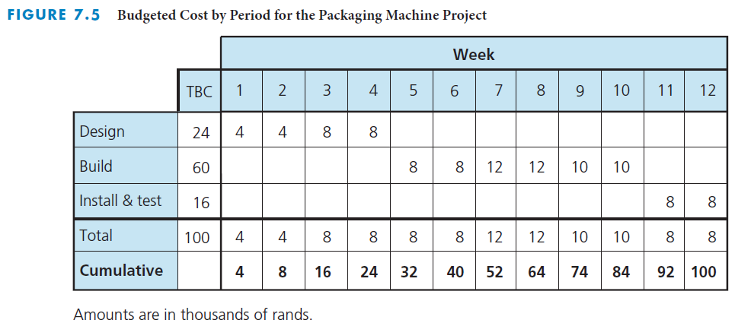
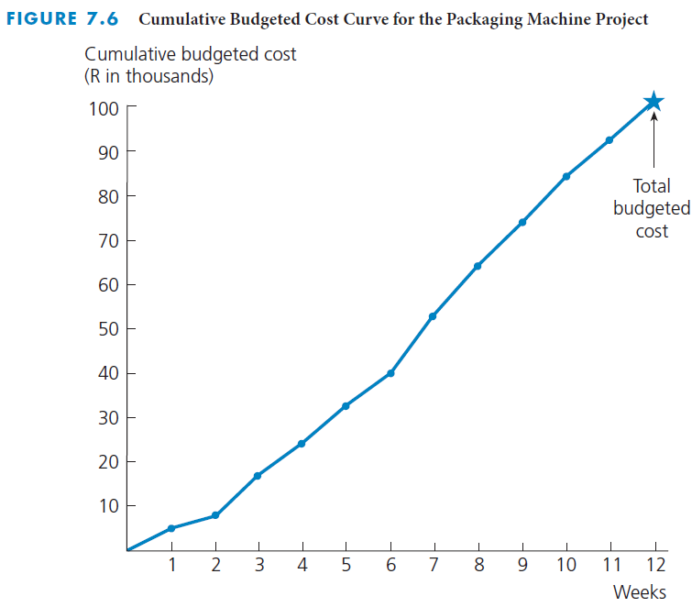
Packaging machine project develop cumulative budgeted cost
Determine budgeted cost by period
Graph the cumulative budgeted cost curve
Notes:
Packaging machine project: Develop cumulative budgeted cost
The two figures on this slide depict the development of the cumulative budgeted cost for a packaging machine project.
The figure on the top shows the budgeted cost by period for the packaging machine project.
The figure on the bottom shows the cumulative budgeted cost curve for the packaging machine project.
The points on the graph correspond to the cumulative total shown in the figure on the top.

Slide 13
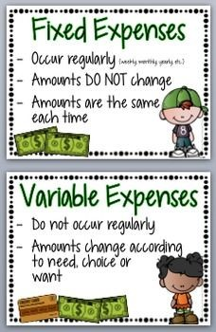
How often do your daily transport expenses to and from the campus change over a period of one semester?
  Do other types of expenses in your budget change the same way?
What do you think it means when a cost or expense of something is said to be “fixed”?
What would happen if a project manager was not aware of the different types of costs when determining a project budget?

Slide 14
Determine Actual Cost
Actual cost
  Collect data regularly for funds actually expended
  Charge to work package numbers
Committed costs
  Periodically assign portion of total cost to actual cost
  Include costs for items that will be paid for later
Compare actual cost to budgeted cost
  Calculate cumulative actual cost
  Compare to cumulative budgeted cost
Notes:
Determine actual cost
Once the project starts, it is necessary to keep track of actual cost and committed cost so that they can be compared to the CBC.
To keep track of actual cost on a project, it is necessary to set up a system to collect, on a regular and timely basis, data on funds actually expended.
Large projects have charge codes assigned to different work package numbers to determine how the actual costs compare to the planned costs.
In many projects, large Rand amounts are expended for materials or services (such as on subcontractors or consultants) that are used over a period of time longer than one cost reporting period.
These committed costs need to be treated in a special way so that the system periodically assigns a portion of their total cost to actual cost.
Committed costs are also known as commitments or encumbered costs.
Costs are committed when an item is ordered even though actual payment may take place at some later time.
Cumulative actual cost (CAC) should be then be calculated.
As data are collected on actual cost, including portions of any committed cost, they need to be totaled by work package so that they can be compared to the cumulative budgeted cost.

Slide 15
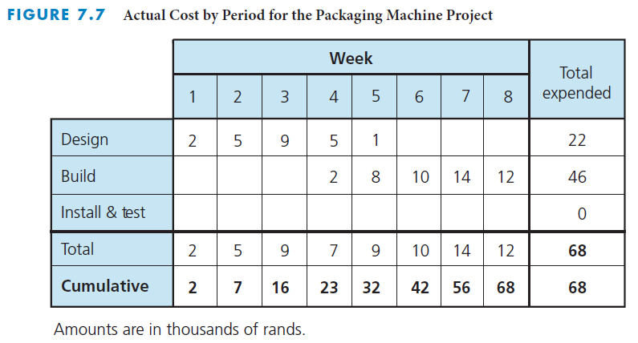
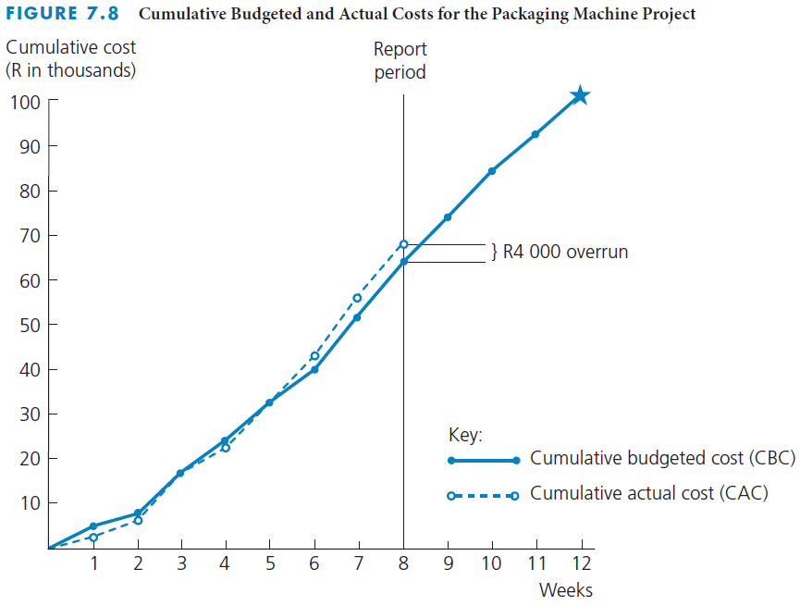
Packaging machine project determine actual cost
End of Week 8
  Planned cost = R64,000
  Actual cost = R68,000
Compare CAC with CBC
Notes:
Packaging machine project: Determine actual cost
The figure on the top indicates that at the end of week 8 of the packaging machine project, R68 000 has actually been expended, although only R64 000 was budgeted.
With the CAC values, it’s possible to draw a cumulative actual cost curve, which you see in the figure on the bottom of this slide.

Slide 16
Determine Value of Work Performed
Example project
At Day 5
Paint 10 similar rooms
Total budgeted cost of R2 000
Budget is R200 per room
R1 000 has been spent
3 rooms have been painted
Earned value =
0.30 X R2 000 = R600
Have expended R400 more than the earned value
Notes:
Determine value of work performed
Let’s take a moment to think about an example of determining the value of work performed.
Consider a project that involves painting ten similar rooms over ten days (one room per day) for a total budgeted cost of R2 000.
This makes the budget R200 per room.
At of the end of day 5, you determine that R1 000 has been spent, which is on track monetarily. The problem is that only three rooms have been painted.
Earned value, the value of the work actually performed, is a key parameter that must be determined throughout the project.
Determining the earned value involves collecting data on the percent completed for each work package and then converting this percentage to a Rand amount by multiplying the TBC of the work package by the percent complete.
In many cases, the estimate is subjective.
It is important that the person estimating the percent complete not only assess how much work has been performed. but also consider what work remains to be done.
For example, in the project involving painting ten rooms for R2 000:
If three rooms are completed, that means that 30 per cent of the work has been performed.
The earned value is: 0.30 x R2 000 = R600
This means that the project has expended R400 more than the earned value by day 5.

Slide 17
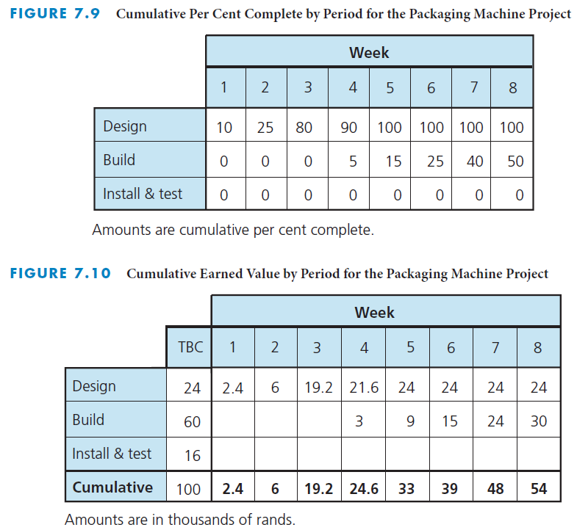
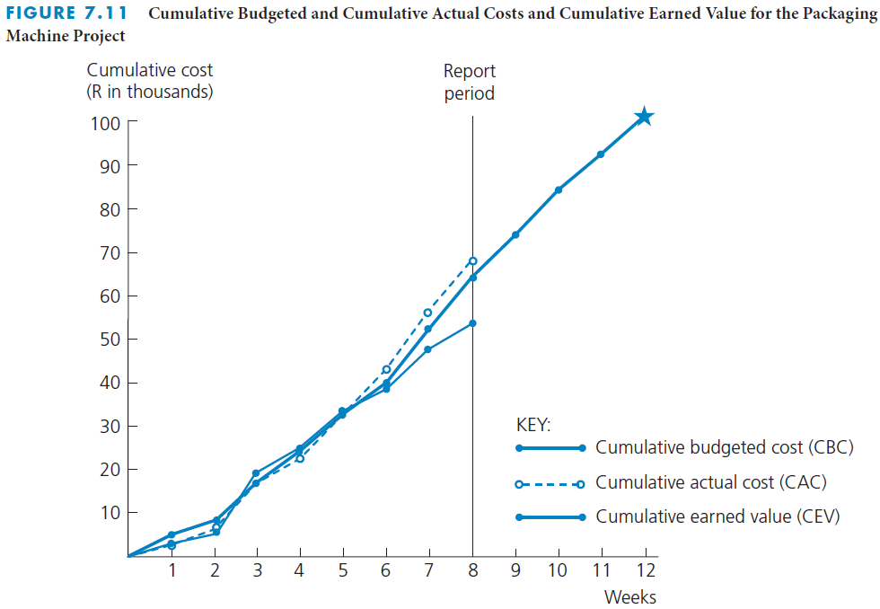
Packaging machine project determine value of work performed
Notes:
Packaging machine project: Determine value of work performed
Here we see three figures that will help us understand how to determine the value of work performed on the packaging project.
The figure in the top left depicts the cumulative percentage complete by period for the packaging machine project.
The figure on the bottom left depicts the cumulative earned value by period for the packaging machine project.
To help you understand the different costs visually, the figure on the right illustrates the CBC, CAC, and CEV for the entire project.
You will note that the CAC is running above the CBC, and the CEV is running below the CBC.

Slide 18
Analyse Cost Performance
Four cost-related measures
  TBC – total budgeted cost
  CBC – cumulative budgeted cost
  CAC – cumulative actual cost
  CEV – cumulative earned value
Use to analyse project cost performance
Plot CBC, CAC, and CEV curves on the same graph
  Reveal any trends toward improving or deteriorating cost performance
Notes:
Analyse cost performance
There are four cost-related measures that are used to analyse project cost performance:
TBC (total budgeted cost)
CBC (cumulative budgeted cost)
CAC (cumulative actual cost)
CEV (cumulative earned value)
They are used to determine whether the project is being performed within budget and whether the value of the work performed is in line with the actual cost.

Slide 19
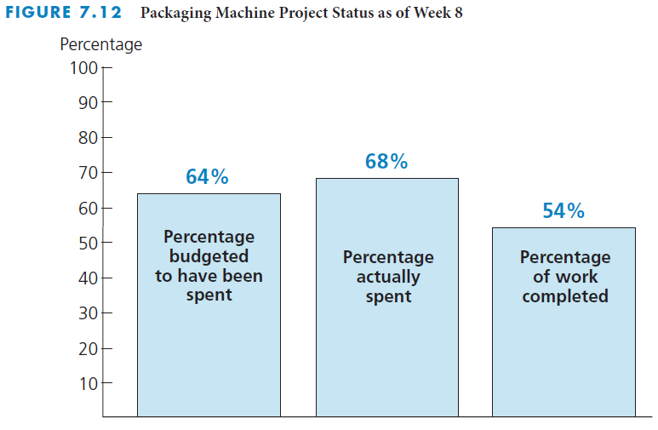
Packaging machine project analyse cost performance
Notes:
Packaging machine project: Analyse cost performance
This figure shows the packaging machine project status, as of the end of week 8:
64% of funds were budgeted to have been spent
68% of overall funds were actually spent
54% of the total work was completed

Slide 20
Cost performance index
Measure of the cost efficiency with which the project is being performed
Cost performance index =
Cumulative earned value/Cumulative actual cost
CPI = CEV/CAC
Notes:
Cost performance idex
Another indicator of cost performance is the cost performance index (CPI)
The cost performance index (CPI) is a measure of the cost efficiency with which the project is being performed.
The formula for determining the CPI is:
Cost performance index = Cumulative earned value/Cumulative actual cost (or CPI = CEV/CAC)

Slide 21
Packaging machine project cost performance index
End of Week 8
Determine CPI
R64 000 was budgeted
R68 000 was actually expended
R54 000 was the earned value of work actually performed
CEV = R54 000
CAC = R68 000
CPI = CEV/CAC
= R54 000/R68 000
= 0.79
For every R1.00 actually expended, only R0.79 of earned value was received.
Notes:
Packaging machine project: Cost performance index
Let’s take a minute to look at the CPI for the packaging machine project.
Remember that the CPI is calculated by: Cost performance index = Cumulative earned value/Cumulative actual cost (CPI = CEV/CAC)
In the packaging machine project, the CPI as of week 8 is: CPI = R54 000/R68 000 = 0.79
This ratio indicates that for every R1.00 actually expended, only R0.79 of earned value was received.
When the CPI dips below 1.0 or is trending smaller, corrective action should be taken.

Slide 22
Cost variance
Indicator of cost performance
Difference between the cumulative earned value of the work performed and the cumulative actual cost
Cost variance =
Cumulative earned value – Cumulative actual cost
CV = CEV – CAC
Notes:
Cost variance
Another indicator of cost performance is cost variance (CV), which is the difference between the cumulative earned value of the work performed and the cumulative actual cost.
Cost variance = Cumulative earned value – Cumulative actual cost (or CV = CEV – CAC)

Slide 23
Packaging machine project cost variance
End of Week 8
Determine CV
R64 000 was budgeted
R68 000 was actually expended
R54 000 was the earned value of work actually performed
CEV = R54 000
CAC = R68 000
CV = CEV – CAC
= R54 000 – R68 000
= –R14 000
The value of the work performed through week 8 is R14 000 less than the amount actually expended.
Notes:
Packaging machine project: Cost variance
In the packaging machine project, the cost variance as of week 8 is: CV = R54 000 – R68 000 = –R14 000
This calculation indicates that the value of the work performed through week 8 is R14 000 less than the amount actually expended.

Slide 24
Estimate Cost at Completion
Forecast what the total costs will be at the completion of the project or work package
3 different methods
  FCAC = TBC/CPI
  FCAC = CAC + (TBC – CEV)
  FCAC = CAC + Re-estimate of remaining work
Another method
  TCPI = (TBC – CEV)/(TBC – CAC)
Notes:
Estimate cost at completion
Based on analysis of actual cost, it is possible to forecast what the total costs will be at the completion of the project or work package.
There are three different methods for determining the forecasted cost at completion (FCAC).
The first method assumes that the work to be performed on the remaining portion of the project or work package will be done at the same rate of efficiency as the work performed up to that point.
Forecasted cost at completion = Total budgeted cost/Cost performance index
A second method for determining the FCAC assumes that, regardless of the efficiency rate the project or work package has had in the past, the work to be performed on the remaining portion of the project or work package will be in line with the budget.
Forecasted cost at completion = Cumulative actual cost + (Total budgeted cost – Cumulative earned value)
A third method for determining the forecasted cost at completion is to re-estimate the costs for all the remaining work to be performed and then add this re-estimate to the cumulative actual cost.
FCAC = CAC + Re-estimate of remaining work to be performed
Another measure for estimating cost at completion is the to-complete performance index (TCPI)
It is calculated as: TCPI = (TBC – CEV)/(TBC – CAC)

Slide 25
Packaging machine project estimate cost at completion
End of Week 8
Determine FCAC
R64 000 was budgeted
R68 000 was actually expended
R54 000 was the earned value of work actually performed
CEV = R54 000
CAC = R68 000
CPI = 0.79
TBC = R100 000
FCAC = TBC / CPI
  = R100 000/0.79 = R126 582
FCAC = CAC + (TBC – CEV)
  = R68 000 + (R100 000 – R54 000)
  = R68 000 + R46 000
  = R114 000
TCPI = (TBC – CEV)/(TBC – CAC)
= (R100 000 − R54 000)/(R100 000 − R68 000)
  = R46 000/R32 000
  = 1.44
Notes:
Packaging machine project: Estimate cost at completion
Let us look that the packaging machine project again and apply the methods we just learned for determining the forecasted cost at completion.
Using the first method, the forecasted cost at completion is: FCAC = R100 000/0.79 = R126 582
Using the second method, the forecasted cost at completion is: FCAC = R68 000 + (R100 000 – R54 000)= R68 000 + R46 000= R114 000
We can also use the to-complete performance index (TCPI) to determined the FCAC.
Using this method, the to-complete performance index is: TCPI = (R100 000 − R54 000)/(R100 000 − R68 000) = R46 000/R32 000 = 1:44

Slide 26

Important Project Costs, Budget and Earned Value Concepts
TBC
Total Budgeted Cost - The sum of the estimated costs of all the specific activities that make up that work package or the project
BAC
Budget at completion (same as TBC)
CBC
Cumulative Budgeted Cost – The amount that is budgeted to complete all the work that is scheduled to be performed up to a specific point in time.

Slide 27


PV
Planned value (same as CBC)
BCWS
Budgeted cost of work scheduled (same as CBC)
CAC
Cumulative actual cost – The amount of costs actually expended and committed to complete all the work performed up to a specific point in time
ACWP
Actual cost of work performed (same as CAC)

Slide 28
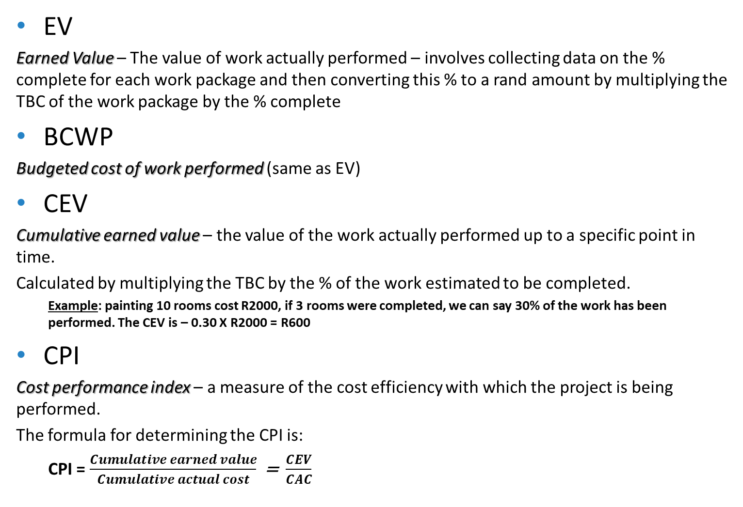
EV
Earned Value – The value of work actually performed – involves collecting data on the % complete for each work package and then converting this % to a rand amount by multiplying the TBC of the work package by the % complete
BCWP
Budgeted cost of work performed (same as EV)
CEV
Cumulative earned value – the value of the work actually performed up to a specific point in time.
Calculated by multiplying the TBC by the % of the work estimated to be completed.
  Example: painting 10 rooms cost R2000, if 3 rooms were completed, we can say 30% of the work has been performed. The CEV is – 0.30 X R2000 = R600
CPI
Cost performance index – a measure of the cost efficiency with which the project is being performed.
The formula for determining the CPI is:
  CPI = $\frac{Cumulative earned value}{Cumulative actual cost}$ = $\frac{CEV}{CAC}$

Slide 29
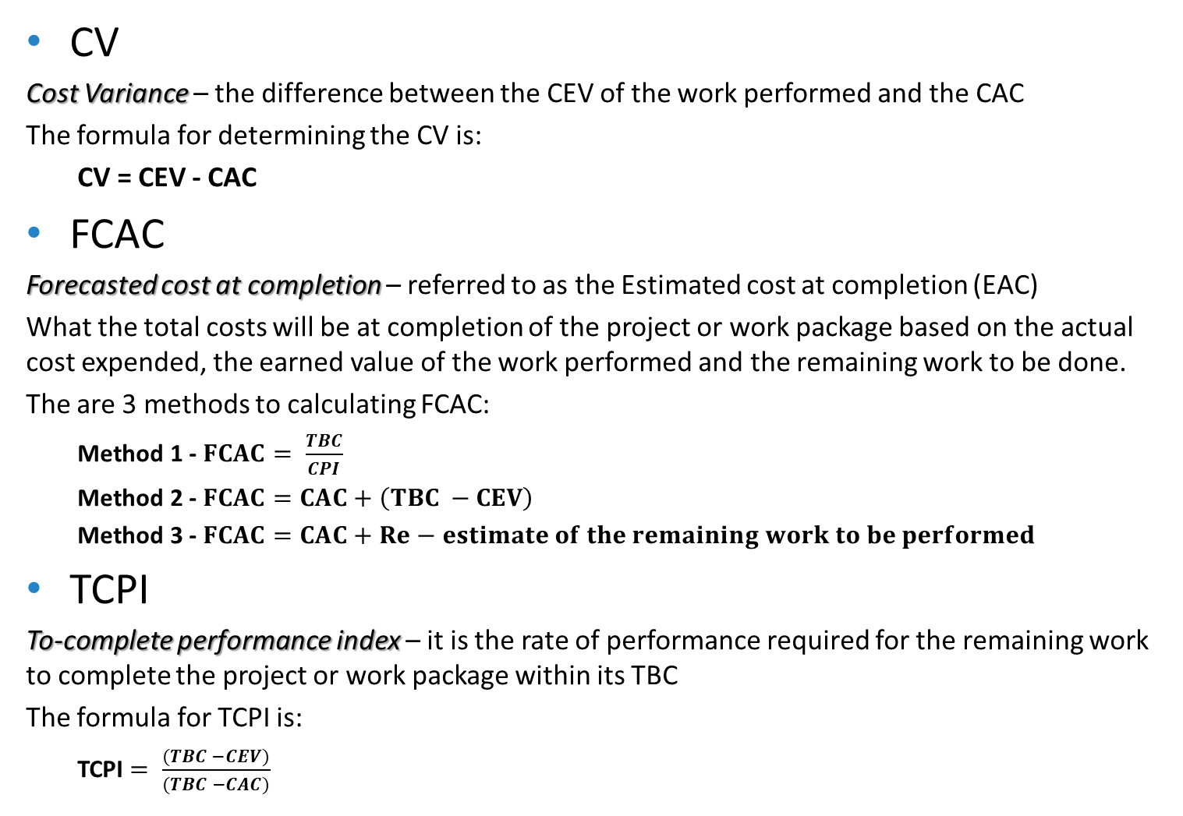
CV
Cost Variance – the difference between the CEV of the work performed and the CAC
The formula for determining the CV is:
  CV = CEV - CAC
FCAC
Forecasted cost at completion – referred to as the Estimated cost at completion (EAC)
What the total costs will be at completion of the project or work package based on the actual cost expended, the earned value of the work performed and the remaining work to be done.
The are 3 methods to calculating FCAC:
  Method 1 - $FCAC= \frac{TBC}{CPI}$
  Method 2 - $FCAC=CAC+\left(TBC −CEV\right)$
  Method 3 - $FCAC=CAC+Re−estimate of the remaining work to be performed$
TCPI
To-complete performance index – it is the rate of performance required for the remaining work to complete the project or work package within its TBC
The formula for TCPI is:
  TCPI $= \frac{(TBC −CEV)}{(TBC −CAC)}$

Slide 30
Control Costs
Analyse cost performance on a regular basis
  Determine which work packages require corrective action
  Decide what specific corrective action
  Revise the project plan
Evaluate negative cost variance
Take corrective actions
  Near term activities
  Activities with large cost estimate
Reduce costs of activities
Evaluate the trade-off of cost and scope
Notes:
Control costs
The key to effective cost control is to analyse cost performance on a regular and timely basis.
It is crucial that cost variances and inefficiencies be identified early so that corrective action can be taken before the situation gets worse.
Controlling costs involves the following:
Analysing cost performance to determine which work packages may require corrective action
Deciding what specific corrective action should be taken
Revising the project plan – including time and cost estimates – to incorporate the planned corrective action
When evaluating work packages that have a negative cost variance, you should focus on taking corrective actions to reduce the costs of two types of activities:
Activities that will be performed in the near term
If you put off corrective actions until some point in the distant future, the negative cost variance may deteriorate.
Activities that have a large cost estimate
Taking corrective measures that reduce the cost of a R20 000 activity by 10 per cent will have a larger impact than totally eliminating a R300 activity.
There are various ways to reduce the costs of activities:
One way is to substitute less expensive materials
Another is to assign a person with greater expertise or more experience to perform or help with the activity
Reducing the scope or requirements is another way
Increasing productivity through improved methods or technology
In many cases, there will be tradeoffs – reducing cost variances may involve a reduction in project scope or a delay in the project schedule.
The key to effective cost control is aggressively addressing negative cost variances and cost inefficiencies as soon as they are identified.

Slide 31


What is the key to managing cash flow?
How would cash flow on a project be managed?
How would cash flow on a project be controlled?

Slide 32
Manage Cash Flow
Ensure that cash comes in faster than it goes out
Negotiate payment terms
  Provide a down payment
  Make equal monthly payments
  Provide frequent payments
Avoid only one payment at end of project
Control outflow of cash
Notes:
Manage cash flow
It is important to manage the cash flow on a project.
Managing cash flow involves making sure that sufficient payments are received from the customer in time to cover the costs of performing the project.
The key to managing cash flow is to ensure that cash comes in faster than it goes out.
The contractor might try to negotiate payment terms that require the customer to do one or more of the following:
Provide a down payment at the start of the project
Make equal monthly payments based on the expected duration of the project
Provide frequent payments, such as weekly or monthly payments, rather than quarterly payments
The worst scenario from the contractor’s point of view is to have the customer make only one payment at the end of the project.
On the other hand, the contractor should control its outflow of cash by delaying payments as long as possible until they are due.

Slide 33
Cost Estimating for Information Systems Development
Common errors in estimating costs
  Underestimating the work time necessary to complete an activity
  Requiring rework to meet the user requirements
  Underestimating growth in the project scope
  Not anticipating new hardware purchases
  Making corrections to flaws in excess of the reserve planning
  Changing the design strategy
  Increasing resources to fast-track phases of the SDLC
Notes:
Cost estimating for information systems development
Chapter 4 defined the information system (IS) as a computer-based system that accepts data as input, processes the data, and produces information required by users. Chapter 5 revealed that much scheduling is conducted in a haphazard manner, resulting in a large number of IS projects not finishing on time. Chapter 6 reinforced the resource requirements planning necessary for people, hardware, software, data, and network resources.
This chapter addresses cost estimating in an IS project.
Accurately estimating costs and including a reserve amount are essential in creating a realistic budget that allows the contractor to complete the work without cost overruns.
Having a good plan and schedule helps to develop good cost estimates and a baseline budget.
Common errors in estimating costs include:
Underestimating the work time necessary to complete an activity
Requiring rework to meet the user requirements
Underestimating growth in the project scope
Not anticipating new hardware purchases
Making corrections to flaws that cost more than what was allotted in the reserve planning
Changing the design strategy
Increasing resources to fast-track phases of the SDLC

Slide 34
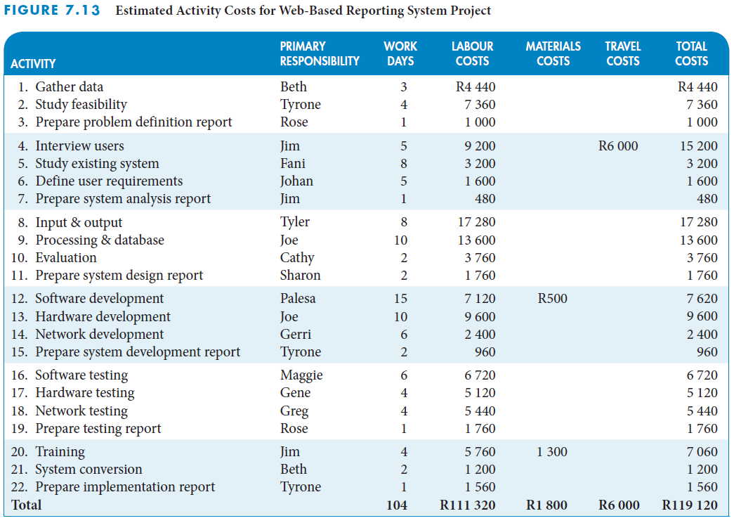
IS example: estimated activity costs
Notes:
IS example: Estimated activity costs
Recall from Chapters 4, 5, and 6 that Beth Smith was assigned to be project manager by the IS Department of Ukudala Office Designs.
The figure on this slide depicts the estimated activity costs for the web-based reporting development project.
It has a 5% reserve for cost overruns, fast-tracking of the project, or increased costs of materials or travel for the interviews.
Chapter 5 described how Beth had scheduled the ES, EF, LS, and LF times for the activities necessary to complete the Web-based reporting system development project for Ukudala Office Designs.
Chapter 6 described how Beth and the project team planned the resources for the 60-day schedule for the project. Management approved a budget of R125 000 to complete the project and train the sales staff.
After confirming with the primary responsible resources that the tasks could be completed with the estimated level of effort on each task, Beth worked with the human resources team to use the hourly wage for each of the employees to determine the labour costs for each of the web-based reporting system project activities.
Beth and the project team estimated the costs associated with traveling to complete user interviews (R3 000), the price of packaged software (R500), and the costs of training materials (R1 300).
The budgeted costs of the work to complete the project were near the R125 000 limit, even without training the sales staff.

Slide 35
Project Management Information Systems
Store all costs associated with each resource
Calculate the budget for each work package
Determine cost for the entire projects
Define different rate structures for each resource
Analyse cost performance
Notes:
Project management information systems
All costs associated with each resource in a project can be stored and software will calculate the budget for each work package and for the entire project.
Project management software usually allows the user to define different rate structures for each resource and when charges for those resources will actually be accrued.
Cost tables and graphs are often available to help analyse cost performance.
See Appendix A in the textbook for a thorough discussion of Project Management software.

Slide 36
Critical Success Factors
Estimated activity costs must be based on the estimated activity resources.
The person who will be responsible for performing the activity should estimate the costs for that activity. This generates commitment from the person.
Cost estimates should be reasonable and realistic.
Once the project starts, it is important to monitor actual costs and work performance to ensure that everything is within budget.
A system should be established to collect, on a regular and timely basis, data on costs actually expended and committed, and the earned value (percent complete) of the work performed, so they can be compared to the cumulative budgeted cost (CBC).
If at any time during the project it is determined that the project is overrunning the budget, or the value of the work performed is not keeping up with the actual amount of costs expended, corrective action must be taken immediately.

Slide 37
Critical Success Factors (continued)
It is important to use the time-phased cumulative budgeted cost (CBC), rather than the total budgeted cost (TBC), as the baseline against which cumulative actual cost (CAC) is compared. It would be misleading to compare the actual costs expended to the total budgeted cost because cost performance will always look good as long as actual costs are below the TBC.
To permit a realistic comparison of cumulative actual cost to cumulative budgeted cost, portions of the committed costs should be assigned to actual costs while the associated work is in progress.
The earned value of the work actually performed is a key parameter that must be determined and reported throughout the project.
For each reporting period, the percent complete data should be obtained from the person responsible for the work. It is important that the person make an honest assessment of the work performed relative to the entire work scope.
One way to prevent inflated percent complete estimates is to keep the work packages or activities small in terms of scope and duration. It is important that the person estimating the percent complete assess not only how much work has been performed but also what work remains to be done.

Slide 38
Critical Success Factors (continued)
The key to effective cost control is to analyse cost performance on a timely and regular basis. Early identification of cost variances (CV) allows corrective actions to be taken immediately, before the situation gets worse.
For analysing cost performance, it is important that all the data collected be as current as possible and be based on the same reporting period.
Trends in the cost performance index (CPI) should be monitored carefully. If the CPI goes below 1.0 or gradually decreases, corrective action should be taken.
As part of the regular cost performance analysis, the estimated or forecasted cost at completion (FCAC) should be calculated.
The key to effective cost control is to aggressively address work packages or activities with negative cost variances and cost inefficiencies as soon as they are identified. A concentrated effort must be applied to these areas. The amount of negative cost variance should determine the priority for applying these concentrated efforts.

Slide 39
Critical Success Factors (continued)
When attempting to reduce negative cost variances, focus on activities that will be performed in the near term and on activities that have large estimated costs.
Addressing cost problems early will minimise the negative impact on scope and schedule. Once costs get out of control, getting back within budget becomes more difficult and is likely to require reducing the project scope or quality, or extending the project schedule.
The key to managing cash flow is to ensure that cash comes in faster than it goes out.
It is desirable to receive payments (cash inflow) from the customer as early as possible, and to delay making payments (cash outflow) to suppliers or subcontractors as long as possible.

Slide 40
Summary
The total project cost is often estimated during the initiating phase of the project when the project charter or a proposal is prepared, but detailed plans are not usually prepared at that time.
The project budgeting process involves two steps: the budget for each work package is determined and the budget for each work package is then distributed over the expected time.
Aggregating the estimated costs of the specific activities for the appropriate work packages in the work breakdown structure will establish a total budgeted cost (TBC).
The cumulative budgeted cost (CBC) is the time-phased baseline budget that will be used to analyse the cost performance of the project.
At any time during the project, it is possible to forecast what the total costs will be at the completion of the project or work package based on analysis of actual cost expended and the earned value of work performed.
The key to effective cost control is to analyse cost performance on a regular and timely basis.
It is important to manage the cash flow on a project.

