Slide 1


Introduction to Machine Learning
Kenneth Broni
24th September, 2024
Department of Computer Engineering
School of Engineering Sciences
University of Ghana

Slide 2
Presentation outline
Introduction
Machine Learning
Supervised Learning
Unsupervised Learning
Machine Learning Algorithm

Slide 3
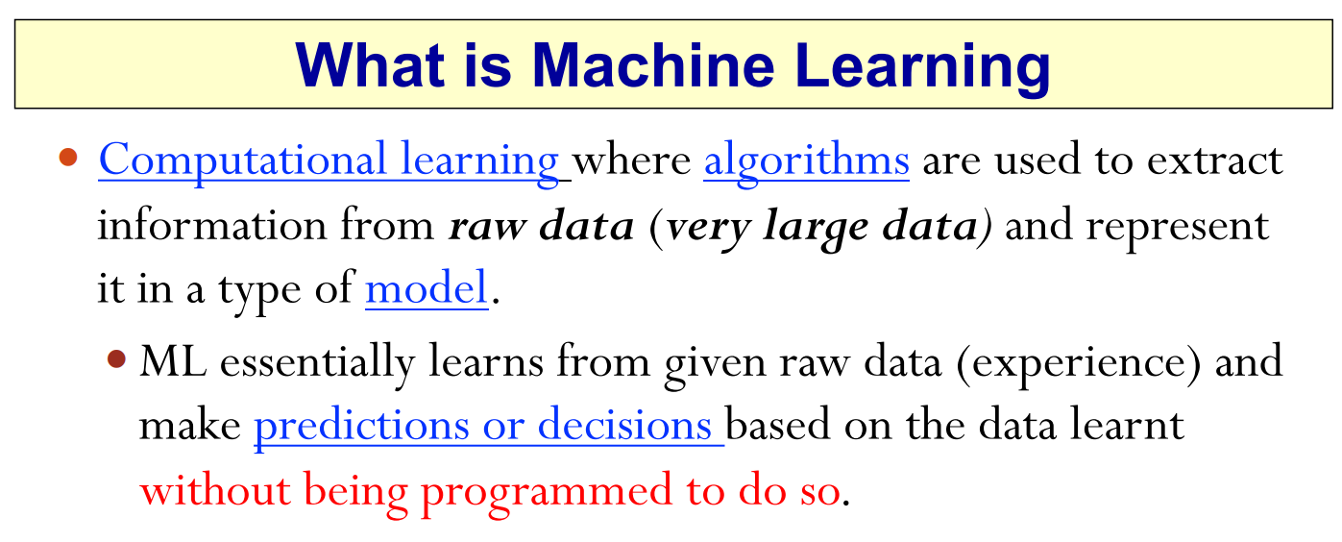
Introduction
Section 1.1, page 5

Slide 4
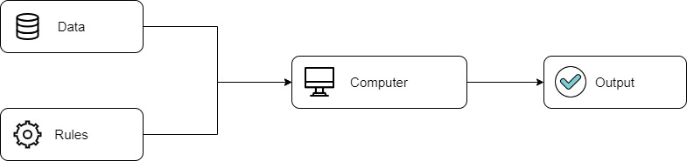
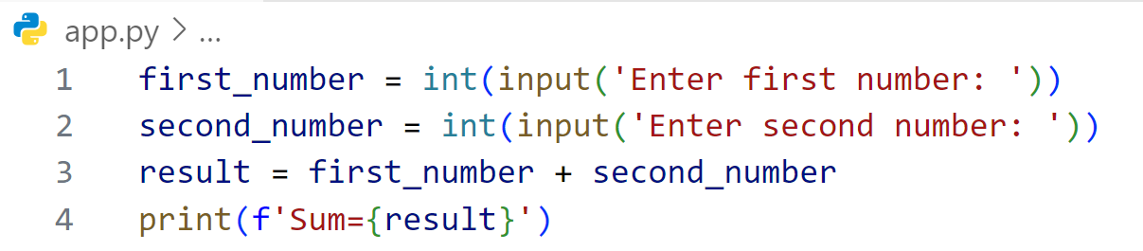
Introduction
Traditional Programming
2
3
5
+

Slide 5
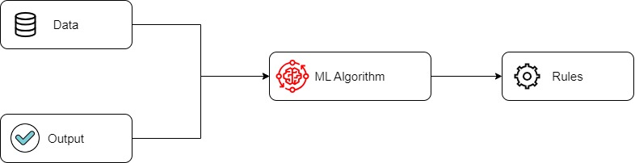
Machine Learning
Machine Learning (Supervised Learning)

Slide 6

Supervised Machine Learning
Input Data
Machine Learning (Supervised Learning)
x1 | x2
2 | 3
4 | 5
1 | 0
1 | 1
3 | 4
x1 | x2 | y
2 | 3 | 5
4 | 5 | 9
1 | 0 | 1
1 | 1 | 2
3 | 4 | 7
Output Data
y
5
9
1
2
7

Slide 7
Supervised Machine Learning
x1 | x2
2 | 3
4 | 5
1 | 0
1 | 1
3 | 4
+
y
5
9
1
2
7

Slide 8
Machine Learning
Section 1.1, page 5

Slide 9
Machine Learning
Making Predictions
100
500
400

Slide 10

Machine Learning Algorithms
Simple Linear Regression
Age (weeks) | Weight (N)
2 | 12.0
4 | 16.0
5 | 18.5
6 | 20.8
7 | 23.1
8 | 26.0
9 | 30.0
10 | 32.0
15 | 40.0
20 | 47.3
Machine Learning Training
Data
Learning Rule:
y = 0.4843x - 4.2669
y = mx + c

Slide 11
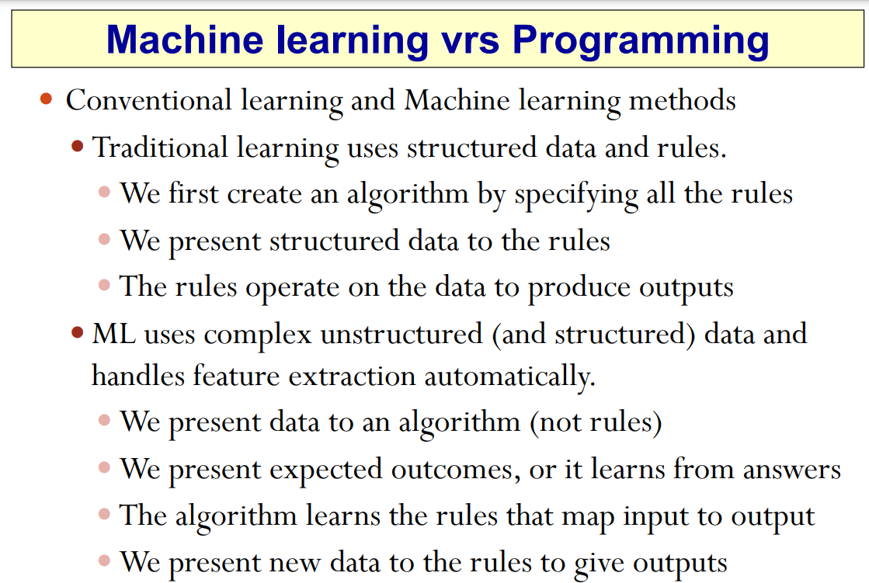
Machine Learning Algorithms
Section 1.1, page 7

Slide 12
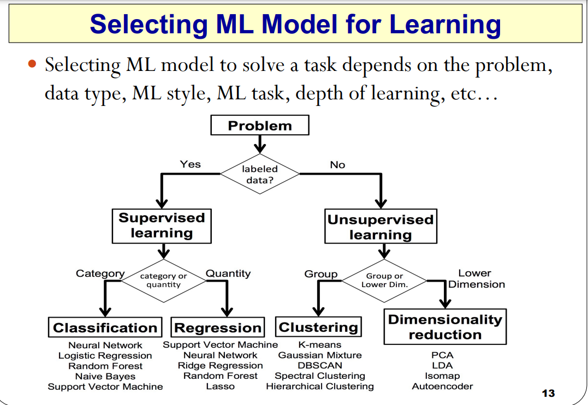
Machine Learning Algorithms
Section 1.1, page 13

Slide 13
Machine Learning Algorithms
Age (weeks) | Weight (N)
2 | 12.0
4 | 16.0
5 | 18.5
6 | 20.8
7 | 23.1
8 | 26.0
9 | 30.0
10 | 32.0
15 | 40.0
20 | 47.3
Age (weeks) | Weight (N) | Height | Gender
2 | 12.0 | 5 | Male
4 | 16.0 | 4 | Female
5 | 18.5 | 5 | Female
6 | 20.8 | 2 | Male
7 | 23.1 | 3 | Male
8 | 26.0 | 5 | Male
9 | 30.0 | 4 | Female
10 | 32.0 | 4 | Male
15 | 40.0 | 6 | Female
20 | 47.3 | 7 | Female

Slide 14
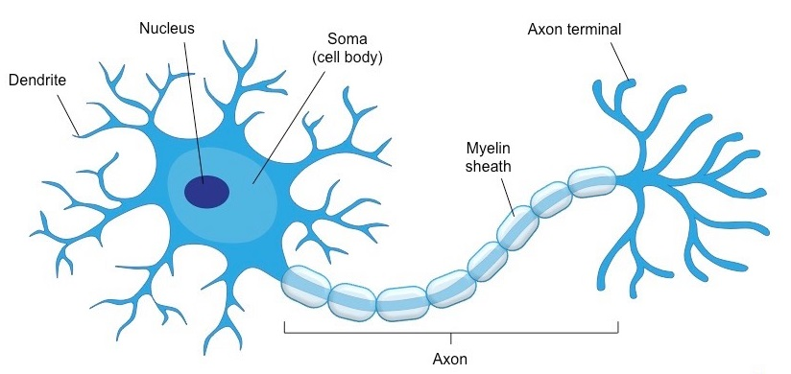
Neural Networks
A neural network is a massively parallel and distributed network made up of simple processing units, also known as neurons [3].
Artificial Neural Networks (ANNs) are inspired by the structural and functional characteristics of the biological human brain. Thus, ANNs operate in a manner such that they mimic the operations of the human brain [3].
Figure 5: Biological neuron

Slide 15
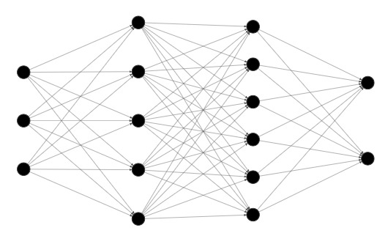
Artificial Neural Network Architecture
Input Layer
Hidden Layer
Output Layer
Figure 6: Artificial Neural Network Architecture

Slide 16
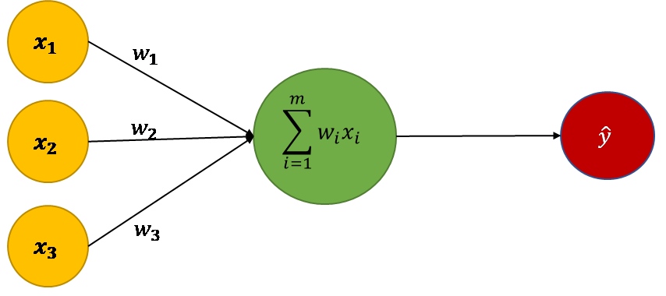
Engineering Model of a Neuron
Parameters:
Inputs features
Weights
Bias
………….eqn 1

Slide 17
Input (x)
In Artificial Neural Network (ANN), input refers to the data or features provided to the network for processing.
Each input corresponds to a feature or variable in the dataset that the ANN is attempting to learn from.
Age (weeks) | Weight (N)
2 | 12.0
4 | 16.0
5 | 18.5
6 | 20.8
Age (weeks) | Weight (N) | Height | Gender
2 | 12.0 | 5 | Male
4 | 16.0 | 4 | Female
5 | 18.5 | 5 | Female
6 | 20.8 | 2 | Male

Slide 18


Weights (w)
Research on Electoral Violence in Ghana:
Sample size = 50
Cluster 1 = 40
Cluster 2 = 10
Can money influence electoral violence?
Cluster 2 Profile
Carefully selected individuals
Inspector General of Police
NCCE Boss
CHRAJ Boss
Chief Justice
Prof. Gyampo
J.A Kuffour
Nana Addo Danquah Akuffo Addo
John Mahama
Speaker of Parliament
General Mosquito
Cluster 1 Profile
Randomly selected students from UG
Unweighted:
Total = 40
Weighted:
Total = quantity x weight
40 x 1
Total = 40
Unweighted:
Total = 10
Weighted:
Total = quantity x weight
10 x 5
Total = 50

Slide 19
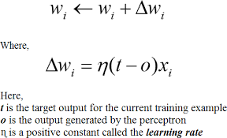
ANN Learning Process
Age (weeks) | Weight (N) | Height | Gender F = 0 ; M = 1
2 | 12.0 | 5 | 1
4 | 16.0 | 4 | 0
5 | 18.5 | 5 | 0
6 | 20.8 | 2 | 1
7 | 23.1 | 3 | 1
y = (x1*w1)+(x2*w2)+(x3*w3)
y = (2*0.2) + (12*-0.01) + (5*0.11)
y = 0.83
error = target – output
error = 1 – 0.83
error = 0.17
= 5 (1 – 0.83) x 2
= 0.63
= 0.5 (1 – 0.83) x 2
= 0.17
error
………….eqn 2
………….eqn 1
………….eqn 3

Slide 20
Artificial Neural Network Architecture
Input Layer
Hidden Layer
Output Layer
Figure 6: Artificial Neural Network Architecture

Slide 21
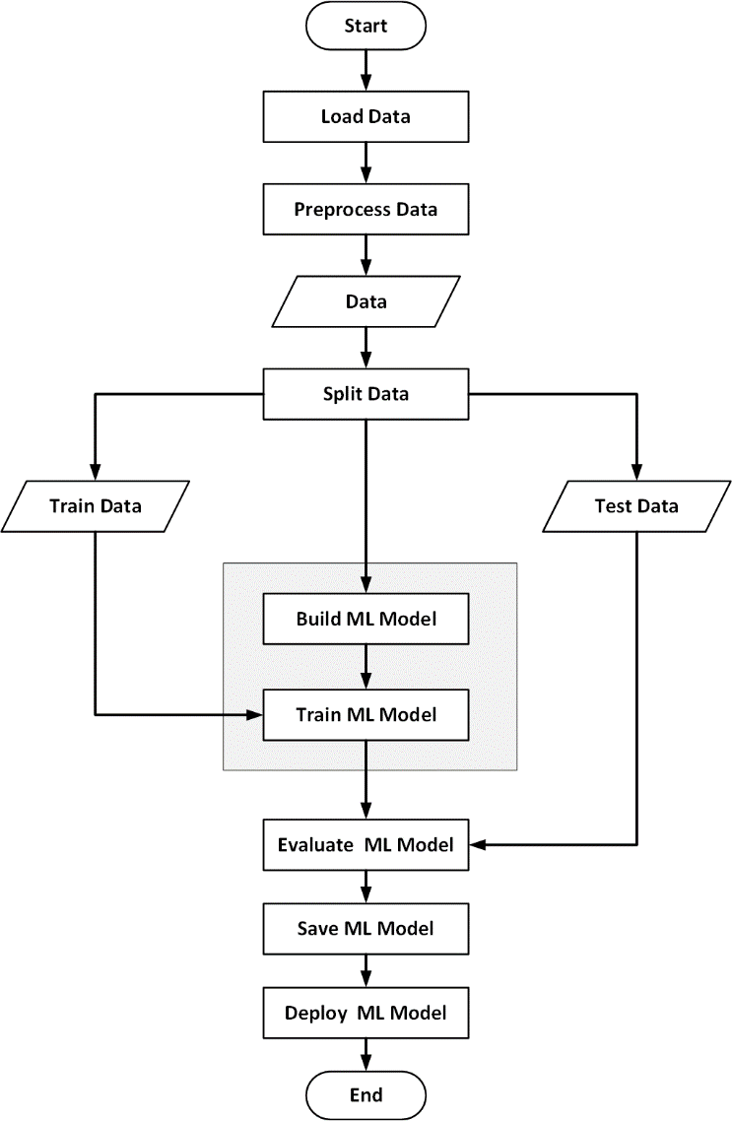
Machine Learning Model Development
dataset
dataset
Age | Weight | Height | Gender
2 | 12.0 | 5 | 1
4 | 16.0 | 4 | 0
5 | 18.5 | 5 | 0
6 | 20.8 | 2 | 1
7 | 23.1 | 3 | 1
8 | 26.0 | 5 | 1
9 | 30.0 | 4 | 0
10 | 32.0 | 4 | 1
15 | 40.0 | 6 | 0
20 | 47.3 | 7 | 0
dataset
dataset
x_train
dataset
dataset
dataset
dataset
x_test
Fig.7 Machine Learning Model Development Flowchart

Slide 22
Thank You

