Slide 1


Faculty Of Arts And Sciences Computer networks – CSI 345 LAB Spring 2022 FINAL Project
AMERICAN UNIVERSITY OF SCIENCE & TECHNOLOGY
Fouad Dakhoul (12210449)
Youssef Chayeb (12210624)
Mohamad Madi (12203006)
Yaakoub khalil (12200055)
Submitted to:
dr. gaby abou haidar

Slide 2
Enterprise Infrastructure Network:
Simulates a real enterprise setup
Head office to Branch office connectivity.
VLSM – VLANS – Router and Switch security
FINAL PROJECT: Computer networks – CSI 345 LAB

Slide 3
Material and Component used:
Packet Tracer Software
CCNA v7: Introduction to Networks
CCNA v7: Switching Routing and Wireless Essentials
Microsoft Office
FINAL PROJECT: Computer networks – CSI 345 LAB

Slide 4
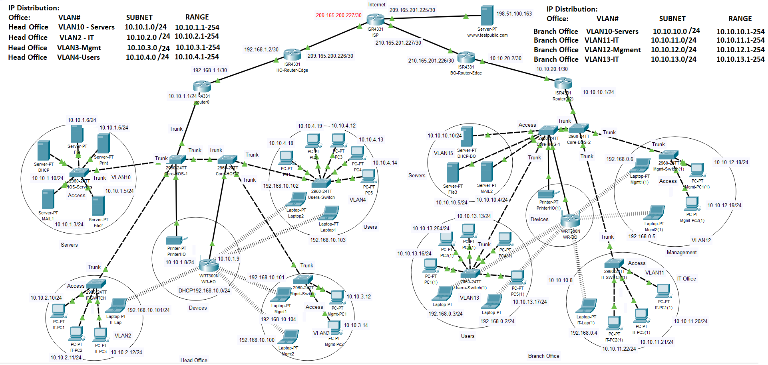
Network Design – Diagram:
FINAL PROJECT: Computer networks – CSI 345 LAB

Slide 5
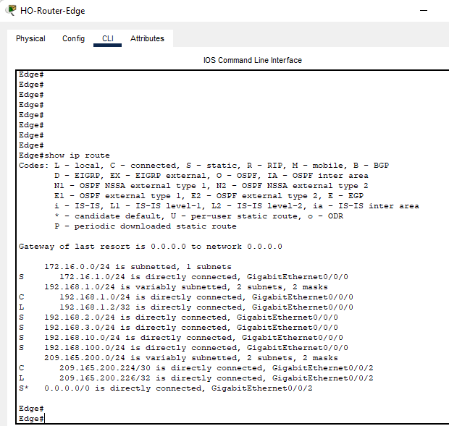
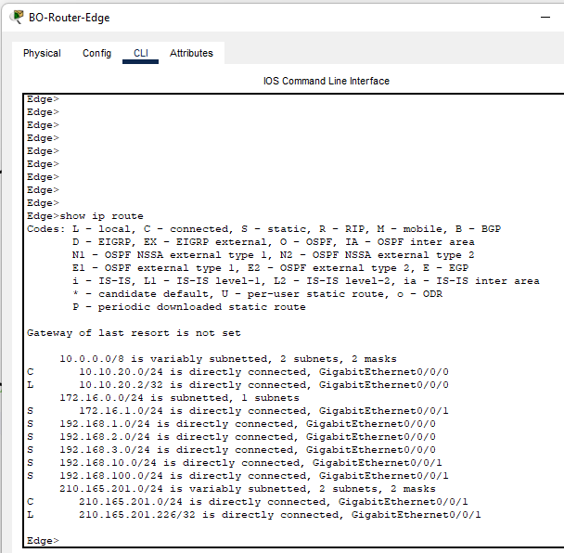
Network Design – Screenshots:
Static Route configuration
FINAL PROJECT: Computer networks – CSI 345 LAB

Slide 6
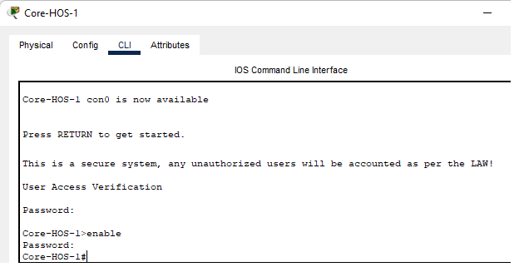
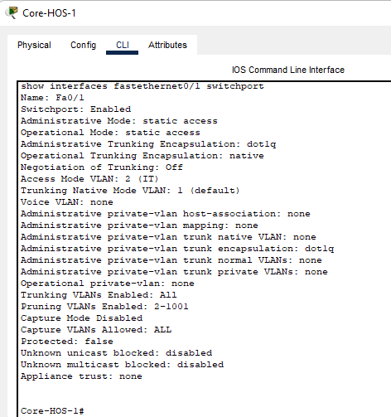
Network Design – Screenshots:
Password configuration
Port Trunk configuration
FINAL PROJECT: Computer networks – CSI 345 LAB

Slide 7
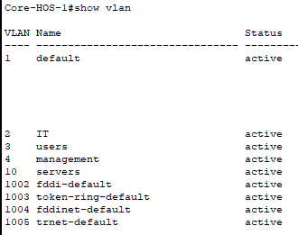
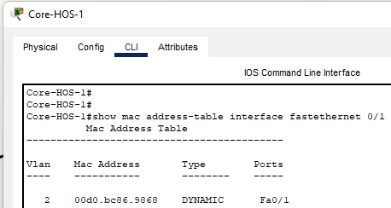
Network Design – Screenshots:
VLANs List
VLAN Assignment
FINAL PROJECT: Computer networks – CSI 345 LAB

Slide 8
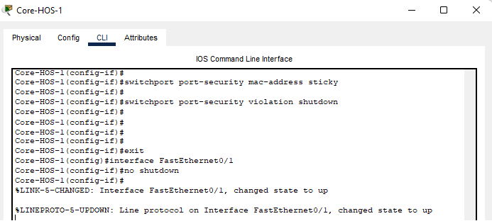
Network Design – Screenshots:
Switch Port security – mac-address sticky
FINAL PROJECT: Computer networks – CSI 345 LAB

Slide 9
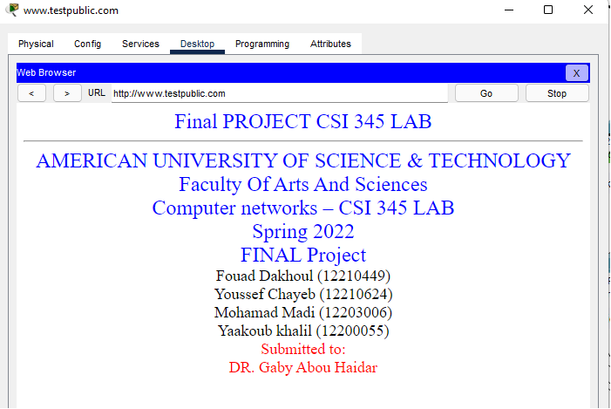
Network Design – Screenshots:
Public Website Access
FINAL PROJECT: Computer networks – CSI 345 LAB

Slide 10
Discussion:
Enterprise network, simulating a real enterprise setup.
Head Office, and Branch office, interconnected using back to back secure routers throughout the ISP link.
Several offices (ex: Management, IT, Users, Servers etc..) in each location.
FINAL PROJECT: Computer networks – CSI 345 LAB

Slide 11
Discussion:
Secured offices using different VLANs.
Edge routers have been configured to route internal router traffic to the internet and to the branch office.
FINAL PROJECT: Computer networks – CSI 345 LAB

Slide 12
Discussion:
Configured Secure wireless setup for each office, using WPA2 encryption and password.
Edge routers that route internal traffic to the internet and to branch office.
FINAL PROJECT: Computer networks – CSI 345 LAB

Slide 13
Discussion:
DHCP server Providing IP addresses for the computers.
Servers configured with Static IP Addresses.
Redundant switches in each office, providing the maximum service availability to the users.
FINAL PROJECT: Computer networks – CSI 345 LAB

Slide 14
Problems:
Connectivity through VLANs
Connectivity issues from HO to BO
Accessing the public website from ISP configured IPs
FINAL PROJECT: Computer networks – CSI 345 LAB

Slide 15
Conclusion:
From the smallest two pcs connectivity throughout peer to peer, to the extended large enterprise setup. This project gave us the opportunity to work and achieve a high-level exposure, and a real life experience in the world of networking.
FINAL PROJECT: Computer networks – CSI 345 LAB

Slide 16

FINAL PROJECT: Computer networks – CSI 345 LAB

Slide 17
Thank You!
_____________________
FINAL PROJECT: Computer networks – CSI 345 LAB

