Slide 1





YAADHUM OORAE GLOBAL CONCLAVE HACKATHON
(An Initiative by Chief Minister of Tamil Nadu, India)
TEAM NAME : ALL_in_CAPS
TEAM LEAD NAME : Prakash Chandrasing Borade
TEAM MEMBERS : 1.Rushikesh Arun Chaudhari
2.Ashutosh Nandkishor Patil
3.Ankush Sanjaysing Jadhao
TEAM ID : STM017
TRACK NAME : Smart Transportation & Mobility

Slide 2
INDEX TERMS:
PROBLEM STATEMENT
INTRODUCTION
NOVELTY
LIVE WORKING SESSION
PROS & CONS OF PROPOSED MODEL
REFERENCES

Slide 3
PROBLEM STATEMENT:
An application to be developed to help the farmers transport commodities from Farms to factories.
MOTIVATION:
We are son of farmers in remote area from Maharashtra . We have seen many crops getting Low rates or even rotting in field due to unavailability of transportation. Hence transportation can help farmers to get more profit. Industries can gain their share of profit easily when raw commodities and goods are easily available from farmers. This helps in reducing the manufacturing cost of processed good. Hence , resulting in higher gain for Industries.

Slide 4
INTRODUCTION
This Portal is made up for farmer to sell there Products to Industries also we provide online payment option.
Here we have try to fulfil the gap between Farmer and factories.
Here we have build this project with the help of following Technology :
Technology Stack : php , javascript , bootstrap , javascript.
Database : MySql

Slide 5
NOVELTY
We let farmers compare various prices from various industries for their goods resulting in more profitable environment for customers.
Due to Covid-19,Various Markets where shut down. This caused huge decrease in earning of farmers . But with help of our Application , farmers can easily transport their goods directly to factories , causing money in their pocket even in Pandemic.

Slide 6
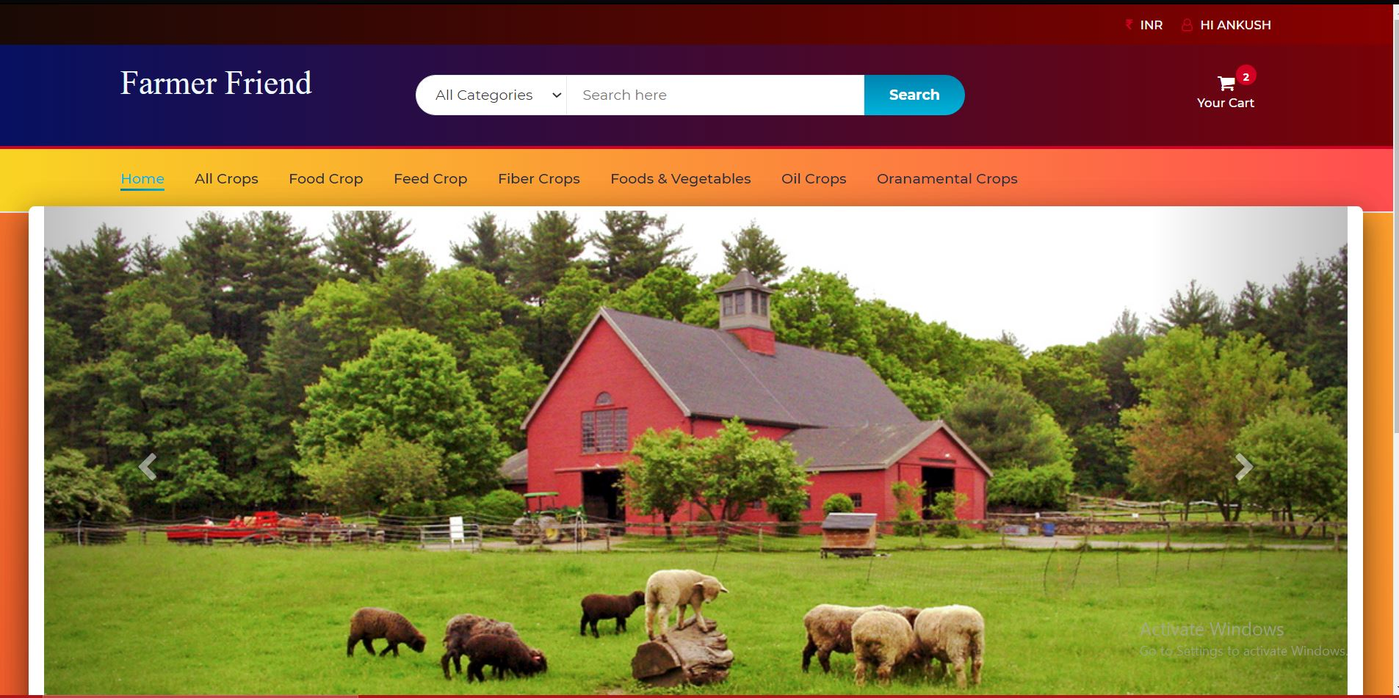
LIVE WORKING SESSION

Slide 7
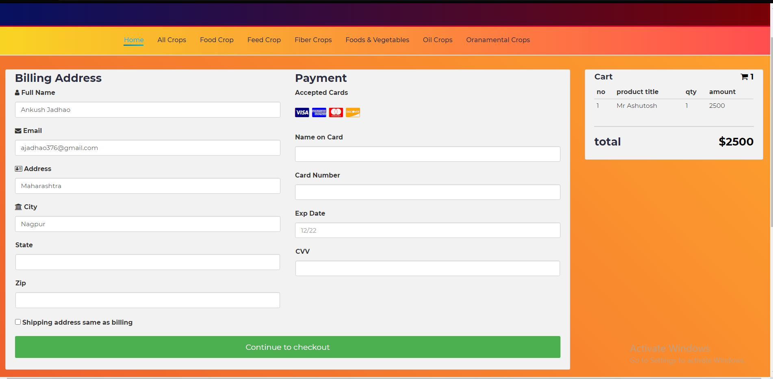
LIVE WORKING SESSION

Slide 8
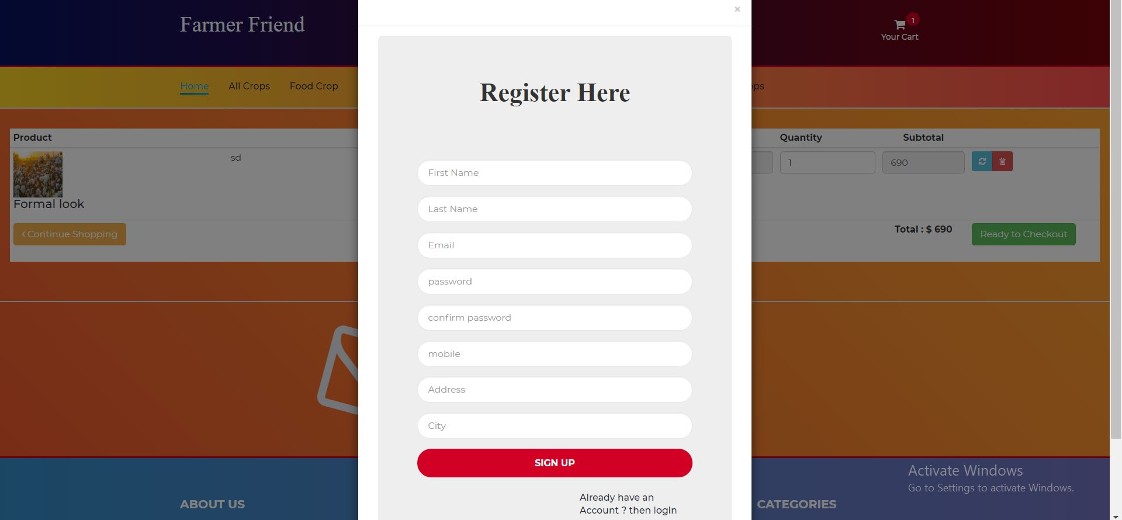
LIVE WORKING SESSION

Slide 9
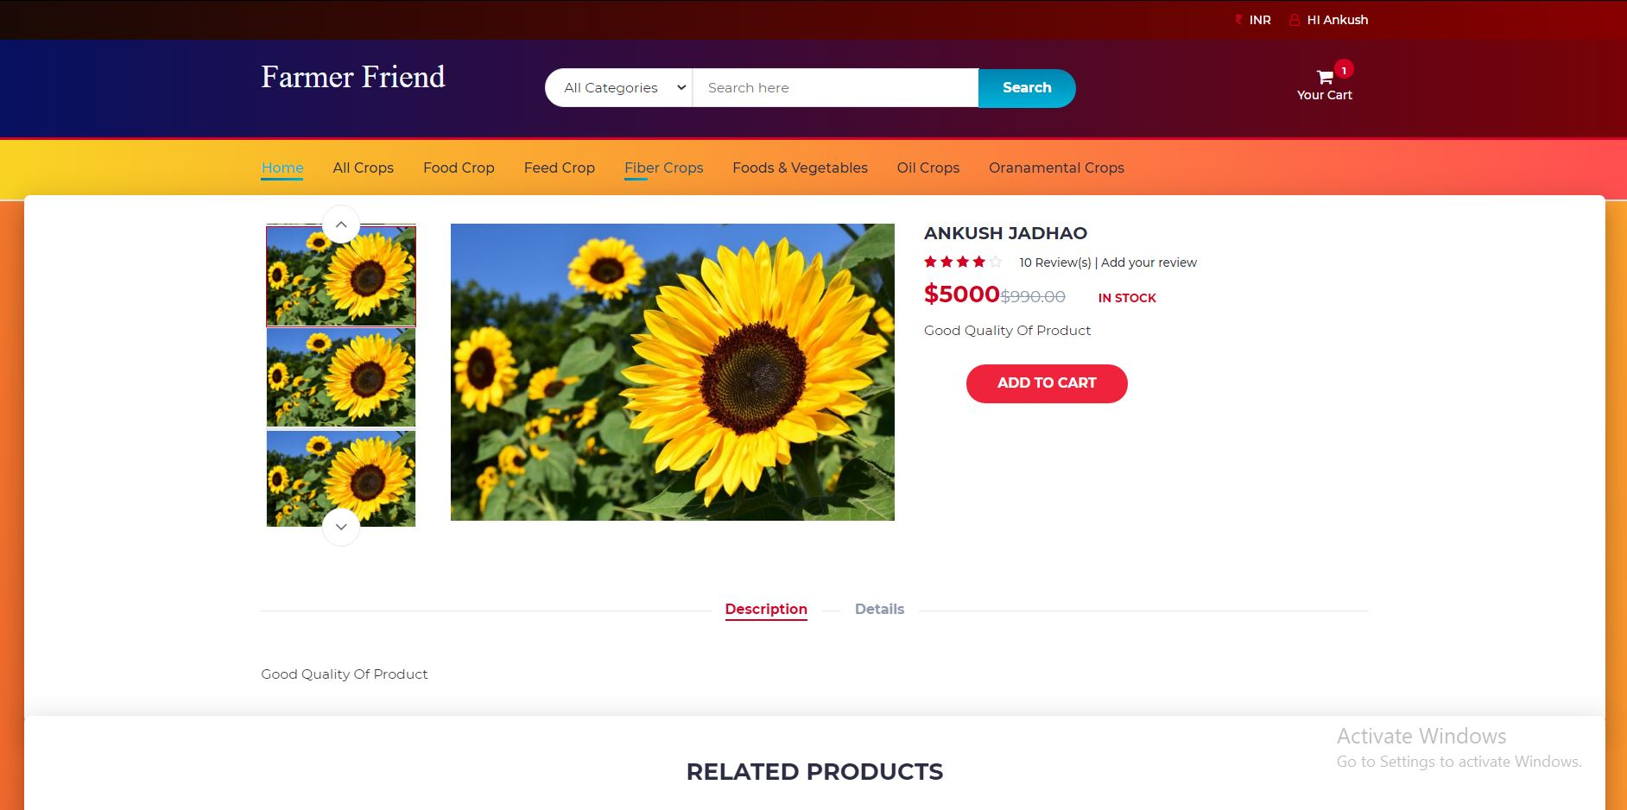
LIVE WORKING SESSION

Slide 10
PROS & CONS OF PROPOSED MODEL:
PROS :
Simple Graphical User Interface (GUI).
Easy to Understand .
Location
CONS :
There is no Live Support for Queries.
Live Tracking

Slide 11
REFERENCES:
https://www.w3schools.com

