Slide 1
يوسف محمود سيد
يوسف محمود عبد المنعم
محمد سيد شعبان
محمود مدحت يمانى

Slide 2
Derotate

Slide 3
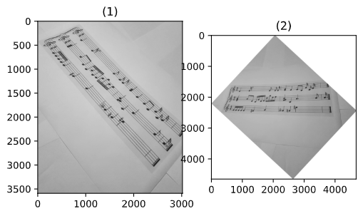

Slide 4
Crop

Slide 5
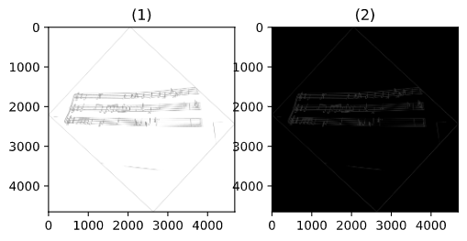

Slide 6
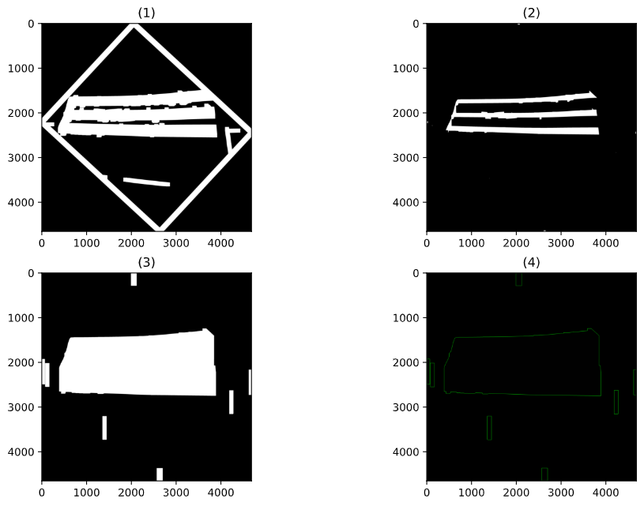
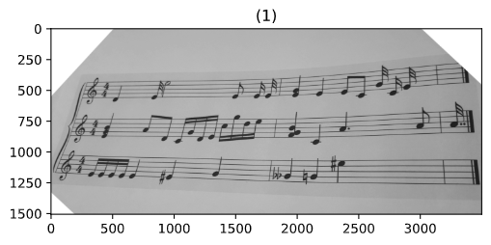
Structuring element size depends on distance between staves

Slide 7
Line Separation

Slide 8
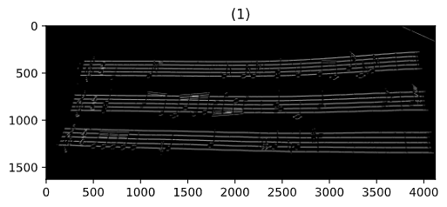
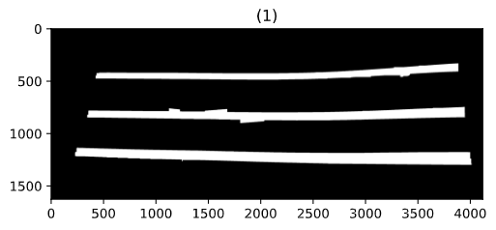
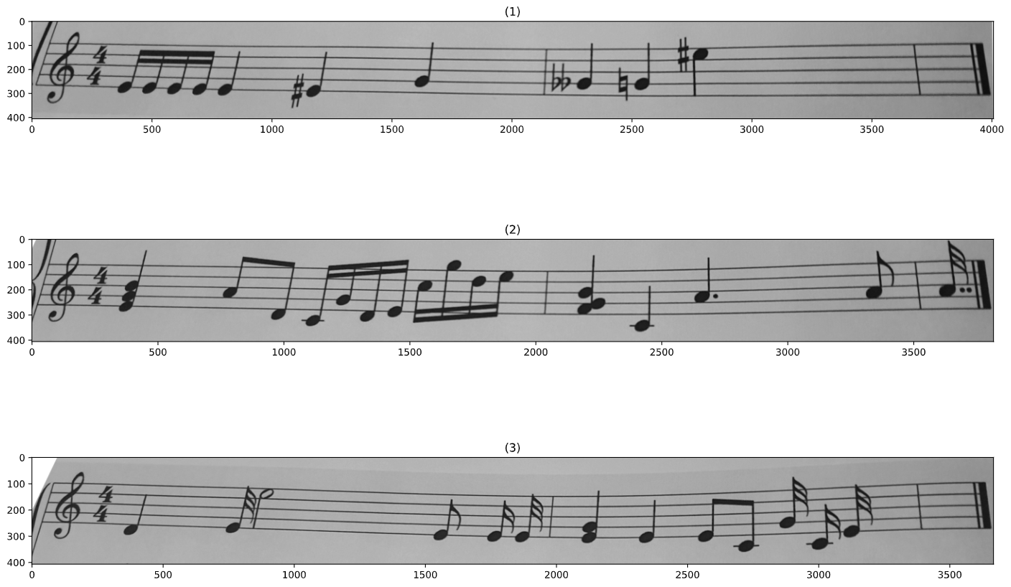
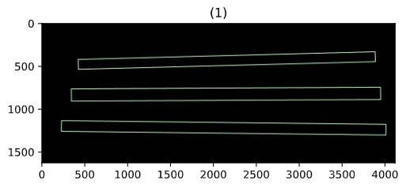
Structuring element size depends on distance between staves

Slide 9
Note Segmentation

Slide 10
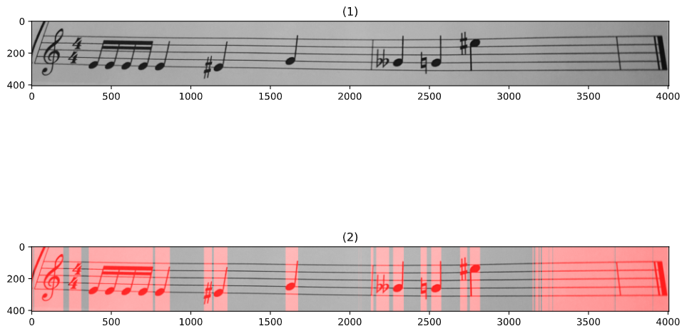

Slide 11
Note Classification

Slide 12
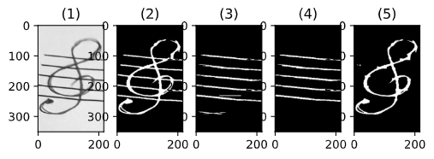
Staff line removal

Slide 13
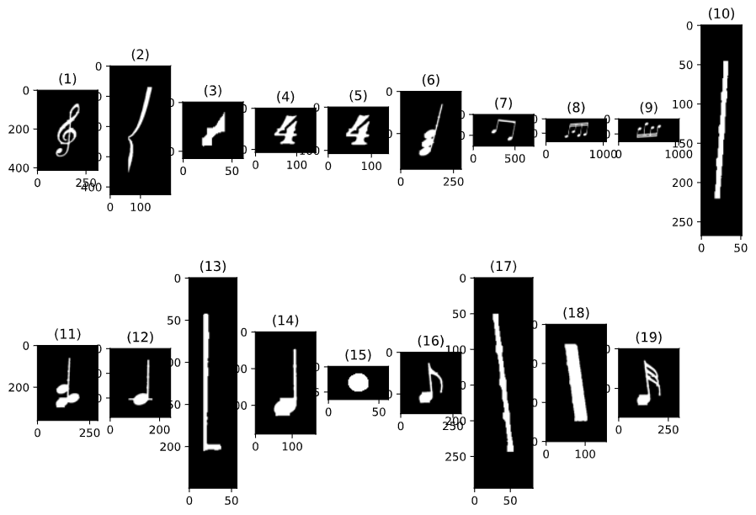
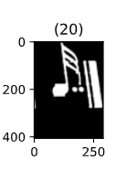
Zoom in + separate adjacent notes

Slide 14
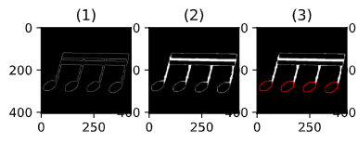
Detecting heads

Slide 15
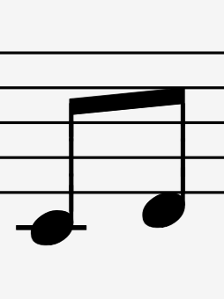
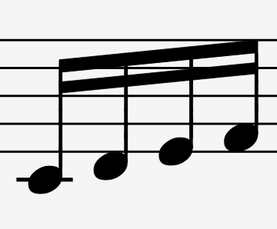
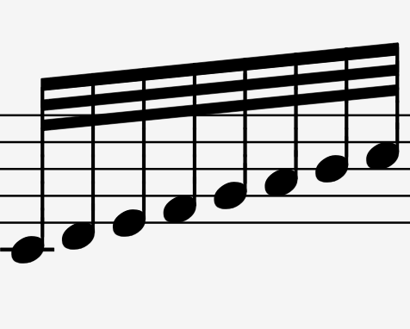
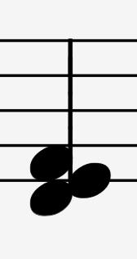
If more than 2 heads -> beam / cord
Wide -> beam
2 -> /8
4 -> /16
8 -> /32
Narrow -> cord

Slide 16
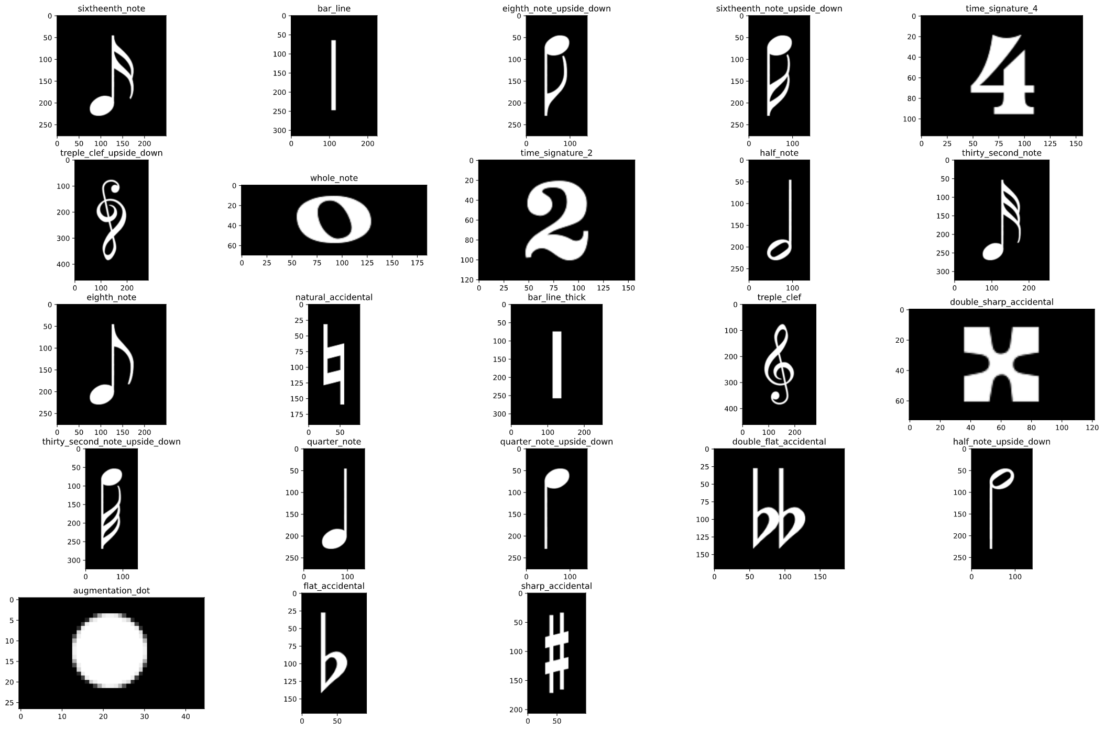
If less than 2 heads -> classifier (SVM)
Data Augmentation

Slide 17
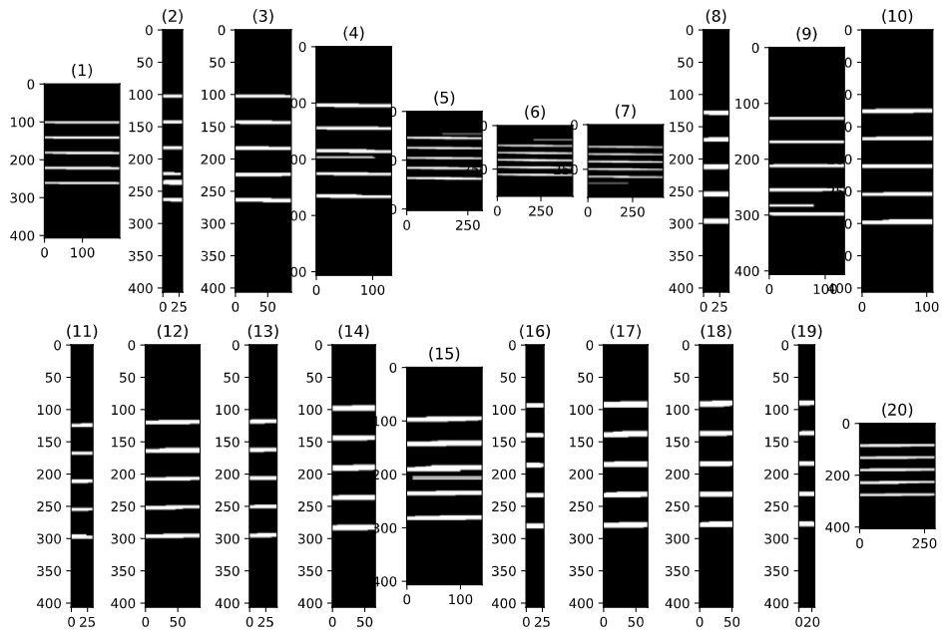
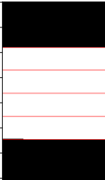
Note’s vertical position
(x, y)

Slide 18
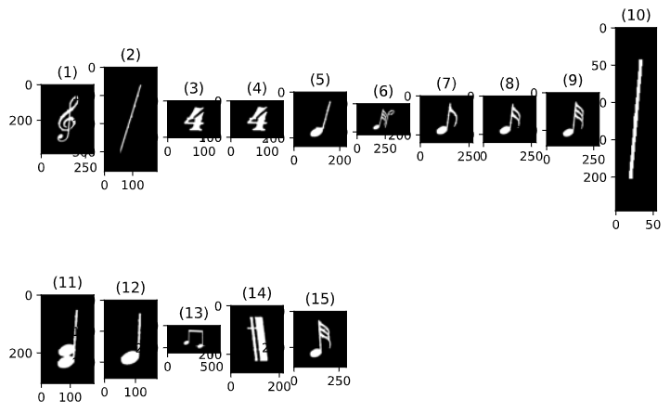
Strength
Classifier works well.
Extremely stable segmentation.

Slide 19
Weaknesses
Cord detection is poor.
No detection for augmentation dots.
Upside down rotation.

