Slide 1
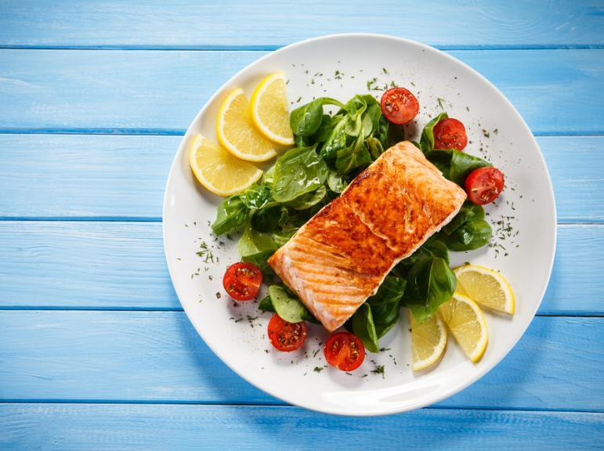
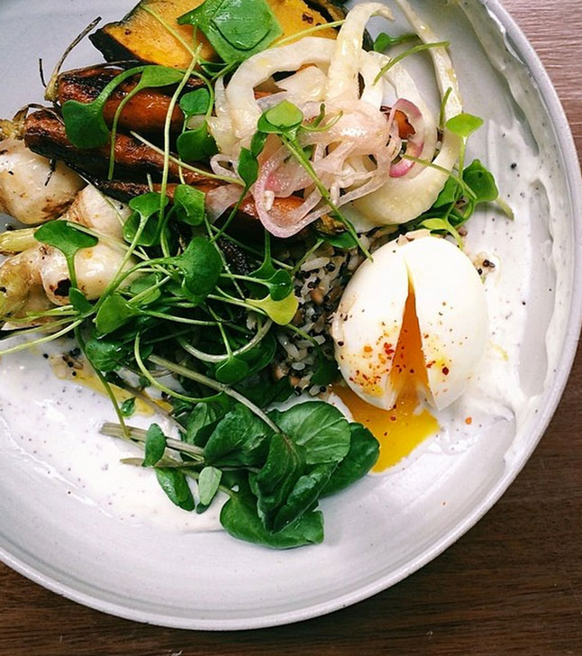
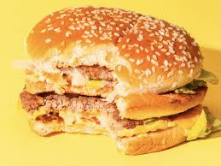

Yummy Kitchen
Recipes
Eat
Ideas
Welcome to yummy kitchen where you can learn to cook dishes that taste delicious and look amazing. Learn more here.

Slide 2

Yummy Kitchen
Recipes
Eat
Ideas
About
Filter
Name
Ingredients:
Egg
Peppers
cheese
Instructions:
First grate the cheese.
…

Slide 3
Yummy Kitchen
Filter
Delivery
Name:
Address:
Card number:
Exp month:
Security number:
Cancel
Pay

Slide 4
Yummy Kitchen
This website is about making tasty food that tastes delicious and looks amazing. Learn how to cook various dishes. We cater for vegans and vegetarians. Not bothered to cook? No Problem! We’ll cook for you!

Slide 5
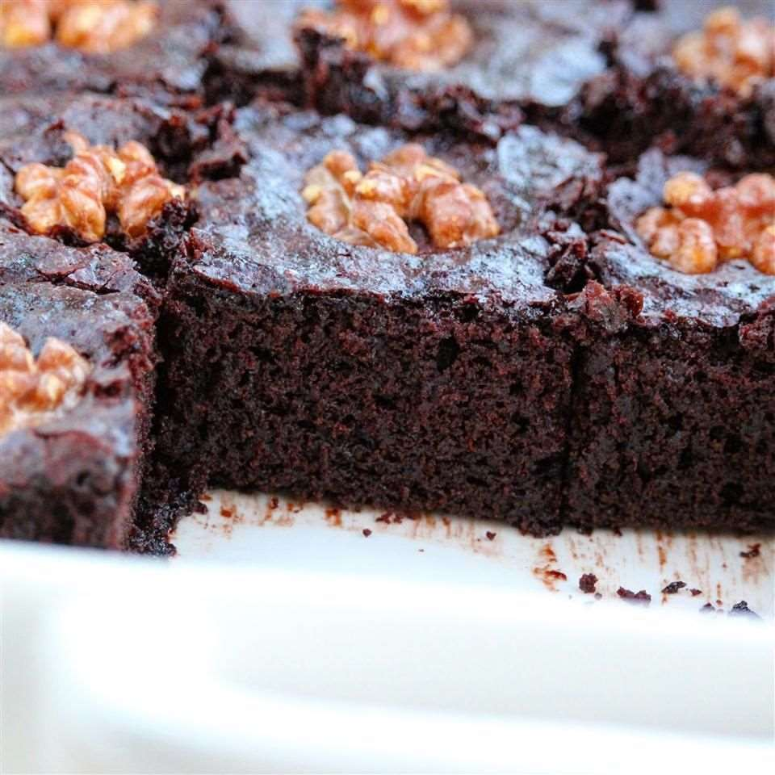
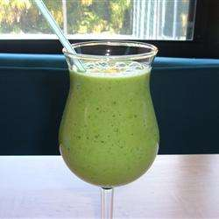
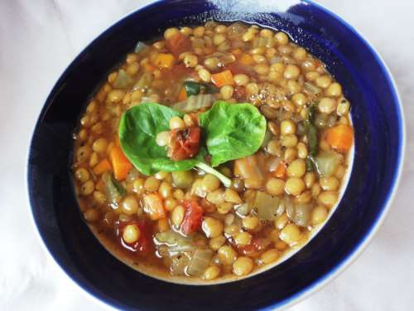
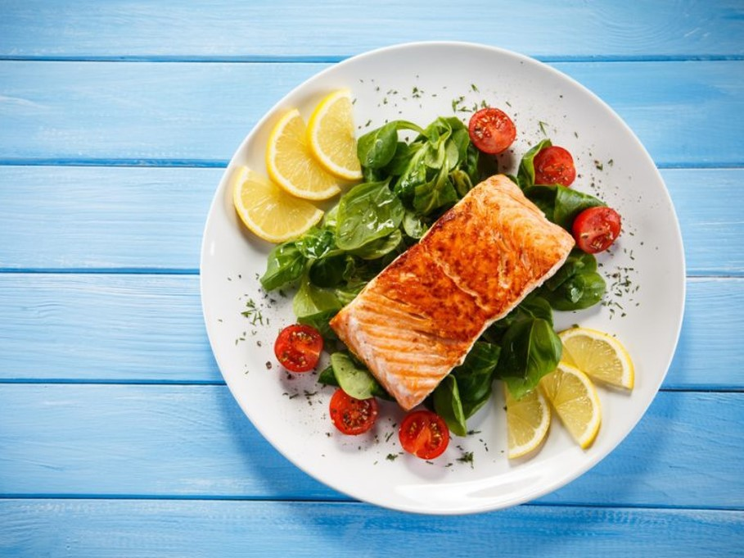
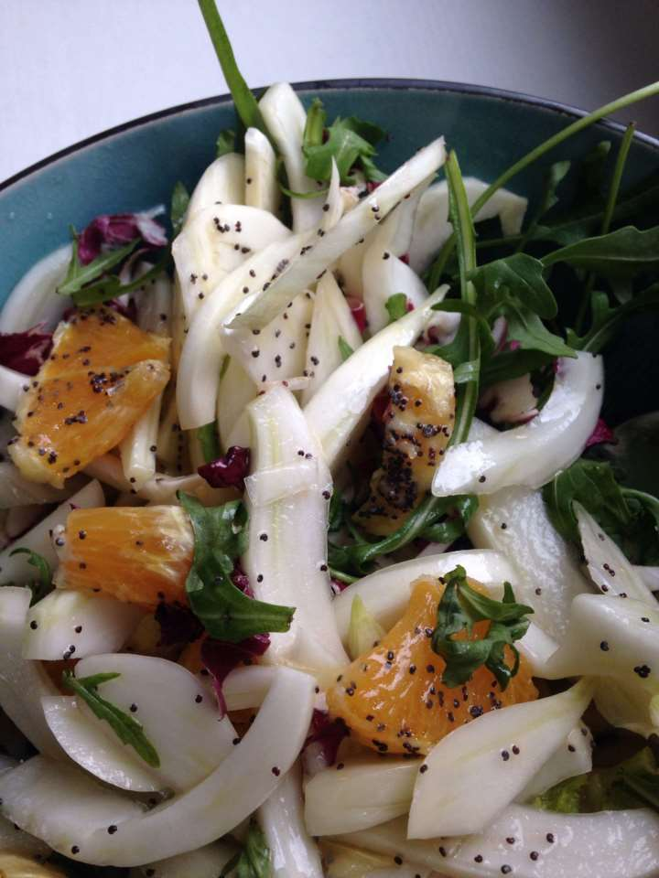
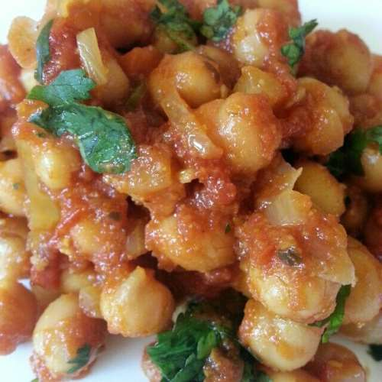
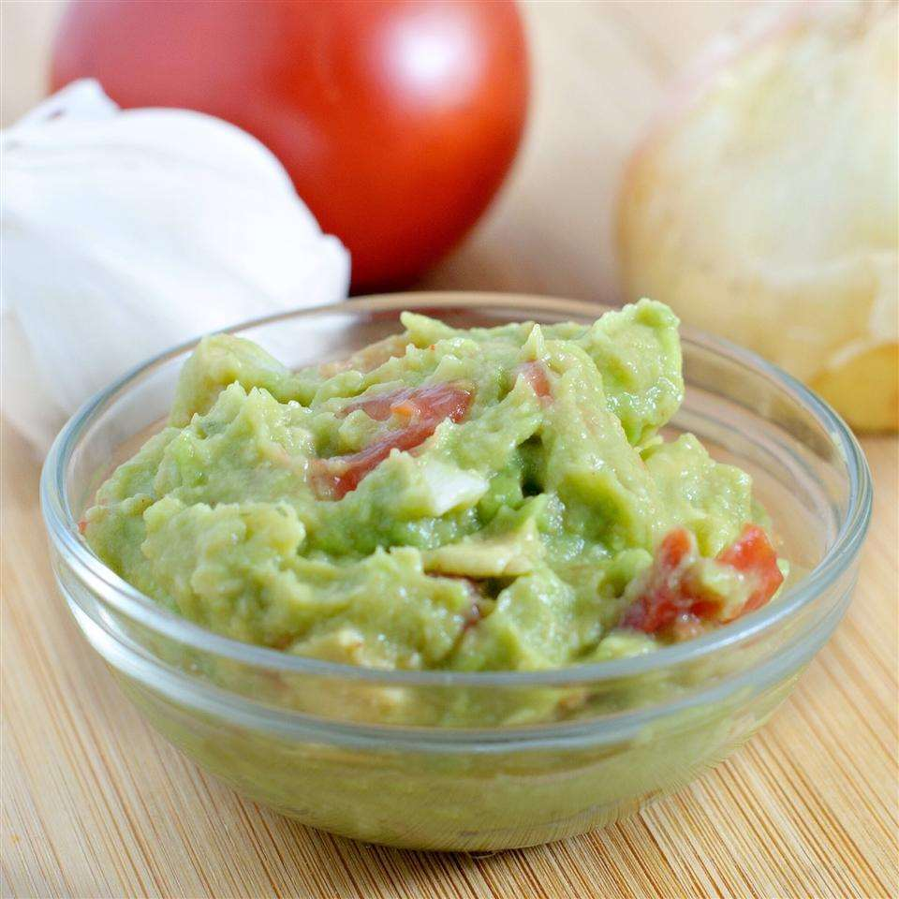
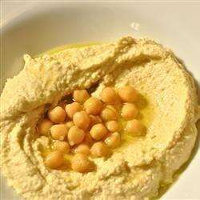
Yummy Kitchen
Feeling a bit uninspired? Making the same old dishes? Have a look at our ideas page to get the creativity flowing and add some originality to your old dishes by adding your own unique twist.

