Slide 1
AIR QUALITY MEASURING DEVICE CALCULATING NH3 ,NOx, CO2 USING INTERNET OF THINGS
SURIYA SUNDARAM K S (21162107012)
SRIPRASATH SATHIYAMOORTHY (2116210701261)
YAASHISH G (2116210701317)

Slide 2
Abstract
This Air pollution poses significant threats to human health and the environment, necessitating the development of advanced monitoring systems. This project presents an IoT-based air quality measuring device designed to monitor concentrations of key pollutants, including Ammonia (NH₃), Nitrogen Oxides (NOx), and Carbon Dioxide (CO₂). The device utilizes MQ gas sensors connected to a microcontroller Arduino Uno for real-time data acquisition and processing. A Liquid Crystal Display (LCD) provides immediate visual feedback of air quality status, categorized as "Good," "Poor," or "Toxic" based on predefined thresholds. The system's portability, low power consumption, and cost-effectiveness make it suitable to use in different places. It helps different people make quick decisions about air quality. By combining advanced gas sensors with IoT connectivity, this device offers several key advantages like Real-time Monitoring ,enabling timely detection of pollutant levels and rapid response to changing environmental conditions.

Slide 3
existing system
The existing systems for air quality monitoring rely on immobile monitoring stations equipped with high-precision instruments to measure pollutants like ammonia (NH₃), nitrogen oxides (NOx), and carbon dioxide (CO₂). While these systems provide accurate and reliable data, they have several limitations. They are expensive to set up and maintain, limiting their deployment, especially in developing regions. Their stationary nature results in limited coverage, often failing to comprehensively monitor larger urban or rural areas. Real-time data accessibility is often restricted, with significant delays due to manual collection and processing. Additionally, these systems lack flexibility as they cannot easily adapt to dynamic monitoring needs or indoor environments. The proposed IoT-based air quality measuring device addresses these challenges and offers a more dynamic and accessible approach to air quality monitoring.

Slide 4
proposed system
The Proposed System Is An IOT-based Air Quality Measuring Device Designed To Monitor The Concentrations Of Ammonia (NH₃), Nitrogen Oxides (NOx), And Carbon Dioxide (CO₂) In Real-time. It Uses Advanced Gas Sensors Connected To A Microcontroller For Data Processing. The Device Transmits Collected Data For Immediate Analysis And Visualization. Designed To Be Portable, Cost-effective, And Energy-efficient, It Is Suitable For Various Environments, Including Urban Areas, Industrial Sites, And Indoor Spaces. The System Features A User-friendly Interface For Easy Operation And Includes Alert Mechanisms, Such Way It Displays The Toxicity Level By Display Three Stages Of Alert Messages Such As Good , Poor And Toxic.

Slide 5
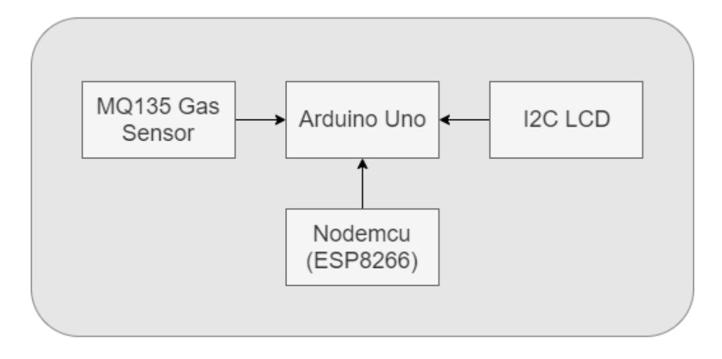
architecture

Slide 6
modules
Sensor Module
Microcontroller Module
Power Supply Module
Environmental Enclosure

Slide 7
explanation of each module
Sensor Module
This Module Includes Gas Sensors For Measuring Concentrations Of NH3, NOx, And CO2 In The Air. Each Sensor Is Calibrated And Interfaced With The Microcontroller Unit To Provide Accurate Measurements.
Microcontroller Module
The Microcontroller Module Serves As The Central Processing Unit Of The Device. It Collects Data From The Sensor Module, Processes It, And Performs Calculations To Determine Pollutant Concentrations. Common Microcontroller Platforms Like Arduino Are Utilized For Their Versatility And Ease Of Programming

Slide 8
explanation of each module
Power Supply Module
The Power Supply Module Provides The Necessary Electrical Power To Operate The Device. It May Include Rechargeable Batteries, Solar Panels, Or Power Adapters, Depending On The Deployment Environment And Power Requirements Of The Device.
Environmental Enclosure
The Environmental Enclosure Protects The Internal Components Of The Device From Weather Conditions, Dust, And Other Environmental Factors. It Is Designed To Be Durable, Waterproof, And Resistant To Corrosion, Ensuring The Reliability And Longevity Of The Device In Outdoor Environments.

Slide 9
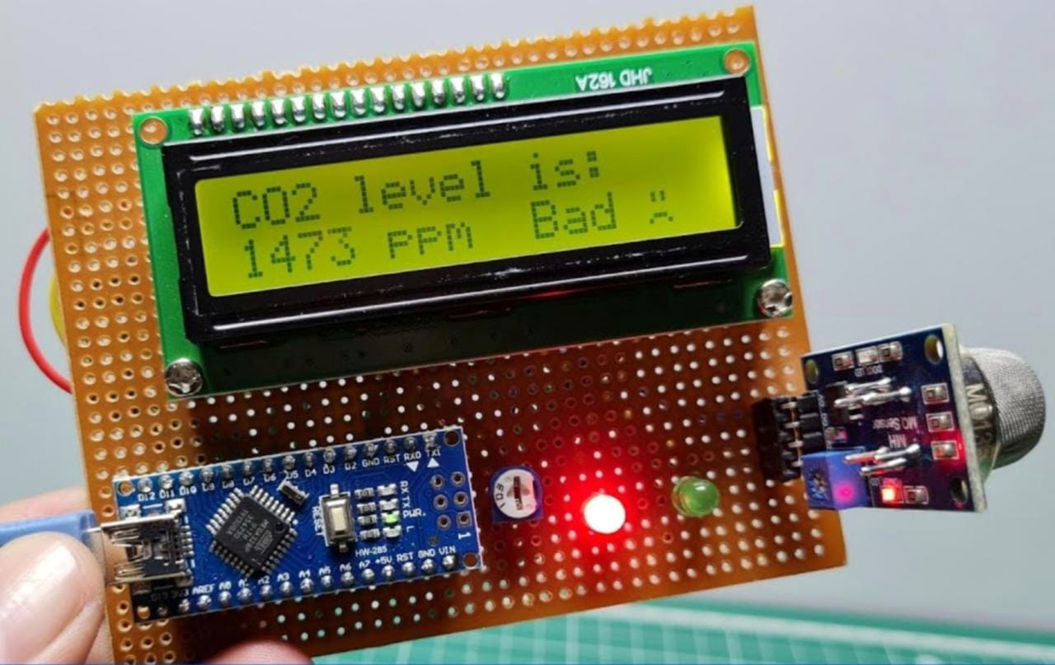
RESULT

Slide 10
⁠conclusion
This Project Successfully Developed An Iot-based Air Quality Measuring Device Capable Of Real-time Monitoring Of Ammonia (Nh₃), Nitrogen Oxides (Nox), And Carbon Dioxide (Co₂). The Device, Featuring Advanced Gas Sensors And A Microcontroller, Proved Effective In Providing Accurate And Immediate Air Quality Data. Its User-friendly Interface, Portability, And Low Power Consumption Make It A Practical And Flexible Solution For Diverse Environments, Including Urban Areas, Industrial Sites, And Indoor Spaces. The Incorporation Of Alert Mechanisms Ensures Timely Warnings When Pollutant Levels Are Unsafe, Enhancing The Device's Utility In Protecting Public Health. Additionally, The Project Demonstrated That Such A Device Could Be Produced Cost-effectively, Making It Accessible For Broader Deployment, Even In Resource-limited Settings. Overall, This Project Highlights The Potential For Iot Technology To Significantly Improve Air Quality Monitoring And Management, Contributing To Better Environmental And Public Health Outcomes.

Slide 11
⁠FUTURE ENHANCEMENTS
This IoT-based air quality measuring device project is vast and promising. It encompasses several avenues for advancement and application. One direction involves improving sensor accuracy and range to detect a wider array of pollutants like particulate matter (PM2.5 and PM10) and volatile organic compounds (VOCs). Integrating with smart city infrastructure enables real-time air quality data to inform urban planning and traffic management strategies. Incorporating data analytics and machine learning allows for predictive capabilities, aiding proactive pollution mitigation. Cloud connectivity offers long-term data storage and comprehensive analysis, empowering stakeholders with valuable insights into pollutant sources and correlations. Additionally, a dedicated mobile application enhances user accessibility and provides personalized health recommendations. Exploring solar power integration improves device sustainability for remote deployment. In summary, integrating cloud technology into the project enhances data management, analysis, and collaboration, significantly improving air quality monitoring and management efforts

