Slide 1

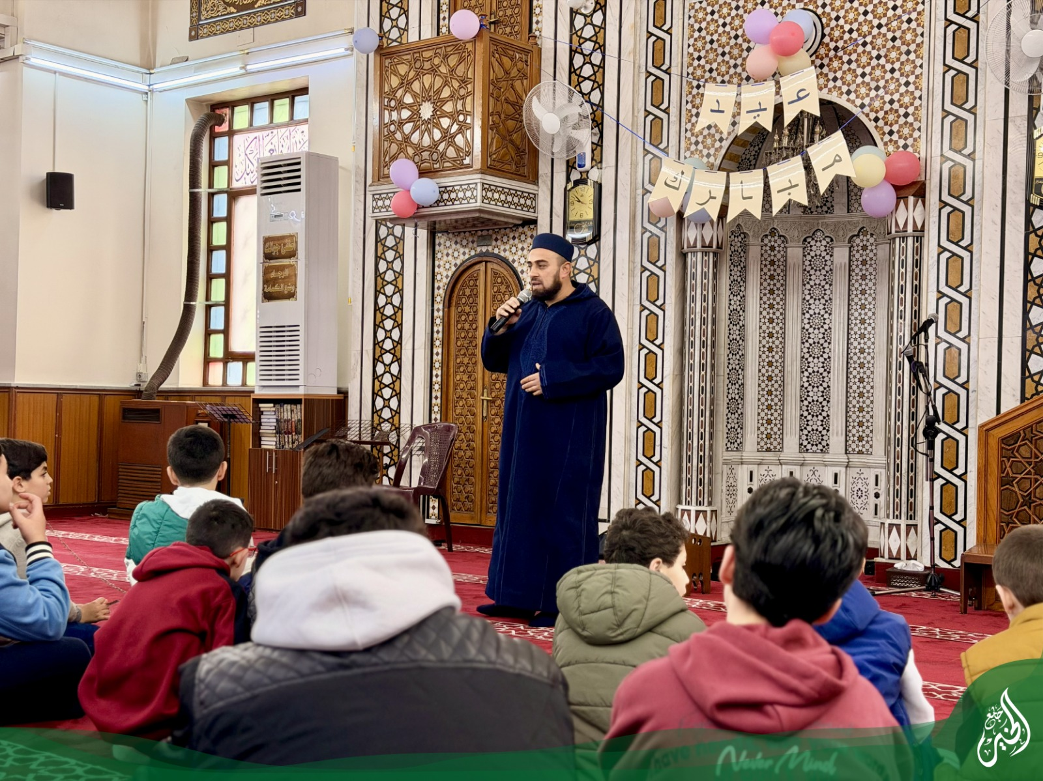
AlKhair App
A management platform for Quran education, community operations, and finance.
Built from the current Laravel 12 + Livewire codebase in AlKhairPhp.
Focus: students, memorization, operations, and reporting.
Presentation overview deck
Generated from the current AlKhairPhp codebase | 2026-05-14
01

Slide 2
Product Summary
What the app mainly does
The current repository implements a single system for running the daily academic and administrative workflow of AlKhair.
Main functionality:
The repo shows this scope clearly:
â€¢ students, parents, teachers, users, and permissions
â€¢ courses, groups, schedules, and enrollments
â€¢ memorization sessions, Quran tests, assessments, and points
â€¢ invoices, payments, finance requests, cash boxes, and reports
â€¢ website pages, ID cards, print templates, barcodes, and APIs
Run the end-to-end operations of a Quran and mosque education center in one place.
- People and access
- Teaching groups and enrollments
- Daily learning and attendance tracking
- Family billing, activities, and finance
Not a generic CMS or only a website
Generated from the current AlKhairPhp codebase | 2026-05-14
02

Slide 3
Feature Map
Main modules in the app
These are the major functional areas that appear in routes, models, Livewire screens, and services.
People and access
Academic structure
Quran tracking
Users, roles, permissions, parents, teachers, students, profile photos, and scoped dashboards.
Courses, running groups, schedules, academic years, grade levels, and student enrollments.
Page-level memorization, quick entry, partial tests, final tests, awqaf tests, and progression rules.
Attendance and performance
Finance and activities
Identity, website, and API
Student attendance, teacher attendance, assessments, results, points ledger, and student notes.
Invoices, receipts, payments, activity registrations, request workflows, cash boxes, transfers, and exchange.
ID cards, print templates, barcodes, bilingual public website, API tokens, and integration endpoints.
The strongest center of gravity is the combination of student operations, Quran progress tracking, and finance.
Generated from the current AlKhairPhp codebase | 2026-05-14
03

Slide 4
Core Workflow
How the main business flow works
The application is organized around the journey from student onboarding to daily tracking, evaluation, and billing.
01
Register
02
Set up
03
Track
04
Assess
05
Reward
06
Bill
Create parent, teacher, and student records. Assign permissions and profile data.
Set up courses, groups, schedules, academic year context, and active enrollments.
Capture attendance, memorization sessions, Quran tests, and supporting notes.
Record assessments, exam results, pass or fail status, and progression milestones.
Apply point policies, manual adjustments, and cached progress summaries.
Issue invoices, collect payments, manage requests, and review finance reports.
Presentation takeaway: the app is not a collection of unrelated CRUD screens. It models one operational lifecycle for a learning center.
Generated from the current AlKhairPhp codebase | 2026-05-14
04

Slide 5

Differentiators
What makes this app specific to AlKhair
The Quran workflow and learning rules are where the product becomes specialized.
- Memorization is stored page by page, not as a loose summary.
- Duplicate lifetime pages are detected and prevented unless explicitly overridden.
- Final and awqaf tests follow progression rules based on passed earlier stages.
- Student progress screens combine pages, tests, attendance, points, and notes.
- A daily teacher summary API already exists for Telegram or n8n automation.
Memorization
Page-level history
Progression
Rule-driven tests
Automation
Daily teacher digest
Generated from the current AlKhairPhp codebase | 2026-05-14
05

Slide 6
Operations
Finance, activities, and operational support
The repo contains a fuller finance layer than a basic billing module.
Family billing
Activity finance
Request workflows
Invoices, invoice items, payments, printable receipts, and invoice status tracking.
Registrations, fee collection, expense tracking, and expected versus collected revenue.
Pull requests, expense requests, revenue requests, review actions, posting, and settlement.
Cash control
Multi-currency
Operational tools
Cash boxes, assigned currencies, transfers between boxes, and non-negative balance safeguards.
Currency rates, base and local equivalents, and exchange transactions with audit trails.
Reports, exports, barcodes, print templates, and ID card generation for front-desk workflows.
Generated from the current AlKhairPhp codebase | 2026-05-14
06

Slide 7
Access Model
Who uses the app
Dashboards and access are role-based, with scoped permissions in both web and API flows.
Admin / Manager
Teacher
Parent
Student
Full operational visibility.
Manages people, settings, reports, finance, and system-wide workflows.
Works on assigned groups.
Records attendance, memorization, Quran tests, assessments, and internal notes.
Views family-facing data.
Follows student progress, enrollments, activities, invoices, and payments.
Uses a personal dashboard.
Sees personal learning progress, points, attendance, and active enrollments.
The API also uses token-based authentication with permission checks, so integrations follow the same access model.
Generated from the current AlKhairPhp codebase | 2026-05-14
07

Slide 8
Close
Suggested demo path and final message
Use this order if you want to walk stakeholders through the app live after the presentation.
Recommended demo flow:
1. Dashboard and role-based navigation
2. Students and parent records
3. Groups and enrollments
4. Memorization and Quran tests
5. Attendance and points
6. Invoices, payments, and finance reports
7. Website or API integration screens
Main takeaway: AlKhair App is the operational backbone for a Quran learning organization, combining education tracking, community workflows, and finance in one system.
Generated from the current AlKhairPhp codebase | 2026-05-14
08

