Slide 1
R
RehabIQ
21M+
Americans need SUD treatment
The Clinical Copilot for Mental Health Recovery
AI-powered clinical intelligence that gives rehab counselors back their time, their memory, and their ability to see the bigger picture.
40%
of counselor time lost to paperwork
90%
don't receive specialized care
Track 2: Neuroscience & Mental Health
Claude Builder's Club Hackathon · Indiana University · 2026
Team: Naishal, Yashwi, Vedant, Dhruvil

Slide 2
THE PROBLEM
Counselors are drowning. Their clients pay the price.
Who are we building this for?
AI assists rather than replace
Rehabilitation counselors managing 30-40+ clients across IOP, outpatient, and residential programs. They spend 40% of their time on documentation instead of with clients. By the time they notice a pattern, it's often too late.
RehabIQ surfaces patterns and suggests, it never decides. Every DAP note is a draft the counselor edits. Every clinical recommendation says 'Consider...' not 'Do this.' The counselor walks into every session more informed, but every decision stays human.

Slide 3
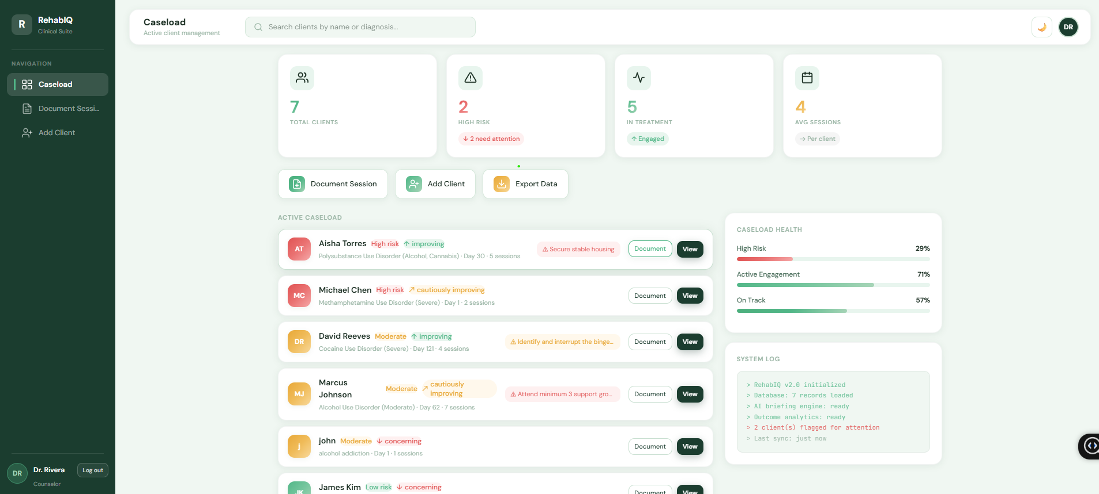
PRODUCT DEMO
RehabIQ in action
📝
DAP note generation
Raw notes → structured clinical docs in seconds
📋
Pre-session briefings
AI-prepared context before every session
📊
Outcome tracking
[ Live demo plays here ]
Visual dashboard with recovery domain scores
🔍
Pattern detection
Cross-session insights humans would miss
➕
Client management
Full intake, treatment plans, persistent storage

Slide 4
ETHICAL ALIGNMENT
What could go wrong?
Data privacy & compliance
HIGH
AI accuracy & clinical safety
MEDIUM
Risk: Protected Health Information (PHI) exposure. SUD records carry extra federal protections.
Risk: AI-generated notes could contain inaccuracies. False low-risk scores could lead to missed interventions.
Mitigation: End-to-end encryption for all PII. HIPAA-compliant infrastructure with BAA agreements. 42 CFR Part 2 compliance, federal regulations that protect substance use disorder treatment records with stricter consent requirements than standard HIPAA, preventing disclosure without explicit patient authorization.
Mitigation: Every AI output is an editable draft, counselors review, modify, and approve before finalizing. All sections are fully editable so clinicians remain in control. Configurable alert thresholds. AI is the facilitator; the counselor is the decision-maker.
Clinician adoption & trust
MEDIUM
Interoperability & scalability
LOW
Risk: Staff resistance to AI-generated documentation. Concern about being replaced.
Risk: Integration with existing EHR systems. Performance under large caseloads.
Mitigation: Opt-in AI suggestions, counselors choose when to use AI. Training modules and feedback loops. Clear messaging: RehabIQ amplifies clinical judgment, it doesn't replace it. Counselor-in-the-loop at every step.
Mitigation: FHIR R4 API architecture for EHR integration (Epic, Netsmart, Kipu). SQLite for hackathon; production-ready PostgreSQL path. Auto-scaling infrastructure roadmap.

Slide 5
THE VISION
WHAT'S NEXT
From documentation to intelligence.
Phase 1
HIPAA-compliant cloud deployment with end-to-end encryption
RehabIQ doesn't just record what happened, it connects the dots across time, surfaces what matters, and helps counselors make better clinical decisions faster.
Phase 2
EHR integration via FHIR R4 APIs (Epic, Netsmart, Kipu, BestNotes)
Phase 3
Anonymized outcome benchmarking across treatment centers
⏱️
Saves 2-3 hours of documentation per counselor per day
🔍
Catches cross-session patterns humans miss across 30+ caseloads
📊
Tracks whether interventions are actually working — not just used
16,000+
SUD treatment facilities in the US alone
🤝
Every decision stays with the counselor. AI surfaces, humans decide.

