Slide 1

PROJECT PRESENTATION
Predictive Modeling and Data Engineering Pipelines for Maternal Health Risk Stratification
in Low-Resource Public Health Frameworks
Yabets Desalegn
Student ID: GSE9850/18
Course: Data Management and Engineering
August 2026

Slide 2
OVERVIEW
Agenda
01
Problem, Objectives & Research Questions
05
Experimental Results
02
Related Works
06
Interpretation & Validity Checks
03
Dataset & Data Preparation
07
Conclusions & Way Forward
04
Methodology & Model Selection Protocol
Maternal Health Risk Stratification
2

Slide 3
01 · INTRODUCTION
Problem Statement & Motivation
Reducing maternal mortality is directly tied to Sustainable Development Goal 3.
Pregnant women in low-resource settings often lack continuous clinical supervision.
Early risk indicators - abnormal blood pressure, glucose, heart rate, or fever - frequently go undetected until a crisis emerges.
Low-cost IoT sensing now allows basic vital-sign collection in remote areas.
Manually interpreting six or more combined vital signs is difficult for non-specialist health workers.
This motivates an automated, machine-learning-based risk stratification pipeline.
SDG 3
Directly tied to the UN Sustainable
Development Goal on health
IoT
Low-cost sensing enables remote
maternal vital-sign monitoring
6+
Vital signs a health worker must
mentally combine per patient
Maternal Health Risk Stratification
3

Slide 4
01 · INTRODUCTION
Project Objectives
1
Build a reproducible, leakage-safe data engineering pipeline for cleaning, auditing, and engineering features from raw maternal vital-sign data.
2
Train and rigorously compare seven ML/DL-style algorithms for three-class maternal risk classification.
3
Select a final model using cross-validation-only selection ,never test-set-driven model shopping.
4
Interpret the selected model with multiple complementary techniques: native importance, permutation importance, learning curves, and error analysis.
5
Critically assess strengths, weaknesses, and responsible-use boundaries for low-resource deployment.
Maternal Health Risk Stratification
4

Slide 5
01 · INTRODUCTION
Six Research Questions
RQ1
Predictive accuracy
RQ2
Model comparison
How accurately can the seven algorithms classify maternal risk?
Which model performs best and is it statistically significant?
RQ3
Class imbalance
RQ4
Feature contribution
How does imbalance affect per-class recall vs. plain accuracy?
Which features matter most, consistently across methods?
RQ5
Generalization
RQ6
Responsible use
Do learning curves show overfitting, underfitting, or a data ceiling?
What are the limitations and human-oversight requirements?
Maternal Health Risk Stratification
5

Slide 6
02 · RELATED WORKS
Positioning Against Prior Research
[1]
Ahmed et al., 2020
[2]
Ahmed & Kashem, 2020
Reviewed IoT-based maternal risk factors, establishing the risk taxonomy used in this dataset.
Original dataset source (n=1,014; Dhaka, Bangladesh) — matched exactly by this project's integrity check.
[3]
Togunwa et al., 2023
[4]
Assaduzzaman et al., 2023
Hybrid ANN + Random Forest model — confirms ensemble trees outperform linear/neural approaches.
Traditional ML comparison — reinforces tree-based methods as the strongest accuracy/interpretability balance.
Gap this project addresses: none of the above separate CV-based model selection from test evaluation, apply a formal significance test, or cross-check two independent importance methods.
Maternal Health Risk Stratification
6

Slide 7
03 · DATA
Dataset Overview
1,014
7
3
0
Total records
Raw columns
(6 features + target)
Risk classes
low / mid / high
Missing values
Source: IoT-based maternal risk monitoring, Dhaka, Bangladesh (Ahmed & Kashem, 2020) via UCI Machine Learning Repository / Kaggle.
Six raw vital signs: Age, SystolicBP, DiastolicBP, BS (blood glucose), BodyTemp, HeartRate.
Dataset integrity was explicitly verified before analysis (row count and all 3 classes present) the pipeline halts rather than silently continuing if a mismatch is detected.
This safeguard mattered in practice: an earlier data source mistakenly resolved to a different, binary-only (808-row) file and was caught by this exact check.
Maternal Health Risk Stratification
7

Slide 8
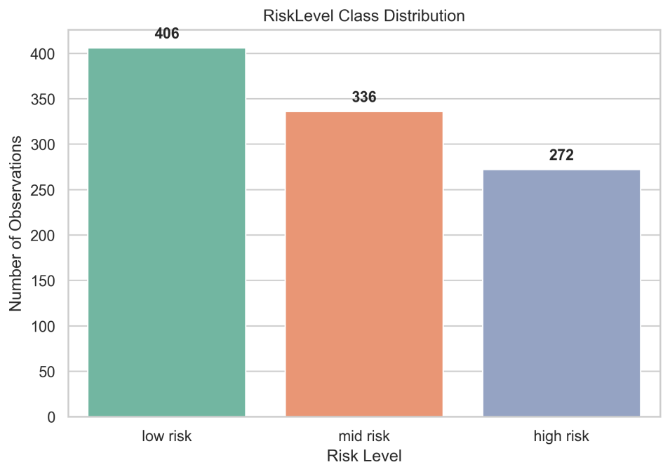
03 · DATA
Class Distribution & Data Quality
Low risk: 406 records (40.0%)
Mid risk: 336 records (33.1%)
High risk: 272 records (26.8%)
Moderate class imbalance macro-averaged metrics prioritized throughout.
562 of 1,014 rows (55.4%) are exact duplicates; retained deliberately since no patient identifier exists to confirm they are erroneous.
Maternal Health Risk Stratification
8

Slide 9
03 · DATA
Feature Engineering
Pulse Pressure
SystolicBP - DiastolicBP
Recognized cardiovascular risk indicator
Mean Arterial Pressure
DiastolicBP + (Pulse Pressure / 3)
Standard clinical composite BP measure
Systolic/Diastolic Ratio
SystolicBP / DiastolicBP
Additional blood-pressure relationship signal
Age Group (one-hot)
adolescent / adult / advanced maternal age
Recognized maternal age risk categories
Final analysis feature set: 11 columns (6 raw + 3 engineered + 2 one-hot age-group indicators) -> Ordinal target encoding: low=0, mid=1, high=2 -> Train 811 / Test 203 (80/20 stratified split)
Maternal Health Risk Stratification
9

Slide 10
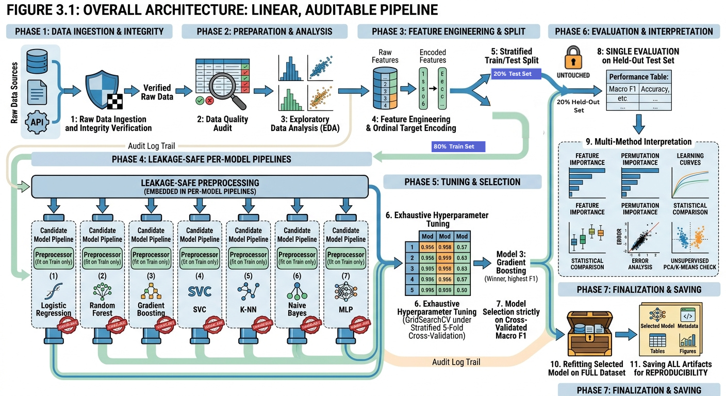
04 · METHODOLOGY
Overall Pipeline Architecture
Maternal Health Risk Stratification
10

Slide 11
04 · METHODOLOGY
Why Cross-Validation-Only Model Selection
“The test set is touched exactly once to report the honest, unbiased performance of the already-selected model.”
What we avoided
What we did instead
Choosing the model by comparing candidates directly on the test set a subtle but real form of test-set leakage into model selection.
Selected strictly by cross-validated macro F1 on the training set (via GridSearchCV), before the test set was consulted at all.
Maternal Health Risk Stratification
11

Slide 12
04 · METHODOLOGY
Seven Algorithms Compared
Logistic Regression
Decision Tree
1
2
Linear baseline / lower-bound reference
Interpretable rule-based classifier
K-Nearest Neighbors
Support Vector Machine
3
4
Non-parametric, distance-based
Kernel-based (RBF)
Random Forest
Gradient Boosting
5
6
Bagging ensemble of trees
Sequential boosting ensemble
MLP Neural Network
7
Feed-forward neural network
Maternal Health Risk Stratification
12

Slide 13
05 · RESULTS
Hyperparameter Tuning — All 7 Models Tuned
Model | Best CV Macro F1 | Configurations | Tuning Time (s)
Random Forest | 0.8338 | 48 | 35.66
Gradient Boosting | 0.8208 | 36 | 12.02
Decision Tree | 0.8120 | 24 | 0.47
KNN | 0.8057 | 20 | 0.45
SVM | 0.6895 | 12 | 1.29
MLP Neural Network | 0.6585 | 8 | 1.48
Logistic Regression | 0.6180 | 6 | 7.29
Random Forest achieved the highest cross-validated Macro F1 (0.8338) and was selected as the final model before the test set was consulted.
Maternal Health Risk Stratification
13

Slide 14
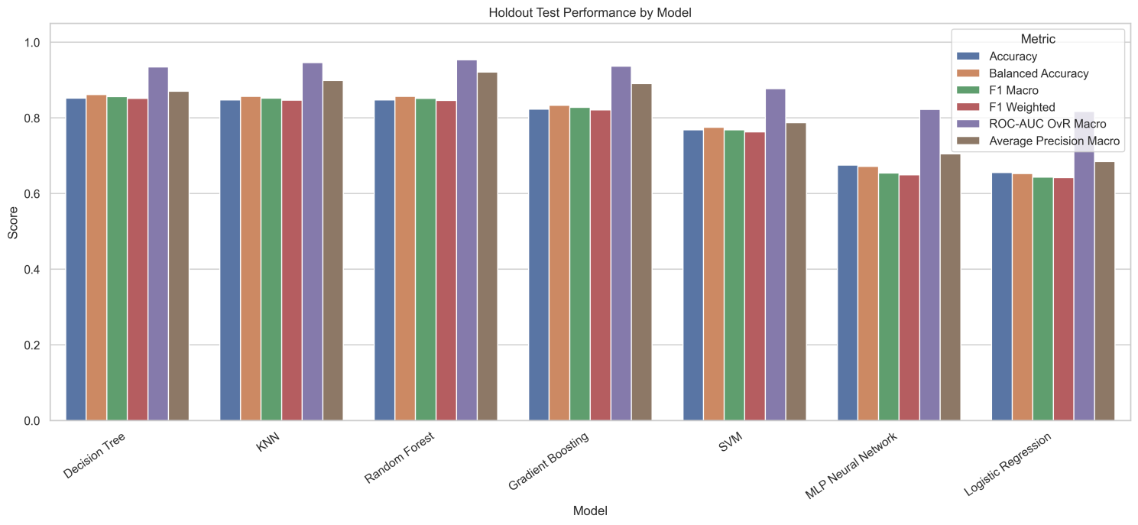
05 · RESULTS
Held-Out Test Set — All 7 Tuned Models
n = 203 held-out test records. Random Forest: Accuracy 0.847 · Macro F1 0.851 · ROC-AUC (macro) 0.953 · Average Precision 0.921.
Maternal Health Risk Stratification
14

Slide 15
05 · RESULTS
An Important Methodological Observation
On the test set alone, Decision Tree (F1 = 0.856) and KNN (F1 = 0.852) marginally edge out Random Forest (F1 = 0.851).
Why Random Forest was still chosen
What Random Forest still won on
It had the strongest cross-validated Macro F1 (0.834 vs. 0.812 for Decision Tree) across 5 folds - a more stable estimate than one 203-record test set.
Best ROC-AUC (0.953) and Average Precision (0.921) on the test set - stronger probability ranking even where point-prediction F1 was marginally lower.
Maternal Health Risk Stratification
15

Slide 16
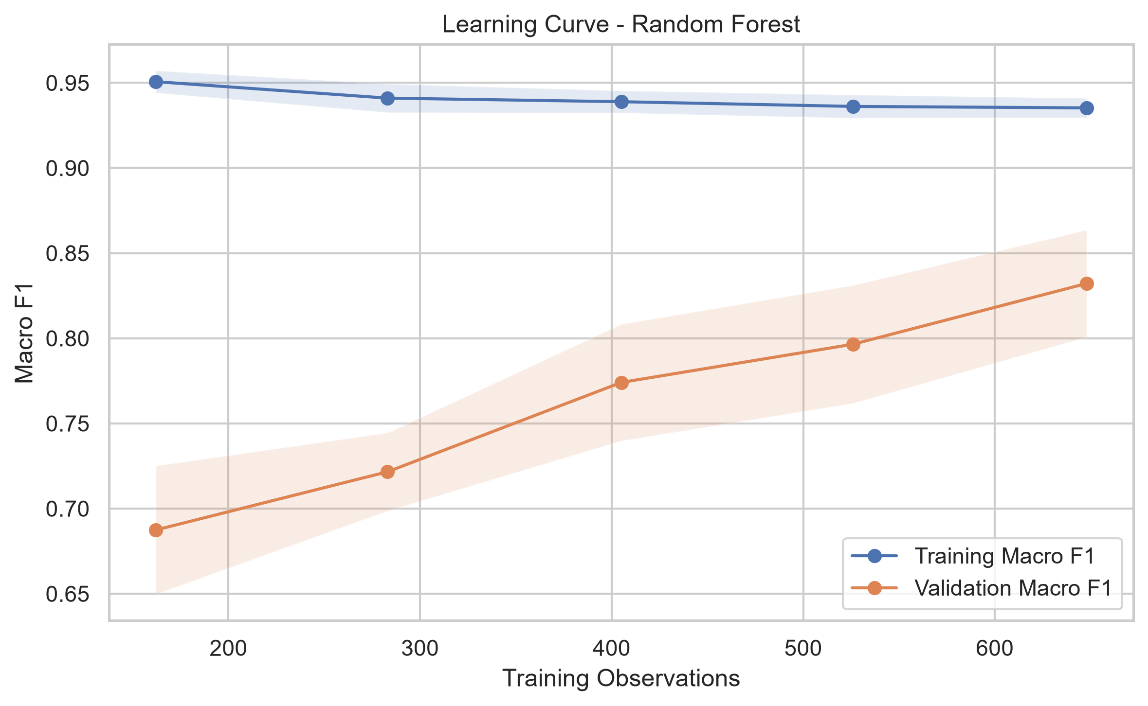
05 · RESULTS
Generalization: Learning Curve (RQ5)
CV Macro F1 (0.834) and holdout Macro F1 (0.851) are broadly consistent no strong indication of severe overfitting.
The validation curve is still rising as training size grows, while the training curve stays high and stable.
This suggests more data could still improve performance further, especially given the duplicate-record limitation noted earlier.
Maternal Health Risk Stratification
16

Slide 17
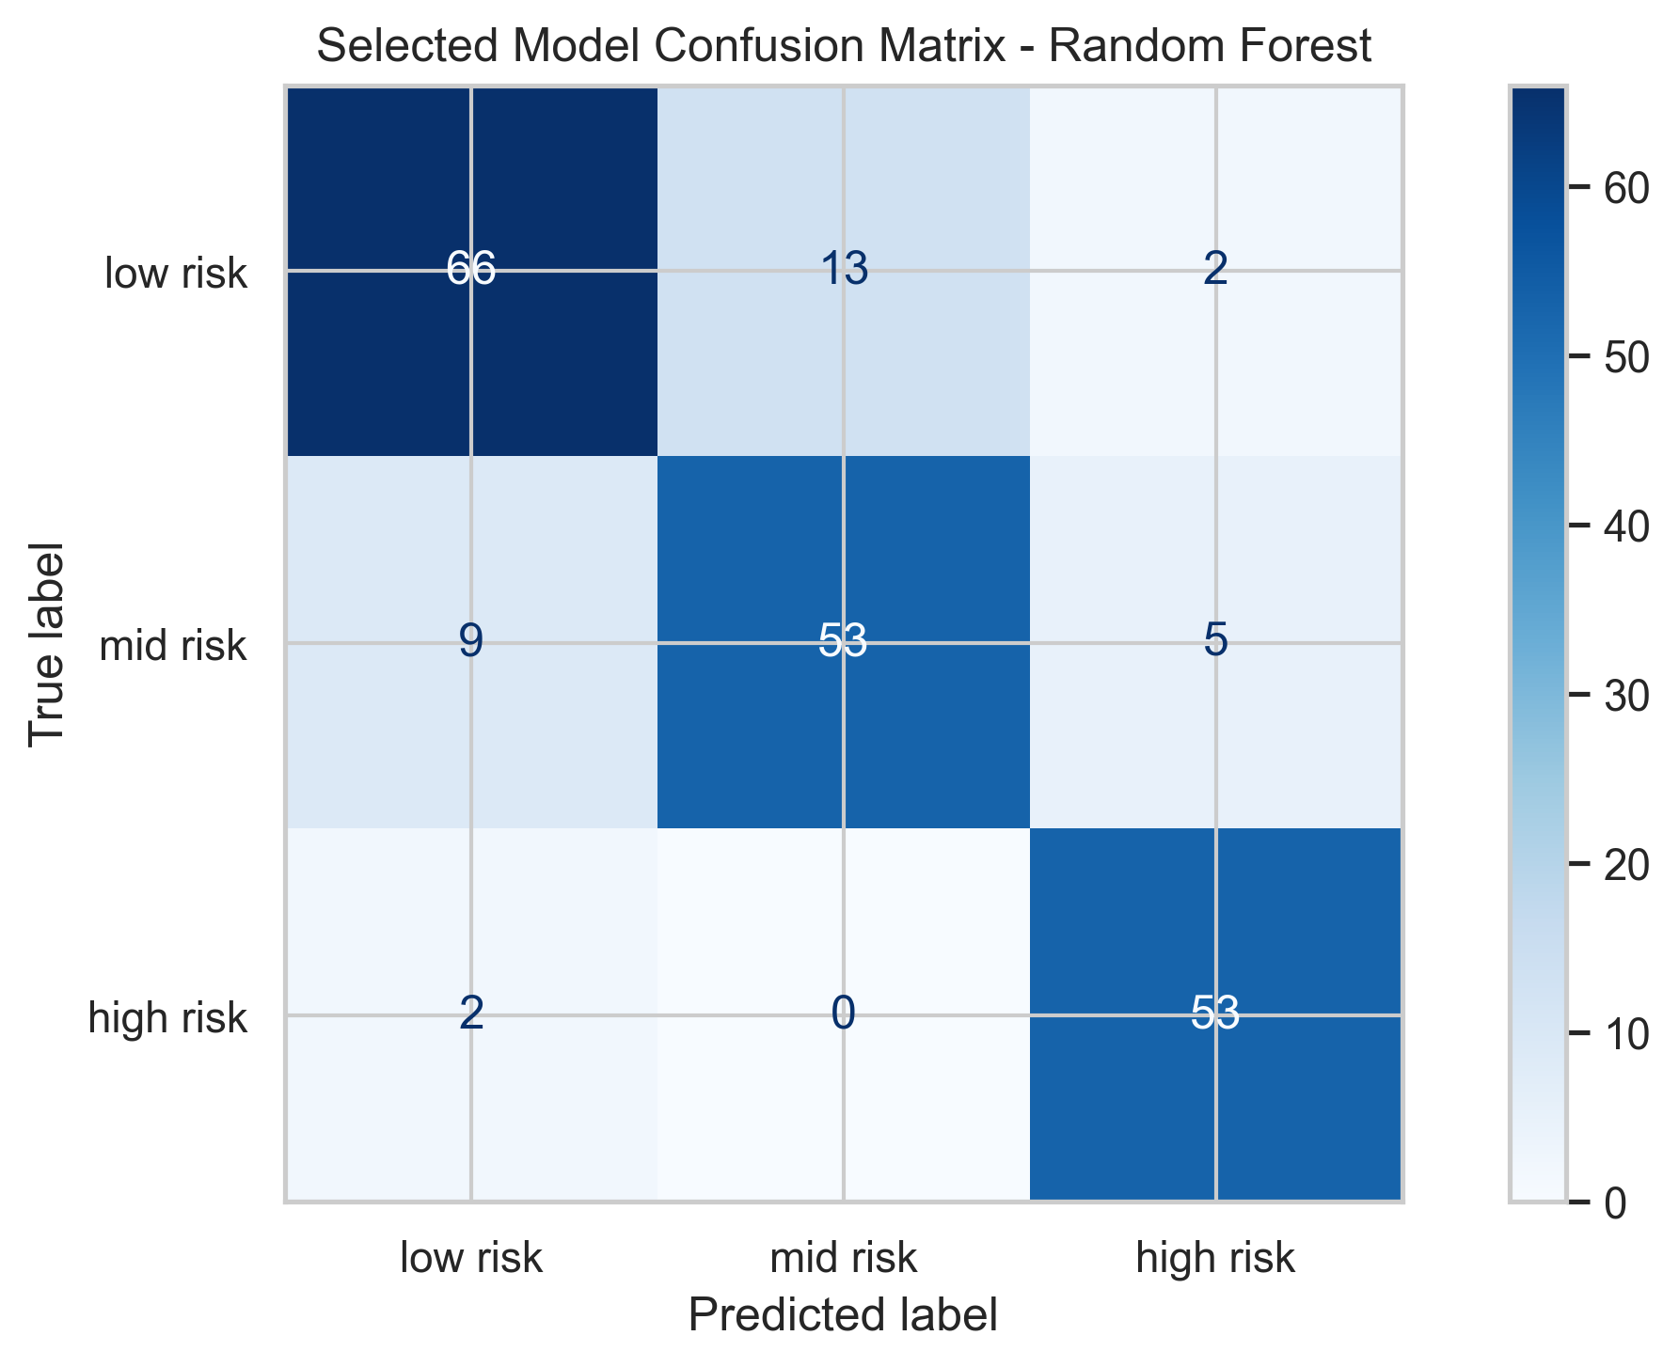
05 · RESULTS
Selected Model: Random Forest
84.7%
85.1%
Test Accuracy
Macro F1
95.3%
92.1%
ROC-AUC (macro)
Avg. Precision
Class | Precision | Recall | F1 | Support
Low risk | 0.86 | 0.81 | 0.84 | 81
Mid risk | 0.80 | 0.79 | 0.80 | 67
High risk | 0.88 | 0.96 | 0.92 | 55
Maternal Health Risk Stratification
17

Slide 18
05 · RESULTS
Error Analysis — Where Does the Model Fail?
172 / 203
31 / 203
85.7%
71%
Correct predictions (84.7%)
Incorrect predictions (15.3%)
Balanced Accuracy
Of errors are Low ↔ Mid
22 of the 31 total errors (71%) are confusions between low risk and mid risk — the model's dominant weakness is that boundary, not a failure to catch high-risk cases.
Per-Class Recall
Low risk
81.5%
Low risk: 66 correct, 13 -> mid, 2 -> high
Mid risk: 53 correct, 9 -> low, 5 -> high
High risk: 53 correct, 2 -> low, 0 -> mid
Mid risk
79.1%
High risk
96.4%
High-risk cases are identified reliably; low-vs-mid separation is the clear improvement target.
Maternal Health Risk Stratification
18

Slide 19
05 · RESULTS
Per-Class Performance & Class Imbalance (RQ3)
Model | Low-Risk Recall | Mid-Risk Recall | High-Risk Recall
Decision Tree | 0.81 | 0.81 | 0.96
Random Forest (selected) | 0.81 | 0.79 | 0.96
KNN | 0.81 | 0.79 | 0.96
Gradient Boosting | 0.79 | 0.75 | 0.96
SVM | 0.81 | 0.58 | 0.93
MLP Neural Network | 0.86 | 0.31 | 0.84
Logistic Regression | 0.80 | 0.37 | 0.78
Mid-risk recall is consistently the weakest across nearly every model.
Tree-based models nearly double linear/neural mid-risk recall (79-81% vs. 31-37%).
High-risk recall stays strong (78-96%) for all models — the most severe class is the easiest to separate.
Maternal Health Risk Stratification
19

Slide 20
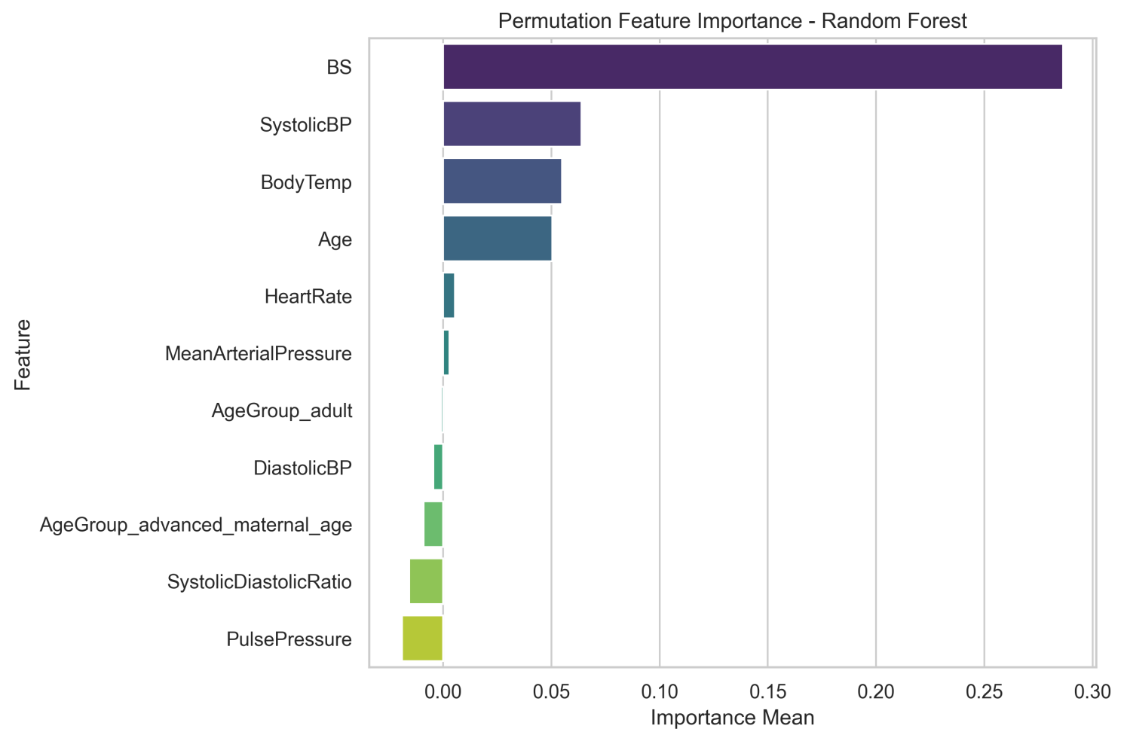
06 · INTERPRETATION
Feature Importance (RQ4)
Blood glucose (BS) dominates by a wide margin under both permutation (0.287) and built-in (0.339) importance.
SystolicBP, BodyTemp, and Age also rank consistently high in both methods.
Engineered ratio features (Pulse Pressure, Systolic/Diastolic Ratio) show near-zero or negative permutation importance the raw vital signs already carry the real signal.
Impurity-based importance alone would have overstated these derived features' value.
Caveat: feature importance indicates predictive contribution it does not by itself establish causality or clinical importance.
Maternal Health Risk Stratification
20

Slide 21
06 · INTERPRETATION
Statistical Significance & Validity Notes
Friedman Test: statistic = 27.257, p = 0.00013 (significant at alpha = 0.05)
Because the same cross-validation framework was used for both hyperparameter selection and this comparison, the result is interpreted as supportive evidence of real performance differences not as fully independent statistical confirmation.
Duplicate-Row Caveat (RQ5 / RQ6)
562 of 1,014 rows are exact duplicates, and the dataset has no patient-level identifier.
Random train/test splitting may therefore place identical observations in both partitions.
Although the test set was never used for model selection, reported hold-out performance may still be optimistic as a result.
Future validation should use patient-level or grouped splitting where such identifiers become available.
Maternal Health Risk Stratification
21

Slide 22
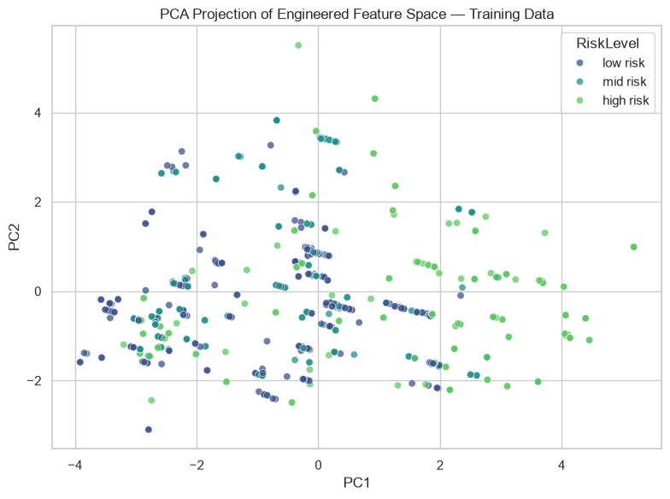
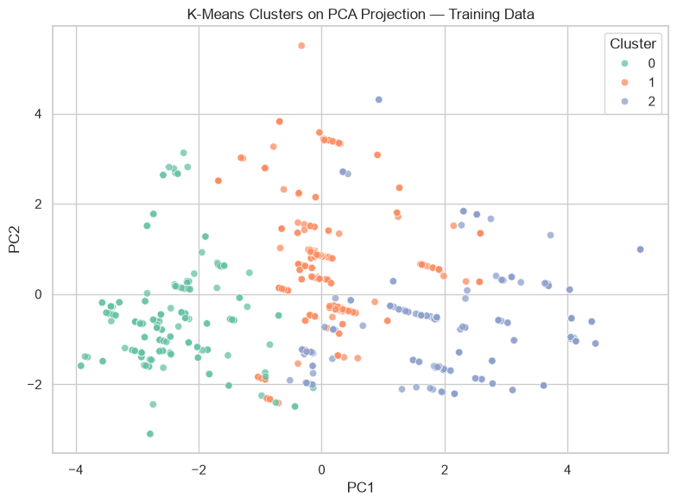
06 · INTERPRETATION
Unsupervised Check: PCA & K-Means
117 of 217 high-risk training observations (53.9%) fall in one cluster . but that same cluster also contains 70 low-risk and 56 mid-risk observations, showing substantial overlap.
Maternal Health Risk Stratification
22

Slide 23
FINDINGS
Answers to the Research Questions (1/2)
Strong signal exists: CV Macro F1 up to 0.834; held-out test Macro F1 of 0.851, accuracy 0.847.
RQ1
Random Forest won by the pre-specified CV protocol; Friedman test supports real differences across models (p = 0.00013), interpreted as supportive, not independently confirmatory.
RQ2
High-risk recall (96.4%) far exceeds mid-risk recall (79.1%) = macro-averaging was essential to a fair comparison.
RQ3
Maternal Health Risk Stratification
23

Slide 24
FINDINGS
Answers to the Research Questions (2/2)
Blood glucose (BS) is the dominant feature under both importance methods; engineered ratio features added little beyond the raw vital signs.
RQ4
CV and test Macro F1 were broadly consistent (0.834 vs. 0.851), but the duplicate-row caveat means this should not be read as strong proof of generalization.
RQ5
Promising performance, but not clinical readiness: appropriate role is clinician-in-the-loop decision support, not autonomous diagnosis.
RQ6
Maternal Health Risk Stratification
24

Slide 25
07 · CONCLUSIONS
Strengths & Limitations
Strengths
Limitations
Model selection strictly CV-based, never test-driven
All 7 models exhaustively tuned, not just top performers
Two independent importance methods cross-checked
Formal Friedman significance test applied
Duplicate-row policy stated transparently, not hidden
Fully reproducible: fixed seeds, saved versions, validation gate
Single-country dataset; only 452 truly unique records
Only 6 raw vital signs , no obstetric or lab history
No external or clinical validation performed
Duplicate rows + no patient ID may inflate hold-out score
Random Forest did not top every single test metric
No subgroup fairness or calibration testing yet
Maternal Health Risk Stratification
25

Slide 26
07 · CONCLUSIONS
Key Takeaways
0.851
0.953
p<0.001
96.4%
Test Macro F1
(Random Forest)
Test ROC-AUC
(macro)
Friedman test
(model differences)
High-risk recall
Ensemble tree-based methods substantially outperform linear and neural baselines on this task. Blood glucose is the dominant predictor. The pipeline is reproducible and methodologically sound but the model remains a research prototype, not a deployable clinical tool, pending external validation, fairness testing, and clinician review.
Maternal Health Risk Stratification
28

Slide 27
07 · CONCLUSIONS
Suggested Way Forward
Collect a larger, multi-site dataset for proper external validation.
1
Incorporate obstetric history and lab-confirmed diagnoses to strengthen the low/mid-risk boundary.
2
Conduct subgroup fairness analysis and probability calibration testing.
3
Pursue clinician review as a clinician-in-the-loop decision-support aid , never autonomous diagnosis.
4
Apply cost-sensitive learning to penalize the most dangerous error type (high-risk mislabeled as lower-risk).
5
Maternal Health Risk Stratification
26

Slide 28
DEMONSTRATION
Live Prediction Demonstration
Example Input
Random Forest Prediction
Age
35
HIGH RISK
Systolic BP
140
High
94.9%
Diastolic BP
95
Mid
2.6%
Blood Sugar (BS)
8.5
Body Temp
98.6
Low
2.5%
Heart Rate
88
Technical demonstration only not a clinical recommendation.
Maternal Health Risk Stratification
27

Slide 29
References
[1] M. Ahmed, M. A. Kashem, M. Rahman, and S. Khatun, "Review and Analysis of Risk Factor of Maternal Health in Remote Area Using the Internet of Things (IoT)," in InECCE2019, LNEE vol. 632, Springer, 2020, pp. 357-365.
[2] M. Ahmed and M. A. Kashem, "IoT Based Risk Level Prediction Model For Maternal Health Care In The Context Of Bangladesh," in 2020 2nd Int. Conf. Sustainable Technologies for Industry 4.0 (STI), 2020, pp. 1-6.
[3] T. O. Togunwa, A. O. Babatunde, and K.-R. Abdullah, "Deep hybrid model for maternal health risk classification in pregnancy," Frontiers in Artificial Intelligence, vol. 6, 2023.
[4] M. Assaduzzaman, A. Al Mamun, and M. Hasan, "Early Prediction of Maternal Health Risk Factors Using Machine Learning Techniques," in 2023 ICONAT, Goa, India, 2023.
[5] M. Ahmed, "Maternal Health Risk," UCI Machine Learning Repository, 2020. doi: 10.24432/C5DP5D
[6] F. Pedregosa et al., "Scikit-learn: Machine Learning in Python," JMLR, vol. 12, pp. 2825-2830, 2011.
[7] M. Friedman, "The Use of Ranks to Avoid the Assumption of Normality Implicit in the Analysis of Variance," JASA, vol. 32, no. 200, pp. 675-701, 1937.
Maternal Health Risk Stratification
29

Slide 30
Thank You
Questions & Discussion
Yabets Desalegn · GSE9850/18 · Data Management and Engineering

