Slide 1
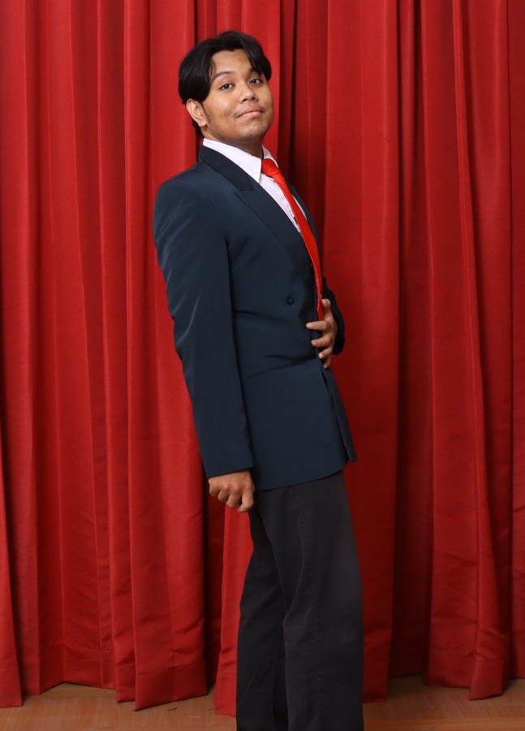
ALIEF SUKMA DEWANTA // SYSTEM IDENTITY & VALUE MANIFESTO // TELKOM UNIV MIS GRADUATE (OCT 2026)
SEC_REF: [01 / 12]
// TACTICAL DOSSIER: IT PROJECT MANAGEMENT & SYSTEMS ARCHITECTURE
ALIEF SUKMA DEWANTA
IT Project Manager • IT Business Analyst • Systems Analyst
EXECUTIVE VALUE PROPOSITION
Fresh graduate in Management Information Systems (GPA 3.66/4.00, Telkom University, Convocation: Oct 26, 2026) bridging business stakeholders with technical execution. Delivered three system projects, one ERP deployment, and one enterprise big data pipeline using Agile and Waterfall methodologies. Formally certified in Google Project Management and IBM Systems Analysis, with proven mastery in BRD/FSD specifications, TOGAF EA, and UAT governance.
6+
Delivered Projects
3+
Leadership Roles
5
Industry Certifications
3.66
MIS GPA (High Honors)
ALIEF SUKMA DEWANTA [STATUS: VERIFIED]
TACTICAL PORTFOLIO & SPECIFICATION DOSSIER • GOOGLE PM & IBM SYSTEMS ANALYST CERTIFIED • SURABAYA, ID (OPEN TO RELOCATION) • aliefsd84@gmail.com

Slide 2
ALIEF SUKMA DEWANTA // OPERATIONAL LENSES & CORE COMPETENCIES // TELKOM UNIV MIS GRADUATE (OCT 2026)
SEC_REF: [02 / 12]
// MULTIDISCIPLINARY CAPABILITY MATRIX
Four Specialized Delivery Lenses Across the Systems Lifecycle
IT PROJECT MANAGER
Waterfall & Agile Sprint Governance
▸ Sprint planning, WBS dependency tracking, backlog grooming in Jira.
▸ Cross-functional developer coordination across 8-week delivery cycles.
▸ Comprehensive QA & UAT facilitation with defect tracking & sign-off.
▸ Risk mitigation, stakeholder status reporting & scope change governance.
IT BUSINESS ANALYST
Requirements Elicitation & BRD/FSD Authoring
▸ Authored formal Business Requirements (BRD) & Functional Specs (FSD).
▸ Elicited multi-tier departmental requirements across 4 operational divisions.
▸ BPMN 2.0 As-Is / To-Be process mapping, User Stories & Acceptance Criteria.
▸ Data analysis & requirement validation in Excel (IF, VLOOKUP, Pivot Tables).
SYSTEMS ANALYST
Enterprise Architecture & Data Modeling
▸ Modeled UML Use Case, Activity, and Sequence diagrams in Visual Paradigm.
▸ Engineered 3NF-normalized relational schemas (MySQL) & time-series tables.
▸ Defined REST API data contracts, ingestion protocols & RBAC matrices.
▸ TOGAF ADM 9.2 Enterprise Architecture & COBIT 2019 governance frameworks.
SYSTEM IMPLEMENTOR
ERP Deployment, Data Cleansing & SOPs
▸ Configured multi-module Odoo ERP (Website/E-Commerce, Purchasing, Inventory).
▸ Master data auditing, SKU catalog standardization, and opening stock migration.
▸ Configured automated reordering rules & procurement requisition routing.
▸ Conducted end-user operational training and authored standard SOP manuals.
TACTICAL PORTFOLIO & SPECIFICATION DOSSIER • GOOGLE PM & IBM SYSTEMS ANALYST CERTIFIED • SURABAYA, ID (OPEN TO RELOCATION) • aliefsd84@gmail.com

Slide 3
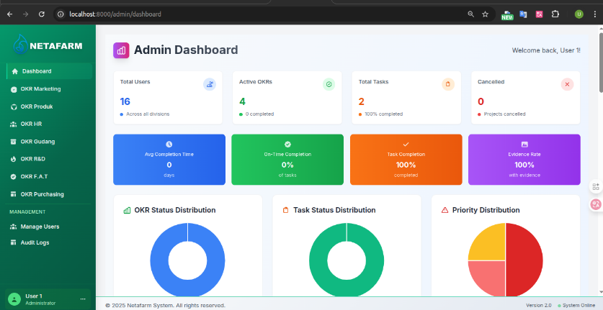
ALIEF SUKMA DEWANTA // FLAGSHIP SYSTEM PROJECT 01 // TELKOM UNIV MIS GRADUATE (OCT 2026)
SEC_REF: [03 / 12]
// FLAGSHIP PROJECT 01: CV. NETAFARM INDOLESTARI (SIDOARJO)
OKR & Cross-Functional Task Management System
CORE DELIVERABLES & GOVERNANCE ARTIFACTS
• Business Problem: Siloed communication across 4 departments (Management, Sales, Warehouse, Field Ops) resulting in untracked agricultural SKUs (2,000+) and missing delivery deadlines.
• Formal BRD Deliverable: Authored comprehensive Business Requirements Document aligning executive stakeholders, establishing business drivers, and defining As-Is vs. To-Be OKR workflows.
• Formal FSD / FRD Deliverable: Specified functional scope, User Stories, Acceptance Criteria (Given-When-Then), and granular Role-Based Access Control (RBAC) permission matrices.
• Project Management (Jira): Led 3 developers over an 8-week Waterfall delivery cycle, managing WBS, sprint backlog, black/white-box QA, and UAT sign-off with company leadership.
• Data Validation (Excel): Analyzed user surveys and task completion rates using Excel formulas (IF, VLOOKUP) to validate system requirements prior to engineering handover.
📂 OFFICIAL GOOGLE DRIVE ARTIFACT ARCHIVE [BRD & FSD]:
https://drive.google.com/drive/folders/1Ym-B6uoR0V2FTENJeCdkSvyU6m_mF0q4?usp=sharing
TECH STACK & METRICS:
Laravel 10, MySQL 8, Bootstrap 5, Chart.js | CV. Netafarm Indolestari | Awarded Official Company Certificate of Appreciation
TACTICAL PORTFOLIO & SPECIFICATION DOSSIER • GOOGLE PM & IBM SYSTEMS ANALYST CERTIFIED • SURABAYA, ID (OPEN TO RELOCATION) • aliefsd84@gmail.com

Slide 4
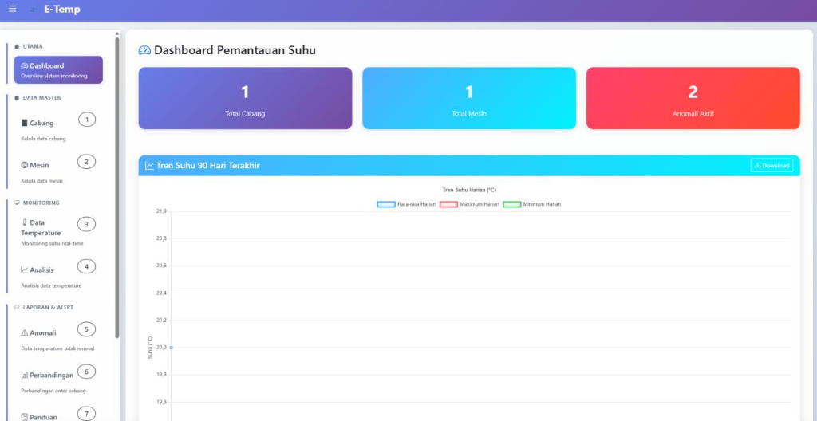
ALIEF SUKMA DEWANTA // FLAGSHIP SYSTEM PROJECT 02 // TELKOM UNIV MIS GRADUATE (OCT 2026)
SEC_REF: [04 / 12]
// FLAGSHIP PROJECT 02: CV. DIMAS DJAYA TEKNIK (SURABAYA)
E-Temp Industrial Cold-Chain Monitoring System
BRD, FSD, AND 02-WORKBOOK-TEST-CASE (EXCEL QA)
• Business Problem: Eliminated error-prone manual clipboard temperature checks across 12 industrial cold-storage machines, mitigating high-risk inventory spoilage.
• Formal BRD Deliverable: Authored Business Requirements Document establishing cold-chain compliance rules, multi-branch fleet operational constraints, and SLA targets.
• Formal FSD Deliverable: Specified real-time sensor polling intervals, automated excursion anomaly alert thresholds, time-series data schemas, and Python API + Laravel contracts.
• 02-Workbook-Test-Case (Excel QA): Engineered and executed comprehensive web QA test suite in Excel: positive/negative test cases, boundary checks, defect tracking, and UAT sign-off matrix.
• Data Visualization (Excel): Consolidated multi-branch temperature logs via Excel VLOOKUP and Pivot Tables to generate monthly comparative machine performance reports.
📂 OFFICIAL GOOGLE DRIVE ARTIFACT ARCHIVE [BRD, FSD & QA WORKBOOK]:
https://drive.google.com/drive/folders/1yJeAjFuiJ__W35Yup2n8pDP-jdXFUZht?usp=sharing
TECH STACK & METRICS:
Laravel 11, PHP 8.2, Python API, MySQL, Chart.js | 12 Industrial Cold Storage Machines | Client: CV. Dimas Djaya Teknik
TACTICAL PORTFOLIO & SPECIFICATION DOSSIER • GOOGLE PM & IBM SYSTEMS ANALYST CERTIFIED • SURABAYA, ID (OPEN TO RELOCATION) • aliefsd84@gmail.com

Slide 5
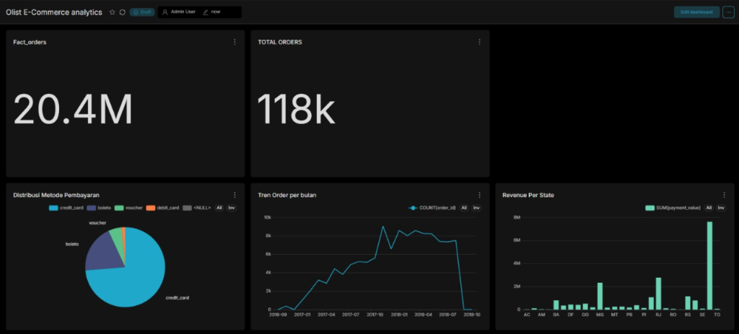
ALIEF SUKMA DEWANTA // BIG DATA & ENTERPRISE ARCHITECTURE // TELKOM UNIV MIS GRADUATE (OCT 2026)
SEC_REF: [05 / 12]
// BIG DATA CAPSTONE PROJECT: E-COMMERCE ENTERPRISE LAKEHOUSE
Enterprise E-Commerce Big Data Lakehouse & Executive Analytics
DATA ARCHITECTURE & BUSINESS ANALYTICS
• Scale & Dataset: Architected pipeline processing 1.5M+ rows from 9 relational tables of Brazilian E-Commerce data (100k orders, R$20.4M total GMV).
• 3-Layer Medallion Lakehouse: Designed Hadoop HDFS data warehouse across Raw (Landing), Staging (Cleansed/Typed), and Cleaned (Analytics-ready Star Schema).
• ETL/ELT Batch & Streaming: Engineered Spark SQL transformations joining 6 source tables into 118,107 unified fact records; simulated Kafka real-time ingestion topics.
• Predictive Delivery Analytics: Trained Spark MLlib Linear Regression model predicting order delivery duration based on freight value and geolocation distance.
• Executive BI Dashboards: Deployed Apache Superset dashboards tracking monthly revenue velocity, payment method breakdowns, freight cost impacts, and customer lifetime value.
TECH STACK & METRICS:
Hadoop HDFS, PySpark, Kafka, MLlib, Superset | 1.5M+ Rows
📊 SLIDE DECK: https://drive.google.com/file/d/1-_KjfIORiWMeEm45z8R80D6LOb4IdRg4/view?usp=drive_link
TACTICAL PORTFOLIO & SPECIFICATION DOSSIER • GOOGLE PM & IBM SYSTEMS ANALYST CERTIFIED • SURABAYA, ID (OPEN TO RELOCATION) • aliefsd84@gmail.com

Slide 6
ALIEF SUKMA DEWANTA // ENTERPRISE SYSTEMS IMPLEMENTATION // TELKOM UNIV MIS GRADUATE (OCT 2026)
SEC_REF: [06 / 12]
// ENTERPRISE PROJECT 04: NUHSANTARA MERCHANDISE (SURABAYA)
Odoo ERP Multi-Module Implementation & Business Process Reengineering
ERP IMPLEMENTOR LEAD
Module Configuration & Master Data
▸ Configured 3 core Odoo ERP modules: Website/E-Commerce, Purchasing, and Inventory Management.
▸ Audited and cleaned legacy master catalogs (SKU numbering, barcode mapping, vendor records).
▸ Migrated opening stock balances and established automated reorder thresholds to prevent stockouts.
▸ Delivered comprehensive operational training and authored end-user SOP documentation.
IT BUSINESS ANALYST
Workflow Fit-Gap & Process Design
▸ Conducted fit-gap analysis between partner's legacy manual procurement and standard Odoo ERP capabilities.
▸ Mapped As-Is retail inventory turnover and designed streamlined To-Be automated requisition approval flows.
▸ Established unified vendor price comparison lists and purchase order routing based on expenditure tiers.
▸ Defined KPI tracking for inventory holding costs, stock turnover ratio, and vendor lead times.
PROJECT COORDINATOR
Milestones & UAT Sign-off
▸ Coordinated cross-functional tasks across a 3-member team over a 4-month academic implementation.
▸ Created deployment roadmap, managed project timeline, and prioritized high-impact modules.
▸ Conducted rigorous User Acceptance Testing (UAT) sessions with retail leadership and store managers.
▸ Ensured seamless system handover with zero operational disruption to active merchandising sales.
TACTICAL PORTFOLIO & SPECIFICATION DOSSIER • GOOGLE PM & IBM SYSTEMS ANALYST CERTIFIED • SURABAYA, ID (OPEN TO RELOCATION) • aliefsd84@gmail.com

Slide 7
ALIEF SUKMA DEWANTA // TECHNICAL DOSSIER & SPECIALIZED PROJECTS // TELKOM UNIV MIS GRADUATE (OCT 2026)
SEC_REF: [07 / 12]
// ADDITIONAL SPECIALIZED ENGAGEMENTS & APPLIED RESEARCH
Enterprise Architecture, Governance, BI & Applied Machine Learning
COBIT 2019 IT GOVERNANCE RESEARCH
PT Infoglobal Teknologi Semesta (2024)
Co-authored research evaluating 10 design factors and prioritizing EDM03, APO12, DSS05, DSS04, and MEA03 governance objectives.
Tags: COBIT 2019 • Risk Management • IT Governance Audit
ARIMA-GARCH STOCK VOLATILITY PREDICTION
PT Pertamina Geothermal Energy Tbk (PGEO)
Undergraduate Thesis (Grade A, 2026): Python forecasting web app (Streamlit, arch, statsmodels) modeling PGEO return volatility on IDX.
Manuscript (PDF): drive.google.com/file/d/1sFt-QrZIYCprjvEfZtW41hoVChWjGJXn
Tags: Python • Econometrics • Streamlit • Thesis (Grade A)
ENTERPRISE ARCHITECTURE BLUEPRINT
Infoglobal IT Division (TOGAF ADM 9.2)
Modeled full TOGAF architecture in Visual Paradigm across Business, Data, Application, and Technology domains to align IT roadmap with corporate strategy.
Tags: TOGAF 9.2 • Visual Paradigm • IT Blueprint
AI CHATBOT WITH MODEL CONTEXT PROTOCOL (MCP)
Google Cloud Gen AI Academy APAC (2026)
Built AI chatbot capstone leveraging Model Context Protocol (MCP) for dynamic context retrieval, integrating generative AI with enterprise cloud APIs.
Tags: Google Cloud • Model Context Protocol • Gen AI
POWER BI SALES PERFORMANCE INTELLIGENCE
PT Gelatik Confectionery (2025)
Built interactive executive dashboard analyzing regional sales velocity, customer purchasing frequency, and revenue distribution trends.
Tags: Power BI • DAX Data Modeling • Sales Analytics
TACTICAL PORTFOLIO & SPECIFICATION DOSSIER • GOOGLE PM & IBM SYSTEMS ANALYST CERTIFIED • SURABAYA, ID (OPEN TO RELOCATION) • aliefsd84@gmail.com

Slide 8
ALIEF SUKMA DEWANTA // DECLASSIFIED SCIENTIFIC RESEARCH // TELKOM UNIV MIS GRADUATE (OCT 2026)
SEC_REF: [08 / 12]
// PEER-REVIEWED SCIENTIFIC PUBLICATION: SINTA 2 ACCREDITED JOURNAL
Enterprise Architecture Design for Digital Village Public Services
JOURNAL RECORD: Jurnal Masyarakat Mandiri (JMM) • Vol. 8, No. 6 (December 2024) • ISSN 2614-4921 / E-ISSN 2598-8158
Original Title: Perancangan Enterprise Architecture Menggunakan TOGAF ADM 9.2 pada Pelayanan Publik Desa Sukalaksana
• Research Objective: Bridged fragmented administrative public services in Desa Sukalaksana into an integrated digital governance blueprint using the TOGAF ADM 9.2 framework.
• Architectural Scope: Executed Phase A through Phase F (Preliminary, Architecture Vision, Business Architecture, Information Systems Architecture [Data & Application], Technology Architecture, and Migration Planning).
• Gap Analysis & Resolution: Identified and addressed 14 critical governance and operational gaps, developing target architectural blueprints modeled in Visual Paradigm.
• Application & Tech Blueprint: Specified an integrated public service platform, citizen portal, relational database schema, and mobile-friendly cloud deployment infrastructure.
• Academic Validation: Peer-reviewed, approved, and formally published in an accredited SINTA 2 national journal, demonstrating rigorous research execution.
🔗 DOI REFERENCE: https://doi.org/10.31764/jmm.v8i6.29744 | INDEXED IN SINTA S2, GOOGLE SCHOLAR, GARUDA
📄 RESEARCHGATE FULL-TEXT (PDF): https://www.researchgate.net/publication/392726934_PERANCANGAN_IT_BLUEPRINT_SEBAGAI_STRATEGI_PENGEMBANGAN_KONSEP_SMART_VILLAGE
TACTICAL PORTFOLIO & SPECIFICATION DOSSIER • GOOGLE PM & IBM SYSTEMS ANALYST CERTIFIED • SURABAYA, ID (OPEN TO RELOCATION) • aliefsd84@gmail.com

Slide 9
ALIEF SUKMA DEWANTA // CAREER TIMELINE & LEADERSHIP // TELKOM UNIV MIS GRADUATE (OCT 2026)
SEC_REF: [09 / 12]
// PROFESSIONAL EXPERIENCE & LEADERSHIP ROLES
Practical Industry Experience, Academic Mentorship & Organizational Leadership
PROJECT COORDINATOR (INTERNSHIP)
CV. Netafarm Indolestari (Jun – Aug 2025)
▸ Authored formal Business Requirements Document (BRD) & Functional Specification Document (FSD / FRD).
▸ Coordinated a 3-person developer team over an 8-week Waterfall cycle in Jira to deliver an OKR task tracking system.
▸ Conducted black-box and white-box testing, managed defect resolution, and facilitated UAT sign-off with leadership.
▸ Awarded official Company Certificate of Appreciation for on-time and high-quality system handover.
REQUIREMENT ANALYST (ACADEMIC PROJECT)
CV. Dimas Djaya Teknik (Sep – Dec 2025)
▸ Authored formal BRD & FSD for multi-branch industrial cold-chain monitoring system (12 machines).
▸ Engineered complete web QA test suite in '02-Workbook-Test-Case' (Excel), validating features against Acceptance Criteria.
▸ Designed application architecture (Laravel, PHP, Python API, MySQL) and telemetry excursion alert logic.
▸ Consolidated temperature readings via Excel VLOOKUP and Pivot Tables to generate monthly comparative reports.
LABORATORY ASSISTANT, ENTERPRISE ARCHITECTURE
Telkom University Surabaya (Sep 2024 – Dec 2025)
▸ Appointed for two consecutive academic semesters to mentor 50+ students in Enterprise Architecture design.
▸ Developed course modules and graded case studies applying the TOGAF ADM 9.2 framework in Visual Paradigm.
▸ Organized and served as Keynote Speaker for 'DevOps x System Analyst: Modern IT Career Path' seminar (120+ attendees).
▸ Supervised team modeling across Business, Data, Application, and Technology domains.
TACTICAL PORTFOLIO & SPECIFICATION DOSSIER • GOOGLE PM & IBM SYSTEMS ANALYST CERTIFIED • SURABAYA, ID (OPEN TO RELOCATION) • aliefsd84@gmail.com

Slide 10
ALIEF SUKMA DEWANTA // VERIFIED CREDENTIALS & CERTIFICATIONS // TELKOM UNIV MIS GRADUATE (OCT 2026)
SEC_REF: [10 / 12]
// FORMAL INDUSTRY CERTIFICATIONS & ACADEMIC ACCREDITATION
Verified Industry Credentials Across Project Management, Systems Analysis & SAP
GOOGLE PROJECT MANAGEMENT PROFESSIONAL
Google (Coursera) • Issued 2026
Mastered Agile & Scrum governance, Waterfall WBS planning, project charters, risk management registers, sprint estimation, and executive stakeholder communication across 6 comprehensive courses.
Drive: drive.google.com/file/d/1px_zULs9ktCtz4HS9y-mV5yoizBd3pu0
GOOGLE AI ESSENTIALS & GCP GEN AI
Google Career Certs & Cloud Academy • 2026
Certified in foundation AI prompt engineering, workplace AI productivity tooling, enterprise Generative AI APIs, and Model Context Protocol (MCP) multi-agent systems.
Drive: drive.google.com/file/d/1w9exZvruwxxjmYWl_AabMteworOG7CKH
SAP CERTIFIED: SCM500 (PROCUREMENT)
SAP SE • Issued 2026
Formal certification in enterprise procurement flows, purchase requisition lifecycle, master vendor data management, inventory valuation, and goods receipt verification.
Drive: drive.google.com/file/d/1Jld8wiO7VhbPhoA1k-4gh8whQ5Q0zFCP
SAP CERTIFIED: HR050 (HUMAN CAPITAL)
SAP SE • Issued 2026
Certified in SAP enterprise human capital management workflows, organizational structure design, employee lifecycle data administration, and corporate personnel reporting.
Drive: drive.google.com/file/d/1rbG-AEVhXtDvmtQMFCuqIaCu8rKrhB2F
EF SET ENGLISH: C2 ADVANCED
EF Standard English Test • Score 77/100 (C2)
Demonstrated bilingual command of professional English at CEFR C2 Advanced standard; capable of cross-border executive alignment and international system documentation.
Drive: drive.google.com/file/d/1ZR8rK2Md03JX2uoQHXl3r09yCc6Qydpe
BACHELOR OF SCIENCE IN INFORMATION SYSTEMS
Telkom University • Graduated Oct 2026 (GPA 3.66/4.00)
Completed 144 credits with High Honors. Specialization in Enterprise Systems, Big Data Analytics, Systems Architecture, and Business Process Management. Convocation: Oct 26, 2026.
TACTICAL PORTFOLIO & SPECIFICATION DOSSIER • GOOGLE PM & IBM SYSTEMS ANALYST CERTIFIED • SURABAYA, ID (OPEN TO RELOCATION) • aliefsd84@gmail.com

Slide 11
ALIEF SUKMA DEWANTA // TECHNICAL SKILLS & TOOLING MATRIX // TELKOM UNIV MIS GRADUATE (OCT 2026)
SEC_REF: [11 / 12]
// TOOLING & METHODOLOGY REPERTOIRE
Comprehensive Competency Matrix Across Governance, Data, & Architecture
PROJECT MANAGEMENT & DELIVERY
▸ Methodologies:
Waterfall (SDLC), Agile Scrum, Hybrid Governance
▸ Work Breakdown (WBS):
Milestone scheduling, critical path, Gantt charts
▸ Tools & Tracking:
Jira Software, Trello, Google Workspace
▸ Quality & Testing:
UAT facilitation, black/white-box QA, defect logging
▸ Risk & Scope:
Scope change control, risk registers, stakeholder reports
BUSINESS & SYSTEMS ANALYSIS
▸ Core Deliverables:
BRD, FSD/FRD, Project Charters, User Stories
▸ Process Modeling:
BPMN 2.0 (As-Is / To-Be), Flowcharts, Mind Mapping
▸ Data Analysis (Excel):
VLOOKUP, INDEX/MATCH, Pivot Tables, IF conditions
▸ Systems Architecture:
TOGAF ADM 9.2, COBIT 2019, Visual Paradigm
▸ UML & Data Schemas:
Use Case, Activity, Sequence, 3NF Relational ERD
ENTERPRISE SYSTEMS & BIG DATA
▸ ERP Implementation:
Odoo ERP (Modules: E-Commerce, Inventory, Purchase)
▸ SAP Credentials:
SAP SCM500 (Procurement), SAP HR050 (HCM)
▸ Big Data Architecture:
Hadoop HDFS, Apache Spark (PySpark), Apache Kafka
▸ Databases & APIs:
MySQL, PostgreSQL, RESTful JSON APIs, Postman
▸ Business Intelligence:
Apache Superset, Power BI, Chart.js Dashboards
TACTICAL PORTFOLIO & SPECIFICATION DOSSIER • GOOGLE PM & IBM SYSTEMS ANALYST CERTIFIED • SURABAYA, ID (OPEN TO RELOCATION) • aliefsd84@gmail.com

Slide 12
ALIEF SUKMA DEWANTA // COMMUNICATION CHANNELS & DISPATCH // TELKOM UNIV MIS GRADUATE (OCT 2026)
SEC_REF: [12 / 12]
// INITIATE COMMUNICATION: OPEN FOR IMMEDIATE OPPORTUNITIES
Let's Build Resilient, High-Impact IT Systems Together
TARGET ROLES & AVAILABILITY
• IT Project Manager / Project Coordinator
Governing sprint schedules, team velocity, WBS dependencies, and UAT sign-off.
• IT Business Analyst (IT BA)
Conducting requirement elicitation, authoring BRD/FSD, BPMN workflows, and user stories.
• Systems Analyst / Enterprise Architect
Designing software architecture, UML diagrams, relational data schemas, and API contracts.
• ERP Specialist / System Implementor
Managing module deployment, master data migration, fit-gap analysis, and end-user training.
DIRECT CONTACT FREQUENCIES
▸ EMAIL DISPATCH:
aliefsd84@gmail.com
Primary contact channel for recruitment & discussions
▸ LINKEDIN PROFILE:
linkedin.com/in/aliefsd84
Connect for professional recommendations & endorsements
▸ ONLINE PORTFOLIO:
Interactive Web Dossier with Live Demos & Lightbox Feeds
Full responsive Web HUD version of this portfolio
▸ LOCATION NODE:
Surabaya, East Java, Indonesia
Available for on-site, hybrid, or remote work globally (Open to relocation)
TACTICAL PORTFOLIO & SPECIFICATION DOSSIER • GOOGLE PM & IBM SYSTEMS ANALYST CERTIFIED • SURABAYA, ID (OPEN TO RELOCATION) • aliefsd84@gmail.com

