Slide 1
SCRATCH
ABEM BRUCK
8/26/2025

Slide 2
SCRATCH
Is a programing language used to make games, movies, songs and so much more

Slide 3

BLOCKS AND VARIABLES
Blocks and Variables are used to make an action on the sprite,
Example: move 10 steps block

Slide 4
BACKDROPS AND SPRITES
Backdrops and sprites ae very helpful to make games and more

Slide 5
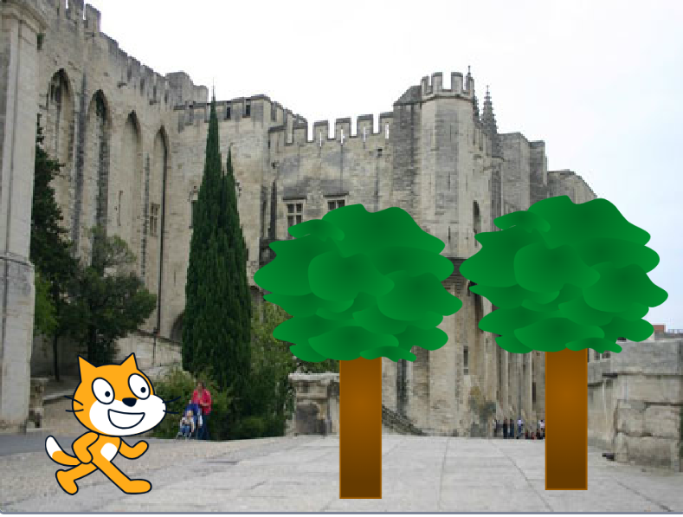

Slide 6
MICRO BIT

Slide 7
MICRO BIT
Is a is a tiny micro computer designed to make learning coding and electronics fun and accessible especially for students and beginners.

Slide 8
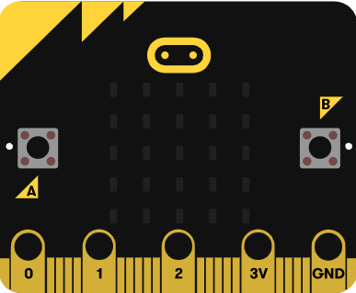
THE MICRO COMPUTER

Slide 9
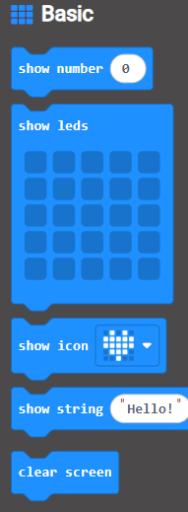
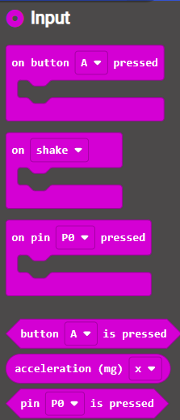
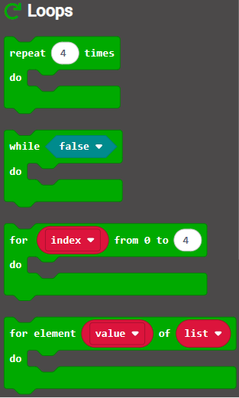
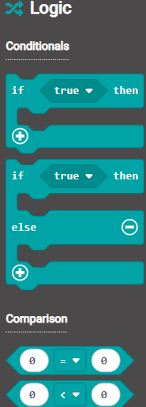
MICRO BIT BLOCKS

Slide 10
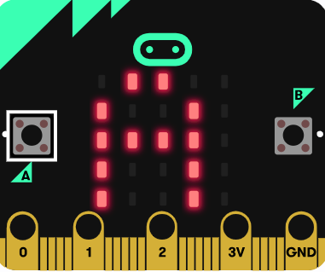
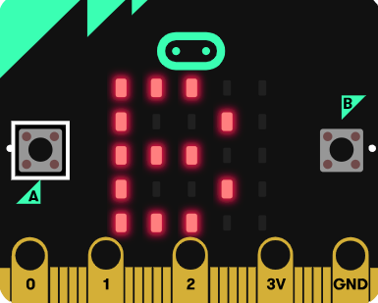
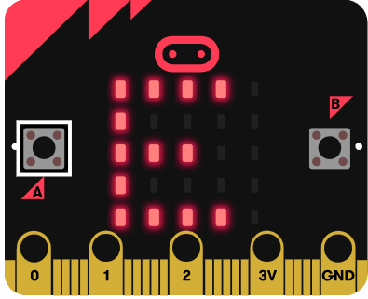
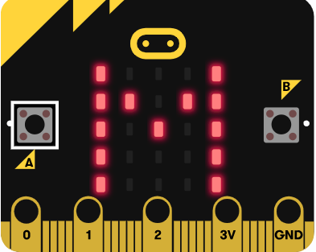
NAME TAGS

Slide 11
THANK YOU FOR LISTENINNG

