Slide 1

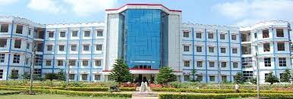

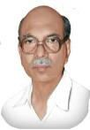




PATRONS
PBR VISVODAYA
Institute of Technology and Science
(Autonomous)
(Udayagiri Road,kavali,SPSR Nellore Andhra Pradesh-524201)
Sri.D.Vidyadhar Kumar Reddy
-Chairman
Dr.D.Prathyusha Reddi
-Academic Director
A TWO DAY TECHNO AND CULTURAL
EVENTS
CHIEF PATRONS
SPREE 2K23
-“Rise High and Shine”
contactus@visvodayata.ac.in
Dr.B.Dattatreya Sarma
-Principal , PBR VITS
pbrvits_offical
ORGANIZING COMMITTEE
17th & 18th November,2023
Mr.P.Eswaraiah
-HOD,Dept of CSE
Dr.R.KondaReddi
-Professor,Dept of CSE

Slide 2
About PBRVITS
IMPORTANT DATES
Convener
Last date for Registrations:31-02-2023
Mr.K.Ravi Chand
-Associate professor,Dept of CSE
PBR Visvodaya Institute of Technology & Science is awarded permanent affiliation by JNTUA, Anantapuramu. It had been accredited by NAAC with an A grade in 2015 for 5 years. Apart from direct academic activity, the teaching staff are involved in research activities as well as in consultancy works.
TECHNICAL
Paper Presentation
Poster Presentation
Technical Quiz
Project Expo
Debugging
Elocution
Co-Convener
Raja Bhargav
-Assistant Professor,Dept of CSE
About SPREE2k23
The college conducts various programmes to bring out the best calibers of students. the technical events are going to be conducted. We wish for your participation. SPREE-2K23 is a wonderful platform to showcase your talents.
Student co-ordinator:-
1.K.Sri Harshavardhan Reddy:7989397138
Members:-
2.P.Rakshitha:9381365501
3.U.Sathish:8074243825
4.A.Srihari:6301716763
5.K.SubbaReddy:8919270448
Rules & Regulations:-
Maximum team member for paper Presentation :2
Poster Presentation:2
Technical Quiz :3
Project Expo:3
Debugging:2
Elocution:1

