Slide 1
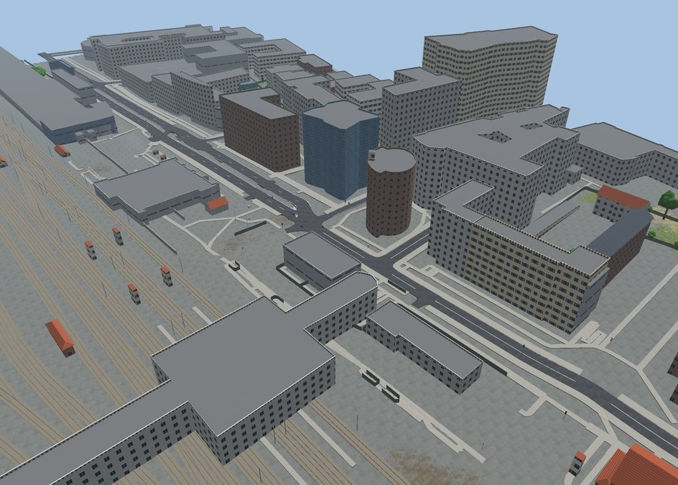
DIGITAL TWIN GENERATOR
duplicat_env
Pick a real road or zone on a map. Get the same place in CARLA, Autoware and RoadRunner.
Free and open data only · no API key
Notes:
The project: one page, one click, and a real place becomes a simulation environment for CARLA, Autoware and RoadRunner. The picture is a generated scene of the Massy stations, rendered from the output files.

Slide 2
One click, three simulators
CARLA
AUTOWARE
ROADRUNNER
FBX + OpenDRIVE
Lanelet2 + point cloud
An editable project
The 3D world for cameras and LiDAR, and the road network the cars drive on.
The HD map for planning and the map Autoware localises against.
Same roads, library trees and signs; every building is a prop you can move.
All three share one local frame: a point in the OpenDRIVE is the same point in Lanelet2 and in Unreal.
Notes:
What comes out of one run. The key design choice: everything is built from the same OpenDRIVE network, so the car in CARLA and the Autoware planner see the same lanes.

Slide 3
How a run works
1
2
3
4
5
Pick
Download
Network
Scene
Write
A route along roads, a freehand line, or a closed area.
OSM, terrain, LIDAR, photos and textures, all in parallel.
Real junctions, exits and roundabouts, with heights.
Terrain, ground types, buildings, trees, signs, barriers.
FBX, OpenDRIVE, Lanelet2, point cloud, RoadRunner.
A browser page drives it, with a progress bar per step. The same pipeline runs from the command line.
Notes:
Five stages. Step 2 runs every download at once; step 3 uses CARLA's own OSM converter, then our fixes on top; step 5 writes every format from the same scene.

Slide 4
The services we use, and why
Service | What it gives | Why this one
OpenStreetMap | Roads, buildings, signs | Open and the most detailed free map
Overpass, Geofabrik | OSM for the zone | Live queries; offline extract when busy
OSRM, Valhalla | Route along the roads | Free, no key; two avoid wrong-way detours
IGN RGE ALTI | Terrain height, 1 to 2 m | Official French model, open data
IGN LIDAR HD | Trees over 3 m | Height and crown measured, not guessed
IGN photos, BD TOPO | Ground types, heights | Tell grass from dirt; fill OSM's gaps
AWS Terrain Tiles | Height outside France | Worldwide and free
ambientCG, Poly Haven | Ground photo textures | CC0, free to ship with the map
CARLA, RoadRunner | Junctions; editing | Already installed on this machine
Not Google Maps: its terms forbid extracting the data, and the API needs a key and billing.
Notes:
Every source is free and needs no account. France gets the best data thanks to IGN's open data; elsewhere the generator falls back to OSM and AWS Terrain Tiles.

Slide 5
The road comes first
847
0
10 m
junctions on the 56 km A10 loop, built from OSM
roads or traffic lights left at height 0, in our xodr and in RoadRunner's
every point of the route checked: on a lane, reachable from the start
Roads longer than 1 km are split at exact joints. Service roads and bus-lane roads stay drivable. Neighbouring lanes share their line so Autoware can change lanes to reach an exit.
Notes:
The route is the critical part. Each problem found in testing became a fix and a check: heights on every road type, traffic lights, split joints, bus lanes, lane changes. The checks run without Unreal.

Slide 6
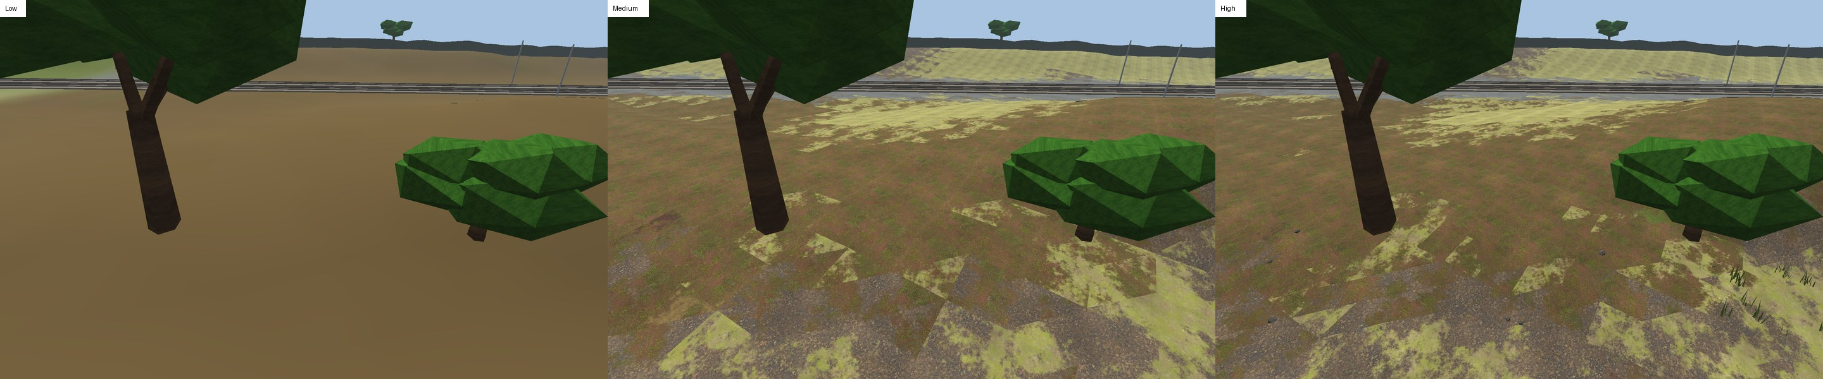
Ground that looks like the place
Low. Flat colours with soft blends. No download.
Medium. CC0 photo textures; one ground type thins out into the next.
High. Sharper textures, grass tufts, flowers and small stones near the road.
Notes:
The ground type of each 4 m cell comes from the colour and infrared aerial photos, BD TOPO and OSM landuse. The transitions work in CARLA, RoadRunner and the preview alike, because they are baked into the mesh and textures.

Slide 7
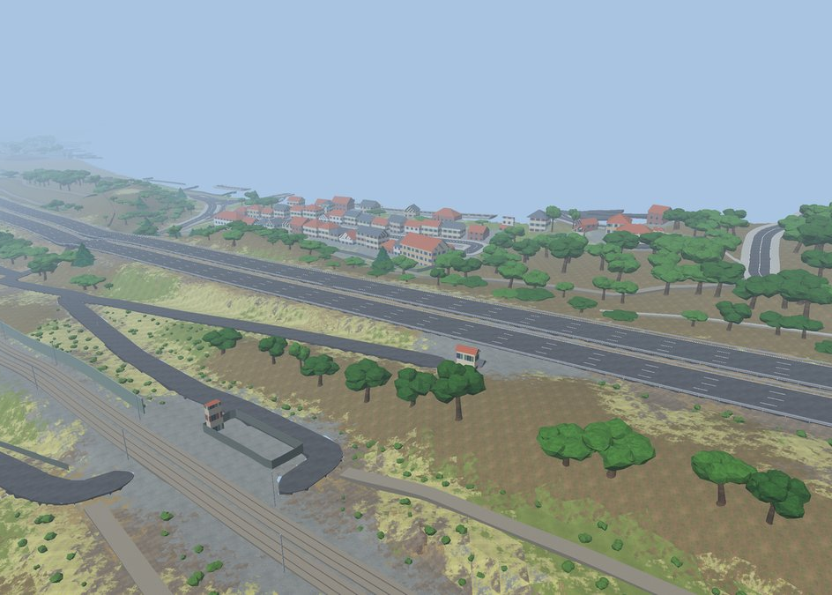
Real trees, real buildings
Trees come from the IGN LIDAR: position, height and crown width are measured. Near the road they get a detailed model.
Buildings take their footprint from OSM and their height from BD TOPO, with a facade and roof style by type.
Notes:
The 5.7 km Briis-sous-Forges test has 7,464 trees and bushes, all at their real spots; 3,013 near the road use the detailed model.

Slide 8
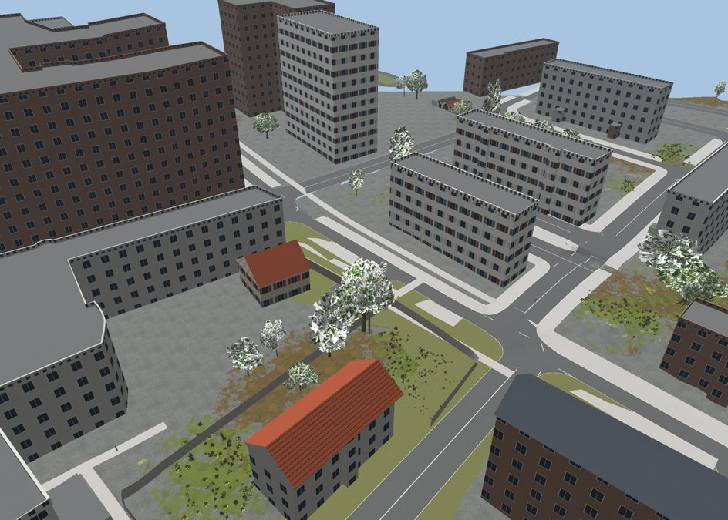
Edit it in RoadRunner
RoadRunner runs without a window and builds the project through its API: the same roads, its own library trees, signs and grass.
Every building is a separate prop. Move it, turn it, delete it, then export to CARLA from RoadRunner.
Notes:
RoadRunner R2026a with the Scene Builder add-on. Its own exports (CARLA FBX, Lanelet2, OpenDRIVE) work on the 56 km route now that the road joints match exactly.

Slide 9
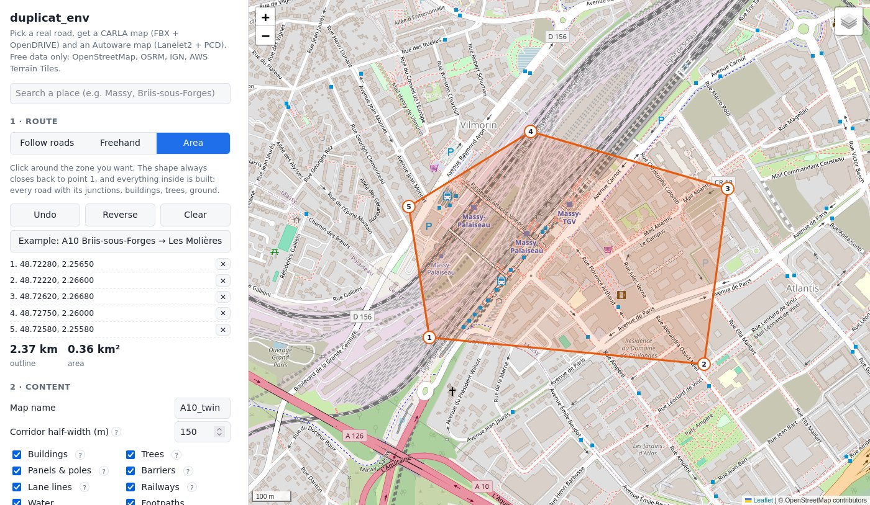
A road or a whole zone
Follow roads, freehand, or Area: click around a zone and the shape closes back to its start.
Everything inside is built. A 0.36 km² zone at Massy gives 742 roads and 96 junctions in about 30 s.
Notes:
Area mode fetches OSM with polygon queries and picks the main road inside the zone for the spawn point and the checks.

Slide 10
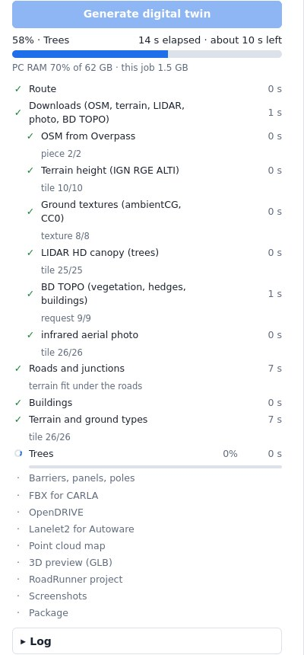
Fast, and kind to the PC
29 → 9 min
for a new 56 km route: parallel downloads, one thread per core, RoadRunner in the background.
Above 80% RAM in use on the PC, new work waits, so CARLA and Autoware keep running.
Notes:
Each step shows its own bar, time and detail line. The job updates at least every 2 s, so a frozen job is visible.

Slide 11
Where it stands
Checked
Next
Road heights and links, ours and RoadRunner's
Lanelet2 routing every 10 m
No overlapping road surfaces
Same result with 1 thread or 20
Run make import in CARLA on a full route
Semantic tags for the segmentation camera
Drive Autoware on the Lanelet2 map
Notes:
Everything on the left runs without Unreal. The Unreal import and the Autoware drive are the next steps to test on this machine.

