Slide 1
Lab 3
Distributed Intelligent Systems
Alexander Bahr
11.10.2017

Slide 2
What this lab is about
Familiarize yourself with the e-puck robot
  how to program the robot using the e-puck library
  how to transfer data to and from the robot using serial comm.
Basic understanding of:
  e-puck sensors
  stepper motor
Implementation: Basic robot control
  Braitenberg
  Rule-based
Robot Navigation:
  Pure odometry
  Feature aided odometry

Slide 3
Software
On a GIT repository
  download files by executing
  git clone https://disalgit.epfl.ch/epuck/epuck.git
Content of folder EpuckDevelopmentTree/
  e-puck library
  test programs (not needed in this lab)
Executables: already installed in GR B0 01 and GR C0 02
  epuckconnect
  epuckupload

Slide 4
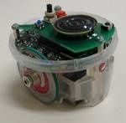
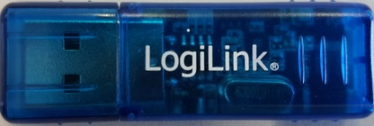
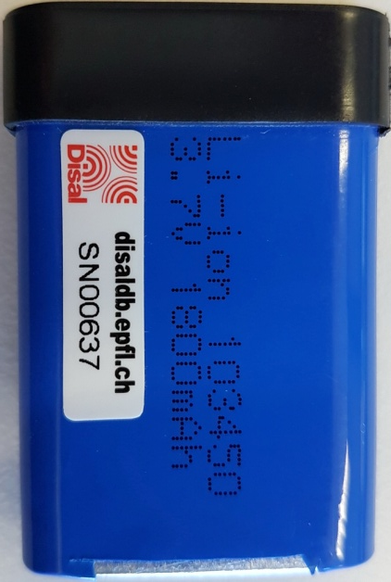
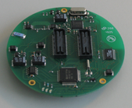
Hardware
You will receive:
  1 e-puck robot
  1 Battery
  1 USB-Bluetooth dongle
  3 walls
  6 stands

Slide 5
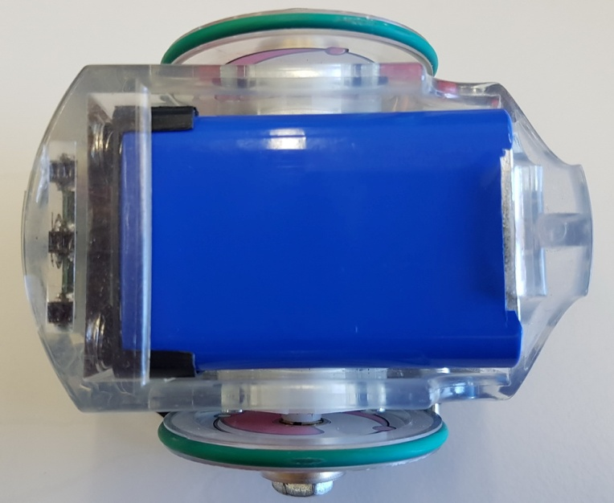
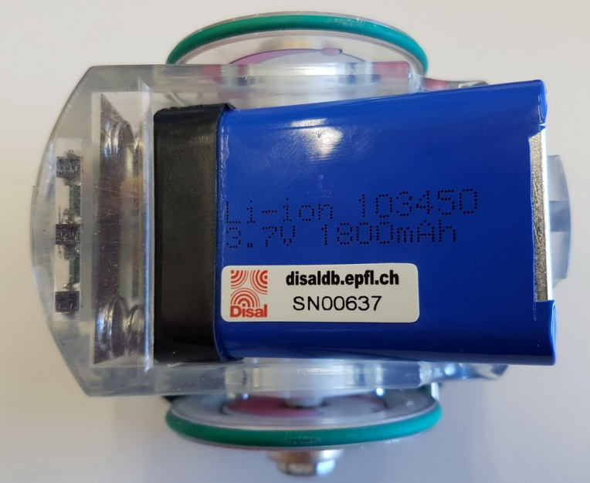
e-puck: insert battery
If you can see the serial number it’s wrong

Slide 6
e-puck: Reminder
You will need to use 2 buttons on the robot:
reset
power
(behind right wheel)
Also: watch for the power (green) and the low-power LED (red)

Slide 7
Programming an e-puck
Turn on robot, plug USB dongle into computer
Upload program abc.hex
epuckupload -f abc.hex 123
Remember:
Before compiling a C file (abc.c), edit your Makefile:
EPUCKLIBROOT=/home/user/mydocs/epuck/EpuckDevelopmentTree/library

Slide 8
Bluetooth issues
If you are having problems connecting and/or uploading code, do the following:
  Unplug the USB-Bluetooth dongle
  Plug in the USB-Bluetooth dongle
  Left click on the Bluetooth icon on the top right screen
    Disable
    Enable
You cannot upload code while the minicom is used!

