Slide 1
Lab 6
Tutorial
Alexander Bahr
1-11-2017

Slide 2
Collective Decision
Consensus
  System converges, even though there is no “leader”
  The value of the final consensus cannot be predicted
  Each individual makes the best choice it can with the information available to it, and adjusts as necessary

Slide 3
Partial Perception
If all agents have perfect & complete knowledge of the system state, solution is trivial
  i.e. majority vote
But, this is usually not the case…
  Local information → local decision
  Well-mixed → eventual convergence

Slide 4
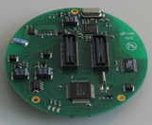
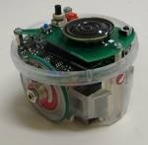
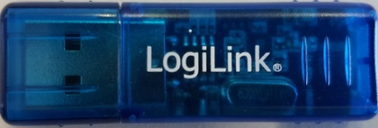
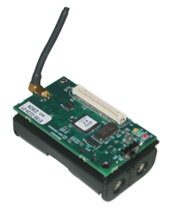
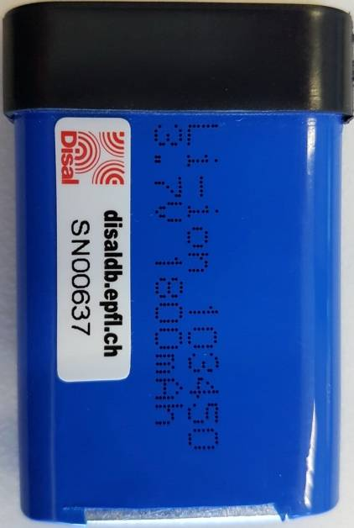
Hardware
Each group of 2 will receive:
  2 e-puck robots
  2 batteries
  2 radio modules
  1 USB-Bluetooth dongle
  4 walls
  4 stands
  0.5 MICAz

Slide 5
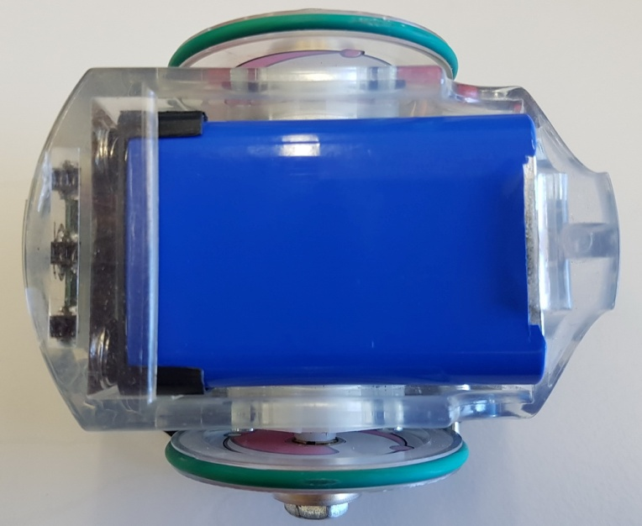
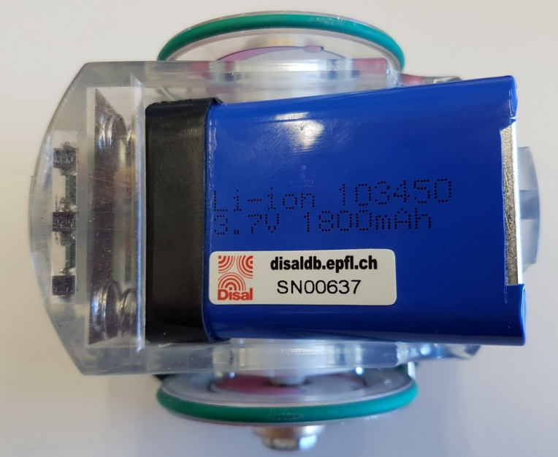
e-puck: insert battery
If you can see the serial number it’s wrong

Slide 6
e-puck: Reminder
You will need to use 2 buttons on the robot:
reset
power
(behind right wheel)
Also: watch for the power (green) and the low-power LED (red)

Slide 7
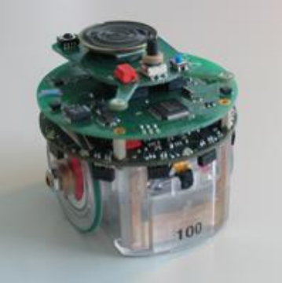
Technical notes
E-puck part
Communication board should be sandwiched between e-puck base & speaker board
Calibrate IR sensors as indicated
Watch for the low battery light

