Slide 1
Group 3
Jacob Darling
Austen Erickson
Gretchen Mojica Carrero
Mikaila Steinbrugge
Hugo Vega Hernandez

Slide 2
Outland Adventures
Blythe Timmerson and Jim Ford are outdoor enthusiasts who wish to share their passion for exploring far-off places.
Outland Adventures is their solution. Initially a side hobby, the company quickly gained traction and became a full-time commitment.
They wish to track all the information related to trip popularity and equipment sales.
They are seeking assistance to optimize their supply organization and ensure they are meeting the demands of their customers.
Important details such as pricing for airfare, equipment rentals, and required vaccinations should also be included.

Slide 3
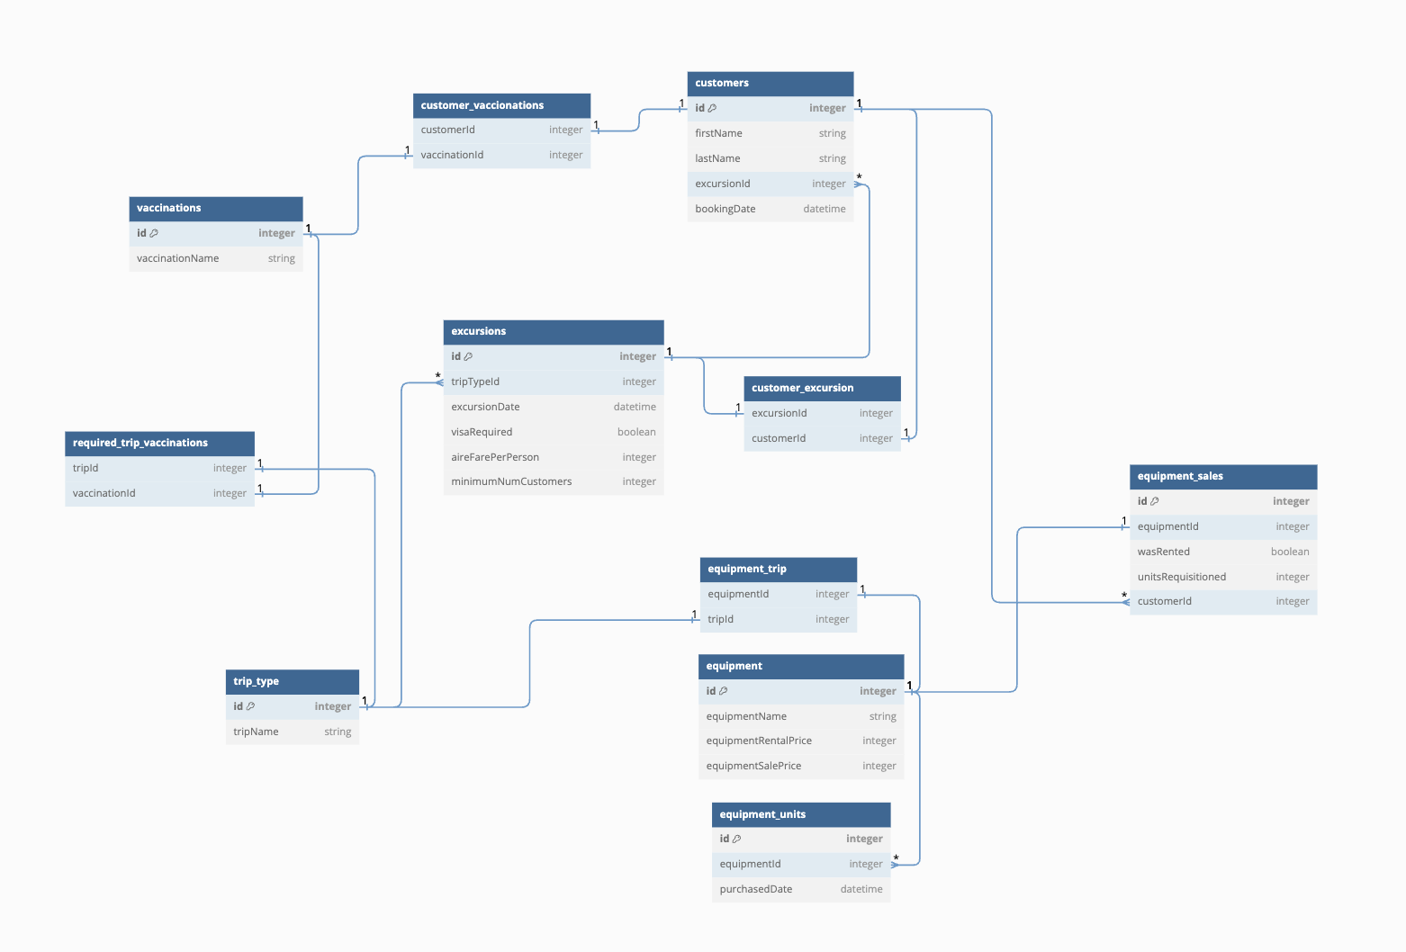
ERD

Slide 4
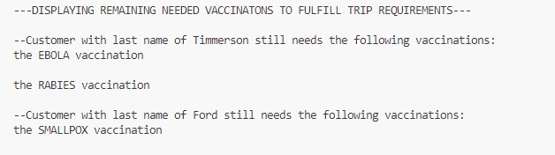
Report 1
Each excursion has a list of required vaccinations for the countries that will be traversed. This report takes that data and compares it to the customers' current vaccinations. The output shows the customer by last name and clearly prints their missing vaccinations.

Slide 5
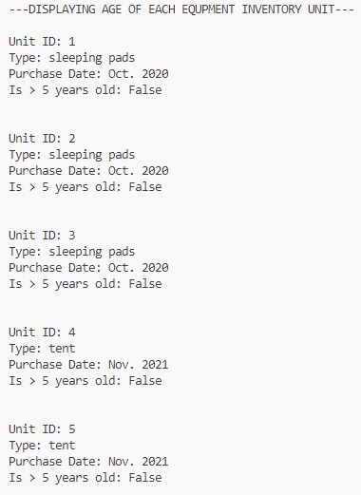
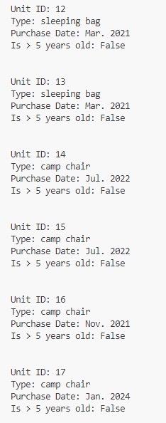
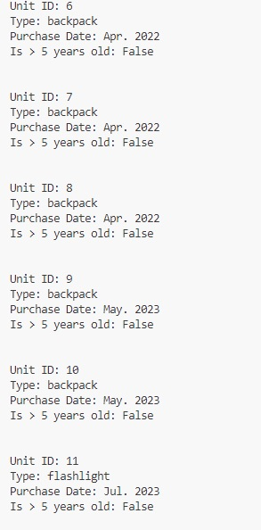
Report 2
Safety is always a top priority, and in addition to providing equipment, Outland Adventures is committed to maintaining its stock. Any equipment older than five years should be replaced. This report will gather the inventory and the purchase date of the equipment. The results display the item details and if it needs replacing.

Slide 6
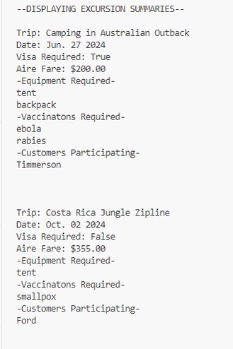
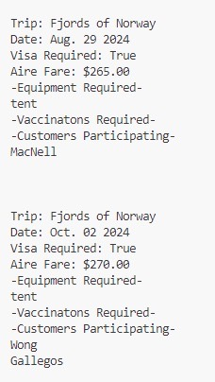
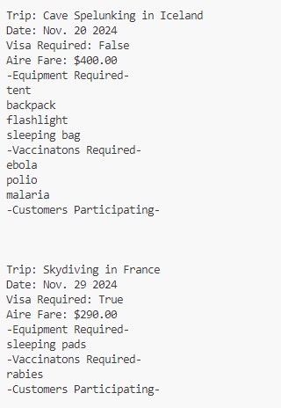
Report 3
Tracking trends will allow Outland Adventures to decide which excursions are most popular. Any trips with declining reservations may be reevaluated for the future. This report gathers data from past excursions, including pricing, vaccination requirements, equipment needed, and participating customers.

Slide 7
Assumptions
Customers will not sign up for overlapping excursions as it is impossible for them to be in two places at once.
Customers will either rent or buy equipment; they cannot provide their own equipment.
Two excursions of the same trip type can happen simultaneously.
Customers' safety is our top priority. Therefore, they will need to get the necessary vaccinations before attending the excursion.
The purchase date of equipment units for inventory will be used to determine the equipment unit age.

Slide 8
Conclusion
Through implementing a robust database Outland Adventures can ensure the safety of their customers. Providing information about required vaccinations and overall costs will ensure customers have all the details needed before booking. These reports can also be used to analyze previous sales to track the popularity of both excursions and equipment sales. This database can assist Outland Adventures in elevating its business model to the next level.

