Slide 1

Implementing a Just Culture
Creating a Fair and Open Environment

Slide 2

Understanding Just Culture
A culture where staff are not punished for actions, omissions, suggestions, or decisions commensurate with their experience and training
Gross negligence, willful violations, and destructive acts are not tolerated
A focus on learning from adverse events rather than assigning blame
Accountability is balanced between individuals and the organization

Slide 3

Overcoming Conceptual and Linguistic Hurdles
Conceptual Barriers: Culture cannot be designed or implemented top-down, for adaptive change to stick it must be bottom-up and slow
Linguistic Barriers: Discussing safety involves a long list of negative terms that can reinforce the human-as-hazard perspective
Slogans such as “zero accidents” undermine safety and justice by creating unrealistic expectations

Slide 4

Personal, Social, and Historical Challenges
Personal and Social Barriers: Judgement of performance is affected by outcome severity, hindsight, and who is affected
Trust is fragile and it takes time to develop confidence that one will not be punished for mistakes
Historical Barriers: Unfair treatment in the past influences current beliefs
Blaming for honest mistakes can create a long-lasting negative impact

Slide 5
Societal and Evolutionary Influences
Societal Barriers: Fear that systems can fail catastrophically due to human variability leads to the blame game
Evolutionary Barriers: Our sense of justice is inherited from primitive ancestors, leading to misplaced thinking in complex systems

Slide 6
Professional, Organizational, Regulatory, and Technological Obstacles
Professional and Organizational Barriers: Different professions have different ideas about justice; professional experience can distort views
Regulatory Barriers: Regulations may be inconsistent, leading to open interpretations
Technological Barriers: Technology can make it easy for things to go catastrophically wrong

Slide 7
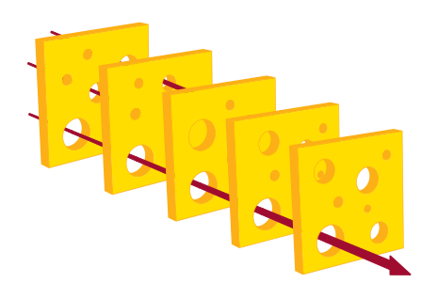
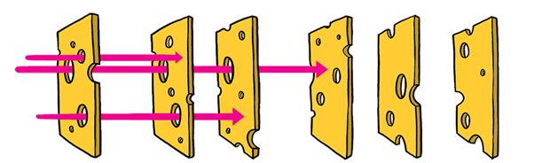
Swiss Cheese Model of Accident Causation
In this model each prevention tool, whether it’s an individual, entity, or protocol, is represented as a slice of Swiss cheese. Known for its holes, these gaps represent weak points, flaws, and deficiencies.
Accidents arise when a threat is able to traverse through these holes
With enough slices, it is possible to prevent a majority of accidents

Slide 8
References
Bell, A. (2018, April 18). How to use the swiss cheese accident causation model. Enterprise Training Solutions Blog. https://blog.enterprisetraining.com/swiss-cheese-accident-causation-model/
Shorrock, S. (2024, November 2). Why is it just so difficult? barriers to “just culture” in the real world. Humanistic Systems. https://humanisticsystems.com/2023/10/18/why-is-it-just-so-difficult-barriers-to-just-culture-in-the-real-world/

