Slide 1
SA Assignment – Group14
Subscriber
imdb
RabbitMQ Queue
Imdb Api
Queue publisher
Polling queue
Console input
Insert into DB
Postgres DB
PollDB
Table records

Slide 2
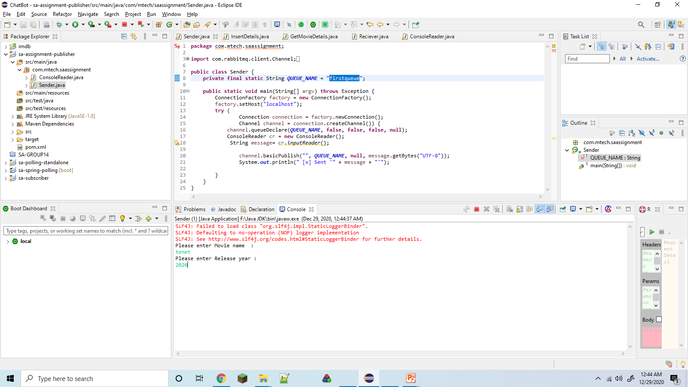
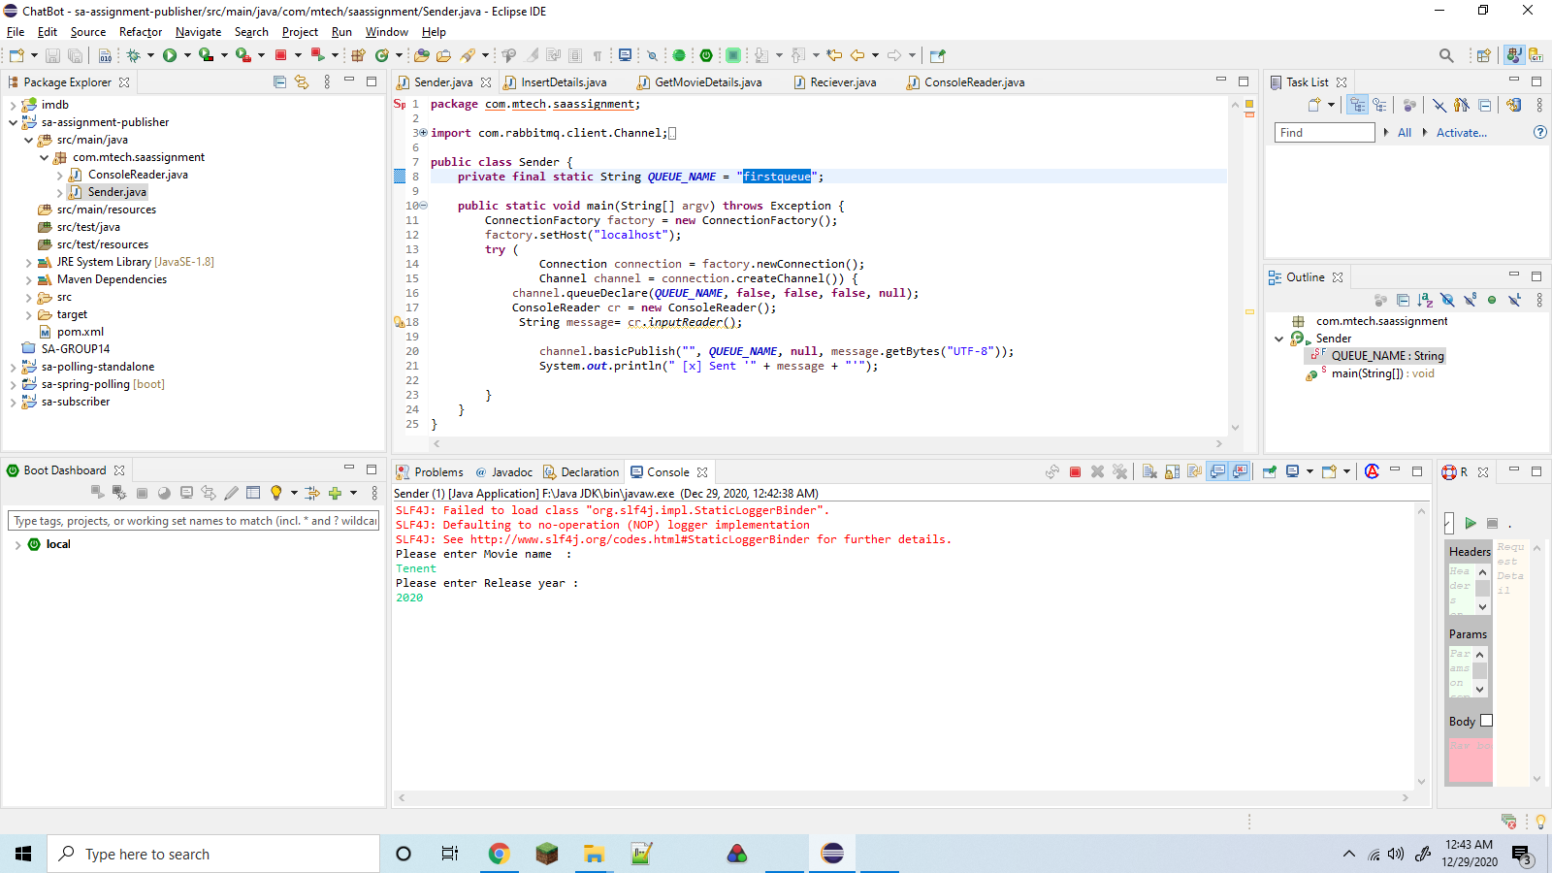

Slide 3
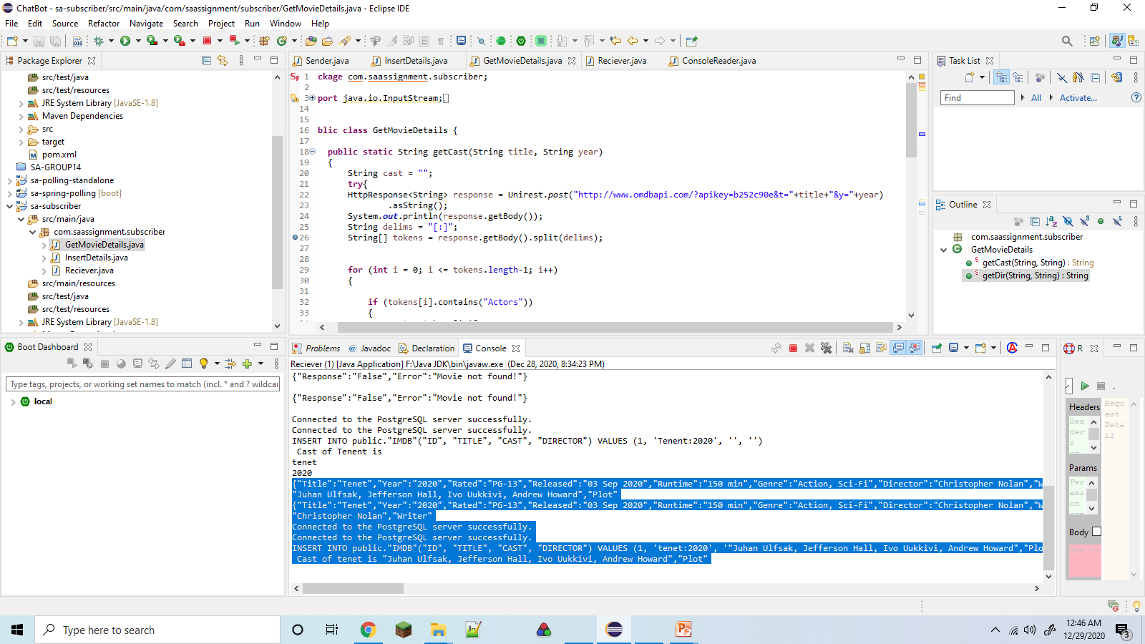
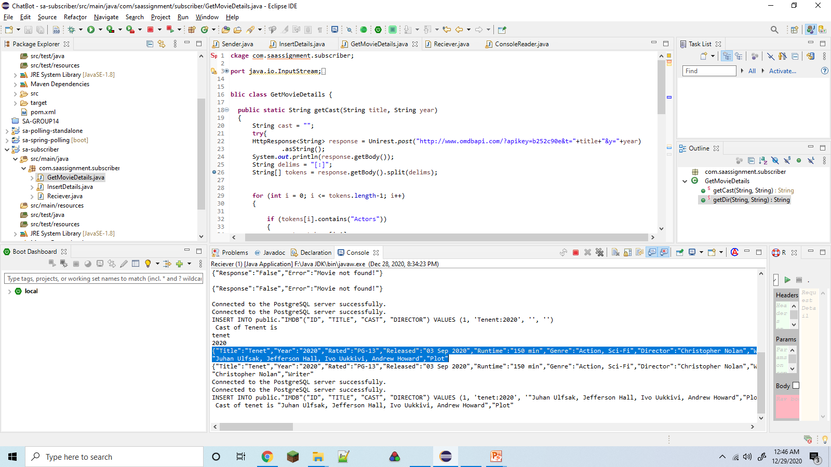

Slide 4
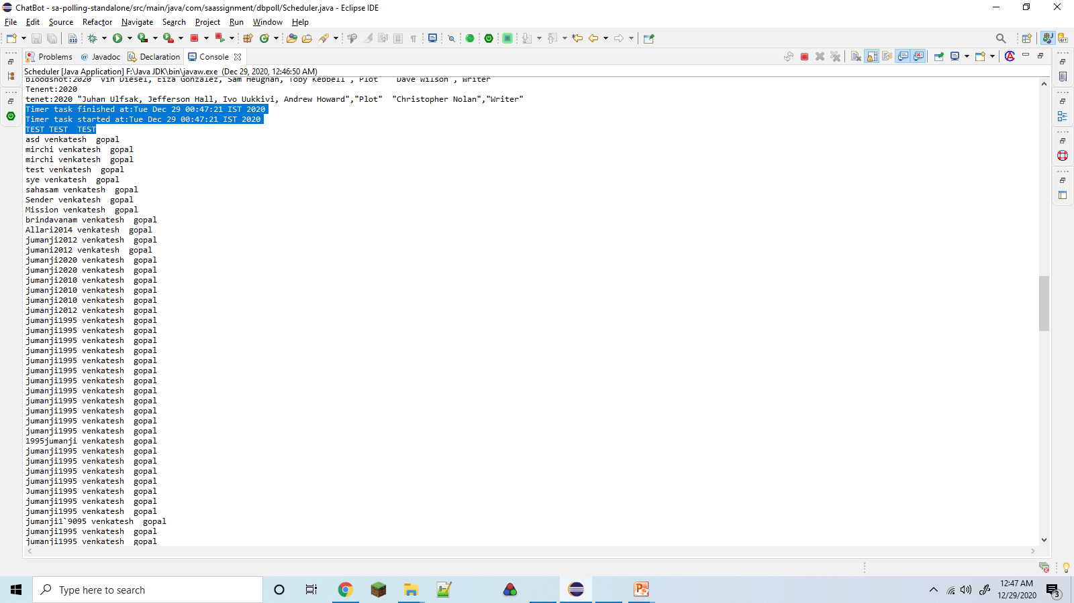

Slide 5
