Slide 1
Collaborative Filtering: A Tutorial
William W. Cohen
Center for Automated Learning and Discovery
Carnegie Mellon University

Slide 2
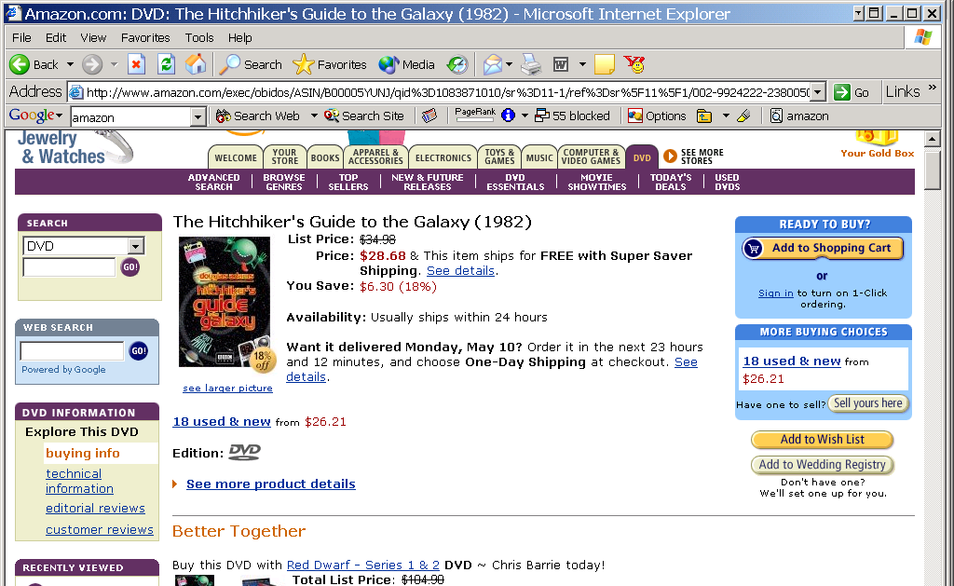
Everyday Examples of Collaborative Filtering...

Slide 3
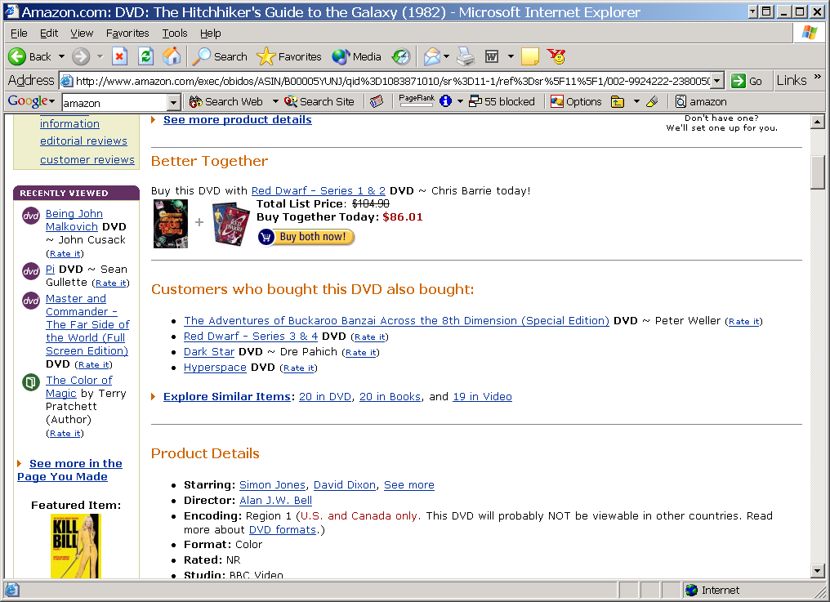
Rate it?
The Dark Star's crew is on a 20-year mission ..but unlike Star Trek... the nerves of this crew are ... frayed to the point of psychosis. Their captain has been killed by a radiation leak that also destroyed their toilet paper. "Don't give me any of that 'Intelligent Life' stuff," says Commander Doolittle when presented with the possibility of alien life. "Find me something I can blow up.“...

Slide 4
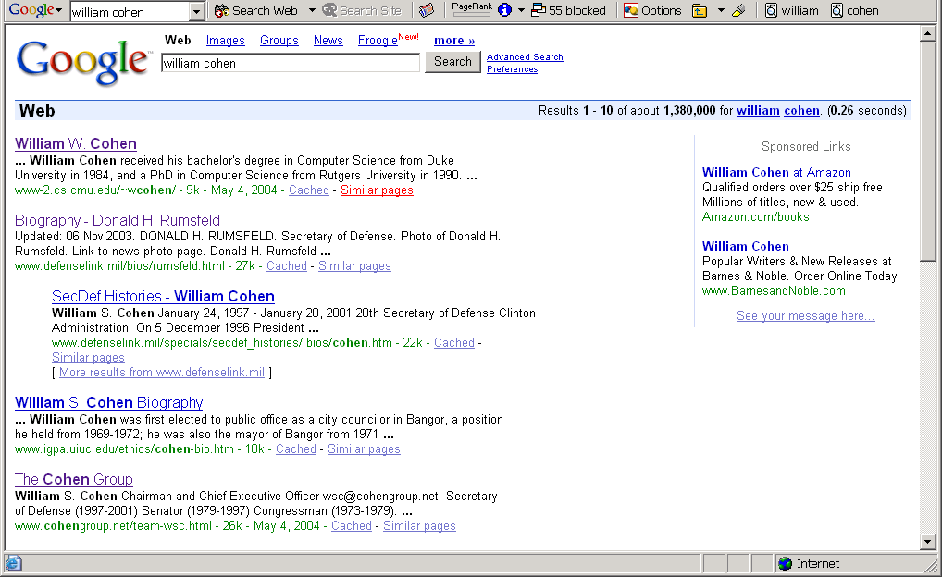
Everyday Examples of Collaborative Filtering...

Slide 5
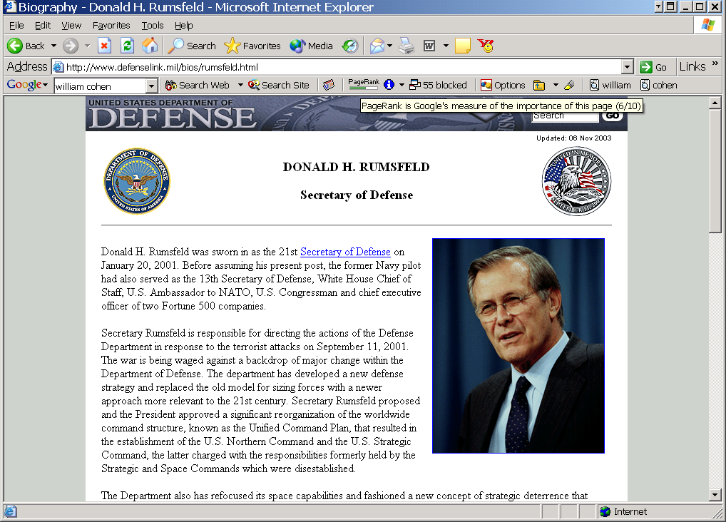

Slide 6
Everyday Examples of Collaborative Filtering...

Slide 7
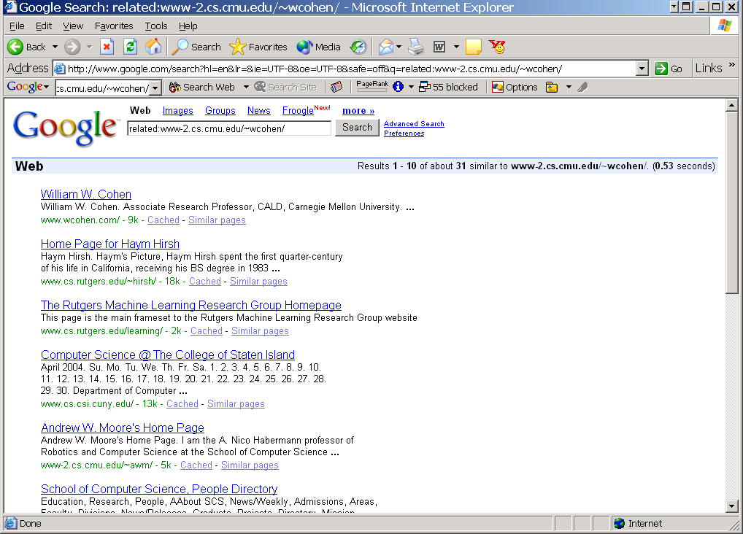

Slide 8
Google’s PageRank
Inlinks are “good” (recommendations)
Inlinks from a “good” site are better than inlinks from a “bad” site
but inlinks from sites with many outlinks are not as “good”...
“Good” and “bad” are relative.
web site xxx
web site xxx
web site xxx
web site a b c d e f g
web
site
pdq pdq ..
web site yyyy
web site a b c d e f g
web site yyyy

Slide 9
Google’s PageRank
web site xxx
Imagine a “pagehopper” that always either
follows a random link, or
jumps to random page
web site xxx
web site a b c d e f g
web
site
pdq pdq ..
web site yyyy
web site a b c d e f g
web site yyyy

Slide 10
Google’s PageRank
(Brin & Page, http://www-db.stanford.edu/~backrub/google.html)
web site xxx
Imagine a “pagehopper” that always either
follows a random link, or
jumps to random page
PageRank ranks pages by the amount of time the pagehopper spends on a page:
or, if there were many pagehoppers, PageRank is the expected “crowd size”
web site xxx
web site a b c d e f g
web
site
pdq pdq ..
web site yyyy
web site a b c d e f g
web site yyyy

Slide 11
Everyday Examples of Collaborative Filtering...
Bestseller lists
Top 40 music lists
The “recent returns” shelf at the library
Unmarked but well-used paths thru the woods
The printer room at work
Many weblogs
“Read any good books lately?”
....
Common insight: personal tastes are correlated:
  If Alice and Bob both like X and Alice likes Y then Bob is more likely to like Y
  especially (perhaps) if Bob knows Alice

Slide 12
Outline
Non-systematic survey of some CF systems
  CF as basis for a virtual community
  memory-based recommendation algorithms
  visualizing user-user via item distances
  CF versus content filtering
Algorithms for CF
CF with different inputs
  true ratings
  assumed/implicit ratings
Conclusions/Summary

Slide 13
BellCore’s MovieRecommender
Recommending And Evaluating Choices In A Virtual Community Of Use. Will Hill, Larry Stead, Mark Rosenstein and George Furnas, Bellcore; CHI 1995
  By virtual community we mean "a group of people who share characteristics and interact in essence or effect only". In other words, people in a Virtual Community influence each other as though they interacted but they do not interact. Thus we ask: "Is it possible to arrange for people to share some of the personalized informational benefits of community involvement without the associated communications costs?"

Slide 14
MovieRecommender Goals
Recommendations should:
simultaneously ease and encourage rather than replace social processes....should make it easy to participate while leaving in hooks for people to pursue more personal relationships if they wish.
be for sets of people not just individuals...multi-person recommending is often important, for example, when two or more people want to choose a video to watch together.
be from people not a black box machine or so-called "agent".
tell how much confidence to place in them, in other words they should include indications of how accurate they are.

Slide 15
BellCore’s MovieRecommender
Participants sent email to videos@bellcore.com
System replied with a list of 500 movies to rate on a 1-10 scale (250 random, 250 popular)
  Only subset need to be rated
New participant P sends in rated movies via email
System compares ratings for P to ratings of (a random sample of) previous users
Most similar users are used to predict scores for unrated movies (more later)
System returns recommendations in an email message.

Slide 16
Suggested Videos for: John A. Jamus.
Your must-see list with predicted ratings:
7.0 "Alien (1979)"
6.5 "Blade Runner"
6.2 "Close Encounters Of The Third Kind (1977)"
Your video categories with average ratings:
6.7 "Action/Adventure"
6.5 "Science Fiction/Fantasy"
6.3 "Children/Family"
6.0 "Mystery/Suspense"
5.9 "Comedy"
5.8 "Drama"

Slide 17
The viewing patterns of 243 viewers were consulted. Patterns of 7 viewers were found to be most similar. Correlation with target viewer:
0.59 viewer-130 (unlisted@merl.com)
0.55 bullert,jane r (bullert@cc.bellcore.com)
0.51 jan_arst (jan_arst@khdld.decnet.philips.nl)
0.46 Ken Cross (moose@denali.EE.CORNELL.EDU)
0.42 rskt (rskt@cc.bellcore.com)
0.41 kkgg (kkgg@Athena.MIT.EDU)
0.41 bnn (bnn@cc.bellcore.com)
By category, their joint ratings recommend:
Action/Adventure:
  "Excalibur" 8.0, 4 viewers
  "Apocalypse Now" 7.2, 4 viewers
  "Platoon" 8.3, 3 viewers
Science Fiction/Fantasy:
  "Total Recall" 7.2, 5 viewers
Children/Family:
  "Wizard Of Oz, The" 8.5, 4 viewers
  "Mary Poppins" 7.7, 3 viewers
Mystery/Suspense:
  "Silence Of The Lambs, The" 9.3, 3 viewers
Comedy:
  "National Lampoon's Animal House" 7.5, 4 viewers
  "Driving Miss Daisy" 7.5, 4 viewers
  "Hannah and Her Sisters" 8.0, 3 viewers
Drama:
  "It's A Wonderful Life" 8.0, 5 viewers
  "Dead Poets Society" 7.0, 5 viewers
  "Rain Man" 7.5, 4 viewers
Correlation of predicted ratings with your actual ratings is: 0.64 This number measures ability to evaluate movies accurately for you. 0.15 means low ability. 0.85 means very good ability. 0.50 means fair ability.

Slide 18
BellCore’s MovieRecommender
Evaluation:
  Withhold 10% of the ratings of each user to use as a test set
  Measure correlation between predicted ratings and actual ratings for test-set movie/user pairs

Slide 19
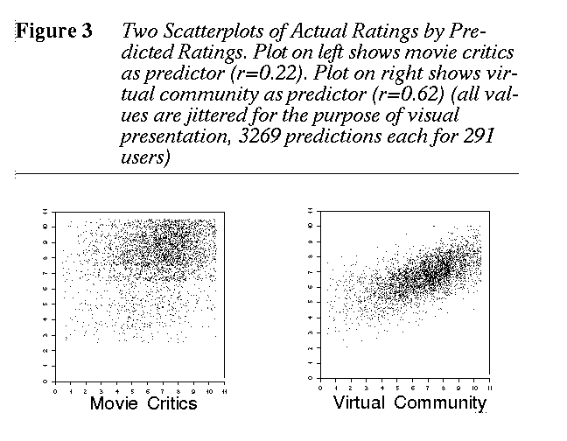

Slide 20
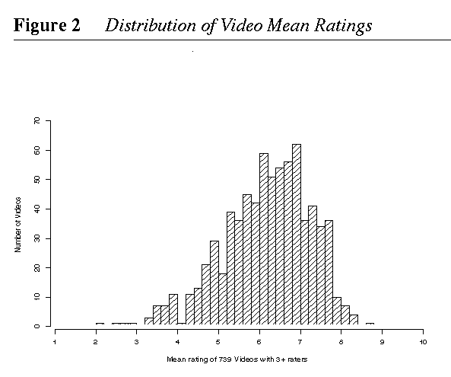
Another key observation: rated movies tend to have positive ratings:
i.e., people rate what they watch, and watch what they like
Question: Can observation replace explicit rating?

Slide 21
BellCore’s MovieRecommender
Participants sent email to videos@bellcore.com
System replied with a list of 500 movies to rate New participant P sends in rated movies via email
System compares ratings for P to ratings of (a random sample of) previous users
Most similar users are used to predict scores for unrated movies
  Empirical Analysis of Predictive Algorithms for Collaborative Filtering Breese, Heckerman, Kadie, UAI98
System returns recommendations in an email message.

Slide 22
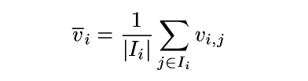
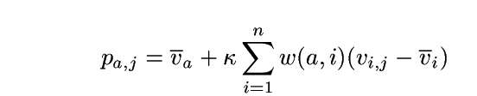
Algorithms for Collaborative Filtering 1: Memory-Based Algorithms (Breese et al, UAI98)
v_{i,j}= vote of user i on item j
I_{i} = items for which user i has voted
Mean vote for i is
Predicted vote for “active user” a is weighted sum
normalizer
weights of n similar users

Slide 23
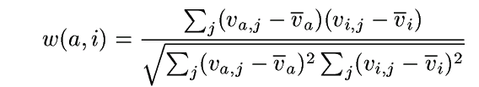
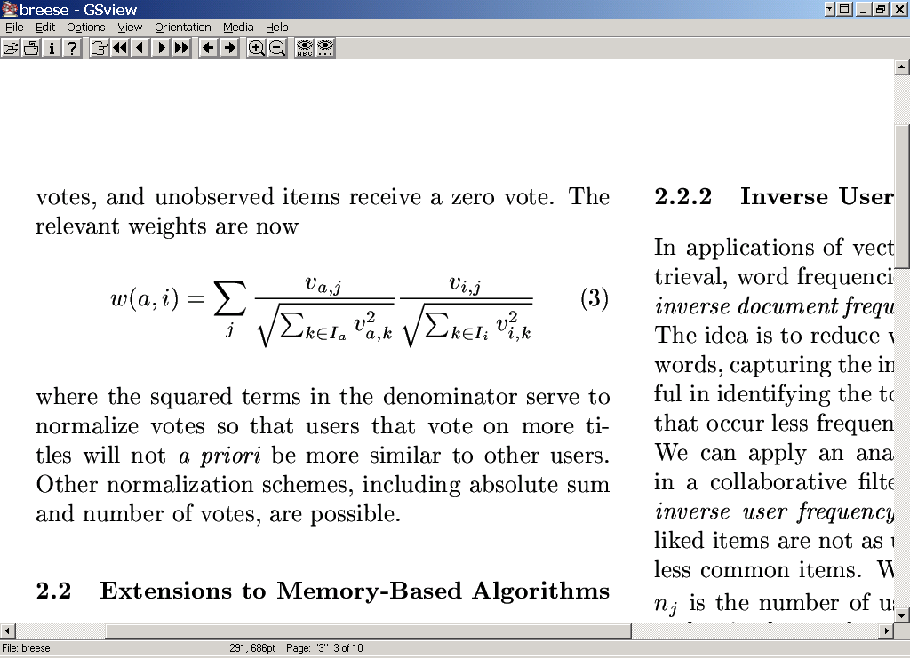
Algorithms for Collaborative Filtering 1: Memory-Based Algorithms (Breese et al, UAI98)
K-nearest neighbor
Pearson correlation coefficient (Resnick ’94, Grouplens):
Cosine distance (from IR)

Slide 24
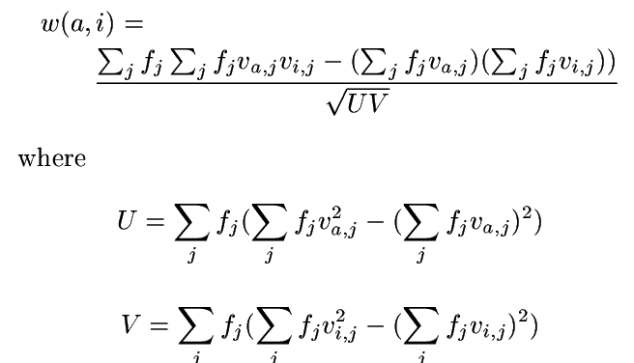
Algorithms for Collaborative Filtering 1: Memory-Based Algorithms (Breese et al, UAI98)
Cosine with “inverse user frequency” f_{i} = log(n/n_{j}), where n is number of users, n_{j} is number of users voting for item j

Slide 25
Algorithms for Collaborative Filtering 1: Memory-Based Algorithms (Breese et al, UAI98)
Evaluation:
  split users into train/test sets
  for each user a in the test set:
    split a’s votes into observed (I) and to-predict (P)
    measure average absolute deviation between predicted and actual votes in P
    predict votes in P, and form a ranked list
    assume (a) utility of k-th item in list is max(v_{a,j}-d,0), where d is a “default vote” (b) probability of reaching rank k drops exponentially in k. Score a list by its expected utility R_{a}
  average R_{a} over all test users

Slide 26
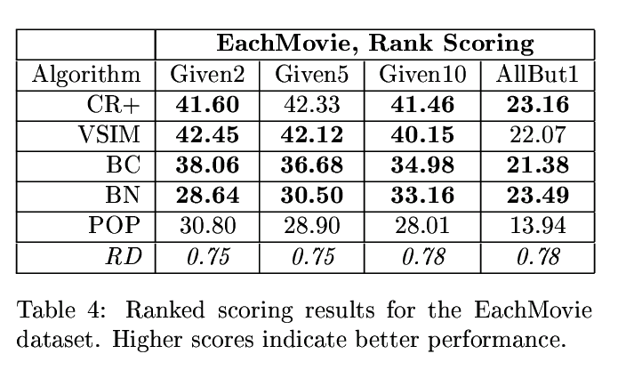
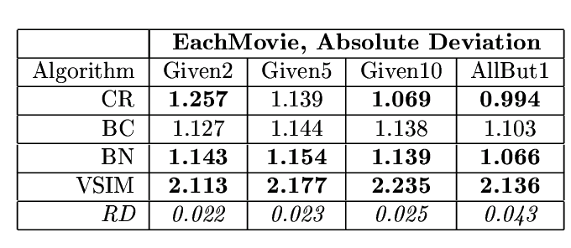
Algorithms for Collaborative Filtering 1: Memory-Based Algorithms (Breese et al, UAI98)
Why are these numbers worse?
soccer score
golf score

Slide 27
Visualizing Cosine Distance
similarity of doc a to doc b =
word 1
doc c
word 2
doc d
...
doc a
word j
doc b
...
word n

Slide 28
Visualizing Cosine Distance
distance from user a to user i =
item 1
item 2
...
user a
item j
user i
...
Suppose user-item links were probabilities of following a link
Then w(a,i) is probability of a and i “meeting”
item n

Slide 29
Visualizing Cosine Distance
Approximating Matrix Multiplication for Pattern Recognition Tasks, Cohen & Lewis, SODA 97—explores connection between cosine distance/inner product and random walks
item 1
item 2
...
user a
item j
user i
...
Suppose user-item links were probabilities of following a link
Then w(a,i) is probability of a and i “meeting”
item n

Slide 30
Outline
Non-systematic survey of some CF systems
  CF as basis for a virtual community
  memory-based recommendation algorithms
  visualizing user-user via item distances
  CF versus content filtering
Algorithms for CF
CF with different inputs
  true ratings
  assumed/implicit ratings

Slide 31
LIBRA Book Recommender
Content-Based Book Recommending Using Learning for Text Categorization. Raymond J. Mooney, Loriene Roy, Univ Texas/Austin; DL-2000
[CF] assumes that a given user’s tastes are generally the same as another user ... Items that have not been rated by a sufficient number of users cannot be effectively recommended. Unfortunately, statistics on library use indicate that most books are utilized by very few patrons. ... [CF] approaches ... recommend popular titles, perpetuating homogeneity.... this approach raises concerns about privacy and access to proprietary customer data.

Slide 32
LIBRA Book Recommender
Database of textual descriptions + meta-information about books (from Amazon.com’s website)
  title, authors, synopses, published reviews, customer comments, related authors, related titles, and subject terms.
Users provides 1-10 rating for training books
System learns a model of the user
  Naive Bayes classifier predicts Prob(user rating>5|book)
System explains ratings in terms of “informative features” and explains features in terms of examples

Slide 33
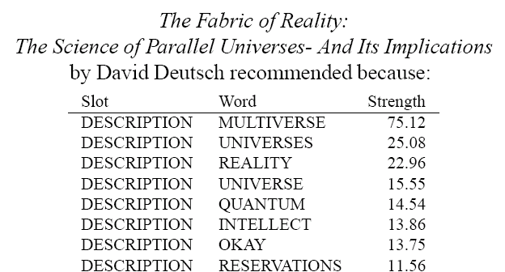
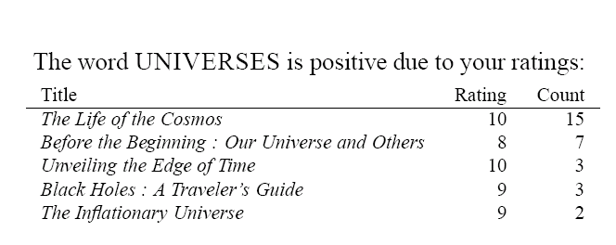
LIBRA Book Recommender
....

Slide 34
LIBRA Book Recommender
Key differences from MovieRecommender:
vs collaborative filtering, recommendation is based on properties of the item being recommended, not tastes of other users
vs memory-based techniques, LIBRA builds an explicit model of the user’s tastes (expressed as weights for different words)
....

Slide 35
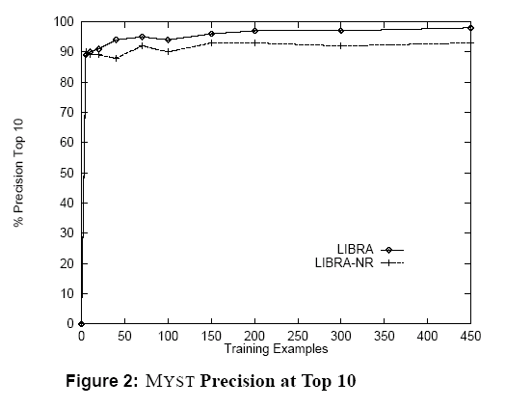
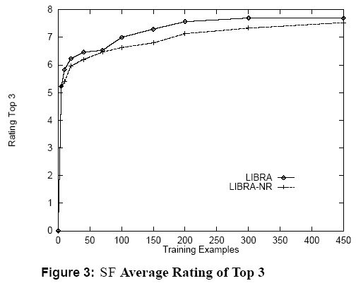
LIBRA Book Recommender
LIBRA-NR = no related author/title features

Slide 36
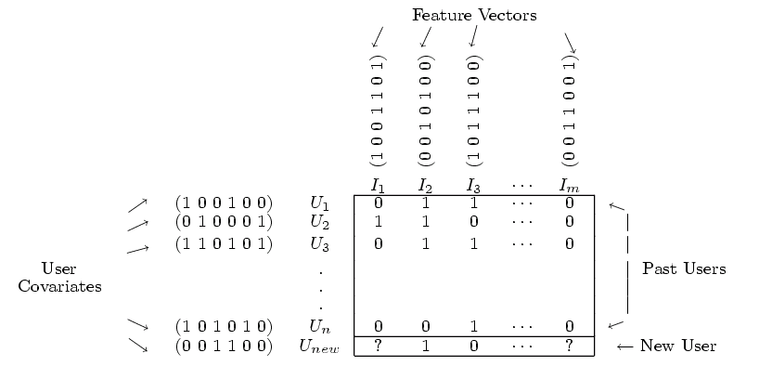
Collaborative + Content Filtering
(Basu et al, AAAI98; Condliff et al, AI-STATS99)

Slide 37
Collaborative + Content Filtering
(Basu et al, AAAI98; Condliff et al, AI-STATS99)
 |  | Airplane | Matrix | Room with a View | ... | Hidalgo
 |  | comedy | action | romance | ... | action
Joe | 27,M,70k | 9 | 7 | 2 |  | 7
Carol | 53,F,20k | 8 |  | 9
...
Kumar | 25,M,22k | 9 | 3 |  |  | 6
U_{a} | 48,M,81k | 4 | 7 | ? | ? | ?

Slide 38
Collaborative + Content Filtering
As Classification (Basu, Hirsh, Cohen, AAAI98)
Classification task: map (user,movie) pair into {likes,dislikes}
Training data: known likes/dislikes
Test data: active users
Features: any properties of user/movie pair
 |  | Airplane | Matrix | Room with a View | ... | Hidalgo
 |  | comedy | action | romance | ... | action
Joe | 27,M,70k | 1 | 1 | 0 |  | 1
Carol | 53,F,20k | 1 |  | 1 |  | 0
...
Kumar | 25,M,22k | 1 | 0 | 0 |  | 1
U_{a} | 48,M,81k | 0 | 1 | ? | ? | ?

Slide 39
Collaborative + Content Filtering
As Classification (Basu et al, AAAI98)
Examples: genre(U,M), age(U,M), income(U,M),...
genre(Carol,Matrix) = action
income(Kumar,Hidalgo) = 22k/year
Features: any properties of user/movie pair (U,M)
 |  | Airplane | Matrix | Room with a View | ... | Hidalgo
 |  | comedy | action | romance | ... | action
Joe | 27,M,70k | 1 | 1 | 0 |  | 1
Carol | 53,F,20k | 1 |  | 1 |  | 0
...
Kumar | 25,M,22k | 1 | 0 | 0 |  | 1
U_{a} | 48,M,81k | 0 | 1 | ? | ? | ?

Slide 40
Collaborative + Content Filtering
As Classification (Basu et al, AAAI98)
Examples: usersWhoLikedMovie(U,M):
usersWhoLikedMovie(Carol,Hidalgo) = {Joe,...,Kumar}
usersWhoLikedMovie(U_{a}, Matrix) = {Joe,...}
Features: any properties of user/movie pair (U,M)
 |  | Airplane | Matrix | Room with a View | ... | Hidalgo
 |  | comedy | action | romance | ... | action
Joe | 27,M,70k | 1 | 1 | 0 |  | 1
Carol | 53,F,20k | 1 |  | 1 |  | 0
...
Kumar | 25,M,22k | 1 | 0 | 0 |  | 1
U_{a} | 48,M,81k | 0 | 1 | ? | ? | ?

Slide 41
Collaborative + Content Filtering
As Classification (Basu et al, AAAI98)
Examples: moviesLikedByUser(M,U):
moviesLikedByUser(*,Joe) = {Airplane,Matrix,...,Hidalgo}
actionMoviesLikedByUser(*,Joe)={Matrix,Hidalgo}
Features: any properties of user/movie pair (U,M)
 |  | Airplane | Matrix | Room with a View | ... | Hidalgo
 |  | comedy | action | romance | ... | action
Joe | 27,M,70k | 1 | 1 | 0 |  | 1
Carol | 53,F,20k | 1 |  | 1 |  | 0
...
Kumar | 25,M,22k | 1 | 0 | 0 |  | 1
U_{a} | 48,M,81k | 0 | 1 | ? | ? | ?

Slide 42
Collaborative + Content Filtering
As Classification (Basu et al, AAAI98)
genre={romance}, age=48, sex=male, income=81k, usersWhoLikedMovie={Carol}, moviesLikedByUser={Matrix,Airplane}, ...
Features: any properties of user/movie pair (U,M)
 |  | Airplane | Matrix | Room with a View | ... | Hidalgo
 |  | comedy | action | romance | ... | action
Joe | 27,M,70k | 1 | 1 | 0 |  | 1
Carol | 53,F,20k | 1 |  | 1 |  | 0
...
Kumar | 25,M,22k | 1 | 0 | 0 |  | 1
U_{a} | 48,M,81k | 1 | 1 | ? | ? | ?

Slide 43
Collaborative + Content Filtering
As Classification (Basu et al, AAAI98)
genre={romance}, age=48, sex=male, income=81k, usersWhoLikedMovie={Carol}, moviesLikedByUser={Matrix,Airplane}, ...
genre={action}, age=48, sex=male, income=81k, usersWhoLikedMovie = {Joe,Kumar}, moviesLikedByUser={Matrix,Airplane},...
 |  | Airplane | Matrix | Room with a View | ... | Hidalgo
 |  | comedy | action | romance | ... | action
Joe | 27,M,70k | 1 | 1 | 0 |  | 1
Carol | 53,F,20k | 1 |  | 1 |  | 0
...
Kumar | 25,M,22k | 1 | 0 | 0 |  | 1
U_{a} | 48,M,81k | 1 | 1 | ? | ? | ?

Slide 44
Collaborative + Content Filtering
As Classification (Basu et al, AAAI98)
genre={romance}, age=48, sex=male, income=81k, usersWhoLikedMovie={Carol}, moviesLikedByUser={Matrix,Airplane}, ...
genre={action}, age=48, sex=male, income=81k, usersWhoLikedMovie = {Joe,Kumar}, moviesLikedByUser={Matrix,Airplane},...
Classification learning algorithm: rule learning (RIPPER)
  If NakedGun33/13 moviesLikedByUser and Joe usersWhoLikedMovie and genre=comedy then predict likes(U,M)
  If age>12 and age<17 and HolyGrail moviesLikedByUser and director=MelBrooks then predict likes(U,M)
  If Ishtar moviesLikedByUser then predict likes(U,M)

Slide 45
Collaborative + Content Filtering
As Classification (Basu et al, AAAI98)
Classification learning algorithm: rule learning (RIPPER)
  If NakedGun33/13 moviesLikedByUser and Joe usersWhoLikedMovie and genre=comedy then predict likes(U,M)
  If age>12 and age<17 and HolyGrail moviesLikedByUser and director=MelBrooks then predict likes(U,M)
  If Ishtar moviesLikedByUser then predict likes(U,M)
Important difference from memory-based approaches:
  again, Ripper builds an explicit model—of how user’s tastes relate items, and to the tastes of other users

Slide 46
Basu et al 98 - results
Evaluation:
  Predict liked(U,M)=“M in top quartile of U’s ranking” from features, evaluate recall and precision
  Features:
    Collaborative: UsersWhoLikedMovie, UsersWhoDislikedMovie, MoviesLikedByUser
    Content: Actors, Directors, Genre, MPAA rating, ...
    Hybrid: ComediesLikedByUser, DramasLikedByUser, UsersWhoLikedFewDramas, ...
Results: at same level of recall (about 33%)
  Ripper with collaborative features only is worse than the original MovieRecommender (by about 5 pts precision – 73 vs 78)
  Ripper with hybrid features is better than MovieRecommender (by about 5 pts precision)

Slide 47
Technical Paper Recommendation
(Basu, Hirsh, Cohen, Neville-Manning, JAIR 2001)
 |  | Shallow parsing with conditional random fields.Sha and Pereira, ... | Hidden Markov Support Vector Machines, Altun et al, ... | ... | Large Margin Classification Using the Perceptron Algorithm, Freund and Schapire
Haym | cs.rutgers.edu/ ~hirsh
William | cs.cmu.edu/ ~wcohen
...
Soumen | cs.ucb.edu/ ~soumen
A special case of CF is when items and users can both be represented over the same feature set (e.g., with text)
How similar are these two documents?

Slide 48
Technical Paper Recommendation
(Basu et al, JAIR 2001)
 |  | Shallow parsing with conditional random fields.Sha and Pereira, ... | Hidden Markov Support Vector Machines, Altun et al, ... | ... | Large Margin Classification Using the Perceptron Algorithm, Freund and Schapire
Haym | cs.rutgers.edu/ ~hirsh
William | cs.cmu.edu/ ~wcohen
...
Soumen | cs.ucb.edu/ ~soumen
A special case of CF is when items and users can both be represented over the same feature set (e.g., with text)
keywords
title
abstract
w₁ w₂ w₃ w₄ .... w_{n-1} w_{n}

Slide 49
Technical Paper Recommendation
(Basu et al, JAIR 2001)
 |  | Shallow parsing with conditional random fields.Sha and Pereira, ... | Hidden Markov Support Vector Machines, Altun et al, ... | ... | Large Margin Classification Using the Perceptron Algorithm, Freund and Schapire
Haym | cs.rutgers.edu/ ~hirsh
William | cs.cmu.edu/ ~wcohen
...
Soumen | cs.ucb.edu/ ~soumen
A special case of CF is when items and users can both be represented over the same feature set (e.g., with text)
Home page, online papers
w₁ w₂ w₃ w₄ .... w_{n-1} w_{n}

Slide 50
Technical Paper Recommendation
(Basu et al, JAIR 2001)
Possible distance metrics between U_{a} and I_{j}:
consider all paths between structured representations of U_{a} and I_{j}
I_{j}
keywords
title
abstract
w₁ w₂ w₃ w₄ .... w_{n-1} w_{n}
U_{a}
Home page
Online papers

Slide 51
Technical Paper Recommendation
(Basu et al, JAIR 2001)
Possible distance metrics between U_{a} and I_{j}:
consider some paths between structured representations
I_{j}
keywords
abstract
w₁ w₂ w₃ w₄ .... w_{n-1} w_{n}
U_{a}
Home page

Slide 52
Technical Paper Recommendation
(Basu et al, JAIR 2001)
Possible distance metrics between U_{a} and I_{j}:
consider all paths, ignore structure
I_{j}
title + abstract, + keywords
w₁ w₂ w₃ w₄ .... w_{n-1} w_{n}
U_{a}
Home page + online papers

Slide 53
Technical Paper Recommendation
(Basu et al, JAIR 2001)
Possible distance metrics between U_{a} and I_{j}:
consider some paths, ignore structure
I_{j}
title + abstract
w₁ w₂ w₃ w₄ .... w_{n-1} w_{n}
U_{a}
Home page only

Slide 54
Technical Paper Recommendation
(Basu et al, JAIR 2001)
Use WHIRL (Datalog + built-in cosine distances) to formulate structure similarity queries
  Product of TFIDF-weighted cosine distances over each part of structure
Evaluation
  Try and predict stated reviewer preferences in AAAI self-selection process
    Noisy, since not all reviewers examine all papers
  Measure precision in top 10, and top 30

Slide 55
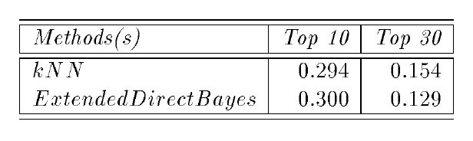
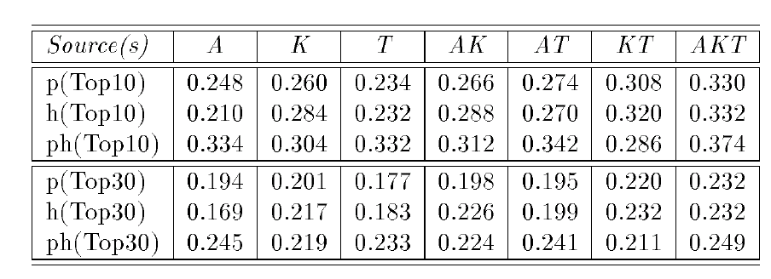
Technical Paper Recommendation
(Basu et al, JAIR 2001)
p=papers, h=homePage
A=abstract, K=keywords, T=title
structured similarity queries with WHIRL

Slide 56
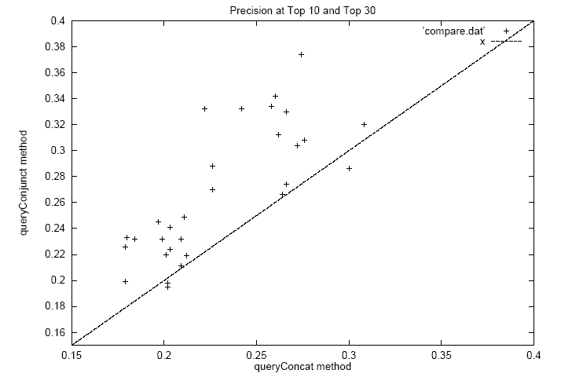
Technical Paper Recommendation
(Basu et al, JAIR 2001)
Structure vs no structure

Slide 57
Outline
Non-systematic survey of some CF systems
  CF as basis for a virtual community
  memory-based recommendation algorithms
  visualizing user-user via item distances
  CF versus content filtering
  Combining CF and content filtering
  CF as matching content and user
Algorithms for CF
  Ranking-based CF
  Probabilistic model-based CF
CF with different inputs
  true ratings
  assumed/implicit ratings

Slide 58
Learning to Order
(Cohen,Schapire,Singer JAIR 99)
Ordering Example: a pair (x,y) where
  The “problem” x is a set of objects
  The “solution” y is a partial order over x
Loss function: Loss(y,y*) is number of incorrectly ordered pairs a<b
Learner uses ordering examples to improve performance.
Outline of Cohen et al 99:
  Learn a binary relation PREFER(a,b) = “a should precede b”
  Given a new set x to order, construct the (possibly inconsistent) pairwise preferences, then find a (nearly) optimal total ordering given the pairs.
  Formal guarantees on learning and ordering algorithm imply a performance guarantee for the whole system

Slide 59
Learning to Order
(Cohen et al JAIR 99)
Learning to Order Things, Cohen, Schapire, Singer, JAIR 1999.
Task: given a set of objects X, find a “good” ranking of X
Inputs:
  On each run, a set of candidate (partial) orderings over X, to choose among and/or combine
  As training data triples (X₁,F₁,Φ₁),..., (X_{m},F_{m},Φ_{m}), where each X is set of objects to order; F is set of “feature” orderings f₁,...,f_{n}, and Φ is the desired ordering of X.

Slide 60
Learning to Order
(Cohen et al JAIR 99)
Outline:
  Approach for constructing linear combinations of “feature” orderings
    Result is “preference” relation PREFER(x,x’)
  Approach for learning linear combinations
  Approach for converting PREFER to approximately optimal mapping
  Formal results of (nearly) optimal combination-learner and bounds on overall performance.

Slide 61
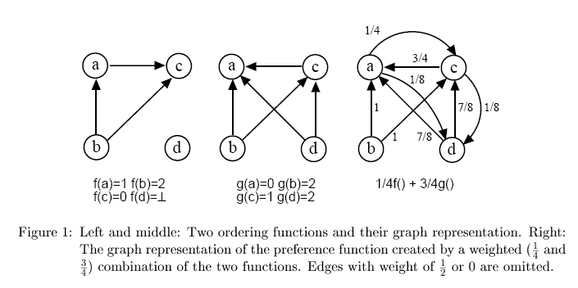
Learning to Order
(Cohen et al JAIR 99)
Ranking functions are graphs with edge weights in [0,1].
Weighted combination of two ordering functions f and g:
weight 0
weight 1
weight 1/2
weight 1/2

Slide 62
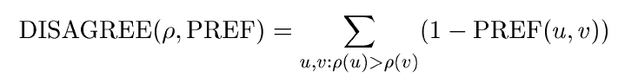
Learning to Order
(Cohen et al JAIR 99)
Outline:
  Approach for constructing linear combinations of “feature” orderings
    Result is “preference” relation PREF(x,x’)
  Approach for learning linear combinations
    Natural extension of existing learning methods
  Approach for converting PREFER to approximately optimal mapping: total order ρ that minimizes
- Unfortunately this is NP-Hard...

Slide 63
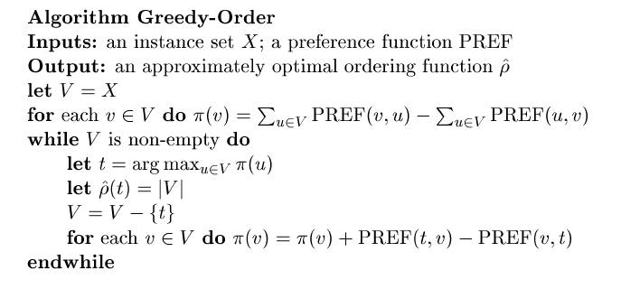
Learning to Order
(Cohen et al JAIR 99)
Fortunately, a “potential-greedy” algorithm obtains good results (within factor of 2x the optimal agreement weight, which is tight)

Slide 64
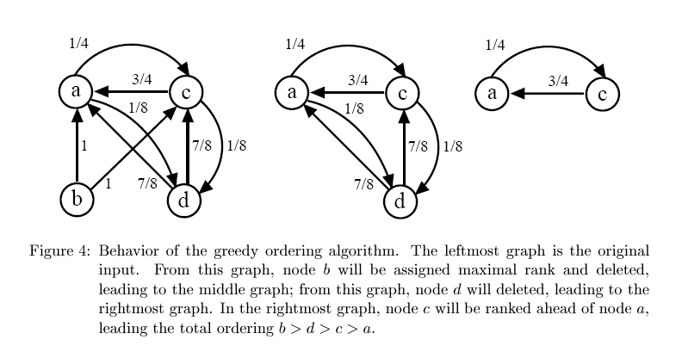
Learning to Order
(Cohen et al JAIR 99)

Slide 65
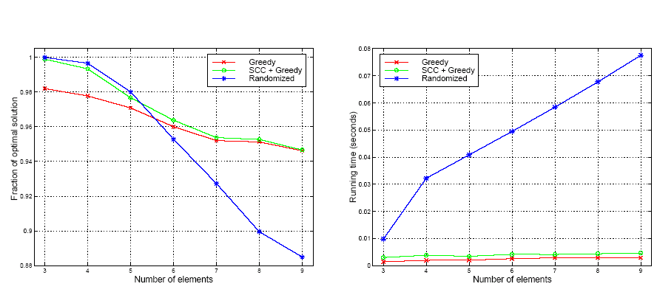
Learning to Order
(Cohen et al JAIR 99)
goodness vs optimal
run-time

Slide 66
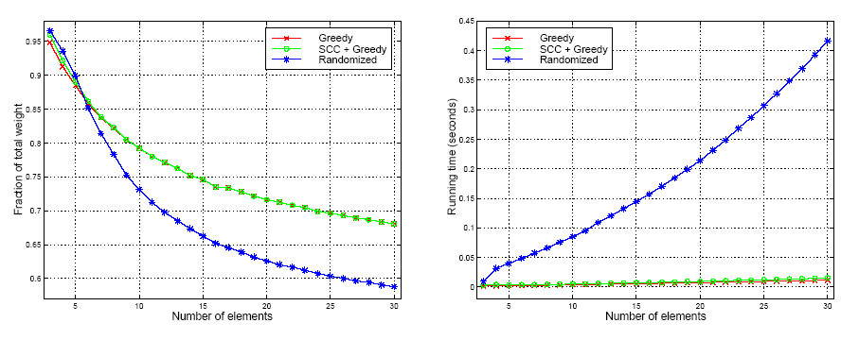
Learning to Order
(Cohen et al JAIR 99)
goodness vs total
run-time

Slide 67
Learning to Order for CF
(Freund,Iyer,Schapire,Singer JMLR 01)
A flaw in rating-based CF data
  users tend to rate on different scales
  this makes ratings hard to aggregate and transfer
A solution:
  disbelieve (ignore) a user’s absolute ratings
  believe (use in training) relative values
    e.g., if user rates item j₁ at “5” and item j₂ as “8” then believe j₁ is preferred to j_{2 .}
  i.e., treat CF as a problem of learning to rank items.

Slide 68
Learning to Order for CF
The formal model:
  objects to rank (e.g. movies) are in set X
  features of object are ranking functions f₁,f₂,..
    if f(x) > f(x’) then x is preferred to x’
    f(x) can be undefined (x is unrated)
  training data is a partial function Φ(x, x’)
    positive iff x should be preferred to x’
  ranking loss: D(x,x’) is distribution over pairs x,x’ where x is preferred to x’, and rloss_{D}(H) is

Slide 69
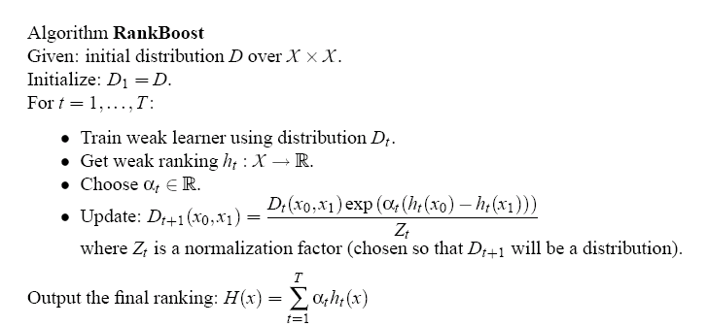
Learning to Order for CF
Assume a “weak learner”, which given a weighted set of examples Φ(x,x’) finds a better-than-useless total ranking function h

Slide 70
Learning to Order for CF
Theorem: usual methods can be used to pick an optimal value for α
Theorem: analogous to the usual case for boosting in classification, rloss_{D}(H) is bounded by
Also: learning can be faster/simpler if Φ is “bipartite”—eg if target ratings are like, don’t like, or don’t care.
  Don’t need to maintain distribution over pairs of x’s.

Slide 71
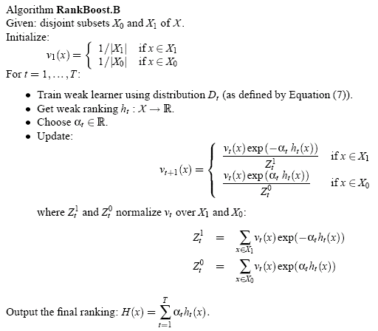
Learning to Order for CF

Slide 72
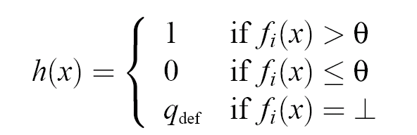
Learning to Order for CF
Possible weak learners:
  A feature function f_{i}—i.e., ratings of some user
    plus def. weight for unrated items to make h total
    sensitive to actual values of f’s
  Thresholded version of some f_{i}
  Values for θ, q_{def} can be found in linear time

Slide 73
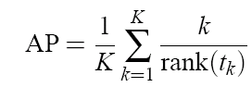
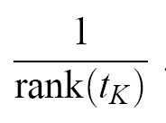
Learning to Order for CF
Evaluation:
  EachMovie dataset
    60k users, 1.6k movies, 2.8M ratings
  Measured, on test data:
    Fraction of pairs mis-ordered by H relative to Φ
    PROT (predicted rank of top-rated movie)
    Average precision:
    Coverage:

Slide 74
Learning to Order for CF
Evaluation: compared RankBoost with
  VSIM (as in Breese et al)
  1-NN (predict using “closest” neighbor to U_{a}, using rloss on known ratings as distance)
  Linear regression (as in Bellcore’s MovieRecommender)
  Vary
    number of features (aka users, community size, ...)
    feature density (movies ranked per community member)
    feedback density (movies ranked per target user)

Slide 75
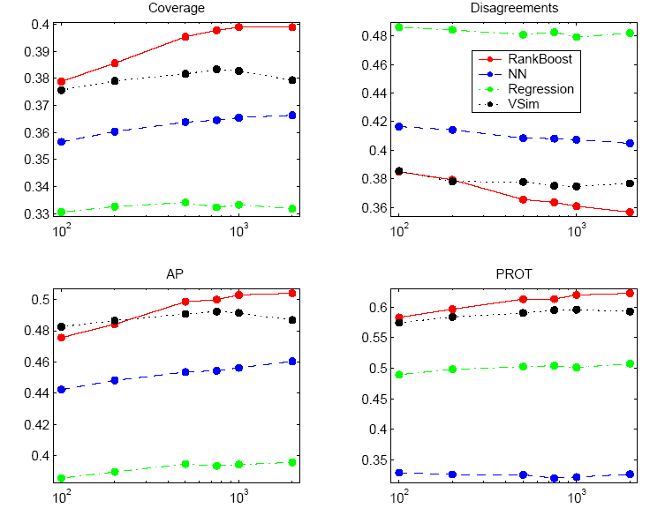
users

Slide 76
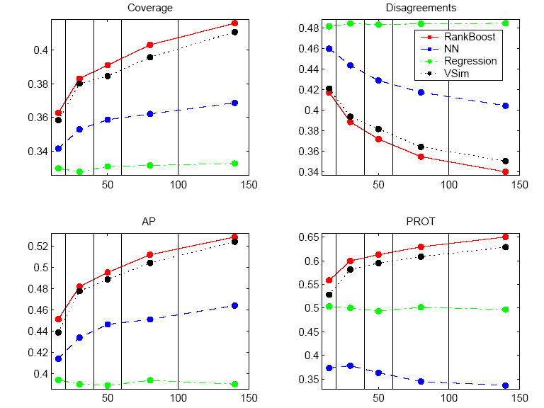
movies ranked/community member

Slide 77
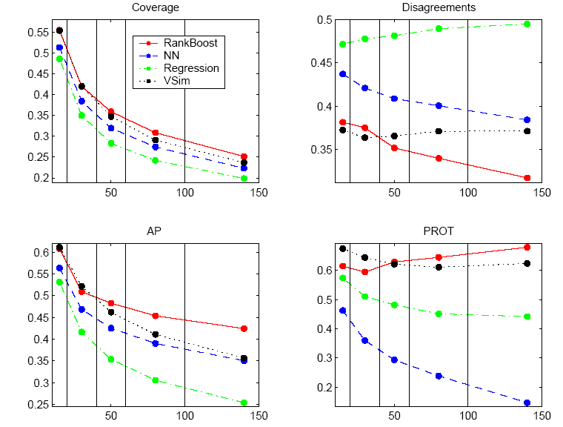
movies ranked by target user

Slide 78
Outline
Non-systematic survey of some CF systems
  CF as basis for a virtual community
  memory-based recommendation algorithms
  visualizing user-user via item distances
  CF versus content filtering
  Combining CF and content filtering
  CF as matching content and user
Algorithms for CF
  Ranking-based CF
  Probabilistic model-based CF
CF with different inputs
  true ratings
  assumed/implicit ratings

Slide 79
CF as density estimation
(Breese et al, UAI98)
Estimate Pr(R_{ij}=k) for each user i, movie j, and rating k
Use all available data to build model for this estimator
R_{ij} | Airplane | Matrix | Room with a View | ... | Hidalgo
Joe | 9 | 7 | 2 | ... | 7
Carol | 8 | ? | 9 | ... | ?
... | ... | ... | ... | ... | ...
Kumar | 9 | 3 | ? | ... | 6

Slide 80
CF as density estimation
(Breese et al, UAI98)
Estimate Pr(R_{ij}=k) for each user i, movie j, and rating k
Use all available data to build model for this estimator
A simple example:

Slide 81
CF as density estimation
(Breese et al, UAI98)
Estimate Pr(R_{ij}=k) for each user i, movie j, and rating k
Use all available data to build model for this estimator
More complex example:
  Group users into M “clusters”: c(1), ..., c(M)
  For movie j,
estimate by counts

Slide 82
CF as density estimation: BC
(Breese et al, UAI98)
Group users into clusters using Expectation-Maximization:
  Randomly initialize Pr(R_{m,j}=k) for each m
  (i.e., initialize the clusters differently somehow)
  E-Step: Estimate Pr(user i in cluster m) for each i,m
  M-Step: Find maximum likelihood (ML) estimator for R_{ij} within each cluster m
    Use ratio of #(users i in cluster m with rating R_{ij}=k) to #(user i in cluster m ), weighted by Pr(i in m) from E-step
  Repeat E-step, M-step until convergence

Slide 83
CF as density estimation: BC
(Breese et al, UAI98)
Aside: clustering-based density estimation is closely related to PageRank/HITS style web page recommendation.
Learning to Probabilistically Recognize Authoritative Documents, Cohn & Chang, ICML-2000.
  Let observed bibliographies be community “users”, and papers “items” to recommend
  Cluster bibliographies into “factors” (subcommunities, user clusters)
  Find top-ranked papers for each “factor” (top movies for each subcommunity/cluster)
    These are “authoritative” (likely to be cited)

Slide 84
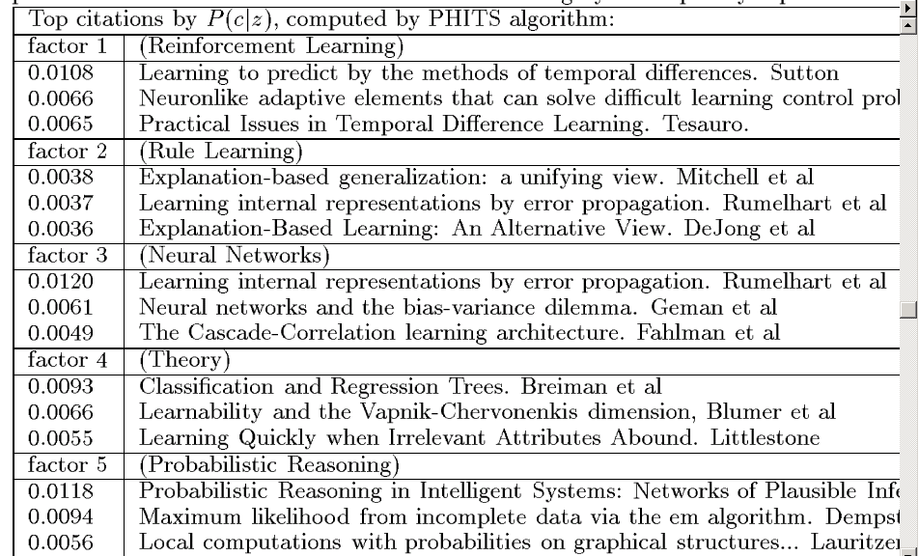

Slide 85
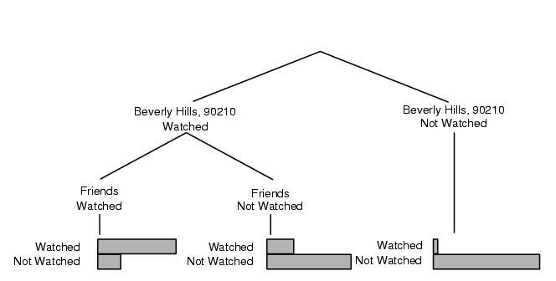
CF as density estimation: BN
(Breese et al, UAI98)
BC assumes movie ratings within a cluster are independent.
Bayes Network approach allows dependencies between ratings, but does not cluster. (Networks are constructed using greedy search.)
Pr(user i watched “Melrose Place”)

Slide 86
Algorithms for Collaborative Filtering 2: Memory-Based Algorithms (Breese et al, UAI98)
soccer score
golf score

Slide 87
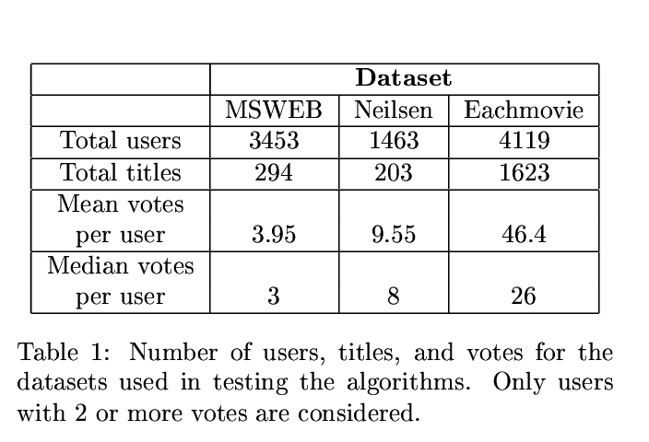
Datasets are different...
fewer items to recommend
fewer votes/user

Slide 88
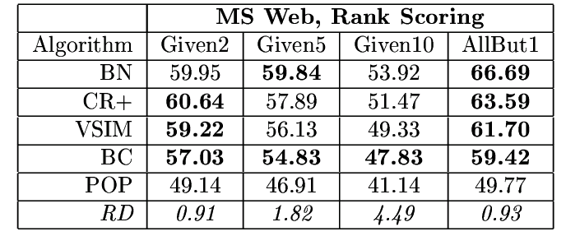
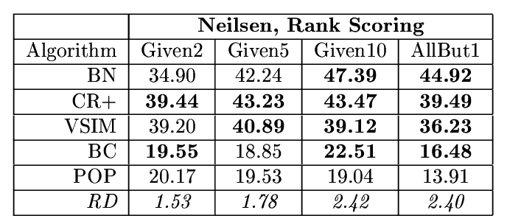
Results on MS Web & Nielson’s
soccer score
soccer score

Slide 89
Outline
Non-systematic survey of some CF systems
  CF as basis for a virtual community
  memory-based recommendation algorithms
  visualizing user-user via item distances
  CF versus content filtering
  Combining CF and content filtering
  CF as matching content and user
Algorithms for CF
  Ranking-based CF
  Probabilistic model-based CF
  Probabilistic memory-based CF?
CF with different inputs
  true ratings
  assumed/implicit ratings

Slide 90
Personality Diagnosis
(Pennock et al, UAI 2000)
Collaborative Filtering by Personality Diagnosis: A Hybrid Memory- and Model-Based Approach, Pennock, Horvitz, Lawrence & Giles, UAI 2000
Basic ideas:
  assume Gaussian noise applied to all ratings
  treat each user as a separate cluster m
  Pr(user a in cluster i) = w(a,i)

Slide 91
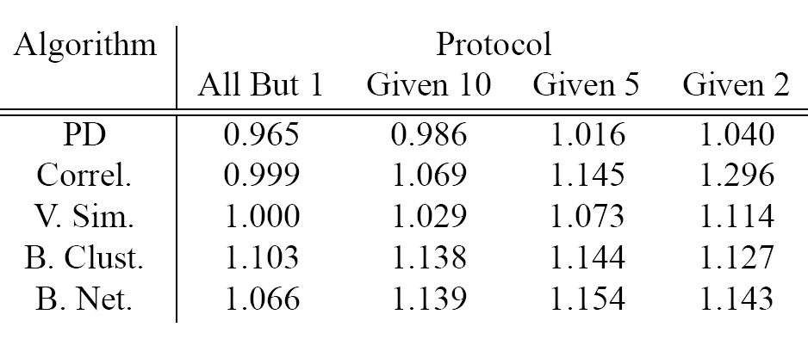
Personality Diagnosis
(Pennock et al, UAI 2000)
Evaluation (EachMovie, following Breese et al):

Slide 92
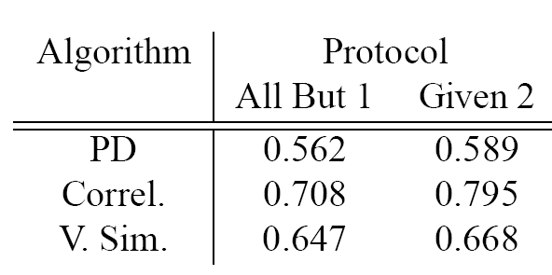
Personality Diagnosis
(Pennock et al, UAI 2000)
Evaluation (CiteSeer paper recommendation):

Slide 93
Outline
Non-systematic survey of some CF systems
  CF as basis for a virtual community
  memory-based recommendation algorithms
  visualizing user-user via item distances
  CF versus content filtering
  Combining CF and content filtering
  CF as matching content and user
Algorithms for CF
  Ranking-based CF
  Probabilistic model-based CF
  Probabilistic memory-based CF
CF with different inputs
  true ratings
  assumed/implicit ratings
  ratings inferred from Web pages

Slide 94
CF with pseudo-users
Web-Collaborative Filtering: Recommending Music by Crawling The Web, Cohen and Fan, WWW-2000
Goal: community filtering without a community
  Approximate community with information automatically extracted from web pages.
Outline:
  problem & baseline CF system
  creating “pseudo-users” from web pages
  CF results with “pseudo-users”

Slide 95
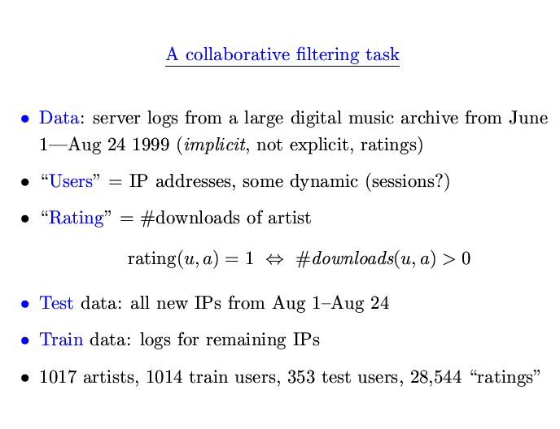

Slide 96
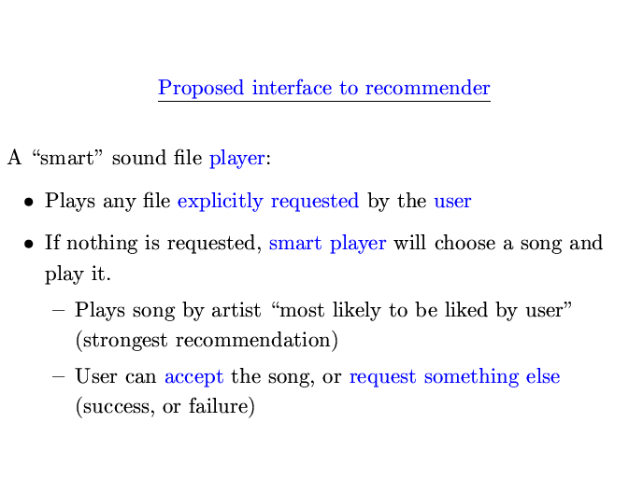

Slide 97
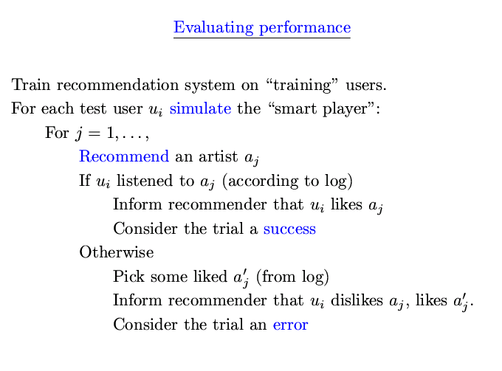

Slide 98
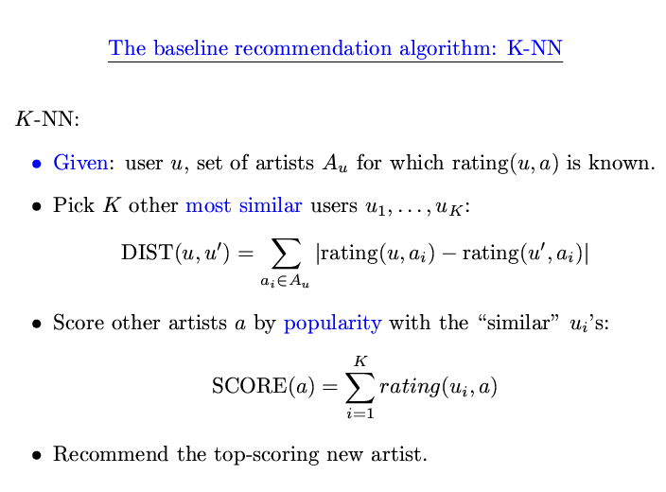

Slide 99
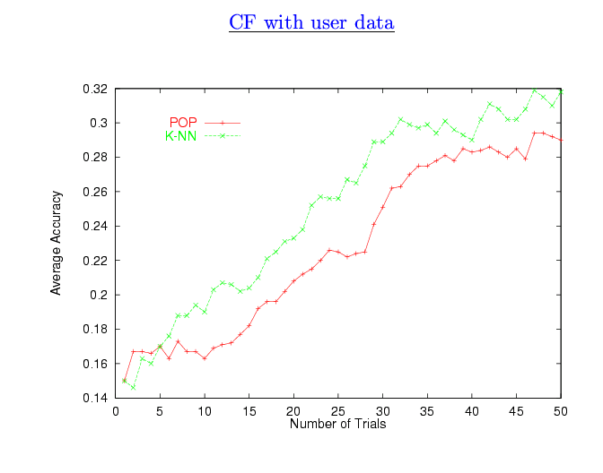

Slide 100
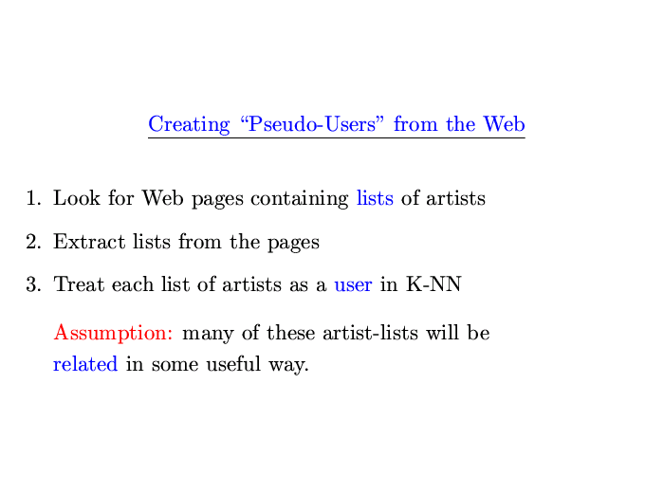

Slide 101
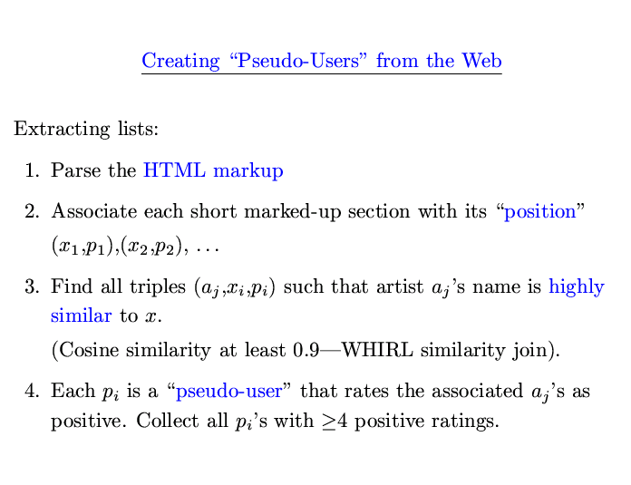

Slide 102


Slide 103


Slide 104


Slide 105


Slide 106


Slide 107


Slide 108


Slide 109


Slide 110


Slide 111


Slide 112


Slide 113


Slide 114


Slide 115
Outline
Non-systematic survey of some CF systems
  CF as basis for a virtual community
  memory-based recommendation algorithms
  visualizing user-user via item distances
  CF versus content filtering
Algorithms for CF
CF with different inputs
  true ratings
  assumed/implicit ratings
Conclusions/Summary

Slide 116
Tools for CF
Memory-based (CR, VSIM, k-NN, PD,matching)
Model-based (rules, BC, BN, boosting)
  Social vs content
  Hybrid social/content features
Probabilistic (PD, BN, BC, PLSA, LDA, ...)
  Independence assumptions made
Distance-based (matching, VSIM, k-NN, CR, PageRank)
  Features used
  Structures exploited
Ranking based
  RankBoost

Slide 117
Summary
BN
RIPPER +
hybrid
features
RIPPER
model-based
LIBRA
RankBoost
(many rounds)
LIBRA-NR
music rec.
with web pages
(XDB)
BC
RankBoost
(k rounds)
PD
memory-based
CR
music rec.
with web pages
(k-NN)
VSIM
k-NN
paper rec.
as matching
MovieRecommender
collaborative/social
content-based

Slide 118
Other issues, not addressed much
Combining and weighting different types of information sources
  How much is a web page link worth vs a link in a newsgroup?
Spamming—how to prevent vendors from biasing results?
Efficiency issues—how to handle a large community?
What do we measure when we evaluate CF?
  Predicting actual rating may be useless!
  Example: music recommendations:
    Beatles, Eric Clapton, Stones, Elton John, Led Zep, the Who, ...
  What’s useful and new? for this need model of user’s prior knowledge, not just his tastes.
    Subjectively better recs result from “poor” distance metrics

Slide 119
Final Comments
CF is one of a handful of learning-related tools that have had broadly visible impact:
  Google, TIVO, Amazon, personal radio stations, ...
Critical tool for finding “consensus information” present in a large community (or large corpus of web pages, or large DB of purchase records, ....)
  Similar in some respects to Q/A with corpora
Science is relatively-well established
  in certain narrow directions, on a few datasets
Set of applications still being expanded
Some resources:
  http://www.sims.berkeley.edu/resources/collab/
  http://www.cs.umn.edu/Research/GroupLens/
  http://www.cis.upenn.edu/~ungar/CF/

