Slide 1
TalkTextify: An Azure-Driven Speech Recognition System
B.Tech CSE Project | Speech and Language Processing

Slide 2
Introduction
TalkTextify is an advanced speech recognition system leveraging Azure Speech and Translator APIs. It allows for real-time speech-to-text conversion and translation into multiple languages.

Slide 3
Technologies Used
- Azure Cognitive Services: Speech and Translator APIs
- Python for backend logic
- Streamlit for web-based interface
- CSS for custom styling

Slide 4
Key Features
- Real-time speech-to-text conversion
- Support for multiple languages
- Integration with Azure Translator for text translation
- Transcription history with save functionality

Slide 5
Technical Overview
The application uses Azure's Speech SDK to capture and transcribe speech. It employs REST APIs for translation and Streamlit to provide an interactive user interface.

Slide 6
Azure Speech API
Azure Speech SDK enables real-time speech recognition. Configuration involves:
- Setting up a subscription key and region
- Choosing the desired language for transcription
- Capturing audio via default microphone

Slide 7
Azure Translator API
Azure Translator is used for text translation:
- Supports multiple target languages
- API setup with subscription key and endpoint
- REST API integration for seamless translations

Slide 8
Language Support
Languages currently supported:
- English
- Hindi
- Spanish
- French
- Russian
- Japanese

Slide 9
Streamlit Interface
Streamlit is used for creating an interactive web application:
- Customizable UI with CSS
- Language selector for transcription
- Buttons for recording, translating, and saving

Slide 10
CSS Customizations
The application includes a dark-themed interface with:
- Gradient backgrounds
- Animated history cards
- Styled buttons and text areas for a modern look

Slide 11
Challenges Faced
- Ensuring real-time performance with Azure APIs
- Handling diverse language inputs and translations
- Implementing responsive UI with Streamlit and CSS

Slide 12
Demonstration
Workflow:
1. User selects language and starts speaking
2. Speech is transcribed in real-time
3. Transcription is translated and displayed
4. Transcription history is maintained

Slide 13
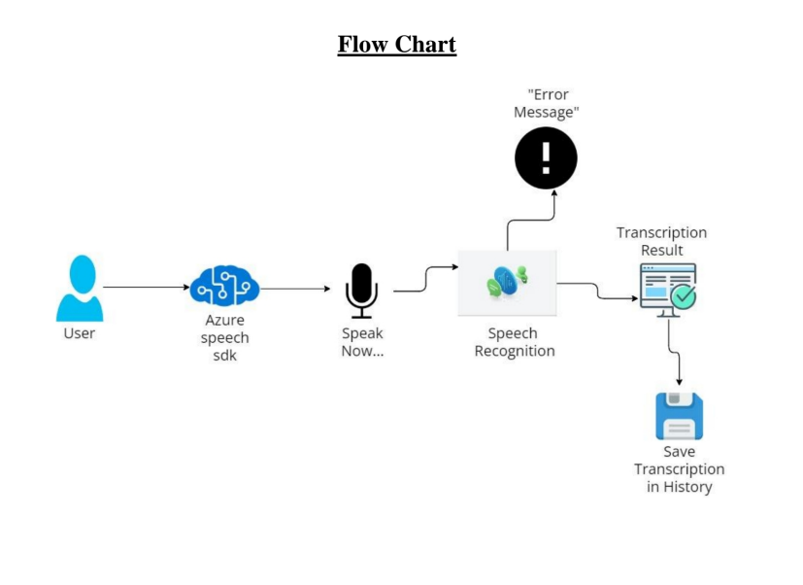

Slide 14
Results and Outputs
The system provides accurate speech-to-text conversion and seamless translations. Users can save and revisit transcriptions.

Slide 15
Conclusion
TalkTextify demonstrates the potential of Azure Cognitive Services for real-time speech recognition and translation. It simplifies communication across languages and serves as a versatile tool for diverse applications.

Slide 16
Future Work
- Adding more languages for transcription and translation
- Enhancing UI/UX for better accessibility
- Exploring offline capabilities for speech recognition

