Slide 1
1st Malaviya Research Conclave-2017
Madan Mohan Malaviya Univ. of Technology, Gorakhpur
8-11 JULY, 2017
OBJECTIVES:
To Interact with researchers, academicians and technologists of renowned institutions of India and abroad through expert talk/lectures to be aware of ongoing research activities, challenges in various research areas across the world.
Open panel discussions on “Research in India: Key Issues & Challenges” with researchers, academicians and technologists with the University faculties, research scholars and M.Tech. students.
Focused interaction with faculties, research scholars and M.Tech. students with specialized disciplines of various departments.
Interactions through the poster presentation/exhibition/discussions with research scholars and M.Tech. students in their respective research area.

Slide 2
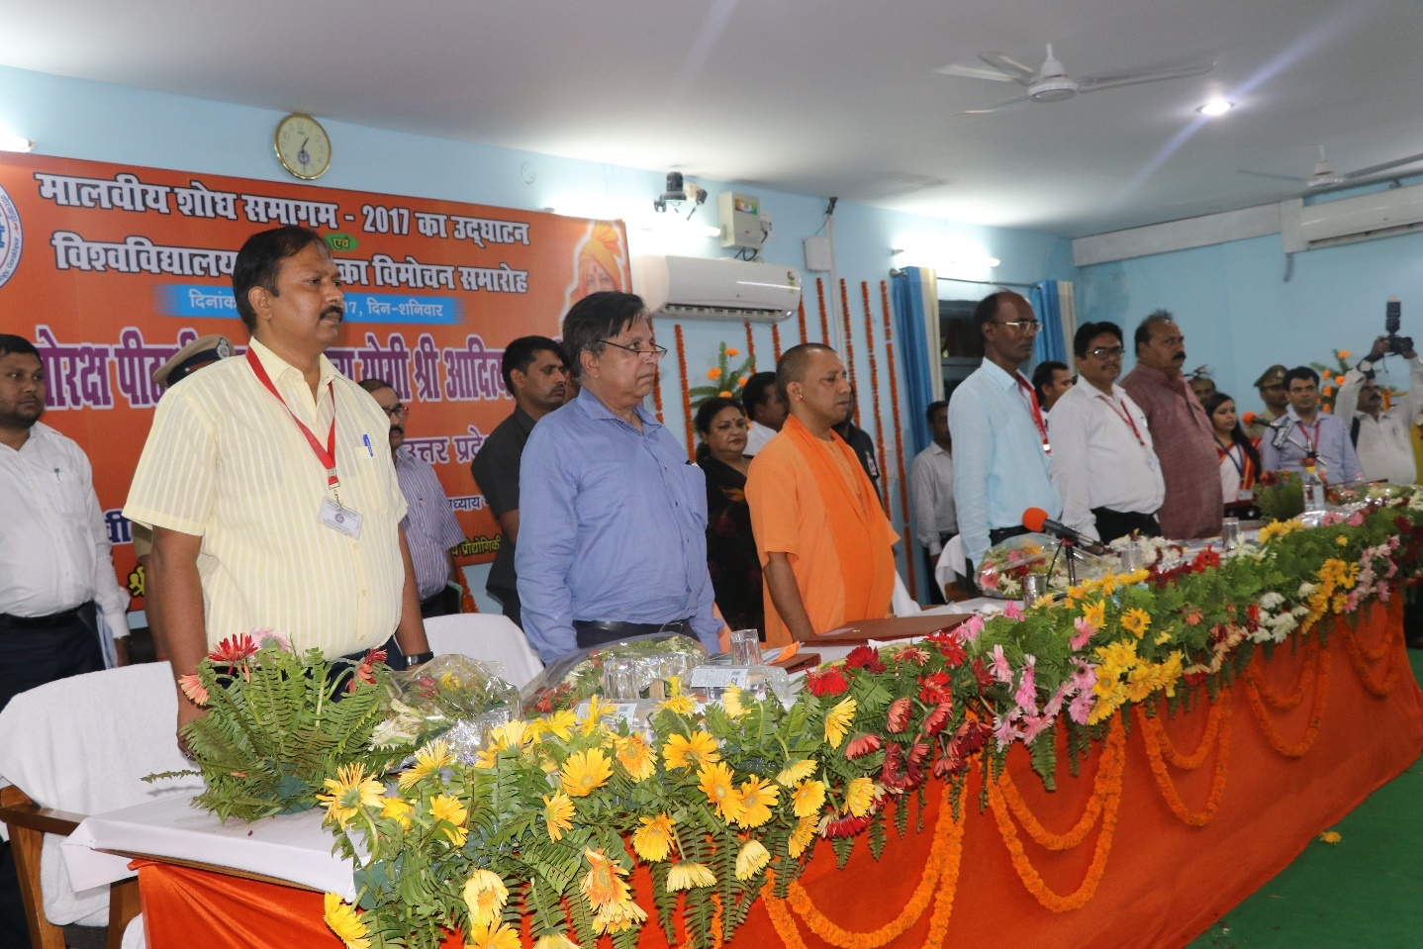
By Honourable Chief Minister Sri Yogi Adityanath Govt. of Uttar Pradesh
Inaugurated

Slide 3
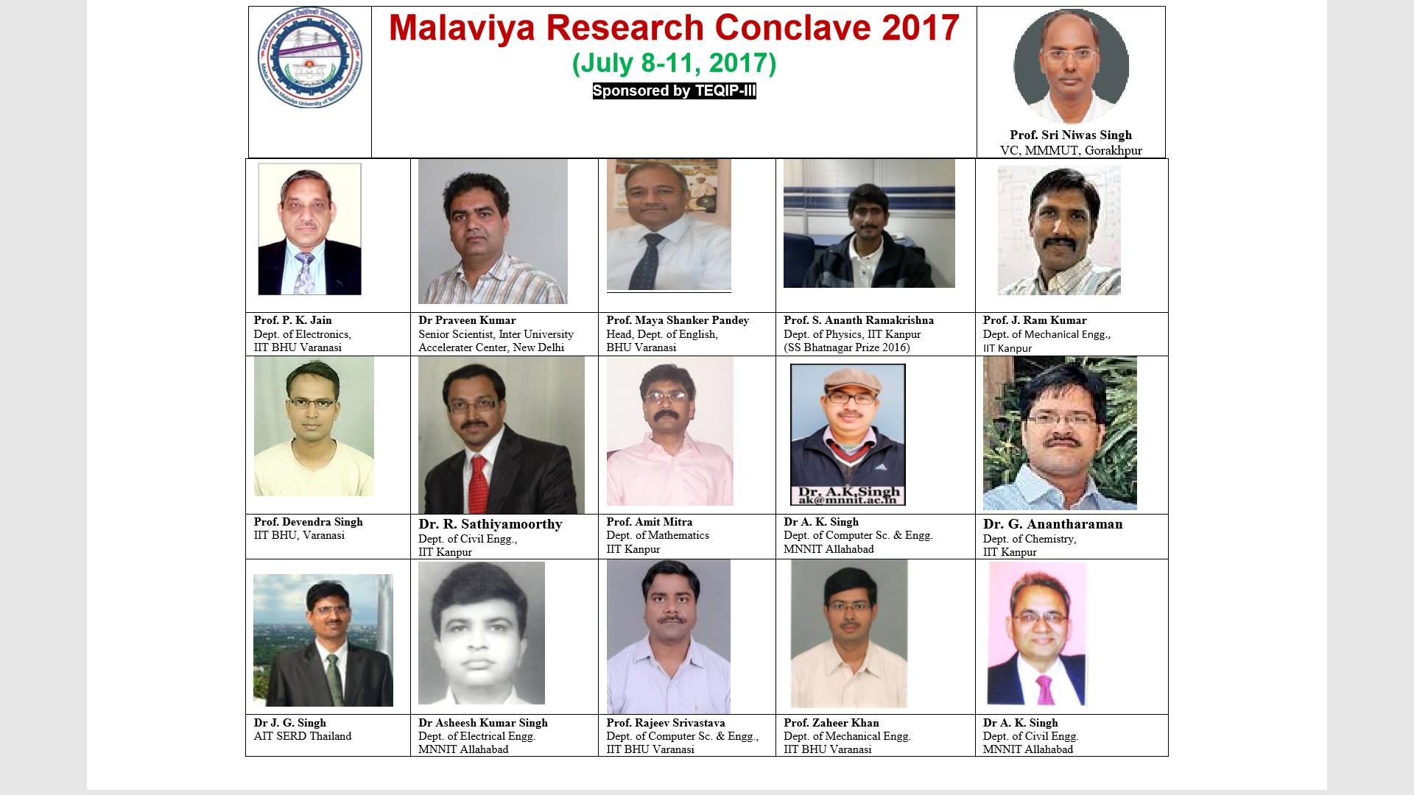

Slide 4
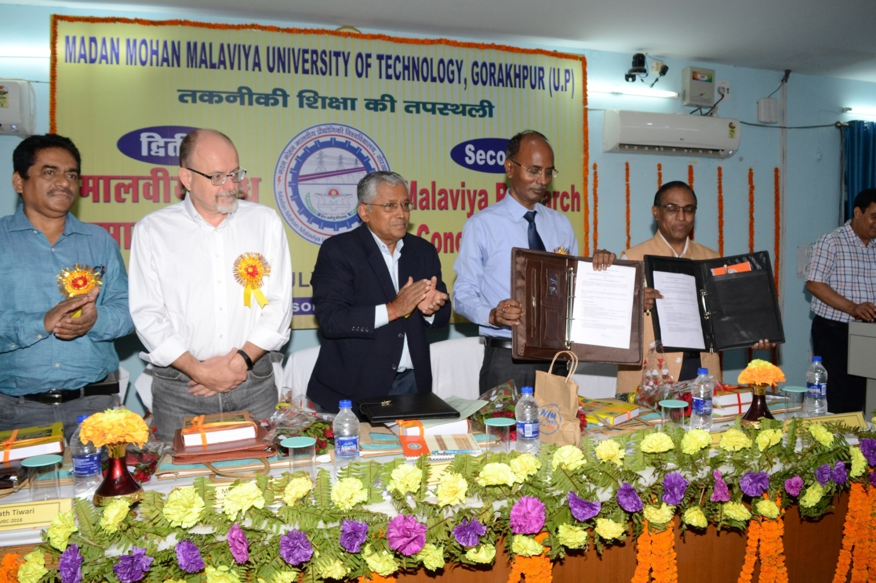
SECOND
Malaviya Research Conclave-2018
6-8 JULY, 2018

Slide 5
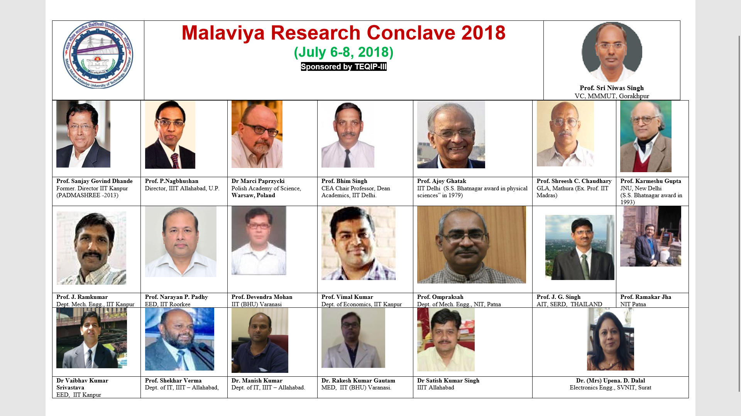
RESOURCE PERSONS

Slide 6
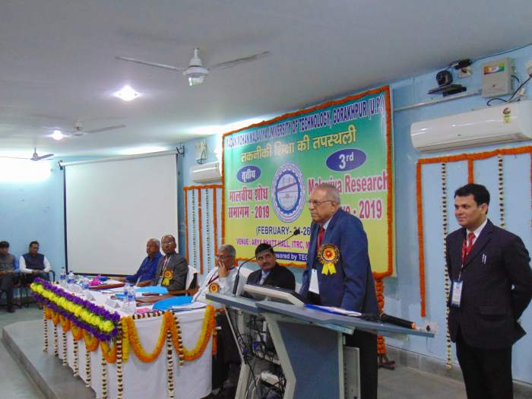
Third
Malaviya Research Conclave-2019
February 24-26, 2019

Slide 7
