Slide 1
Peer Instruction
I pose a challenge question (usually multiple choice), which will help solidify understanding of topics we have studied
Might not just be one correct answer
You each get some time (1-2 minutes) to come up with your answer and vote – use Mentimeter
Then you get some time to convince your group (neighbors) why you think you are right (2-3 minutes)
Learn from and teach each other!
You vote again. May change your vote if you want.
We discuss together the different responses, show the votes, give you opportunity to justify your thinking, and give you further insights

Slide 2
Peer Instruction (PI) Why
Studies show this approach improves learning
Learn by doing, discussing, and teaching each other
Curse of knowledge/expert blind-spot
Compared to talking with a peer who just figured it out and who can explain it in your own jargon
You never really know something until you can teach it to someone else – More improved learning!
Just as important to understand why wrong answers are wrong, or how they could be changed to be right.
Learn to reason about your thinking and answers
More enjoyable - You are involved and active in the learning

Slide 3
How Groups Interact
Best if group members have different initial answers
3 is the “magic” group number
You can self-organize "on-the-fly" or sit together specifically to be a group
Can go 2-4 on a given day to make sure everyone is involved
Teach and learn from each other: Discuss, reason, articulate
If you know the answer, listen to where colleagues are coming from first, then be a great humble teacher, you will also learn by doing that, and you’ll be on the other side in the future
I can’t do that as well because every small group has different misunderstandings and you get to focus on your particular questions
Be ready to justify to the class your vote and justifications!

Slide 4
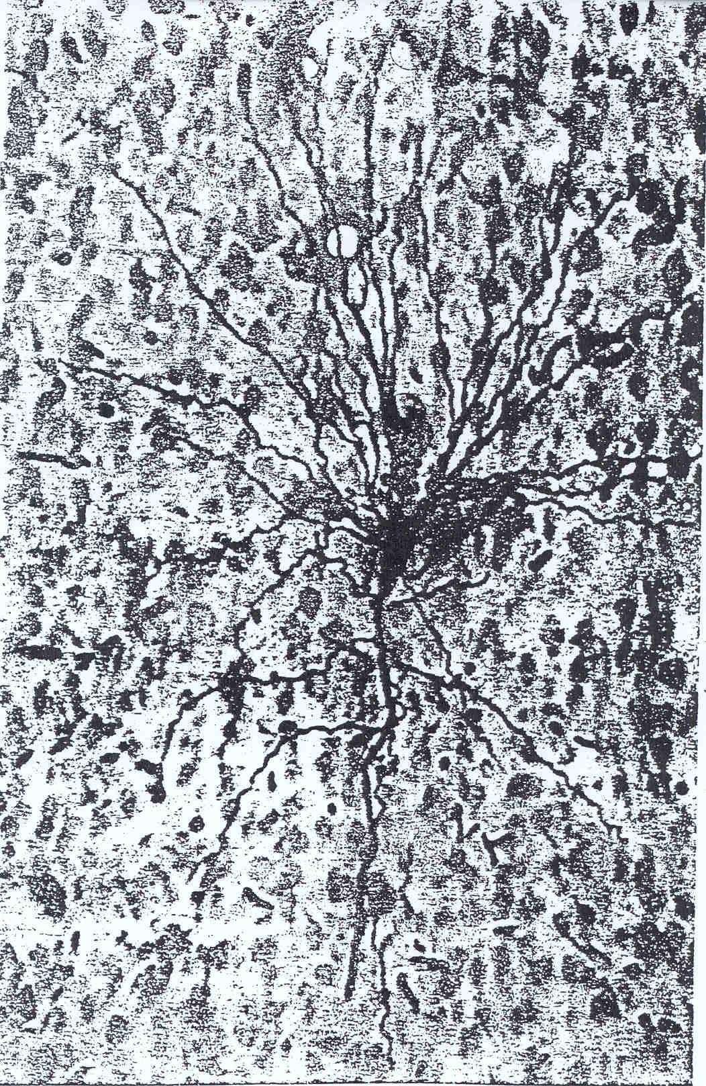

Slide 5
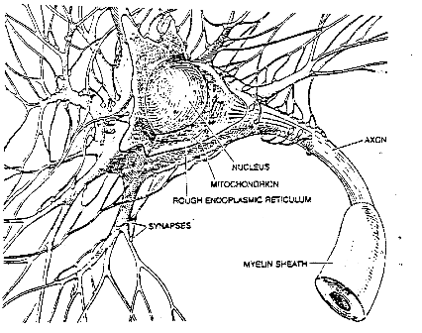
Basic Neuron

Slide 6
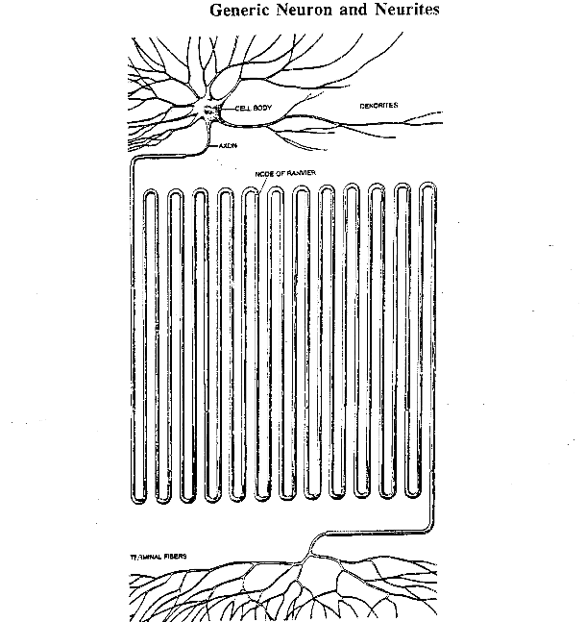
Expanded Neuron

Slide 7
Perceptron Learning Algorithm
First neural network learning model in the 1960’s
Simple and limited (single layer models)
Basic concepts are similar for multi-layer models so this is a good learning tool
Still used in many current applications (modems, etc.)

Slide 8

Perceptron Node – Threshold Logic Unit
x₁
w₁
x₂
w₂
$$θ$$
z
x_{n}
w_{n}

Slide 9
Perceptron Node – Threshold Logic Unit
x₁
w₁
x₂
w₂
$$θ$$
z
x_{n}
w_{n}
Learn weights such that an objective function is maximized.
What objective function should we use?
What learning algorithm should we use?
Notes:
What parameters and objective function

Slide 10
Perceptron Learning Algorithm
x₁
.4
.1
z
x₂
-.2
x₁
x₂
t
.8
.3
1
.4
.1
0

Slide 11
First Training Instance
.8
.4
.1
z
=1
.3
-.2
net = .8*.4 + .3*-.2 = .26
x₁
x₂
t
.8
.3
1
.4
.1
0

Slide 12
Second Training Instance
.4
.4
.1
z
=1
.1
-.2
net = .4*.4 + .1*-.2 = .14
x₁
x₂
t
.8
.3
1
Δw_{i} =
(t - z)
∗ c
∗ x_{i}
.4
.1
0

Slide 13
Perceptron Rule Learning
Δw_{i} = c(t – z) x_{i}
Where w_{i} is the weight from input i to perceptron node, c is the learning rate, t is the target for the current instance, z is the current output, and x_{i} is i^{th} input
Least perturbation principle
Only change weights if there is an error
small c rather than changing weights sufficient to make current pattern correct
Scale by x_{i}
Create a perceptron node with n inputs
Iteratively apply a pattern from the training set and apply the perceptron rule
Each iteration through the training set is an epoch
Continue training until total training set error ceases to improve
Perceptron Convergence Theorem: Guaranteed to find a solution in finite time if a solution exists
Notes:
Author uses y-t and thus negates the delta w

Slide 14
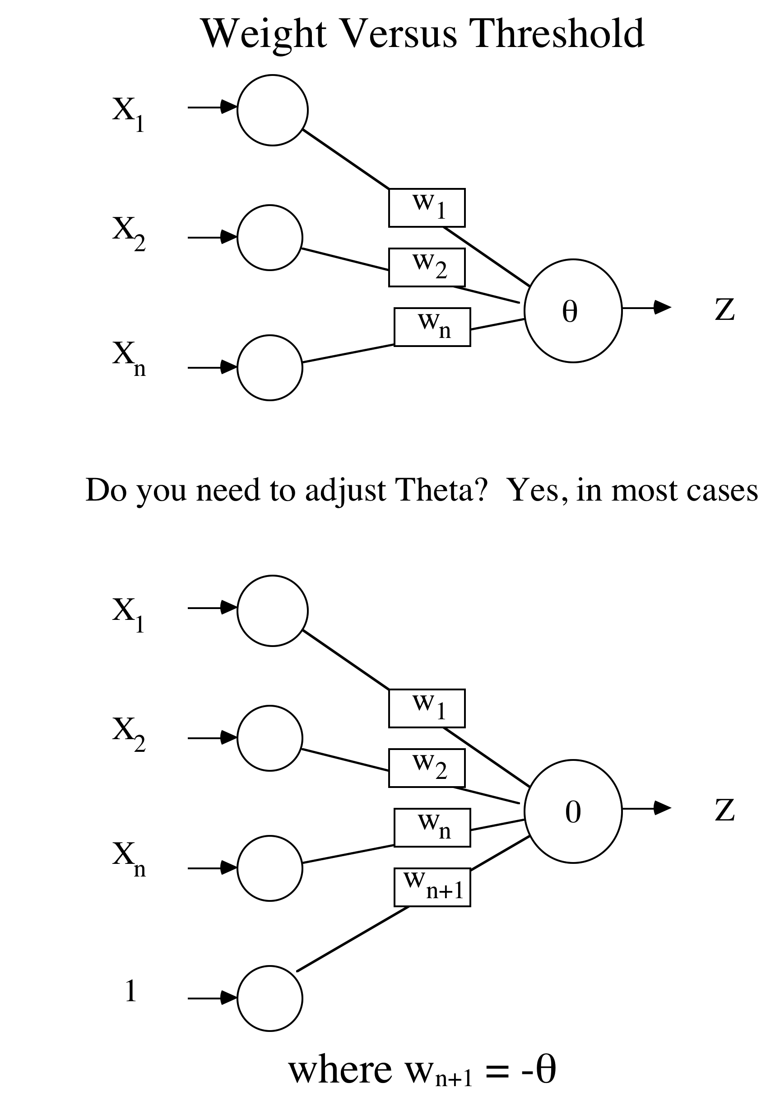

Slide 15
Augmented Pattern Vectors
1 0 1 -> 0
1 0 0 -> 1
Augmented Version
1 0 1 1 -> 0
1 0 0 1 -> 1
Treat threshold like any other weight. No special case. Call it a bias since it biases the output up or down.
Since we start with random weights anyways, can ignore the -θ notion, and just think of the bias as an extra available weight. (note the author uses a -1 input)
Always use a bias weight
Notes:
Author uses -1 into bias, any real difference (back to being a threshold weight), but since starts random anyway, will make no difference, though the final weight will be negated by comparison

Slide 16
Perceptron Rule Example
Assume a 3 input perceptron plus bias (it outputs 1 if net > 0, else 0)
Assume a learning rate c of 1 and initial weights all 0: Δw_{i} = c(t – z) x_{i}
Training set 0 0 1 -> 0
1 1 1 -> 1
1 0 1 -> 1
0 1 1 -> 0
Pattern Target Weight Vector Net Output ΔW
0 0 1 1 0 0 0 0 0

Slide 17
Example
Assume a 3 input perceptron plus bias (it outputs 1 if net > 0, else 0)
Assume a learning rate c of 1 and initial weights all 0: Δw_{i} = c(t – z) x_{i}
Training set 0 0 1 -> 0
1 1 1 -> 1
1 0 1 -> 1
0 1 1 -> 0
Pattern Target Weight Vector Net Output ΔW
0 0 1 1 0 0 0 0 0 0 0 0 0 0 0
1 1 1 1 1 0 0 0 0

Slide 18
Example
Assume a 3 input perceptron plus bias (it outputs 1 if net > 0, else 0)
Assume a learning rate c of 1 and initial weights all 0: Δw_{i} = c(t – z) x_{i}
Training set 0 0 1 -> 0
1 1 1 -> 1
1 0 1 -> 1
0 1 1 -> 0
Pattern Target Weight Vector Net Output ΔW
0 0 1 1 0 0 0 0 0 0 0 0 0 0 0
1 1 1 1 1 0 0 0 0 0 0 1 1 1 1
1 0 1 1 1 1 1 1 1

Slide 19
**Challenge Question** - Perceptron
Assume a 3 input perceptron plus bias (it outputs 1 if net > 0, else 0)
Assume a learning rate c of 1 and initial weights all 0: Δw_{i} = c(t – z) x_{i}
Training set 0 0 1 -> 0
1 1 1 -> 1
1 0 1 -> 1
0 1 1 -> 0
Pattern Target Weight Vector Net Output ΔW
0 0 1 1 0 0 0 0 0 0 0 0 0 0 0
1 1 1 1 1 0 0 0 0 0 0 1 1 1 1
1 0 1 1 1 1 1 1 1
Once this converges the final weight vector will be
1 1 1 1
-1 0 1 0
0 0 0 0
1 0 0 0
None of the above

Slide 20
Example
Assume a 3 input perceptron plus bias (it outputs 1 if net > 0, else 0)
Assume a learning rate c of 1 and initial weights all 0: Δw_{i} = c(t – z) x_{i}
Training set 0 0 1 -> 0
1 1 1 -> 1
1 0 1 -> 1
0 1 1 -> 0
Pattern Target Weight Vector Net Output ΔW
0 0 1 1 0 0 0 0 0 0 0 0 0 0 0
1 1 1 1 1 0 0 0 0 0 0 1 1 1 1
1 0 1 1 1 1 1 1 1 3 1 0 0 0 0
0 1 1 1 0 1 1 1 1

Slide 21
Example
Assume a 3 input perceptron plus bias (it outputs 1 if net > 0, else 0)
Assume a learning rate c of 1 and initial weights all 0: Δw_{i} = c(t – z) x_{i}
Training set 0 0 1 -> 0
1 1 1 -> 1
1 0 1 -> 1
0 1 1 -> 0
Pattern Target Weight Vector Net Output ΔW
0 0 1 1 0 0 0 0 0 0 0 0 0 0 0
1 1 1 1 1 0 0 0 0 0 0 1 1 1 1
1 0 1 1 1 1 1 1 1 3 1 0 0 0 0
0 1 1 1 0 1 1 1 1 3 1 0 -1 -1 -1
0 0 1 1 0 1 0 0 0

Slide 22
Example
Assume a 3 input perceptron plus bias (it outputs 1 if net > 0, else 0)
Assume a learning rate c of 1 and initial weights all 0: Δw_{i} = c(t – z) x_{i}
Training set 0 0 1 -> 0
1 1 1 -> 1
1 0 1 -> 1
0 1 1 -> 0
Pattern Target Weight Vector Net Output ΔW
0 0 1 1 0 0 0 0 0 0 0 0 0 0 0
1 1 1 1 1 0 0 0 0 0 0 1 1 1 1
1 0 1 1 1 1 1 1 1 3 1 0 0 0 0
0 1 1 1 0 1 1 1 1 3 1 0 -1 -1 -1
0 0 1 1 0 1 0 0 0 0 0 0 0 0 0
1 1 1 1 1 1 0 0 0 1 1 0 0 0 0
1 0 1 1 1 1 0 0 0 1 1 0 0 0 0
0 1 1 1 0 1 0 0 0 0 0 0 0 0 0
Notes:
Note it is the relative weight values which make the difference. If we multiply all final weights by a constant ( e.g. ,1) we still get the same results. For perceptron same as if the initial learning rate had been .1,
How would it generalize to novel. Show examples

Slide 23
Perceptron Homework
Assume a 3 input perceptron plus bias (it outputs 1 if net > 0, else 0)
Assume a learning rate c of 1 and initial weights all 1: Δw_{i} = c(t – z) x_{i}
Show weights after each pattern for just one epoch
Training set 1 0 1 -> 0
1 1 0 -> 0
1 0 1 -> 1
0 1 1 -> 1
Pattern Target Weight Vector Net Output ΔW
1 1 1 1

Slide 24
Training Sets and Noise
Assume a Probability of Error at each bit
0 0 1 0 1 1 0 0 1 1 0 -> 0 1 1 0
i.e. P(error) = .05
Or a probability that the algorithm is applied wrong (opposite) occasionally
Averages out over learning

Slide 25
If no bias weight then the hyperplane must go through the origin
Notes:
What if no bias?

Slide 26
Linear Separability

Slide 27
Linear Separability and Generalization
When is data noise vs. a legitimate exception

Slide 28
Limited Functionality of Hyperplane

Slide 29
How to Handle Multi-Class Output
This is an issue with any learning model which only supports binary classification (perceptron, SVM, etc.)
Create 1 perceptron for each output class, where the training set considers all other classes to be negative examples
Run all perceptrons on novel data and set the output to the class of the perceptron which outputs high
If there is a tie, choose the perceptron with the highest net value
Create 1 perceptron for each pair of output classes, where the training set only contains examples from the 2 classes
Run all perceptrons on novel data and set the output to be the class with the most wins (votes) from the perceptrons
In case of a tie, use the net values to decide
Number of models grows by the square of the output classes
Notes:
Use next slide as example

Slide 30
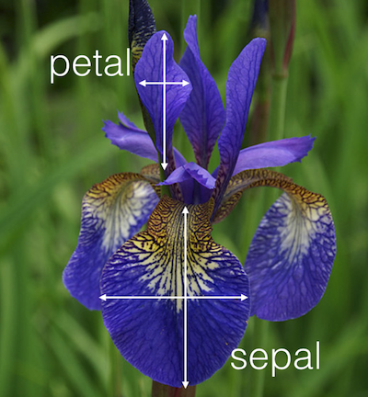
UC Irvine Machine Learning Data Base Iris Data Set
4.8,3.0,1.4,0.3, Iris-setosa
5.1,3.8,1.6,0.2, Iris-setosa
4.6,3.2,1.4,0.2, Iris-setosa
5.3,3.7,1.5,0.2, Iris-setosa
5.0,3.3,1.4,0.2, Iris-setosa
7.0,3.2,4.7,1.4, Iris-versicolor
6.4,3.2,4.5,1.5, Iris-versicolor
6.9,3.1,4.9,1.5, Iris-versicolor
5.5,2.3,4.0,1.3, Iris-versicolor
6.5,2.8,4.6,1.5, Iris-versicolor
6.0,2.2,5.0,1.5, Iris-viginica
6.9,3.2,5.7,2.3, Iris-viginica
5.6,2.8,4.9,2.0, Iris-viginica
7.7,2.8,6.7,2.0, Iris-viginica
6.3,2.7,4.9,1.8, Iris-viginica

Slide 31
Objective Functions: Accuracy/Error
How do we judge the quality of a particular model (e.g. Perceptron with a particular setting of weights)
Consider how accurate the model is on the data set
Classification accuracy = # Correct/Total instances
Classification error = # Misclassified/Total instances (= 1 – acc)
Usually minimize a Loss function (aka cost, error)
For real valued outputs and/or targets
Pattern error = Target – output: Errors could cancel each other
Σ|t_{i} – z_{i}| (L1 loss)
Common approach is Squared Error = Σ(t_{i} – z_{i})² (L2 loss)
Total sum squared error = Σ pattern sqaured errors = Σ Σ (t_{i} – z_{i})²
For nominal data, pattern error is typically 1 for a mismatch and 0 for a match
For nominal (including binary) output and targets, SSE and classification error are equivalent
Notes:
L2 some mathematical advantages with derivative, etc.

Slide 32
Mean Squared Error
Mean Squared Error (MSE) – SSE/n where n is the number of instances in the data set
This can be nice because it normalizes the error for data sets of different sizes
MSE is the average squared error per pattern
Root Mean Squared Error (RMSE) – is the square root of the MSE
This puts the error value back into the same units as the features and can thus be more intuitive
Since we squared the error on the SSE
RMSE is the average distance (error) of targets from the outputs in the same scale as the features

Slide 33
**Challenge Question** - Error
Given the following data set, what is the L1 (Σ|t_{i} – z_{i}|), SSE/L2 (Σ(t_{i} – z_{i})²), MSE, and RMSE error for the entire data set?
x | y | Output | Target | Data Set
2 | -3 | 1 | 1
0 | 1 | 0 | 1
.5 | .6 | .8 | .2
L1 |  |  |  | x
SSE |  |  |  | x
MSE |  |  |  | x
RMSE |  |  |  | x
.4 1 1 1
1.6 2.36 1 1
.4 .64 .21 0.46
1.6 1.36 .68 .82
None of the above

Slide 34
**Challenge Question** - Error
Given the following data set, what is the L1 (Σ|t_{i} – z_{i}|), SSE/L2 (Σ(t_{i} – z_{i})²), MSE, and RMSE error for the entire data set?
x | y | Output | Target | Data Set
2 | -3 | 1 | 1
0 | 1 | 0 | 1
.5 | .6 | .8 | .2
L1 |  |  |  | 1.6
SSE |  |  |  | 1.36
MSE |  |  |  | 1.36/3 = .45
RMSE |  |  |  | .45^.5 = .67
.4 1 1 1
1.6 2.36 1 1
.4 .64 .21 0.46
1.6 1.36 .68 .82
None of the above

Slide 35
SSE Homework
Given the following data set, what is the L1, SSE (L2), MSE, and RMSE error of Output1, Output2, and the entire data set? Fill in cells that have an x.
x | y | Output1 | Target1 | Output2 | Target 2 | Data Set
-1 | -1 | 0 | 1 | .6 | 1.0
-1 | 1 | 1 | 1 | -.3 | 0
1 | -1 | 1 | 0 | 1.2 | .5
1 | 1 | 0 | 0 | 0 | -.2
L1 |  | x |  | x |  | x
SSE |  | x |  | x |  | x
MSE |  | x |  | x |  | x
RMSE |  | x |  | x |  | x

Slide 36
Gradient Descent Learning: Minimize (Maximze) the Objective Function
Error Landscape
SSE:
Sum Squared
Error
Σ (t_{i} – z_{i})²
0
Weight Values
Notes:
How could you create such a graph – Sample, too many weight settings to completely fill in in general, but the abstract notion is important

Slide 37
Deriving a Gradient Descent Learning Algorithm
Goal is to decrease overall error (or other objective function) each time a weight is changed
Total Sum Squared error one possible objective function E: Σ (t_{i} – z_{i})²
Seek a weight changing algorithm such that is negative
If a formula can be found then we have a gradient descent learning algorithm
Delta rule is a variant of the perceptron rule which gives a gradient descent learning algorithm with perceptron nodes

Slide 38
Delta rule algorithm
Delta rule uses (target - net) before the net value goes through the threshold in the learning rule to decide weight update
Weights are updated even when the output would be correct
Because this model is single layer and because of the SSE objective function, the error surface is guaranteed to be parabolic with only one minima
Learning rate
If learning rate is too large can jump around global minimum
If too small, will work, but will take a longer time
Can decrease learning rate over time to give higher speed and still attain the global minimum (although exact minimum is still just for training set and thus…)
Notes:
Still uses threshold logic (perceptron) node

Slide 39
Batch vs Stochastic Update
To get the true gradient with the delta rule, we need to sum errors over the entire training set and only update weights at the end of each epoch
Batch (gradient) vs stochastic (on-line, incremental)
With the stochastic delta rule algorithm, you update after every pattern, just like with the perceptron algorithm (even though that means each change may not be exactly along the true gradient)
Stochastic is more efficient and best to use in almost all cases, though not all have figured it out yet
We’ll take about this a little bit when we get to Backpropagation

Slide 40
Perceptron rule vs Delta rule
Perceptron rule (target - thresholded output) guaranteed to converge to a separating hyperplane if the problem is linearly separable. Otherwise may not converge – could get in cycle
Singe layer Delta rule guaranteed to have only one global minimum. Thus it will converge to the best SSE solution whether the problem is linearly separable or not.
Could have a higher misclassification rate than with the perceptron rule and a less intuitive decision surface – we will discuss this later with regression
Stopping Criteria – For these models stop when no longer making progress
When you have gone a few epochs with no significant improvement/change between epochs (including oscillations)

Slide 42
Linearly Separable Boolean Functions
d = # of dimensions

Slide 43
Linearly Separable Boolean Functions
d = # of dimensions
P = 2^{d} = # of Patterns

Slide 44
Linearly Separable Boolean Functions
d = # of dimensions
P = 2^{d} = # of Patterns
2^{P} = 2^{2d}= # of Functions
n Total Functions Linearly Separable Functions
0 2 2
1 4 4
2 16 14
Notes:
Show funcitons board

Slide 45
Linearly Separable Boolean Functions
d = # of dimensions
P = 2^{d} = # of Patterns
2^{P} = 2^{2d}= # of Functions
n Total Functions Linearly Separable Functions
0 2 2
1 4 4
2 16 14
3 256 104
4 65536 1882
5 4.3 × 10⁹ 94572
6 1.8 × 10¹⁹ 1.5 × 10⁷
7 3.4 × 10³⁸ 8.4 × 10⁹

Slide 47
Linear Models which are Non-Linear in the Input Space
So far we have used
We could preprocess the inputs in a non-linear way and do
To the perceptron algorithm it looks just the same and can use the same learning algorithm, it just has different inputs - SVM
For example, for a problem with two inputs x and y (plus the bias), we could also add the inputs x², y², and x·y
The perceptron would just think it is a 5 dimensional task, and it is linear in those 5 dimensions
But what kind of decision surfaces would it allow for the original 2-d input space?
Notes:
Draw on board

Slide 48
Quadric Machine
All quadratic surfaces (2nd order)
ellipsoid
parabola
etc.
That significantly increases the number of problems that can be solved
But still many problem which are not quadrically separable
Could go to 3rd and higher order features, but number of possible features grows exponentially
Multi-layer neural networks will allow us to discover high-order features automatically from the input space

Slide 49
Simple Quadric Example
-3 -2 -1 0 1 2 3
f₁
Perceptron with just feature f₁ cannot separate the data
Could we add a transformed feature to our perceptron?

Slide 50
Simple Quadric Example
-3 -2 -1 0 1 2 3
f₁
Perceptron with just feature f₁ cannot separate the data
Could we add a transformed feature to our perceptron?
f₂ = f₁²

Slide 51
Simple Quadric Example
f₂
-3 -2 -1 0 1 2 3
-3 -2 -1 0 1 2 3
f₁
f₁
Perceptron with just feature f₁ cannot separate the data
Could we add another feature to our perceptron f₂ = f₁²
Note could also think of this as just using feature f₁ but now allowing a quadric surface to separate the data
Notes:
Note didn’t need feature f1 in this case, just f1^2 (not all combinations needed). Perceptron would learn to ignore f1 and just use f2

Slide 52
Quadric Machine Homework
Assume a 2 input perceptron expanded to be a quadric perceptron (it outputs 1 if net > 0, else 0). Note that with binary inputs of -1, 1, that x² and y² would always be 1 and thus do not add info and are not needed (they would just act like two more bias weights)
Assume a learning rate c of .4 and initial weights all 0: Δw_{i} = c(t – z) x_{i}
Show weights after each pattern for one epoch with the following non-linearly separable training set (XOR).
Has it learned to solve the problem after just one epoch?
Which of the quadric features are actually needed to solve this training set?
x | y | Target
-1 | -1 | 0
-1 | 1 | 1
1 | -1 | 1
1 | 1 | 0

