Slide 1
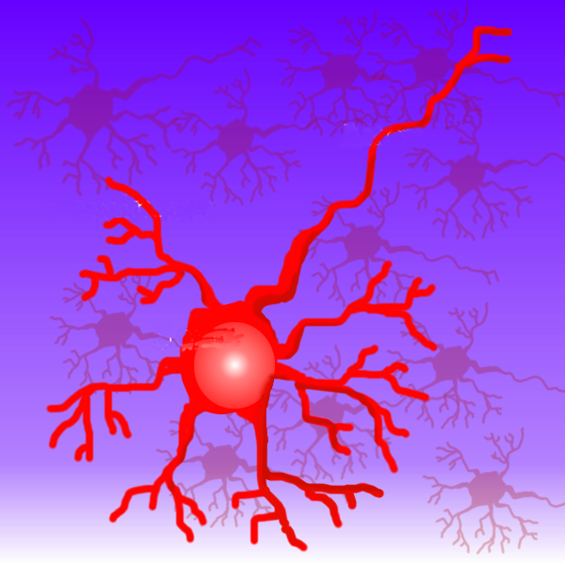
Machine Learning and Neural Networks

Slide 2
Definitions
Machine learning investigates the mechanisms by which knowledge is acquired through experience
Machine Learning is the field that concentrates on induction algorithms and on other algorithms that can be said to ``learn.''

Slide 3
Model
A model of learning is fundamental in any machine learning application:
  who is learning (a computer program)
  what is learned (a domain)
  from what the learner is learning (the information source)

Slide 4
A domain
  Concept learning is one of the most studied domain: the learner will try to come up with a rule useful to separate positive examples from negative examples.

Slide 5
The information source
examples: the learner is given positive and negative examples
queries: the learner gets information about the domain by asking questions
experimentation: the learner may get information by actively experiment with the domain

Slide 6
Other component of the model are
the prior knowledge
  of the learner about the domain. For example the learner may know that the unknown concept can be represented in a certain way
the performance criteria
  that defines how we know that the learner has learned something and how it can demonstrate it. Performance criteria can include:
  off line or on line measures
  descriptive or predictive output
  accuracy
  efficiency

Slide 7
What techniques we will see
kNN algorithm
Winnow algorithm
Naïve Bayes classifier
Decision trees
Reinforcement learning (Rocchio algorithm)
Genetic algorithm

Slide 8
k-NN algorithm
The definition of k-nearest neighbors is trivial:
  Suppose that each esperience can be represented as a point in an space For a particular point in question, find the k points in the population that are nearest to the point in question. The class of the majority of the of these neighbors is the class to the selected point.

Slide 9
k-NN algorithm
c
c1
c3
₁
c4
c4
c1
c₂
c2
New input
c4
c3
c2
Inputs already classified
Class 1

Slide 10
k-NN algorithm
Finding the k-nearest neighbors reliably and efficiently can be difficult. Other metrics that the Euclidean can be used.
The implicit assumption in using any k-nearest neighbors technique is that items with similar attributes tend to cluster together.

Slide 11
k-NN algorithm
The k-nearest neighbors method is most frequently used to tentatively classify points when firm class bounds are not established.
The learning is done using only positive examples not negative.

Slide 12
k-NN algorithm
Used in
  Schwab, I., Pohl, W., and Koychev, I. (2000) Learning to recommend from positive evidence. In: H. Lieberman (ed.) Proceedings of 2000 International Conference on Intelligent User Interfaces, New Orleans, LA, January 9-12, 2000, ACM Press, pp. 241-247

Slide 13

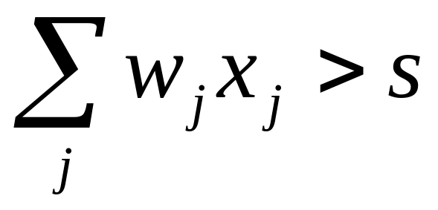
Winnow Algorithm
Is useful to distinguish binary patterns into two classes using a threshold S and a set of weights
the pattern x holds to the class y=1 if
(1)

Slide 14
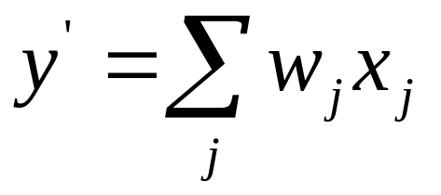
Winnow Algorithm
The algorithm:
  take an example (x, y)
  generate the answer of the classifier
  if the answer is correct do nothing
  else apply some correction

Slide 15
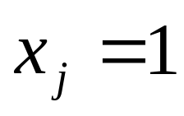
Winnow Algorithm
If y’>y the the weights are too high and are diminished
If y’<y the the weights are too low and are corrected
in both cases are corrected only the ones corresponding to

Slide 16
Winnow Algorithm application
Used in
  M.J. Pazzani “ A framework for Collaborative, Content Based and Demographic Filtering” Artificial Intelligence Review, Dec 1999
  R.Armstrong, D. Freitag, T. Joachims, and T. Mitchell " WebWatcher: A Learning Apprentice for the World Wide Web " 1995.

Slide 17
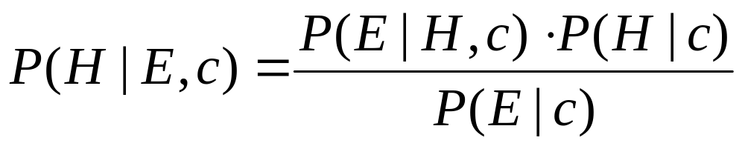
Naïve Bayes Classifier
Bayes theorem : given an Hypotesis H, an Evidence E and a context c

Slide 18
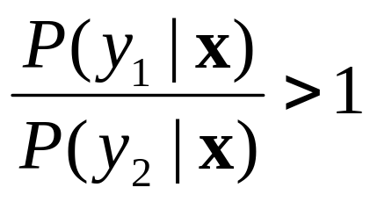
Naïve Bayes Classifier
Suppose to have a set of objects that can hold to two categories, y₁ and y₂, described using n features x₁, x₂, …, x_{n}.
If
then the object holds to the category y₁
We drop
the context

Slide 19
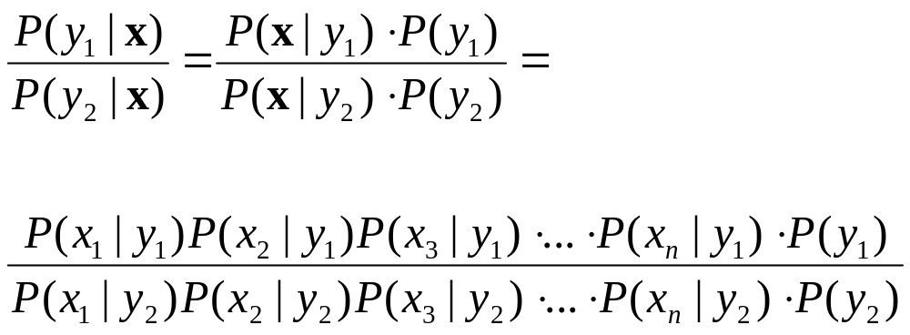
Naïve Bayes Classifier
Using the Bayes theorem:
Supposing that all
the features are
not correlated

Slide 20
Naïve Bayes Classifier
Used in:
  Mladenic, D. (2001) Using text learning to help Web browsing. In: M. Smith, G. Salvendy, D. Harris and R. J. Koubek (eds.) Usability evaluation and interface design. Vol. 1, (Proceedings of 9th International Conference on Human-Computer Interaction, HCI International'2001, New Orleans, LA, August 8-10, 2001) Mahwah, NJ: Lawrence Erlbaum Associates, pp. 893-897.
  Schwab, I., Pohl, W., and Koychev, I. (2000) Learning to recommend from positive evidence. In: H. Lieberman (ed.) Proceedings of 2000 International Conference on Intelligent User Interfaces, New Orleans, LA, January 9-12, 2000, ACM Press, pp. 241-247, also available at .Self, J. (1986) The application of machine learning to student modelling. Instr. Science, Instructional Science 14, 327-338.

Slide 21
Naïve Bayes Classifier
  Bueno D., David A. A. (2001) METIORE: A Personalized Information Retrieval System. In M. Bauer, P. J. Gmytrasiewicz and J. Vassileva (eds.) User Modeling 2001. Lecture Notes on Artificial Intelligence, Vol. 2109, (Proceedings of 8th International Conference on User Modeling, UM 2001, Sonthofen, Germany, July 13-17, 2001) Berlin: Springer-Verlag, pp. 188-198.
  Frasconi P., Soda G., Vullo A., Text Categorization for Multi-page Documents: A HybridNaive Bayes HMM Approach, ACM JCDL’01, June 24-28, 2001

Slide 22
Decision trees
A decision tree is a tree whose internal nodes are tests (on input patterns) and whose leaf nodes are categories (of patterns).
Each test has mutually exclusive and exhaustive outcomes.

Slide 23
Decision trees
T₁
3 classes
4 tests (maybe 4 variables)
T₂
T₃
T₄
2
1
1
1
3
2

Slide 24
Decision trees
The test:
  might be multivariate (tests on several features of the input) or univariate (test only one feature);
  might have two or more outcomes.
The features can be categorical or numerical.

Slide 25
Decision trees
Suppose to have n binary features
The main problem in learning decision trees is to decide the order of tests on variables
In order to decide, the average entropy of each test attribute is calculated and the lower one is chosen.

Slide 26
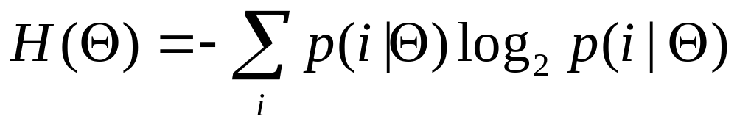
Decision trees
If we have binary patterns and a set of pattern Θ it is possible to write the entropy as
were p(i|Θ) is the probability that a random pattern from Θ belongs to the class i

Slide 27
Decision trees
We will approximate the probability p(i|Θ) using the number of patterns in Θ belonging to the class i divided by the total number of pattern in Θ

Slide 28
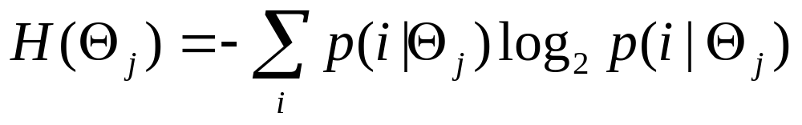
Decision trees
T
If a test T have k outcomes, k subsets Θ₁, Θ₂, ...Θ_{k}, are considered with n₁, n₂, …, n_{k} patterns.
It is possible to calculate:
...
...
1
J
K

Slide 29
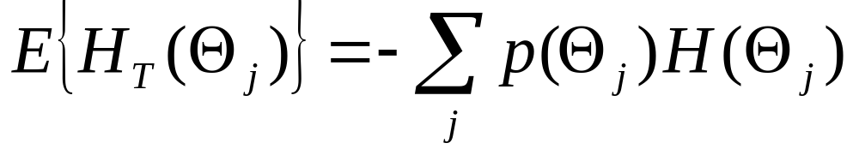
Decision trees
The average entropy over all the Θ_{j}
again we evaluate p(Θ_{j} ) has the number of patterns in Θ that outcomes j divided by the total number of patterns in Θ

Slide 30
Decision trees
We calculate the average entropy for all the test T and chose the lower one.
We write the part of the tree and go head in order to chose again the test that gives the lower entropy

Slide 31
Decision trees
The knowledge in the tree is strongly dependent from the examples

Slide 32
Reinforcement Learning
An agent tries to optimize its interaction with a dynamic environment using trial and error.
The agent can make an action u that applied to the environment changes its state from x to x’. The agent receives a reinforcement r.

Slide 33
Reinforcement Learning
There are three parts of a Reinforcement Learning Problem:
  The environment
  The reinforcement function
  The value function

Slide 34
Reinforcement Learning
The environment
  at least partially observable by means of sensors or symbolic description. The theory is based on an environment that shows its “true” state.

Slide 35
Reinforcement Learning
The reinforcement function
  a mapping from the couple (state, action) to the reinforcement value. There are three classes of reinforcement functions:
    Pure delayed reward: the reinforcements are all zero except for the terminal state (games, inverted pendulum)
    Minimum time to goal: cause an agent to perform actions that generate the shortest path to a goal state

Slide 36
Reinforcement Learning
    Minimization: the reinforcement is a function of of limited resources and the agent have to achieve the goal while minimizing the energy used

Slide 37
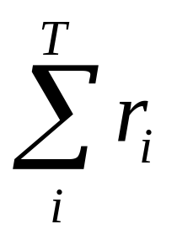
Reinforcement Learning
The Value Function:
  defines how to choose a “good” action. First we have to define
    policy (state) action
    value of a state I (following a defined policy)
    the optimal policy maximize the value of a state
T is the final state

Slide 38
Reinforcement Learning
The Value Function
  is a mapping (state) State Value
  If the optimal value function is founded the optimal policy can be extracted.

Slide 39
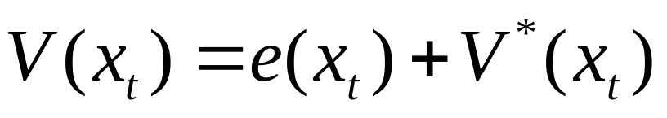
Reinforcement Learning
Given a state x_{t}
V*(x_{t}) is the optimal state value;
V(x_{t}) is the approximation we have;
where e(x_{t}) is the approximation error

Slide 40
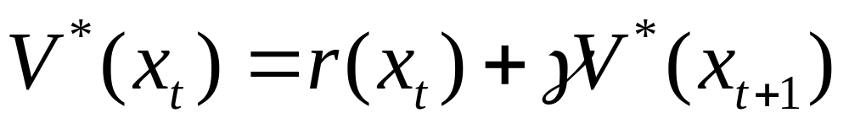
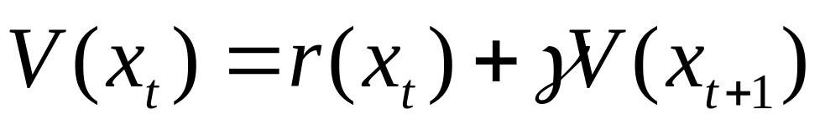
Reinforcement Learning
Moreover
where γ is a discount factor that causes immediate reinforcement to have more importance than future reinforcements

Slide 41
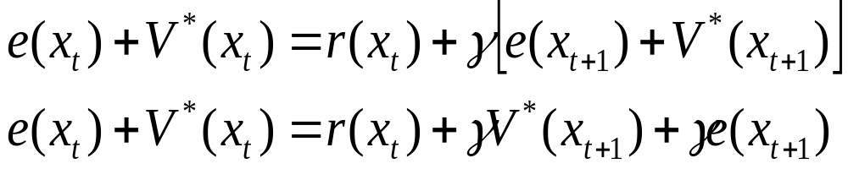
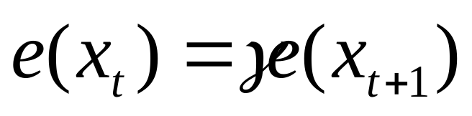
Reinforcement Learning
We can find
that gives
(**)

Slide 42
Reinforcement Learning
The learning process goal is to find an approximation V(x_{t}) that makes the equation (**) true for all the state.
The finale state T of a process has a value that is defined a priori so e(T)=0, so e(T-1)=0 it the (**) is true and then backwards to the initial state.

Slide 43
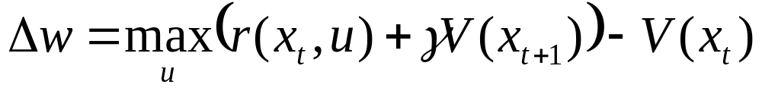
Reinforcement Learning
Assuming that the function approximator for the V* is a look-up table (a table with an approximate state value w for each state) then it is possible to sweep through the state space and update the values in the table according to:

Slide 44
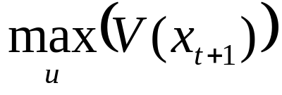
Reinforcement Learning
where u is the action performed that causes the transition to the state x_{t+1}. This must be done by using some kind of simulation in order to evaluate

Slide 45
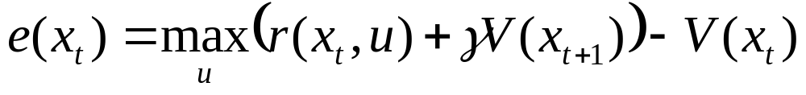
Reinforcement Learning
The last equation can be rewritten as
Each update reduce the value of e(x_{t+1})
the learning stops when e(x_{t+1})=0

Slide 46
Neural Networks
An artificial network consists of a pool of simple processing units which communicate by sending signals to each other over a large number of weighted connections.

Slide 47
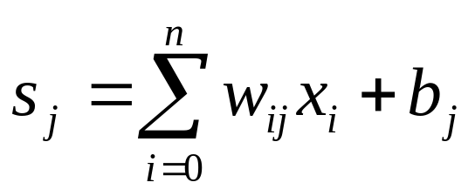
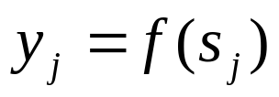
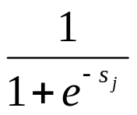
Artificial Neuron
w_{1j}
x₁
w_{2j}
x₂
y_{j}
w_{nj}
x_{n}
b_{j}

Slide 48
Neural Networks
Each unit performs a relatively simple job: receive input from neighbors or external sources and use this to compute an output signal which is propagated to other units (Test stage).
Apart from this processing, there is the task of the adjustment of the weights (Learning stage).
The system is inherently parallel in the sense that many units can carry out their computations at the same time.

Slide 49


Neural Networks
1. Learning stage
2. Test stage
(working stage)
Your knowledge
is useless !!

Slide 50
Classification (connections)
As for this pattern of connections, the main distinction we can make is between:
Feed-forward networks, where the data flow from input to output units is strictly feed-forward. The data processing can extend over multiple layers of units, but no feedback connections or connections between units of the same layer are present.

Slide 51
Classification
Classification (connections)
Recurrent networks that do contain feedback connections. Contrary to feed-forward networks, the dynamical properties of the network are important. In some cases, the activation values of the units undergo a relaxation process such that the network will evolve to a stable state in which these activations do not change anymore.

Slide 52
Recurrent Networks
In other applications, the change of the activation values of the output neurons are significant, such that the dynamical behavior constitutes the output of the network.

Slide 53
Classification (Learning)
We can categorise the learning situations in two distinct sorts. These are:
Supervised learning in which the network is trained by providing it with input and matching output patterns. These input-output pairs are usually provided by an external teacher.

Slide 54
Classification (Learning)
Unsupervised learning in which an (output) unit is trained to respond to clusters of pattern within the input. In this paradigm the system is supposed to discover statistically salient features of the input population. Unlike the supervised learning paradigm, there is no a priori set of categories into which the patterns are to be classified; rather the system must develop its own representation of the input stimuli.

Slide 55
Perceptron
A single layer feed-forward network consists of one or more output neurons, each of which is connected with a weighting factor w_{ij} to all of the inputs x_{i}.
b
x_{i}
b

Slide 56
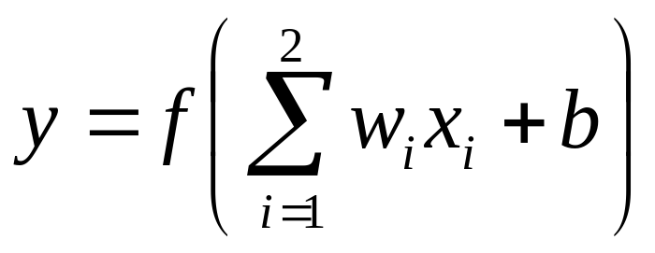
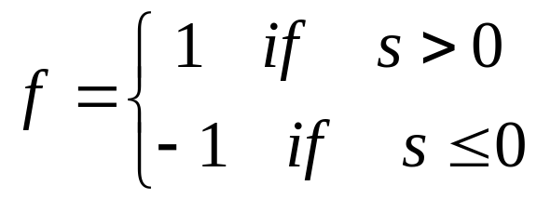
Perceptron
In the simplest case the network has only two inputs and a single output. The output of the neuron is:
suppose that the activation function is a threshold

Slide 57
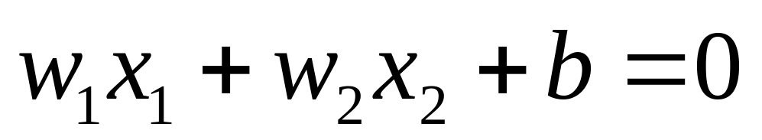
Perceptron
In this example the simple network (the neuron) can be used to separate the inputs in two classes.
The separation between the two classes is given by

Slide 58
Perceptron
x₁
x
x
x
x
x
x
x
x
x
x₂

Slide 59
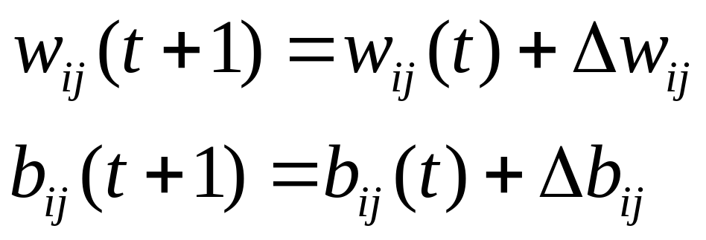
Learning in Perceptrons
The weights of the neural networks are modified during the learning phase

Slide 60
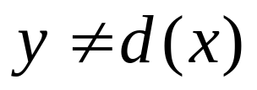
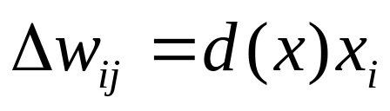
Learning in Perceptrons
Start with random weights
Select an input couple (x, d(x))
if then modify the weight according with
Note that the weights are not modified if the network gives the correct answer

Slide 61
Convergence theorem
If there exists a set of connection weights w* which is able to perform the transformation y = d(x), the perceptron learning rule will converge to some solution (which may or may not be the same as w* ) in a finite number of steps for any initial choice of the weights.

Slide 62
Linear Units
w_{1j}
w_{2j}
Y_{j}=s_{j}
x₂
w_{nj}
x_{n}
b_{j}

