Slide 1
Chapter 3:
Supervised Learning

Slide 2
Road Map
Basic concepts
Decision tree induction
Evaluation of classifiers
Rule induction
Classification using association rules
Naïve Bayesian classification
Naïve Bayes for text classification
Support vector machines
K-nearest neighbor
Ensemble methods: Bagging and Boosting
Summary
CS583, Bing Liu, UIC

Slide 3
An example application
An emergency room in a hospital measures 17 variables (e.g., blood pressure, age, etc) of newly admitted patients.
A decision is needed: whether to put a new patient in an intensive-care unit.
Due to the high cost of ICU, those patients who may survive less than a month are given higher priority.
Problem: to predict high-risk patients and discriminate them from low-risk patients.
CS583, Bing Liu, UIC

Slide 4
Another application
A credit card company receives thousands of applications for new cards. Each application contains information about an applicant,
  age
  Marital status
  annual salary
  outstanding debts
  credit rating
  etc.
Problem: to decide whether an application should approved, or to classify applications into two categories, approved and not approved.
CS583, Bing Liu, UIC

Slide 5
Machine learning and our focus
Like human learning from past experiences.
A computer does not have “experiences”.
A computer system learns from data, which represent some “past experiences” of an application domain.
Our focus: learn a target function that can be used to predict the values of a discrete class attribute, e.g., approve or not-approved, and high-risk or low risk.
The task is commonly called: Supervised learning, classification, or inductive learning.
CS583, Bing Liu, UIC

Slide 6
The data and the goal
Data: A set of data records (also called examples, instances or cases) described by
  k attributes: A₁, A₂, … A_{k}.
  a class: Each example is labelled with a pre-defined class.
Goal: To learn a classification model from the data that can be used to predict the classes of new (future, or test) cases/instances.
CS583, Bing Liu, UIC
Notes:
Induction is different from deduction and DBMS does not not support induction;
The result of induction is higher-level information or knowledge: general statements about data
There are many approaches. Refer to the lecture notes for CS3244 available at the Co-Op.
We focus on three approaches here, other examples:
Other approaches
Instance-based learning
other neural networks
Concept learning (Version space, Focus, Aq11, …)
Genetic algorithms
Reinforcement learning

Slide 7
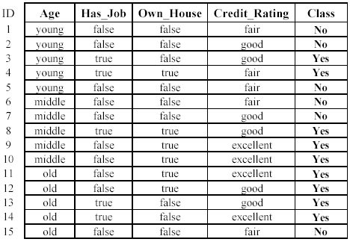
An example: data (loan application)
Approved or not
CS583, Bing Liu, UIC

Slide 8
An example: the learning task
Learn a classification model from the data
Use the model to classify future loan applications into
  Yes (approved) and
  No (not approved)
What is the class for following case/instance?
CS583, Bing Liu, UIC

Slide 9
Supervised vs. unsupervised Learning
Supervised learning: classification is seen as supervised learning from examples.
  Supervision: The data (observations, measurements, etc.) are labeled with pre-defined classes. It is like that a “teacher” gives the classes (supervision).
  Test data are classified into these classes too.
Unsupervised learning (clustering)
  Class labels of the data are unknown
  Given a set of data, the task is to establish the existence of classes or clusters in the data
CS583, Bing Liu, UIC

Slide 10
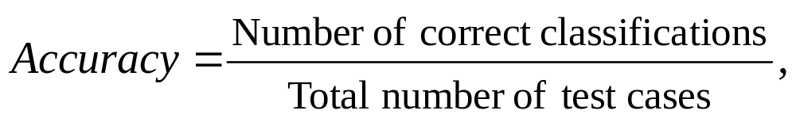
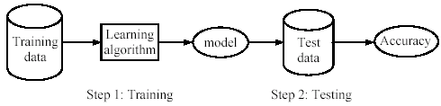
Supervised learning process: two steps
Learning (training): Learn a model using the training data
Testing: Test the model using unseen test data to assess the model accuracy
CS583, Bing Liu, UIC

Slide 11
What do we mean by learning?
Given
  a data set D,
  a task T, and
  a performance measure M,
a computer system is said to learn from D to perform the task T if after learning the system’s performance on T improves as measured by M.
In other words, the learned model helps the system to perform T better as compared to no learning.
CS583, Bing Liu, UIC

Slide 12
An example
Data: Loan application data
Task: Predict whether a loan should be approved or not.
Performance measure: accuracy.
No learning: classify all future applications (test data) to the majority class (i.e., Yes):
Accuracy = 9/15 = 60%.
We can do better than 60% with learning.
CS583, Bing Liu, UIC

Slide 13
Fundamental assumption of learning
Assumption: The distribution of training examples is identical to the distribution of test examples (including future unseen examples).
In practice, this assumption is often violated to certain degree.
Strong violations will clearly result in poor classification accuracy.
To achieve good accuracy on the test data, training examples must be sufficiently representative of the test data.
CS583, Bing Liu, UIC

Slide 14
Road Map
Basic concepts
Decision tree induction
Evaluation of classifiers
Rule induction
Classification using association rules
Naïve Bayesian classification
Naïve Bayes for text classification
Support vector machines
K-nearest neighbor
Ensemble methods: Bagging and Boosting
Summary
CS583, Bing Liu, UIC

Slide 15
Introduction
Decision tree learning is one of the most widely used techniques for classification.
  Its classification accuracy is competitive with other methods, and
  it is very efficient.
The classification model is a tree, called decision tree.
C4.5 by Ross Quinlan is perhaps the best known system. It can be downloaded from the Web.
CS583, Bing Liu, UIC

Slide 16
The loan data (reproduced)
Approved or not
CS583, Bing Liu, UIC

Slide 17
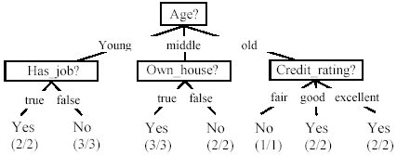
A decision tree from the loan data
Decision nodes and leaf nodes (classes)
CS583, Bing Liu, UIC

Slide 18
Use the decision tree
No
CS583, Bing Liu, UIC

Slide 19
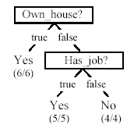
Is the decision tree unique?
No. Here is a simpler tree.
We want smaller tree and accurate tree.
  Easy to understand and perform better.
Finding the best tree is NP-hard.
All current tree building algorithms are heuristic algorithms
CS583, Bing Liu, UIC

Slide 20

From a decision tree to a set of rules
A decision tree can be converted to a set of rules
Each path from the root to a leaf is a rule.
CS583, Bing Liu, UIC

Slide 21
Algorithm for decision tree learning
Basic algorithm (a greedy divide-and-conquer algorithm)
  Assume attributes are categorical now (continuous attributes can be handled too)
  Tree is constructed in a top-down recursive manner
  At start, all the training examples are at the root
  Examples are partitioned recursively based on selected attributes
  Attributes are selected on the basis of an impurity function (e.g., information gain)
Conditions for stopping partitioning
  All examples for a given node belong to the same class
  There are no remaining attributes for further partitioning – majority class is the leaf
  There are no examples left
CS583, Bing Liu, UIC

Slide 22
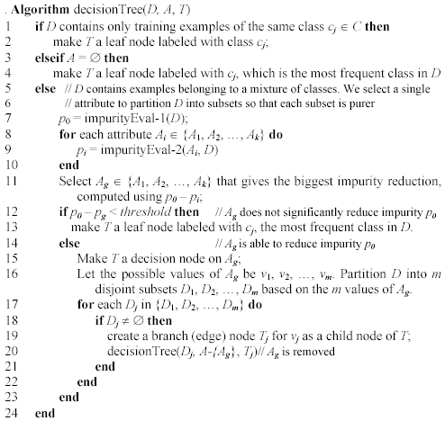
Decision tree learning algorithm
CS583, Bing Liu, UIC

Slide 23
Choose an attribute to partition data
The key to building a decision tree - which attribute to choose in order to branch.
The objective is to reduce impurity or uncertainty in data as much as possible.
  A subset of data is pure if all instances belong to the same class.
The heuristic in C4.5 is to choose the attribute with the maximum Information Gain or Gain Ratio based on information theory.
CS583, Bing Liu, UIC

Slide 24
The loan data (reproduced)
Approved or not
CS583, Bing Liu, UIC

Slide 25
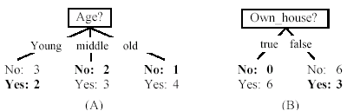
Two possible roots, which is better?
Fig. (B) seems to be better.
CS583, Bing Liu, UIC

Slide 26
Information theory
Information theory provides a mathematical basis for measuring the information content.
To understand the notion of information, think about it as providing the answer to a question, for example, whether a coin will come up heads.
  If one already has a good guess about the answer, then the actual answer is less informative.
  If one already knows that the coin is rigged so that it will come with heads with probability 0.99, then a message (advanced information) about the actual outcome of a flip is worth less than it would be for a honest coin (50-50).
CS583, Bing Liu, UIC

Slide 27
Information theory (cont …)
For a fair (honest) coin, you have no information, and you are willing to pay more (say in terms of $) for advanced information - less you know, the more valuable the information.
Information theory uses this same intuition, but instead of measuring the value for information in dollars, it measures information contents in bits.
One bit of information is enough to answer a yes/no question about which one has no idea, such as the flip of a fair coin
CS583, Bing Liu, UIC

Slide 28
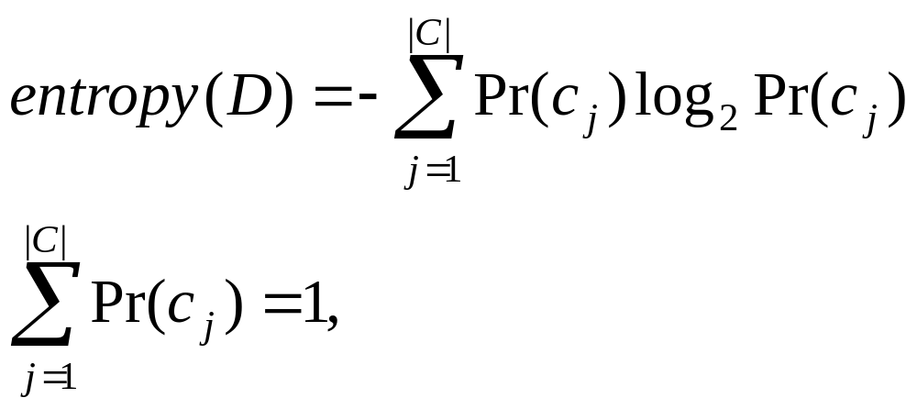
Information theory: Entropy measure
The entropy formula,
Pr(c_{j}) is the probability of class c_{j} in data set D
We use entropy as a measure of impurity or disorder of data set D. (Or, a measure of information in a tree)
CS583, Bing Liu, UIC

Slide 29
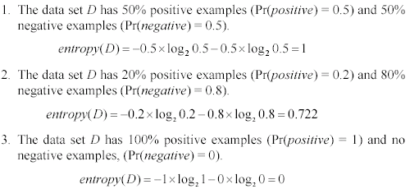
Entropy measure: let us get a feeling
As the data become purer and purer, the entropy value becomes smaller and smaller. This is useful to us!
CS583, Bing Liu, UIC

Slide 30

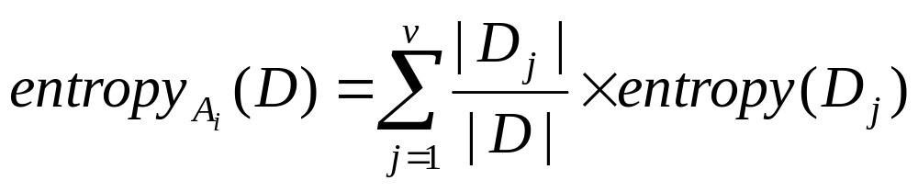
Information gain
Given a set of examples D, we first compute its entropy:
If we make attribute A_{i}, with v values, the root of the current tree, this will partition D into v subsets D₁, D₂ …, D_{v} . The expected entropy if A_{i} is used as the current root:
CS583, Bing Liu, UIC

Slide 31
Information gain (cont …)
Information gained by selecting attribute A_{i} to branch or to partition the data is
We choose the attribute with the highest gain to branch/split the current tree.
CS583, Bing Liu, UIC

Slide 32
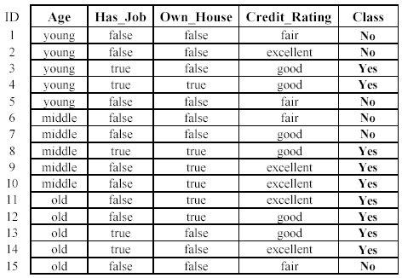
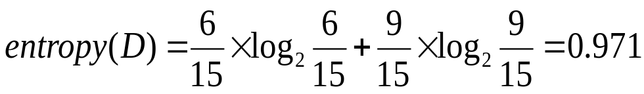
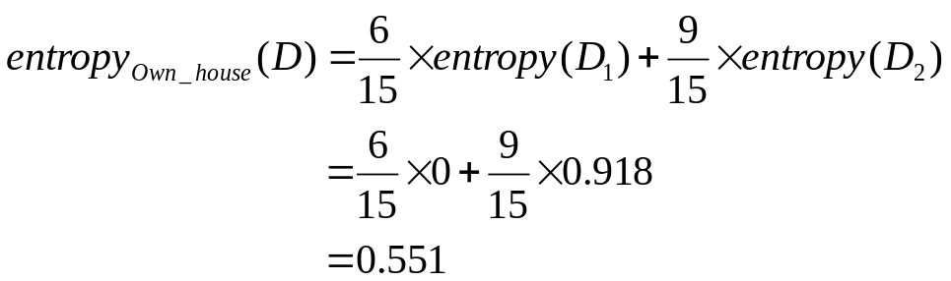
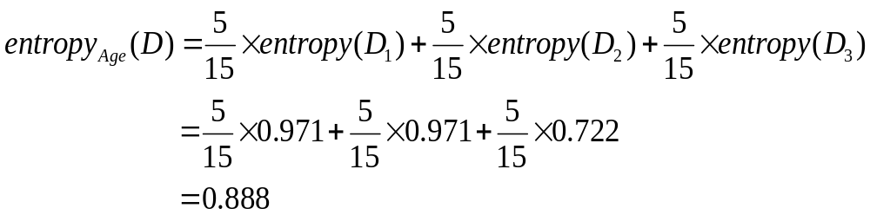
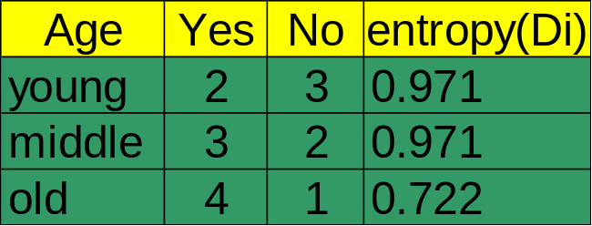

An example
Own_house is the best choice for the root.
CS583, Bing Liu, UIC

Slide 33
We build the final tree
We can use information gain ratio to evaluate the impurity as well (see the handout)
CS583, Bing Liu, UIC

Slide 34
Handling continuous attributes
Handle continuous attribute by splitting into two intervals (can be more) at each node.
How to find the best threshold to divide?
  Use information gain or gain ratio again
  Sort all the values of an continuous attribute in increasing order {v₁, v₂, …, v_{r}},
  One possible threshold between two adjacent values v_{i} and v_{i+1}. Try all possible thresholds and find the one that maximizes the gain (or gain ratio).
CS583, Bing Liu, UIC

Slide 35
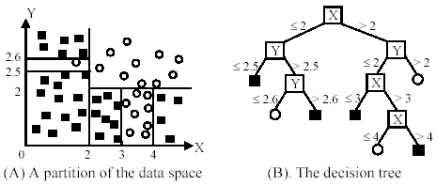
An example in a continuous space
CS583, Bing Liu, UIC

Slide 36
Avoid overfitting in classification
Overfitting: A tree may overfit the training data
  Good accuracy on training data but poor on test data
  Symptoms: tree too deep and too many branches, some may reflect anomalies due to noise or outliers
Two approaches to avoid overfitting
  Pre-pruning: Halt tree construction early
    Difficult to decide because we do not know what may happen subsequently if we keep growing the tree.
  Post-pruning: Remove branches or sub-trees from a “fully grown” tree.
    This method is commonly used. C4.5 uses a statistical method to estimates the errors at each node for pruning.
    A validation set may be used for pruning as well.
CS583, Bing Liu, UIC

Slide 37
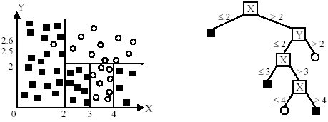
An example
Likely to overfit the data
CS583, Bing Liu, UIC

Slide 38
Other issues in decision tree learning
From tree to rules, and rule pruning
Handling of miss values
Handing skewed distributions
Handling attributes and classes with different costs.
Attribute construction
Etc.
CS583, Bing Liu, UIC

Slide 39
Road Map
Basic concepts
Decision tree induction
Evaluation of classifiers
Rule induction
Classification using association rules
Naïve Bayesian classification
Naïve Bayes for text classification
Support vector machines
K-nearest neighbor
Ensemble methods: Bagging and Boosting
Summary
CS583, Bing Liu, UIC

Slide 40

Evaluating classification methods
Predictive accuracy
Efficiency
  time to construct the model
  time to use the model
Robustness: handling noise and missing values
Scalability: efficiency in disk-resident databases
Interpretability:
  understandable and insight provided by the model
Compactness of the model: size of the tree, or the number of rules.
CS583, Bing Liu, UIC

Slide 41
Evaluation methods
Holdout set: The available data set D is divided into two disjoint subsets,
  the training set D_{train} (for learning a model)
  the test set D_{test} (for testing the model)
Important: training set should not be used in testing and the test set should not be used in learning.
  Unseen test set provides a unbiased estimate of accuracy.
The test set is also called the holdout set. (the examples in the original data set D are all labeled with classes.)
This method is mainly used when the data set D is large.
CS583, Bing Liu, UIC

Slide 42
Evaluation methods (cont…)
n-fold cross-validation: The available data is partitioned into n equal-size disjoint subsets.
Use each subset as the test set and combine the rest n-1 subsets as the training set to learn a classifier.
The procedure is run n times, which give n accuracies.
The final estimated accuracy of learning is the average of the n accuracies.
10-fold and 5-fold cross-validations are commonly used.
This method is used when the available data is not large.
CS583, Bing Liu, UIC

Slide 43
Evaluation methods (cont…)
Leave-one-out cross-validation: This method is used when the data set is very small.
It is a special case of cross-validation
Each fold of the cross validation has only a single test example and all the rest of the data is used in training.
If the original data has m examples, this is m-fold cross-validation
CS583, Bing Liu, UIC

Slide 44
Evaluation methods (cont…)
Validation set: the available data is divided into three subsets,
  a training set,
  a validation set and
  a test set.
A validation set is used frequently for estimating parameters in learning algorithms.
In such cases, the values that give the best accuracy on the validation set are used as the final parameter values.
Cross-validation can be used for parameter estimating as well.
CS583, Bing Liu, UIC

Slide 45
Classification measures
Accuracy is only one measure (error = 1-accuracy).
Accuracy is not suitable in some applications.
In text mining, we may only be interested in the documents of a particular topic, which are only a small portion of a big document collection.
In classification involving skewed or highly imbalanced data, e.g., network intrusion and financial fraud detections, we are interested only in the minority class.
  High accuracy does not mean any intrusion is detected.
  E.g., 1% intrusion. Achieve 99% accuracy by doing nothing.
The class of interest is commonly called the positive class, and the rest negative classes.
CS583, Bing Liu, UIC

Slide 46
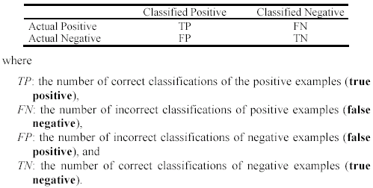
Precision and recall measures
Used in information retrieval and text classification.
We use a confusion matrix to introduce them.
CS583, Bing Liu, UIC

Slide 47

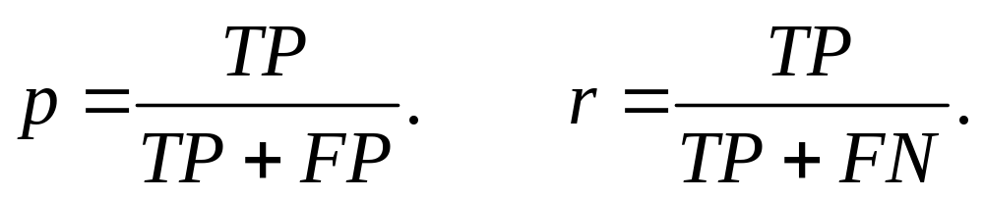
Precision and recall measures (cont…)
Precision p is the number of correctly classified positive examples divided by the total number of examples that are classified as positive.
Recall r is the number of correctly classified positive examples divided by the total number of actual positive examples in the test set.
CS583, Bing Liu, UIC

Slide 48

An example
This confusion matrix gives
  precision p = 100% and
  recall r = 1%
  because we only classified one positive example correctly and no negative examples wrongly.
Note: precision and recall only measure classification on the positive class.
CS583, Bing Liu, UIC

Slide 49
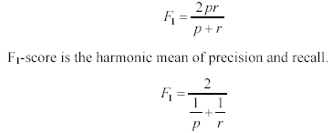
F₁-value (also called F₁-score)
It is hard to compare two classifiers using two measures. F₁ score combines precision and recall into one measure
The harmonic mean of two numbers tends to be closer to the smaller of the two.
For F₁-value to be large, both p and r much be large.
CS583, Bing Liu, UIC

Slide 50


Receive operating characteristics curve
It is commonly called the ROC curve.
It is a plot of the true positive rate (TPR) against the false positive rate (FPR).
True positive rate:
False positive rate:
CS583, Bing Liu, UIC

Slide 51


Sensitivity and Specificity
In statistics, there are two other evaluation measures:
  Sensitivity: Same as TPR
  Specificity: Also called True Negative Rate (TNR)
Then we have
CS583, Bing Liu, UIC

Slide 52
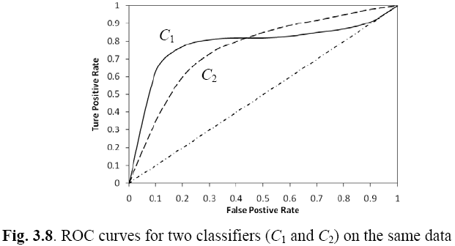
Example ROC curves
CS583, Bing Liu, UIC

Slide 53
Area under the curve (AUC)
Which classifier is better, C₁ or C₂?
  It depends on which region you talk about.
Can we have one measure?
  Yes, we compute the area under the curve (AUC)
If AUC for C_{i} is greater than that of C_{j}, it is said that C_{i} is better than C_{j}.
  If a classifier is perfect, its AUC value is 1
  If a classifier makes all random guesses, its AUC value is 0.5.
CS583, Bing Liu, UIC

Slide 54
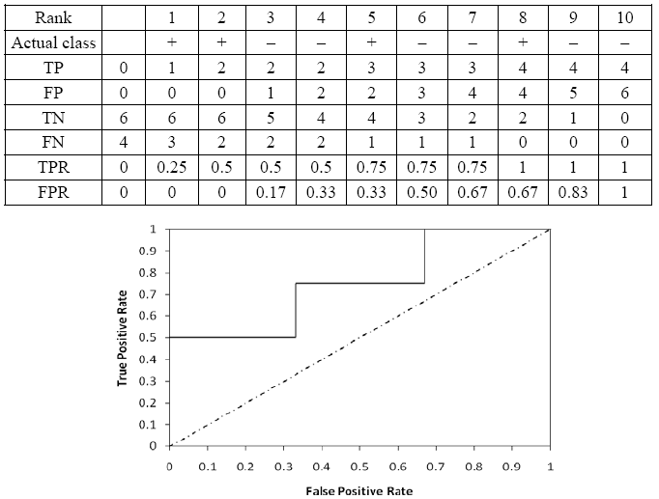
Drawing an ROC curve
CS583, Bing Liu, UIC

Slide 55
Another evaluation method:
Scoring and ranking
Scoring is related to classification.
We are interested in a single class (positive class), e.g., buyers class in a marketing database.
Instead of assigning each test instance a definite class, scoring assigns a probability estimate (PE) to indicate the likelihood that the example belongs to the positive class.
CS583, Bing Liu, UIC

Slide 56
Ranking and lift analysis
After each example is given a PE score, we can rank all examples according to their PEs.
We then divide the data into n (say 10) bins. A lift curve can be drawn according how many positive examples are in each bin. This is called lift analysis.
Classification systems can be used for scoring. Need to produce a probability estimate.
  E.g., in decision trees, we can use the confidence value at each leaf node as the score.
CS583, Bing Liu, UIC

Slide 57
An example
We want to send promotion materials to potential customers to sell a watch.
Each package cost $0.50 to send (material and postage).
If a watch is sold, we make $5 profit.
Suppose we have a large amount of past data for building a predictive/classification model. We also have a large list of potential customers.
How many packages should we send and who should we send to?
CS583, Bing Liu, UIC

Slide 58
An example
Assume that the test set has 10000 instances. Out of this, 500 are positive cases.
After the classifier is built, we score each test instance. We then rank the test set, and divide the ranked test set into 10 bins.
  Each bin has 1000 test instances.
  Bin 1 has 210 actual positive instances
  Bin 2 has 120 actual positive instances
  Bin 3 has 60 actual positive instances
  …
  Bin 10 has 5 actual positive instances
CS583, Bing Liu, UIC

Slide 59
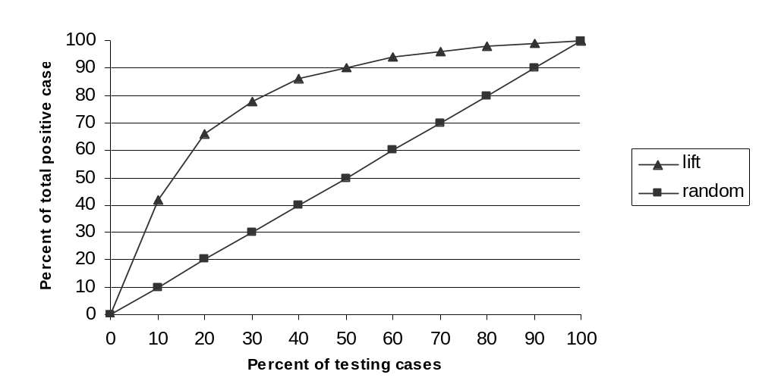
Lift curve
Bin 1 2 3 4 5 6 7 8 9 10
CS583, Bing Liu, UIC

Slide 60
Road Map
Basic concepts
Decision tree induction
Evaluation of classifiers
Rule induction
Classification using association rules
Naïve Bayesian classification
Naïve Bayes for text classification
Support vector machines
K-nearest neighbor
Summary
CS583, Bing Liu, UIC

Slide 61
Introduction
We showed that a decision tree can be converted to a set of rules.
Can we find if-then rules directly from data for classification?
Yes.
Rule induction systems find a sequence of rules (also called a decision list) for classification.
The commonly used strategy is sequential covering.
CS583, Bing Liu, UIC

Slide 62
Sequential covering
Learn one rule at a time, sequentially.
After a rule is learned, the training examples covered by the rule are removed.
Only the remaining data are used to find subsequent rules.
The process repeats until some stopping criteria are met.
Note: a rule covers an example if the example satisfies the conditions of the rule.
We introduce two specific algorithms.
CS583, Bing Liu, UIC

Slide 63
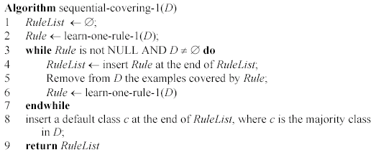
Algorithm 1: ordered rules
The final classifier:
<r₁, r₂, …, r_{k}, default-class>
CS583, Bing Liu, UIC

Slide 64
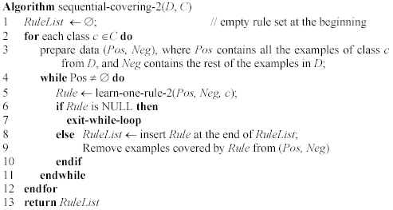
Algorithm 2: ordered classes
Rules of the same class are together.
CS583, Bing Liu, UIC

Slide 65
Algorithm 1 vs. Algorithm 2
Differences:
  Algorithm 2: Rules of the same class are found together. The classes are ordered. Normally, minority class rules are found first.
  Algorithm 1: In each iteration, a rule of any class may be found. Rules are ordered according to the sequence they are found.
Use of rules: the same.
  For a test instance, we try each rule sequentially. The first rule that covers the instance classifies it.
  If no rule covers it, default class is used, which is the majority class in the data.
CS583, Bing Liu, UIC

Slide 66
Learn-one-rule-1 function
Let us consider only categorical attributes
Let attributeValuePairs contains all possible attribute-value pairs (A_{i} = a_{i}) in the data.
Iteration 1: Each attribute-value is evaluated as the condition of a rule. I.e., we compare all such rules A_{i} = a_{i} → c_{j} and keep the best one,
  Evaluation: e.g., entropy
  Also store the k best rules for beam search (to search more space). Called new candidates.
CS583, Bing Liu, UIC

Slide 67
Learn-one-rule-1 function (cont …)
In iteration m, each (m-1)-condition rule in the new candidates set is expanded by attaching each attribute-value pair in attributeValuePairs as an additional condition to form candidate rules.
These new candidate rules are then evaluated in the same way as 1-condition rules.
  Update the best rule
  Update the k-best rules
The process repeats unless stopping criteria are met.
CS583, Bing Liu, UIC

Slide 68
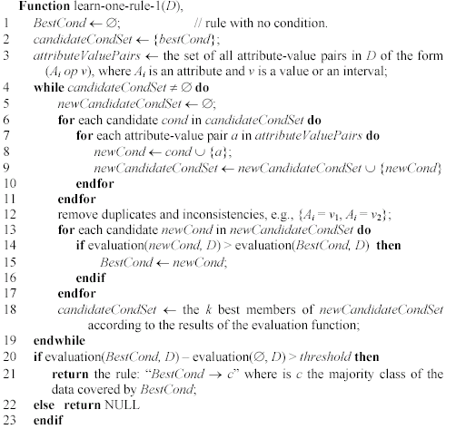
Learn-one-rule-1 algorithm
CS583, Bing Liu, UIC

Slide 69
Learn-one-rule-2 function
Split the data:
  Pos -> GrowPos and PrunePos
  Neg -> GrowNeg and PruneNeg
Grow sets are used to find a rule (BestRule), and the Prune sets are used to prune the rule.
GrowRule works similarly as in learn-one-rule-1, but the class is fixed in this case. Recall the second algorithm finds all rules of a class first (Pos) and then moves to the next class.
CS583, Bing Liu, UIC

Slide 70
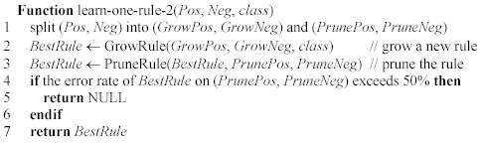
Learn-one-rule-2 algorithm
CS583, Bing Liu, UIC

Slide 71
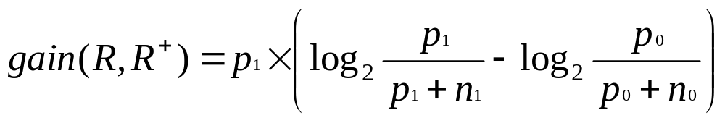
Rule evaluation in learn-one-rule-2
Let the current partially developed rule be:
R: av₁, .., av_{k} → class
  where each av_{j} is a condition (an attribute-value pair).
By adding a new condition av_{k+1}, we obtain the rule
R+: av₁, .., av_{k}, av_{k+1}→ class.
The evaluation function for R+ is the following information gain criterion (which is different from the gain function used in decision tree learning).
Rule with the best gain is kept for further extension.
CS583, Bing Liu, UIC

Slide 72
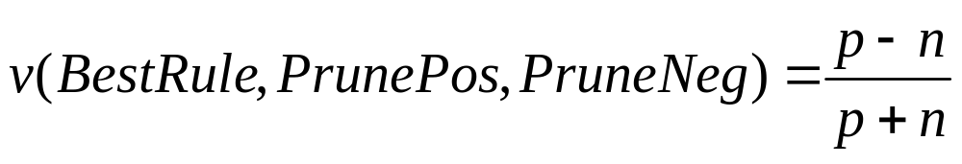
Rule pruning in learn-one-rule-2
Consider deleting every subset of conditions from the BestRule, and choose the deletion that maximizes the function:
where p (n) is the number of examples in PrunePos (PruneNeg) covered by the current rule (after a deletion).
CS583, Bing Liu, UIC

Slide 73
Discussions
Accuracy: similar to decision tree
Efficiency: Run much slower than decision tree induction because
  To generate each rule, all possible rules are tried on the data (not really all, but still a lot).
  When the data is large and/or the number of attribute-value pairs are large. It may run very slowly.
Rule interpretability: Can be a problem because each rule is found after data covered by previous rules are removed. Thus, each rule may not be treated as independent of other rules.
CS583, Bing Liu, UIC

Slide 74
Road Map
Basic concepts
Decision tree induction
Evaluation of classifiers
Rule induction
Classification using association rules
Naïve Bayesian classification
Naïve Bayes for text classification
Support vector machines
K-nearest neighbor
Ensemble methods: Bagging and Boosting
Summary
CS583, Bing Liu, UIC

Slide 75
Three approaches
Three main approaches of using association rules for classification.
  Using class association rules to build classifiers
  Using class association rules as attributes/features
  Using normal association rules for classification
CS583, Bing Liu, UIC

Slide 76
Using Class Association Rules
Classification: mine a small set of rules existing in the data to form a classifier or predictor.
  It has a target attribute: Class attribute
Association rules: have no fixed target, but we can fix a target.
Class association rules (CAR): has a target class attribute. E.g.,
Own_house = true → Class =Yes [sup=6/15, conf=6/6]
  CARs can obviously be used for classification.
CS583, Bing Liu, UIC

Slide 77
Decision tree vs. CARs
The decision tree below generates the following 3 rules.
Own_house = true → Class =Yes [sup=6/15, conf=6/6]
Own_house = false, Has_job = true → Class=Yes [sup=5/15, conf=5/5]
Own_house = false, Has_job = false → Class=No [sup=4/15, conf=4/4]
But there are many other rules that are not found by the decision tree
CS583, Bing Liu, UIC

Slide 78
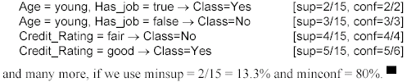
There are many more rules
CAR mining finds all of them.
In many cases, rules not in the decision tree (or a rule list) may perform classification better.
Such rules may also be actionable in practice
CS583, Bing Liu, UIC

Slide 79
Decision tree vs. CARs (cont …)
Association mining require discrete attributes. Decision tree learning uses both discrete and continuous attributes.
  CAR mining requires continuous attributes discretized. There are several such algorithms.
Decision tree is not constrained by minsup or minconf, and thus is able to find rules with very low support. Of course, such rules may be pruned due to the possible overfitting.
CS583, Bing Liu, UIC

Slide 80
Considerations in CAR mining
Multiple minimum class supports
  Deal with imbalanced class distribution, e.g., some class is rare, 98% negative and 2% positive.
  We can set the minsup(positive) = 0.2% and minsup(negative) = 2%.
  If we are not interested in classification of negative class, we may not want to generate rules for negative class. We can set minsup(negative)=100% or more.
Rule pruning may be performed.
CS583, Bing Liu, UIC

Slide 81
Building classifiers
There are many ways to build classifiers using CARs. Several existing systems available.
Strongest rules: After CARs are mined, do nothing.
  For each test case, we simply choose the most confident rule that covers the test case to classify it. Microsoft SQL Server has a similar method.
  Or, using a combination of rules.
Selecting a subset of Rules
  used in the CBA system.
  similar to sequential covering.
CS583, Bing Liu, UIC

Slide 82
CBA: Rules are sorted first
Definition: Given two rules, r_{i} and r_{j}, r_{i}  r_{j} (also called ri precedes r_{j} or r_{i} has a higher precedence than r_{j}) if
  the confidence of r_{i} is greater than that of r_{j}, or
  their confidences are the same, but the support of r_{i} is greater than that of r_{j}, or
  both the confidences and supports of r_{i} and r_{j} are the same, but r_{i} is generated earlier than r_{j}.
A CBA classifier L is of the form:
L = <r₁, r₂, …, r_{k}, default-class>
CS583, Bing Liu, UIC

Slide 83
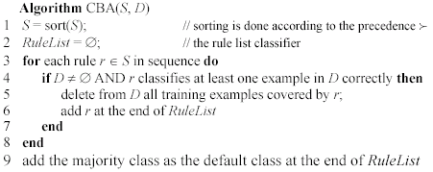
Classifier building using CARs
This algorithm is very inefficient
CBA has a very efficient algorithm (quite sophisticated) that scans the data at most two times.
CS583, Bing Liu, UIC

Slide 84
Using rules as features
Most classification methods do not fully explore multi-attribute correlations, e.g., naïve Bayesian, decision trees, rules induction, etc.
This method creates extra attributes to augment the original data by
  Using the conditional parts of rules
  Each rule forms an new attribute
  If a data record satisfies the condition of a rule, the attribute value is 1, and 0 otherwise
One can also use only rules as attributes
  Throw away the original data
CS583, Bing Liu, UIC

Slide 85
Using normal association rules for classification
A widely used approach
Main approach: strongest rules
Main application
  Recommendation systems in e-commerce Web site (e.g., amazon.com).
  Each rule consequent is the recommended item.
Major advantage: any item can be predicted.
Main issue:
  Coverage: rare item rules are not found using classic algo.
  Multiple min supports and support difference constraint help a great deal.
CS583, Bing Liu, UIC

Slide 86
Road Map
Basic concepts
Decision tree induction
Evaluation of classifiers
Rule induction
Classification using association rules
Naïve Bayesian classification
Naïve Bayes for text classification
Support vector machines
K-nearest neighbor
Ensemble methods: Bagging and Boosting
Summary
CS583, Bing Liu, UIC

Slide 87
Bayesian classification
Probabilistic view: Supervised learning can naturally be studied from a probabilistic point of view.
Let A₁ through A_{k} be attributes with discrete values. The class is C.
Given a test example d with observed attribute values a₁ through a_{k}.
Classification is basically to compute the following posteriori probability. The prediction is the class c_{j} such that
is maximal
CS583, Bing Liu, UIC

Slide 88
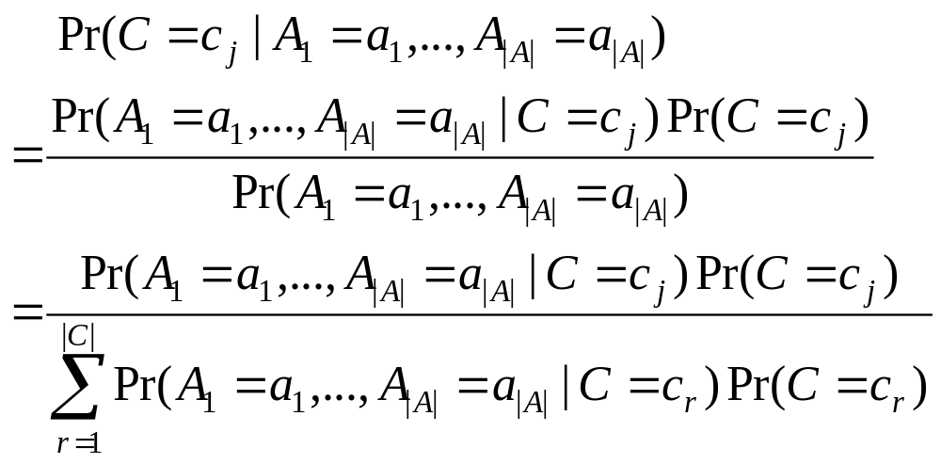
Apply Bayes’ Rule
Pr(C=c_{j}) is the class prior probability: easy to estimate from the training data.
CS583, Bing Liu, UIC

Slide 89
Computing probabilities
The denominator P(A₁=a₁,...,A_{k}=a_{k}) is irrelevant for decision making since it is the same for every class.
We only need P(A₁=a₁,...,A_{k}=a_{k} | C=c_{i}), which can be written as
Pr(A₁=a₁|A₂=a₂,...,A_{k}=a_{k}, C=c_{j})* Pr(A₂=a₂,...,A_{k}=a_{k} |C=c_{j})
Recursively, the second factor above can be written in the same way, and so on.
Now an assumption is needed.
CS583, Bing Liu, UIC

Slide 90
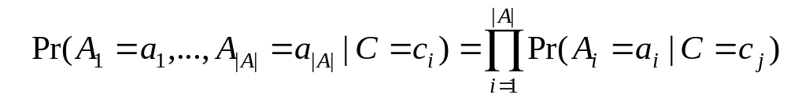
Conditional independence assumption
All attributes are conditionally independent given the class C = c_{j}.
Formally, we assume,
Pr(A₁=a₁ | A₂=a₂, ..., A_{|A|}=a_{|A|}, C=c_{j}) = Pr(A₁=a₁ | C=c_{j})
and so on for A₂ through A_{|A|}. I.e.,
CS583, Bing Liu, UIC

Slide 91
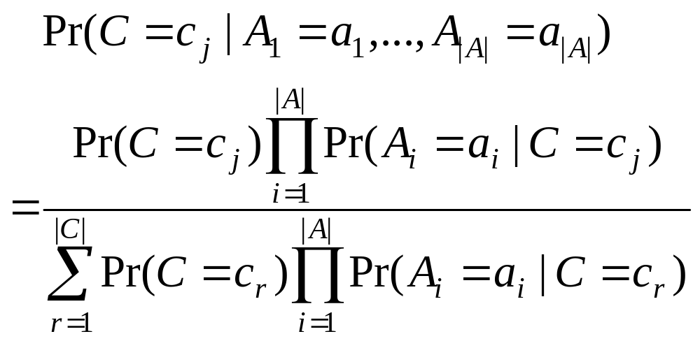
Final naïve Bayesian classifier
We are done!
How do we estimate P(A_{i} = a_{i}| C=c_{j})? Easy!.
CS583, Bing Liu, UIC

Slide 92
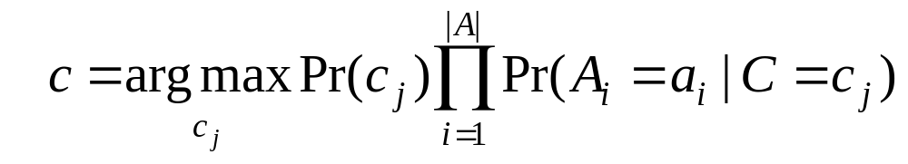
Classify a test instance
If we only need a decision on the most probable class for the test instance, we only need the numerator as its denominator is the same for every class.
Thus, given a test example, we compute the following to decide the most probable class for the test instance
CS583, Bing Liu, UIC

Slide 93
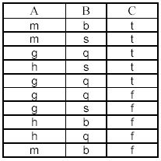
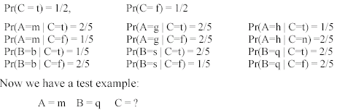
An example
Compute all probabilities required for classification
CS583, Bing Liu, UIC

Slide 94
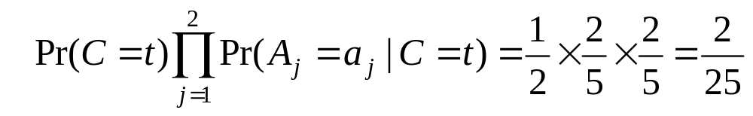
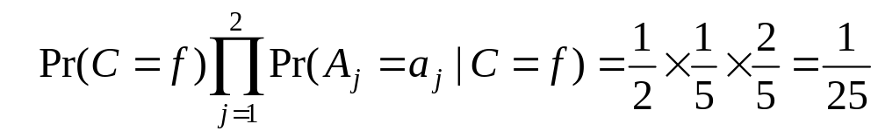
An Example (cont …)
For C = t, we have
For class C = f, we have
C = t is more probable. t is the final class.
CS583, Bing Liu, UIC

Slide 95
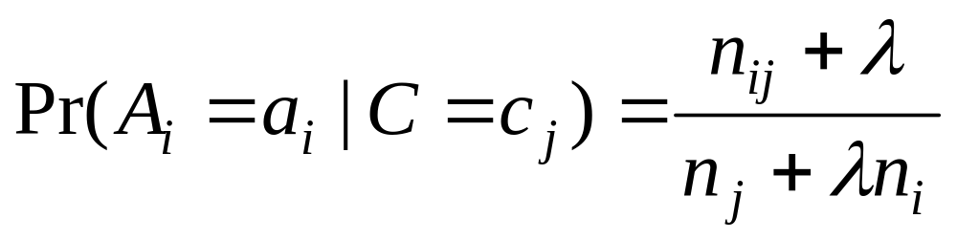
Additional issues
Numeric attributes: Naïve Bayesian learning assumes that all attributes are categorical. Numeric attributes need to be discretized.
Zero counts: An particular attribute value never occurs together with a class in the training set. We need smoothing.
Missing values: Ignored
CS583, Bing Liu, UIC

Slide 96
On naïve Bayesian classifier
Advantages:
  Easy to implement
  Very efficient
  Good results obtained in many applications
Disadvantages
  Assumption: class conditional independence, therefore loss of accuracy when the assumption is seriously violated (those highly correlated data sets)
CS583, Bing Liu, UIC

Slide 97
Road Map
Basic concepts
Decision tree induction
Evaluation of classifiers
Rule induction
Classification using association rules
Naïve Bayesian classification
Naïve Bayes for text classification
Support vector machines
K-nearest neighbor
Ensemble methods: Bagging and Boosting
Summary
CS583, Bing Liu, UIC

Slide 98
Text classification/categorization
Due to the rapid growth of online documents in organizations and on the Web, automated document classification has become an important problem.
Techniques discussed previously can be applied to text classification, but they are not as effective as the next three methods.
We first study a naïve Bayesian method specifically formulated for texts, which makes use of some text specific features.
However, the ideas are similar to the preceding method.
CS583, Bing Liu, UIC

Slide 99
Probabilistic framework
Generative model: Each document is generated by a parametric distribution governed by a set of hidden parameters.
The generative model makes two assumptions
  The data (or the text documents) are generated by a mixture model,
  There is one-to-one correspondence between mixture components and document classes.
CS583, Bing Liu, UIC

Slide 100
Mixture model
A mixture model models the data with a number of statistical distributions.
  Intuitively, each distribution corresponds to a data cluster and the parameters of the distribution provide a description of the corresponding cluster.
Each distribution in a mixture model is also called a mixture component.
The distribution/component can be of any kind
CS583, Bing Liu, UIC

Slide 101
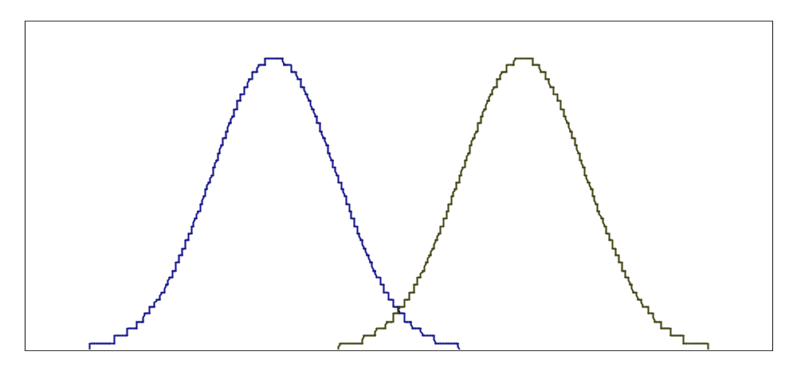
An example
The figure shows a plot of the probability density function of a 1-dimensional data set (with two classes) generated by
  a mixture of two Gaussian distributions,
  one per class, whose parameters (denoted by θ_{i}) are the mean (μ_{i}) and the standard deviation (σ_{i}), i.e., θ_{i} = (μ_{i}, σ_{i}).
class 1 class 2
CS583, Bing Liu, UIC

Slide 102
Mixture model (cont …)
Let the number of mixture components (or distributions) in a mixture model be K.
Let the jth distribution have the parameters θ_{j}.
Let Θ be the set of parameters of all components, Θ = {ϕ₁, ϕ₂, …, ϕ_{K}, θ₁, θ₂, …, θ_{K}}, where ϕ_{j} is the mixture weight (or mixture probability) of the mixture component j and θ_{j} is the parameters of component j.
How does the model generate documents?
CS583, Bing Liu, UIC

Slide 103
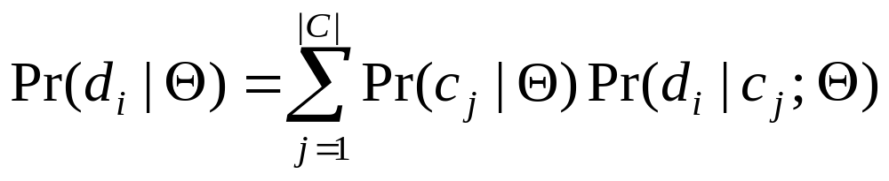
Document generation
Due to one-to-one correspondence, each class corresponds to a mixture component. The mixture weights are class prior probabilities, i.e., ϕ_{j} = Pr(c_{j}|Θ).
The mixture model generates each document d_{i} by:
  first selecting a mixture component (or class) according to class prior probabilities (i.e., mixture weights), ϕ_{j} = Pr(c_{j}|Θ).
  then having this selected mixture component (c_{j}) generate a document d_{i} according to its parameters, with distribution Pr(d_{i}|c_{j}; Θ) or more precisely Pr(d_{i}|c_{j}; θ_{j}).
(23)
CS583, Bing Liu, UIC

Slide 104
Model text documents
The naïve Bayesian classification treats each document as a “bag of words”. The generative model makes the following further assumptions:
  Words of a document are generated independently of context given the class label. The familiar naïve Bayes assumption used before.
  The probability of a word is independent of its position in the document. The document length is chosen independent of its class.
CS583, Bing Liu, UIC

Slide 105
Multinomial distribution
With the assumptions, each document can be regarded as generated by a multinomial distribution.
In other words, each document is drawn from a multinomial distribution of words with as many independent trials as the length of the document.
The words are from a given vocabulary V = {w₁, w₂, …, w_{|V|}}.
CS583, Bing Liu, UIC

Slide 106
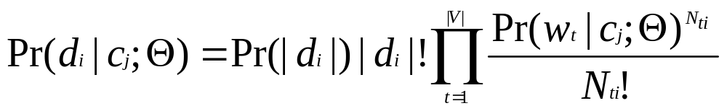
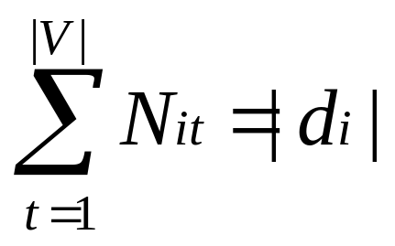
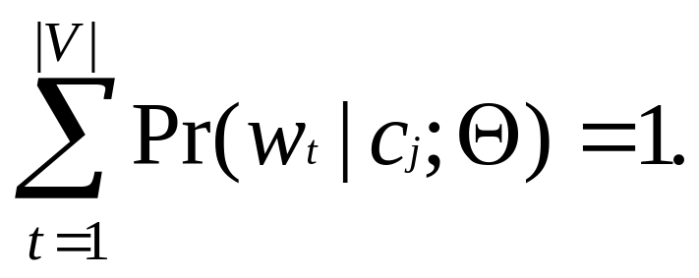
Use probability function of multinomial distribution
(24)
where N_{ti} is the number of times that word w_{t} occurs in document d_{i} and
(25)
CS583, Bing Liu, UIC

Slide 107
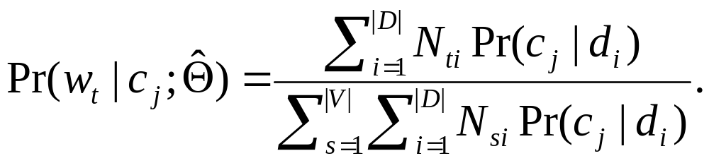
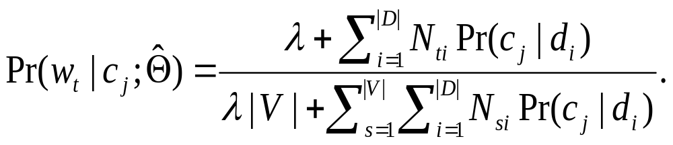
Parameter estimation
The parameters are estimated based on empirical counts.
In order to handle 0 counts for infrequent occurring words that do not appear in the training set, but may appear in the test set, we need to smooth the probability. Lidstone smoothing, 0 ≤ λ ≤ 1
(26)
(27)
CS583, Bing Liu, UIC

Slide 108
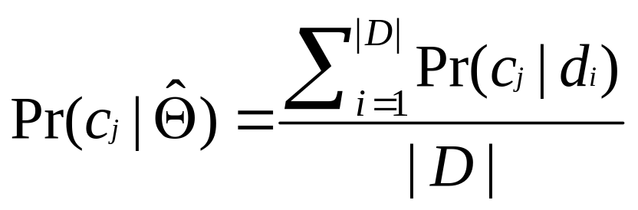
Parameter estimation (cont …)
Class prior probabilities, which are mixture weights ϕ_{j}, can be easily estimated using training data
(28)
CS583, Bing Liu, UIC

Slide 109
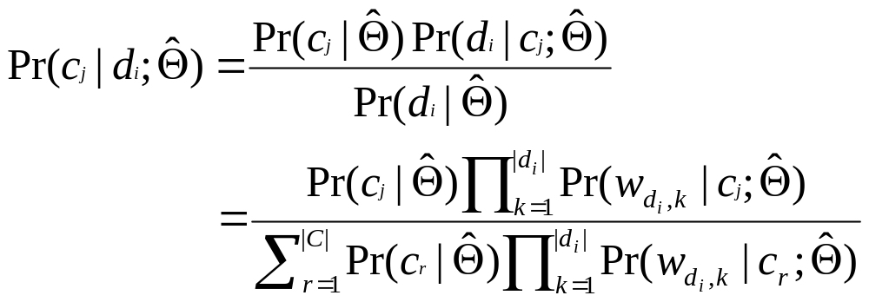
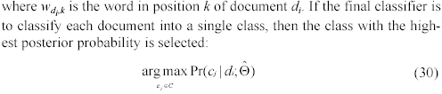
Classification
Given a test document d_{i}, from Eq. (23) (27) and (28)
CS583, Bing Liu, UIC

Slide 110
Discussions
Most assumptions made by naïve Bayesian learning are violated to some degree in practice.
Despite such violations, researchers have shown that naïve Bayesian learning produces very accurate models.
  The main problem is the mixture model assumption. When this assumption is seriously violated, the classification performance can be poor.
Naïve Bayesian learning is extremely efficient.
CS583, Bing Liu, UIC

Slide 111
Road Map
Basic concepts
Decision tree induction
Evaluation of classifiers
Rule induction
Classification using association rules
Naïve Bayesian classification
Naïve Bayes for text classification
Support vector machines
K-nearest neighbor
Ensemble methods: Bagging and Boosting
Summary
CS583, Bing Liu, UIC

Slide 112
Introduction
Support vector machines were invented by V. Vapnik and his co-workers in 1970s in Russia and became known to the West in 1992.
SVMs are linear classifiers that find a hyperplane to separate two class of data, positive and negative.
Kernel functions are used for nonlinear separation.
SVM not only has a rigorous theoretical foundation, but also performs classification more accurately than most other methods in applications, especially for high dimensional data.
It is perhaps the best classifier for text classification.
CS583, Bing Liu, UIC

Slide 113

Basic concepts
Let the set of training examples D be
{(x₁, y₁), (x₂, y₂), …, (x_{r}, y_{r})},
where x_{i} = (x₁, x₂, …, x_{n}) is an input vector in a real-valued space X ⊆ R^{n} and y_{i} is its class label (output value), y_{i} ∈ {1, -1}.
1: positive class and -1: negative class.
SVM finds a linear function of the form (w: weight vector)
f(x) = ⟨w ⋅ x⟩ + b
CS583, Bing Liu, UIC

Slide 114

The hyperplane
The hyperplane that separates positive and negative training data is
⟨w ⋅ x⟩ + b = 0
It is also called the decision boundary (surface).
So many possible hyperplanes, which one to choose?
CS583, Bing Liu, UIC

Slide 115

Maximal margin hyperplane
SVM looks for the separating hyperplane with the largest margin.
Machine learning theory says this hyperplane minimizes the error bound
CS583, Bing Liu, UIC

Slide 116

Linear SVM: separable case
Assume the data are linearly separable.
Consider a positive data point (x⁺, 1) and a negative (x⁻, -1) that are closest to the hyperplane
<w ⋅ x> + b = 0.
We define two parallel hyperplanes, H₊ and H₋, that pass through x⁺ and x⁻ respectively. H₊ and H₋ are also parallel to <w ⋅ x> + b = 0.
CS583, Bing Liu, UIC

Slide 117


Compute the margin
Now let us compute the distance between the two margin hyperplanes H₊ and H₋. Their distance is the margin (d₊ + d₋ in the figure).
Recall from vector space in algebra that the (perpendicular) distance from a point x_{i} to the hyperplane ⟨w ⋅ x⟩ + b = 0 is:
where ||w|| is the norm of w,
(36)
(37)
CS583, Bing Liu, UIC

Slide 118


Compute the margin (cont …)
Let us compute d₊.
Instead of computing the distance from x⁺ to the separating hyperplane ⟨w ⋅ x⟩ + b = 0, we pick up any point x_{s} on ⟨w ⋅ x⟩ + b = 0 and compute the distance from x_{s} to ⟨w ⋅ x⁺⟩ + b = 1 by applying the distance Eq. (36) and noticing ⟨w ⋅ x_{s}⟩ + b = 0,
(38)
(39)
CS583, Bing Liu, UIC

Slide 119


A optimization problem!
Definition (Linear SVM: separable case): Given a set of linearly separable training examples,
D = {(x₁, y₁), (x₂, y₂), …, (x_{r}, y_{r})}
Learning is to solve the following constrained minimization problem,
summarizes
⟨w ⋅ x_{i}⟩ + b ≥ 1 for y_{i} = 1
⟨w ⋅ x_{i}⟩ + b ≤ -1 for y_{i} = -1.
(40)
CS583, Bing Liu, UIC

Slide 120

Solve the constrained minimization
Standard Lagrangian method
where α_{i} ≥ 0 are the Lagrange multipliers.
Optimization theory says that an optimal solution to (41) must satisfy certain conditions, called Kuhn-Tucker conditions, which are necessary (but not sufficient)
Kuhn-Tucker conditions play a central role in constrained optimization.
(41)
CS583, Bing Liu, UIC

Slide 121

Kuhn-Tucker conditions
Eq. (50) is the original set of constraints.
The complementarity condition (52) shows that only those data points on the margin hyperplanes (i.e., H₊ and H₋) can have α_{i} > 0 since for them y_{i}(⟨w ⋅ x_{i}⟩ + b) – 1 = 0.
These points are called the support vectors, All the other parameters α_{i} = 0.
CS583, Bing Liu, UIC

Slide 122
Solve the problem
In general, Kuhn-Tucker conditions are necessary for an optimal solution, but not sufficient.
However, for our minimization problem with a convex objective function and linear constraints, the Kuhn-Tucker conditions are both necessary and sufficient for an optimal solution.
Solving the optimization problem is still a difficult task due to the inequality constraints.
However, the Lagrangian treatment of the convex optimization problem leads to an alternative dual formulation of the problem, which is easier to solve than the original problem (called the primal).
CS583, Bing Liu, UIC

Slide 123

Dual formulation
From primal to a dual: Setting to zero the partial derivatives of the Lagrangian (41) with respect to the primal variables (i.e., w and b), and substituting the resulting relations back into the Lagrangian.
  I.e., substitute (48) and (49), into the original Lagrangian (41) to eliminate the primal variables
(55)
CS583, Bing Liu, UIC

Slide 124

Dual optimization prolem
This dual formulation is called the Wolfe dual.
For the convex objective function and linear constraints of the primal, it has the property that the maximum of L_{D} occurs at the same values of w, b and α_{i}, as the minimum of L_{P} (the primal).
Solving (56) requires numerical techniques and clever strategies, which are beyond our scope.
CS583, Bing Liu, UIC

Slide 125


The final decision boundary
After solving (56), we obtain the values for α_{i}, which are used to compute the weight vector w and the bias b using Equations (48) and (52) respectively.
The decision boundary
Testing: Use (57). Given a test instance z,
If (58) returns 1, then the test instance z is classified as positive; otherwise, it is classified as negative.
(57)
(58)
CS583, Bing Liu, UIC

Slide 126
Linear SVM: Non-separable case
Linear separable case is the ideal situation.
Real-life data may have noise or errors.
  Class label incorrect or randomness in the application domain.
Recall in the separable case, the problem was
With noisy data, the constraints may not be satisfied. Then, no solution!
CS583, Bing Liu, UIC

Slide 127
Relax the constraints
To allow errors in data, we relax the margin constraints by introducing slack variables, ξ_{i} (≥ 0) as follows:
⟨w ⋅ x_{i}⟩ + b ≥ 1 − ξ_{i} for y_{i} = 1
⟨w ⋅ x_{i}⟩ + b ≤ −1 + ξ_{i} for y_{i} = -1.
The new constraints:
Subject to: y_{i}(⟨w ⋅ x_{i}⟩ + b) ≥ 1 − ξ_{i}, i =1, …, r,
ξ_{i} ≥ 0, i =1, 2, …, r.
CS583, Bing Liu, UIC

Slide 128

Geometric interpretation
Two error data points x_{a} and x_{b} (circled) in wrong regions
CS583, Bing Liu, UIC

Slide 129

Penalize errors in objective function
We need to penalize the errors in the objective function.
A natural way of doing it is to assign an extra cost for errors to change the objective function to
k = 1 is commonly used, which has the advantage that neither ξ_{i} nor its Lagrangian multipliers appear in the dual formulation.
(60)
CS583, Bing Liu, UIC

Slide 130


New optimization problem
(61)
This formulation is called the soft-margin SVM. The primal Lagrangian is
where α_{i}, μ_{i} ≥ 0 are the Lagrange multipliers
(62)
CS583, Bing Liu, UIC

Slide 131

Kuhn-Tucker conditions
CS583, Bing Liu, UIC

Slide 132
From primal to dual
As the linear separable case, we transform the primal to a dual by setting to zero the partial derivatives of the Lagrangian (62) with respect to the primal variables (i.e., w, b and ξ_{i}), and substituting the resulting relations back into the Lagrangian.
Ie.., we substitute Equations (63), (64) and (65) into the primal Lagrangian (62).
From Equation (65), C − α_{i} − μ_{i} = 0, we can deduce that α_{i} ≤ C because μ_{i} ≥ 0.
CS583, Bing Liu, UIC

Slide 133

Dual
The dual of (61) is
Interestingly, ξ_{i} and its Lagrange multipliers μ_{i} are not in the dual. The objective function is identical to that for the separable case.
The only difference is the constraint α_{i} ≤ C.
CS583, Bing Liu, UIC

Slide 134

Find primal variable values
The dual problem (72) can be solved numerically.
The resulting α_{i} values are then used to compute w and b. w is computed using Equation (63) and b is computed using the Kuhn-Tucker complementarity conditions (70) and (71).
Since no values for ξ_{i}, we need to get around it.
  From Equations (65), (70) and (71), we observe that if 0 < α_{i} < C then both ξ_{i} = 0 and y_{i}⟨w ⋅ x_{i}⟩ + b – 1 + ξ_{i} = 0. Thus, we can use any training data point for which 0 < α_{i} < C and Equation (69) (with ξ_{i} = 0) to compute b.
(73)
CS583, Bing Liu, UIC

Slide 135

(65), (70) and (71) in fact tell us more
(74) shows a very important property of SVM.
  The solution is sparse in α_{i}. Many training data points are outside the margin area and their α_{i}’s in the solution are 0.
  Only those data points that are on the margin (i.e., y_{i}(⟨w ⋅ x_{i}⟩ + b) = 1, which are support vectors in the separable case), inside the margin (i.e., α_{i} = C and y_{i}(⟨w ⋅ x_{i}⟩ + b) < 1), or errors are non-zero.
  Without this sparsity property, SVM would not be practical for large data sets.
CS583, Bing Liu, UIC

Slide 136

The final decision boundary
The final decision boundary is (we note that many α_{i}’s are 0)
The decision rule for classification (testing) is the same as the separable case, i.e.,
sign(⟨w ⋅ x⟩ + b).
Finally, we also need to determine the parameter C in the objective function. It is normally chosen through the use of a validation set or cross-validation.
(75)
CS583, Bing Liu, UIC

Slide 137
How to deal with nonlinear separation?
The SVM formulations require linear separation.
Real-life data sets may need nonlinear separation.
To deal with nonlinear separation, the same formulation and techniques as for the linear case are still used.
We only transform the input data into another space (usually of a much higher dimension) so that
  a linear decision boundary can separate positive and negative examples in the transformed space,
The transformed space is called the feature space. The original data space is called the input space.
CS583, Bing Liu, UIC

Slide 138

Space transformation
The basic idea is to map the data in the input space X to a feature space F via a nonlinear mapping φ,
After the mapping, the original training data set {(x₁, y₁), (x₂, y₂), …, (x_{r}, y_{r})} becomes:
{(φ(x₁), y₁), (φ(x₂), y₂), …, (φ(x_{r}), y_{r})}
(76)
(77)
CS583, Bing Liu, UIC

Slide 139

Geometric interpretation
In this example, the transformed space is also 2-D. But usually, the number of dimensions in the feature space is much higher than that in the input space
CS583, Bing Liu, UIC

Slide 140

Optimization problem in (61) becomes
CS583, Bing Liu, UIC

Slide 141

An example space transformation
Suppose our input space is 2-dimensional, and we choose the following transformation (mapping) from 2-D to 3-D:
The training example ((2, 3), -1) in the input space is transformed to the following in the feature space:
((4, 9, 8.5), -1)
CS583, Bing Liu, UIC

Slide 142
Problem with explicit transformation
The potential problem with this explicit data transformation and then applying the linear SVM is that it may suffer from the curse of dimensionality.
The number of dimensions in the feature space can be huge with some useful transformations even with reasonable numbers of attributes in the input space.
This makes it computationally infeasible to handle.
Fortunately, explicit transformation is not needed.
CS583, Bing Liu, UIC

Slide 143
Kernel functions
We notice that in the dual formulation both
  the construction of the optimal hyperplane (79) in F and
  the evaluation of the corresponding decision function (80)
  only require dot products ⟨φ(x) ⋅ φ(z)⟩ and never the mapped vector φ(x) in its explicit form. This is a crucial point.
Thus, if we have a way to compute the dot product ⟨φ(x) ⋅ φ(z)⟩ using the input vectors x and z directly,
  no need to know the feature vector φ(x) or even φ itself.
In SVM, this is done through the use of kernel functions, denoted by K,
K(x, z) = ⟨φ(x) ⋅ φ(z)⟩
(82)
CS583, Bing Liu, UIC

Slide 144

An example kernel function
Polynomial kernel
K(x, z) = ⟨x ⋅ z⟩^{d}
Let us compute the kernel with degree d = 2 in a 2-dimensional space: x = (x₁, x₂) and z = (z₁, z₂).
This shows that the kernel ⟨x ⋅ z⟩² is a dot product in a transformed feature space
(83)
(84)
CS583, Bing Liu, UIC

Slide 145
Kernel trick
The derivation in (84) is only for illustration purposes.
We do not need to find the mapping function.
We can simply apply the kernel function directly by
  replace all the dot products ⟨φ(x) ⋅ φ(z)⟩ in (79) and (80) with the kernel function K(x, z) (e.g., the polynomial kernel ⟨x ⋅ z⟩^{d} in (83)).
This strategy is called the kernel trick.
CS583, Bing Liu, UIC

Slide 146
Is it a kernel function?
The question is: how do we know whether a function is a kernel without performing the derivation such as that in (84)? I.e,
  How do we know that a kernel function is indeed a dot product in some feature space?
This question is answered by a theorem called the Mercer’s theorem, which we will not discuss here.
CS583, Bing Liu, UIC

Slide 147

Commonly used kernels
It is clear that the idea of kernel generalizes the dot product in the input space. This dot product is also a kernel with the feature map being the identity
CS583, Bing Liu, UIC

Slide 148
Some other issues in SVM
SVM works only in a real-valued space. For a categorical attribute, we need to convert its categorical values to numeric values.
SVM does only two-class classification. For multi-class problems, some strategies can be applied, e.g., one-against-rest, and error-correcting output coding.
The hyperplane produced by SVM is hard to understand by human users. The matter is made worse by kernels. Thus, SVM is commonly used in applications that do not required human understanding.
CS583, Bing Liu, UIC

Slide 149
Road Map
Basic concepts
Decision tree induction
Evaluation of classifiers
Rule induction
Classification using association rules
Naïve Bayesian classification
Naïve Bayes for text classification
Support vector machines
K-nearest neighbor
Ensemble methods: Bagging and Boosting
Summary
CS583, Bing Liu, UIC

Slide 150
k-Nearest Neighbor Classification (kNN)
Unlike all the previous learning methods, kNN does not build model from the training data.
To classify a test instance d, define k-neighborhood P as k nearest neighbors of d
Count number n of training instances in P that belong to class c_{j}
Estimate Pr(c_{j}|d) as n/k
No training is needed. Classification time is linear in training set size for each test case.
CS583, Bing Liu, UIC

Slide 151

kNNAlgorithm
k is usually chosen empirically via a validation set or cross-validation by trying a range of k values.
Distance function is crucial, but depends on applications.
CS583, Bing Liu, UIC

Slide 152
Example: k=6 (6NN)
Government
Science
Arts
A new point
Pr(science| )?
CS583, Bing Liu, UIC

Slide 153
Discussions
kNN can deal with complex and arbitrary decision boundaries.
Despite its simplicity, researchers have shown that the classification accuracy of kNN can be quite strong and in many cases as accurate as those elaborated methods.
kNN is slow at the classification time
kNN does not produce an understandable model
CS583, Bing Liu, UIC

Slide 154
Road Map
Basic concepts
Decision tree induction
Evaluation of classifiers
Rule induction
Classification using association rules
Naïve Bayesian classification
Naïve Bayes for text classification
Support vector machines
K-nearest neighbor
Ensemble methods: Bagging and Boosting
Summary
CS583, Bing Liu, UIC

Slide 155
Combining classifiers
So far, we have only discussed individual classifiers, i.e., how to build them and use them.
Can we combine multiple classifiers to produce a better classifier?
Yes, sometimes
We discuss two main algorithms:
  Bagging
  Boosting
CS583, Bing Liu, UIC

Slide 156
Bagging
Breiman, 1996
Bootstrap Aggregating = Bagging
  Application of bootstrap sampling
    Given: set D containing m training examples
    Create a sample S[i] of D by drawing m examples at random with replacement from D
    S[i] of size m: expected to leave out 0.37 of examples from D
CS583, Bing Liu, UIC

Slide 157
Bagging (cont…)
Training
  Create k bootstrap samples S[1], S[2], …, S[k]
  Build a distinct classifier on each S[i] to produce k classifiers, using the same learning algorithm.
Testing
  Classify each new instance by voting of the k classifiers (equal weights)
CS583, Bing Liu, UIC

Slide 158
Bagging Example
Original | 1 | 2 | 3 | 4 | 5 | 6 | 7 | 8
Training set 1 | 2 | 7 | 8 | 3 | 7 | 6 | 3 | 1
Training set 2 | 7 | 8 | 5 | 6 | 4 | 2 | 7 | 1
Training set 3 | 3 | 6 | 2 | 7 | 5 | 6 | 2 | 2
Training set 4 | 4 | 5 | 1 | 4 | 6 | 4 | 3 | 8
CS583, Bing Liu, UIC

Slide 159
Bagging (cont …)
When does it help?
  When learner is unstable
    Small change to training set causes large change in the output classifier
    True for decision trees, neural networks; not true for k-nearest neighbor, naïve Bayesian, class association rules
  Experimentally, bagging can help substantially for unstable learners, may somewhat degrade results for stable learners
CS583, Bing Liu, UIC
Bagging Predictors, Leo Breiman, 1996

Slide 160
Boosting
A family of methods:
  We only study AdaBoost (Freund & Schapire, 1996)
Training
  Produce a sequence of classifiers (the same base learner)
  Each classifier is dependent on the previous one, and focuses on the previous one’s errors
  Examples that are incorrectly predicted in previous classifiers are given higher weights
Testing
  For a test case, the results of the series of classifiers are combined to determine the final class of the test case.
CS583, Bing Liu, UIC

Slide 161
AdaBoost
Weighted
training set
called a weaker classifier
(x₁, y₁, w₁)
(x₂, y₂, w₂)
…
(x_{n}, y_{n}, w_{n})
Build a classifier h_{t} whose accuracy on training set > ½ (better than random)
Non-negative weights
sum to 1
Change weights
CS583, Bing Liu, UIC

Slide 162

AdaBoost algorithm
CS583, Bing Liu, UIC

Slide 163

Bagging, Boosting and C4.5
C4.5’s mean error rate over the
10 cross-validation.
Bagged C4.5
vs. C4.5.
Boosted C4.5 vs. C4.5.
Boosting vs. Bagging
CS583, Bing Liu, UIC

Slide 164
Does AdaBoost always work?
The actual performance of boosting depends on the data and the base learner.
  It requires the base learner to be unstable as bagging.
Boosting seems to be susceptible to noise.
  When the number of outliners is very large, the emphasis placed on the hard examples can hurt the performance.
CS583, Bing Liu, UIC

Slide 165
Road Map
Basic concepts
Decision tree induction
Evaluation of classifiers
Rule induction
Classification using association rules
Naïve Bayesian classification
Naïve Bayes for text classification
Support vector machines
K-nearest neighbor
Summary
CS583, Bing Liu, UIC

Slide 166
Summary
Applications of supervised learning are in almost any field or domain.
We studied 8 classification techniques.
There are still many other methods, e.g.,
  Bayesian networks
  Neural networks
  Genetic algorithms
  Fuzzy classification
  This large number of methods also show the importance of classification and its wide applicability.
It remains to be an active research area.
CS583, Bing Liu, UIC

